Slide 1
Web Technologies
Lecture 7
Synchronous vs. asynchronous

Slide 2
Motivation
“If the web is the human body, Javascript tags are like its nerve endings” - www.krux.com
Means through which pages sense, respond, execute, measure, and remember
Problem
Tag activity slows down pages
0.1s delay can translate into a 1% drop in customer activity (Amazon)
30% variance in page views based on load time (AOL)
Load times are increasingly important in Google and Bing search rankings

Slide 3
Javascript is synchronous
Javascript is the #1 cause of slow web pages
Blocking behavior
When it loads nothing else happens
Browsers render page elements synchronously
One element cannot load until the one before it has
Solution
Load elements in a non blocking manner
Asynchronously

Slide 4
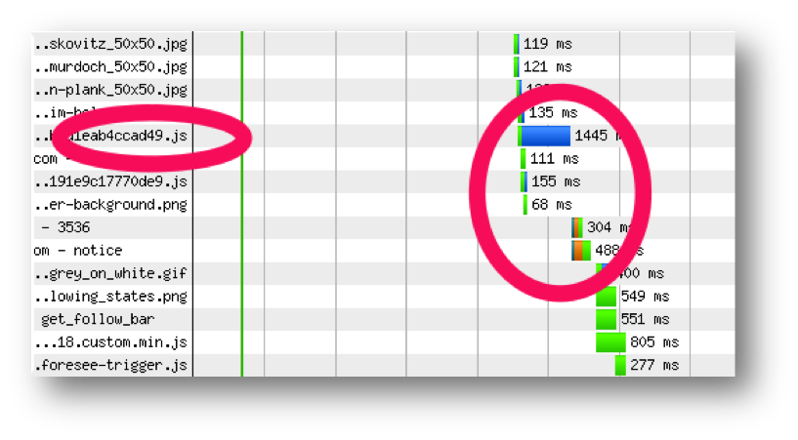
Example
http://www.krux.com/blog/krux-engineers/synchronous-versus-asynchronous-tags-whats-the-big-deal/

Slide 5
Why is JS not asynchronous?
document.write construct
Inserts something into a web page
Text, tag, etc.
It expects to alter the page inline, inserting content as the page is loaded
Messes the content if loaded asynchronously
Why do we still use it?
We cannot get rid of it until the entire stack can guarantee that document.write will not be used

Slide 6
Solutions
Element creation
document.createElement(‘div’)
InnerHTML
element.innerHTML(‘some content’)
Libraries (JQuery library)
Iframes
Work only if access to top level page is not needed
HTML 5 attributes for the script element
Only work if the script does not use document.write

Slide 7
Load scripts asynchronously
Do not wait for scripts to render page
Solution
New HTML 5 script attributes
defer: script loads after page finished loading
async: script loads concurrently with the page
Example
<script type="text/javascript" src="busy.js" async></script>

Slide 8
Example
Javascript blocking code
var startNow = new Date();
var pauseFor = 5000; // In milliseconds
while (new Date() - startNow < pauseFor) ;
HTML code
<html>
<head>
<script type="text/javascript" src="busy.js"></script>
<script type="text/javascript">alert("Time's up"); </script>
</head>
</html>
Outcome
The alert pops out after the 5,000ms timeout elapses

Slide 9
Example
Javascript blocking code
var startNow = new Date();
var pauseFor = 5000; // In milliseconds
while (new Date() - startNow < pauseFor) ;
HTML code
<html>
<head>
<script type="text/javascript" src="busy.js“ async></script>
<script type="text/javascript">alert("Time's up"); </script>
</head>
</html>
Outcome
The alert pops out before the 5,000ms timeout elapses

Slide 10
Callbacks
JS functions are first class objects
Their type is object
They can be stored in variables, passed as arguments, returned from functions, etc.
Essence of callbacks
Pass a function as an argument to another function and later execute that passed-in function or even return it to be executed later
Most widely used functional programming technique in JavaScript

Slide 11
Callbacks
When passing a callback as argument we do not call the function
var data = getData( function (data) {
alert(“We have ” + data)
});
The function will be called somewhere in the body of the function
function getData(callback) {
var data = … //read the data
callback(data);
return data;
}

Slide 12
Asynchronous data transfer
Load data without blocking the interface
Facebook comments
Twitter tweets
Youtube movies
Solution
Use XMLHttpRequest object
Supported by: Chrome, IE7+, Firefox, Safari, and Opera
AJAX (Asynchronous Javascript and XML)
XHTML + CSS + DOM + XML + XMLHttpRequest

Slide 13
Example
function loadXMLAsync (filePath) {
var req = new XMLHttpRequest();
req.open("GET", filePath, true);
req.send(null);
req.onreadystatechange = function () {
if (req.readyState == 4) {
if (req.status == 200) {
xml = req.responseXML;
processXML (xml);
}
else
alert ("Error loading XML");
}
}
}
Notes
For local access use req.status == 0 instead of the HTTP code 200
State: 0 – uninitialized, 1 – loading, 2 – loaded, 3 – interactive, 4 – complete

Slide 14
Processing incoming XMLs
DOM
createElement
appendChild
function processXML(xml) {
var imgs = xml.getElementsByTagName('image');
body = document.getElementsByTagName(“body”);
for (var i=0; i<imgs.length; i++) {
var image = document.createElement(“img”);
image.src = imgs[i].firstChild.nodeValue; //set src attribute
body[0].appendChild(image);
}
}

Slide 15
Older IE browsers
< IE7
Use ActiveXObject instead
if (window.XMLHttpRequest) {
req = new XMLHttpRequest();
req.overrideMimeType('text/xml'); }
else if (window.ActiveXObject) { //try to get the most modern implementation
var list = ["Microsoft.XmlHttp","MSXML2.XmlHttp","MSXML2.XmlHttp.3.0","MSXML2.XmlHttp.4.0","MSXML2.XmlHttp.5.0"];
var ok = false;
var i = 5;
while (i >= 0 && ok == false) {
try {
req = new ActiveXObject(list[i]);
ok = true;
} catch (e) {}
i--;
}
}

Slide 16
Async vs. sync API
Rule of thumb
If API
requires IO, or
heavy processing
(>15ms) expose it asynchronously from the start

Slide 17
Building asynchronous APIs
Design APIs to be asynchronous from the start
var data = getData()
alert(“We have ” + data);
Freezes the user interface until data is fetched
getData( function (data) {
alert(“We have ” + data)
});
Designed asynchronously even if the app needs to be async or not in a later stage
Use callbacks

Slide 18
What’s next?
JQUERY
Server side programming
Web services
Cloud computing

