Slide 1
Web Technologies
Lecture 8
JQuery

Slide 2
JQuery
“A fast and concise JavaScript Library that simplifies HTML document traversing, event handling, animating, and Ajax interactions for rapid web development.” - jQuery.com
Write less do more
$("p.neat").addClass(“anim").show("slow");

Slide 3
Advantages
Easy of use
Simpler syntax and less lines of code
Large library set
Many functions for HTML manipulation, animation, event handling, AJAX, etc.
Strong open source community
Many libraries
Efficiency and security
Great documentation and tutorials

Slide 4
Disadvantages
Functionality may be limited
Despite the many libraries, depending on the website complexity raw Javascript may still be required
JQuery file is always required
25-100KB which need to be loaded with your website
Strain on the client
Strain on the server (if your website hosts it)
Performance
Vanilla Javascript is faster than JQuery
Code is not always shorter
$(this).attr("id") vs. this.id

Slide 5
DOM and JQuery
Identification
How do I obtain a reference to the node that I want
Traversal
How do I move around the DOM tree
Node Manipulation
How do I get or set aspects of a DOM node
Tree Manipulation
How do I change the structure of the page

Slide 6
Terminology
JQuery function
Global jQuery object or the $ function depending on the context
JQuery object
The object returned by the JQuery function that often represents a group of elements
Selected elements
The DOM elements that you have selected, most likely by some CSS selector

Slide 7
JQuery function
The $ function always (even for ID selectors) returns an array-like object called a JQuery object
Example:
document.getElementById("id") == $("#myid")[0];
The JQuery object wraps the originally selected DOM objects
You can access the actual DOM object by accessing the elements of the jQuery object
$ adds extra functionality to DOM elements
Passing an existing DOM object to $ will give it the jQuery upgrade
Example:
var elem = document.getElementById("myelem");
elem = $(elem);

Slide 8
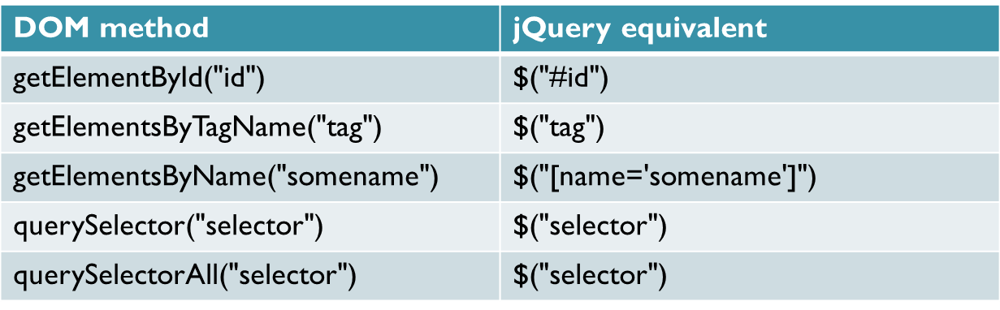
Node selectors
Imported from CSS
Patterns used to select the element(s) you want to handle
http://www.w3schools.com/jquery/jquery_ref_selectors.asp
http://api.jquery.com/category/selectors/
www.webstepbook.com/supplements-2ed/slides/ppt/22-jQuery1.pptx

Slide 9
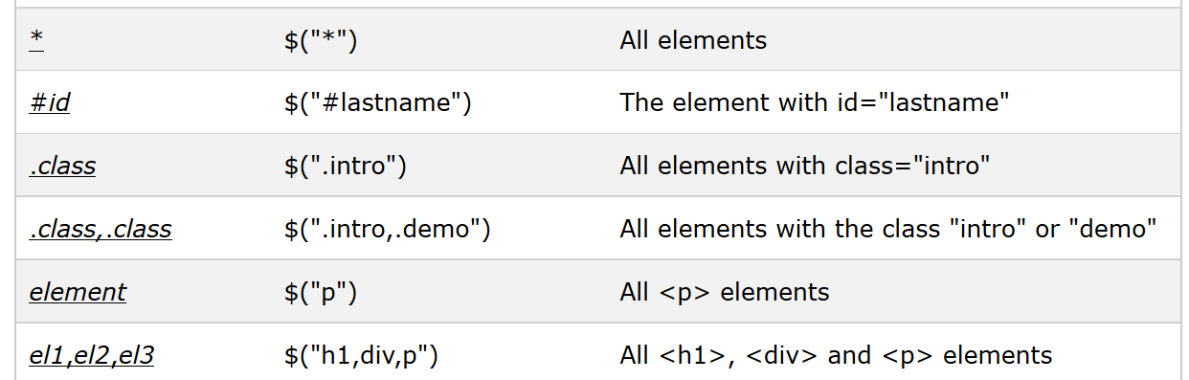
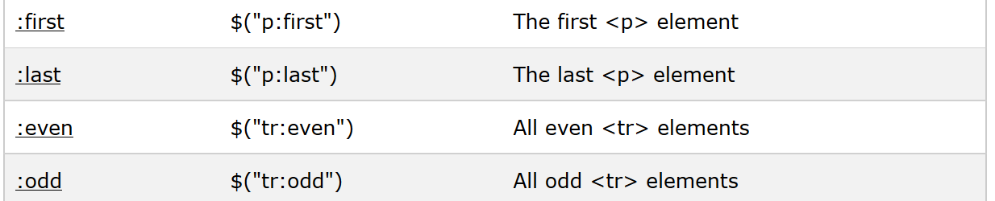
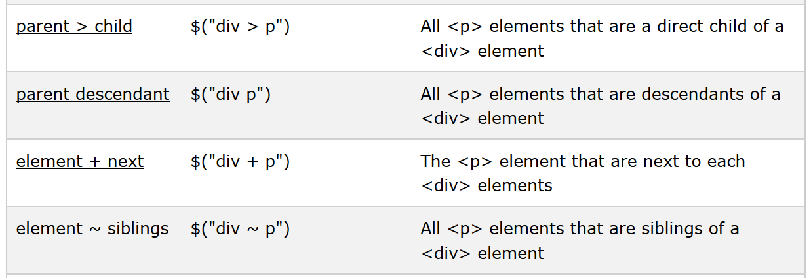
Examples

Slide 10
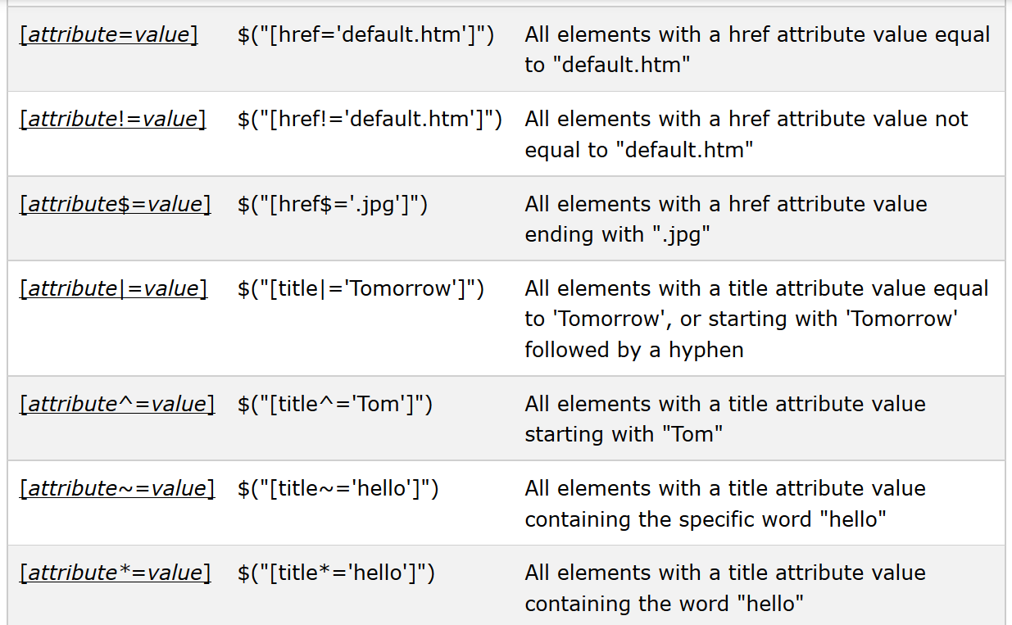
Examples

Slide 11
Writing efficient selector
Use IDs if possible
Fast access
$(“#myelement”)
Avoid selecting by class only
$(“.myclass”)
Inefficient in older browsers
Keep it simple
No more than 2 or 3 qualifiers unless you have a very complex HTML
Example: $(“p#intro em”) instead of $("body #page:first-child article.main p#intro em");
JQuery works from last selector to first
Retrieve best qualified selector first
Example: $("em", $("p#intro")) instead of $(“p#intro em”)

Slide 12
Complex examples
All p tags that have no children, but only if they don't have a class of ignore
$(“p:empty:not([class=‘ignore’])”)
Any p element with the text "REPLACE_ME" in it
$(“p:contains(‘REPLACE_TEXT’)”)
All div tags with a child that has a class of special
$(“div”).children(“.special”)
All heading elements (h1, h2, h3, h4, h5, h6)
$(“h1,h2,h3,h4,h5,h6”)
Every other visible li
$(“li:even:visible”)

Slide 13
Handling events, CSS, animations
$(document).ready(function() {
$("button").click(function() {
$("p").css("background-color", "yellow");
});
});
$("button").click(function() { $("div").animate( { left: '250px', opacity: '0.5', height: '150px', width: '150px' }); });

Slide 14
What’s next?
Server side programming
Web services
Cloud computing

