Slide 1

Mobile Application Development Course 12
Android Studio
Working with Databases
West University of Timisoara, Romania
Computer Science Department
IE3, Fall 2015
Dr. Liviu Octavian Mafteiu-Scai

Slide 2

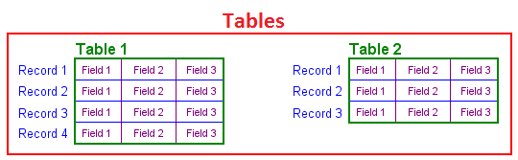
Mobile App Development 12, Android Studio Working with Databases - Android SQLite Databases
Databases - an overview
Database Tables provide the basic level of data structure in a database. A database can contain multiple tables and each table is designed to hold information of a specific type.
It is helpful to view a database table as being similar to a spreadsheet:
- a column represents a data field in the corresponding table.
- each new record that is saved to a table is stored in a row. Rows are also sometimes referred to as records or entries
Each table has a name that must be unique within that particular database. A table name, once assigned to a table in one database, may only be re-used within the context of a different database.
Database Schema define the characteristics of the data stored in a database table. More, are also used to define the structure of entire databases and the relationship between the various tables contained in a database.
Primary Key: a database table must contain one or more columns that can be used to identify each row in the table uniquely.

Slide 3

Mobile App Development 12, Android Studio Working with Databases - Android SQLite Databases
SQL ⬄Structured Query Language
a language designed to enable the reading and writing of database data
What is SQLite ?
SQLite is an embedded, relational database management system (RDBMS).
embedded
⬄ SQLite is provided in the form of a library that is linked into applications
⬄NO standalone database server
All database operations are handled internally using functions from SQLite library.
SQLite is written in C programming language !

Slide 4
Mobile App Development 12, Android Studio Working with Databases - Android SQLite Databases
Android SQLite Java Classes
SQLite is written in the C, Android apps are writen in Java
SO
to bridge this “language gap”, the Android SDK includes a set of classes that provide a Java layer on top of the SQLite database management system.
1. Cursor class include methods:
close() – Releases all resources used by the cursor and closes it.
getCount() – Returns the number of rows contained within the result set.
moveToFirst() – Moves to the first row within the result set.
moveToLast() – Moves to the last row in the result set.
moveToNext() – Moves to the next row in the result set.
move() – Moves by a specified offset from the current position in the result set.
get<type>() – Returns the value of the specified <type> contained at the specified column index of the row at the current cursor position (variations consist of getString(), getInt(), getShort(), getFloat() and getDouble()).

Slide 5
Mobile App Development 12, Android Studio Working with Databases - Android SQLite Databases
Android SQLite Java Classes
SQLiteDatabase class methods:
insert() – Inserts a new row into a database table.
delete() – Deletes rows from a database table.
query() – Performs a specified database query and returns matching results via a Cursor object.
execSQL() – Executes a single SQL statement that does not return result data.
rawQuery() – Executes an SQL query statement and returns matching results in the form of a Cursor object.
SQLiteOpenHelper class methods:
onCreate() – Called when the database is created for the first time.
onUpgrade() – Called in the event that the application code contains a more recent database version number reference.
getWritableDatabase() – Opens or creates a database for reading and writing. Returns a reference to the database in the form of a SQLiteDatabase object.
getReadableDatabase() – Creates or opens a database for reading only. Returns a reference to the database in the form of a SQLiteDatabase object.
close() – Closes the database.

Slide 6
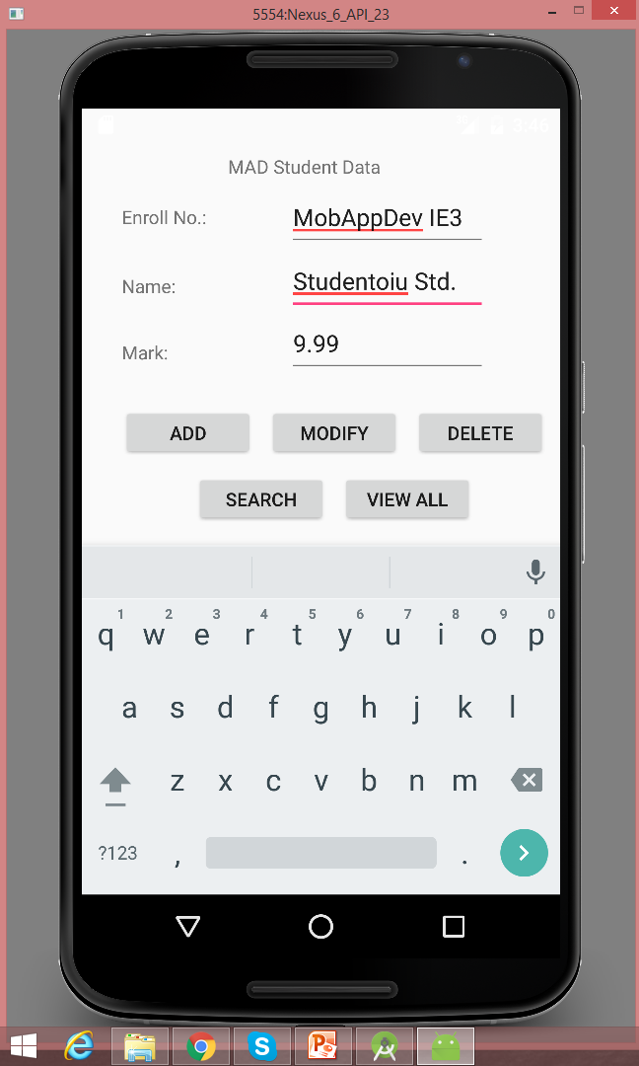
Mobile App Development 12, Android Studio Working with Databases – Example 1
Goal:
An Android app for managing a sample student database (EnrollNumbe, StudentName and StudentMarks). The user’s operations will be : Add, Modify, Delete, Search and ViewAll records.
The user interface layout
(based on an AbsoluteLayout style)
Absolute layouts are less flexible and harder to maintain than other types of layouts without absolute positioning.
! it's a little deprecated !

Slide 7
Mobile App Development 12, Android Studio Working with Databases – Example 1
content_main.xml
<?xml version="1.0" encoding="utf-8"?> <AbsoluteLayout xmlns:android="http://schemas.android.com/apk/res/android" android:id="@+id/myLayout" android:stretchColumns="0" android:layout_width="fill_parent" android:layout_height="fill_parent"> <TextView android:text="@string/title" android:layout_x="110dp" android:layout_y="10dp" android:layout_width="wrap_content" android:layout_height="wrap_content"/> <TextView android:text="@string/enroll_no" android:layout_x="30dp" android:layout_y="48dp" android:layout_width="wrap_content" android:layout_height="wrap_content"/> <EditText android:id="@+id/editEnrollno" android:layout_x="155dp" android:layout_y="33dp" android:layout_width="150dp" android:layout_height="50dp"/> <TextView android:text="@string/name" android:layout_x="30dp" android:layout_y="100dp" android:layout_width="wrap_content" android:layout_height="wrap_content"/> <EditText android:id="@+id/editName" android:inputType="text" android:layout_x="155dp" android:layout_y="81dp" android:layout_width="150dp" android:layout_height="50dp"/> <TextView android:text="@string/marks" android:layout_x="30dp" android:layout_y="150dp" android:layout_width="wrap_content" android:layout_height="wrap_content"/>
<EditText android:id="@+id/editMarks" android:inputType="numberDecimal" android:layout_x="155dp" android:layout_y="128dp" android:layout_width="150dp" android:layout_height="50dp"/> <Button android:id="@+id/btnAdd" android:text="@string/add" android:layout_x="30dp" android:layout_y="200dp" android:layout_width="100dp" android:layout_height="40dp"/> <Button android:id="@+id/btnDelete" android:text="@string/delete" android:layout_x="250dp" android:layout_y="200dp" android:layout_width="100dp" android:layout_height="40dp"/> <Button android:id="@+id/btnModify" android:text="@string/modify" android:layout_x="140dp" android:layout_y="200dp" android:layout_width="100dp" android:layout_height="40dp"/> <Button android:id="@+id/btnSearch" android:text="@string/view" android:layout_x="85dp" android:layout_y="250dp" android:layout_width="100dp" android:layout_height="40dp"/> <Button android:id="@+id/btnViewAll" android:text="@string/view_all" android:layout_x="195dp" android:layout_y="250dp" android:layout_width="100dp" android:layout_height="40dp"/> </AbsoluteLayout>

Slide 8
Mobile App Development 12, Android Studio Working with Databases – Example 1
strings.xml
<?xml version="1.0" encoding="utf-8"?> <resources> <string name="app_name">MAD Student Database App</string> <string name="title">MAD Student Data</string> <string name="enroll_no">Enroll No.: </string> <string name="name">Name: </string> <string name="marks">Mark: </string> <string name="add">Add</string> <string name="delete">Delete</string> <string name="modify">Modify</string> <string name="view">Search</string> <string name="view_all">View All</string> </resources>

Slide 9
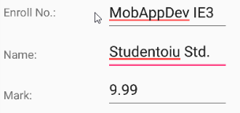
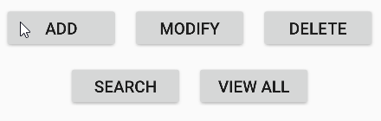
Mobile App Development 12, Android Studio Working with Databases – Example 1
MainActivity.java (1)
package com.example.mafteiu_scai.mystudents; import android.app.Activity; import android.app.AlertDialog.Builder; import android.content.Context; import android.database.Cursor; import android.database.sqlite.SQLiteDatabase; import android.os.Bundle; import android.view.View; import android.view.View.OnClickListener; import android.widget.Button; import android.widget.EditText; import com.example.mafteiu_scai.mystudents.R; public class MainActivity extends Activity implements OnClickListener { EditText editEnrollno, editName, editMarks; Button btnAdd, btnDelete, btnModify, btnSearch, btnViewAll; SQLiteDatabase db; public void onCreate(Bundle savedInstanceState) { super.onCreate(savedInstanceState); setContentView(R.layout.content_main); editEnrollno = (EditText) findViewById(R.id.editEnrollno); editName = (EditText) findViewById(R.id.editName); editMarks = (EditText) findViewById(R.id.editMarks); btnAdd = (Button) findViewById(R.id.btnAdd); btnDelete = (Button) findViewById(R.id.btnDelete); btnModify = (Button) findViewById(R.id.btnModify); btnSearch = (Button) findViewById(R.id.btnSearch); btnViewAll = (Button) findViewById(R.id.btnViewAll); btnAdd.setOnClickListener(this); btnDelete.setOnClickListener(this); btnModify.setOnClickListener(this); btnSearch.setOnClickListener(this); btnViewAll.setOnClickListener(this); db = openOrCreateDatabase("MADStudentsDB", Context.MODE_PRIVATE, null); db.execSQL("CREATE TABLE IF NOT EXISTS student(enrollno VARCHAR,name VARCHAR,marks VARCHAR);"); }
import SQLite classes.
Called when the activity is first created.
Called when when a button is pressed.
Path to database file to open and/or create
the structure of table student

Slide 10
Mobile App Development 12, Android Studio Working with Databases – Example 1
MainActivity.java (2)
public void onClick(View view) {
if (view == btnAdd) { if (editEnrollno.getText().toString().trim().length() == 0 || editName.getText().toString().trim().length() == 0 || editMarks.getText().toString().trim().length() == 0) { showMessage("Error", "Please enter all student data"); return; } db.execSQL("INSERT INTO student VALUES('" + editEnrollno.getText() + "','" + editName.getText() + "','" + editMarks.getText() + "');"); showMessage("Success", "Record added"); clearText(); }
if (view == btnDelete) { if (editEnrollno.getText().toString().trim().length() == 0) { showMessage("Error", "Please enter Student Enroll Number"); return; } Cursor c = db.rawQuery("SELECT * FROM student WHERE enrollno='" + editEnrollno.getText() + "'", null); if (c.moveToFirst()) { db.execSQL("DELETE FROM student WHERE enrollno='" + editEnrollno.getText() + "'"); showMessage("Success", "Record Deleted"); } else { showMessage("Error", "Invalid Enroll Number"); } clearText(); }
add students to the database under certain conditions
delete a student from table, based in enroll number
The rawQuery method has two parameters:
-String query: The select statement
-String[] selection args: The arguments if a WHERE clause is included in the select statement

Slide 11
Mobile App Development 12, Android Studio Working with Databases – Example 1
MainActivity.java (3)
if (view == btnModify) { if (editEnrollno.getText().toString().trim().length() == 0) { showMessage("Error", "Please enter Enroll Number"); return; } Cursor c = db.rawQuery("SELECT * FROM student WHERE enrollno='" + editEnrollno.getText() + "'", null); if (c.moveToFirst()) { db.execSQL("UPDATE student SET name='" + editName.getText() + "',marks='" + editMarks.getText() + "' WHERE enrollno='" + editEnrollno.getText() + "'"); showMessage("Success", "Student Data Modified"); } else { showMessage("Error", "Invalid Enroll Number"); } clearText(); } if (view == btnSearch) { if (editEnrollno.getText().toString().trim().length() == 0) { showMessage("Error", "Please enter Student enroll number"); return; } Cursor c = db.rawQuery("SELECT * FROM student WHERE enrollno='" + editEnrollno.getText() + "'", null); if (c.moveToFirst()) { editName.setText(c.getString(1)); editMarks.setText(c.getString(2)); } else { showMessage("Error", "Invalid Enroll Number"); clearText(); } }
modify students’s data
Search a record (student), based on enroll number

Slide 12
Mobile App Development 12, Android Studio Working with Databases – Example 1
MainActivity.java (4)
if (view == btnViewAll) { Cursor c = db.rawQuery("SELECT * FROM student", null); if (c.getCount() == 0) { showMessage("Error", "No students found in database"); return; } StringBuffer buffer = new StringBuffer(); while (c.moveToNext()) { buffer.append("Enroll Number: " + c.getString(0) + "\n"); buffer.append("Name: " + c.getString(1) + "\n"); buffer.append("Mark: " + c.getString(2) + "\n\n"); } showMessage("MAD Student Data", buffer.toString()); } }
public void showMessage(String title, String message) { Builder builder = new Builder(this); builder.setCancelable(true); builder.setTitle(title); builder.setMessage(message); builder.show(); } public void clearText() { editEnrollno.setText(""); editName.setText(""); editMarks.setText(""); editEnrollno.requestFocus(); } }
View all records (students) of database
Display error/warning messages for user
Clear the TextEdit forms

Slide 13
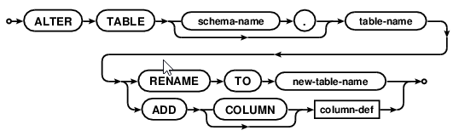
Mobile App Development 12, Android Studio Working with Databases – Example 1
Warning
SQLite supports a limited subset of ALTER TABLE. The ALTER TABLE command in SQLite allows the user to rename a table or to add a new column to an existing table.

Slide 14
Mobile App Development 12, Android Studio Working with Databases
Homework: add buttons and methods for Next and Prev. records in table.
Indications:
protected void onCreate(Bundle savedInstanceState) {
super.onCreate(savedInstanceState);
setContentView(R.layout.activity_main);
DisplayRecord(cursor);
}
public void NextRecord (View view){
if (cursor.moveToNext())
{
DisplayRecord(cursor);
}
}
public void PreviousRecord (View view){
if (cursor.moveToPrevious())
{
DisplayRecord(cursor);
}
}
public void DisplayRecord(Cursor c) {
EditText nameTxt = (EditText)findViewById(R.id.Name);
EditText phoneTxt = (EditText)findViewById(R.id.Phone);
EditText emailTxt = (EditText)findViewById(R.id.Email);
nameTxt.setText(c.getString(1));
phoneTxt.setText(c.getString(2));
emailTxt.setText(c.getString(3));
}

Slide 15
Mobile App Development 12, Android Studio Working with Databases
A new database example
more complicated but no more complex

Slide 16
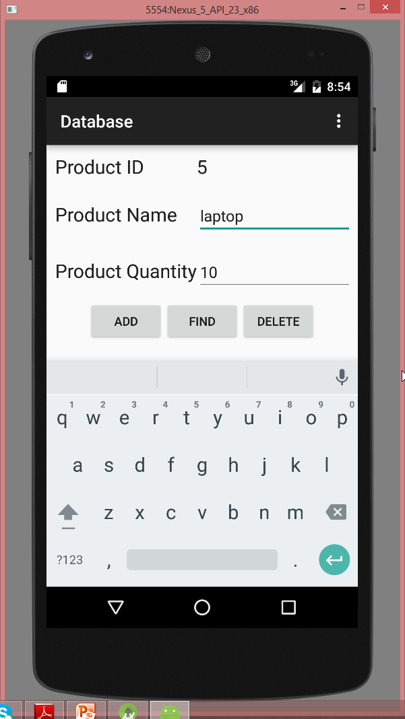
Mobile App Development 12, Android Studio Working with Databases – Example 2
Goal:
An Android app for managing a products database (ID, Name and Quantity). The user’s operations will be : Add, Find and Delete records.
The user interface layout

Slide 17
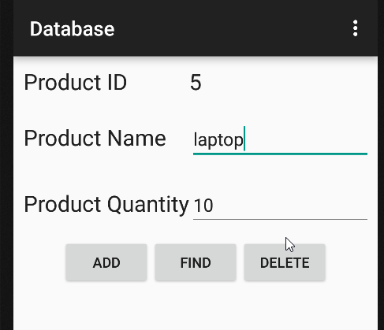
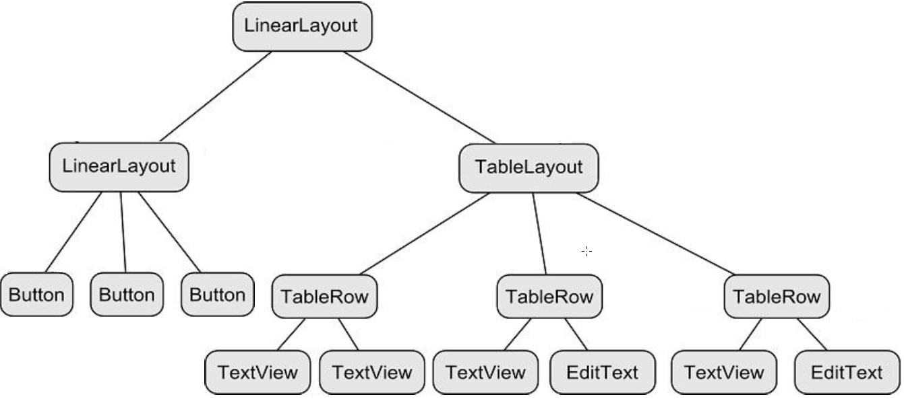
Mobile App Development 12, Android Studio Working with Databases – Example 2
The hierarchical tree structure of the application:

Slide 18
Mobile App Development 12, Android Studio Working with Databases – Example 2
Creating the Database Project -steps-
Start Android Studio and create a new project, entering Database into the Application name field and myname.com as the Company Domain setting before clicking on the Next button.
Enable the Phone and Tablet option on the form factors screen.
Set the minimum SDK setting to API 8: Android 2.2 (Froyo).
Create a blank activity named DatabaseActivity with corresponding layout and menu resource files named activity_database and menu_database respectively.

Slide 19
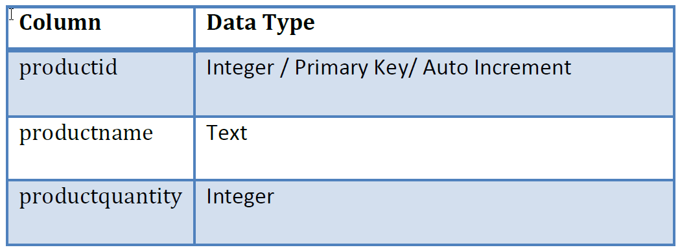
Mobile App Development 12, Android Studio Working with Databases – Example 2
The database schema for the products table is:
- The name of the database will be productID.db which contains a single table named products.
- Each record in the database table will contain a unique product ID, a product description and the quantity of that product item currently in stock, corresponding to column names of “productid”, “productname” and “productquantity” respectively.
- The productid column will act as the primary key and will be automatically assigned and incremented by the database management system.

Slide 20
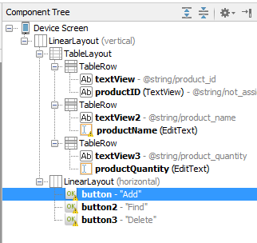
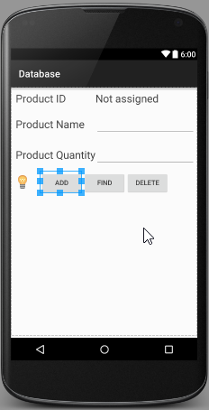
Mobile App Development 12, Android Studio Working with Databases – Example 2
Creating the Layout
Under the previous tree structure, using Design option to edit activity_database.xml. The final form must be:
<LinearLayout android:orientation="vertical" android:layout_width="fill_parent" android:layout_height="fill_parent" xmlns:android="http://schemas.android.com/apk/res/android"> <TableLayout android:layout_width="match_parent" android:layout_height="wrap_content" android:layout_gravity="center_horizontal"> <TableRow android:layout_width="fill_parent" android:layout_height="fill_parent" android:layout_margin="10dp"> <TextView android:layout_width="wrap_content" android:layout_height="wrap_content" android:textAppearance="?android:attr/textAppearanceLarge" android:text="@string/product_id" android:id="@+id/textView" /> <TextView android:layout_width="wrap_content" android:layout_height="wrap_content" android:textAppearance="?android:attr/textAppearanceLarge" android:text="@string/not_assigned" android:id="@+id/productID" /> </TableRow> <TableRow android:layout_width="fill_parent" android:layout_height="fill_parent" android:layout_margin="10dp"> <TextView android:layout_width="wrap_content" android:layout_height="wrap_content" android:textAppearance="?android:attr/textAppearanceLarge" android:text="@string/product_name" android:id="@+id/textView2" /> <EditText android:layout_width="wrap_content" android:layout_height="wrap_content" android:id="@+id/productName" android:layout_column="1" /> </TableRow>
<TableRow android:layout_width="fill_parent" android:layout_height="fill_parent" android:layout_margin="10dp">
<TextView android:layout_width="wrap_content" android:layout_height="wrap_content" android:textAppearance="?android:attr/textAppearanceLarge" android:text="@string/product_quantity" android:id="@+id/textView3" /> <EditText android:layout_width="wrap_content" android:layout_height="wrap_content" android:inputType="numberDecimal" android:ems="10" android:id="@+id/productQuantity" /> </TableRow> </TableLayout> <LinearLayout android:orientation="horizontal" android:layout_width="wrap_content" android:layout_height="fill_parent" android:layout_gravity="center_horizontal"> <Button android:layout_width="wrap_content" android:layout_height="wrap_content" android:text="Add" android:id="@+id/button" android:onClick="newProduct" /> <Button android:layout_width="wrap_content" android:layout_height="wrap_content" android:text="Find" android:id="@+id/button2" android:onClick="lookupProduct"/> <Button android:layout_width="wrap_content" android:layout_height="wrap_content" android:text="Delete" android:id="@+id/button3" android:onClick="removeProduct" /> </LinearLayout> </LinearLayout>

Slide 21
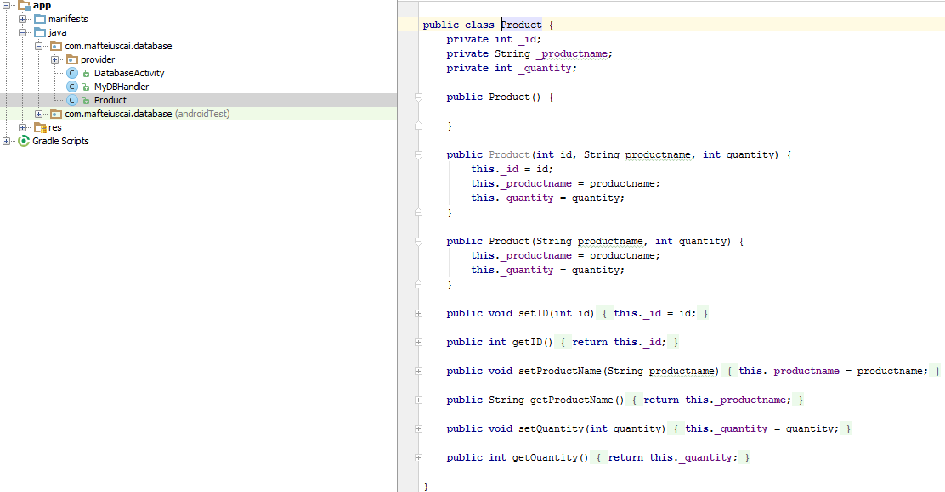
Mobile App Development 12, Android Studio Working with Databases – Example 2
Creating the Data Model
The database handler will be a subclass of SQLiteOpenHelper and will provide an abstract layer between the underlying SQLite database and the activity class. This subclass is for adding, removing and querying database entries.
For this, create a new class in project, named Product (Product.java file):

Slide 22
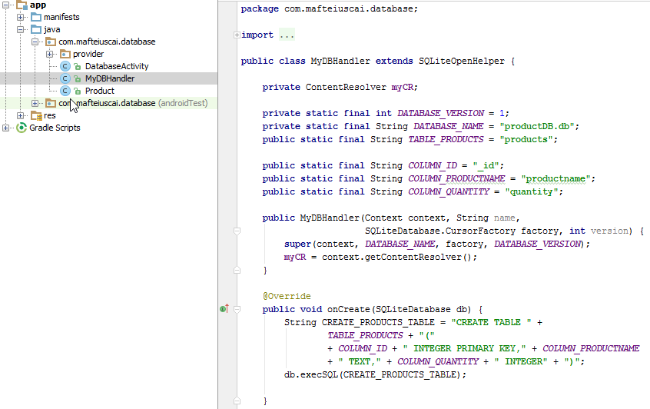
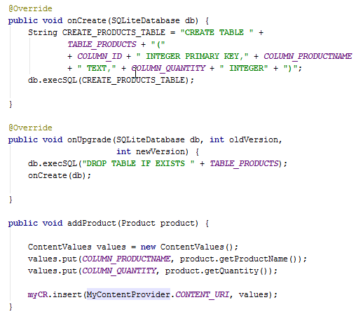
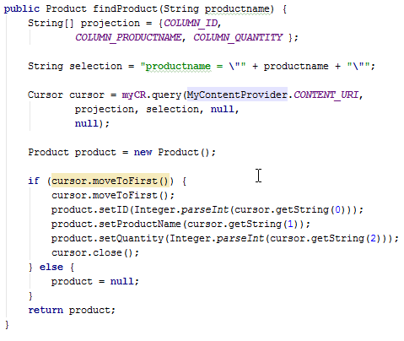
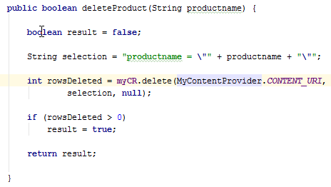
Mobile App Development 12, Android Studio Working with Databases – Example 2
Implementing the Data Handler
The data handler will be implemented by subclassing from the Android SQLiteOpenHelper class with onCreate() and onUpgrade() methods. So, add a new class named MyDBHandler:

Slide 23
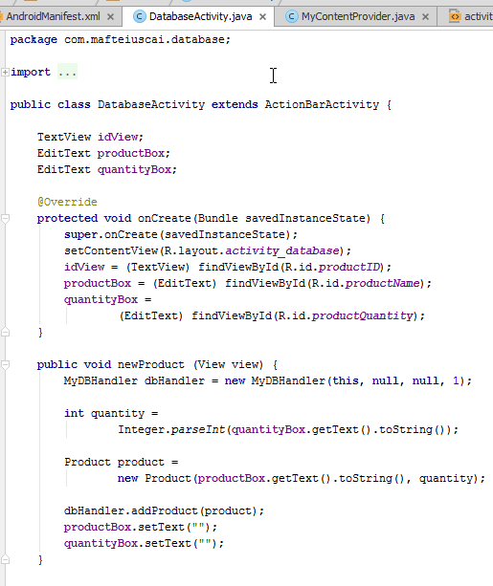
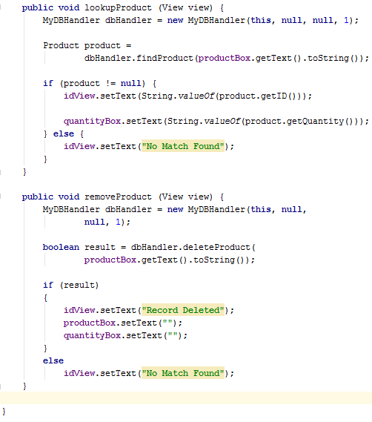
Mobile App Development 12, Android Studio Working with Databases – Example 2
Implementing the Activity Event Methods
In DatabaseActivity.java source file implement the code to identify the views in the user interface and to implement the three “on Click” target methods:

Slide 24
`
Ta-Ta for now!

