Slide 1

Mobile Application Development Course 9
Android Studio
Input and Output operations
simple
numerical computations using
mobile devices
West University of Timisoara, Romania
Computer Science Department
IE3, Fall 2015
Dr. Liviu Octavian Mafteiu-Scai

Slide 2

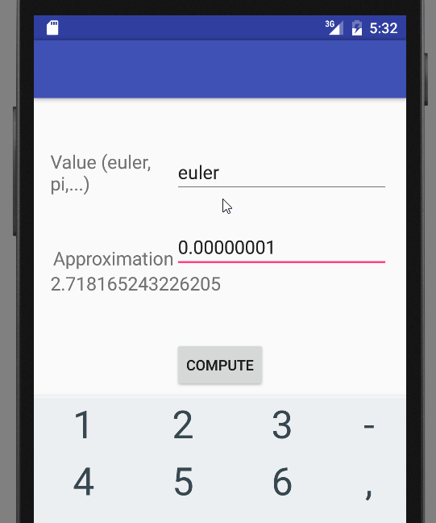
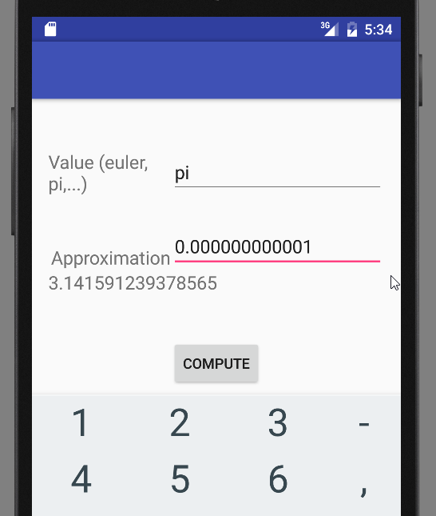
Mobile App Development 9, Android Studio Goal
Computations App

Slide 3
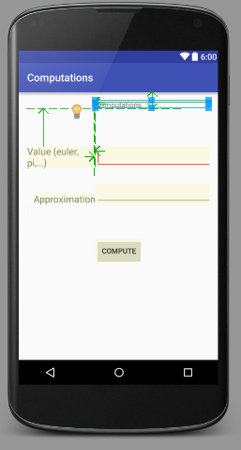
Mobile App Development 9, Android Studio Computations App
Layout -> content_main.xml file Design form

Slide 4
Mobile App Development 9, Android Studio Computations App
Layout -> content_main.xml file Edit form
RelativeLayout
is a view group that displays child views in relative positions, to one another.
vs. LinearLayout
<RelativeLayout xmlns:android="http://schemas.android.com/apk/res/android" xmlns:tools="http://schemas.android.com/tools" android:layout_width="match_parent" android:layout_height="match_parent" android:paddingBottom="@dimen/activity_vertical_margin" android:paddingLeft="@dimen/activity_horizontal_margin" android:paddingRight="@dimen/activity_horizontal_margin" android:paddingTop="@dimen/activity_vertical_margin"> <TextView android:id="@+id/textView1" android:layout_width="fill_parent" android:layout_height="wrap_content" android:text="Computations" android:layout_alignParentTop="true" android:layout_toRightOf="@+id/textView2" android:layout_toEndOf="@+id/textView2" />
paddingBottom in dimens.xml file
<dimen name="activity_horizontal_margin">16dp</dimen>
The constant fill_parent was replaced with match_parent in Android 2.2 .
Or, use the value –1.
fill_parent ⬄that means that the view wants to be as big as its parent (minus padding)
wrap_content ⬄ some similar with “Autosize” from Windows Form Control.
toRightOf is a property of RelativeLayout it will have no effect in LinearLayout.
Positions the left edge of this view to the right of the given anchor view ID.

Slide 5
Mobile App Development 9, Android Studio Computations App
Layout -> content_main.xml file Edit form
<Button android:id="@+id/btnCompute" android:layout_width="wrap_content" android:layout_height="wrap_content" android:text="Compute" android:layout_below="@+id/txtResult" android:layout_centerHorizontal="true" android:layout_marginTop="43dp" />
<EditText android:id="@+id/txtApprox" android:layout_width="fill_parent" android:layout_height="wrap_content" android:ems="2" android:inputType="number|numberDecimal" android:layout_alignBottom="@+id/textView3" android:layout_alignLeft="@+id/txtValue" android:layout_alignStart="@+id/txtValue" />
In MainActivity.java file:
btnCompute = (Button)findViewById(R.id.btnCompute);
“Compute“: the string on the button
In MainActivity.java file:
secondApprox = (EditText)findViewById(R.id.txtApprox);
ems is a typography term, that controls text size.
The em is the font size.
In TextView there is an attribute named android:ems. The description is "Makes the TextView be exactly this many ems wide"

Slide 6
Mobile App Development 9, Android Studio Computations App
Activity -> Main_Activity.java file
package name: launch the application using its package name.
A class for mapping from String values to various Parcelable types.
This class represents the basic building block for user interface components. A View occupies a rectangular area on the screen and is responsible for drawing and event handling. View is the base class for widgets, which are used to create interactive UI components (buttons, text fields, etc.).
package com.example.mafteiu_scai.computations; import android.os.Bundle; import android.view.View; import android.view.View.OnClickListener; import android.support.v7.app.AppCompatActivity; import android.widget.Button; import android.widget.EditText; import android.widget.TextView;
Interface definition for a callback to be invoked when a view is clicked
Base class for activities that use the support library action bar features.
Represents a push-button widget. Push-buttons can be pressed or clicked by the user to perform an action.
Displays text to the user and optionally allows them to edit it.
EditText is a thin/layer over TextView that configures itself to be editable

Slide 7
Mobile App Development 9, Android Studio Computations App
Activity -> Main_Activity.java file
Base class for activities that use the support Library action bar features, derived from:
java.lang.Object
↳android.content.Context
↳android.content.ContextWrapper
↳android.view.ContextThemeWrapper
↳android.app.Activity
↳android.support.v4.app.FragmentActivity
↳ android.support.v7.app.AppCompatActivity
public class MainActivity extends AppCompatActivity {
// Variable Declaration
EditText firstValue;
EditText secondApprox;
TextView computeResult;
Button btnCompute;
double approx, sum;
String value;
double prev_term;
double curr_term;
int n, i;
double aux;
Variables from controls
In connection with content_main.xml file
corresponding variables of … used in java processing
Other variables used in computation

Slide 8
Mobile App Development 9, Android Studio Computations App
Activity -> Main_Activity.java file
protected void onCreate(Bundle savedInstanceState) {
super.onCreate(savedInstanceState);
setContentView(R.layout.activity_main);
firstValue = (EditText)findViewById(R.id.txtValue);
secondApprox = (EditText)findViewById(R.id.txtApprox);
computeResult = (TextView)findViewById(R.id.txtResult);
btnCompute = (Button)findViewById(R.id.btnCompute);
btnCompute.setOnClickListener(new OnClickListener() {
public void onClick(View v) { value = firstValue.getText().toString(); approx = double.parseDouble(secondApprox.getText().toString());
onCreate: a method that initialize the activity.
setContentView(int) with a layout resource define the UI
findViewById(int) is used to retrieve the widgets in UI, needed to interact with java program
Create click listener object
onClick, the method that will be invoked when the button is clicked.
converting String to Double in Android
getText() a method that can be used to get the copied text from the clipboard

Slide 9
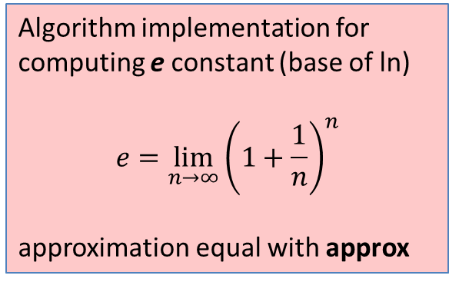
Mobile App Development 9, Android Studio Computations App
Activity -> Main_Activity.java file
Compare two string
Compares the given object to a string and returns true if they are equal.
if(value.equals("euler")) { //e from ln double prev_term = 2; double curr_term = 1.5*1.5; n=2; while (curr_term - prev_term > approx) { prev_term = curr_term; n++; aux = 1 + 1.0/n; curr_term = aux; for(int j=2;j<=n;j++) curr_term *=aux; } sum = curr_term; computeResult.setText(Double.toString(sum)); }
Algorithm implementation for computing e constant (base of ln)
$$e=\lim_{n→∞}{{\left(1+\frac{1}{n}\right)}^{n}}$$
approximation equal with approx
Replace text in computeResult (in TextView) with converted value of sum.

Slide 10

Mobile App Development 9, Android Studio Computations App
Activity -> Main_Activity.java file
if(value.equals("pi")) { //pi double prev_term = 1; double curr_term = -1.0/3; sum = prev_term + curr_term; i=2; int sign=-1; while (Math.abs(prev_term) - Math.abs(curr_term) > approx)
{ prev_term = curr_term; i++; sign *= (-1); curr_term = sign * 1.0 / (2*i-1); sum += curr_term; } sum = 4.0 * sum; computeResult.setText(Double.toString(sum)); } else computeResult.setText("Incorrect string for Value"); }
PI computing algorithm

Slide 11
Mobile App Development 9, Android Studio Computations App – lab activity 1
Design and Implement
an
Android App
for solving
Quadratic Equations

Slide 12
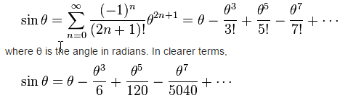
Mobile App Development 9, Android Studio Computations App – lab activity 2
Using the previsious example/app, compute sin function using the series:

Slide 13
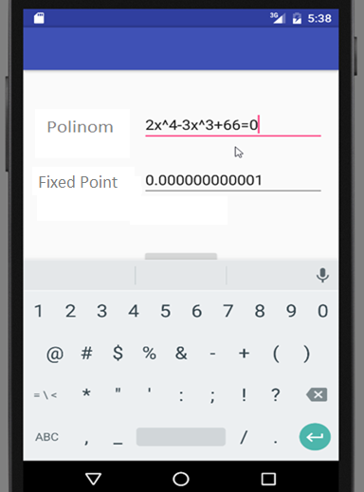
Mobile App Development 9, Android Studio Computations App – lab activity 3
Modify the first given example to calculate the value of a polynomial in a fixed point

Slide 14
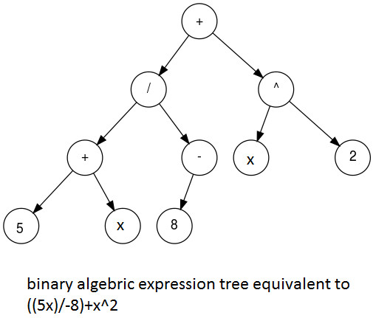
Mobile App Development 9, Android Studio Computations App – lab activity 3
Compute polinom value for a fixed point x – first theoretical considerations

Slide 15
Mobile App Development 9, Android Studio Computations App – lab activity 3
Compute polinom value for a fixed point x – second “theoretical” considerations
brute force

Slide 16
`
Ta-Ta for now!

