Slide 1
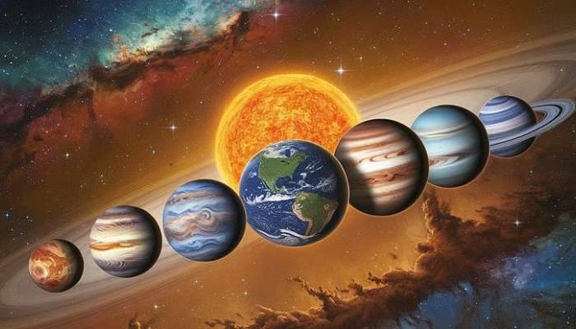
ST 13: Heliophysics and Planetary Science Branch
Pushing Boundaries in Heliophysics and Planetary Science

