Slide 1

Finite Element Method:
A Homemade
2D Solver
Vasiliy Tereshkov
https://github.com/vtereshkov/fem

Slide 2
Topics
Editor
Mesh generation
FEM solver
Visualization
Self-check
Implementation

Slide 3
Editor: Requirements
2D plate boundary: one non-self-intersecting polygon
Holes: only polygons, no circles
Extra points for manual mesh refinement
Constraints: each fixing a point in both X and Y
External loads: only forces, no torques
Material: Young modulus, Poisson ratio, max stress

Slide 4
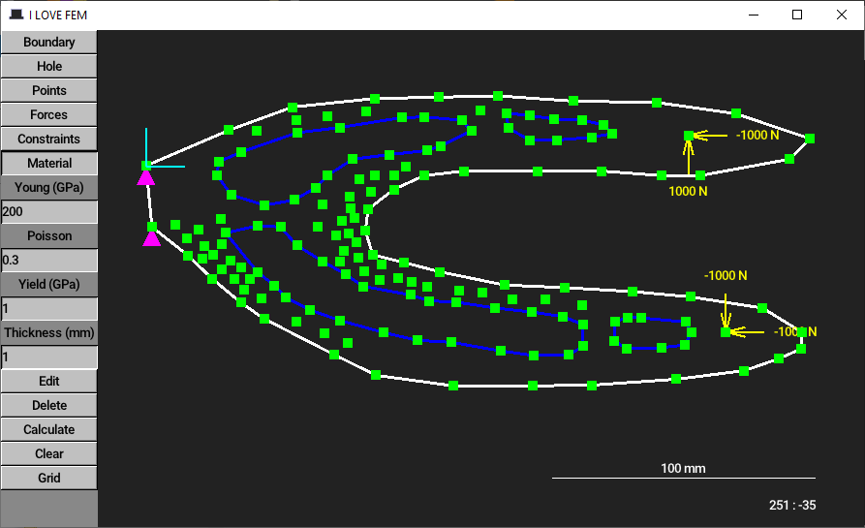
Editor: GUI

Slide 5
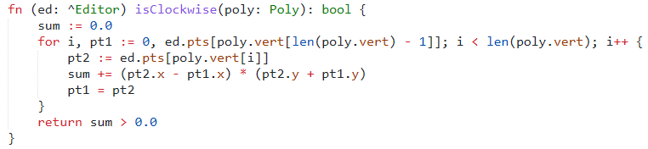
Editor: Clockwise or counter-clockwise?
Boundary: counter-clockwise
Holes: clockwise

Slide 6
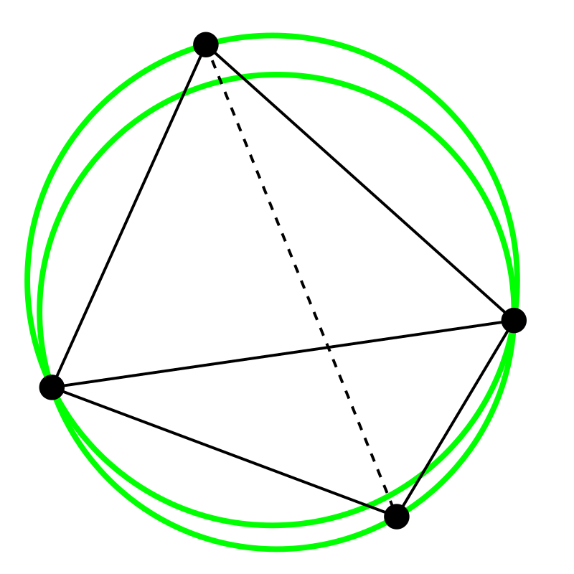
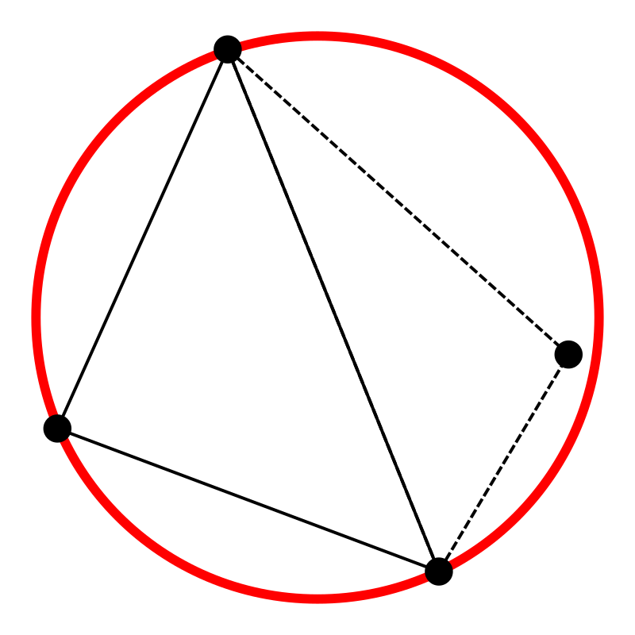
Mesh generation: Delaunay triangulation
How to avoid extremely long and thin triangles?
Point
inside
Good
Bad
Source: https://en.wikipedia.org/wiki/Delaunay_triangulation

Slide 7
Mesh generation: Bowyer-Watson algorithm
Start with a fake super-triangle

Slide 8
Mesh generation: Bowyer-Watson algorithm
Add points one by one
Point 1

Slide 9
Mesh generation: Bowyer-Watson algorithm
Add points one by one
Point 2

Slide 10
Mesh generation: Bowyer-Watson algorithm
Two triangles
are no longer
Delaunay
Point 3

Slide 11
Mesh generation: Bowyer-Watson algorithm
Remove bad triangulation
Point 3

Slide 12
Mesh generation: Bowyer-Watson algorithm
Retriangulate bad polygon
Point 3

Slide 13
Mesh generation: Bowyer-Watson algorithm
Add points one by one
Point 4

Slide 14
Mesh generation: Bowyer-Watson algorithm
Remove the super-triangle

Slide 15
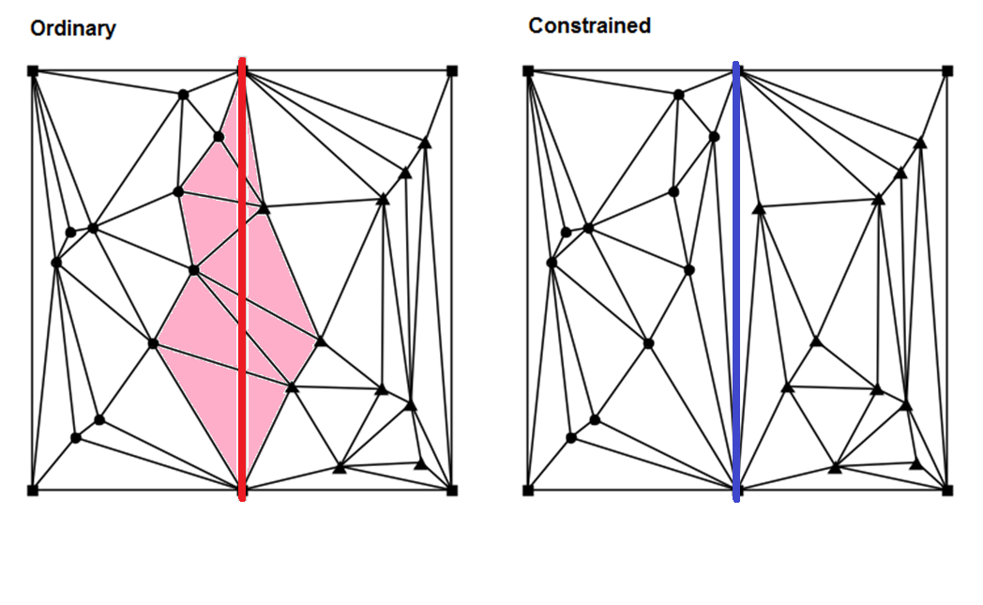
Mesh generation: Missing edges
Source: https://gwlucastrig.github.io/TinfourDocs/DelaunayIntroCDT/index.html

Slide 16
Mesh generation: Missing edges
Zooming in
Source: https://gwlucastrig.github.io/TinfourDocs/DelaunayIntroCDT/index.html

Slide 17
Mesh generation: Missing edges: Sloan algorithm
Retriangulate bad quad by swapping its diagonals

Slide 18
Mesh generation: Missing edges
No longer Delaunay, but who cares if we need this edge?

Slide 19
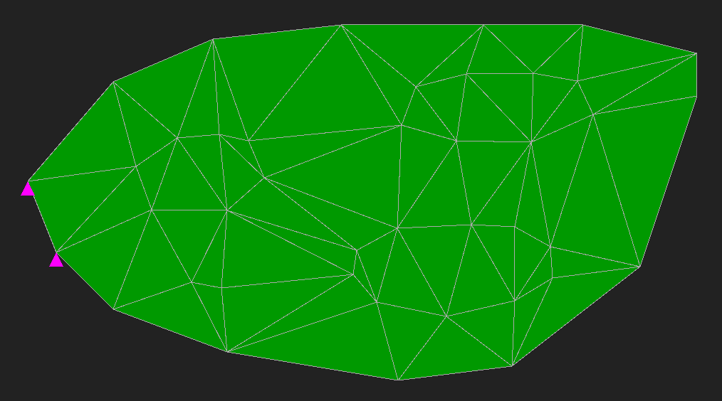
Mesh generation: Removing outside triangles
Convex hull triangulation: boundaries ignored

Slide 20
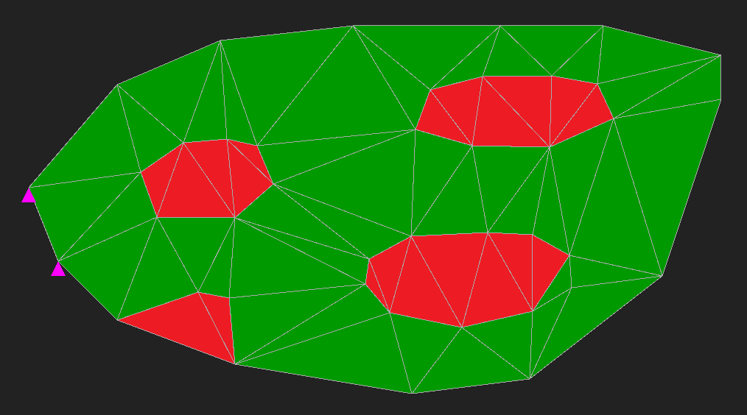
Mesh generation: Removing outside triangles
Outside
Outside
Inside
Outside
Outside

Slide 21
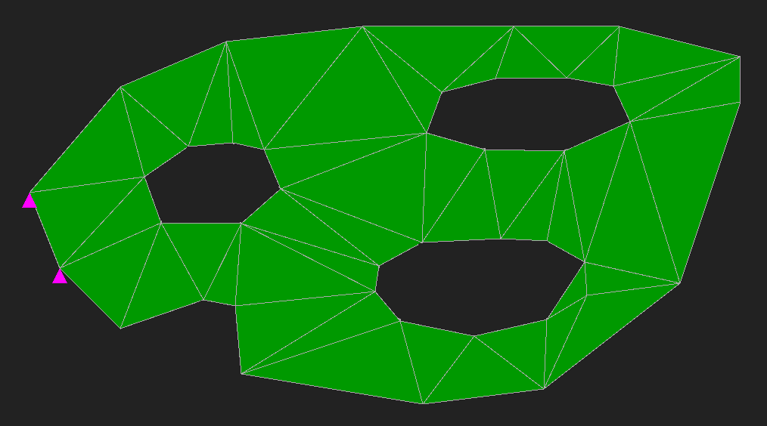
Mesh generation: Removing outside triangles

Slide 22
Mesh generation: Removing outside triangles
Zooming in

Slide 23
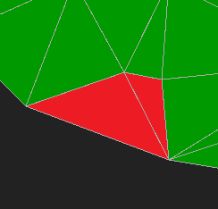
Mesh generation: Removing outside triangles
First outside triangle: contains a boundary segment, but in opposite direction

Slide 24
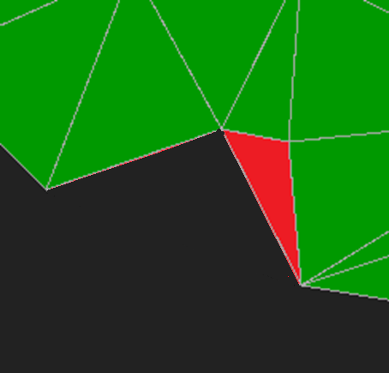
Mesh generation: Removing outside triangles
Next outside triangle(s): all neighbors, except the inside triangles

Slide 25
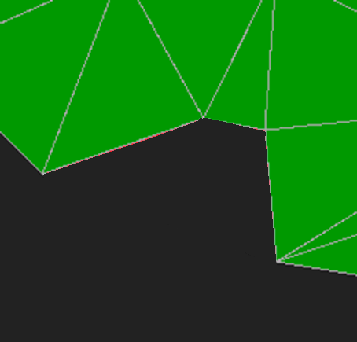
Mesh generation: Removing outside triangles
Remove recursively!

Slide 26
Mesh generation: Validation
Boundary:
No intersections
Each point must belong to 0 or 2 edges
Mesh:
Each point must belong to a triangle

Slide 27
FEM: Discretization
∞ points
N points (nodes)
∞ unknown displacements
2N unknown displacements
Interpolate in between

Slide 28
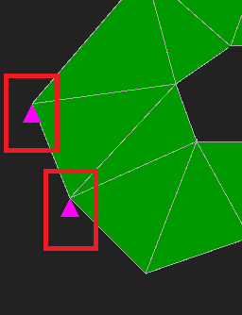
FEM: Constraints
No displacement
No DOF
No equation
No reaction force

Slide 29
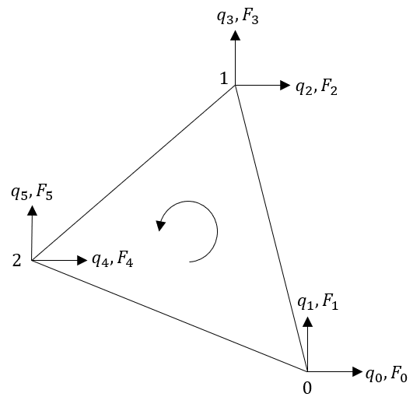
FEM: Triangular element
q =
unknown independent displacements (DOFs)
F =
external forces (0 if not set)

Slide 30
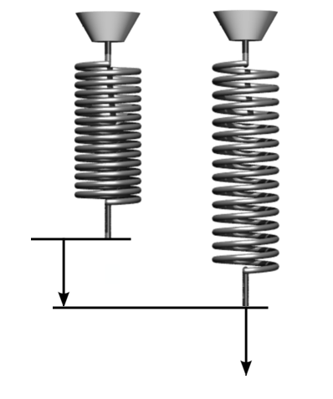
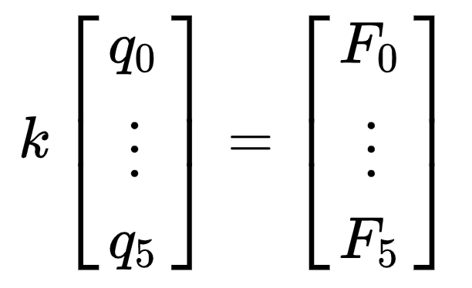
FEM: Triangular element: “Hooke’s law”
?
q
F
1 DOF:
kq = F
q
6 DOFs:
F
Source: https://en.wikipedia.org/wiki/Stiffness

Slide 31
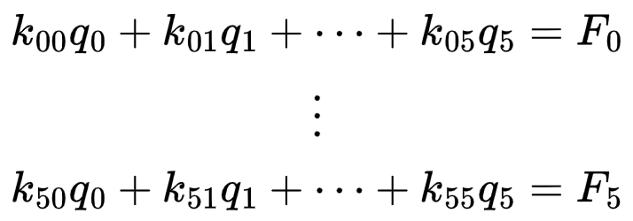
FEM: Triangular element: “Hooke’s law”
In scalar form:

Slide 32
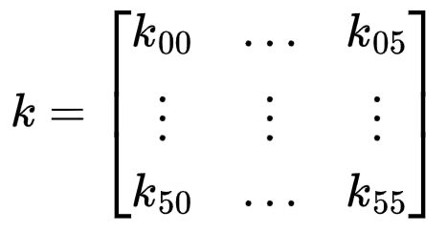



FEM: Triangular element: Stiffness matrix
6×6 matrix
Indexed by element DOFs
Depends on triangle sides, material and thickness
= force
needed to make
Explicit formula in fem::createElement()

Slide 33
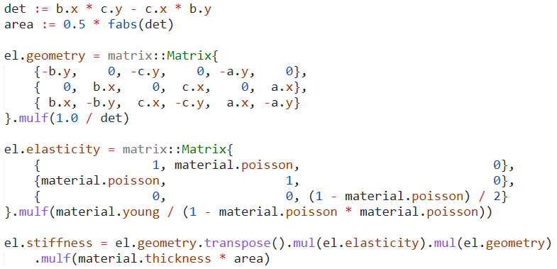
FEM: Triangular element: Stiffness matrix

Slide 34
FEM: Connecting elements
Element: 6 DOFs
Whole model: 2N DOFs
Element DOF
(0…5)
Global DOF
(0…2N—1)

Slide 35
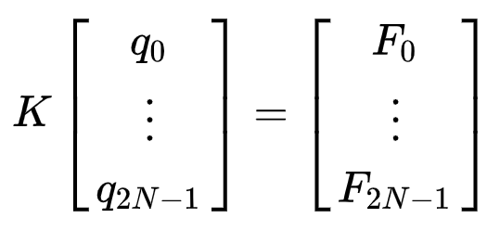
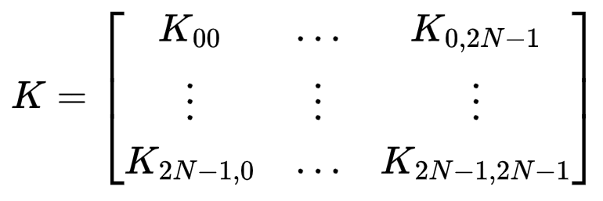
FEM: Global stiffness matrix
2N×2N matrix
Indexed by global DOFs
Made of element stiffness matrices

Slide 36

FEM: Global stiffness matrix
Pseudocode:
K = 0
for each element
for each i
for each j
Element DOF
i
j
Global DOF
m
n

Slide 37
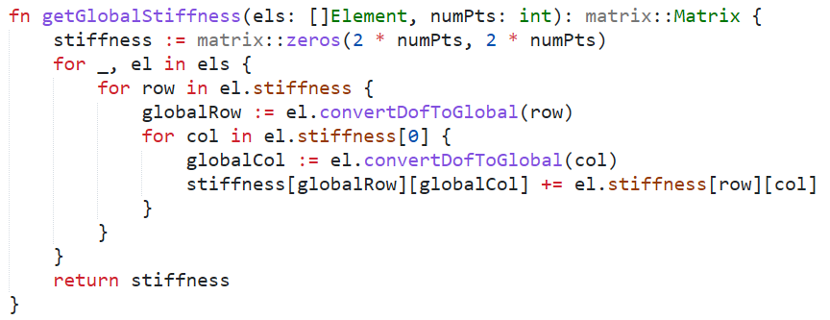
FEM: Global stiffness matrix

Slide 38
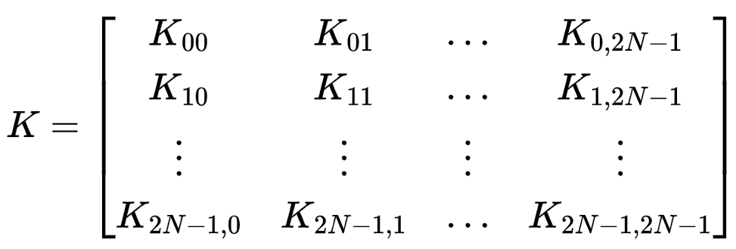
FEM: Constraints
Constrained DOFs? Just strike them out!
Constrained DOF

Slide 39
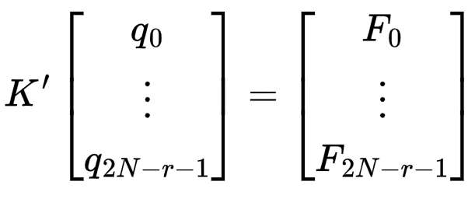
FEM: Constraints
After r constrained DOFs removed:
(2N — r) × (2N — r) matrix
Non-degenerate: can solve for q

Slide 40
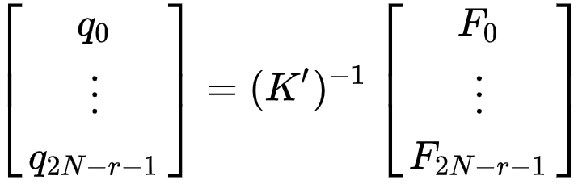
FEM: Displacements
Solve for q
1 DOF:
q = F / k
(2N — r) DOFs:

Slide 41
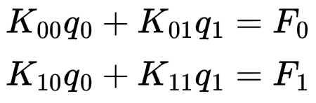
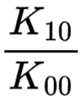

FEM: Displacements: Gaussian elimination
Don’t want to inverse K’? Solve K’q = F directly
Example: 2 unconstrained DOFs
(1)
(2)
How many (1)s do we subtract from (2) to eliminate
?
Answer:

Slide 42
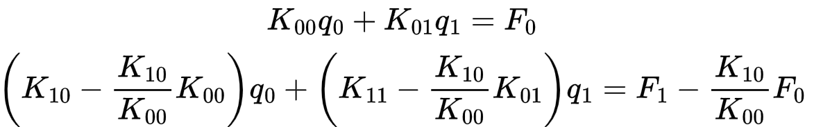


FEM: Displacements: Gaussian elimination
0
Find
, then

Slide 43
FEM: Stresses
Displacements interpolated linearly
Constant strain over element
Constant stress over element
Constant color in stress visualization

Slide 44
FEM: Stresses
X tension
Y tension
Shear
3 stresses responsible for 3 “elastic” DOFs
Explicit formula in fem::getEquivalentStress()

Slide 45
FEM: Stresses
X tension
Y tension
Shear
Von Mises equivalent stress
Explicit formula in fem::getEquivalentStress()

Slide 46
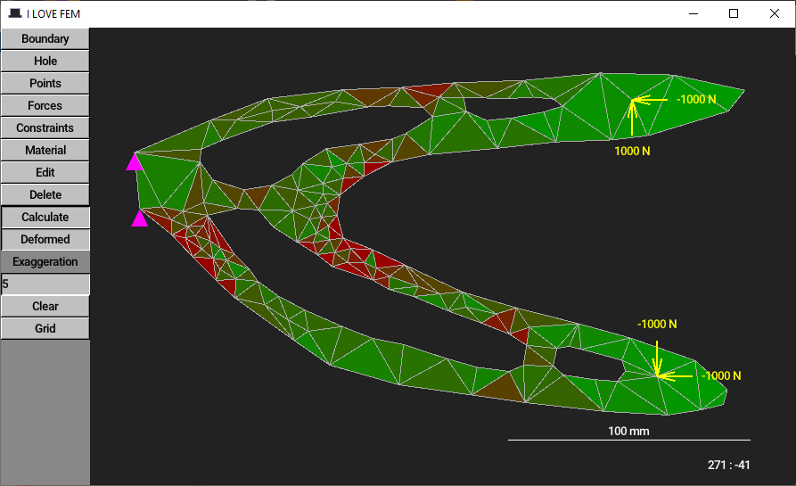
Visualization

Slide 47
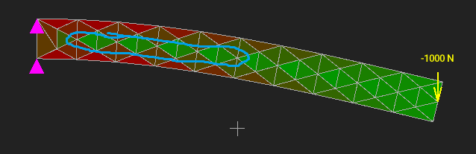

Self-check
Beam bending
Not stressed?!
Tension
Compression
Not stressed!

Slide 48


Implementation
Umka: a statically typed embeddable scripting language
https://github.com/vtereshkov/umka-lang
tophat: a 2D framework for making games in Umka
https://tophat2d.dev/

Slide 49
Questions?

