Slide 1
SoundScape

Slide 2
Table of Contents
Audio Feature Extraction in Time and Frequency Domain
Model to Classify sound as Shrill and Soft
Manipulating the sound coming from different sources and channels to create an ambient experience.

Slide 3
Problem Definition
Spatial Audio Experience that can be integrated in any kind of particular environment providing us a real time audio ambience of sounds such as traffic, trains , human interaction , nature sounds etc.
This can be integrated in Google Earth Engine which already consists of street and flight view of different location on earth. Additionally, we can add audio aspect to it also providing us a real time experience of being virtually present in that location.

Slide 4
How it will work?
Basically, what we are trying to do is take a sample of raw audio and process it to inform that what kind of audio is present in an environment at particular time of day.
We can do it by taking a sound and converting it to a digitalized audio signal that we can manipulate and extract features.
Our first step will be converting a analog audio signal to a digital audio signal because analog signal is continuous and requires infinite memory to store continuous values.
We can convert using Sampling and Quantization.
Next step is to extract features in both time domain and frequency domain for an audio signal so that we can understand it better.

Slide 5
Experimental Details
Extracting Features in time and frequency domain
Time domain features :
Amplitude Envelope - Maximum amplitude value of all samples in a frame.
Root mean square energy - RMS of all samples in a frame.
Zero crossing rate - Number of times a signal crosses the horizontal axis.

Slide 6
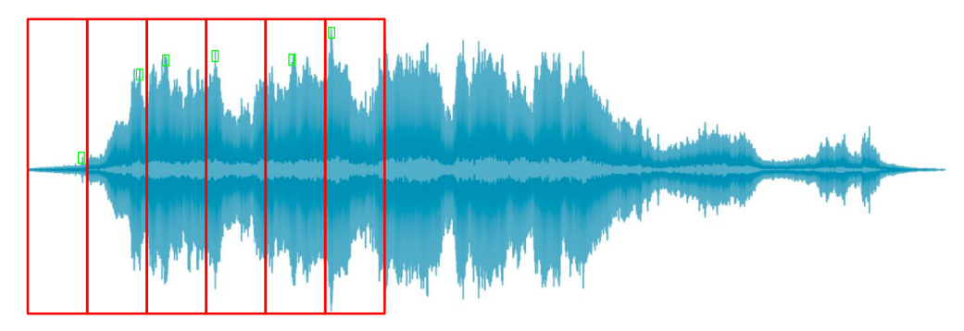
Amplitude Envelope
Gives rough idea of loudness
Sensitive to outliers
Onset detection, music genre classification

Slide 7
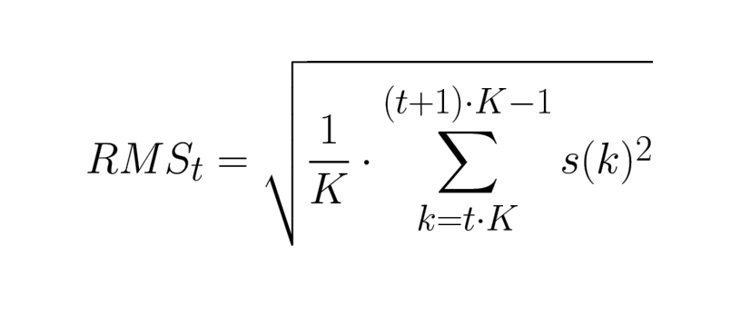
Root Mean Square Energy
Indicator of loudness
Less sensitive to outliers than Amplitude Envelope
Audio segmentation, music genre classification

Slide 8
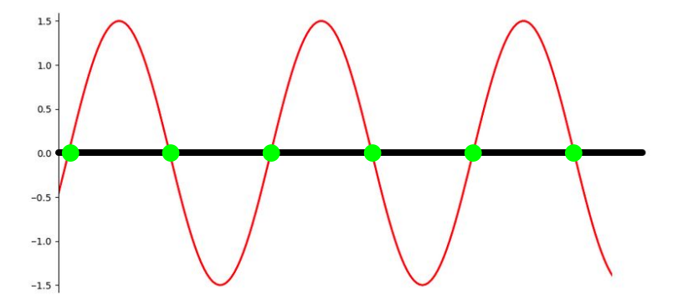
Zero Crossing Rate
Recognition of percussive vs pitched sounds
Monophonic pitch estimation
Voice / unvoiced decision for speech signals

Slide 9
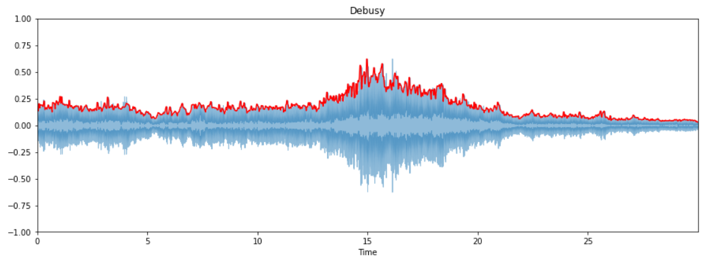
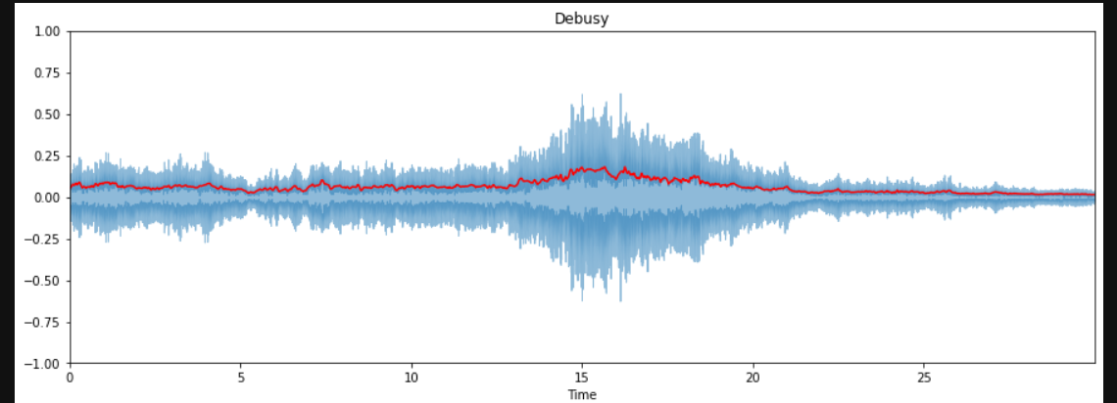

Slide 10
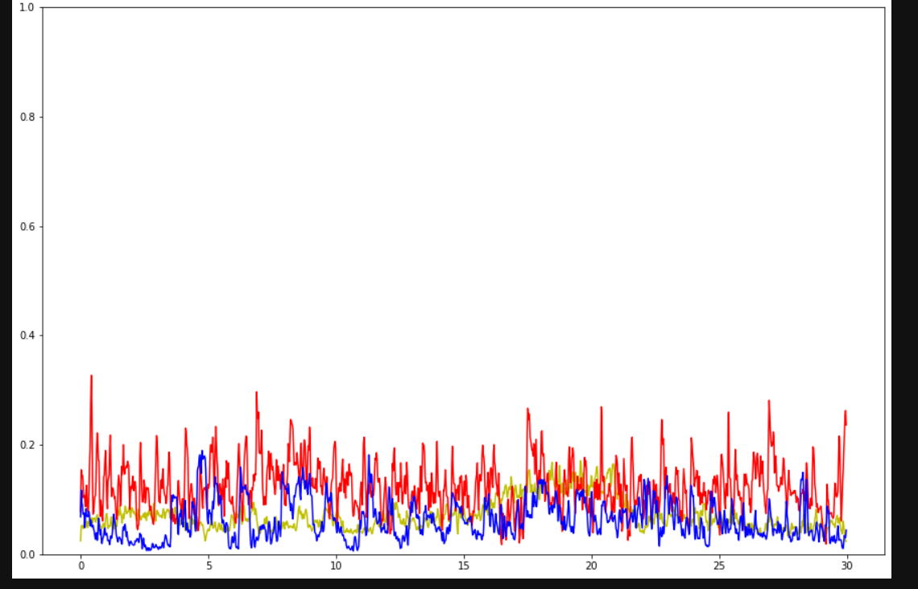

Slide 11
Frequency Domain Features
Spectral Centroid - Frequency band where most of the energy is concentrated.
Band Energy Ratio - Comparison of energy in the lower/higher frequency bands.
Spectral Bandwidth - Weighted mean of the distances of frequency bands from SC

Slide 12
Model to Classify sound as Shrill and Soft
For the classification of sound, we have extracted audio features from the file.
A Sound Classifier class has been defined with 3 main methods ‘analyze_audio’ ,‘classify_sound’ and ‘plot_clusters’.
The analyze_audio method uses the librosa library to extract audio features from the specified WAV files. It calculates the mean spectral centroid, mean spectral bandwidth, and mean zero-crossing rate for each audio file.
The classify_sound method uses the extracted features and applies the K-Means clustering algorithm to cluster the audio files into two groups (Soft or Shrill).

Slide 13
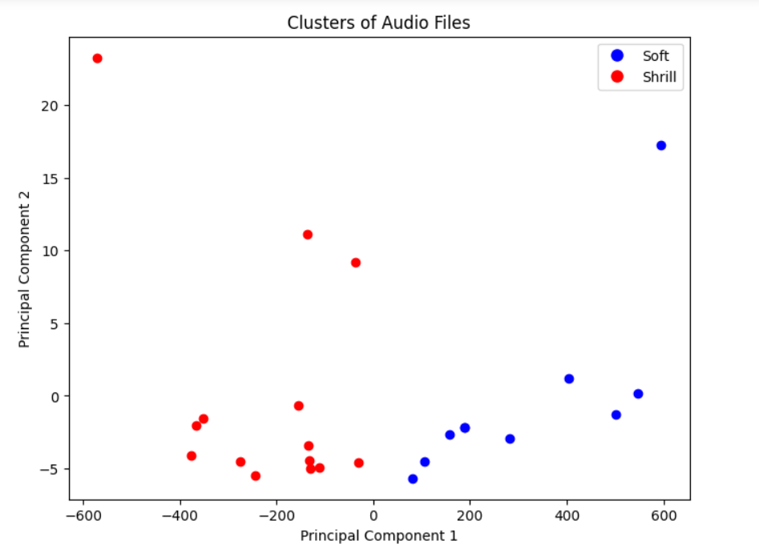
Results
Since we're dealing with three audio features, we'll reduce the dimensionality using Principal Component Analysis (PCA) to visualize the clusters in 2D.

Slide 14
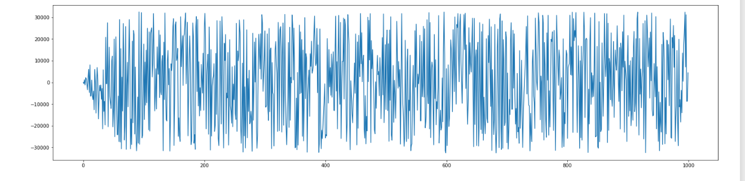
Manipulating the sound coming from different sources and channels to create an ambient experience.
First we started our project for mono-sound which is single channel audio signal.
We used various python libraries for this task.
Below is our input signal which is converted to digital audio signal using techniques like sampling and quantization.

Slide 15
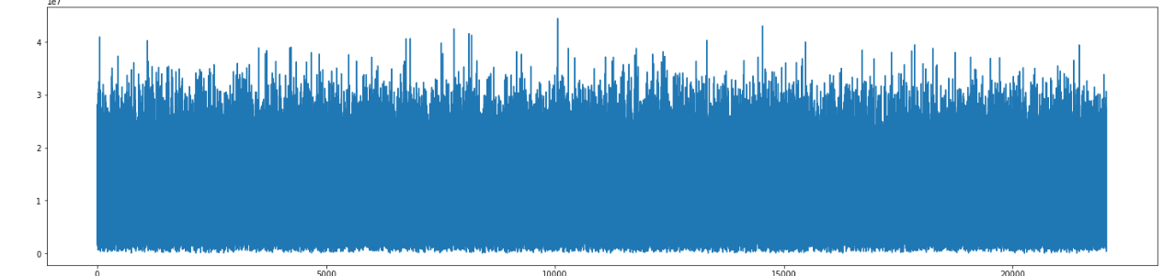
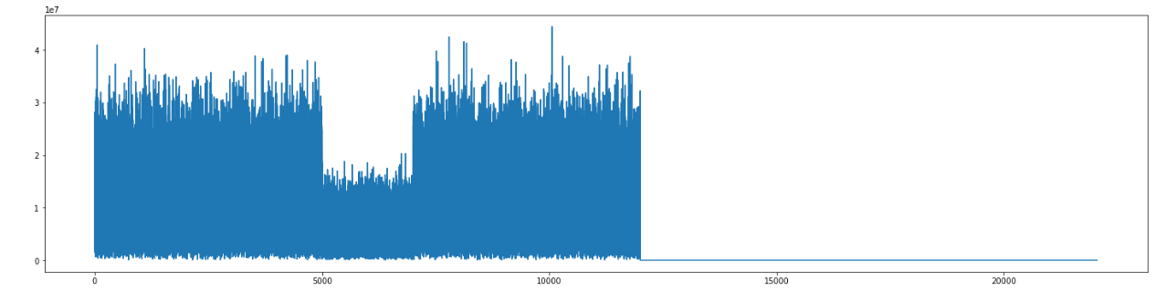
Results
We transformed our sound to frequency domain using Fourier Transform so that we can manipulate the sound

Slide 16
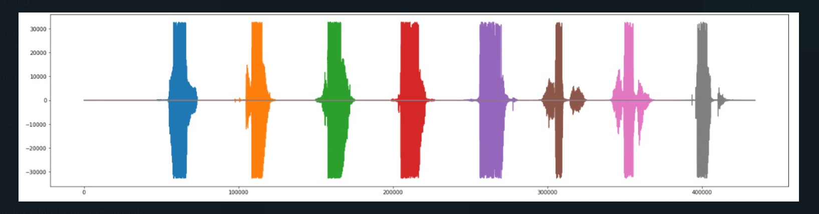
Now we move on to Stereo Sound from Multiple Channels
For this sample audio we have 8 different channels as displayed below.
We separated these channels and manipulated the sound of different channels seperately and combine them to form a final output signal.
Then we removed the distortion from our output audio using cutoff frequency and low-pass butterworth filter.

Slide 17
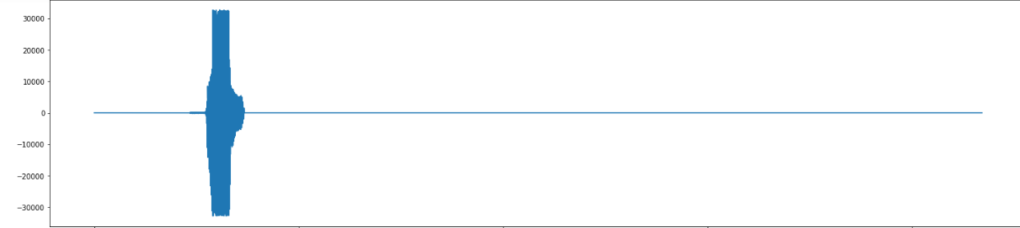
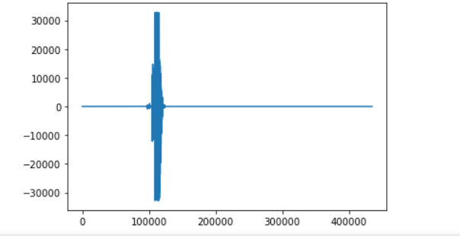
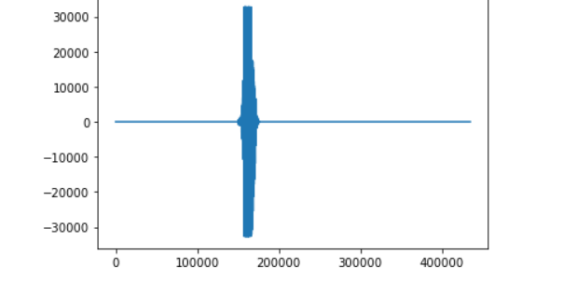
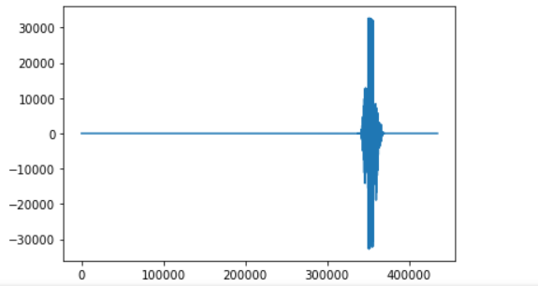
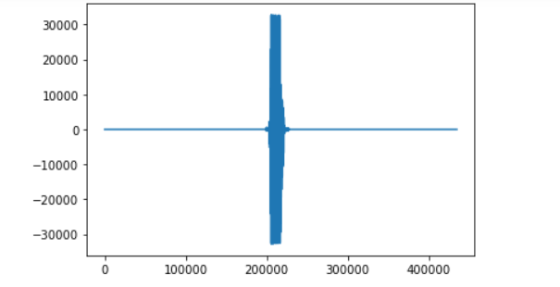
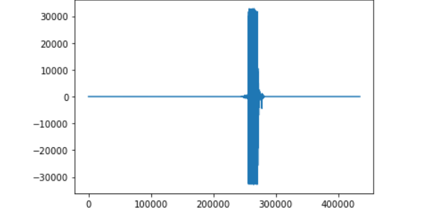
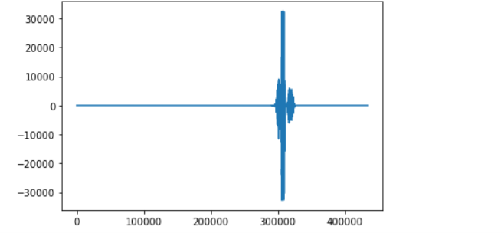
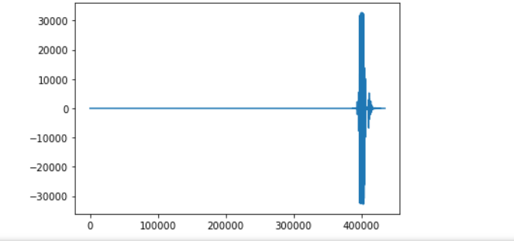
Output from Stereo Sound
Different Audio Channels separated

Slide 18
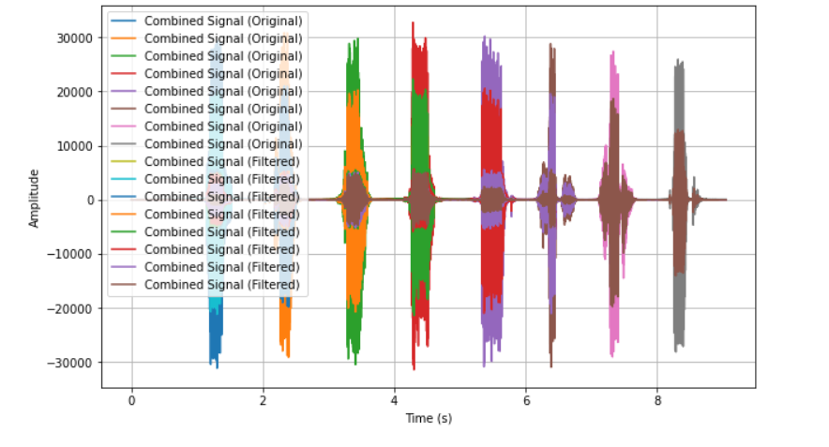
Final Output Signal With Distortion Removed

Slide 19
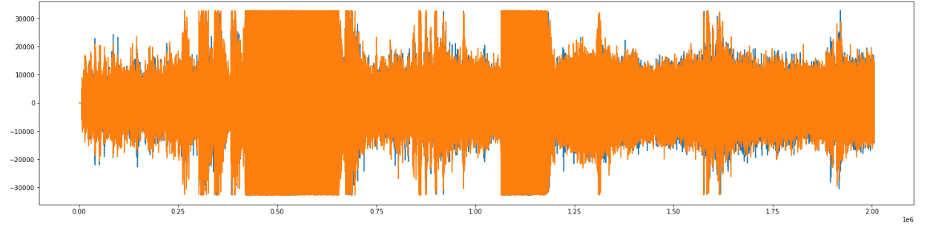
Now we move on to the real sounds
We have collected different audio sample around lucknow city for real sounds. Here is the input signal of sound around Lucknow Railway station.

Slide 20
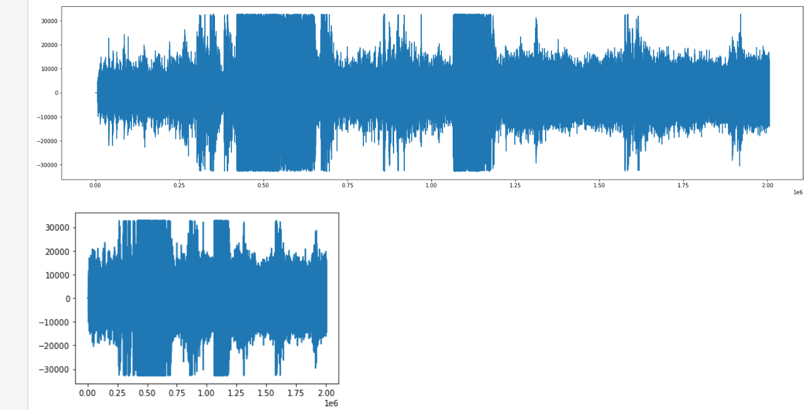
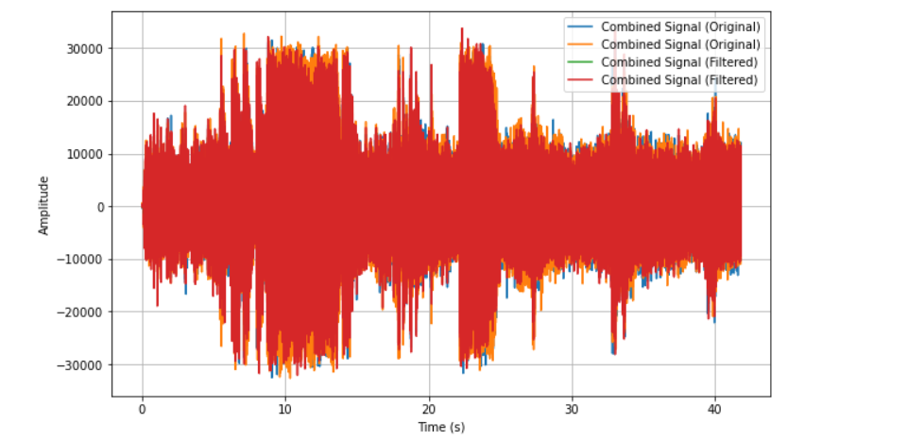
Output Signal
Since our recorder can only capture two channels at a time hence theses two channels are
And Output Signal after combining is:

Slide 21
Conclusion and Future Scope
This technology can be used in various fields also such as :
Real Estate: Providing potential buyers a virtual experience of a particular area at different times of day so that they can choose accordingly.
Industrial Applications: It can be very helpful in detecting faults in different machine used in Industry. More specifically, it can used to detect a particular faulty part of a machine making different sound from what it used to and it can be detected and replaced hence enhancing the yield of machine.
One of the best applications is Audiometric Test.

Slide 22
AudioMetric Test
An audiogram is a special hearing test that helps measure your hearing abilities across a range of different pitches and volumes. It’s a bit like a hearing check up, and it’s done using a machine that generates various tonal sounds.
By a GUI controlled test, the audiologist can create tonal sounds at different pitches and volumes. These sounds are like different musical notes, and they vary from high-pitched to low-pitched and from very soft to very loud. The computer makes sure the sounds are just right for the test.
User will hear the sounds through headphones and let the audiologist know when each sound is heard.
Audiologist then records the responses of user and creates a graph called Audiogram showing how well you hear sounds at different pitches and volumes.
Audiogram is like a mapping of user’s hearing ability. Using which audiologist may tell whether you have hearing loss or not. Or whether you have trouble with high-pitched sounds, low-pitched sounds, or sounds at different volumes.
By using a GUI to generate these tonal sounds, the audiogram becomes a more customizable and precise way to check your hearing. It helps the audiologist determine your specific hearing needs and whether hearing aids or other solutions may be necessary to help you hear better.

