Slide 1
Vietnam-MixedTrafficSim
APEX = Anticipatory · Predictive · EXclusion — a safety-constrained planner for Vietnamese mixed traffic
ELEC5050 Robotics - Group 15 | Do Minh Phung, Vu Thanh Quang, Nguyen Quoc Linh

Slide 2
The Problem: Mixed Traffic in Vietnam
AV motion planners assume Western traffic: marked lanes, rule-abiding drivers.
In Vietnam, >90% of vehicles are motorcycles that:
lane-split and squeeze through sub-meter gaps,
cut in at short range and cross at junctions, ignoring signals.
Standard planners react too late -> unsafe.
Goal: a planner that ANTICIPATES motorcycle conflicts on the real VinUni road.

Slide 3
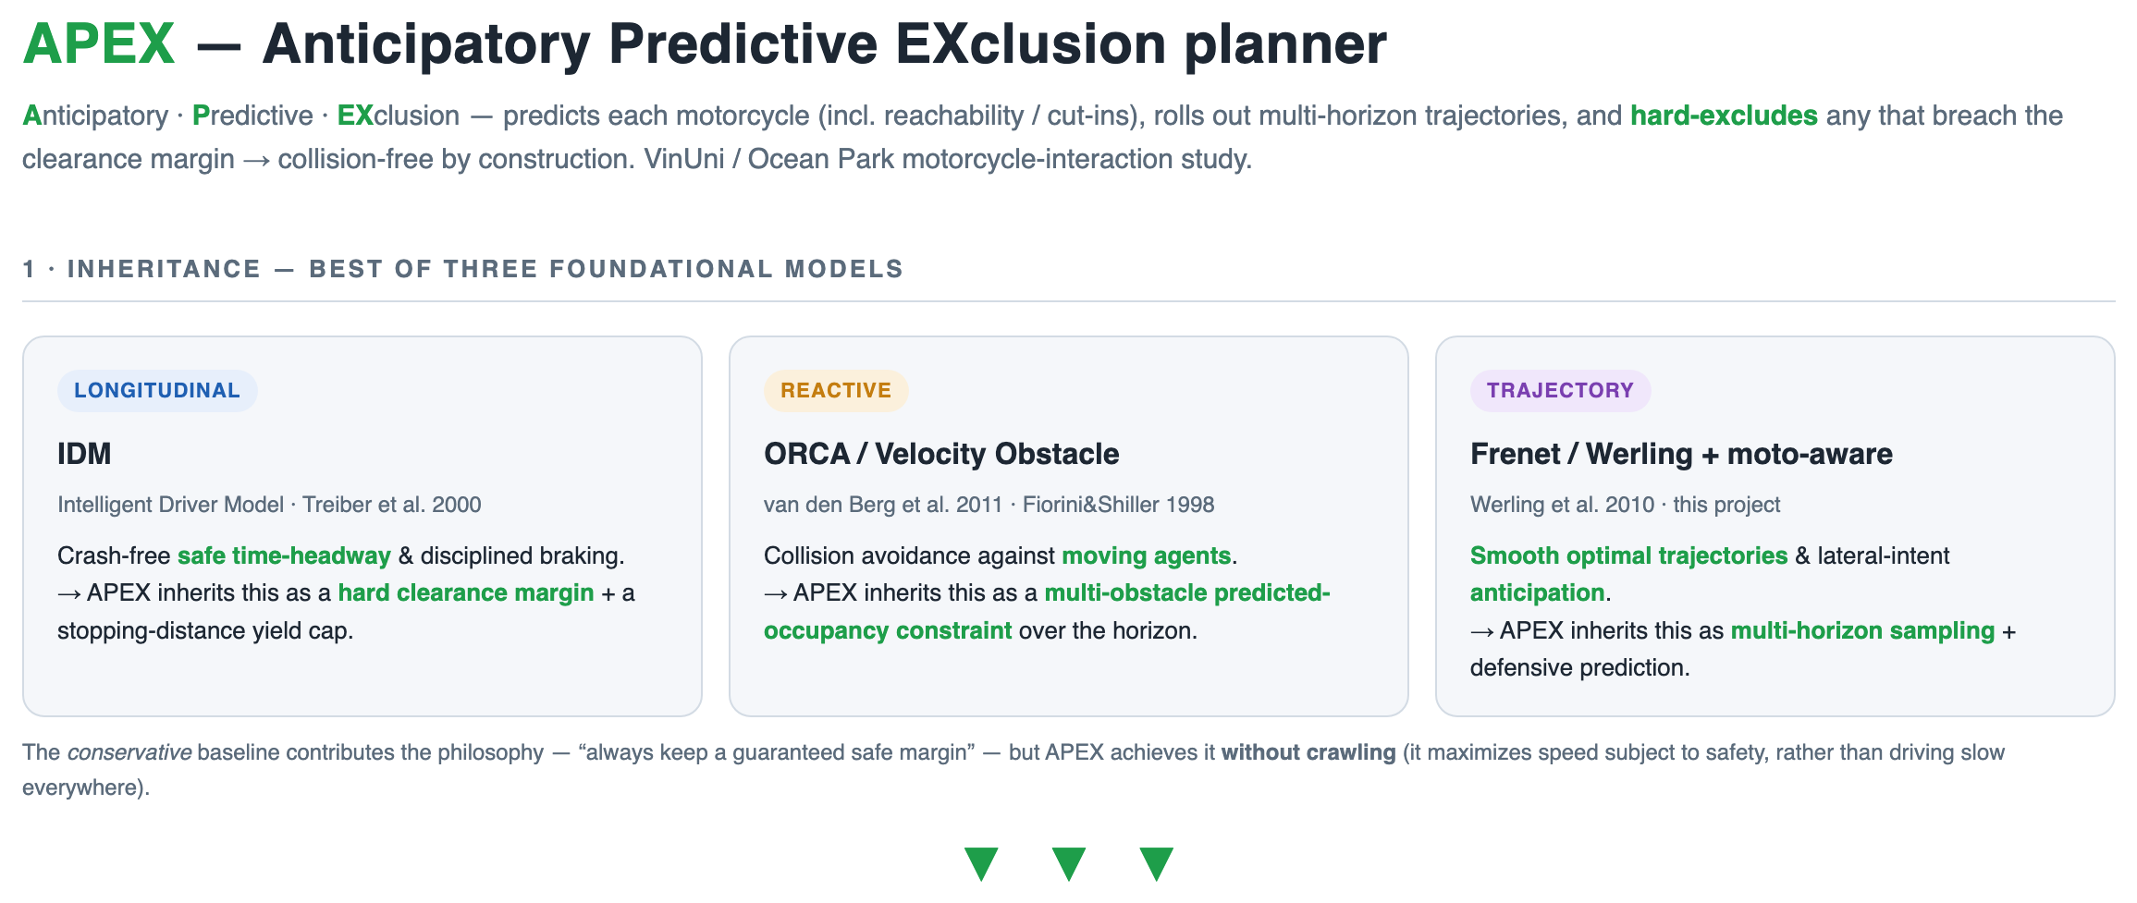

Slide 4
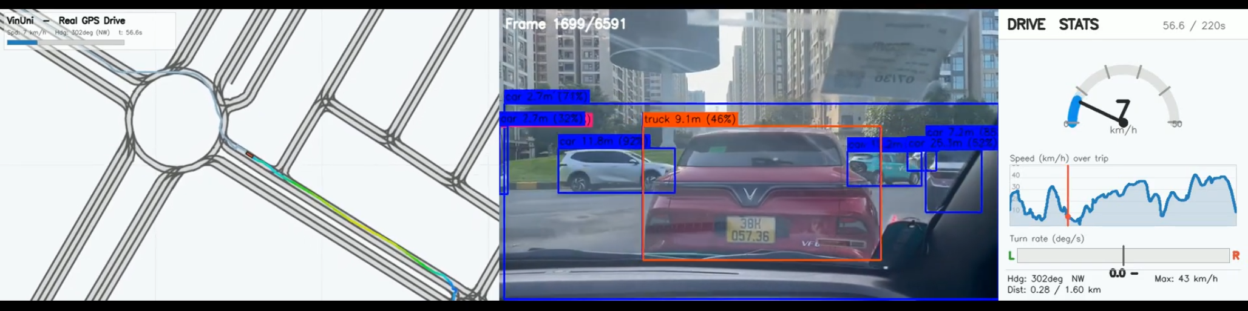
Grounded in real Vietnamese data (PR2)
5 real car trips around VinUni / Ocean Park (QL5 corridor, roundabout, lakeside, residential, faculty parking).
iPhone 12 Sensor Logger: video + GPS + IMU (100 Hz) + compass + barometer.
YOLOv8 detects car / motorcycle / pedestrian -> actor counts (density), nearest range (TTC), class mix.
Synchronized 3-panel replay: GPS on the CommonRoad/Lanelet2 map | camera detections | drive stats.
Two demo modes from real density: low-traffic (<=4 actors/frame) vs high-traffic (>4).
Motorcycle calibration: 4 behaviours (lane-splitting, cut-in, close-following, ambiguous priority)
-> lateral velocity, acceleration, heading-change, gap -> stochastic moto agents = APEX's occupancy-ellipse + dynamic safety cost.

Slide 5
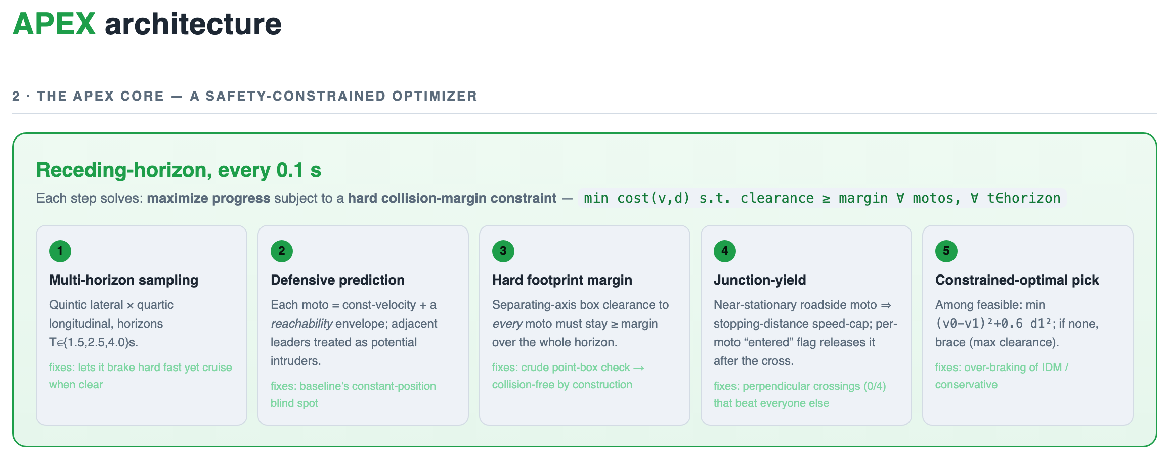

Slide 6
Results: 52 scenarios x 6 planners
Planner | Collisions | <0.3 m fails | Min-clr | Mean R_T
IDM (Treiber 2000) | 5/52 | 7/52 | 5.73 m | 1.57
ORCA/VO (van den Berg 2011) | 1/52 | 1/52 | 2.02 m | 1.34
baseline (Frenet, naive) | 28/52 | 30/52 | 1.24 m | 1.27
conservative | 0/52 | 0/52 | 13.96 m | 1.86
moto-aware (prev. ours) | 13/52 | 14/52 | 2.31 m | 1.33
APEX (predictive, ours) | 0/52 | 0/52 | 2.16 m | 1.43
Only conservative & APEX are crash-free - and APEX is the efficient one:
0 collisions / 0 clearance-fails -> -100% vs baseline (28) and vs our previous moto-aware (13)
23% faster than the only other crash-free planner (R_T 1.43 vs 1.86); beats published IDM & ORCA
Metrics (PR2 Sec 6): collision = 0, min clearance > 0.3 m, TTC exposure < 2 s, AEB = 0, efficiency R_T <= 1.25.

Slide 7
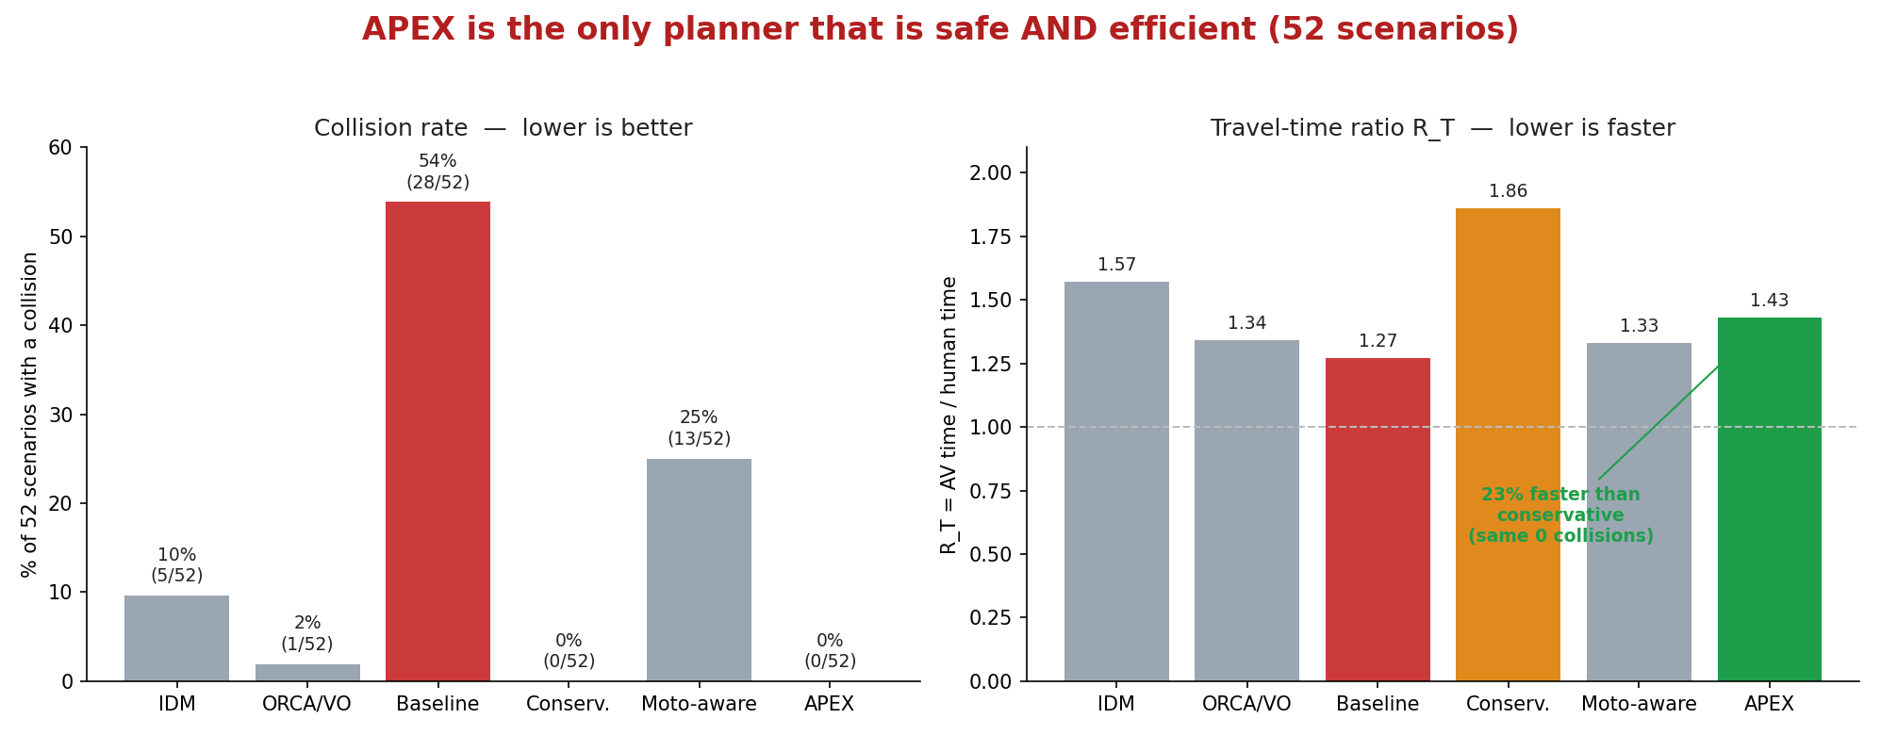

Slide 8
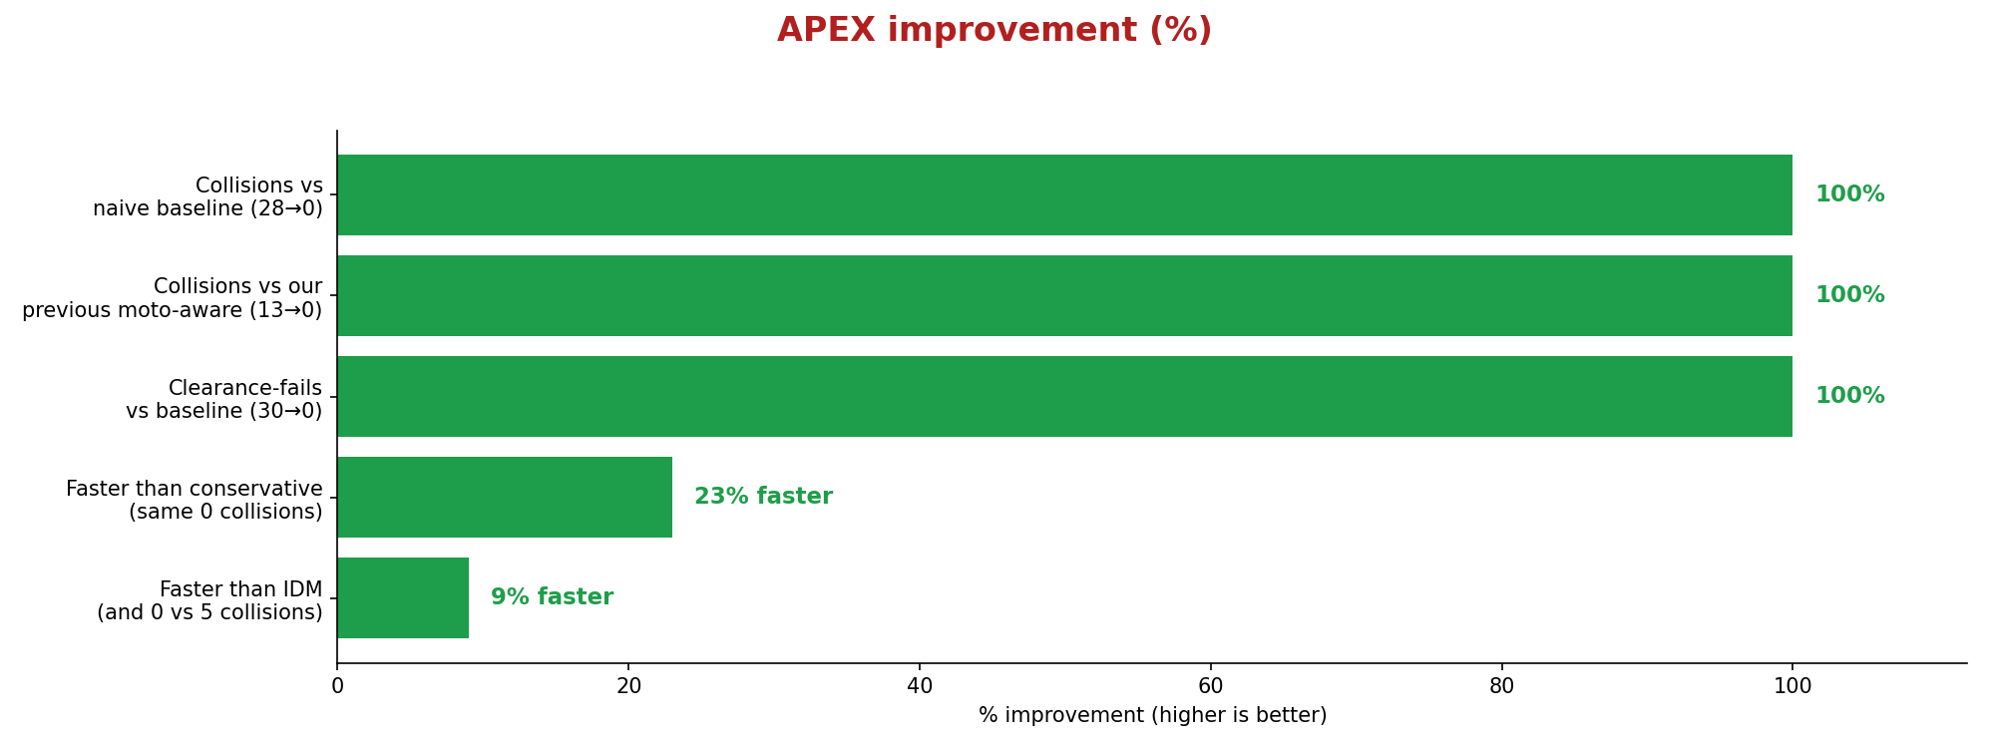

Slide 9
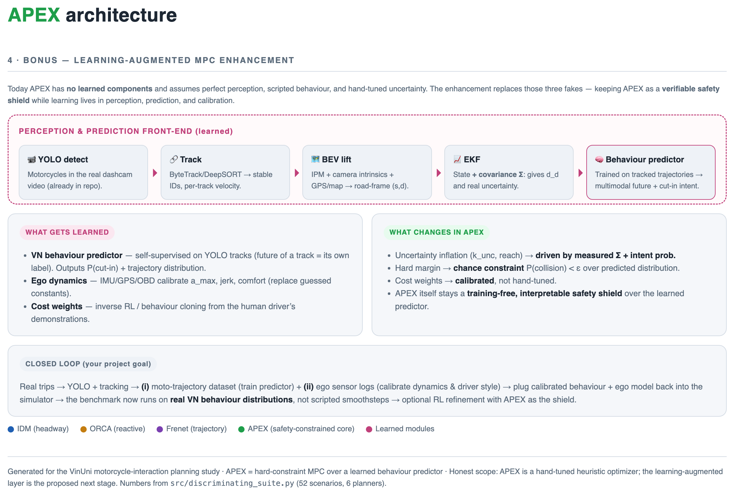

Slide 10
Live demo & next steps
6 scenario videos (4 panels: baseline | ORCA/VO | moto-aware | APEX) - others collide, APEX stays safe:
cut-in, junction crossing, shoulder merge, multi-lane weave, two- and three-motorcycle scenes.
Aligns with the CommonRoad 2024 competition (winning Frenet paradigm; we add prediction it lacked).
Honest limits (PR2 Sec 7): motorcycle-behaviour calibration in progress; YOLO range is approximate.
Next: calibrate motorcycle behaviour from 200 h moto + 5 car-trip data; CARLA 3D validation.

