Slide 1
Reactome Connectivity and Path Traversal Project
Thawfeek Varusai

Slide 2
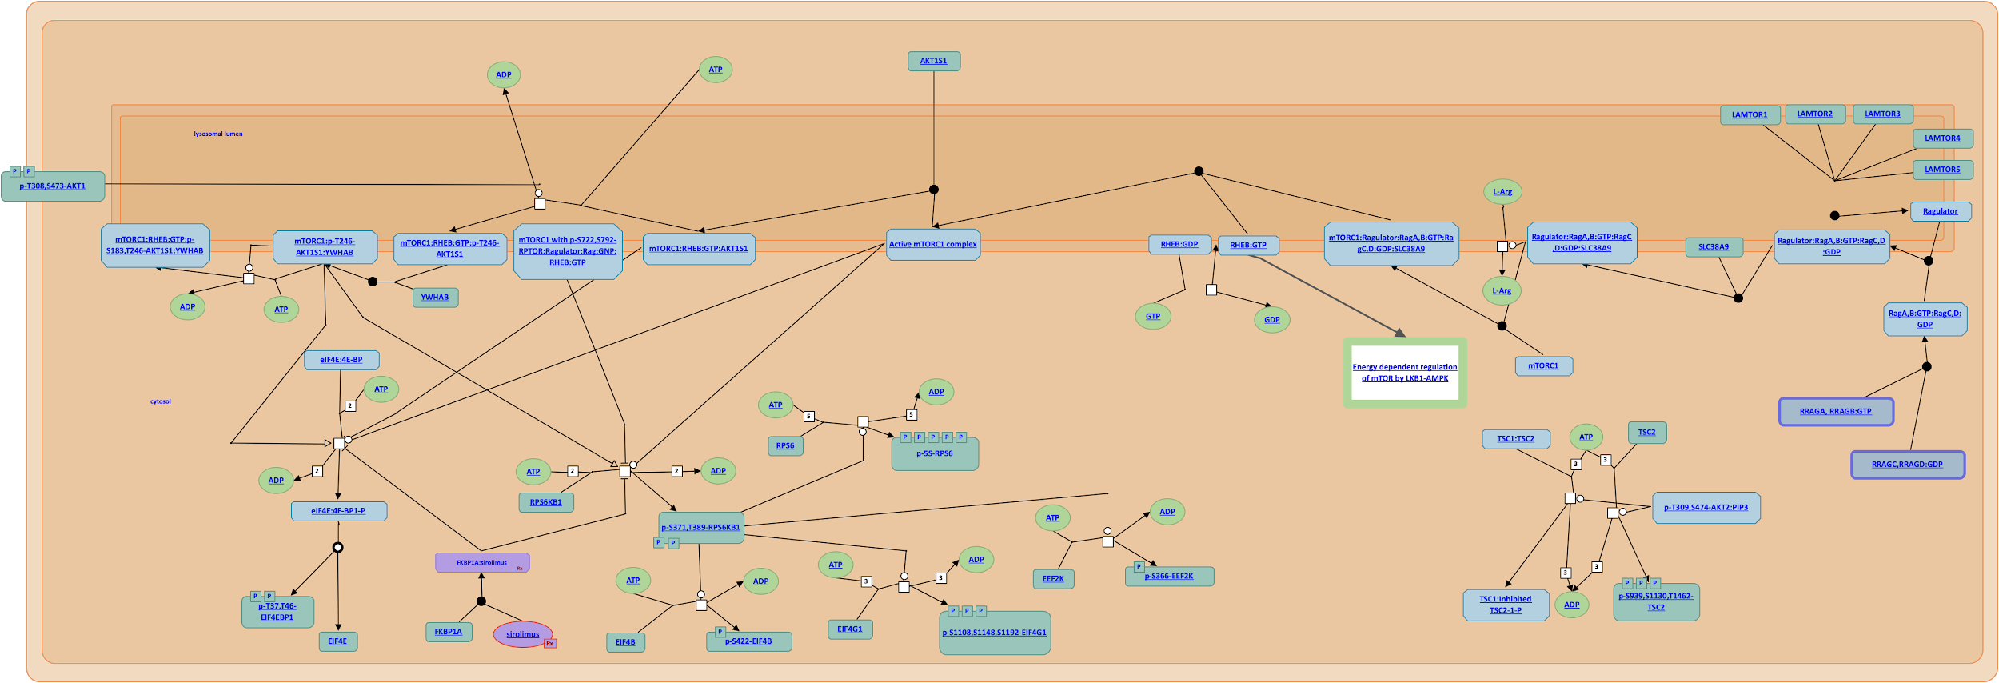
Connectivity project
2
3
1
If output of reaction is input/catalyst/regulator of another reaction then they’re connected

Slide 3
Preliminary results
Type of connection | Number of connections
precedingEvent | 131
Computationally predicted | 122
Potentially missing | 61
Reviewed and approved | 61
Autophagy
% of newly predicted connections: ~47%
% of predicted connections that were approved: 100%

Slide 4
Preliminary results
Type of connection | Number of connections
precedingEvent | 66
Computationally predicted | 155
Potentially missing | 90
Reviewed and approved | 40
SARS-Cov-1
% of newly predicted connections: ~136%
% of predicted connections that were approved: ~44%

Slide 5
Preliminary results
Type of connection | Number of connections
precedingEvent | 1870
Computationally predicted | 3110
Potentially missing | 1240
Reviewed and approved | 200* (in progress)
Immune system
% of newly predicted connections: ~66%
% of predicted connections that were approved: ~16%* (in progress)

Slide 6
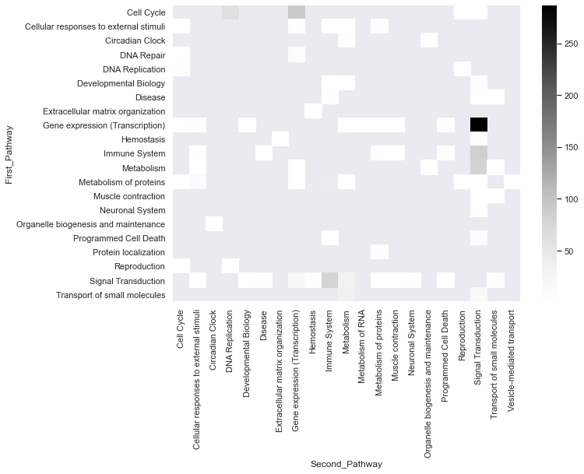
Inter-TopLevelPathway connection predictions
The darker the shade more the number of connections

Slide 7
Start/End project
End
Start
Start Reaction: Indegree = 0 & Outdegree >0
End Reaction: Indegree >0 & Outdegree = 0

Slide 8
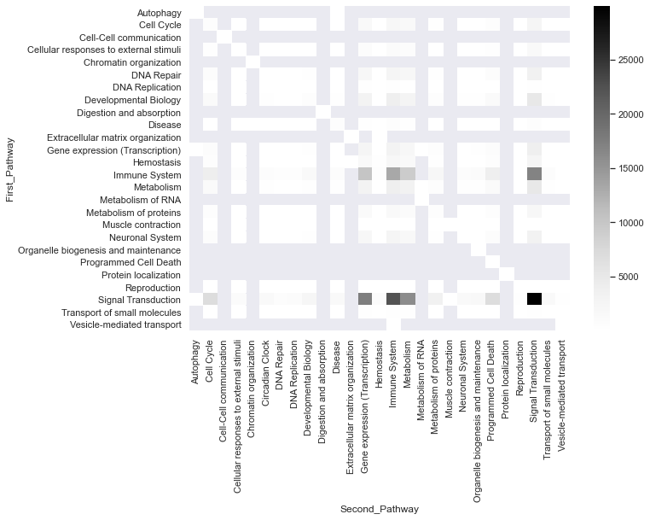
All of Reactome Start/End reactions
The darker the shade more the number of connections

Slide 9
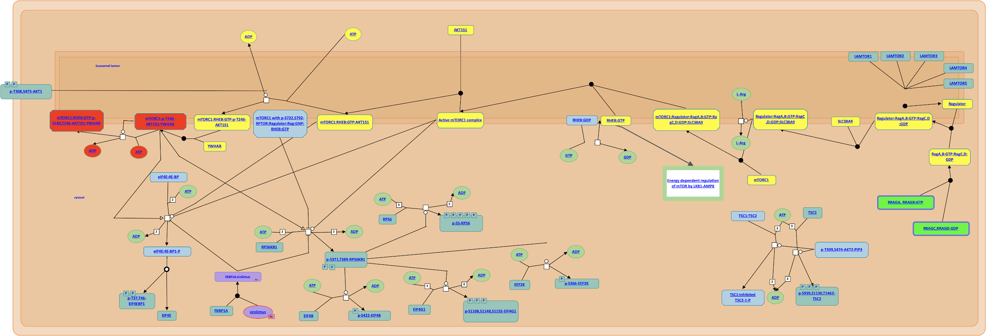
mTOR Signaling Pathway - amino acid starvation activates Akt

Slide 10
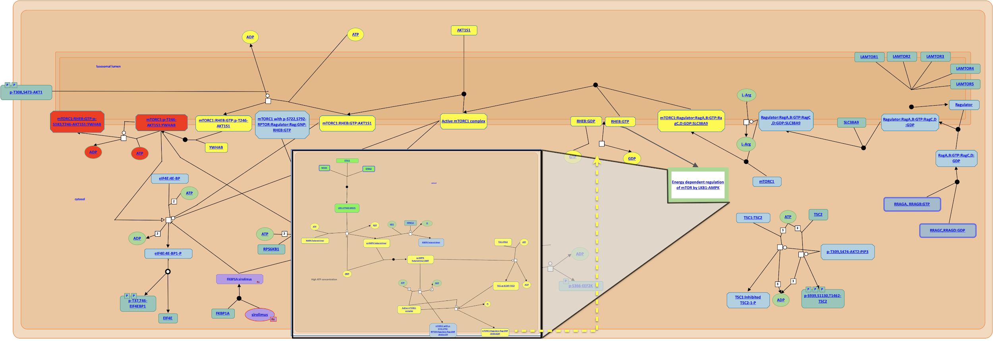
mTOR Signaling Pathway - ATP starvation activates Akt (cross-pathway)

Slide 11
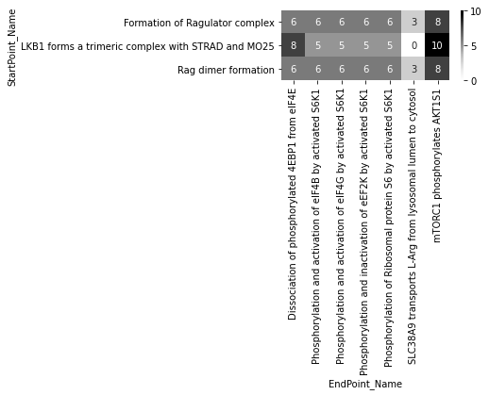

Start/End analysis of mTOR signaling pathway
precedingEvent + predicted connections
The darker the shade more the number of steps in path
Start Reactions
End Reactions

Slide 12
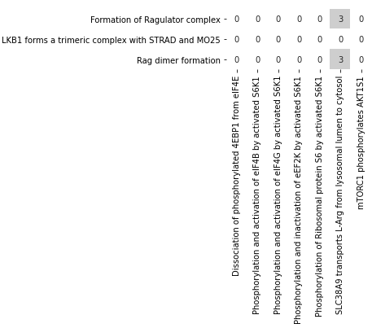
Impact of connectivity in start/end analysis
precedingEvent + predicted connections
precedingEvent
The darker the shade more the number of steps in path
Start Reactions
mTOR Signaling Pathway
End Reactions
End Reactions

Slide 13
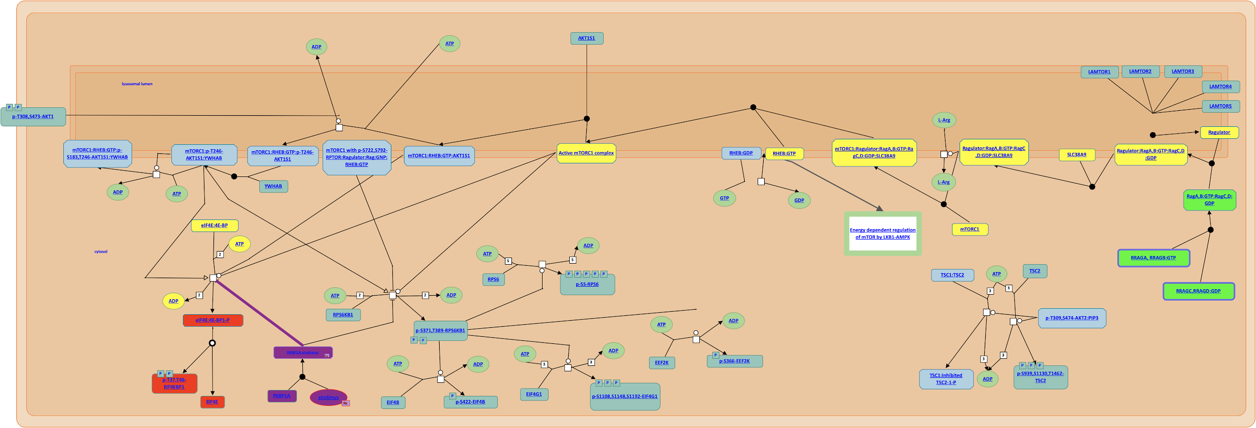
mTOR Signaling Pathway - amino acid starvation triggers protein translation and a drug (sirolimus) inhibits this process

Slide 14
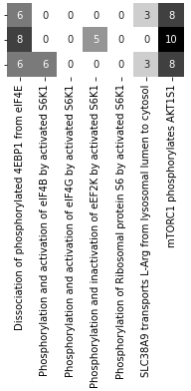
Drug effect in start/end analysis
precedingEvent + predicted connections + drug event
(FKBP1A binds sirolimus)
precedingEvent + predicted connections
The darker the shade more the number of steps in path
Start Reactions
mTOR Signaling Pathway
End Reactions
End Reactions

Slide 15
Start/end analysis overview
precedingEvent + predicted connections + drug event
(FKBP1A binds sirolimus)
precedingEvent + predicted connections
precedingEvent
The darker the shade more the number of steps in path
Start Reactions
mTOR Signaling Pathway
End Reactions
End Reactions
End Reactions

Slide 16
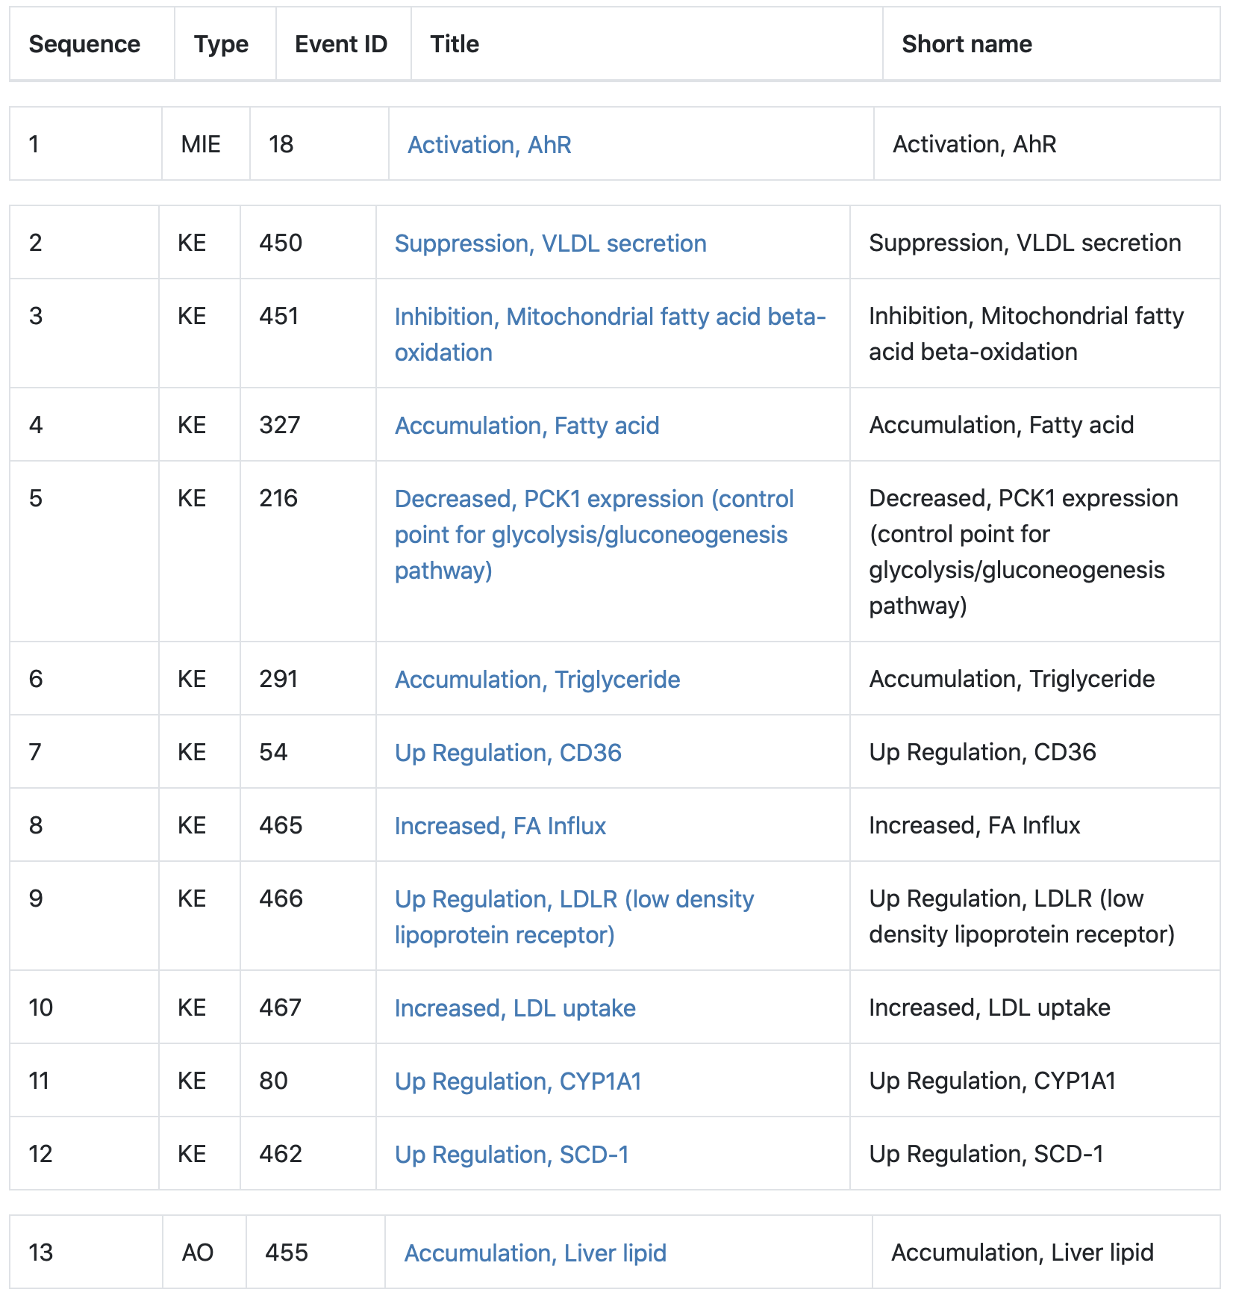
AOPwiki: AHR is a ligand-activated transcription factor that may cause deposition of fat in liver
Each step is a reaction/process
Step 1: MIE is the start event
Steps 2-12: KE are intermediate events
Step 13: AOP is the end event

Slide 17
AOPwiki: relation to start/end project
AO
KE
KE
MIE
Connection
Reaction
MIE or Start Reaction
AO or End Reaction

Slide 18
AOPwiki: comments
How to map the events from AOPwiki to Reactome reaction(s)?
AOPwiki is manually curated information. We could use some of their information such as stressors (compounds triggering the start reaction)
Could Reactome suggest alternate routes from MEI to AO based on our reactions and pathways?

Slide 19
Plans
Kickstart the connectivity project as a formal reviewing task for curators
Feasible approach for curators to review start/end reactions
Reactome mapping options for AOPwiki
Path traversal feature in Reactome website
Use case for start/end analysis with drug effect in OTAR

