Slide 1
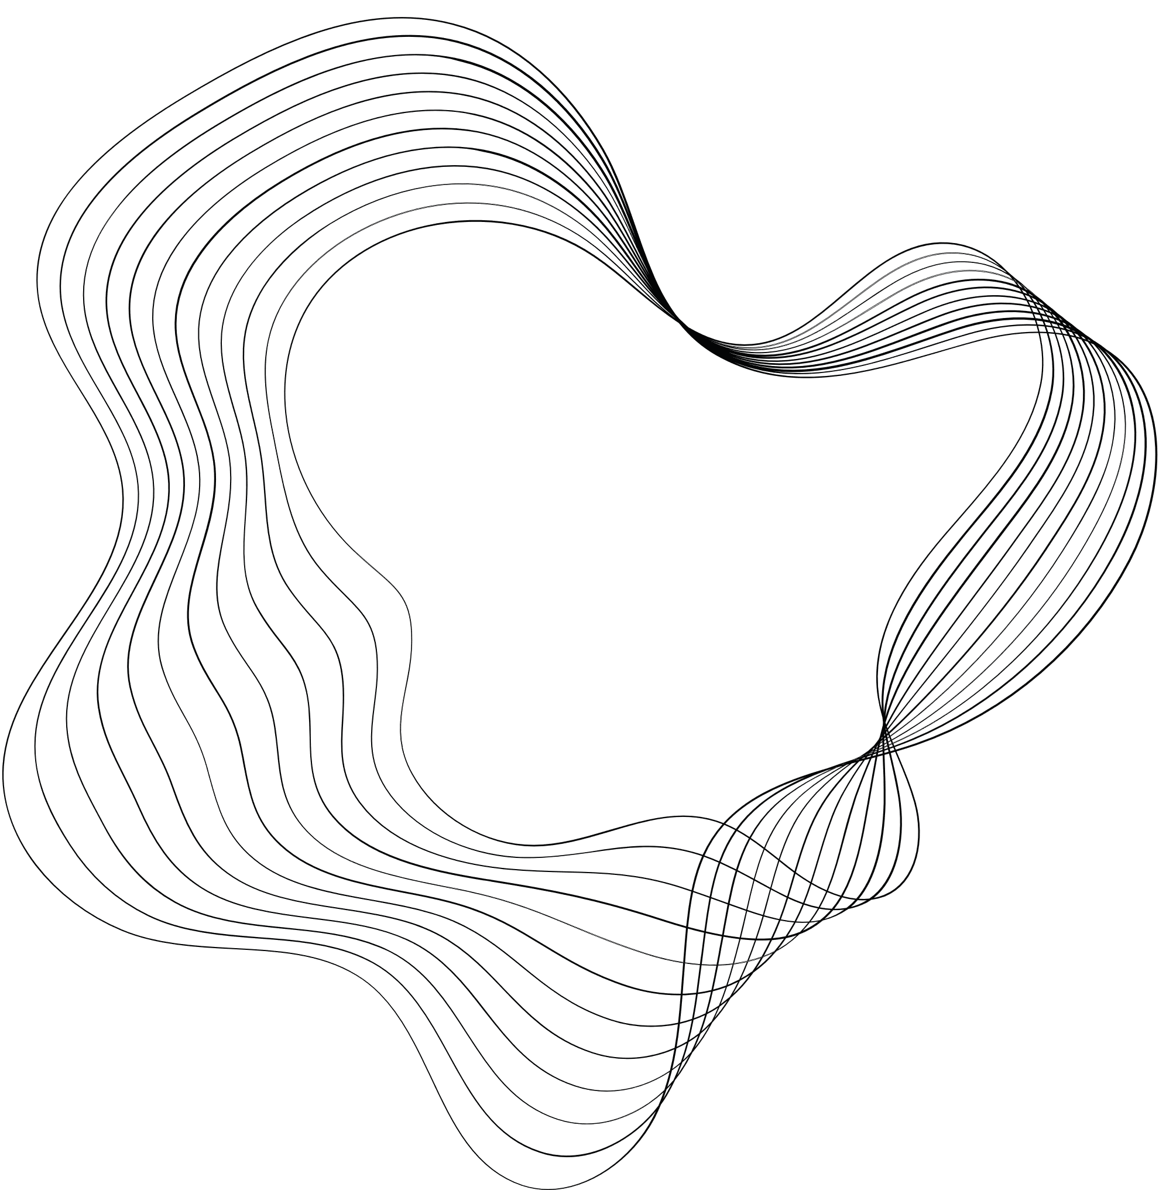

TDT University
Natural Language Processing
Final Project
INTRODUCTION TO
NATURAL LANGUAGE PROCESSING
Truong Gia Bao - 521H0201
Vi Thanh Dat - 521H0390
Le Nguyen Tuyet Nhi - 521H0364

Slide 2

TDT University
Natural Language Processing
Final Project
CONTENT
1.
Attention mechanism in Sequence-to-Sequence.
Building the Lstm-to-Lstm model with attention and without attention.
2.
Information Extraction.
Build a Transformer model.

Slide 3

TDT University
Natural Language Processing
Final Project
1. ATTENTION MECHANISM IN
SEQUENCE-TO-SEQUENCE MODELS.
Attention is a technique that allows models to weigh the relevance of different inputs differently, focusing more on those aspects that are crucial for a task at a specific moment in the computation. It can be viewed as a mechanism of selectively concentrating on a few relevant things while ignoring others in large datasets or long input sequences.

Slide 4
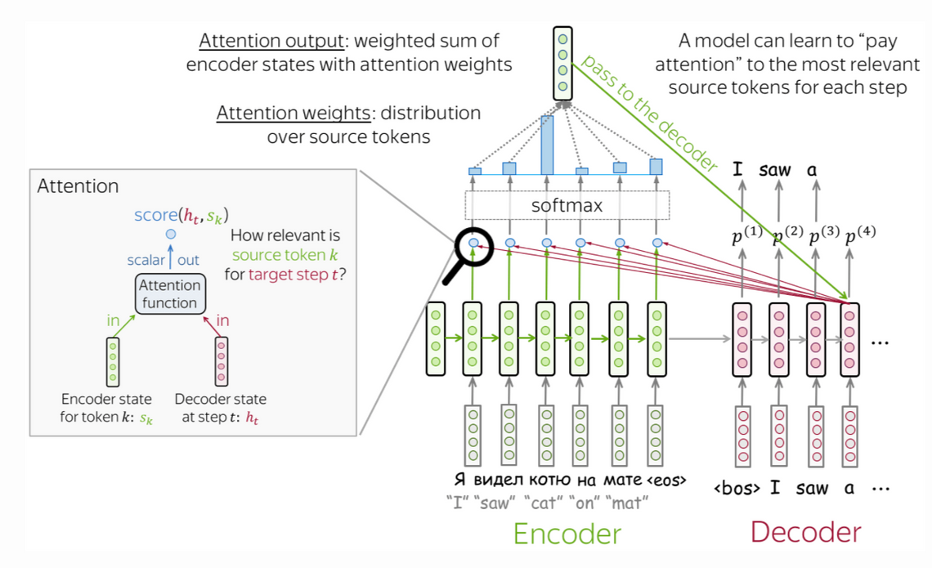
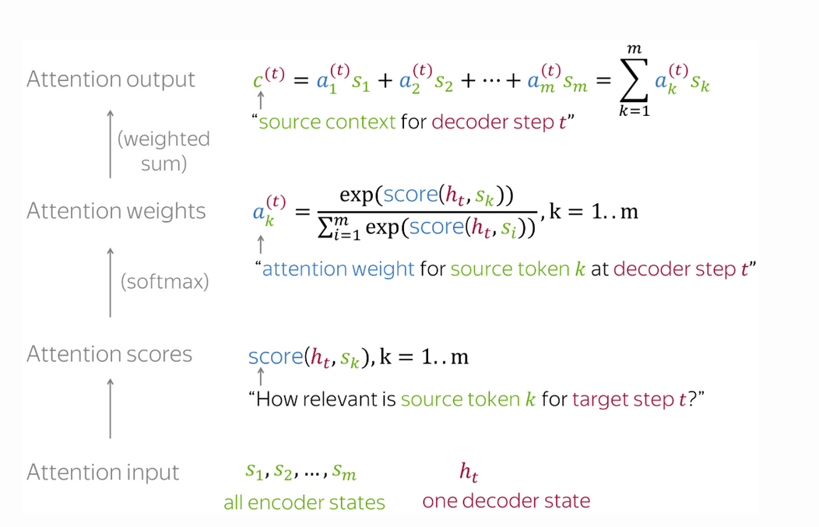
TDT University
Natural Language Processing
Final Project
HOW ATTENTIONS WORKS
This image illustrates the attention mechanism in a neural network, specifically in a sequence-to-sequence (seq2seq) model, which is commonly used in machine translation.

Slide 5
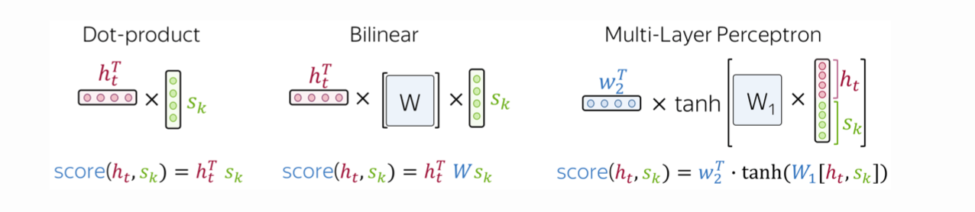
HOW TO COMPUTE ATTENTION SCORE
1. Dot-product: The simplest method.
2. Bilinear function (Luong attention): Used in the paper Effective Approaches to Attention-based Neural Machine Translation.
3. Multi-layer perceptron (Bahdanau attention): The method proposed in the original paper.
TDT University
Natural Language Processing
Final Project

Slide 6
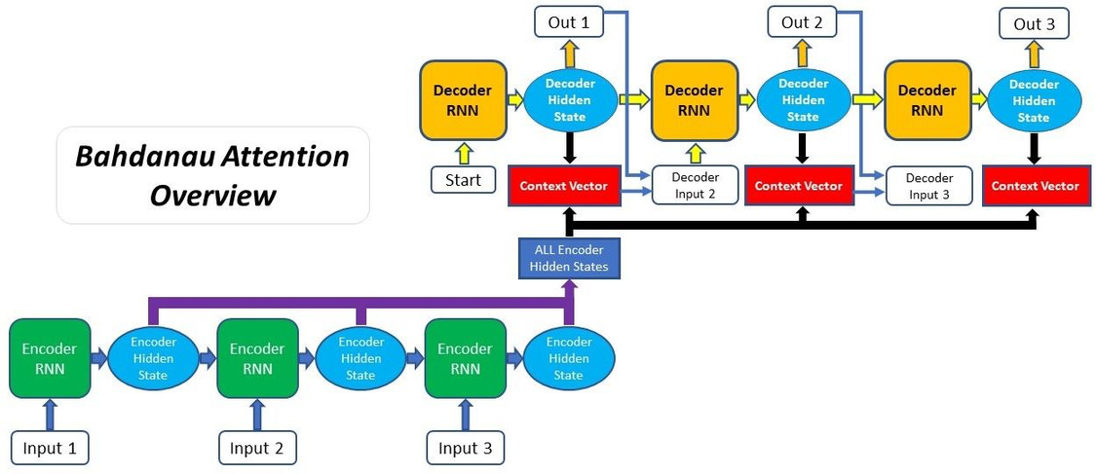
THE BAHDANAU ATTENTION
The Bahdanau model’s encoder uses two Recurrent Neural Networks (RNNs), one reading the input sequence forwards and the other reading it backwards. This approach allows the model to capture information from both past and future contexts relative to the current token, which is particularly useful for languages where the meaning of a word can depend on subsequent words.
TDT University
Natural Language Processing
Final Project

Slide 7
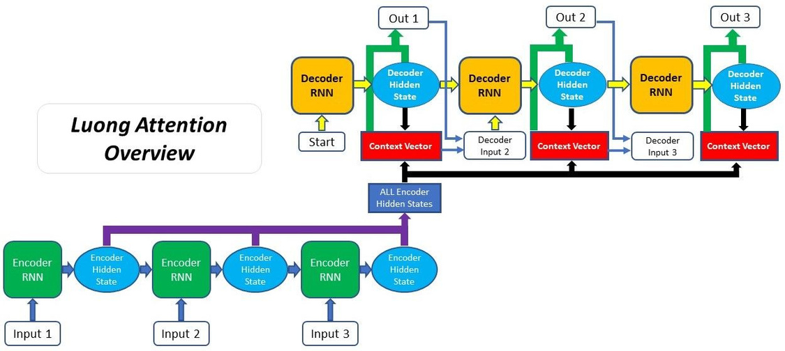
THE LUONG ATTENTION
Minh-Thang Luong et al. developed the Luong attention technique, commonly referred to as "global attention," which enhances the performance of the Bahdanau et al. attention mechanism while simplifying it. The Luong attention model is distinguished by its unique method of applying attention in the decoder and determining attention scores.
TDT University
Natural Language Processing
Final Project

Slide 8


ATTENTION IN LSTM
Since the advent of models like Transformers, which mostly rely on self-attention to interpret input data, the attention mechanism has been a key component of many state-of-the-art outcomes in a variety of NLP tasks.
Because of their superior ability to capture long-range dependencies, attention mechanisms may be linked to both transformers and LSTM and GRU networks.
TDT University
Natural Language Processing
Final Project

Slide 9

ATTENTION IN TRANSFORMER
Unlike traditional models like LSTM, Transformer does not rely on sequentiality but takes advantage of Attention's parallel processing capabilities to capture the relationship between words in a sentence more flexibly.
The Attention mechanism in Transformer is called Multi-Head Self-Attention. It allows the model to learn many different types of relationships between words in a sentence, thereby significantly improving the model's performance.
TDT University
Natural Language Processing
Final Project

Slide 10
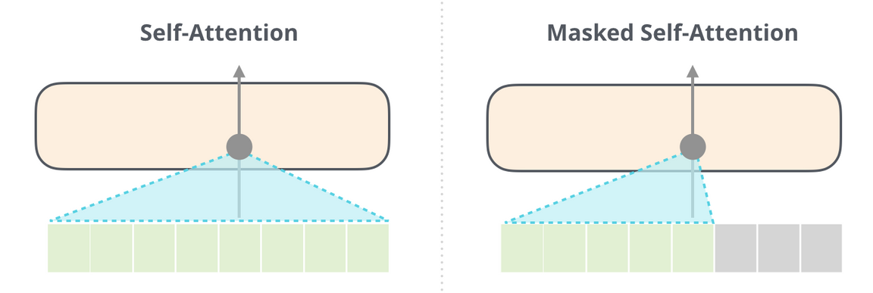
TDT University
Natural Language Processing
Final Project
ATTENTION IN GPT
Attention in GPT models, particularly the transformer architecture, is a key mechanism that allows the model to focus on relevant parts of the input sequence when generating output. It works by assigning weights to different input tokens, indicating their importance for the current prediction.

Slide 11
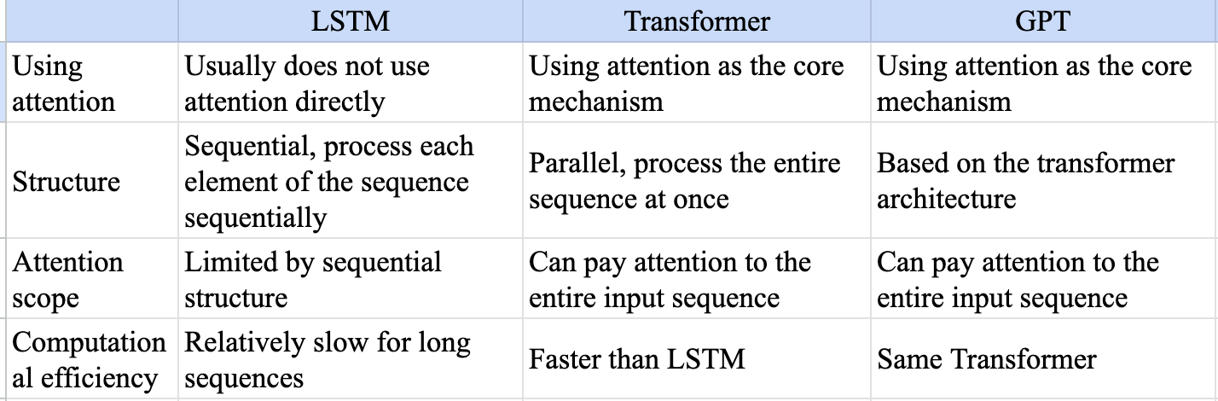
ATTENTION IN LTSM VS TRANSFORMER VS GPT
TDT University
Natural Language Processing
Final Project

Slide 12

BUILDING MODEL
TDT University
Natural Language Processing
Final Project

Slide 13
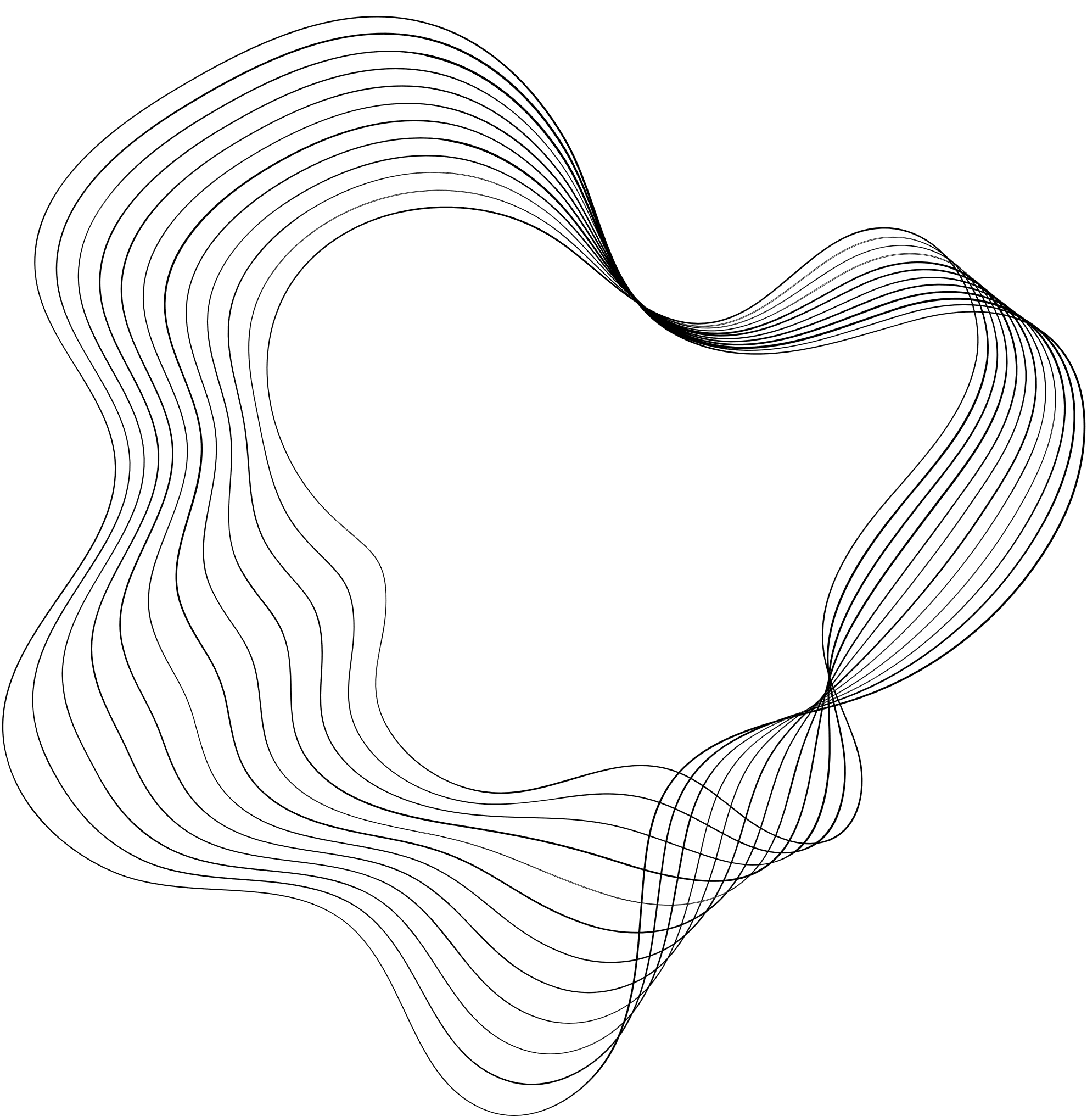

TDT University
Natural Language Processing
Final Project
THANK'S FOR WATCHING

