Slide 1


1
Configure Webex Desk device
2
Start presenting
3
Press Start Macro ↓
Start Macro
IP address
192.168.x.x
Username
pptMacro
If you don’t appear in the box below:
Password
yourPasswordHere
The password will automatically hide on presentation start but is on this slide. Think about this when sharing these slides with others!
In a call: you should
always see yourself here.
Not in a call: you may need
to turn on self-view.
NOTE:
- The configured Webex Desk user only needs the RoomControl role
- When you “save as” this presentation, select the “PPTM” format
- Sharing this presentation? Remove your user/pwd/ip
- Keep this slide in your presentation.
- Start presentation from this slide
- More details:
https://github.com/vtjoeh/webex-desk-slide-presenter
Self-view Toggle
Outside of call only + Fullscreen
Above command is used when a slide has no command shape:
- ContentOnly – (default) PC is shared only. Camera is muted.
StopImmersiveShare – In ca call share PC and camera separately.
PreviousSlide - use the pervious slide’s command. If there are no previous slides, then stop immersive share.
SlideNumber # (e.g. SlideNumber 2) – use the command on slide # as the default command.
Above default is triggered when PowerPoint slide show ends:
- StopContentShare (default) – Stop sharing your PC. Main camera gets turned back on.
- ShowPcInCall - Stops any current immersive share, but the PC is still shown to audience in the call.
Note: Both above commands act the same outside of a call.
- Nothing – Experimental. No command is sent at the end of the presentation.
Note: Call fake uri fixscreen@example.com to reset Webex Desk values.
Default Slide Show End:
Default When No Command:
ContentOnly
Default Slide Show End:
StopContentShare
Notes:
CODE CREATED BY Joe Hughes (joehughe@cisco.com - TSA)
STORED on Github: https://github.com/vtjoeh/webex-desk-slide-presenter/
SLIDES created by DJ Uittenbogaard (duittenb@cisco.com - TSA)
INTERNAL INSTRUCTIONS created by DJ Uittenbogaard (duittenb@cisco.com - TSA)
https://cisco.sharepoint.com/Sites/CollaborationAPI/SitePages/Powerpoint-Controlling.aspx
COMMUNITY SUPPORT: Webex space https://eurl.io/#sgWuQ2PIF
To change the name of the Shape go to:
Home → Arrange → Selection Pane…
Insert an object with the following name:
VideoSquare Backgound is immersive share
VideoSquare_Pip Background is real
VideoSquare_FlipPip (reverses the PIP so the PowerPoint is small)
VideoSquare_<1…100> (background is transparent)
CameraOnly (shows only the camera and uses default virtual background)
StopImmersiveShare
SpeakerTrackDiagnostic
SideBySide in call only
SideBySide_[123x]_u in call only
Prominent
ContentOnly
StopContentShare
PreviousSlide
End the Slide Show will send the StopContentShare command automatically

Slide 2
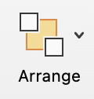




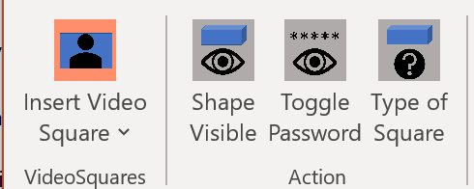

Webex Desk Slide Presenter Instructions – Short version
REFERENCE – SLIDE
1
Prepare
1. Download the PPTM and .js file from Github
https://github.com/vtjoeh/webex-desk-slide-presenter/
2. Connect Laptop to Desk(pro/mini) using a USBc cable
2
Webx Desk: add user and macro
1. Login/Setup/Users/Create-user “pptMacro”, role “RoomControl” and a password
2. Macro-editor, Import from file, select downloaded macro, save it, enable it
3
Open Powerpoint with PPTM file
1. Click “enable macros”
2. On slide 1, enter the DeskPro ip/user/pwd
3. Start presenting on slide 1
4. Click ”Start Macro” button
5. Look at your selfview
Change shape name?
PC Users Only
Ribbon→ Webex Desk
OR
Click
shape
ContentOnly

Slide 3
Square Name Cheat Sheet
REFERENCE – SLIDE
‘current’=your current background settings
(virtual, blurring, none, etc)
NAME | IN CALL ONLY? | Video CHANNEL | Video on SLIDE | Background
VideoSquare | - | no | yes | transparent | Or use ‘VideoShape’
VideoSquare_50 | - | no | yes | transparent | (1-100) Transparency number
VideoSquare_PiP | - | no | yes | real | ​Pip with your physical background
VideoSquare_FlipPip | - | no | yes | real | Reverse Pip (PPT small, you big)
CameraOnly | - | no | yes | current | Show camera, no slide
ContentOnly | - | no | no | - | Slide without video
SideBySide_[123x] | ✓ | no | yes | current | Slide and video same size
SideBySide_[123x]_u | ✓ | yes | no | current | 1=Cam,2=PC(USBc),3=HDMI,u=mute video
Prominent | ✓ | no | yes | current | Small video outside big content
StopContentShare | ✓ | no | yes | current | Stops sharing PPT
StopImmersiveShare | ✓ | yes | no | current | Keeps sharing, video moves to video chan
SpeakerTrackDiagnostic | - | no | yes | real | Send Speaker track in content channel
PreviousSlide | - | - | - | - | Uses the previous slide’s command

Slide 4
Command: VideoSquare_pip
VIDEO channel
no
VIDEO slide
yes
BACKGROUND
real
Shows your real video inside the square, no virtual background.

Slide 5
Command: VideoSquare_FlipPip
VIDEO channel
no
VIDEO slide
yes
BACKGROUND
real
Shows your video (no virtual background) FULL SCREEN and content where the
square is.
Make this shape invisible. The location of the VideoSquare_FlipPip will be the location of the actual slide.
Alternatively, hide the entire slide and use the PreviousSlide command on the next slide.

Slide 6
Command: PreviousSlide
VIDEO channel
depends
VIDEO slide
depends
BACKGROUND
depends
Uses the command from the previous slide. If there is no command on the previous slide, then next slide commands are used.
In this example the command object is offscreen
PreviousSlide

Slide 7
Command: VideoSquare_[1…100]
VIDEO channel
no
VIDEO slide
yes
BACKGROUND
transparent
Changes the transparency.
Example below is VideoSquare_50

Slide 8
Example: Regular Slide No Commands
Default behavior is that the PC source is sent, but the camera is not.
Note: This is a change in behavior from previous versions which automatically turned off immersive share.
The default behavior is configurable by changing the settings in the commands found in the first slide containing the username and password underneath the PowerPoint slide.

Slide 9
Command: StopImmersiveShare
VIDEO channel
yes
VIDEO slide
no
BACKGROUND
current
Immersive Share is turned off → PPT content is still shared but the presenters video image will return to the main channel.
Outside of a call, the PC is shown in the content channel.
Presentation ends? Immersive Share is also automatically turned off
Note: In a call the process of turning Immersive Share on and mute/unmute main video takes ~2-3 seconds while in a call.
In this example the command object is offscreen
StopImmersiveShare

Slide 10
Command: CameraOnly
VIDEO channel
no
VIDEO slide
yes
BACKGROUND
current
This box has the Selection Pane name “cameraOnly” and will send the camera as the main video. Make this shape invisible or offscreen.
Main camera is sent as the content share.
Main camera acts like the main camera.
NOTE: The contents of the slide will briefly appear in the meeting or recording, so it is best to remove content. If the current background is a PC input, then the new background becomes the previously
selected option (e.g. image, blur or disabled).
In call
No call
In this example the command object is offscreen
CameraOnly

Slide 11
Command: ContentOnly
VIDEO channel
no
VIDEO slide
no
BACKGROUND
-
Send only the last PC image, either USB-C or HDMI, whatever was selected last. Make this shape invisible or offscreen.
PC source is shown, main camera muted.
PC source is shown only
In call
No call
If you still want video in the video
channel, then use “StopImmersiveShare”
In this example the command object is offscreen
ContentOnly

Slide 12
Command: SideBySide
VIDEO channel
no
VIDEO slide
yes
BACKGROUND
current
Puts content side by side with the main camera, but only while in a video call.
Side-by-side is shown.
Auto detects if it is the HDMI or USB-C port.
PC content is shown.
In call
No call
only works IN-call !
In this example the command object is offscreen
SideBySide

Slide 13
Command: SideBySide_12
VIDEO channel
no
VIDEO slide
yes
BACKGROUND
current
Reference: SideBySide_[123x]_u
  Puts content side by side or equal. Order of the number determines placement. Determine if you want to share 2 or 3 video inputs. The optional letter ‘u’ at the end of the command unmutes video camera in the main channel.
  1 = main camera
  2 = USB-C (PC input, not web camera)
  3 = HDMI
  x = last active PC input, HDMI or USB-C
  _u = Unmute main video, optional (Without “u” main video is muted by default)
Side-by-side is shown.
Standard PC content is shown.
In call
No call
In this example the command object is offscreen
only works IN-call !
SideBySide_12

Slide 14
Command: SideBySide_21
VIDEO channel
no
VIDEO slide
yes
BACKGROUND
current
Reference: SideBySide_[123x]_u
  Puts content side by side or equal. Order of the number determines placement. Determine if you want to share 2 or 3 video inputs. The optional letter ‘u’ at the end of the command unmutes video camera in the main channel.
  1 = main camera
  2 = USB-C (PC input, not web camera)
  3 = HDMI
  x = last active PC input, HDMI or USB-C
  _u = Unmute main video, optional (Without “u” main video is muted by default)
Side-by-side is shown.
Standard PC content is shown.
In call
No call
In this example the command object is offscreen
only works IN-call !
SideBySide_21

Slide 15
Command: SideBySide_1x
VIDEO channel
no
VIDEO slide
yes
BACKGROUND
current
Reference: SideBySide_[123x]_u
  Puts content side by side or equal. Order of the number determines placement. Determine if you want to share 2 or 3 video inputs. The optional letter ‘u’ at the end of the command unmutes video camera in the main channel.
  1 = main camera
  2 = USB-C (PC input, not web camera)
  3 = HDMI
  x = last active PC input, either HDMI or USB-C
  _u = Unmute main video, optional (Without “u” main video is muted by default)
Side-by-side is shown.
Standard PC content is shown.
In call
No call
In this example the command object is offscreen
only works IN-call !
SideBySide_1x

Slide 16
Command: SideBySide_23_u
VIDEO channel
yes
VIDEO slide
no
BACKGROUND
current
Reference: SideBySide_[123x]_u
  Puts content side by side or equal. Order of the number determines placement. Determine if you want to share 2 or 3 video inputs. The optional letter ‘u’ at the end of the command unmutes video camera in the main channel.
  1 = main camera
  2 = USB-C (PC input, not web camera)
  3 = HDMI
  x = last active PC input, HDMI or USB-C
  _u = Unmute main video, optional (Without “u” main video is muted by default)
Side-by-side is shown.
Standard PC content is shown.
In call
No call
In this example the command object is offscreen
only works IN-call !
SideBySide_23_u

Slide 17
Command: SideBySide_231
VIDEO channel
no
VIDEO slide
yes
BACKGROUND
current
Reference: SideBySide_[123x]_u
  Puts content side by side or equal. Order of the number determines placement. Determine if you want to share 2 or 3 video inputs. The optional letter ‘u’ at the end of the command unmutes video camera in the main channel.
  1 = main camera
  2 = USB-C (PC input, not web camera)
  3 = HDMI
  x = last active PC input, HDMI or USB-C
  _u = Unmute main video, optional (Without “u” main video is muted by default)
Side-by-side is shown.
Standard PC content is shown.
In call
No call
In this example the command object is offscreen
only works IN-call !
SideBySide_231

Slide 18
Command: Prominent
VIDEO channel
no
VIDEO slide
yes
BACKGROUND
current
Puts main camera as small Picture-Outside-Picture (POP)
below content.
POP is shown.
PC content is shown.
In call
No call
only works IN-call !
In this example the command object is offscreen
Prominent

Slide 19
Command: SpeakerTrackDiagnostic
VIDEO channel
no
VIDEO slide
yes
BACKGROUND
current
Turns on SpeakerTrack/Best Overview diagnostic mode and sends it as the content channel.
In this example the command object is offscreen
SpeakerTrackDiagnostic

Slide 20
Command: StopContentShare
VIDEO channel
no
VIDEO slide
yes
BACKGROUND
current
Stops the content share channel. Best to use at the end of a presentation. It does not turn the PowerPoint slide off; it just stops sending it in the content channel.
It pulls up the main camera. Same as CameraOnly
NOTE: The slide with “StopContentShare” will be visible for a short period.
In call
No call
In this example the command object is offscreen
StopContentShare

Slide 21
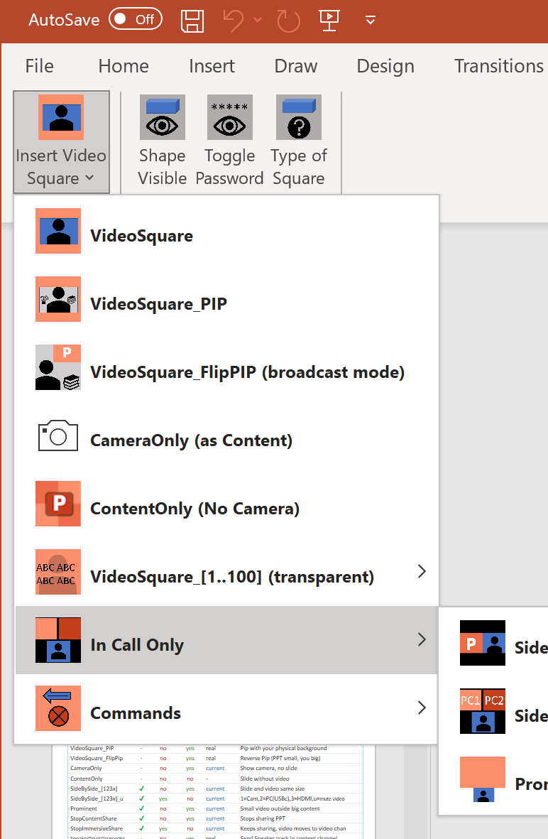

Changes in 0.1.5.4 - PowerPoint Template
Name Changes:
  PowerPoint Template: Changed name from TemplateDeskProMacro_verXXX.pptm to TemplateDeskMacro_verXXX.pptm since it works on Desk Mini and Desk.
  NoVideo command changed to ContentOnly for clarity. NoVideo command still works for backwards compatibility.
Ribbon: Webex Desk
  For PC only, added Webex Desk tab to ribbon with commands to insert VideoSquares and toggle shape visibility. Ribbon does not work on Mac. PowerPoint templates created on the PC by the ribbon commands will work on Mac.
Fixed Bug
  Password character fix.
    Password had problems with the following characters: $ ” + ’
    They can now be used in the PowerPoint password.
    Removed ability to use <> in password and notify end user in a dialog box if characters used. This was due to an issue with command line on a PC when sending CURL commands.
    Tested the following special characters for use in the password:
    ` ~ ! @ # $ % ^ & * ( ) _ + - = { } | [ ] \ : ” ; ‘ ? , .

Slide 22
Changes in 0.1.5.4 - JavaScript
Fixed Bug
  Fixed a major bug that caused problems with using a PC virtual background when not using the PowerPoint. Now at the end of the PowerPoint presentation, the Webex Desk will return to the last virtual background setting except for the PC (HDMI or USB-C) source. After the presentation is done, the PC can then be manually selected as a virtual background if desired.
New Feature
  Reset screen by calling fixscreen@example.com - Call this URI to reset the screen and virtual background settings on the Webex Desk. The call will not connect but it triggers the reset. This was added in case a scenario happens that wasn't tested causes problems on the Webex Desk or if your computer freezes and the PowerPoint can't send the reset command. Call needs to be made outside of a pre-existing calls.
  Update Notification - Added code that checks for updated versions of WebexDeskSlidePresenter.js on Github and alerts the user an update is available. By default this is done on all macro restarts and between 3:00 am and 4:00 am in the morning. These settings can be customized in the javascript variables: checkUpdates.on, checkUpdates.onStartup, checkUpdates.startTime, checkUpdates.window See the Javascript comments for more details.
Compatible
  This version of the javascript macro is comptabile with TemplateDeskProMacro_ver0.1.5.3.pptm and TemplateDeskMacro_ver0.1.5.4.pptm

Slide 23
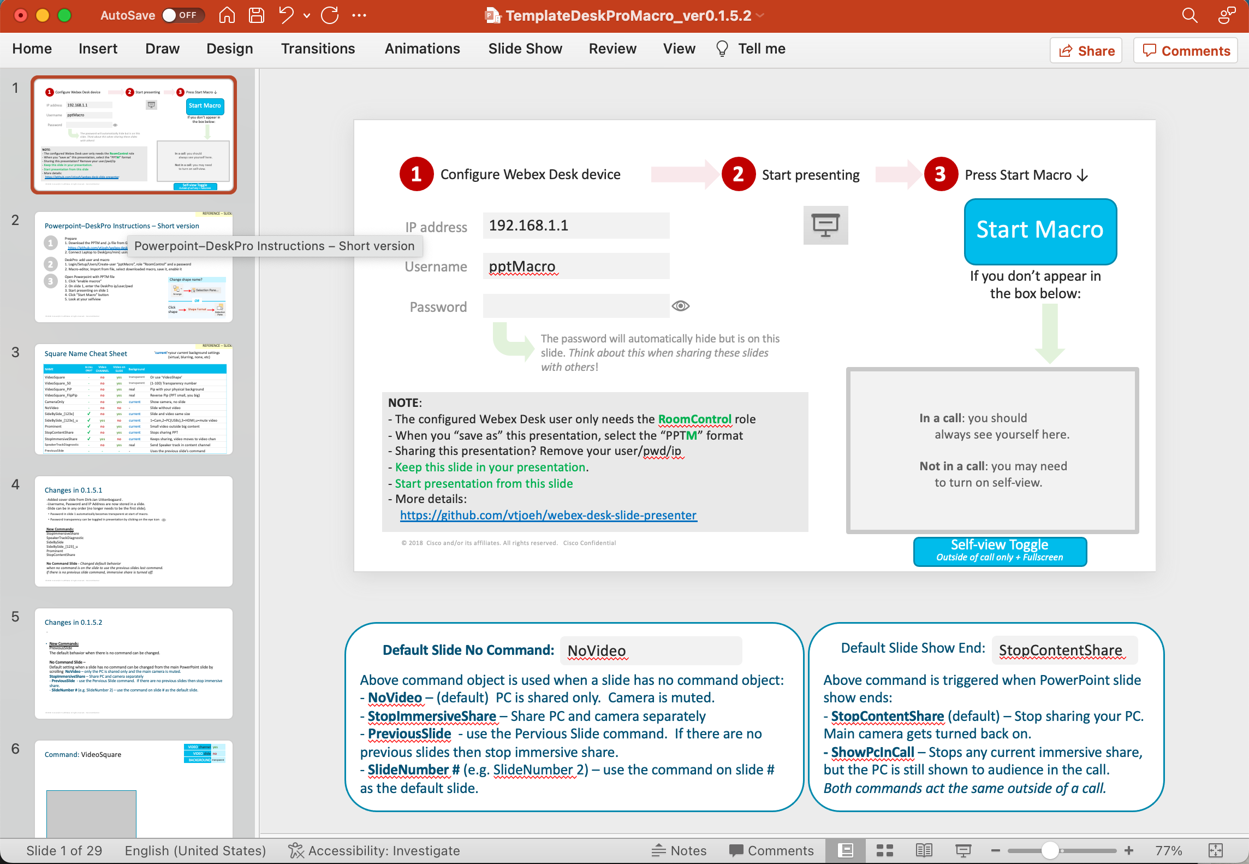
Changes in 0.1.5.3
Fixed Bug:
Fixed an issue where the end of presentation or call would have the Webex Desk not show the last PC source.
Default Slide Show End: Nothing
  Added a new command ”Nothing” that does nothing when a slide show ends. This setting is experimental and not recommended.
  Options: StopContentShare [default], ShowPcInCall, Nothing [New]

Slide 24
Changes in 0.1.5.2
New Commands:
PreviousSlide
NoVideo
Configure Default Settings From PowerPoint
  Default settings can be changed from the main PowerPoint slide by scrolling to the offscreen shapes under the presentation
  Default When No Command:
  Options: NoVideo [default], StopImmersiveShare, PreviousSlide, SlideNumber #
  Default Slide Show End
  Options: StopContentShare [default], ShowPcInCall
Changed SideBySide_[0123] to SideBySide_[123x]
    Because 0 (number) can be confused with O (letter)

Slide 25
Changes in 0.1.5.1
  -Added cover slide from Dirk-Jan Uittenbogaard .
  -Username, Password and IP Address are now stored in a slide.
  -Slide can be in any order (no longer needs to be the first slide).
    Password in slide 1 automatically becomes transparent at start of macro.
    Password transparency can be toggled in presentation by clicking on the eye icon
  New Commands:
  StopImmersiveShare
  SpeakerTrackDiagnostic
  SideBySide
  SideBySide_[123x]_u
  Prominent
  StopContentShare
  No Command Slide - Changed default behavior
  when no command is on the slide to use the previous slides last command.
  If there is no previous slide command, immersive share is turned off. [Changed in 0.1.5.2]

Slide 26
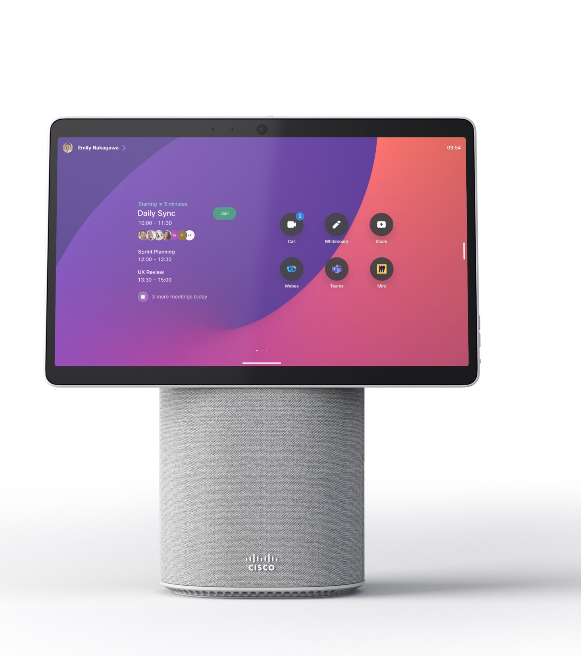
Introducing
Webex Desk Mini
An all-in-one video collaboration
device for the hybrid work environment.
A small, flexible device designed to fit in to any setup at any desk or small space.
15-inch, 1080p touch screen
Quality audio and video
Intelligent to the core
Webex platform

Slide 27
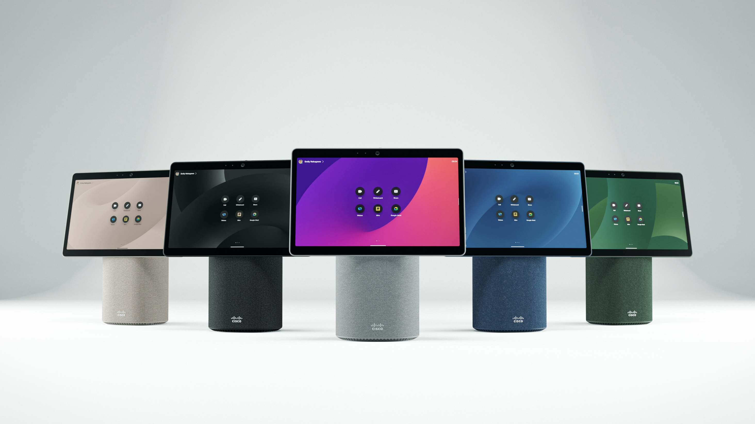
Flare meets functionality
Personalize your workspace - in colorful style

Slide 28
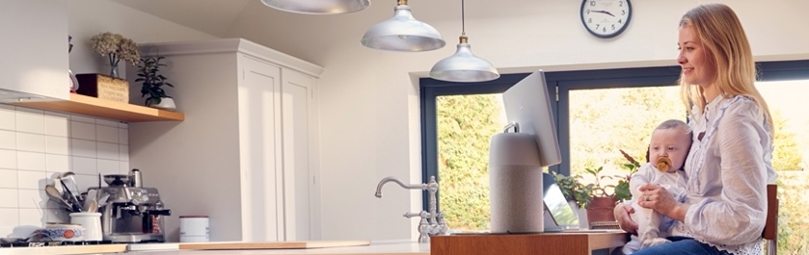

Designed for the modern work environment
Work from home just got simpler
For any home offices, temporary or permanent home office environment — Desk Mini is designed to move and adjust
  A portable, all-in-one collaboration device
  Secure, easy to set up and manage
Examples
Temporary office | Kitchen table | Living room
Bridging the hybrid work gap
Use Desk Mini at any desk or small space. Its flexible designed to travel along with you to new places
  Natural, enjoyable video collaboration
  Distraction-free meetings that feel like you’re face-to-face
  Examples
  Studio | Focus room | Desk

Slide 29
Notes:
Empty Slide – leaving the video enabled

