Slide 1
What is Git and GitHub?
Introduction to Computer Programming (Python)
Week 1
Vivatsathorn Thitasirivit
Rev. 1.0 (Course 1/2023)
https://vtneil.com

Slide 2
Git & GitHub What is it?
Git is a file version manager which is used for managing source codes so that every changes you made will be saved (like a checkpoint when programming).
A Git repository can have many branches for different versions of source codes, there is one special “master” or “main” branch which is the primary (default) branch for every repository.
GitHub is a remote repository online. Local Git repository can “sync” versions, files, and changes with GitHub online.
Local Repository
“Remote”
Git
push
GitHub
Source codes
commit
pull
Simple diagram, partially true

Slide 3
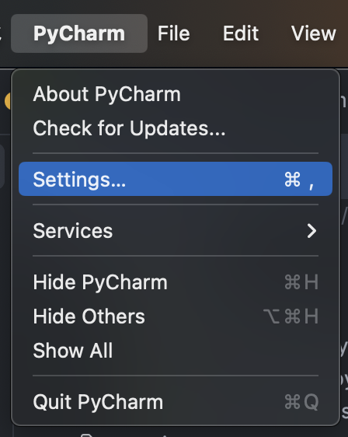
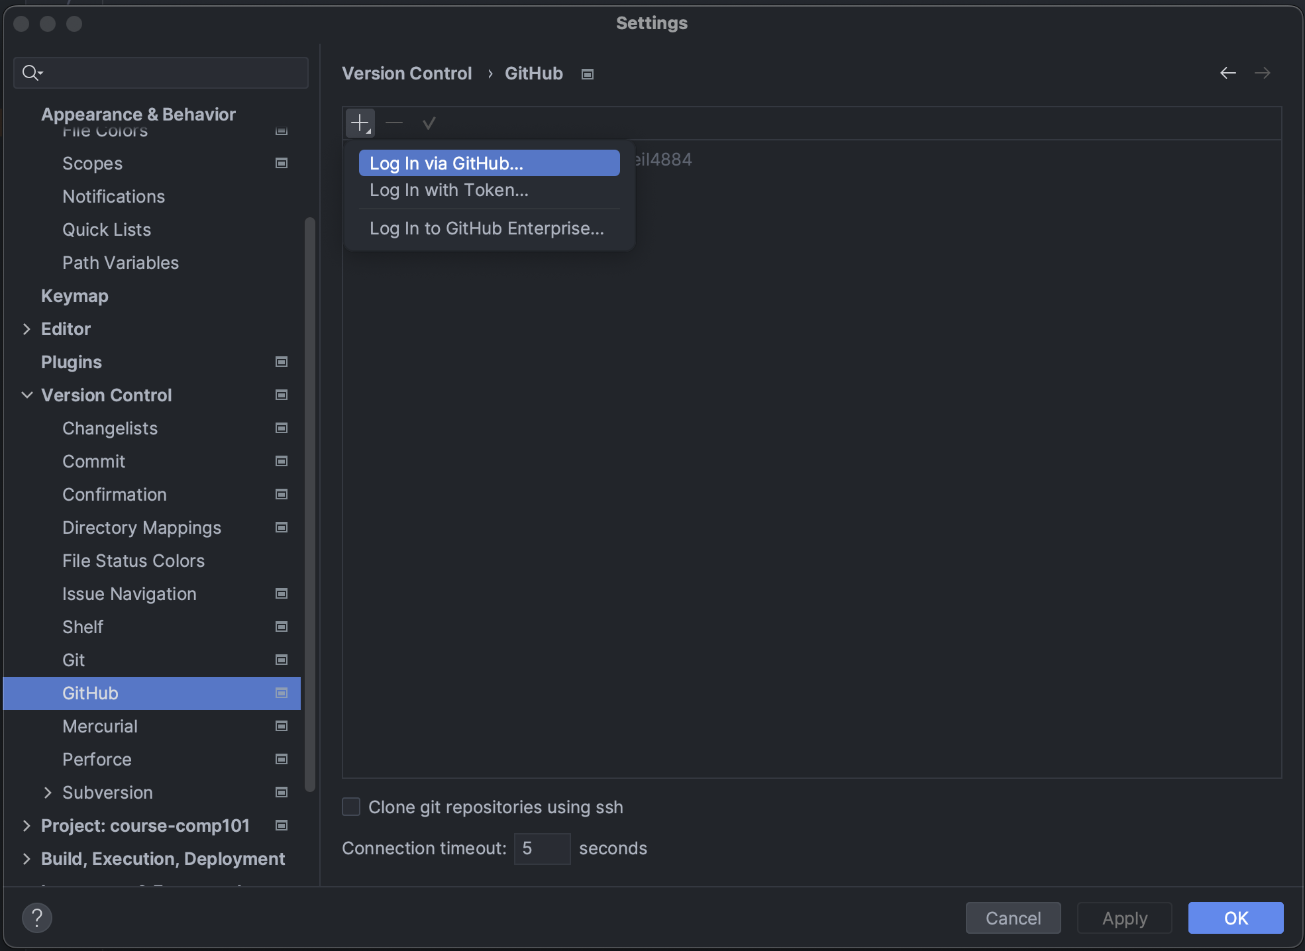
Git & GitHub Setting up in JetBrains IDE
1. Go to IDE settings
2. Go to Version Control > GitHub > Log in via GitHub…

Slide 4
Git & GitHub Setting up in JetBrains IDE
3. Join SPACE AC GitHub Organization
4. Join GitHub Classroom
5. Accept Assignment

