Slide 1
FUNDAMENTALS OF ELECTRICITY
AND ELECTRONICS
BHAVAT NGAMDEEVILAISAK

Slide 2
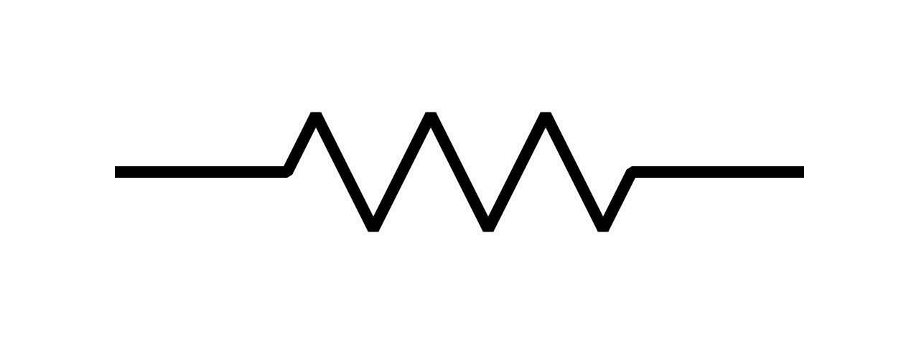
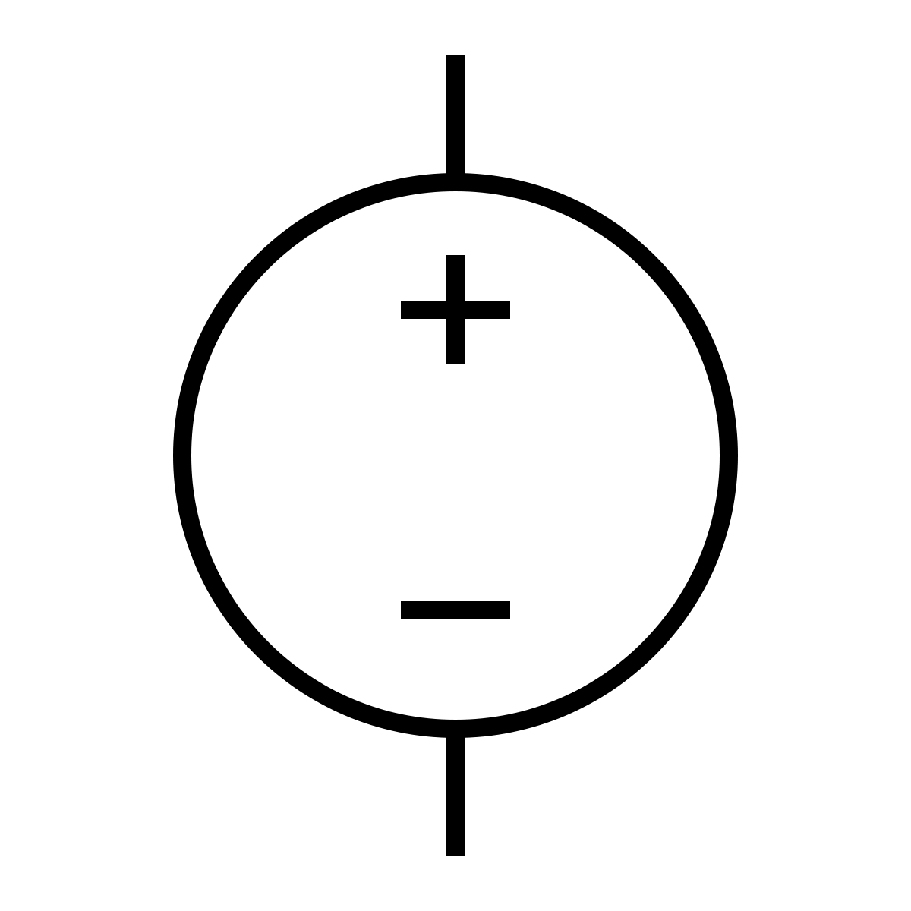
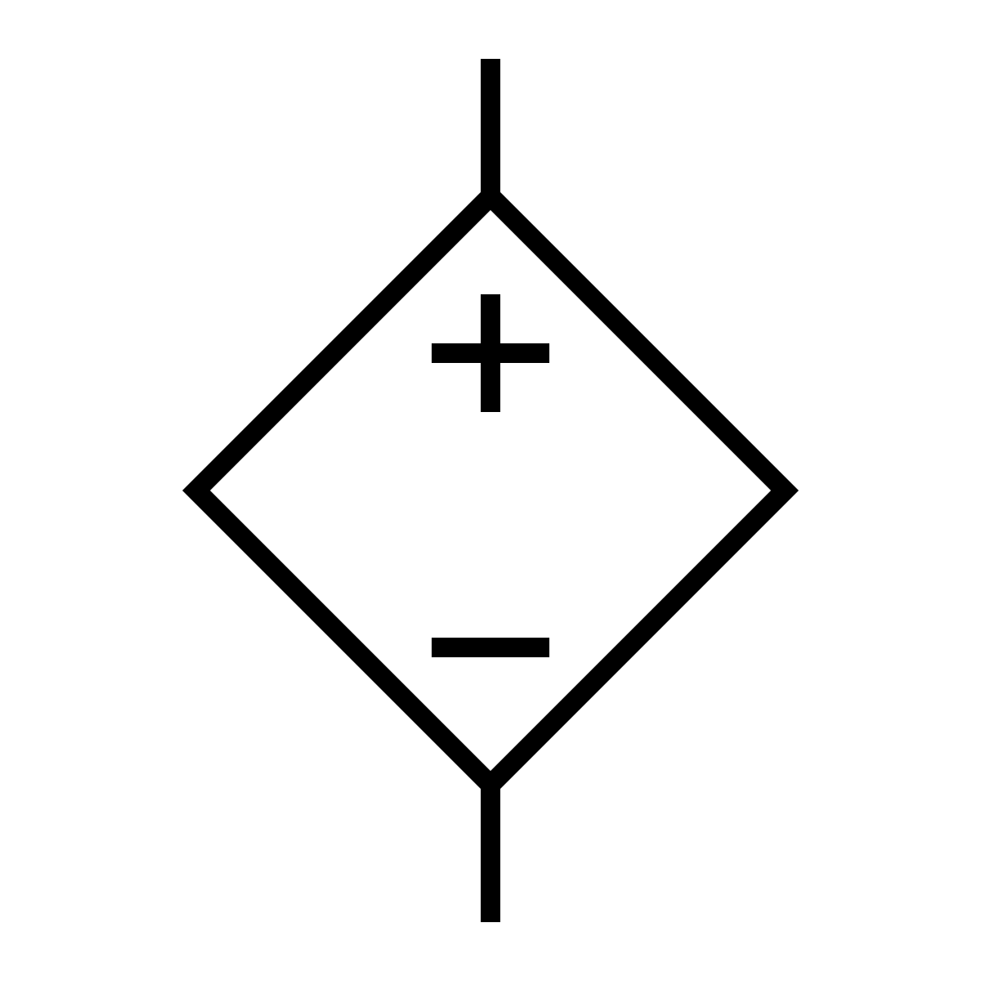
Voltage
“The potential difference between two points”
A
B
IDEAL SOURCES
Independent voltage source
Dependent voltage source
Sora

Slide 3
Voltage
“Measured in Volts (V)”
Rs
Rs
PRACTICAL SOURCES
Independent voltage source
Dependent voltage source
Sora

Slide 4
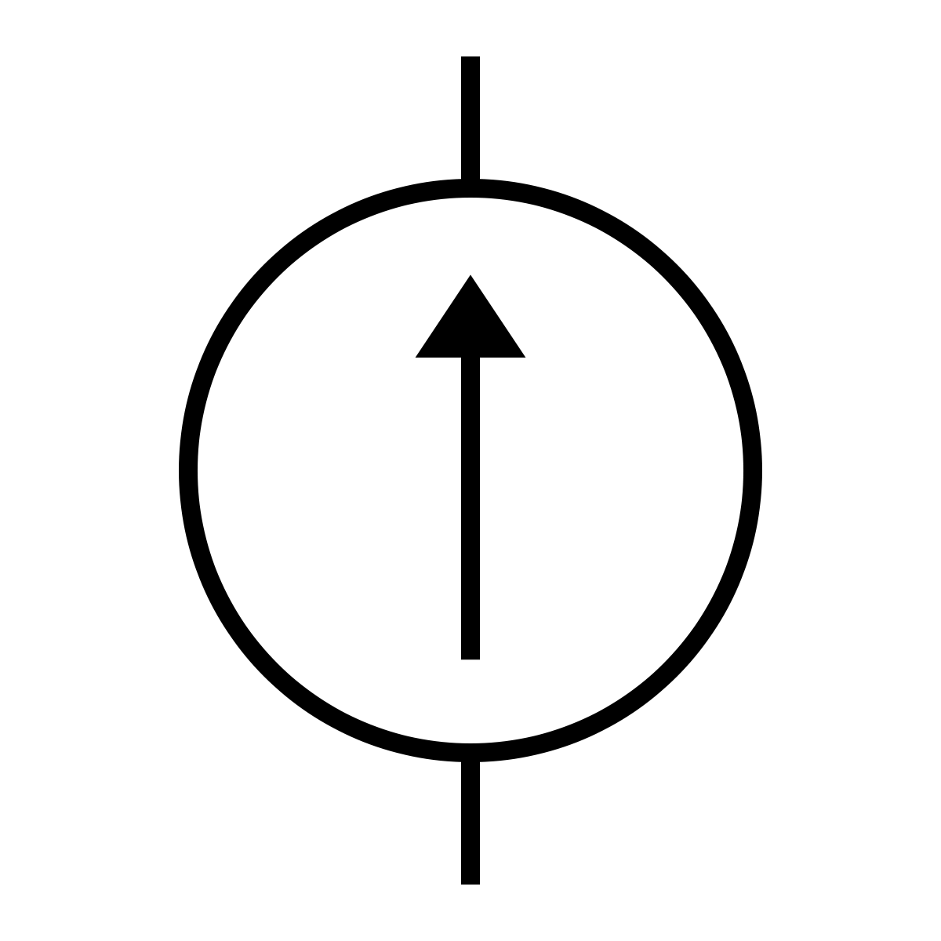

Current
“An amount of charges flow through
a cross section of conductor per amount of time”
A
B
IDEAL SOURCES
Independent current source
Dependent current source
Sora

Slide 5
Current
“Measured in Ampere (A)”
PRACTICAL SOURCES
Independent current source
Dependent current source
Sora

Slide 6
Resistance
“An ability to resists the flow
of current measured in Ohm (Ω)”
A
B
Sora

Slide 7
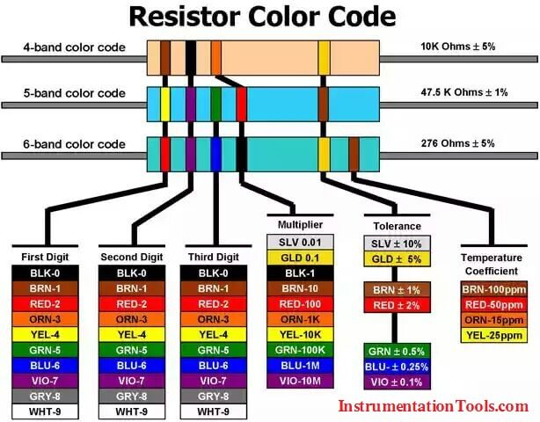

Slide 8
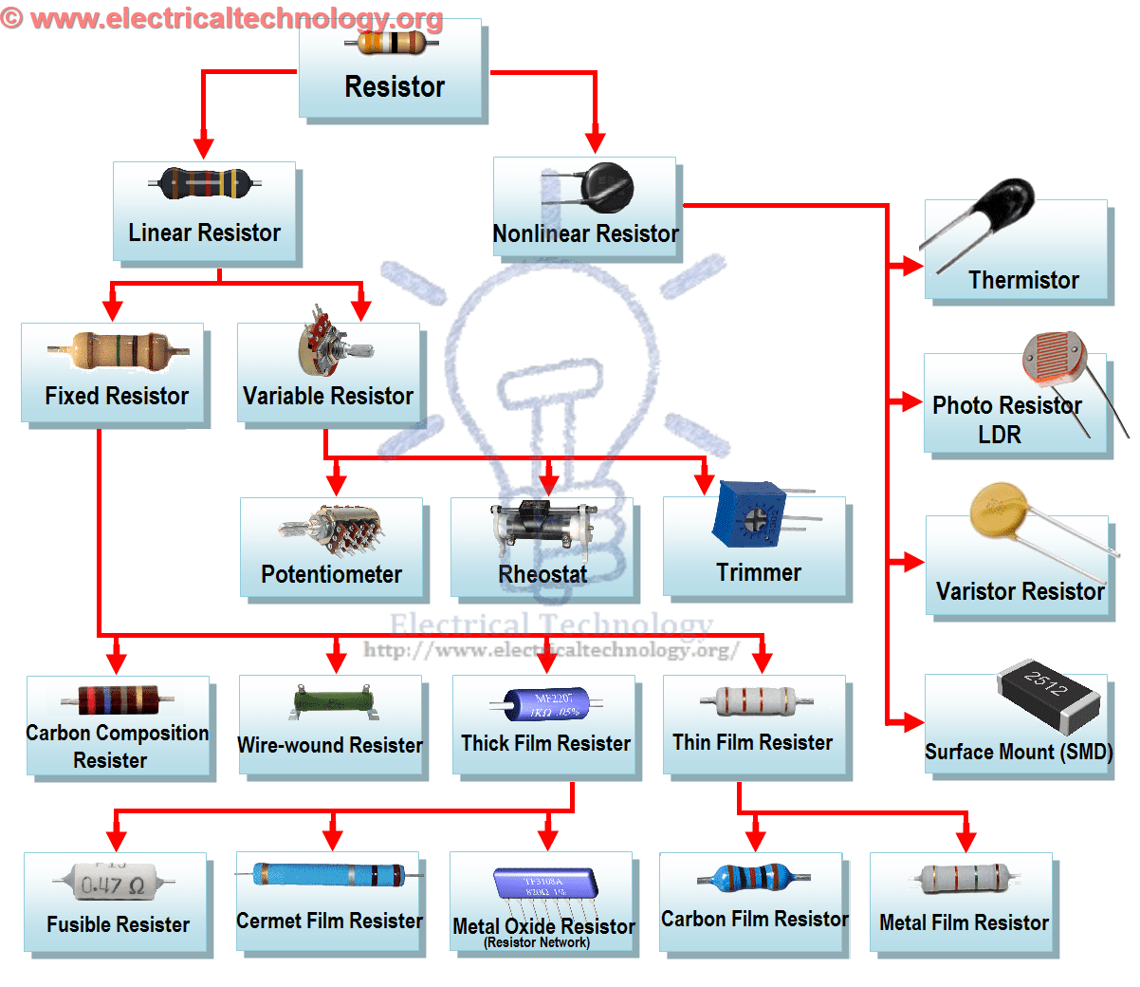

Slide 9
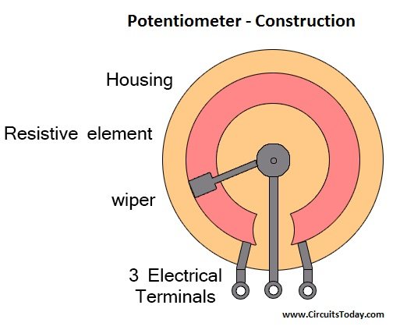
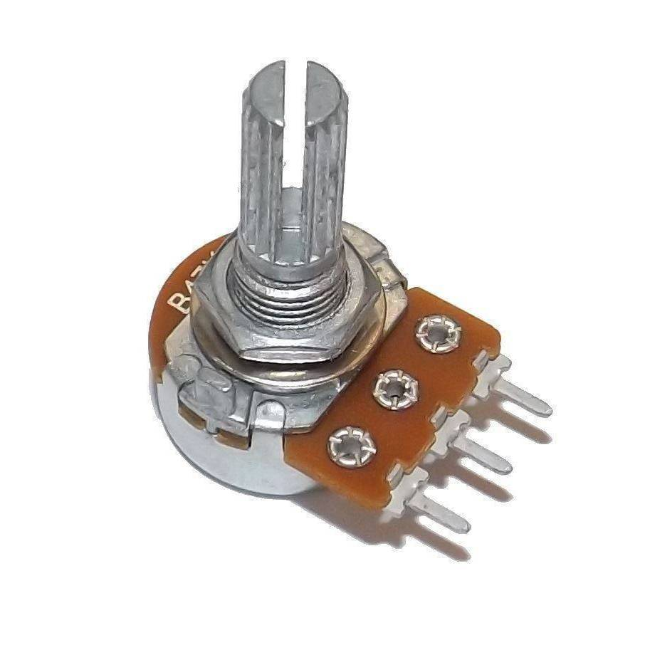
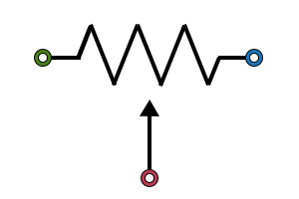
Potentiometer

Slide 10
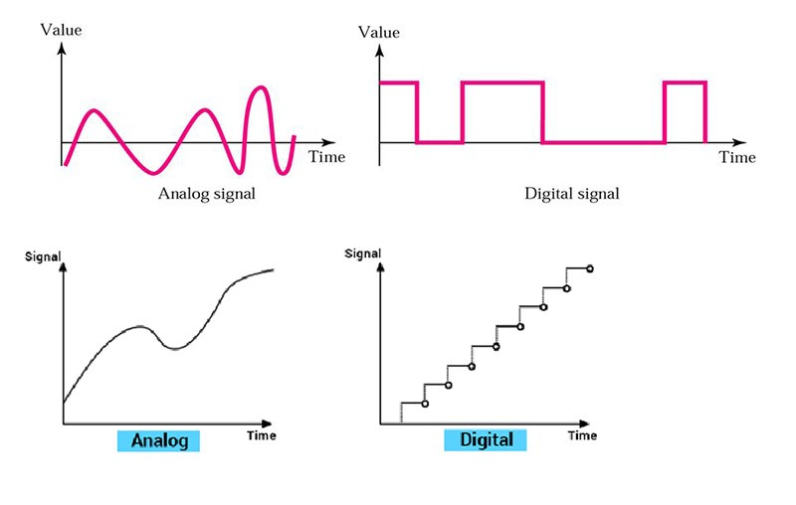
Signal fundamentals

Slide 11
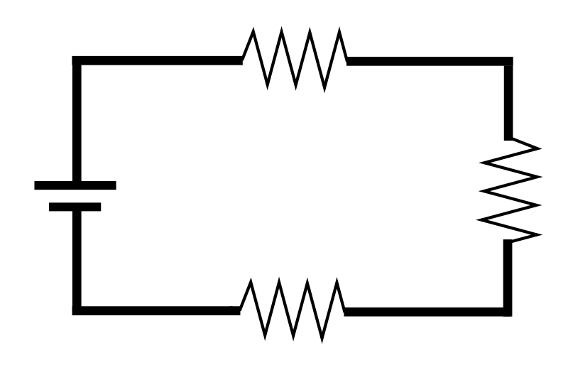
Power
“The time rate of expending or absorbing energy
measured in Watt (W)”
+
-
+
-
Passive sign convention
(Absorb power)
0.5W
+
+
1W
0.25W
-
0.25W
-
+
-
-
+
Active sign convention
(Deliver power)
Absorb power = -(Deliver power)
Sora

Slide 12



Unit transformation you should know
1. Current = Charge / Time : $I=\frac{C}{S}$
2. Power = Energy / Time : P $=\frac{J}{S}$
3. Conductance = 1 / Resistance : ℧ or S $=\frac{1}{R}$
Sora

Slide 13
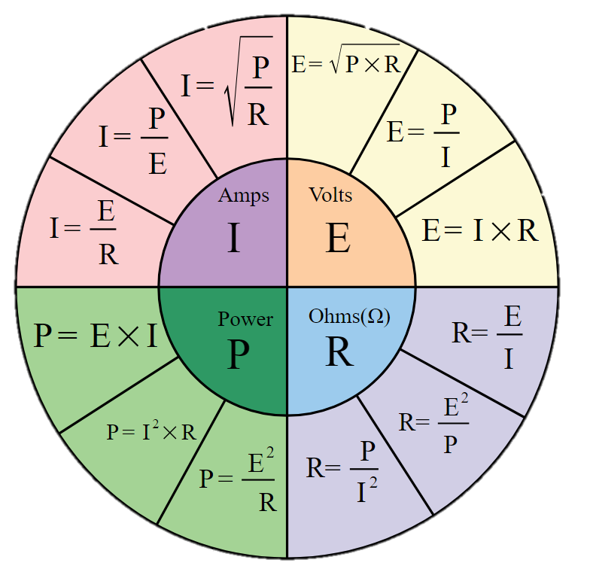
Ohm’s Law
Sora

Slide 14
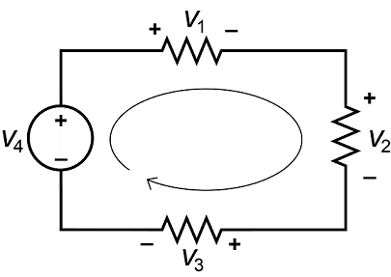




Kirchoff’s Law
I1
I2
I4
I3
KCL : $I_{in}=I_{out}$
KVL : $\sum{V}=0$
KCL : $I_{1}+I_{2}+I_{3}=I_{4}$
KVL : $V_{1}+V_{2}+V_{3}=V_{4}$
The sum of the current entering any point is equal to the sum of the current leaving the same point
The sum of the voltage in any close loop is equal to zero
Sora

Slide 15






Total Resistance
Series connection
2 Resistor connected in parallel
R1
R1
R2
Rn
A
B
$$R_{t}=\frac{R_{1}×R_{2}}{R_{1}+R_{2}}$$
A
R2
B
$$R_{t}=R_{1}+R_{2}+…+R_{n}$$
What if…
Parallel connection
R1
R1
R2
$$R_{a}=\frac{R_{1}×R_{2}}{R_{1}+R_{2}}$$
A
B
R2
Rn
A
R3
B
$$R_{t}=\frac{R_{a}×R_{b}}{R_{a}+R_{b}}$$
$$\frac{1}{R_{t}}=\frac{1}{R_{1}}+\frac{1}{R_{2}}+…+\frac{1}{R_{n}}$$
R4
$$R_{b}=\frac{R_{3}×R_{4}}{R_{3}+R_{4}}$$
Sora

Slide 16
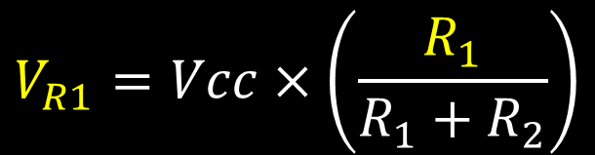

Voltage divider
The voltage is depends on it’s own resistance
$$V_{R1}=Vcc×\left(\frac{R_{1}}{R_{1}+R_{2}}\right)$$
R1
VR1
VCC
$$V_{out}=Vcc×\left(\frac{R_{2}}{R_{1}+R_{2}}\right)$$
R2
Vout
Sora

Slide 17
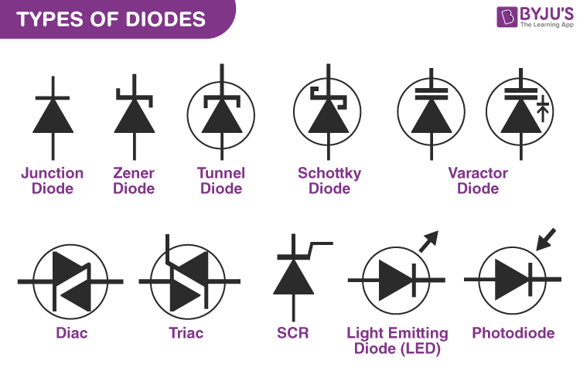
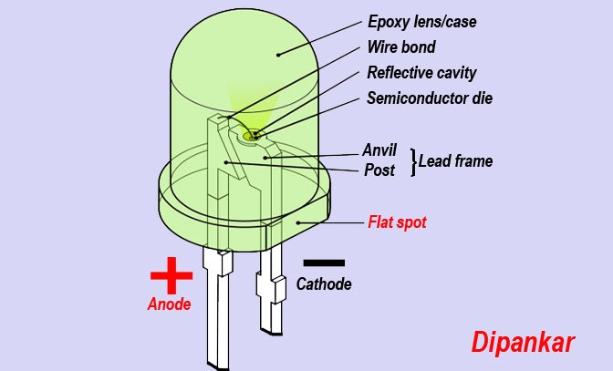
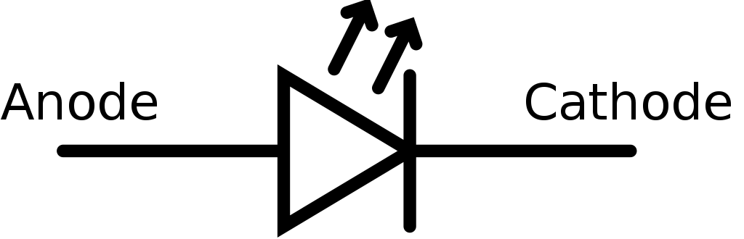
The Light Emitting Diode

Slide 18
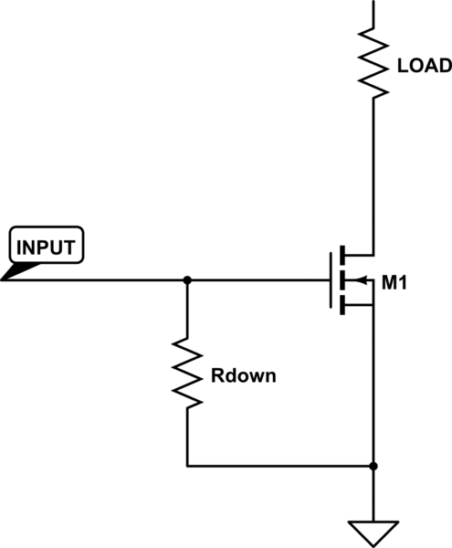
The pulldown resistor

Slide 19
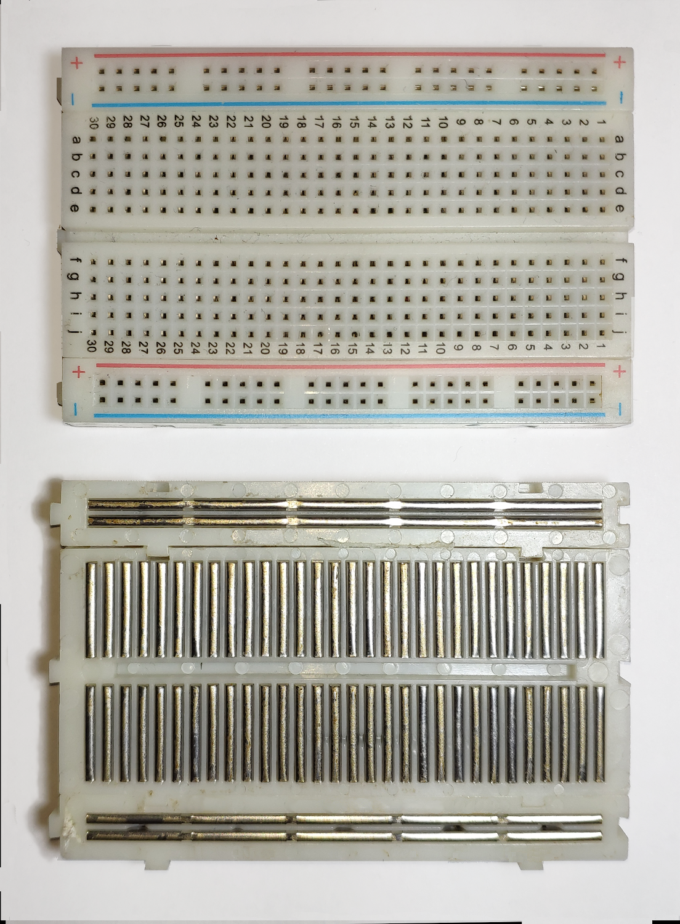
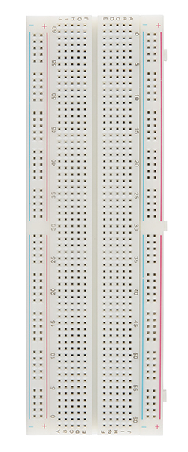
Bread board

