Slide 1
BERT

Slide 2
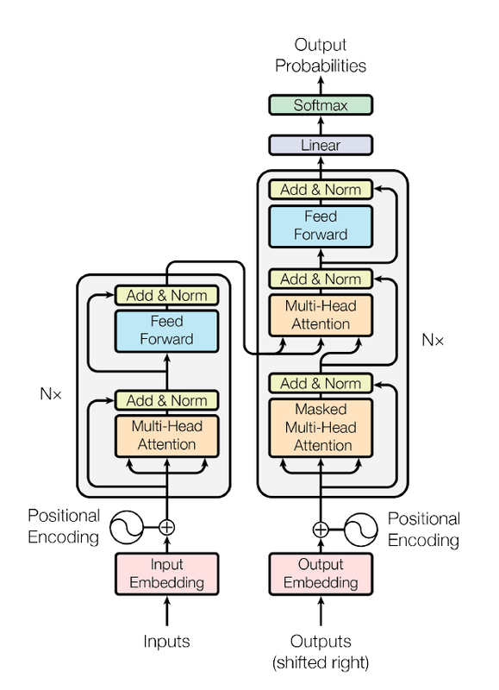
TRANSFORMERS

Slide 3
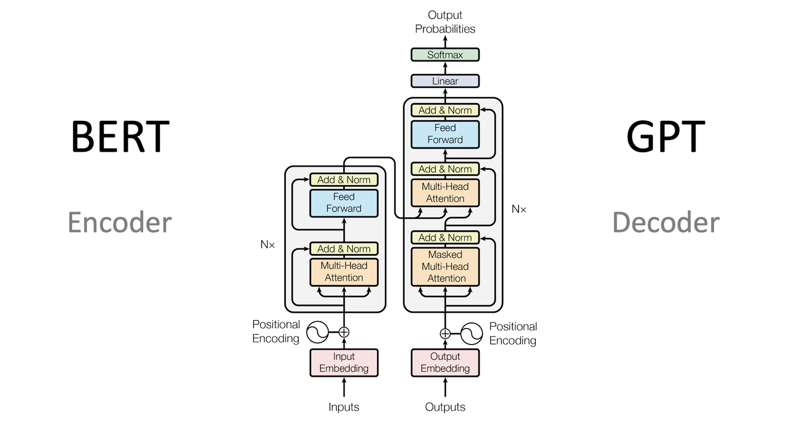

Slide 4
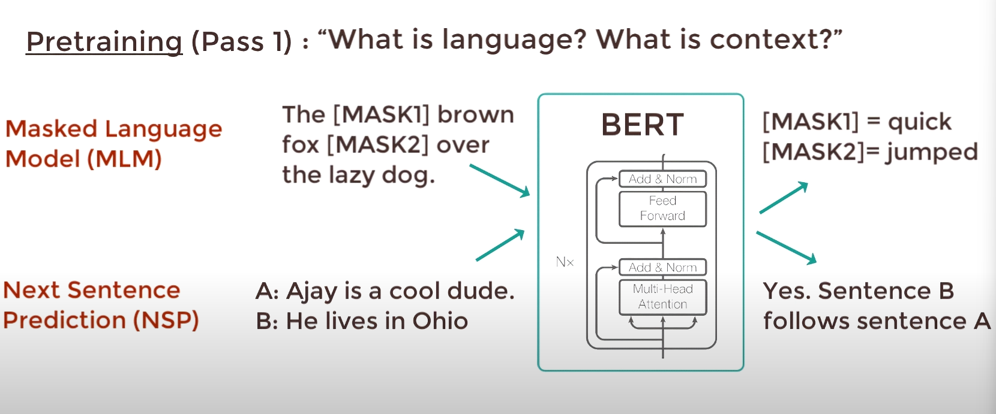
PRE-TRAIN

Slide 5
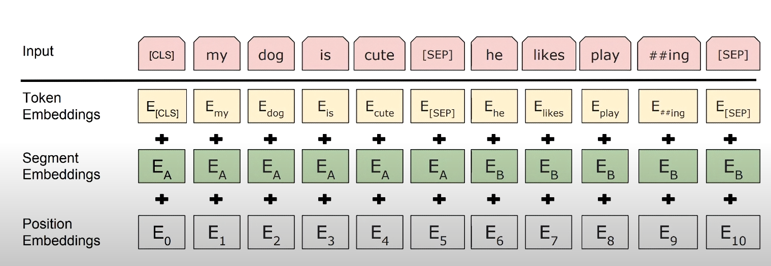
PRE-TRAIN

Slide 6
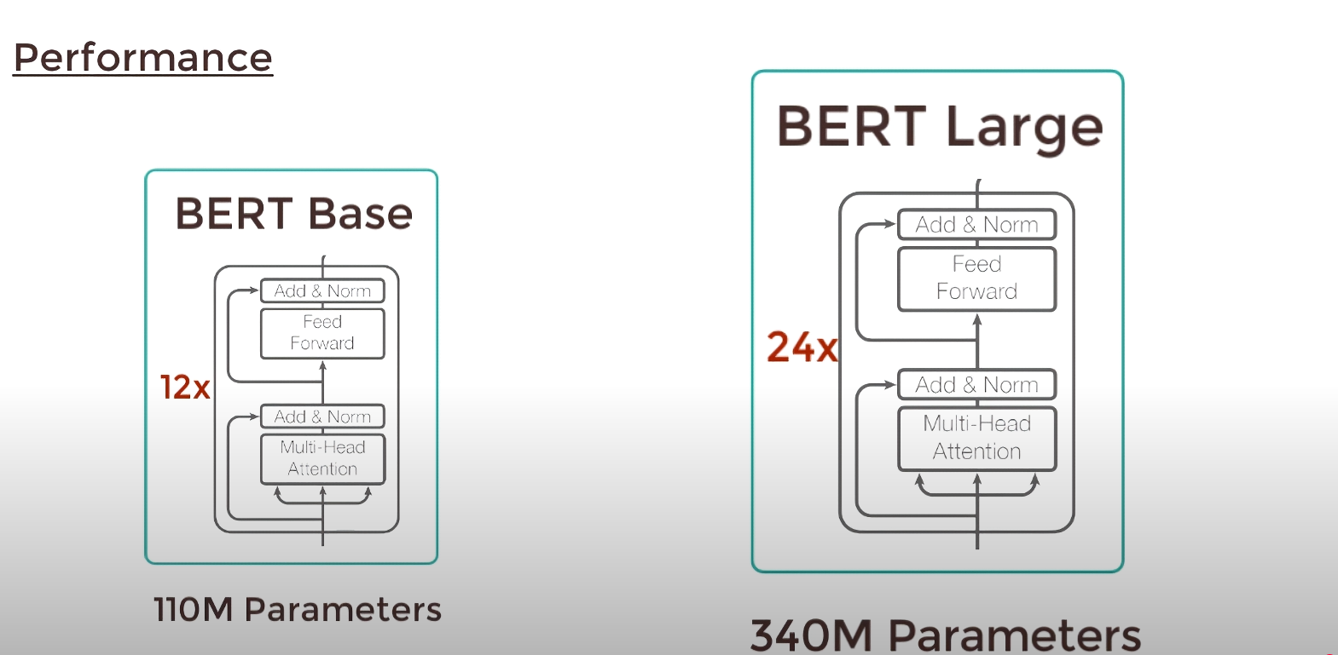
BERT MODELS

