Slide 1
CC5212-1 Procesamiento Masivo de Datos Otoño 2016 Lecture 6: DFS & MapReduce III
Aidan Hogan
aidhog@gmail.com

Slide 2
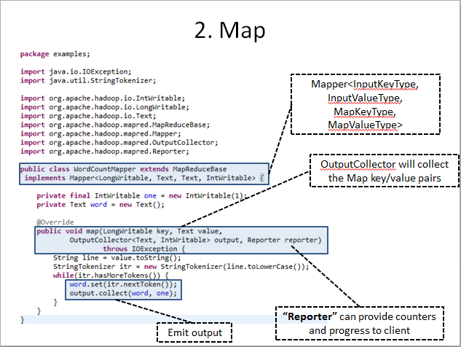
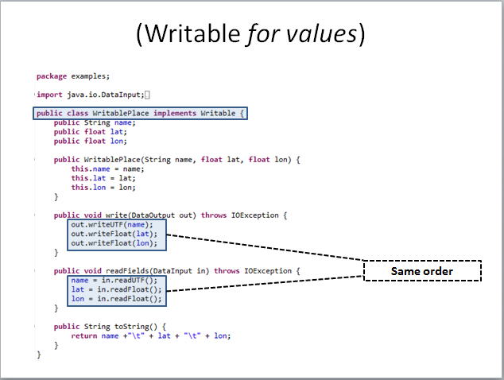
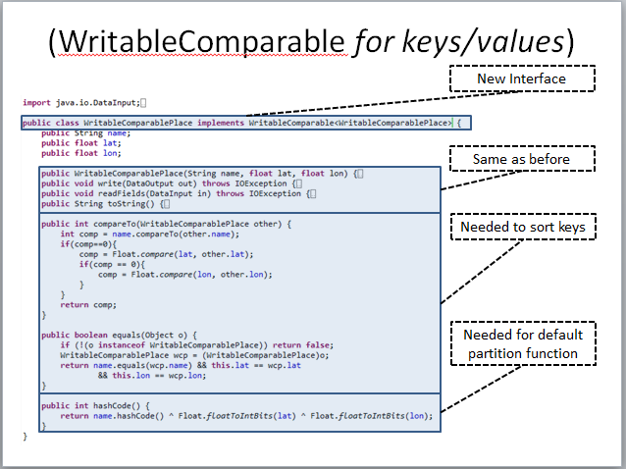
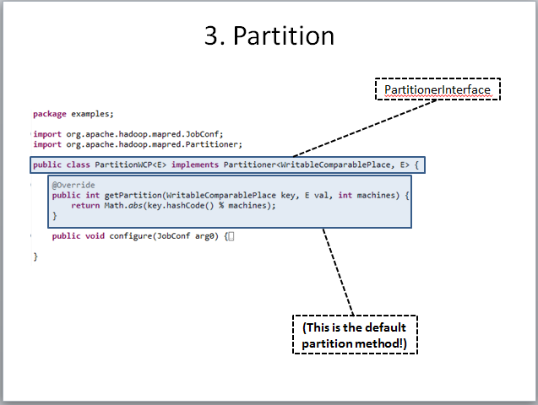

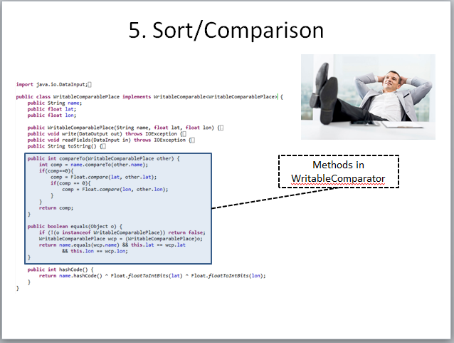
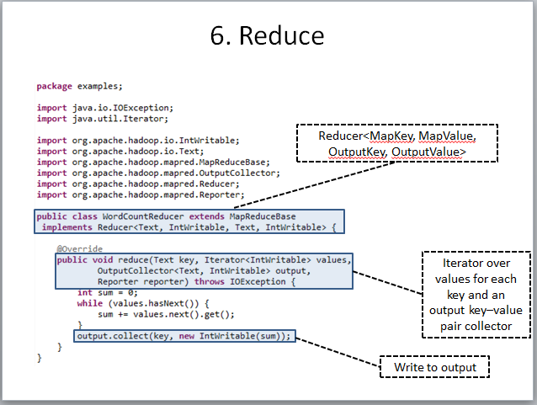
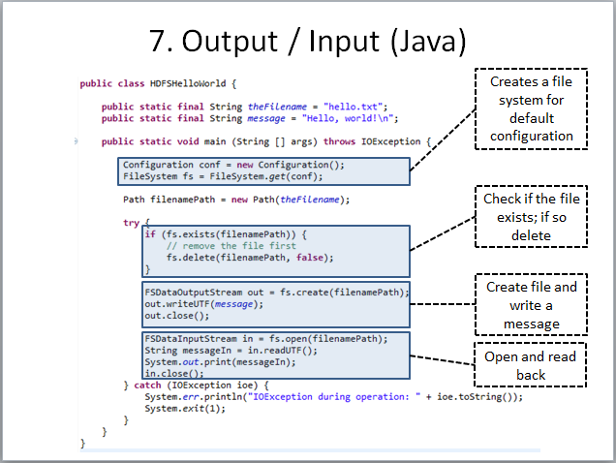
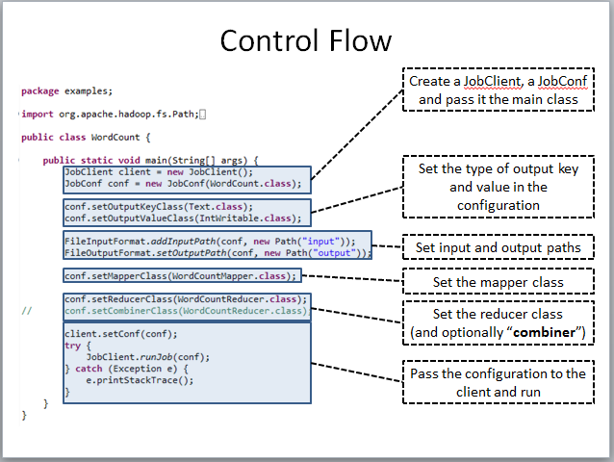
Apache Hadoop (Java)

Slide 3

An Easier Way?

Slide 4
APACHE PIG: OVERVIEW

Slide 5

Apache Pig
Create MapReduce programs to run on Hadoop
Use a high-level “scripting” language called Pig Latin
Can embed User Defined Functions: call a Java function (or Python, Ruby, etc.)
Based on Pig Relations

Slide 6

Pig Latin: Hello Word Count
input_lines = LOAD '/tmp/book.txt' AS (line:chararray);
-- Extract words from each line and put them into a pig bag
-- datatype, then flatten the bag to get one word on each row
words = FOREACH input_lines GENERATE FLATTEN(TOKENIZE(line)) AS word;
-- filter out any words that are just white spaces
filtered_words = FILTER words BY word MATCHES '\\w+';
-- create a group for each word
word_groups = GROUP filtered_words BY word;
-- count the entries in each group
word_count = FOREACH word_groups GENERATE COUNT(filtered_words) AS count, group AS word;
-- order the records by count
ordered_word_count = ORDER word_count BY count DESC;
STORE ordered_word_count INTO '/tmp/book-word-count.txt';
Map
Reduce
Map + Reduce
Any guesses which line(s) correpond to Map, Reduce?

Slide 7
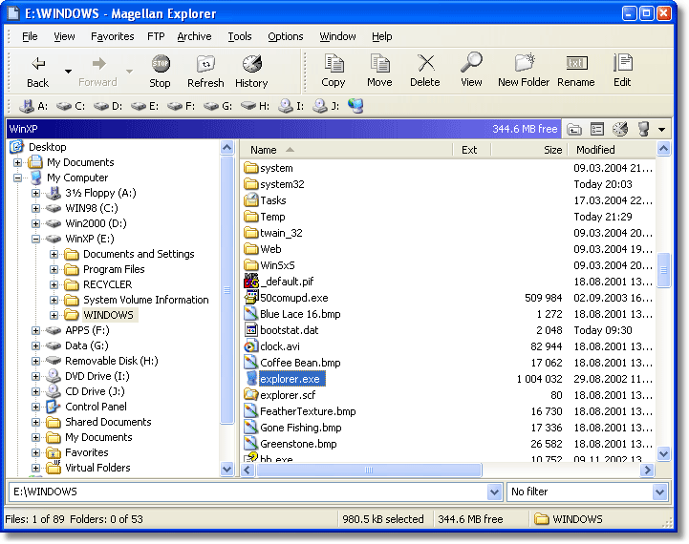
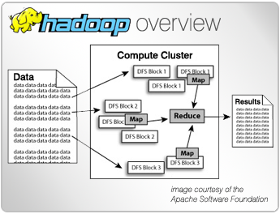
Pig: Local Mode vs. MapReduce Mode

Slide 8
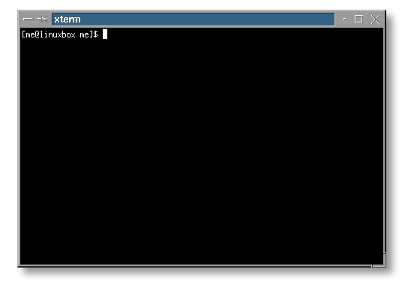
Three Ways to Execute Pig: (i) Grunt
grunt> in_lines = LOAD '/tmp/book.txt' AS (line:chararray);
grunt> words = FOREACH in_lines GENERATE FLATTEN(TOKENIZE(line)) AS word;
grunt> filtered_words = FILTER words BY word MATCHES '\\w+';
grunt> …
…
grunt> STORE ordered_word_count INTO '/tmp/book-word-count.txt';

Slide 9

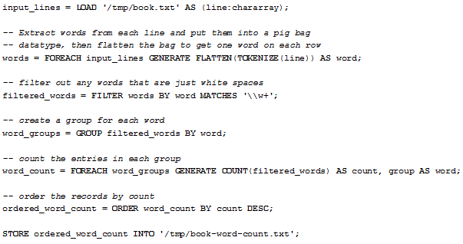
Three Ways to Execute Pig: (ii) Script
grunt> pig wordcount.pig
wordcount.pig

Slide 10
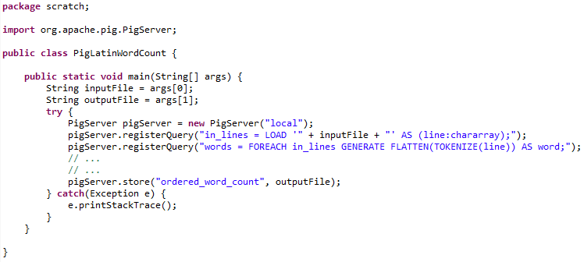

Three Ways to Execute Pig: (iii) Embedded

Slide 11
APACHE PIG: LIDER example

Slide 12

Pig: Products by Hour
transact.txt
customer412 1L_Leche 2014-03-31T08:47:57Z $900
customer412 Nescafe 2014-03-31T08:47:57Z $2.000
customer412 Nescafe 2014-03-31T08:47:57Z $2.000
customer413 400g_Zanahoria 2014-03-31T08:48:03Z $1.240
customer413 El_Mercurio 2014-03-31T08:48:03Z $500
customer413 Gillette_Mach3 2014-03-31T08:48:03Z $8.250
customer413 Santo_Domingo 2014-03-31T08:48:03Z $2.450
customer413 Nescafe 2014-03-31T08:48:03Z $2.000
customer414 Rosas 2014-03-31T08:48:24Z $7.000
customer414 Chocolates 2014-03-31T08:48:24Z $9.230
customer414 300g_Frutillas 2014-03-31T08:48:24Z $1.230
customer415 Nescafe 2014-03-31T08:48:35Z $2.000
customer415 12 Huevos 2014-03-31T08:48:35Z $2.200
…
Your boss in Lider Headquarters tells you to find out the frequency of premium items (price>$1.000) sold per hour counting duplicate items from each customer once …

Slide 13
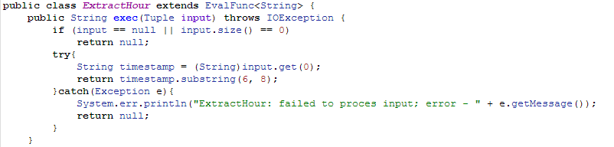
Pig: Products by Hour
grunt> REGISTER userDefinedFunctions.jar
User-defined-functions written in Java (or Python, Ruby, etc. …)
userDefinedFunctions.jar

Slide 14
Pig: Products by Hour
grunt> REGISTER userDefinedFunctions.jar
grunt> raw = LOAD ‘transact.txt' USING PigStorage('\t') AS (cust, item, time, price);
View data as a (streaming) relation with fields (cust, item, etc.) and tuples (data rows) …
cust | item | time | price
customer412 | 1L_Leche | 2014-03-31T08:47:57Z | $900
customer412 | Nescafe | 2014-03-31T08:47:57Z | $2.000
customer412 | Nescafe | 2014-03-31T08:47:57Z | $2.000
customer413 | 400g_Zanahoria | 2014-03-31T08:48:03Z | $1.240
… | … | … | …
raw:

Slide 15
Pig: Products by Hour
grunt> REGISTER userDefinedFunctions.jar
grunt> raw = LOAD ‘transact.txt' USING PigStorage('\t') AS (cust, item, time, price);
grunt> premium = FILTER raw BY org.udf.MinPrice1000(price);
Filter tuples depending on their value for a given attribute (in this case, price < 1000)
cust | item | time | price
customer412 | 1L_Leche | 2014-03-31T08:47:57Z | $900
customer412 | Nescafe | 2014-03-31T08:47:57Z | $2.000
customer412 | Nescafe | 2014-03-31T08:47:57Z | $2.000
customer413 | 400g_Zanahoria | 2014-03-31T08:48:03Z | $1.240
… | … | … | …
premium:

Slide 16
Pig: Products by Hour
grunt> REGISTER userDefinedFunctions.jar
grunt> raw = LOAD ‘transact.txt' USING PigStorage('\t') AS (cust, item, time, price);
grunt> premium = FILTER raw BY org.udf.MinPrice1000(price);
grunt> hourly = FOREACH premium GENERATE cust, item, org.udf.ExtractHour(time) AS hour, price;
cust | item | hour | price
customer412 | Nescafe | 08 | $2.000
customer412 | Nescafe | 08 | $2.000
customer413 | 400g_Zanahoria | 08 | $1.240
customer413 | Gillette_Mach3 | 08 | $8.250
… | … | … | …
hourly:

Slide 17
Pig: Products by Hour
grunt> REGISTER userDefinedFunctions.jar
grunt> raw = LOAD ‘transact.txt' USING PigStorage('\t') AS (cust, item, time, price);
grunt> premium = FILTER raw BY org.udf.MinPrice1000(price);
grunt> hourly = FOREACH premium GENERATE cust, item, org.udf.ExtractHour(time) AS hour, price;
grunt> unique = DISTINCT hourly;
cust | item | hour | price
customer412 | Nescafe | 08 | $2.000
customer412 | Nescafe | 08 | $2.000
customer413 | 400g_Zanahoria | 08 | $1.240
customer413 | Gillette_Mach3 | 08 | $8.250
… | … | … | …
unique:

Slide 18
Pig: Products by Hour
grunt> REGISTER userDefinedFunctions.jar
grunt> raw = LOAD ‘transact.txt' USING PigStorage('\t') AS (cust, item, time, price);
grunt> premium = FILTER raw BY org.udf.MinPrice1000(price);
grunt> hourly = FOREACH premium GENERATE cust, item, org.udf.ExtractHour(time) AS hour, price;
grunt> unique = DISTINCT hourly;
grunt> hrItem = GROUP unique BY (item, hour);
cust | item | hour | price
customer412 | Nescafe | 08 | $2.000
customer413 | 400g_Zanahoria | 08 | $1.240
customer413 | Gillette_Mach3 | 08 | $8.250
customer413 | Santo_Domingo | 08 | $2.450
… | … | … | …
unique:

Slide 19
Pig: Products by Hour
grunt> REGISTER userDefinedFunctions.jar
grunt> raw = LOAD ‘transact.txt' USING PigStorage('\t') AS (cust, item, time, price);
grunt> premium = FILTER raw BY org.udf.MinPrice1000(price);
grunt> hourly = FOREACH premium GENERATE cust, item, org.udf.ExtractHour(time) AS hour, price;
grunt> unique = DISTINCT hourly;
grunt> hrItem = GROUP unique BY (item, hour);
[item,hour] | cust | item | hour | price
[Nescafe,08] | customer412 | Nescafe | 08 | $2.000
 | customer413 | Nescafe | 08 | $2.000
 | customer415 | Nescafe | 08 | $2.000
[400g_Zanahoria,08] | customer413 | 400g_Zanahoria | 08 | $1.240
… | … | … | … | …
hrItem:

Slide 20
Pig: Products by Hour
grunt> REGISTER userDefinedFunctions.jar
grunt> raw = LOAD ‘transact.txt' USING PigStorage('\t') AS (cust, item, time, price);
grunt> premium = FILTER raw BY org.udf.MinPrice1000(price);
grunt> hourly = FOREACH premium GENERATE cust, item, org.udf.ExtractHour(time) AS hour, price;
grunt> unique = DISTINCT hourly;
grunt> hrItem = GROUP unique BY (item, hour);
grunt> hrItemCnt = FOREACH hrItem GENERATE flatten($0), COUNT($1) AS count;
[item,hour] | cust | item | hour | price
[Nescafe,08] | customer412 | Nescafe | 08 | $2.000
 | customer413 | Nescafe | 08 | $2.000
 | customer415 | Nescafe | 08 | $2.000
[400g_Zanahoria,08] | customer413 | 400g_Zanahoria | 08 | $1.240
… | … | … | … | …
count
hrItem:

Slide 21
Pig: Products by Hour
grunt> REGISTER userDefinedFunctions.jar
grunt> raw = LOAD ‘transact.txt' USING PigStorage('\t') AS (cust, item, time, price);
grunt> premium = FILTER raw BY org.udf.MinPrice1000(price);
grunt> hourly = FOREACH premium GENERATE cust, item, org.udf.ExtractHour(time) AS hour, price;
grunt> unique = DISTINCT hourly;
grunt> hrItem = GROUP unique BY (item, hour);
grunt> hrItemCnt = FOREACH hrItem GENERATE flatten($0), COUNT($1) AS count;
[item,hour] | count
[400g_Zanahoria,08] | 1
[Nescafe,08] | 3
… | …
hrItemCnt:

Slide 22
Pig: Products by Hour
grunt> REGISTER userDefinedFunctions.jar
grunt> raw = LOAD ‘transact.txt' USING PigStorage('\t') AS (cust, item, time, price);
grunt> premium = FILTER raw BY org.udf.MinPrice1000(price);
grunt> hourly = FOREACH premium GENERATE cust, item, org.udf.ExtractHour(time) AS hour, price;
grunt> unique = DISTINCT hourly;
grunt> hrItem = GROUP unique BY (item, hour);
grunt> hrItemCnt = FOREACH hrItem GENERATE flatten($0), COUNT($1) AS count;
grunt> hrItemCntSorted = ORDER hrItemCnt BY count DESC;
[item,hour] | count
[400g_Zanahoria,08] | 1
[Nescafe,08] | 3
… | …
hrItemCnt:

Slide 23
Pig: Products by Hour
grunt> REGISTER userDefinedFunctions.jar
grunt> raw = LOAD ‘transact.txt' USING PigStorage('\t') AS (cust, item, time, price);
grunt> premium = FILTER raw BY org.udf.MinPrice1000(price);
grunt> hourly = FOREACH premium GENERATE cust, item, org.udf.ExtractHour(time) AS hour, price;
grunt> unique = DISTINCT hourly;
grunt> hrItem = GROUP unique BY (item, hour);
grunt> hrItemCnt = FOREACH hrItem GENERATE flatten($0), COUNT($1) AS count;
grunt> hrItemCntSorted = ORDER hrItemCnt BY count DESC;
[item,hour] | count
[Nescafe,08] | 3
[400g_Zanahoria,08] | 1
… | …
hrItemCntSorted:

Slide 24

Pig: Products by Hour
grunt> REGISTER userDefinedFunctions.jar
grunt> raw = LOAD ‘transact.txt' USING PigStorage('\t') AS (cust, item, time, price);
grunt> premium = FILTER raw BY org.udf.MinPrice1000(price);
grunt> hourly = FOREACH premium GENERATE cust, item, org.udf.ExtractHour(time) AS hour, price;
grunt> unique = DISTINCT hourly;
grunt> hrItem = GROUP unique BY (item, hour);
grunt> hrItemCnt = FOREACH hrItem GENERATE flatten($0), COUNT($1) AS count;
grunt> hrItemCntSorted = ORDER hrItemCnt BY count DESC;
grunt> STORE hrItemCntSorted INTO ‘output.txt’
[item,hour] | count
[Nescafe,08] | 3
[400g_Zanahoria,08] | 1
… | …
hrItemCntSorted:

Slide 25
APACHE PIG: SCHEMA

Slide 26
Pig Relations
Pig Relations: Like relational tables
Except tuples can be “jagged”
Fields in the same column don’t need to be same type
Relations are by default unordered
Pig Schema: Names for fields, etc.
… AS (cust, item, time, price);
cust | item | time | price
customer412 | 1L_Leche | 2014-03-31T08:47:57Z | $900
customer412 | Nescafe | 2014-03-31T08:47:57Z | $2.000
customer412 | Nescafe | 2014-03-31T08:47:57Z | $2.000
customer413 | 400g_Zanahoria | 2014-03-31T08:48:03Z | $1.240
… | … | … | …

Slide 27

Pig Fields
Pig Fields:
Reference using name
premium = FILTER raw BY org.udf.MinPrice1000(price);
… or position
premium = FILTER raw BY org.udf.MinPrice1000($3);
More readable!
Starts at zero.
cust | item | time | price
customer412 | 1L_Leche | 2014-03-31T08:47:57Z | $900
customer412 | Nescafe | 2014-03-31T08:47:57Z | $2.000
customer412 | Nescafe | 2014-03-31T08:47:57Z | $2.000
customer413 | 400g_Zanahoria | 2014-03-31T08:48:03Z | $1.240
… | … | … | …

Slide 28
Pig Simple Types
Pig Types:
LOAD ‘transact.txt' USING PigStorage('\t') AS (cust:charArray, item:charArray, time:datetime, price:int);
int, long, float, double, biginteger, bigdecimal, boolean, chararray (string), bytearray (blob), datetime

Slide 29
Pig Types: Duck Typing
What happens if you omit types?
Fields default to bytearray
Implicit conversions if needed (~duck typing)
A = LOAD 'data' AS (cust, item, hour, price);
B = FOREACH A GENERATE hour + 4 % 24;
C = FOREACH A GENERATE hour + 4f % 24;
hour an integer
hour a float

Slide 30
Pig Complex Types: Tuple
cat data;
(3,8,9) (4,5,6)
(1,4,7) (3,7,5)
(2,5,8) (9,5,8)
A = LOAD 'data' AS (t1:tuple(t1a:int,t1b:int,t1c:int),t2:tuple(t2a:int,t2b:int,t2c:int));
DUMP A;
((3,8,9),(4,5,6)) ((1,4,7),(3,7,5)) ((2,5,8),(9,5,8))
X = FOREACH A GENERATE t1.t1a,t2.$0;
t1 |  |  | t2
t1a | t1b | t1c | t2a | t2b | t2c
3 | 8 | 9 | 4 | 5 | 6
1 | 4 | 7 | 3 | 7 | 5
2 | 5 | 8 | 9 | 5 | 8
A:

Slide 31
Pig Complex Types: Tuple
cat data;
(3,8,9) (4,5,6)
(1,4,7) (3,7,5)
(2,5,8) (9,5,8)
A = LOAD 'data' AS (t1:tuple(t1a:int,t1b:int,t1c:int),t2:tuple(t2a:int,t2b:int,t2c:int));
DUMP A;
((3,8,9),(4,5,6)) ((1,4,7),(3,7,5)) ((2,5,8),(9,5,8))
X = FOREACH A GENERATE t1.t1a,t2.$0;
DUMP X;
(3,4) (1,3) (2,9)
$0 | $1
3 | 4
1 | 3
2 | 9
X:

Slide 32
Pig Complex Types: Bag
cat data;
(3,8,9)
(2,3,6)
(1,4,7)
(2,5,8)
A = LOAD 'data' AS (c1:int, c2:int, c3:int);
B = GROUP A BY c1;
c1 | c2 | c3
3 | 8 | 9
2 | 3 | 6
1 | 4 | 7
2 | 5 | 8
A:

Slide 33
Pig Complex Types: Bag
cat data;
(3,8,9)
(2,3,6)
(1,4,7)
(2,5,8)
A = LOAD 'data' AS (c1:int, c2:int, c3:int);
B = GROUP A BY c1;
DUMP B;
(1,{(1,4,7)})
(2,{(2,5,8),(2,3,6)})
(3,{(3,8,9)})
group (c1) | A
 | c1 | c2 | c3
3 | 3 | 8 | 9
2 | 2 | 3 | 6
 | 2 | 5 | 8
1 | 1 | 4 | 7
B:

Slide 34

Pig Complex Types: Map
cat prices;
[Nescafe#”$2.000”]
[Gillette_Mach3#”$8.250”]
A = LOAD ‘prices’ AS (M:map []);

Slide 35
Pig Complex Types: Summary
tuple: A row in a table / a list of fields
e.g., (customer412, Nescafe, 08, $2.000)
bag: A set of tuples (allows duplicates)
e.g., { (cust412, Nescafe, 08, $2.000), (cust413, Gillette_Mach3, 08, $8.250) }
map: A set of key–value pairs
e.g., [Nescafe#$2.000]

Slide 36
APACHE PIG: OPERATORS

Slide 37
Pig Atomic Operators
Comparison
==, !=, >, <, >=, <=, matches (regex)
Arithmetic
+ , −, *, /
Reference
tuple.field, map#value
Boolean
AND, OR, NOT
Casting

Slide 38
Pig Conditionals
Ternary operator:
hr12 = FOREACH item GENERATE hour%12, (hour>12 ? ’pm’ : ’am’);
Cases:
X = FOREACH A GENERATE hour%12, (
CASE
WHEN hour>12 THEN ‘pm’
ELSE ‘am’
END
);

Slide 39
Pig Aggregate Operators
Can GROUP multiple items or COGROUP single item
(COGROUP considered more readable for multiple items)
Grouping:
GROUP: group on a single relation
GROUP premium BY (item, hour);
COGROUP: group multiple relations
COGROUP premium BY (item, hour), cheap BY (item, hour);
Aggregate Operations:
AVG, MIN, MAX, SUM, COUNT, SIZE, CONCAT

Slide 40
Pig Joins
cat data1;
(Nescafe,08,120)
(El_Mercurio,08,142)
(Nescafe,09,153)
cat data2;
(2000,Nescafe)
(8250, Gillette_Mach3)
(500, El_Mercurio)
A = LOAD 'data1' AS (prod:charArray, hour:int, count:int);
B = LOAD 'data2' AS (price:int, name:charArray);
X = JOIN A BY prod, B BY name;
DUMP X:
(El_Mercurio,08,142, 500, El_Mercurio)
(Nescafe,08,120, 2000,Nescafe)
(Nescafe,09,153, 2000,Nescafe)
prod | hour | count | price | name
Nescafe | 08 | 120 | 2000 | Nescafe
Nescafe | 09 | 153 | 2000 | Nescafe
El_Mercurio | 08 | 142 | 500 | El_Mercurio
X:

Slide 41
Pig Joins
Inner join: As shown (default)
Self join: Copy an alias and join with that
Outer joins:
LEFT / RIGHT / FULL
Cross product:
CROSS
You guys know (or remember ☺) what an INNER JOIN is versus an OUTER JOIN / LEFT / RIGHT / FULL versus a CROSS PRODUCT?

Slide 42
Pig Aggregate/Join Implementations
Custom partitioning / number of reducers:
PARTITION BY specifies a UDF for partitioning
PARALLEL specifies number of reducers
X = JOIN A BY prod, B BY name PARTITION BY org.udp.Partitioner PARALLEL 5;
X = GROUP A BY hour PARTITION BY org.udp.Partitioner PARALLEL 5;

Slide 43
Pig: Disambiguate
cat data1;
(Nescafe,08,120)
(El_Mercurio,08,142)
(Nescafe,09,153)
cat data2;
(2000,Nescafe)
(8250,Gillette_Mach3)
(500,El_Mercurio)
A = LOAD 'data1' AS (prodName:charArray, hour:int, count:int);
B = LOAD 'data2' AS (price:int, prodName:charArray);
X = JOIN A BY prodName, B BY prodName;
DUMP X:
(El_Mercurio,08,142,500,El_Mercurio)
(Nescafe,08,120, 2000,Nescafe)
(Nescafe,09,153, 2000,Nescafe)
Y = FOREACH X GENERATE prodName
Y = FOREACH X GENERATE A::prodName
which prodName?

Slide 44
Pig: Split
raw = LOAD ‘transact.txt' USING PigStorage('\t') AS (cust, item, time, price);
numeric = FOREACH raw GENERATE cust item time org.udf.RemoveDollarSign(price) AS price;
SPLIT numeric INTO cheap IF price<1000, premium IF price>=1000;
numeric:
cust | item | time | price
customer412 | 1L_Leche | 2014-03-31T08:47:57Z | 900
customer412 | Nescafe | 2014-03-31T08:47:57Z | 2.000
customer412 | Nescafe | 2014-03-31T08:47:57Z | 2.000
customer413 | 400g_Zanahoria | 2014-03-31T08:48:03Z | 1.240
… | … | … | …
cheap:
premium:
cust | item | time | price
customer412 | 1L_Leche | 2014-03-31T08:47:57Z | 900
… | … | … | …
cust | item | time | price
customer412 | Nescafe | 2014-03-31T08:47:57Z | 2.000
customer412 | Nescafe | 2014-03-31T08:47:57Z | 2.000
customer413 | 400g_Zanahoria | 2014-03-31T08:48:03Z | 1.240
… | … | … | …

Slide 45
Pig: Other Operators
FILTER: Filter tuples by an expression
LIMIT: Only return a certain number of tuples
MAPREDUCE: Run a native Hadoop .jar
ORDER BY: Sort tuples
SAMPLE: Sample tuples
UNION: Concatenate two relations

Slide 46
Pig translated to MapReduce in Hadoop
Pig is only an interface/scripting language for MapReduce

Slide 47
JUST TO MENTION …

Slide 48

Apache Hive
SQL-style language that compiles into MapReduce jobs in Hadoop
Similar to Apache Pig but …
Pig more procedural whilst Hive more declarative

Slide 49
RECAP …

Slide 50


Slide 51
Apache Pig (Latin)
Allows for scripting MapReduce jobs:
Procedural, but makes use of relational algebra
Three ways to run:
Interactive command line
Batch script
Call from Java

Slide 52
Apache Pig (Latin)
Schema based on relations:
A bit like databases
Some basic programming operators:
arithmetic, boolean, conditions, casting
Some relational algebra:
joins, groups, count, avg, sum, filter, limit, order by, etc.
For everything else, there’s user-defined functions

Slide 53
More reading
https://pig.apache.org/docs/r0.7.0/piglatin_ref2.html

Slide 54
CONCLUDING MAPREDUCE (FOR NOW) …

Slide 55

Apache Hadoop … Internals (if interested)
http://ercoppa.github.io/HadoopInternals/

Slide 56
Questions
?

