Slide 1
Actores y Actrices

Slide 2
Peligro
Please be careful!

Slide 3
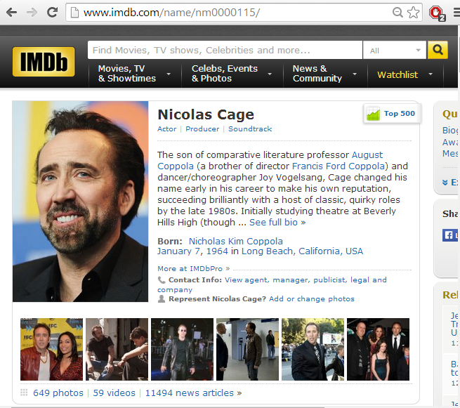
IMDb (I assume you all know?)

Slide 4
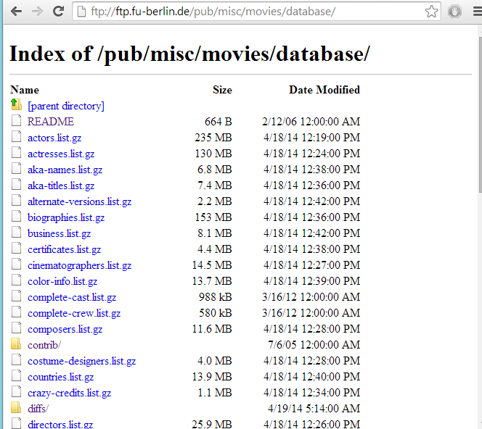
IMDb Dump
Not open/free!

Slide 5
The Question You are Going to Answer …
Which pair of actors/actresses have acted together the most times?

Slide 6
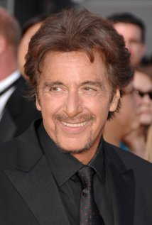
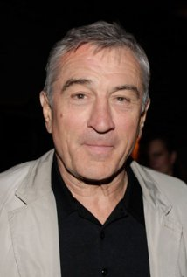



An Example
In how many movies have Al Pacino and Robert Di Nero starred together in IMDb?
?

Slide 7
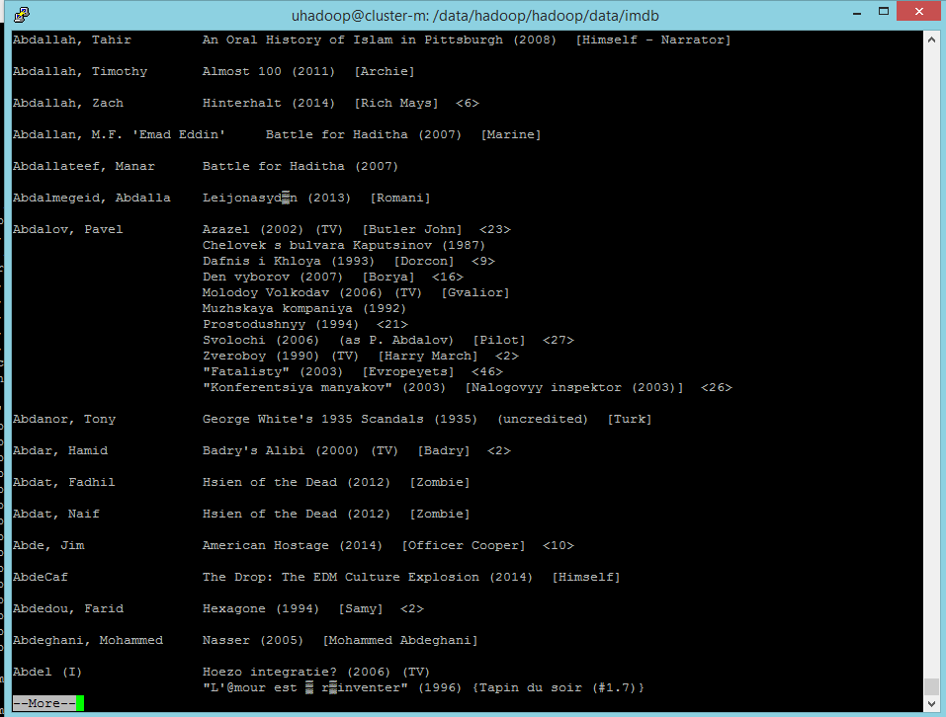

IMDB: Typical File
Log into machine cluster.dcc.uchile.cl
Username: uhadoop
zcat /data/hadoop/hadoop/data/imdb/actors.list.gz | more

Slide 8
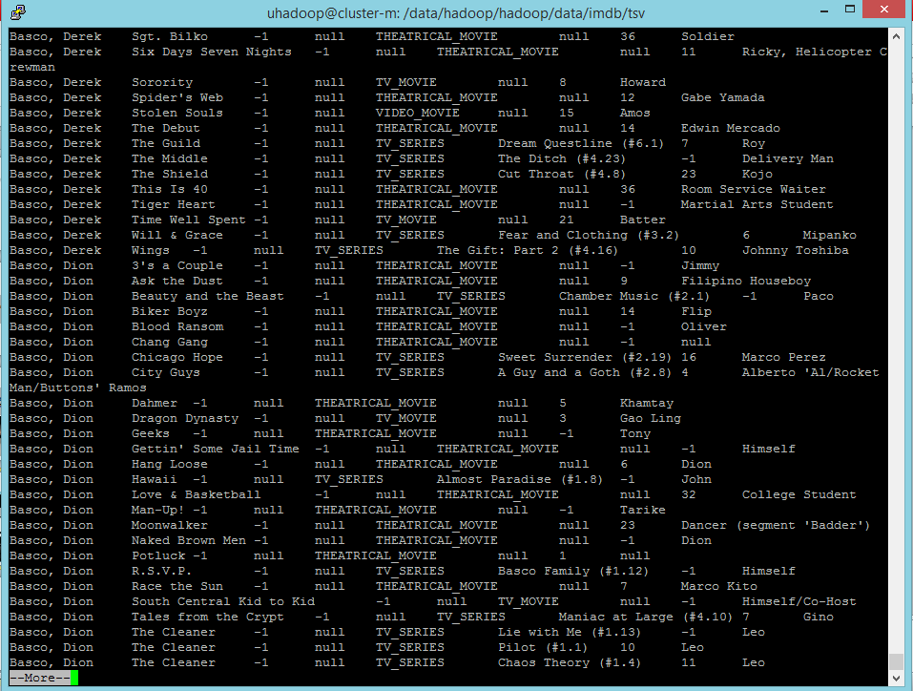

IMDb: Already Parsed
zcat /data/hadoop/hadoop/data/imdb/tsv/actpersons-to-movies.tsv.gz | more
How many theatrical
movies was Uma Thurman
in?
zcat /data/hadoop/hadoop/data/imdb/tsv/actresses-to-movies.tsv.gz | grep -e “^Thurman, Uma” | grep -e “THEATRICAL_MOVIE” | wc -l

Slide 9
The Question You are Going to Answer …
Which pair of actors/actresses have acted together the most times?

Slide 10

1. Download the project
http://aidanhogan.com/teaching/cc5212-1/mdp-lab5.zip

Slide 11
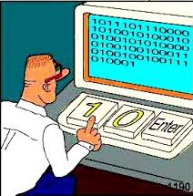
2. Implement the Hadoop job(s)!
Adapt WordCount example
Refer to lab slides from last week
Can use class file for each part of the task
Test on small file
/uhadoop/imdb/actpersons-to-movies.100k.tsv
Run on big file
/uhadoop/imdb/full/actpersons-to-movies.tsv
Write to your directory!!!
/uhadoop/[username]

Slide 12
3. Continuation
Count the pairs
CountPairs.java
Sort the pairs
SortPairs.java
Figure out the input
Figure out the map/reduce phase
Adapt a previous example
WordCount or EmitPairs
Change generics
Implement new Map/Reduce
Run it!

