Slide 1
Counting (co-)Stars

Slide 2
Peligro
Please be careful!

Slide 3
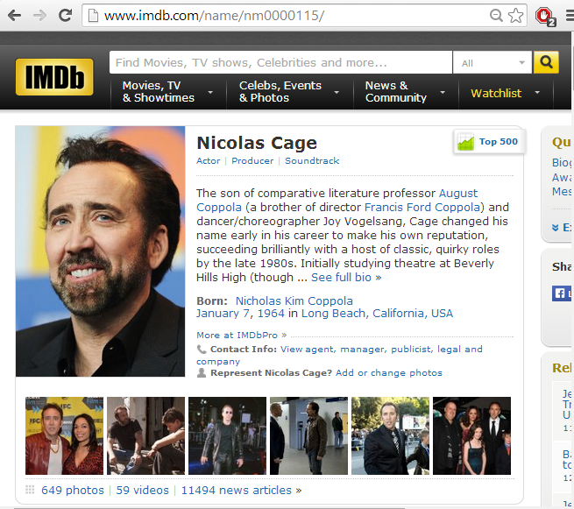
IMDb (I assume you all know?)

Slide 4
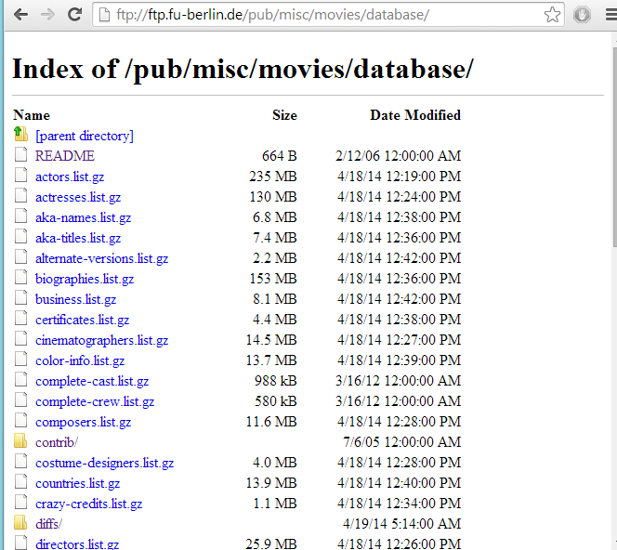
IMDb Dump
Not open/free!

Slide 5
The Question You are Going to Answer …
Which pair of actors/actresses have acted together the most times?

Slide 6





An Example
In how many movies have Al Pacino and Robert De Niro starred together in IMDb?
?

Slide 7
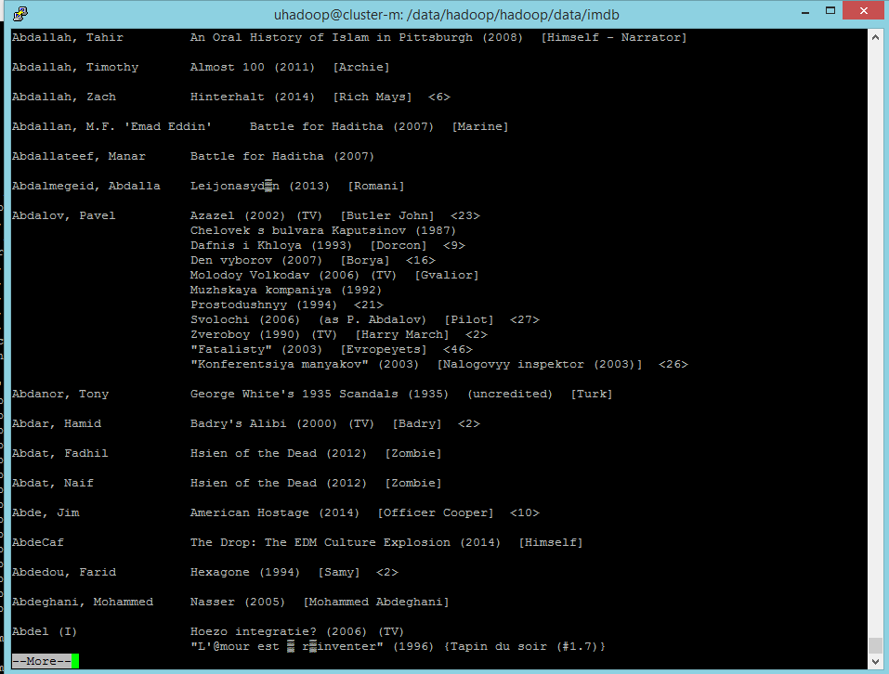

IMDB: Typical File

Slide 8
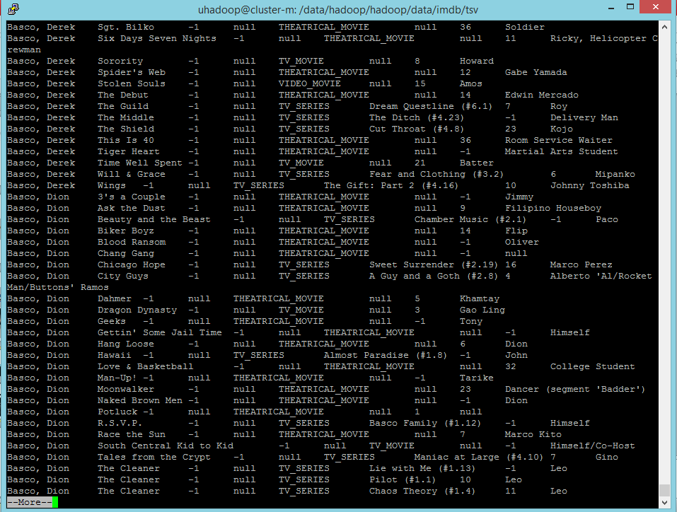
IMDb: Already Parsed
hdfs dfs -cat /uhadoop/shared/imdb/imdb-stars.tsv | grep -e “^Pacino, Al" | more
How many theatrical
movies was Al Pacino in?
hdfs dfs -cat /uhadoop/shared/imdb/imdb-stars.tsv | grep -e “^Pacino, Al" | grep -e “THEATRICAL_MOVIE” | wc -l

Slide 9
The Question You are Going to Answer …
How many times each pair of co-stars has acted together in the IMDb database
… and perhaps if we have time, which pair has acted together the most number of times.

Slide 10
Instructions for DFS/Hadoop, etc.
Same as last week:
http://aidanhogan.com/teaching/cc5212-1-2016/lab/04/mdp-lab04.pdf

Slide 11
Instructions for this lab
http://aidanhogan.com/teaching/cc5212-1-2016/lab/05/mdp-lab05.pdf

Slide 12
Download code project:
http://aidanhogan.com/teaching/cc5212-1-2016/lab/05/mdp-lab05.zip
You do not need to change Main.java
CitationCount.java left for reference
You can copy and adapt this to suit your needs

Slide 13
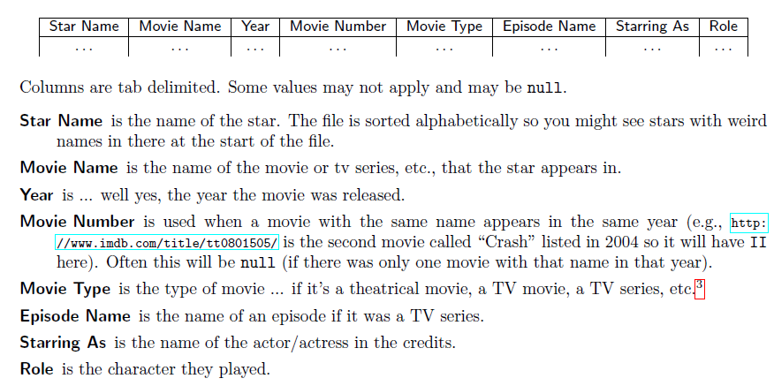
How to proceed
The input format is described in the instructions of the lab

Slide 14
How to proceed
Only consider lines where the movie type is the string “THEATRICAL_MOVIE”
Movies are uniquely identified by Movie Name, Year AND Movie Number (Movie Names alone are not unique)
You can use “##” to concatenate two things
E.g., “Actor1##Actor2”
Output unique co-stars (n*(n-1)/2)
You may need multiple Jobs:
Feel free to run them manually, passing output of one as input of another

Slide 15
Testing …
Test each job seperately
Test over a small file first:
/uhadoop/shared/imdb/imdb-stars-100k.tsv
Use the shared input
Output to a folder in /uhadoop/[username]/imdb/
hadoop jar mdp-lab5.jar [ClassName] [Input] [Output]
When your code works you can assume it will work okay for large file ☺
The large file might take some time.

