Slide 1
CC5212-1 Procesamiento Masivo de Datos Otoño 2016 Lecture 2: Distributed Systems I
Aidan Hogan
aidhog@gmail.com

Slide 2
Massive data needs DISTRIBUTED SYSTEMS …

Slide 3
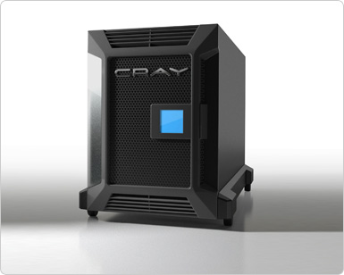
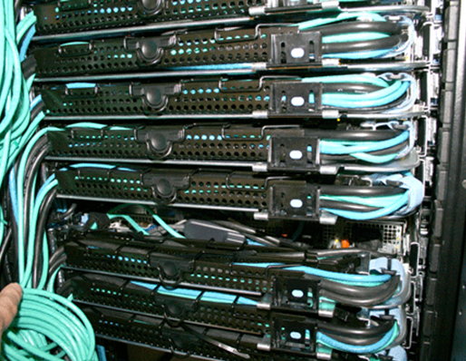
Monolithic vs. Distributed Systems
One machine that’s n times as powerful?
n machines that are equally as powerful?
vs.

Slide 4
Parallel vs. Distributed Systems
Parallel System
often = shared memory
Distributed System
often = shared nothing
Processor
Processor
Processor
Processor
Memory
Processor
Memory
Memory
Processor
Memory

Slide 5

What is a Distributed System?
“A distributed system is a system that enables a collection of independent computers to communicate in order to solve a common goal.”
0010010001011010100
100101110100010001001

Slide 6
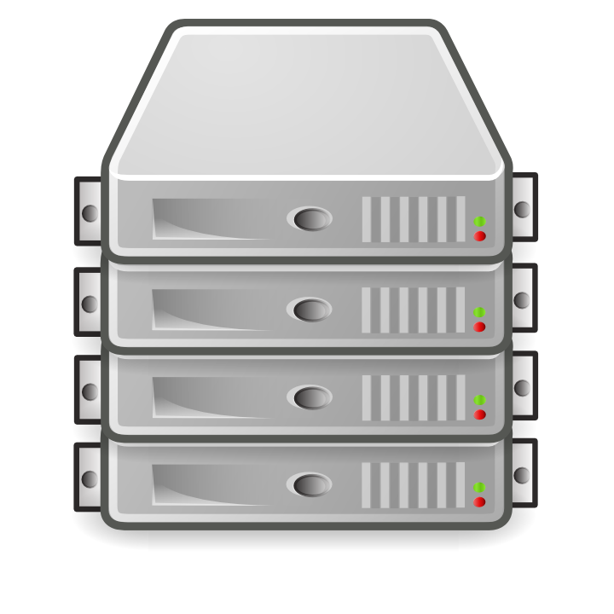


What is a Distributed System?
“An ideal distributed system is a system that makes a collection of independent computers look like one computer (to the user).”

Slide 7
Disadvantages of Distributed Systems
(Possible) Advantages
(Possible) Disadvantages
Cost
Better performance/price
Extensibility
Add another machine!
Reliability
No central point of failure!
Workload
Balance work automatically
Sharing
Remote access to services
Software
Need specialised programs
Networking
Can be slow
Maintenance
Debugging sw/hw a pain
Security
Multiple users
Parallelisation
Not always applicable

Slide 8
WHAT MAKES A GOOD DISTRIBUTED SYSTEM?

Slide 9
Distributed System Design
“An ideal distributed system is a system that makes a collection of independent computers look like one computer (to the user).”
Transparency: Abstract/hide:
Access: How different machines are accessed
Location: What machines have what/if they move
Concurrency: Access by several users
Failure: Keep it a secret from the user

Slide 10
Distributed System Design
Flexibility:
Add/remove/move machines
Generic interfaces
Reliability:
Fault-tolerant: recover from errors
Security: user authentication
Availability: uptime/total-time

Slide 11
Distributed System Design
Performance:
Runtimes (processing)
Latency, throughput and bandwidth (data)
Scalability
Network and infrastructure scales
Applications scale
Minimise global knowledge/bottlenecks!

Slide 12
DISTRIBUTED SYSTEMS: CLIENT–SERVER ARCHITECTURE

Slide 13
Client–Server Model
Client makes request to server
Server acts and responds
(For example: Email, WWW, Printing, etc.)

Slide 14
Client–Server: Thin Client
Few computing resources for client: I/O
Server does the hard work
(For example: PHP-heavy websites, SSH, email, etc.)

Slide 15
Client–Server: Fat Client
Fuller computing resources for client: I/O
Server sends data: computing done client-side
(For example: Javascript-heavy websites, multimedia, etc.)

Slide 16
Client–Server: Mirror Servers
User goes to any machine (replicated/mirror)

Slide 17

Client–Server: Proxy Server
User goes to “forwarding” machine (proxy)

Slide 18



Client–Server: Three-Tier Server
Server
Data
Logic
Presentation
Add all the salaries
Create HTML page
SQL: Query
salary of all employees
HTTP GET:
Total salary
of all employees

Slide 19
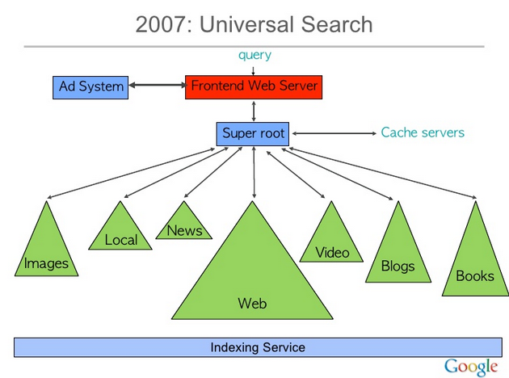
Client–Server: n-Tier Server
Slide from Google’s Jeff Dean:
Presentation
Logical
(multiple tiers)
Data

Slide 20
DISTRIBUTED SYSTEMS: PEER-TO-PEER ARCHITECTURE

Slide 21
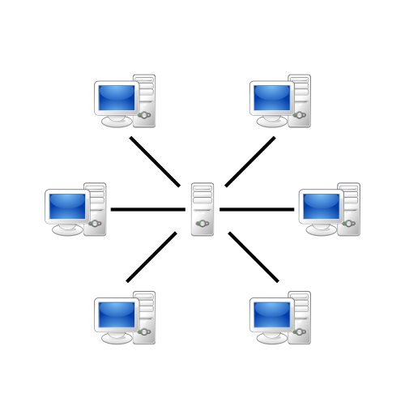
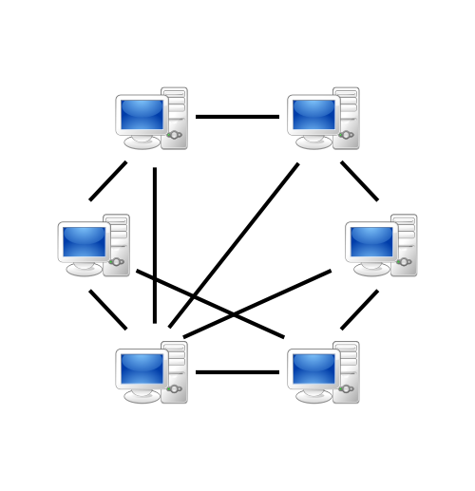
Peer-to-Peer (P2P)
Client–Server
Peer-to-Peer
Clients interact directly with a “central” server
Peers interact directly amongst themselves

Slide 22

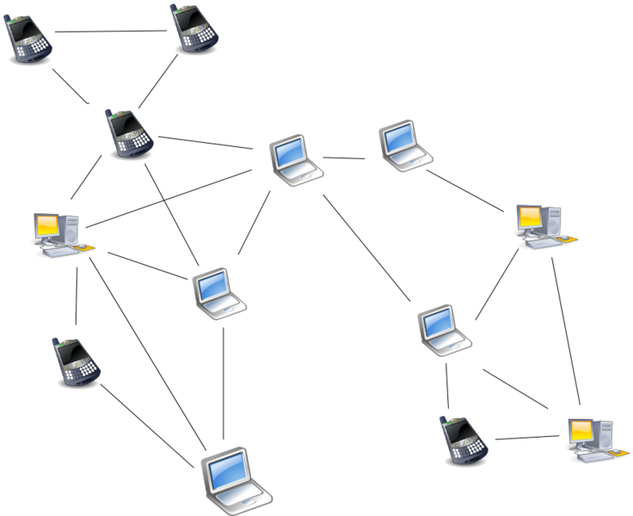
Peer-to-Peer: Unstructured (flooding)
Ricky Martin’s new album?
(For example: Kazaa, Gnutella)

Slide 23

Peer-to-Peer: Unstructured (flooding)
Pixie’s new album?
(For example: Kazaa, Gnutella)

Slide 24

Peer-to-Peer: Structured (Central)
Ricky Martin’s new album?
In central server, each peer registers
Content
Address
Peer requests content from server
Peers connect directly
Central point-of-failure
(For example: Napster … central directory was shut down)

Slide 25
Peer-to-Peer: Structured (Hierarchical)
Super-peers and peers

Slide 26
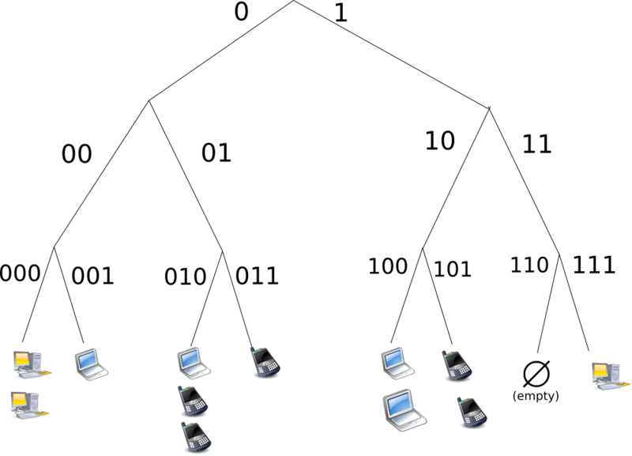


Peer-to-Peer: Structured (DHT)
Distributed Hash Table
(key,value) pairs
key based on hash
Query with key
Insert with (key,value)
Peer indexes key range
Hash: 000
Hash: 111
(For example: Bittorrent’s Tracker)

Slide 27




Peer-to-Peer: Structured (DHT)
Circular DHT:
Only aware of neighbours
O(n) lookups
Implement shortcuts
Skips ahead
Enables binary-search-like behaviour
O(log(n)) lookups
111
000
001
110
010
101
011
100
Pixie’s new album? 111

Slide 28
Peer-to-Peer: Structured (DHT)
Handle peers leaving (churn)
Keep n successors
New peers
Fill gaps
Replicate
111
000
001
110
010
101
011
100

Slide 29
Comparison of P2P Systems
For Peer-to-Peer, what are the benefits of (1) central directory vs. (2) unstructured, vs. (3) structured?
1) Central Directory
Search follows directory (1 lookup)
Connections → O(n)
Central point of failure
Peers control their data
No neighbours
2) Unstructured
3) Structured
Search requires flooding (n lookups)
Connections → O(n²)
No central point of failure
Peers control their data
Peers control neighbours
Search follows structure (log(n) lookups)
Connections → O(n)
No central point of failure
Peers assigned data
Peers assigned neighbours

Slide 30
P2P vs. Client–Server
What are the benefits of Peer-to-Peer vs. Client–Server?
Client–Server
Peer-to-Peer
Data lost in failure/deletes
Search easier/faster
Network often faster (to websites on backbones)
Often central host
Data centralised
Remote hosts control data
Bandwidth centralised
Dictatorial
Can be taken off-line
May lose rare data (churn)
Search difficult (churn)
Network often slower (to conventional users)
Multiple hosts
Data decentralised
Users (often) control data
Bandwidth decentralised
Democratic
Difficult to take off-line

Slide 31
DISTRIBUTED SYSTEMS: HYBRID EXAMPLE (BITTORRENT)

Slide 32
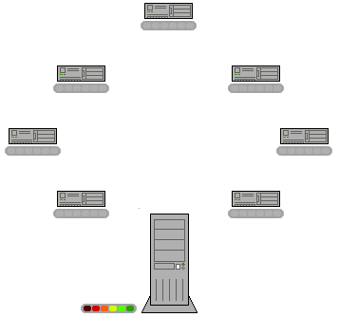


BitTorrent: Search Server
BitTorrent Search
(Server)
“ricky martin”
Client–Server

Slide 33
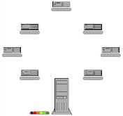
BitTorrent: Tracker
BitTorrent
Peer Tracker
(or DHT)

Slide 34
BitTorrent: File-Sharing

Slide 35
BitTorrent: Hybrid
Uploader
Downloader
Creates torrent file
Uploads torrent file
Announces on tracker
Monitors for downloaders
Connects to downloaders
Sends file parts
Searches torrent file
Downloads torrent file
Announces to tracker
Monitors for peers/seeds
Connects to peers/seeds
Sends & receives file parts
Watches illegal movie
Local / Client–Server / Structured P2P / Direct P2P
(Torrent Search Engines target of law-suits)

Slide 36
DISTRIBUTED SYSTEMS: IN THE REAL WORLD

Slide 37
Real-World Architectures: Hybrid
Often hybrid!
Architectures herein are simplified/idealised
No clear black-and-white (just good software!)
For example, BitTorrent mixes different paradigms
But good to know the paradigms

Slide 38
Physical Location: Cluster Computing
Machines (typically) in a central, local location; e.g., a local LAN in a server room

Slide 39
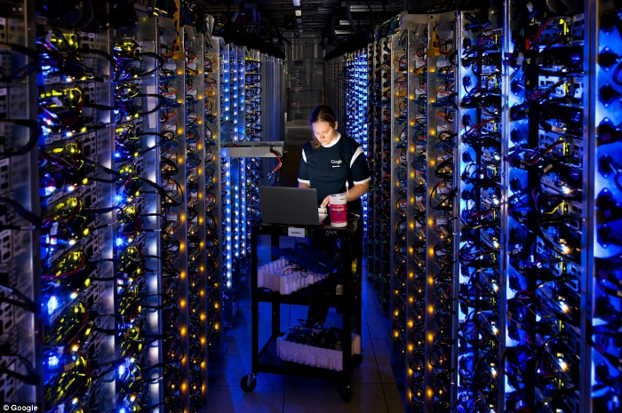
Physical Location: Cluster Computing

Slide 40


Physical Location: Cloud Computing
Machines (typically) in a central, remote location; e.g., a server farm like Amazon EC2

Slide 41
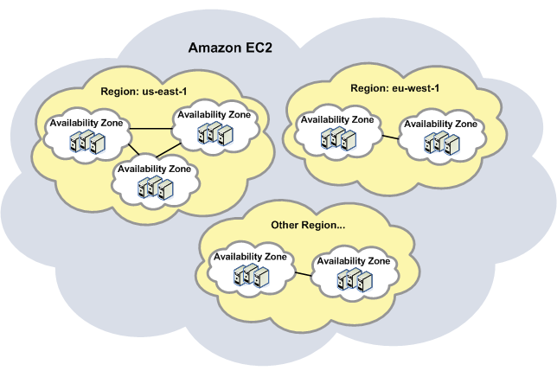
Physical Location: Cloud Computing

Slide 42
Physical Location: Grid Computing
Machines in diverse locations

Slide 43
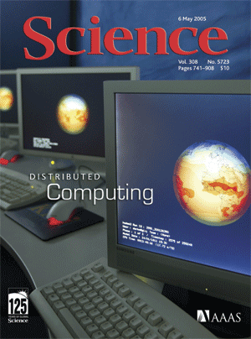
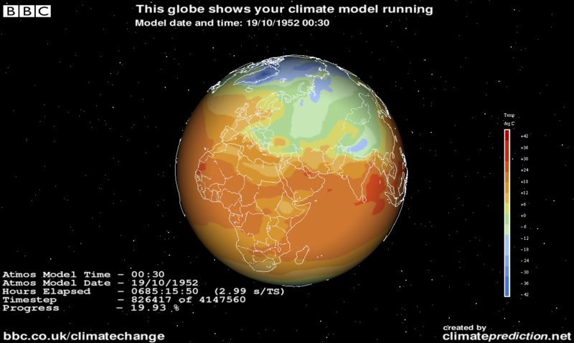
Physical Location: Grid Computing

Slide 44
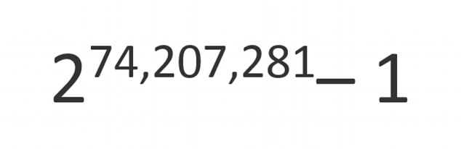
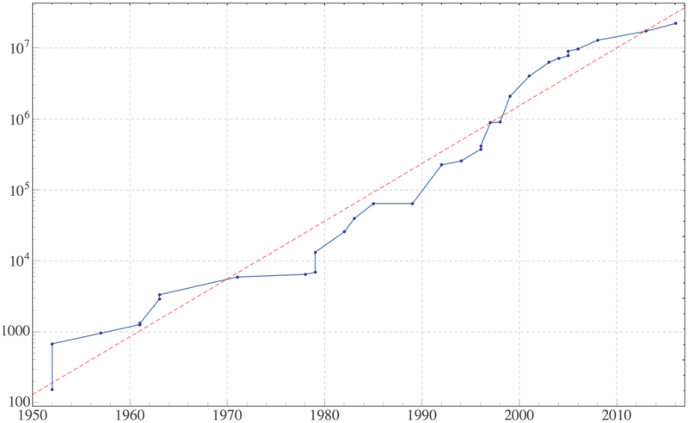
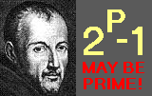

Physical Location: Grid Computing

Slide 45
Physical Locations
Cluster computing:
Typically centralised, local
Cloud computing:
Typically centralised, remote
Grid computing:
Typically decentralised, remote

Slide 46
LIMITATIONS OF DISTrIBUTED SYSTEMS: EIGHT FALLACIES

Slide 47
Eight Fallacies
By L. Peter Deutsch (1994)
James Gosling (1997)
“Essentially everyone, when they first build a distributed application, makes the following eight assumptions. All prove to be false in the long run and all cause big trouble and painful learning experiences.” — L. Peter Deutsch
Each fallacy is a false statement!

Slide 48

1. The network is reliable
Machines fail, connections fail, firewall eats messages
flexible routing
retry messages
acknowledgements!

Slide 49
2. Latency is zero
There are significant communication delays
avoid “races”
local order ≠ remote order
acknowledgements
minimise remote calls
batch data!
avoid waiting
multiple-threads
M2: Copy X from M1
M1:
Store X
M2
M1

Slide 50
3. Bandwidth is infinite
M1:
Copy X (10GB)
M1:
Copy X (10GB)
Limited in amount of data that can be transferred
avoid resending data
avoid bottlenecks
direct connections
caching!!
M2
M1

Slide 51

4. The network is secure
Network is vulnerable to hackers, eavesdropping, viruses, etc.
send sensitive data directly
isolate hacked nodes
hack one node ≠ hack all nodes
authenticate messages
secure connections
M1:
Send Medical History
M1

Slide 52

5. Topology doesn’t change
How machines are physically connected may change (“churn”)!
avoid fixed routing
next-hop routing?
abstract physical addresses
flexible content structure
M3
M2
M4
M1
Message M5 thru M2, M3, M4
M5

Slide 53
6. There is one administrator
Different machines have different policies!
Beware of firewalls!
Don’t assume most recent version
Backwards compat.

Slide 54
7. Transport cost is zero
It costs time/money to transport data: not just bandwidth
(Again)
minimise redundant data transfer
avoid shuffling data
caching
direct connection
compression?

Slide 55
8. The network is homogeneous
Devices and connections are not uniform
interoperability!
route for speed
not hops
load-balancing

Slide 56
Eight Fallacies (to avoid)
Severity of fallacies vary in different scenarios! Which fallacies apply/do not apply for:
Gigabit ethernet LAN?
BitTorrent
The Web
The network is reliable
Latency is zero
Bandwidth is infinite
The network is secure
Topology doesn’t change
There is one administrator
Transport cost is zero
The network is homogeneous

Slide 57

Discussed later: Fault Tolerance

Slide 58
LAB II PREVIEW: JAVA RMI OVERVIEW

Slide 59
Why is Java RMI Important?
We can use it to quickly build distributed systems using some standard Java skills.

Slide 60
What is Java RMI?
RMI = Remote Method Invocation
Remote Procedure Call (RPC) for Java
Predecessor of CORBA (in Java)
Stub / Skeleton model (TCP/IP)
Client
Server
Stub
Network
Skeleton

Slide 61
What is Java RMI?
Stub (Client):
Sends request to skeleton: marshalls/serialises and transfers arguments
Demarshalls/deserialises response and ends call
Skeleton (Server):
Passes call from stub onto the server implementation
Passes the response back to the stub
Client
Server
Stub
Network
Skeleton

Slide 62

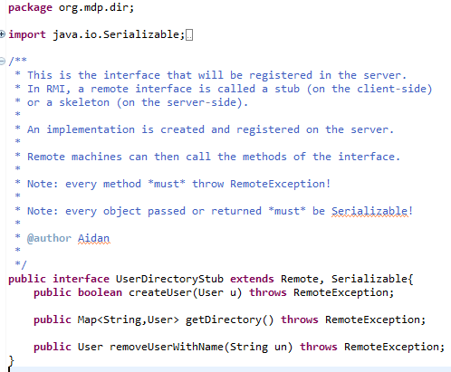
Stub/Skeleton Same Interface!
Client
Server

Slide 63
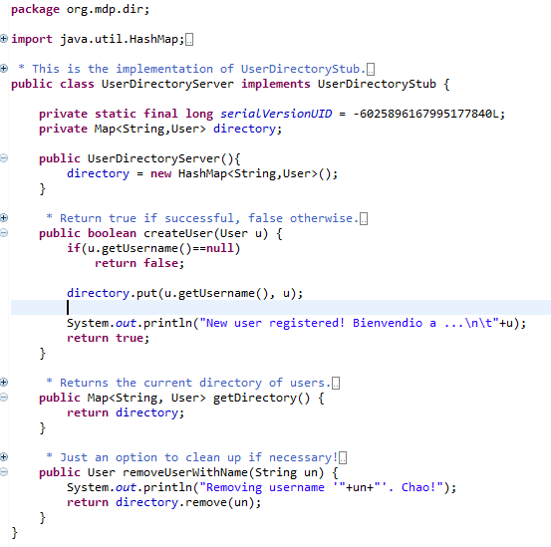
Server Implements Skeleton
Problem?
Synchronisation:
(e.g., should use ConcurrentHashMap)
[Thanks to Tomas Vera ☺]
Server

Slide 64
Server Registry
Server (typically) has a Registry: a Map
Adds skeleton implementations with key (a string)
Server
Registry
“sk3”
SkelImpl3
“sk2”
SkelImpl2
“sk1”
SkelImpl1

Slide 65
Server Creates/Connects to Registry
OR
Server

Slide 66
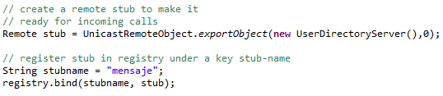
Server Registers Skeleton Implementation As a Stub
Server

Slide 67
Client Connecting to Registry
Client connects to registry (port, hostname/IP)!
Retrieves skeleton/stub with key
Server
Network
Client
“sk2”
Registry
“sk3”
SkelImpl3
“sk2”
SkelImpl2
SkelImpl2
Stub2
“sk1”
SkelImpl1

Slide 68
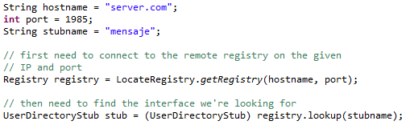
Client Connecting to Registry
Client

Slide 69
Client Calls Remote Methods
Client has stub, calls method, serialises arguments
Server does processing
Server returns answer; client deserialises result
Network
Client
Server
Stub2
concat (“a”,”b”)
SkelImpl2
“ab”

Slide 70
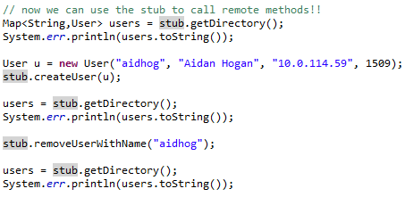
Client Calls Remote Methods
Client

Slide 71
Java RMI: Remember …
Remote calls are pass-by-value, not pass-by-reference (objects not modified directly)
Everything passed and returned must be Serialisable (implement Serializable)
Every stub/skel method must throw a remote exception (throws RemoteException)
Server implementation can only throw RemoteException

Slide 72
RECAP

Slide 73
Topics Covered (Lab)
External Merge Sorting
When it doesn’t fit in memory, use the disk!
Split data into batches
Sort batches in memory
Write batches to disk
Merge sorted batches into final output

Slide 74
Topics Covered
What is a (good) Distributed System?
Client–Server model
Fat/thin client
Mirror/proxy servers
Three-tier
Peer-to-Peer (P2P) model
Central directory
Unstructured
Structured (Hierarchical/DHT)
BitTorrent

Slide 75
Topics Covered
Physical locations:
Cluster (local, centralised) vs.
Cloud (remote, centralised) vs.
Grid (remote, decentralised)
8 fallacies
Network isn’t reliable
Latency is not zero
Bandwidth not infinite,
etc.

Slide 76
Java: Remote Method Invocation
Java RMI:
Remote Method Invocation
Stub on Client Side
Skeleton on Server Side
Registry maps names to skeletons/servers
Server registers skeleton with key
Client finds skeleton with key, casts to stub
Client calls method on stub
Server runs method and serialises result to client

Slide 77

Questions?

