Slide 1
CC5212-1 Procesamiento Masivo de Datos Otoño 2016 Lecture 3: Distributed Systems II
Aidan Hogan
aidhog@gmail.com

Slide 2
TYPES OF DISTRIBUTED SYSTEMS …

Slide 3



Client–Server Model
Client makes request to server
Server acts and responds
(For example: Email, WWW, Printing, etc.)

Slide 4



Client–Server: Three-Tier Server
Server
Data
Logic
Presentation
Add all the salaries
Create HTML page
SQL: Query
salary of all employees
HTTP GET:
Total salary
of all employees

Slide 5
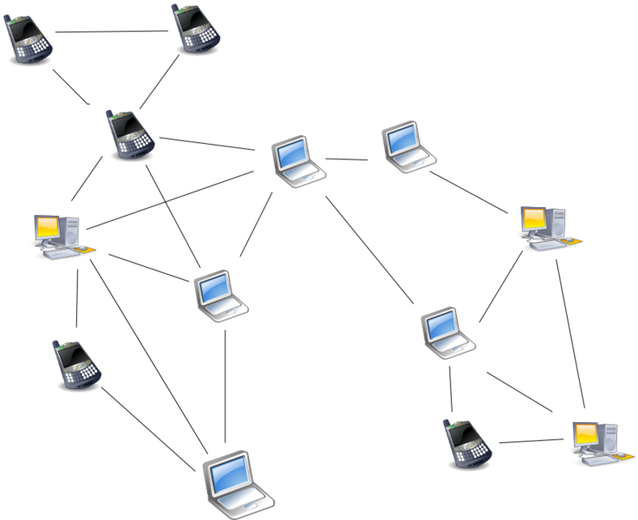

Peer-to-Peer: Unstructured
Pixie’s new album?
(For example: Kazaa, Gnutella)

Slide 6





Peer-to-Peer: Structured (DHT)
Circular DHT:
Only aware of neighbours
O(n) lookups
Implement shortcuts
Skips ahead
Enables binary-search-like behaviour
O(log(n)) lookups
111
000
001
110
010
101
011
100
Pixie’s new album? 111

Slide 7
Desirable Criteria for Distributed Systems
Transparency:
Appears as one machine
Flexibility:
Supports more machines, more applications
Reliability:
System doesn’t fail when a machine does
Performance:
Quick runtimes, quick processing
Scalability:
Handles more machines/data efficiently

Slide 8
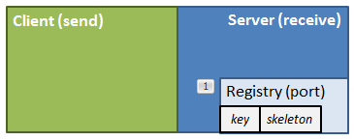
Java RMI in the lab …
172.17.69.XXX
Directory
172.17.69.YYY
localhost
Client (send)
Server (receive)
Registry (port)
key
skeleton

Slide 9
Eight Fallacies (to avoid)
The network is reliable
Latency is zero
Bandwidth is infinite
The network is secure
Topology doesn’t change
There is one administrator
Transport cost is zero
The network is homogeneous
What about the system we built in the lab?

Slide 10
Let’s think about lab 3

Slide 11
Using Java RMI to count trigrams …
172.17.69.XXX
Directory
172.17.69.YYY
localhost
Client (send)
Server (receive)
Registry (port)
key
skeleton

Slide 12
LIMITATIONS OF DISTRIBUTED COMPUTING: CAP THEOREM

Slide 13
But first … ACID
Have you heard of ACID guarantees in a database class?
For traditional (non-distributed) databases …
Atomicity:
Transactions all or nothing: fail cleanly
Consistency:
Doesn’t break constraints/rules
Isolation:
Parallel transactions act as if sequential
Durability
System remembers changes

Slide 14
What is CAP?
Three guarantees a distributed sys. could make
Consistency:
All nodes have a consistent view of the system
Availability:
Every read/write is acted upon
Partition-tolerance:
The system works even if messages are lost

Slide 15


A Distributed System (Replication)
F–J
K–S
A–E
T–Z
T–Z
A–E
F–J
K–S

Slide 16
Consistency
F–J
K–S
A–E
T–Z
There’s 891 users in ‘M’
There’s 891 users in ‘M’
T–Z
A–E
F–J
K–S

Slide 17

Availability
891
F–J
K–S
A–E
T–Z
T–Z
A–E
F–J
K–S
How many users start with ‘M’

Slide 18

Partition-Tolerance
891
F–J
K–S
A–E
T–Z
T–Z
A–E
F–J
K–S
How many users start with ‘M’

Slide 19
The CAP Question
Can a distributed system guarantee consistency (all nodes have the same up-to-date view), availability (every read/write is acted upon) and partition-tolerance (the system works even if messages are lost) at the same time?
What do you think?

Slide 20

The CAP Answer

Slide 21

The CAP “Proof”
891
There’s 891 users in ‘M’
F–J
K–S
A–E
T–Z
T–Z
A–E
F–J
There’s 892 users in ‘M’
K–S
There’s 891 users in ‘M’
How many users start with ‘M’

Slide 22
The CAP “Proof” (in boring words)
Consider machines m₁ and m₂ on either side of a partition:
If an update is allowed on m₂ (Availability), then m₁ cannot see the change: (loses Consistency)
To make sure that m₁ and m₂ have the same, up-to-date view (Consistency), neither m₁ nor m₂ can accept any requests/updates (lose Availability)
Thus, only when m₁ and m₂ can communicate (lose Partition tolerance) can Availability and Consistency be guaranteed

Slide 23
The CAP Theorem
A distributed system cannot guarantee consistency (all nodes have the same up-to-date view), availability (every read/write is acted upon) and partition-tolerance (the system works even if messages are lost) at the same time.
(“Proof” as shown on previous slide ☺)

Slide 24
The CAP Triangle
C
Choose
Two
A
P

Slide 25
CAP Systems
CA: Guarantees to give a correct response but only while network works fine
(Centralised / Traditional)
CP: Guarantees responses are correct even if there are network failures, but response may fail (Weak availability)
C
A
P
(No intersection)
AP: Always provides a “best-effort” response even in presence of network failures (Eventual consistency)

Slide 26
CA System
892
There’s 891 users in ‘M’
There’s 892 users in ‘M’
F–J
K–S
A–E
T–Z
T–Z
A–E
F–J
There’s 892 users in ‘M’
K–S
There’s 891 users in ‘M’
How many users start with ‘M’

Slide 27
CP System
891
There’s 891 users in ‘M’
F–J
K–S
A–E
T–Z
T–Z
A–E
F–J
K–S
There’s 891 users in ‘M’
How many users start with ‘M’

Slide 28
AP System
891
There’s 891 users in ‘M’
F–J
K–S
A–E
T–Z
T–Z
A–E
F–J
There’s 892 users in ‘M’
K–S
There’s 891 users in ‘M’
How many users start with ‘M’

Slide 29
BASE (AP)
In what way was Twitter operating under BASE-like conditions?
Basically Available
Pretty much always “up”
Soft State
Replicated, cached data
Eventual Consistency
Stale data tolerated, for a while

Slide 30
The CAP Theorem
C,A in CAP ≠ C,A in ACID
Simplified model
Partitions are rare
Systems may be a mix of CA/CP/AP
C/A/P often continuous in reality!
But concept useful/frequently discussed:
How to handle Partitions?
Availability? or
Consistency?

Slide 31
consensus

Slide 32
Consensus
Goal: Build a reliable distributed system from unreliable components
“stable replica” semantics: distributed system as a whole acts as if it were a single functioning machine
Core feature: the system, as a whole, is able to agree on values (consensus)
Value may be:
Client inputs
What to store, what to process, what to return
Order of execution
Internal organisation (e.g., who is leader)
…

Slide 33
Consensus
There’s 891 users in ‘M’
F–J
K–S
A–E
T–Z
T–Z
A–E
F–J
K–S
Under what conditions is consensus (im)possible?

Slide 34
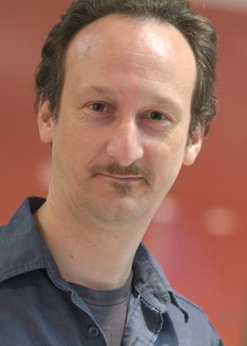


Lunch Problem
10:30AM. Alice, Bob and Chris work in the same city. All three have agreed to go downtown for lunch today but have yet to decide on a place and a time.
Bob
Alice
Chris

Slide 35
CAP Systems (for example …)
CA: They are guaranteed to go to the same place for lunch as long as each of them can be reached in time.
CP: If someone cannot be reached in time, they either all go to the same place for lunch or nobody goes for lunch.
C
A
P
(No intersection)
AP: If someone cannot be reached in time, they all go for lunch downtown but might not end up at the same place.
But how easily they can reach consensus depends on how they communicate!

Slide 36
SYNCHRONOUS vs. Asynchronous

Slide 37
Synchronous vs. Asynchronous
Synchronous distributed system:
Messages expected by a given time
E.g., a clock tick
Missing message has meaning
Asynchronous distributed system:
Messages can arrive at any time
Missing message could arrive any time!

Slide 38

Asynchronous Consensus: Texting
10:45 AM. Alice tries to invite Bob for lunch …
Hey Bob,
Want to go downtown to McDonald’s for lunch at 12:00AM?
11:35 AM. No response. Should Alice head downtown?

Slide 39
Asynchronous Consensus: Texting
10:45 AM. Alice tries to invite Bob for lunch …
Hey Bob,
Want to go downtown to McDonald’s for lunch at 12:00AM?
Hmm … I don’t like McDonald’s much. How about Dominos instead?
11:42 AM. No response. Where should Bob go?

Slide 40
Asynchronous Consensus: Texting
10:45 AM. Alice tries to invite Bob for lunch …
Hey Bob,
Want to go downtown to McDonald’s for lunch at 12:00AM?
Hmm … I don’t like McDonald’s much. How about Dominos instead?
Okay, let’s go to Dominos.
11:38 AM. No response. Did Bob see the acknowledgement?

Slide 41
Asynchronous Consensus
Impossible to guarantee!
A message delay can happen at any time and a node can wake up at the wrong time!
Fischer-Lynch-Patterson (1985): No consensus can be guaranteed amongst working nodes if there is even a single failure
But asynchronous consensus can happen
As you should realise if you’ve ever successfully organised a meeting by email or text ;)

Slide 42
Asynchronous Consensus: Texting
10:45 AM. Alice tries to invite Bob for lunch …
Hey Bob,
Want to go downtown to McDonald’s for lunch at 12:00AM?
Hmm … I don’t like McDonald’s much. How about Dominos instead?
Okay, let’s go to Dominos.
11:38 AM. No response. Bob’s battery died. Alice misses the train downtown waiting for message, heads to the cafeteria at work instead. Bob charges his phone …
Heading to Dominos now. See you there!

Slide 43
Asynchronous Consensus: Texting
How could Alice and Bob find consensus on a time and place to meet for lunch?

Slide 44

Synchronous Consensus: Telephone
10:45 AM. Alice tries to invite Bob for lunch …
Hey Bob,
Want to go downtown to McDonald’s for lunch at 12:00AM?
How about a completo at Domino’s instead?
Okay. 12:00AM?
Yep!
See you then!
10:46 AM. Clear consensus!

Slide 45
Synchronous Consensus
Can be guaranteed!
But only under certain conditions …
What is the core difference between reaching consensus in synchronous (texting or email) vs. asynchronous (phone call) scenarios?

Slide 46
Synchronous Consensus: Telephone
10:45 AM. Alice tries to invite Bob for lunch …
Hey Bob,
Want to go downtown to McDonald’s for lunch at 12:00AM?
How about a completo
beep, beep, beep
Hello?
10:46 AM. What’s the protocol?

Slide 47
From asynchronous to synchronous
Agree on a timeout Δ
Any message not received within Δ = failure
If a message arrives after Δ, system returns to being asynchonous
If Δ is unbounded, the system is asynchronous
May need a large value for Δ in practice
How could we (in some cases) turn an asynchronous system into a synchronous system?

Slide 48
Eventually synchronous
Eventually synchronous: Assumes most messages will return within time Δ
More precisely, the number of messages that do not return in Δ is bounded
We don’t need to set Δ so high
True in many practical systems
If a message does not return in time Δ, if we keep retrying, eventually it will return in time Δ
Why might consensus be easier in an eventually synchronous system?

Slide 49
FAULT TOLERANCE: FAIL–STOP VS. BYZANTINE

Slide 50
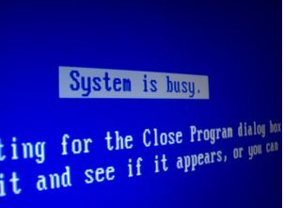

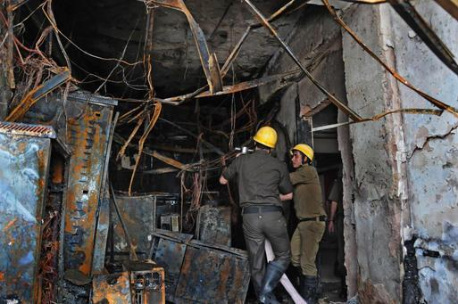
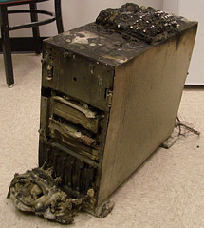
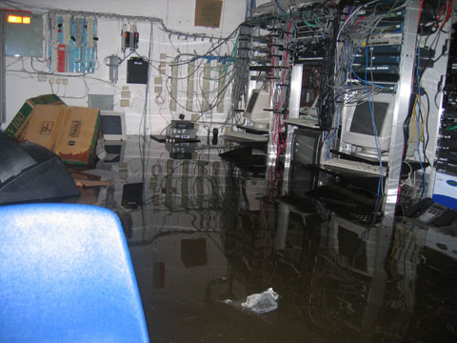
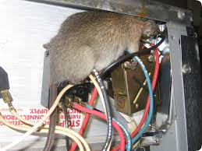
Faults

Slide 51



Fail–Stop Fault
A machine fails to respond or times-out (often hardware or load)
Need at least f+1 replicated machines? (beware asynch.!)
f = number of clean failures
Word
Count
de 4.575.144
la 2.160.185
en 2.073.216
el 1.844.613
y 1.479.936
…

Slide 52
Byzantine Fault
A machine responds incorrectly/maliciously (often software)
Need at least 2f+1 replicated machines?
f = number of (possibly Byzantine) failures
How many replicated machines do we need to guarantee tolerance to f Byzantine faults?
?
Word
Count
el 4.575.144
po 2.160.185
sé 2.073.216
ni 1.844.613
al 1.479.936
…
de 4.575.144
la 2.160.185
en 2.073.216
el 1.844.613
y 1.479.936
…
de 4.575.144
la 2.160.185
en 2.073.216
el 1.844.613
y 1.479.936
…

Slide 53
Fail–Stop/Byzantine
Naively:
Need f+1 replicated machines for fail–stop
Need 2f+1 replicated machines for Byzantine
Not so simple if nodes must agree beforehand!
Replicas must have consensus to be useful!

Slide 54
CONsensus guarantees

Slide 55
Consensus Guarantees
Under certain assumptions; for example
synchronous, eventually synchoronous, asynchronous
fail-stop, byzantine
no failures, one node fails, less than half fail
… there are methods to provide consensus with certain guarantees

Slide 56
A Consensus Protocol
Agreement/Consistency [Safety]: All working nodes agree on the same value. Anything agreed is final!
Validity/Integrity [Safety]: Every working node decides at most one value. That value has been proposed by a working node.
Termination [Liveness]: All working nodes eventually decide (after finite steps).
Safety: Nothing bad ever happens
Liveness: Something good eventually happens

Slide 57
A Consensus Protocol for Lunch
Agreement/Consistency [Safety]: Everyone agrees on the same place downtown for lunch, or agrees not to go downtown.
Validity/Integrity [Safety]: Agreement involves a place someone actually wants to go.
Termination [Liveness]: A decision will eventually be reached (hopefully before lunch).

Slide 58
CONSENSUS PROTOCOL: TWO-PHASE COMMIT

Slide 59
Two-Phase Commit (2PC)
Coordinator & cohort members
Goal: Either all cohorts commit to the same value or no cohort commits to anything
Assumes synchronous, fail-stop behaviour
Crashes are known!

Slide 60



Two-Phase Commit (2PC)
Voting:
I propose McDonalds!
Is that okay?
Yes!
Yes!

Slide 61
Two-Phase Commit (2PC)
2. Commit:
I have two yeses!
Please commit.
Committed!
Committed!

Slide 62
Two-Phase Commit (2PC) [Abort]
Voting:
I propose McDonalds!
Is that okay?
No!
Yes!

Slide 63
Two-Phase Commit (2PC) [Abort]
2. Commit:
I don’t have two yeses!
Please abort.
Aborted!
Aborted!

Slide 64
Two-Phase Commit (2PC)
Voting: A coordinator proposes a commit value. The other nodes vote “yes” or “no” (they cannot propose a new value!).
Commit: The coordinator counts the votes. If all are “yes”, the coordinator tells the nodes to accept (commit) the answer. If one is “no”, the coordinator aborts the commit.
For n nodes, in the order of 4n messages.
2n messages to propose value and receive votes
2n messages to request commit and receive acks

Slide 65
Two-Phase Commit (2PC)
What happens if the coordinator fails?
Cohort members know coordinator has failed!
I have two yeses!
Please commit.
Commit!
Committed!
Did you commit or abort?

Slide 66

Two-Phase Commit (2PC)
What happens if a coordinator and a cohort fail?
Not fault-tolerant!
I have two yeses!
Please commit!
Did the other cohort commit or abort?
Committed!

Slide 67

Two-Phase Commit (2PC)
What happens if there’s a partition?
Not fault-tolerant!
I have two yeses!
Please commit!
Should I commit or abort?
Committed!

Slide 68
CONSENSUS PROTOCOL: THREE-PHASE COMMIT

Slide 69
Three-Phase Commit (3PC)
Voting:
I propose McDonalds!
Is that okay?
Yes!
Yes!

Slide 70
Three-Phase Commit (3PC)
2. Prepare:
I have two yeses!
Prepare to commit.
Prepared to commit!
Prepared to commit!

Slide 71
Three-Phase Commit (3PC)
3. Commit:
Everyone is prepared.
Please commit.
Committed!
Committed!

Slide 72
Three-Phase Commit (3PC)
Voting: (As before for 2PC)
Prepare: If all votes agree, coordinator sends and receives acknowledgements for a “prepare to commit” message
Commit: If all acknowledgements are received, coordinator sends “commit” message
For n nodes, in the order of 6n messages.
4n messages as for 2PC
+2n messages for “prepare to commit”+ “ack.”

Slide 73
Three-Phase Commit (3PC)
What happens if the coordinator fails?
Everyone is prepared. Please commit!
Yes!
Is everyone else prepared to commit?
Prepared to commit!
Prepared to commit!
Okay!
Committing!
Okay!
Committing!

Slide 74
Three-Phase Commit (3PC)
What happens if coordinator and a cohort member fail?
Rest of cohort know if abort/commit!
It’s a commit!
Prepared to commit!
Prepared to commit!
Okay!
Committing!

Slide 75
Two-Phase vs. Three Phase
In 2PC, in case of failure, one cohort may already have committed/aborted while another cohort doesn’t even know if the decision is commit or abort!
In 3PC, this is not the case!
Did you spot the difference?

Slide 76
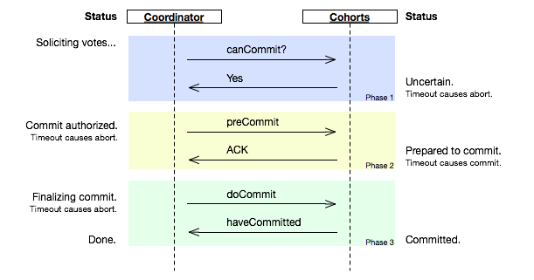
3PC useful to avoid locking

Slide 77
Two/Three Phase Commits
Assumes synchronous behaviour!
Assumes knowledge of failures!
Cannot be guaranteed if there’s a network partition!
Assumes fail–stop errors

Slide 78

How to decide the leader?
We need a leader for consensus … so what if we need consensus for a leader?

Slide 79
CONSENSUS PROTOCOL: PAXOS

Slide 80
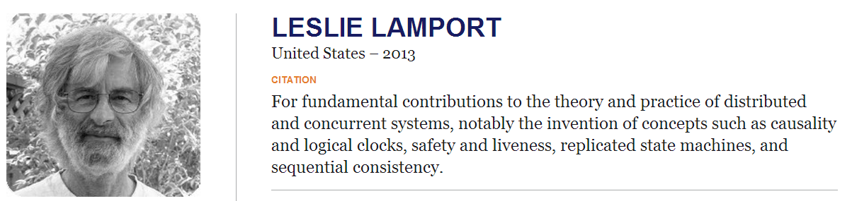
Turing Award: Leslie Lamport
One of his contributions: PAXOS

Slide 81
PAXOS Phase 1a: Prepare
A coordinator proposes with a number n
I wish to lead a proposal! (72)
72

Slide 82
PAXOS Phase 1b: Promise
By saying “okay”, a cohort agrees to reject lower numbers
I wish to lead a proposal! (72)
72
Sorry! 72>23!
I wish to lead a proposal! (23)
Okay (72)! I accept and will reject proposals below 72.
72
72

Slide 83

PAXOS Phase 1a/b: Prepare/Promise
This continues until a majority agree and a leader for the round is chosen …
I wish to lead a proposal! (72)
72
Okay (72)! I accept and will reject proposals below 72.
Okay (72)! I accept and will reject proposals below 72.
72
72

Slide 84
PAXOS Phase 2a: Accept Request
The leader must now propose the value to be voted on this round …
McDonalds? (72)
72
72
72

Slide 85
PAXOS Phase 2b: Accepted
Nodes will accept if they haven’t seen a higher request and acknowledge …
McDonalds? (72)
72
Okay (72)
Okay (72)!
72
72

Slide 86
PAXOS Phase 3: Commit
If a majority pass the proposal, the leader tells the cohort members to commit …
Commit!
72
72
72

Slide 87
PAXOS Round
Leader proposes
Wait for majority
Wait for majority
I’ll lead
with id n?
Okay: n is highest we’ve seen
I propose
“v” with n
Okay “v” sounds good
We’re agreed on “v”
1A:
Prepare
1B:
Promise
2A:
Accept
Request
2B:
Accepted
3A:
Commit

Slide 88
PAXOS: No Agreement?
If a majority cannot be reached, a new proposal is made with a higher number (by another member)

Slide 89
PAXOS: Failure Handling
Leader is fluid: based on highest ID the members have stored
If Leader were fixed, PAXOS would be like 2PC
Leader fails?
Another leader proposes with higher ID
Leader fails and recovers (asynchronous)?
Old leader superseded by new higher ID
Partition?
Requires majority / when partition is lifted, members must agree on higher ID

Slide 90
PAXOS: Guarantees
Validity/Integrity:
(assumes fail-stop errors)
Value proposed by a leader
Agreement/Consistency
(assumes fewer than half encounter errors and that all errors are fail-stop)
A value needs a majority to pass
Each member can only choose one value
Therefore only one agreed value can have a majority in the system!

Slide 91
PAXOS Guarantees:
Termination/Liveness:
(only if at least eventually synchronous)
Apply PAXOS in rounds based on the timeout Δ
If messages exceed Δ, retry in later round

Slide 92
PAXOS variations
Some steps in classical PAXOS not always needed; variants have been proposed:
Cheap PAXOS / Fast PAXOS / Byzantine PAXOS …

Slide 93

PAXOS In-Use
Chubby: “Paxos Made Simple”

Slide 94
RECAP

Slide 95
CAP Systems
CA: Guarantees to give a correct response but only while network works fine
(Centralised / Traditional)
CP: Guarantees responses are correct even if there are network failures, but response may fail (Weak availability)
C
A
P
(No intersection)
AP: Always provides a “best-effort” response even in presence of network failures (Eventual consistency)

Slide 96
Consensus for CP-systems
Synchronous vs. Asynchronous
Synchronous less difficult than asynchronous
Fail–stop vs. Byzantine
Byzantine typically software (arbitrary response)
Fail–stop gives no response

Slide 97
Consensus for CP-systems
Two-Phase Commit (2PC)
Voting
Commit
Three-Phase Commit (3PC)
Voting
Prepare
Commit

Slide 98
Consensus for CP-systems
PAXOS:
1a. Prepare
1b. Promise
2a. Accept Request
2b. Accepted
3. Commit

Slide 99

Questions?

