Slide 1

AuTOMATED REAL TIMEHOSPITAL PATIENT DATA ANALYTICS PLATFORM
University of New Haven – Tagliatela College of Engineering
DSCI 6007-03
Distributed & Scalable Data Engineering

Slide 2



MEET Our team
Vittu Ramadasu Darshan
Sirisha Gajula
Kishan Sai Saguturu
Cloud Solutions Architect
Data Engineering Specialist
Business Intelligence Developer

Slide 3
BUSINESS OVERVIEW
Problem:
Manual hospital data handling is slow and inefficient
Lack of real-time operational insights
Opportunity:
Real-time, automated data-driven hospital management
Smarter decisions, faster responses, better care

Slide 4

SOLUTION OVERVIEW
High-Level Description:
Real-time hospital data simulation using AWS Lambda
Data streaming via Kinesis Firehose into S3 data lake
Automated ETL with AWS Glue and serverless SQL querying using Athena
Daily reports and interactive dashboards via QuickSight
Design Considerations:
Serverless architecture to reduce cost and maintenance
Automation-first approach with EventBridge scheduling
Scalable to handle high patient data volumes
Free Tier usage to minimize expenses
Use Cases:
Daily monitoring of patient inflow and hospital load
Financial risk analysis based on payment methods
Emergency case management tracking
Resource (beds, departments) utilization optimization

Slide 5
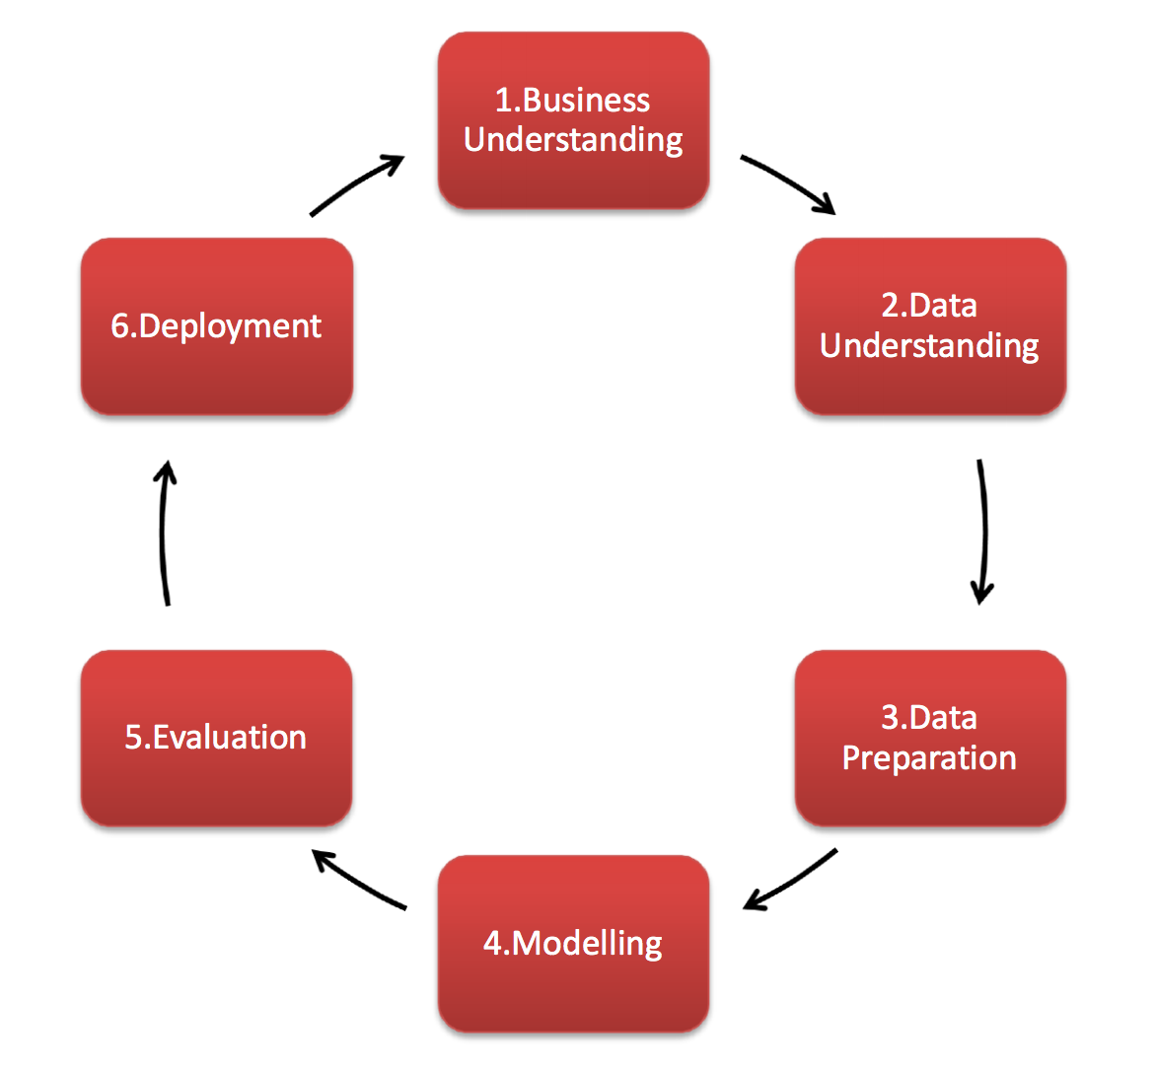
CRISP-DM DIAGRAM

Slide 6
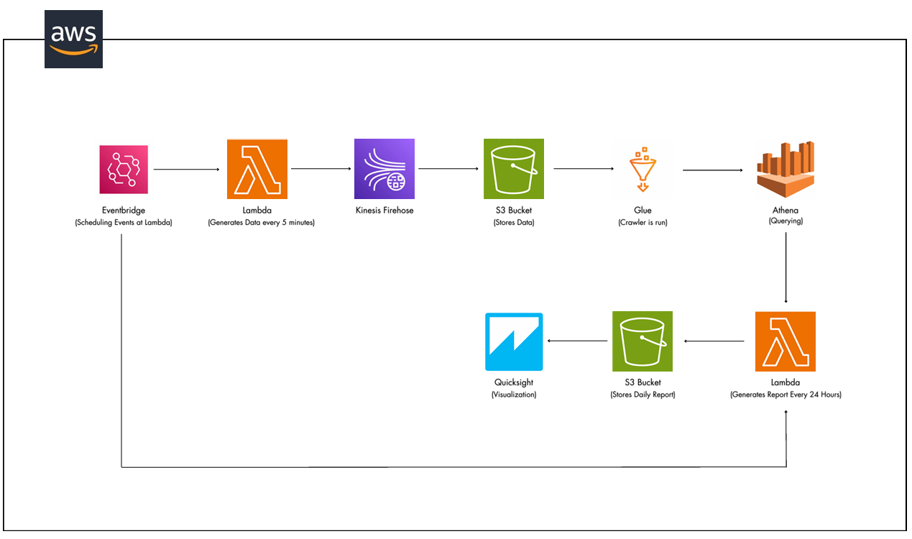
PROJECT ROADMAP

Slide 7







TOOLS & TECHNOLOGIES

Slide 8
LESSONS LEARNED
Challenges Overcome:
Managing Lambda timeouts during large data batch generation
Handling IAM permissions for Lambda to Firehose and Athena access
Refreshing QuickSight datasets dynamically for updated dashboards
Helpful Resources:
AWS Documentation for Lambda, Firehose, Glue, and Athena
AWS Developer Forums for troubleshooting permissions and timeout issues
YouTube tutorials and AWS official blogs on serverless data pipelines

Slide 9
PROJECT DEMO

Slide 10


