Slide 1
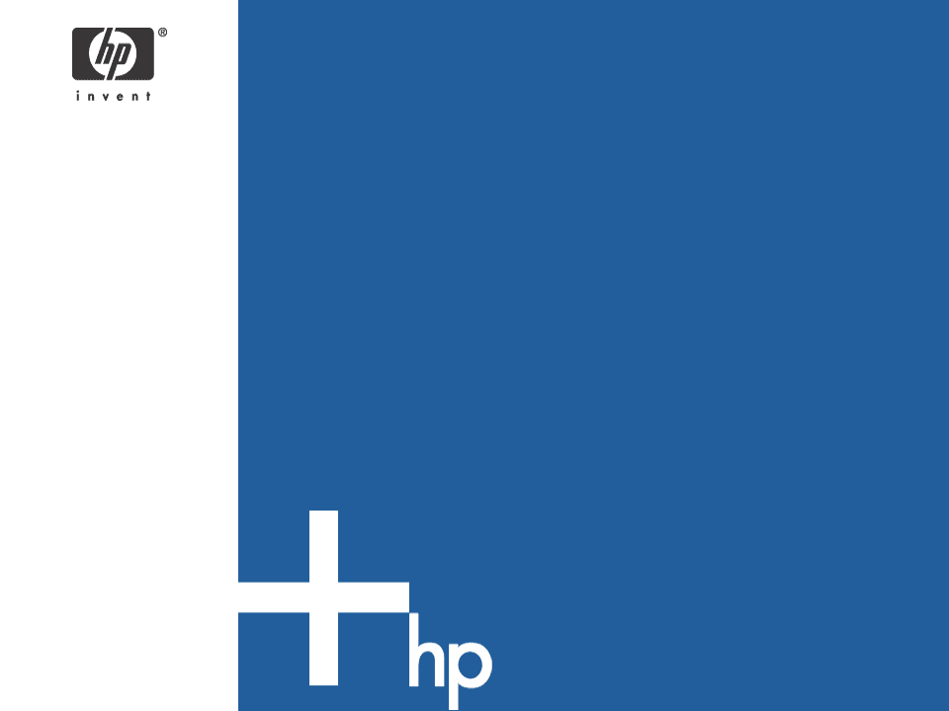
model driven architecture
Dr. R. Chandrashekar
Hewlett-Packard

Slide 2
Contents
Software Models
About mda
About MDA
Challenges
The Future
Disclaimer
The contents of the presentation reflect the author’s personal opinion on the subject and does not necessarily reflect the stand of Hewlett-Packard

Slide 3
Modeling
Modeling is the process of abstracting reality
  Example: Data Modeling
Modeling is imperative to tackle large problems as the real problem may be too large to comprehend in its entirety
Visual Modeling is the process abstracting reality in the form of pictures
  Example: ER Diagrams

Slide 4
Modeling in Real-World
Street Maps
Building Plans
Machine Drawings
Financial Projections

Slide 5
Models in Software
Analysis Models
  Example: Data Flow Diagrams
Design Models
  Example: Structure Charts, State Diagrams
Execution Models
  Call graphs, coverage analysis, performance charts
Infrastructure Models
  Example: Network diagrams

Slide 6
And then came OO modeling!
The Object Oriented Paradigm
OO modeling advocates the use of objects, classes, methods and messages to model an entire system
Popular OO Modeling Notations
  Booch Method
  OMT (Object Modeling Technique)
  UML

Slide 7
Unified Modeling Language
UML is a visual modeling language
The ‘language’ is comprised of visual icons to assist in various aspects of software modeling
UML basically covers the entire lifecycle of software development:
  Requirements (Use case modeling)
  Analysis (Class diagrams, etc.)
  Design (Sequence diagrams, etc.)
  Implementation (Component and Deployment diagrams)

Slide 8
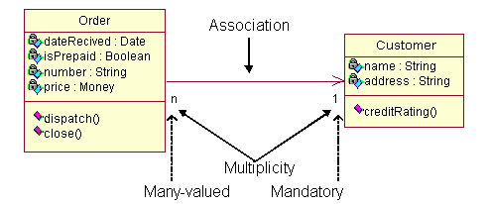
Example UML Class Diagram
Source: http://pigseye.kennesaw.edu/~dbraun/csis4650/A&D/UML_tutorial/class.htm

Slide 9
model driven architecture – “mda”
A paradigm shift from the traditional emphasis on coding to that of modeling
Spend more time on modeling and relatively less time on coding
Architectural decisions are expressed in models as opposed to being expressed in code
To change the architecture, change the model instead of changing the code (only)

Slide 10
Benefits
Improvement in productivity
Greater emphasis on “Design-first” approach enhances the software product quality
Improved consistency and maintainability
Increased portability

Slide 11
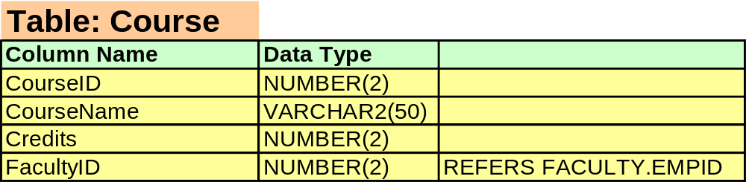
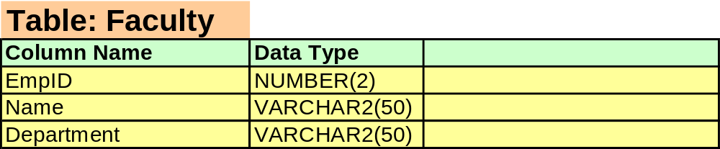
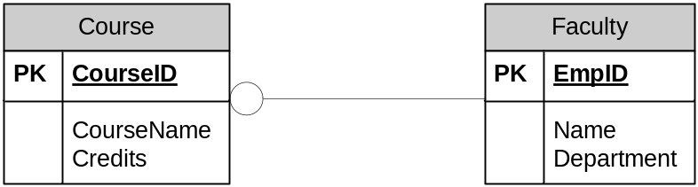
An example
Functionality: A course is taught by on faculty member
Code View
Model View

Slide 12
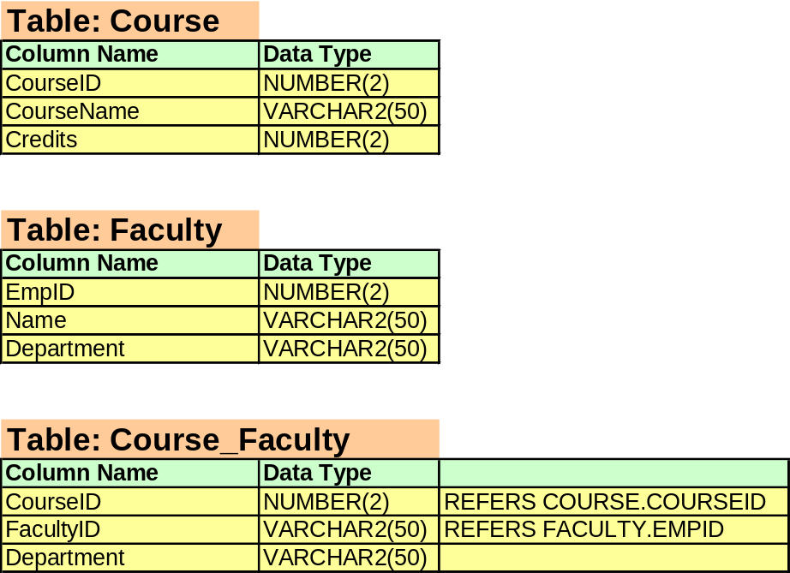

Changed Functionality: A course is taught by more than one faculty member
Review Benefits

Slide 13
Model Driven Architecture® - MDA
MDA® is an OMG-driven standardization effort for model driven architecture
MDA is actively driven by the vendor community comprised of nearly 50 members
Though MDA is vendor-driven, the outcome of the standardization is vendor-neutral
Key MDA Standards
  UML
  Meta-object Facility (MOF)
  XML Meta-Data Interchange (XMI)
  Common Warehouse Meta-model (CWM)

Slide 14
The MDA Paradigm
Computation-Independent Model is created by Business Analysts to document business needs
CIM

Slide 15
The MDA Paradigm
CIM
Computation Independent Model
Platform-Independent Model
Design without being limited by technology
Defined using UML
PIM

Slide 16
The MDA Paradigm
CIM
Computation Independent Model
PIM
Platform Independent Model
Platform-Specific Model
Map it to J2EE or .Net or CORBA or …..
PSM

Slide 17
The MDA Paradigm
CIM
Computation Independent Model
PIM
Platform Independent Model
PSM
Platform Specific Model
Technology-specific code model (java, VB.Net, C++….)
Code

Slide 18
MDA Benefits
All “mda” benefits
Technology-neutral solutions can be developed
Relatively easy to keep up with changing technology standards – the vendors will have to do that
Ultimate goal: “Model-once Run Anywhere” – MORA!

Slide 19
Challenges
MDA-driven development is a major paradigm shift
Industry is still going through the adoption stage
Requires very very strong tool support and they are still evolving
Requires management buy-in (tool investment, training, etc.)

Slide 20
The Future (we hope….)
Software Models for sale!
Seamless Cross-platform product development
Reduced vendor lock-in

Slide 21
Summary
Model-based software development is growing in importance for large / complex projects
UML is one of the most popular modeling languages
Model Driven Architecture is a standardization initiative from OMG for model-based software development

Slide 22
Questions?
?

Slide 23
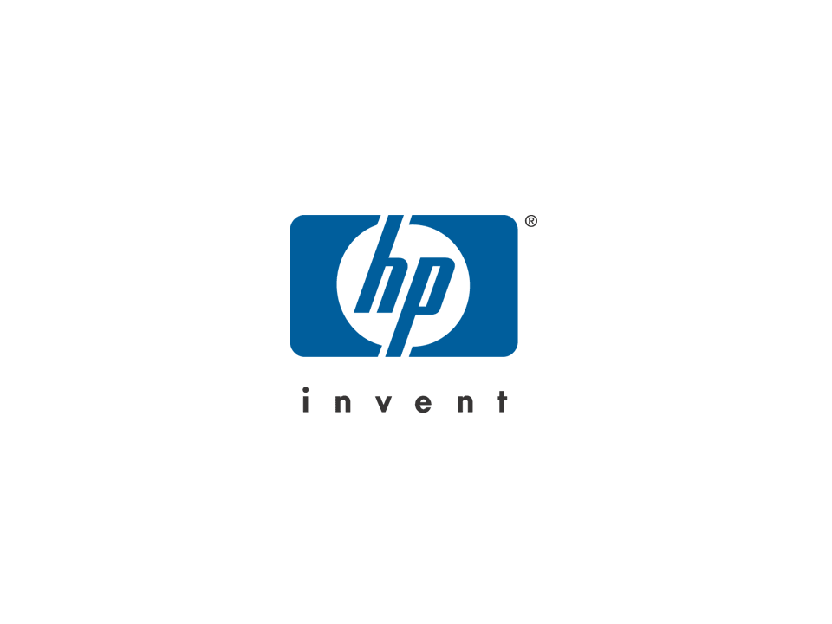
HP logo

