Slide 1
Project Overview
The Time Sheet Management System
(TSM)
Company: Gestalt Technology Services
Team: Venkat , Vishnu, Sreenivasulu, Sadanandam

Slide 2
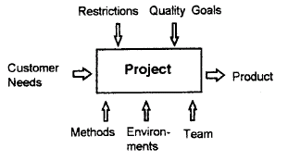
Project Goals
“Any sort of work that is done by the collective effort of a group of people forming a community for a final product may be termed as a Project”.
For the effective working and getting the accurate output out of the work scheduling plays a vital role of importance. It is not only scheduling but effective tracking up of Project as per the schedule is much more important.
And not the least the work force is an important aspect is well. Therefore allotment of work for the right person suitable for the job is of high priority
For example allotment of a module that should be coded in C language is good provided is assigned to a C expert rather than to a Java expert.

Slide 3
Continued…..
For the successful completion of a Project management plays a
crucial role.
One among several tools available is ProMis developed by GTS
and delivered it to an U.S. based firm for an sum of 80,000 $ U.S.
Our project TSM System is a module of ProMis inheriting the subset
of functionalities of ProMis.

Slide 4
ProMis
ProMis (Project Management Information System) is a powerful enterprise wide project-monitoring tool. It helps organization in monitoring and managing multiple projects simultaneously
ProMis is an integrated, comprehensive system that is tuned for execution of large structural detailing projects that are characterized by passing through a number of sequential stages. It can be customized to suit the user’s requirements
ProMis helps in monitoring production and quality and ensures strong Control on production cost. ProMis can be interfaced with the HR and Payroll system, Finance system, purchases Management system

Slide 5
Time Sheet Management System
Time Sheet management System (TSM) is a module of the Project Management System. TSM system focuses on the management of proper flow of work as per time and the successful completion of the project with in the estimated time. The users of this management system are from various authentication levels right from project manager to developers. So many features of the system are inactive to some users basing on their authentication levels.
The TSM system starts with a login screen querying for username and password. And basing upon the user logged on, the system will respond with appropriate menu items active and some inactive. The system should provide this user privilege and basing on the user master table contents. The system should provide the flexibility in changing the password of a particular user.

Slide 6
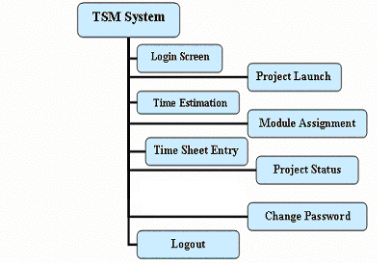
Architecture of the TSM System

Slide 7
Users of TSM System
Project Managers
Project Leaders
Developers

Slide 8
Constraints
1. The Authentication level for the user is a must and basing on which the system should react with corresponding Access privileges.
2. If the authentication level of user is either Project Manager or Project Leader then that particular user should be provided with necessary privileges such as facility to launch the new Project or modify the existing Project basing on the new revision, Time estimate the newly launched project under divide and rule policy i.e., estimating the various modules of the project and their assignment to the work force, As the estimated things are to be assigned in real time the respective modules are assigned to the work force in reality down here and the effective tracking of the project is done only on viewing its current status in this part of the system, facility to add new shifts and facility to change password are the facilities to be provided to the user with this particular authentication.
3. If the authentication level of the user is Developer then that particular user should be provided with necessary privileges such as Entry into the Time Sheet where the user should enter his working hours and the current status of the assigned module i.e., either WIP (Work In Progress) or COMPLETED and the change password utility should be provided along with the above mentioned access privilege.

Slide 9
Continued…..
4. More then one module can be assigned to a particular developer.
5. If the status of a particular module is set as COMPLETED then the corresponding module status in
the module assignment should be set as COMPLETED.
6. If a particular module is COMPLETED by a developer then in the next entry he should not be
provided with any information regarding the module. But, can be provided with the status report of
various other modules assigned to him.
7. Basing on the user logged on the Login Screen should dispose to main window with corresponding
Menus enabled.
8. For launching the new project, time estimation of project, modular assignment of project the
corresponding Buttons should be provided so that they should display the existing items. And some
should provide the flexibility to add new items this is only for users other than developers.

Slide 10
Continued…..
9. As specified above about the child frames that should appear providing information of already
existing items, the situations where we need this are as specified below.
In Launching of Project this is highly needed such as displaying the
  Project internal number and Project initiation date
  Revision number and Revision initiation date.
  Project type and description. And Flexibility to add new ones with save feature.
  Project Manager ID and Name.
  Project Leader ID and Name.
  Classification Type and its description. And Flexibility to add new ones with save feature
  Customer ID, Customer Name, Customer Project ID, Customer Project Name and Order
  Date. And Flexibility to add new ones with save feature.

Slide 11
Continued…..
    In Time Estimation of the Project this is needed as specified below
Project internal number and Project initiation date.
Revision number and Revision initiation date.
In Module Assignment of the Project this is even needed as specified below
  Project internal number and Project initiation date.
  Revision number and Revision initiation date.
The only work that the non developers has with the time sheet entry is adding a new shift to the
existing. Shifts available and add to it with save feature.
The above mentioned three are for the user other than Developers and the next one specified is for developers
In Time Sheet Entry the developer needs the information regarding the existing shifts available
  Selection of a project with corresponding revision number is to be displayed.

Slide 12
Screen shots
Login Window
Main Window
Project Launch Frame
* Common Double Frame
* CDFrame
* CSubFrame
* PTypeFrame
Time Estimation Frame
Module Assignment Frame
Time Sheet Entry Frame
Project Status Frame
Change Password Frame
Logout
Help

Slide 13
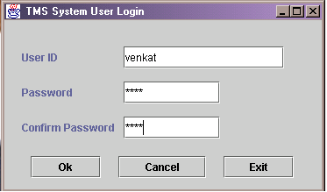
Login Window

Slide 14
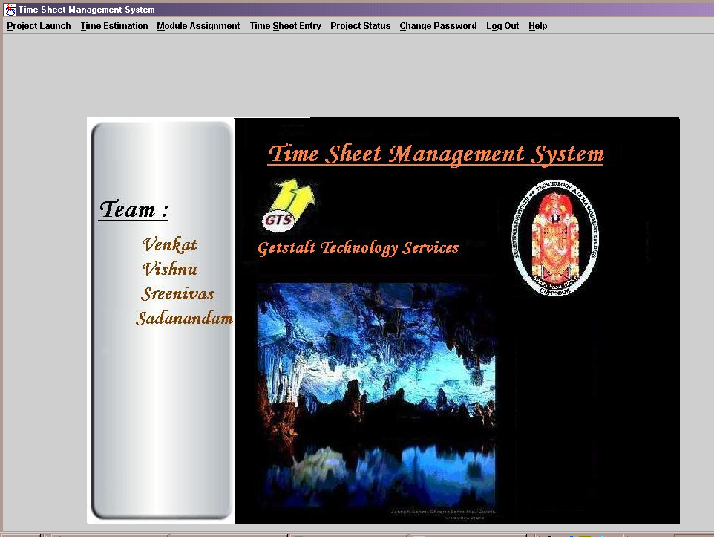
Main Window

Slide 15
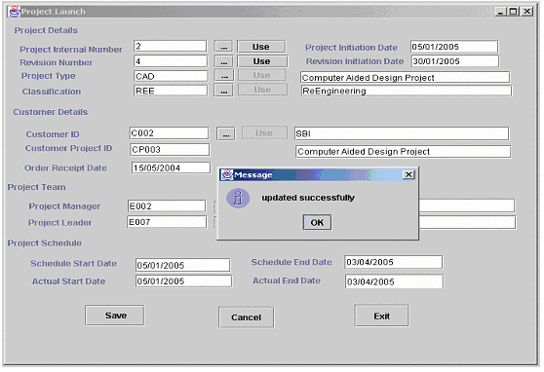
Project Launch

Slide 16
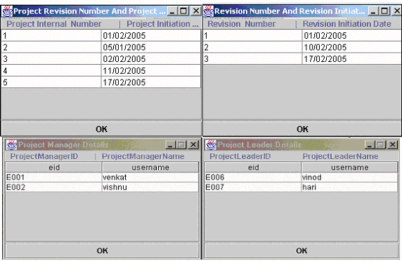
Common Double Sub Frame

Slide 17
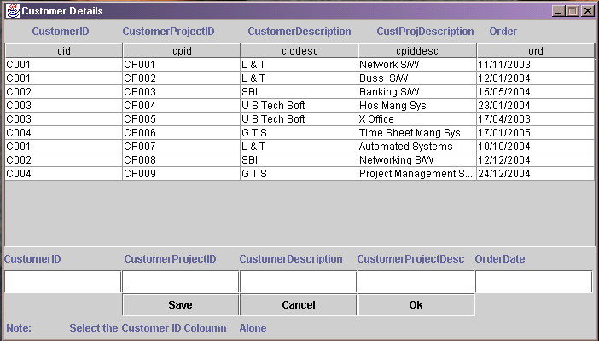
Customer Details Sub Frame

Slide 18
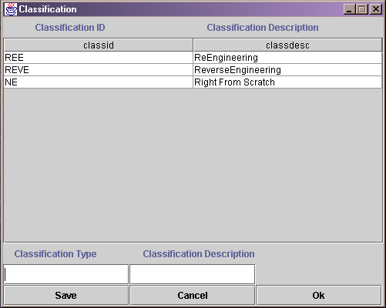
Classification Sub Frame

Slide 19
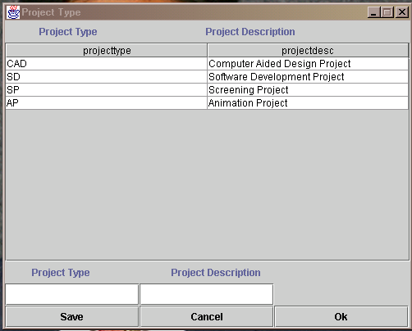
Project Type Sub Frame

Slide 20
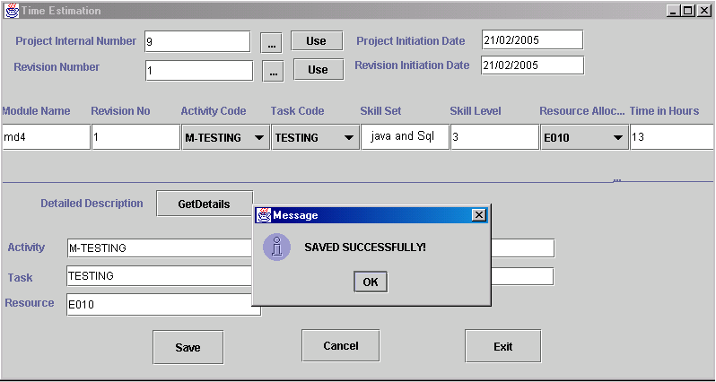
Time Estimation

Slide 21
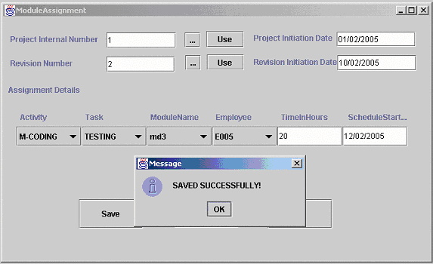
Module Assignment Frame

Slide 22
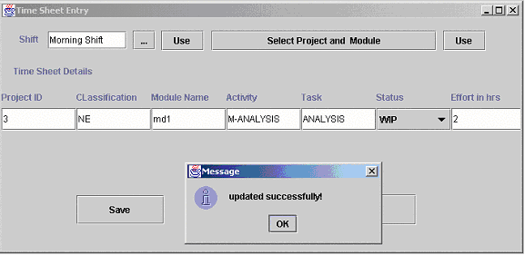
Time Sheet Entry Frame

Slide 23
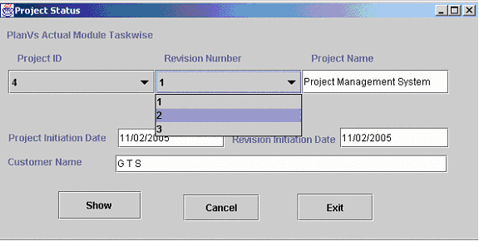
Project Status

Slide 24
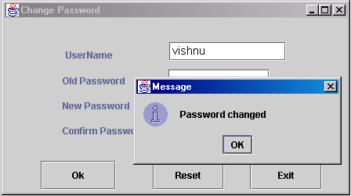
Change Password Frame

Slide 25
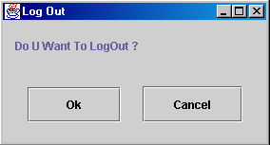
Logout Frame

Slide 26
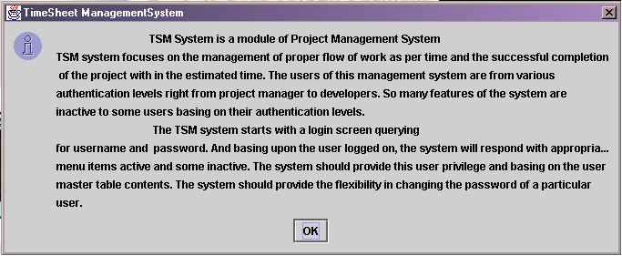
Help

Slide 27
Database Tables Used
The final Database Tables we have got up to now are:
Ø Launch – (pid, pidt, rno, ridate, ptype, clid, cid, cpid, piddes, resdt, pmid, plid,pmname, plname, ssdt, sedt, asdt, aedt).
Ø Customer details – (cid, cpid, ciddesc, cpiddesc, ord).
Ø Classification – (classid, classdesc).
Ø Project type – (project type, project desc).

Slide 28
Continued…..
Moduleassignment – (pid, acode, tcode, mname, eid, time, ssdt, status).
Ø Shifts – (shift).
Ø Usermaster – (eid, username, pwd, ua).
Ø Timeestimation – (pid, mname,rno, acode, tcode, scode, rescode, time).
Ø Timesheetentry – (eid, shift, PID, mname, status, starttime, endtime, totaltime).

