Slide 1
Sky Watch
CNN-based System for Flying Object Detection and Threat Assessment
By: Tarun Vuyyuru, Sean Chaikin
Under : Dr. Muhammad Ali Yousuf
DATA 606: Capstone in Data Science
UMBC

Slide 2
PROJECT TIMELINE
STEP 1
STEP 2
STEP 3
Data Collection and Web Scraping
Choosing Platform and Library
Dev Script for image processing
STEP 6
STEP 5
STEP 4
Examining : Results and Conclusion
Training and fine tuning our CNN
Balancing the data sets distribution

Slide 3
TABLE OF CONTENTS
01
02
03
04
05
06
Data Insights & processing
Introduction
Problem Statement
Training process & Performance metrics
Model architecture
Results and conclusions

Slide 4
Introduction
Sky watch is a convolutional neural network (CNN) that assesses the threat level of flying objects. The development of this CNN was motivated by the need for an objective and efficient system to evaluate the threat level of objects in the sky. The ability to quickly and accurately assess the threat level of flying objects is critical for a variety of industries, including aviation, military defense, and security. With this CNN, we aim to provide a reliable and effective method for assessing the threat level of flying objects. In this presentation, I will walk you through the data, model architecture, training process, evaluation metrics, and results of our CNN. I hope that our work will inspire further advancements in the field of threat assessment and contribute to a safer future for all

Slide 5
Problem we are trying to solve
The problem of accurately assessing the threat level of flying objects has been a challenge for various industries, including aviation, military defense, and security. Traditional methods of threat assessment rely on human judgment, which can be subjective, time-consuming limited by many factors, and prone to errors. The need for an objective and efficient system to evaluate the threat level of objects in the sky has become increasingly important in recent years, due to the growing use of unmanned aerial vehicles (UAVs) and other airborne threats. Our goal was to develop a convolutional neural network (CNN) that can quickly and accurately assess the threat level of flying objects, providing a reliable method for detecting and responding to potential threats

Slide 6
Data Collection & processing

Slide 7
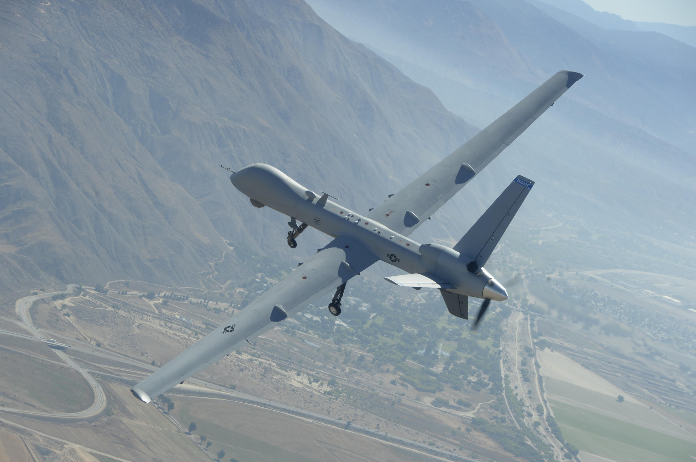
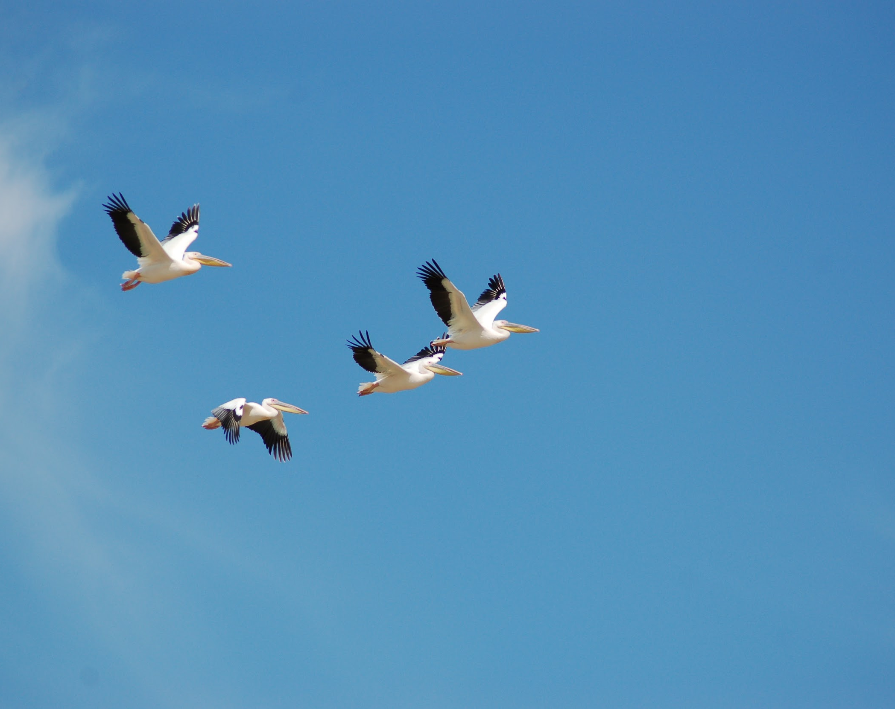
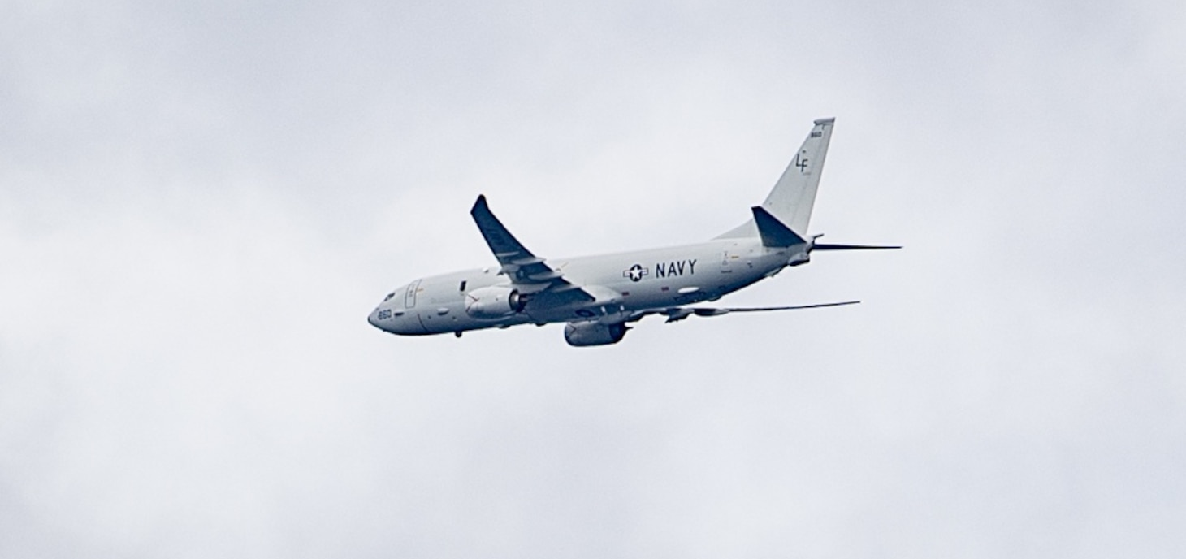
Data(Image) Showcase
Sample images from the data used to train the CNN

Slide 8
5,131
3,230
4,500
Size of the initial data collected in the form of images
Data after filtering
Size of data after augmentation fro better fitting

Slide 9
Collection and processing
Collection
Processing
50% of the data is sourced from various datasets, as referenced below, while the remaining data is obtained through web scraping as the data is ranging from images of birds to images of various aerial vehicles
When collecting the images, we encountered a range of formats and sizes. To ensure consistency, we employed a Python script utilizing the PIL and shutil image processing libraries. This script allowed us to filter and process the images into a more uniform format.

Slide 10
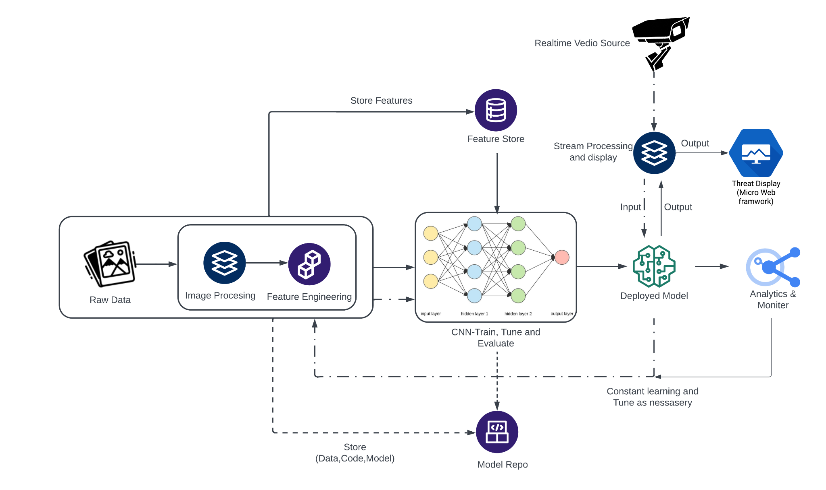
System architecture

Slide 11
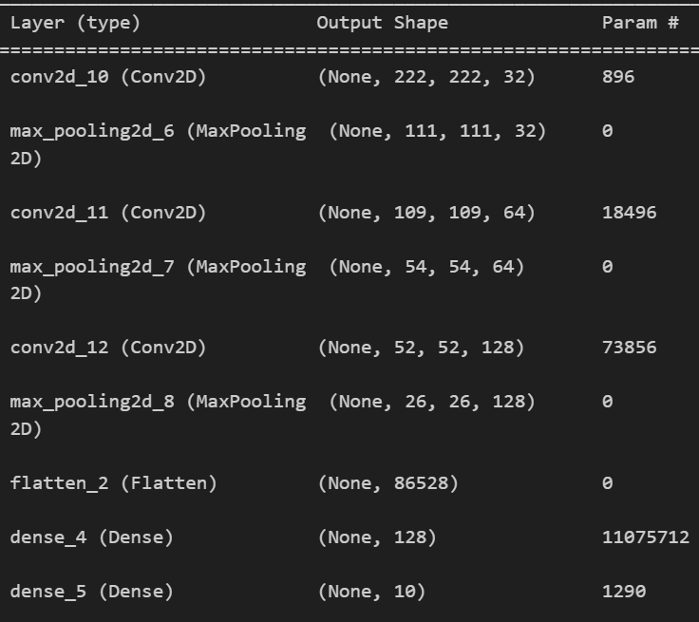
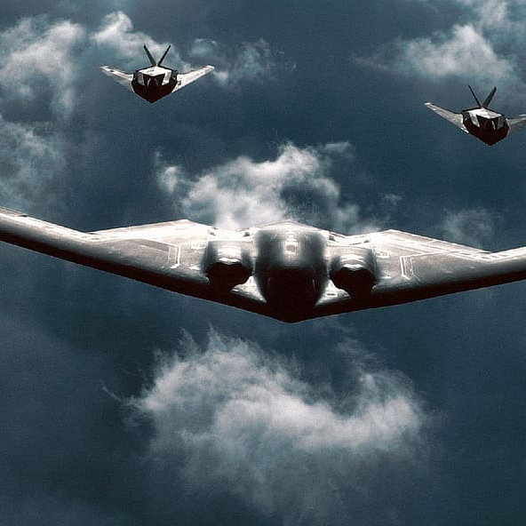
THE NEURAL NETWORK

Slide 12
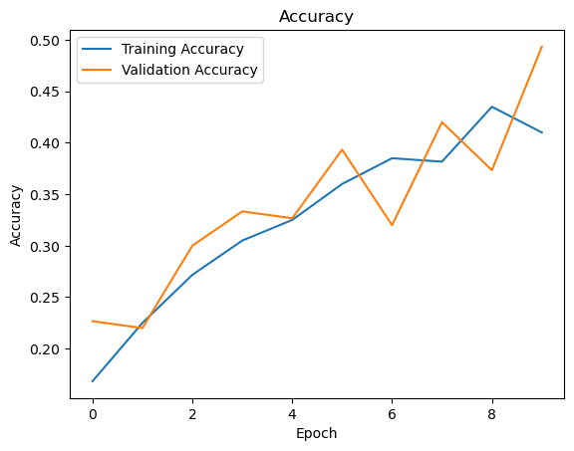
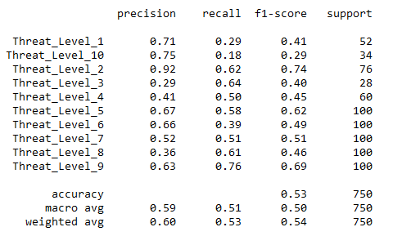
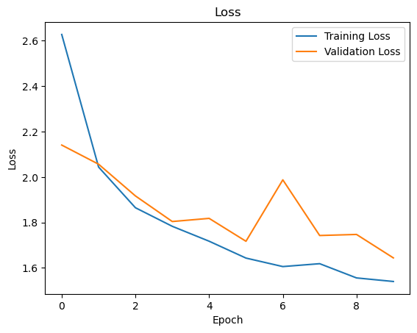
Performance metrics

Slide 13
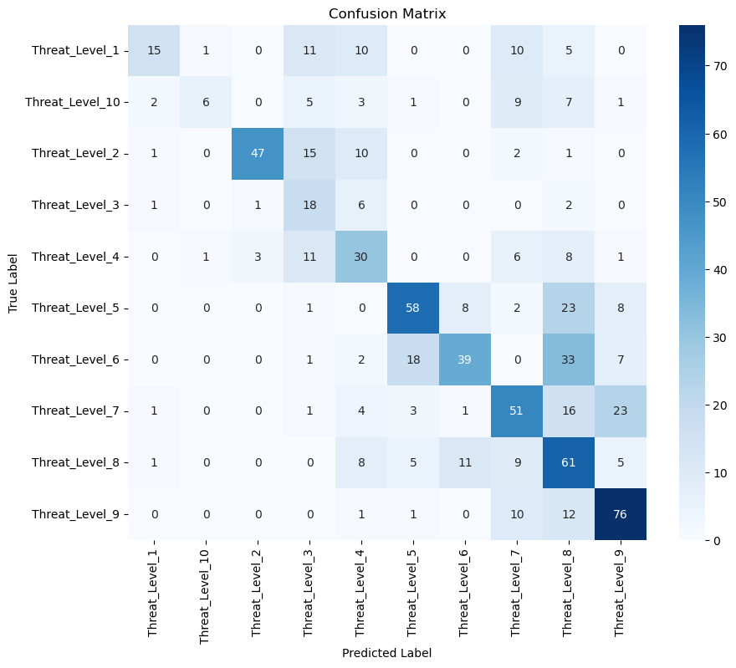
Results
Threat_level 1 - Unique in its diversity when compared to other categories
Threat_Level 10 - Our model encountered a scarcity of missile images, and a significant portion of the available images were stationary. Consequently, it proved challenging for our model to accurately identify the distinguishing streaks at the end of flying missiles.

Slide 14
Conclusion & Final Thoughts
Improve the model with larger and more balanced datasets
Work on getting better Recall percentage
Changing the amount of layers on the network

Slide 15
THANK YOU!
ANY QUESTIONS?
tvuyyur1@umbc.edu , chaiki1@umbc.edu
GitHub Repo: https://github.com/vtreddyy/Data-606-CNN

