Slide 1

Customer Shopping Behavior Analysis
Uncovering insights from 350 transactions across product categories — exploring spending patterns, customer segments, membership types, and satisfaction levels to guide strategic decisions.

Slide 2
Dataset at a Glance
350
11
2
Purchases
Columns
Missing Values
Total transactions analyzed
Features per record
In Satisfaction Level — removed
Demographics
Purchase Details
Shopping Behavior
Age, Gender, City, Membership Type, Satisfaction Level
Item Purchased, Total Spend
Discount Applied, Days Since Last Purchase, Average Rating

Slide 3

Data Preparation in Python
Standardize & Load
Load Data
Inspect
Remove Nulls
After loading the dataset with pandas, df.info() and df.describe() were used to inspect structure and summary statistics. Two null values in the Satisfaction Level column were identified and the records removed. Columns were renamed to snake_case for consistency, then the cleaned DataFrame was loaded into PostgreSQL for SQL analysis.

Slide 4
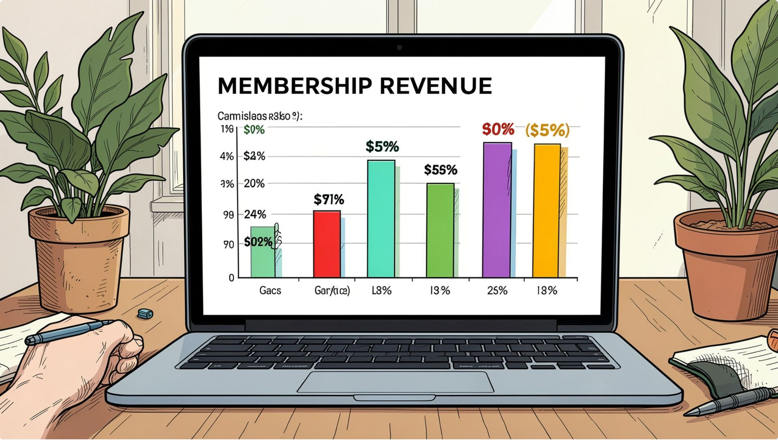
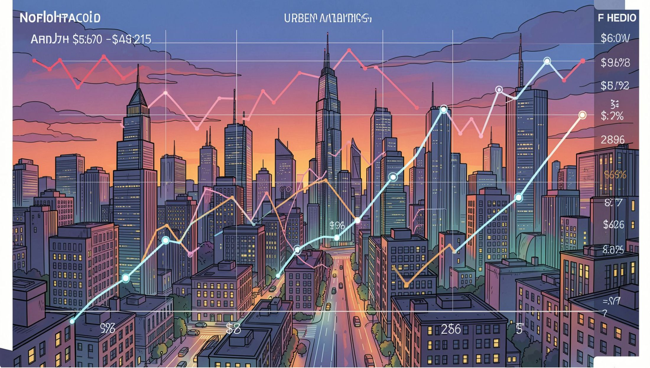
SQL Analysis: Revenue & Order Value
Membership Revenue
Total revenue compared across Gold, Silver, and Bronze membership tiers to identify which segments drive the most value.
Average Order Value by City
Identified average order value for each city to reveal geographic spending differences and regional purchasing behavior.

Slide 5


SQL Analysis: Satisfaction Insights
Are Bronze Members More Unsatisfied?
Compared satisfaction levels across Gold, Silver, and Bronze tiers to test whether Bronze members show significantly higher dissatisfaction rates.
Average Satisfaction by City
San Francisco leads with the highest average satisfaction level. City-level analysis reveals significant geographic variation in customer sentiment.

Slide 6


SQL Analysis: Segmentation
Gender Preference by Membership & City
Member counts segmented by gender, city, and membership type reveal extreme regional demographic splits — e.g., Bronze in Chicago/Houston is 100% Female; Gold in SF is 100% Male.
Discount Impact on Satisfaction
100% of unsatisfied customers received discounts — used as reactive compensation. Discounts do not improve sentiment; Neutral customers received zero discounts.

Slide 7
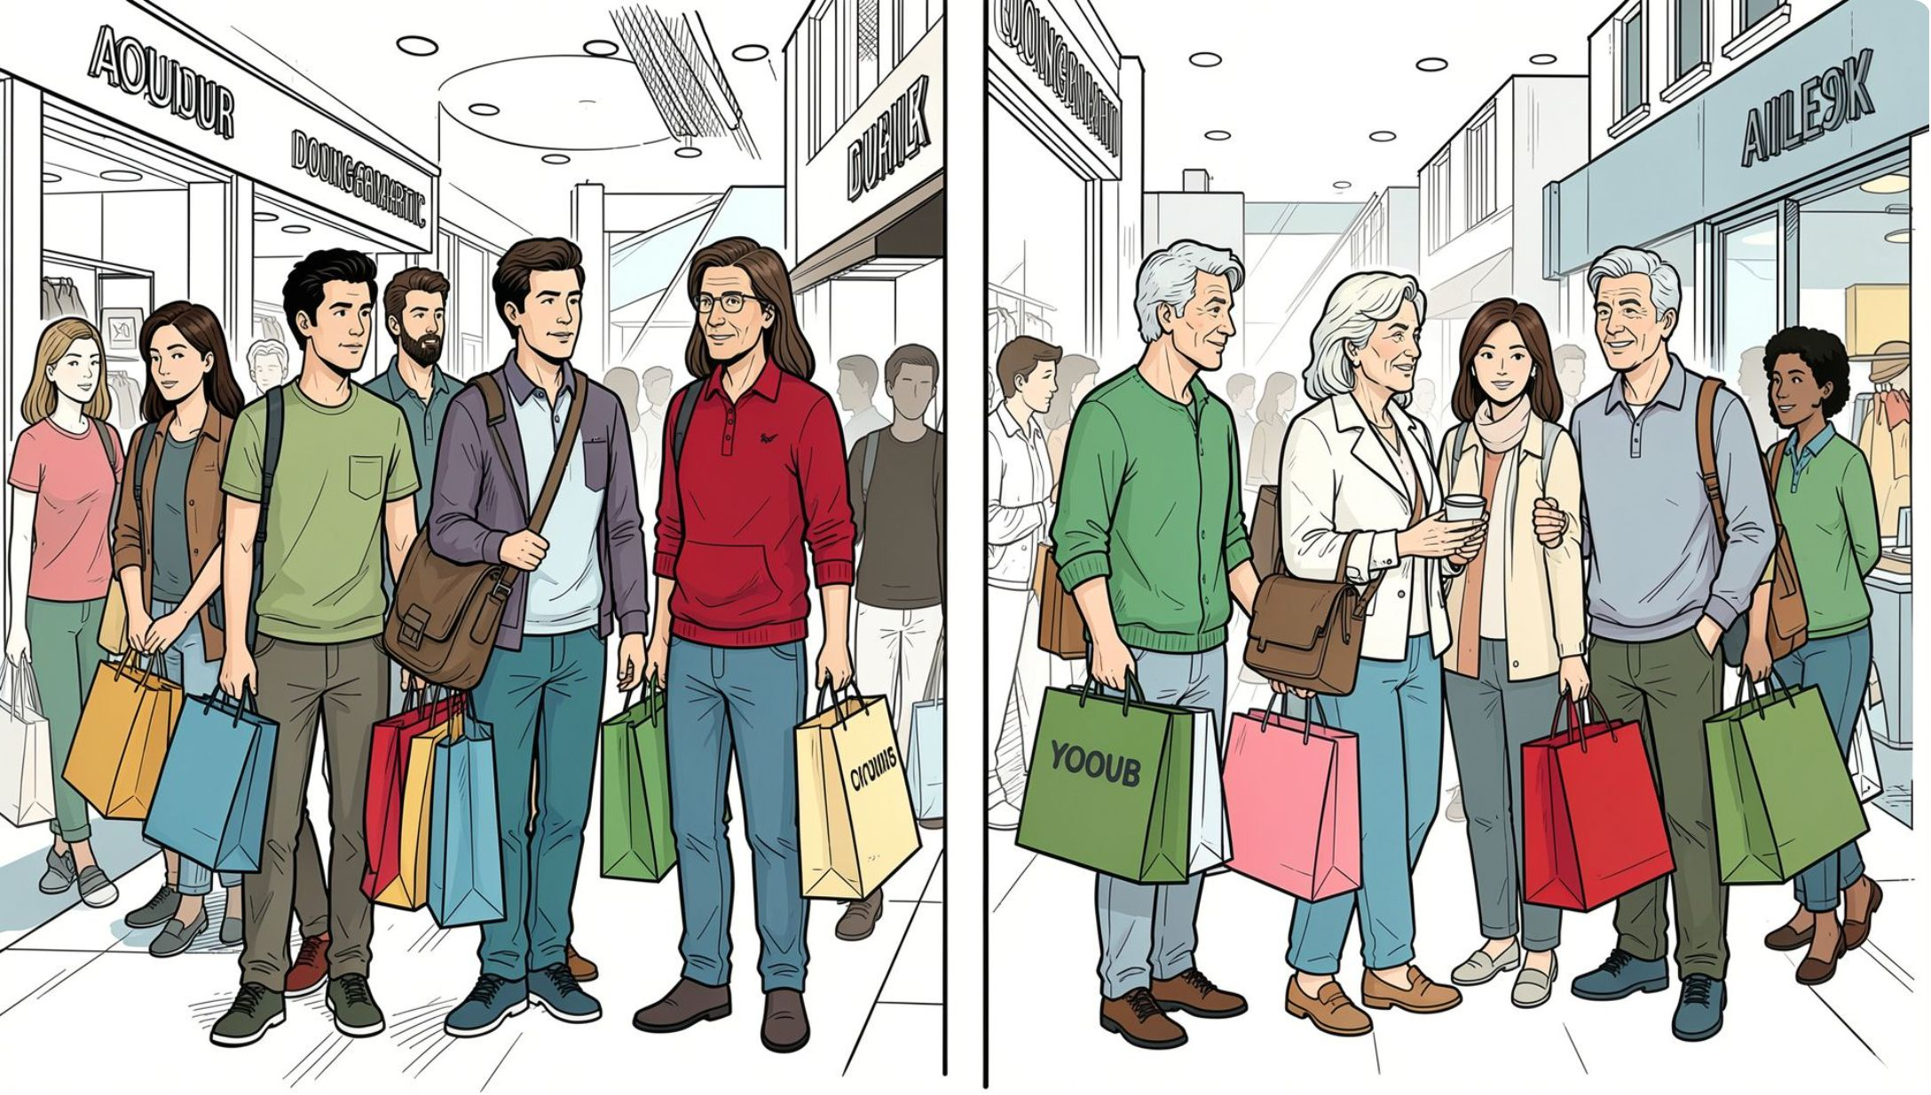
Spending & Volume by Age Group
30–39: The Volume Engine
This age group dominates overall value, generating the highest total revenue ($192k+) and volume (2,725 items) across all segments.
20–29: Highest Individual Value
Despite lower volume, this cohort has the highest average spend per customer at $1,072.18 and 16.3 items per customer — signaling strong willingness to spend per capita.

Slide 8
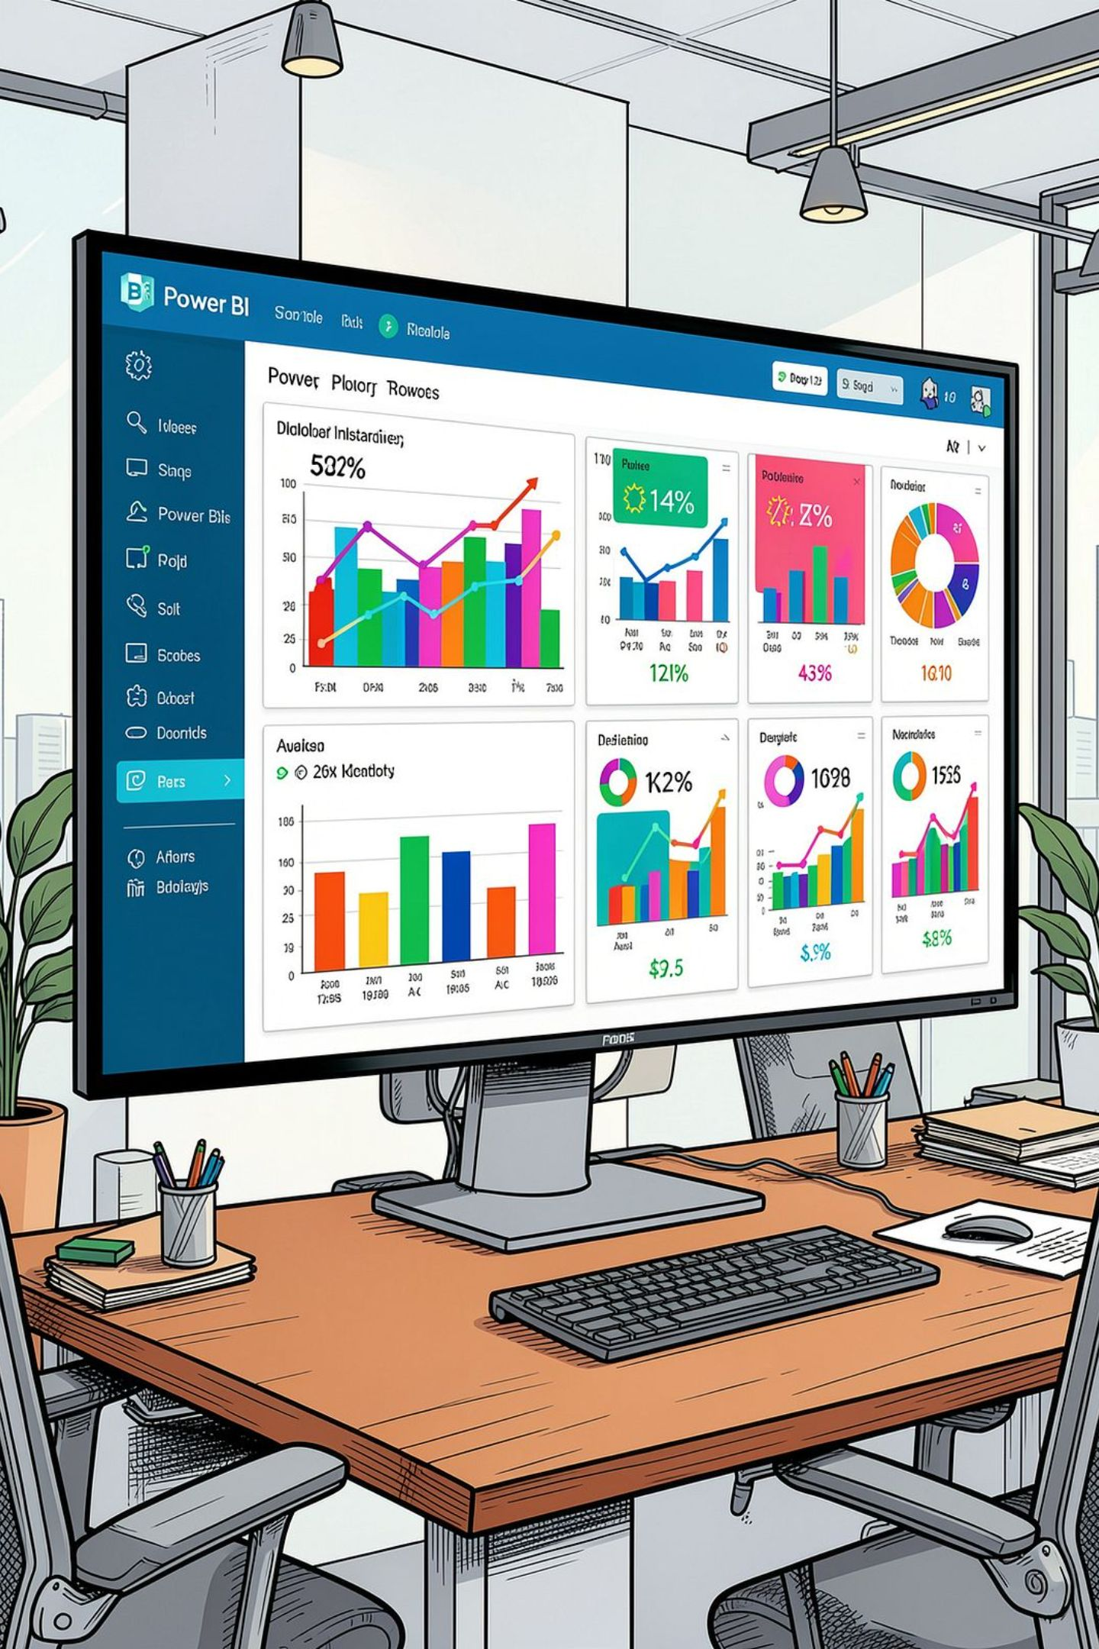
Power BI Dashboard
An interactive Power BI dashboard was built to present all insights visually — consolidating revenue, satisfaction, segmentation, and demographic findings into a single, explorable view for stakeholders.

Slide 9
Recommendations: Discounts & Demographics
🔄 Revamp Discount Policy
👥 Gender-Tailored Regional Campaigns
Stop using discounts as reactive compensation — 100% of unsatisfied customers received them with no sentiment improvement. Shift to proactive rewards for satisfied tiers and investigate root causes of dissatisfaction.
Membership data shows extreme gender splits by city. Target females in Chicago/Houston with Bronze-to-Gold upsell campaigns; design male-centric campaigns for West Coast markets (SF Gold, LA Silver).

Slide 10

Recommendations: Age & Geography
1
2
Differentiate by Age Cohort
Replicate the SF & NY Service Model
30–39: Deploy volume-driven loyalty programs and cross-selling bundles. 20–29: Focus on premium product positioning and high-tier memberships to leverage their $1,072 avg spend.
San Francisco & New York lead with 3.00 avg satisfaction; Miami & Chicago lag at 1.00. Audit fulfillment and shipping in top cities, then replicate best practices in lagging markets.

