Slide 1


Predictive Model Development
for the CERN Dielectron Dataset
Invariant Mass Regression using Machine Learning
EPL448 – Data Mining on the Web | Spring 2026
Team 2: Varnavas Tryfonos · Thrasos Sazeides · Andreas Evagorou

Slide 2





Presentation Outline
Introduction to the Domain
Particle physics & invariant mass
Dataset Overview
100K dielectron events from CMS/LHC
Exploratory Data Analysis
Distributions, correlations, physics structures
Data Preprocessing
5 dataset versions, feature engineering
ML Techniques & Results
4 models, screening, tuning, final evaluation
Key Findings & Comparison
Domain validation, literature, limitations
Team 2 · CERN Dielectron Dataset · EPL448 Spring 2026

Slide 3
Introduction to the Domain
At the Large Hadron Collider (LHC) at CERN, protons collide at nearly the speed of light, producing showers of subatomic particles.
The CMS detector records dielectron events — collisions producing electron–positron pairs (e⁺e⁻).
The invariant mass M of the pair reveals the parent particle: peaks at ~3.1 GeV (J/ψ meson), ~9.5 GeV (Υ meson), and ~91 GeV (Z boson).
Our Goal:
Build regression models to predict invariant mass M from raw kinematic features — a continuous prediction task across the full mass spectrum.
J/ψ Meson
~3.1 GeV
Υ Meson
~9.5 GeV
Z Boson
~91 GeV
Team 2 · CERN Dielectron Dataset · EPL448 Spring 2026

Slide 4
Dataset Overview
100,000
18
1 Target
0
Events
Features
Invariant Mass M
Missing Values
Category | Features | Type
Energy | E1, E2, pt1, pt2 | Numerical
Momentum | px1, px2, py1, py2, pz1, pz2 | Numerical
Angular | eta1, eta2, phi1, phi2 | Numerical
Charge | Q1, Q2 (values: -1, +1) | Categorical
Target | M (invariant mass in GeV) | Continuous
Source: CERN Open Data Portal — CMS Run 2010B dielectron events (McCauley, 2014)
Team 2 · CERN Dielectron Dataset · EPL448 Spring 2026

Slide 5
Exploratory Data Analysis
Target Distribution
Strongly right-skewed (skewness ~1.4), multimodal — three visible resonance peaks at 3.1, 9.5, and 91 GeV.
Energy Features
E1, E2, pt1, pt2 are right-skewed (skewness 2.3–3.0) with long tails from Z boson events. Log transformation reduces this significantly.
Angular Features
eta: symmetric, bounded by detector acceptance. phi: near-uniform over [−π, +π]. No transformation needed.
Correlations
Strong E–pt collinearity (r ≈ 0.87). E1, E2 have highest correlation with target M (r ≈ 0.65–0.70). Charge variables near zero.
Charge Analysis
~97% opposite-sign pairs (e⁺e⁻ signal), ~3% same-sign (background). Motivates binary 'opposite_sign' feature.
Team 2 · CERN Dielectron Dataset · EPL448 Spring 2026

Slide 6
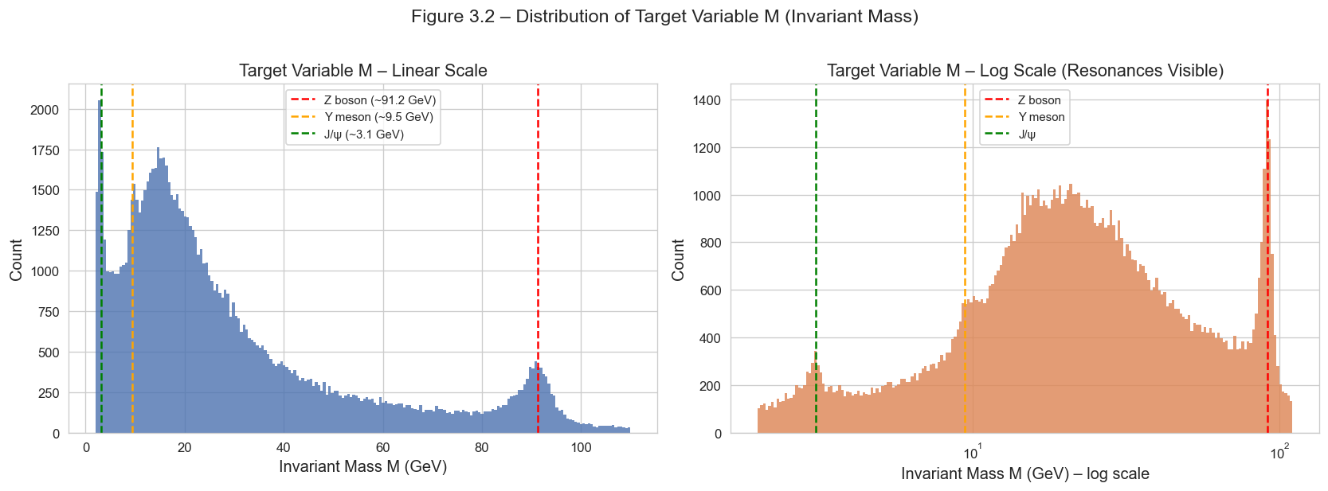
EDA — Target Variable Distribution
Right-skewed distribution with three resonance peaks visible in log scale: J/ψ (~3.1 GeV), Υ (~9.5 GeV), and Z boson (~91 GeV). This multimodal structure motivates region-level evaluation and log-transformation of M.
Team 2 · CERN Dielectron Dataset · EPL448 Spring 2026

Slide 7
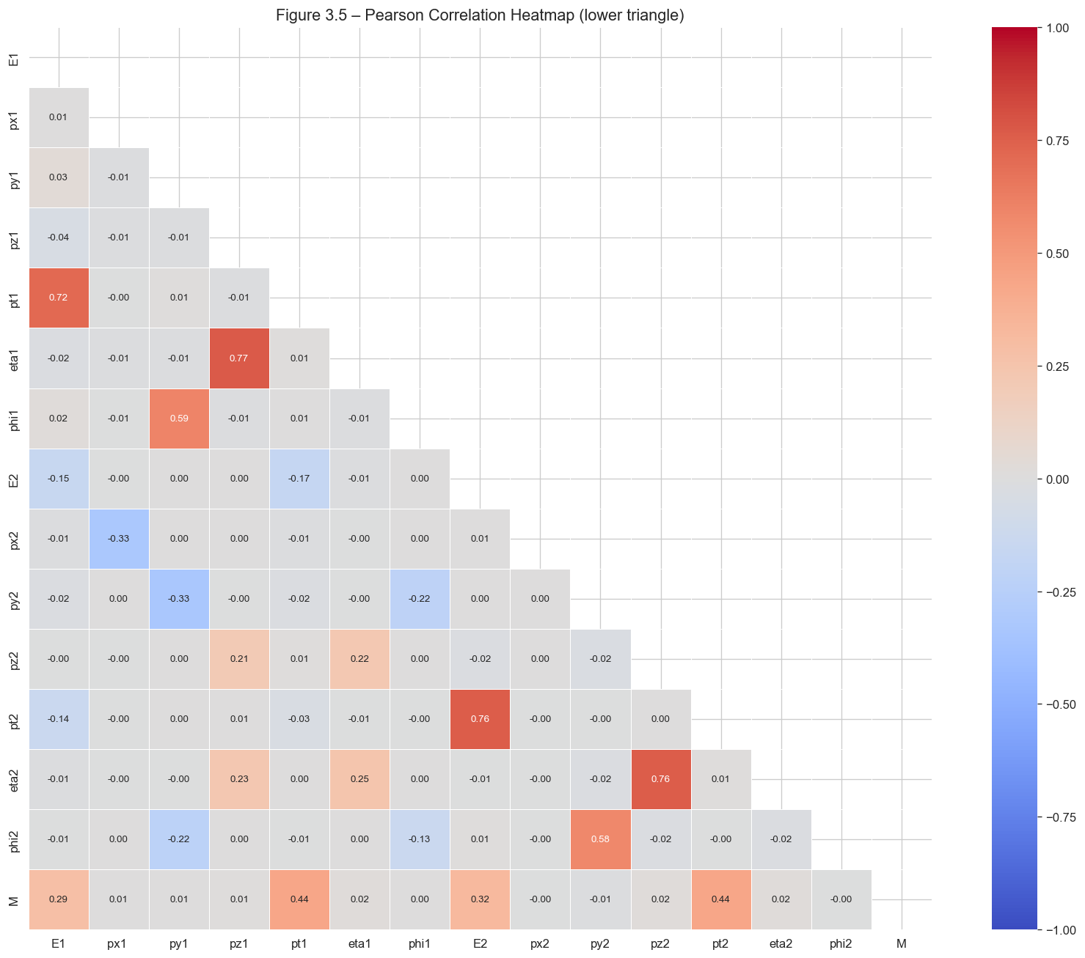
EDA — Correlation Analysis
Key Correlations
E1–pt1 collinearity: r = 0.72
E2–pt2 collinearity: r = 0.76
Highest correlations with target M:
pt1 (r = 0.44), pt2 (r = 0.44), E1 (r = 0.29), E2 (r = 0.32)
Pseudorapidity: eta1–pz1 (r = 0.77), eta2–pz2 (r = 0.76) — strong physics relationship
Charge Q1, Q2: near-zero correlations with all continuous features
Implication: High E–pt collinearity motivates PCA or selective feature removal. Eta–pz relationships suggest physics-informed engineered features.
Team 2 · CERN Dielectron Dataset · EPL448 Spring 2026

Slide 8
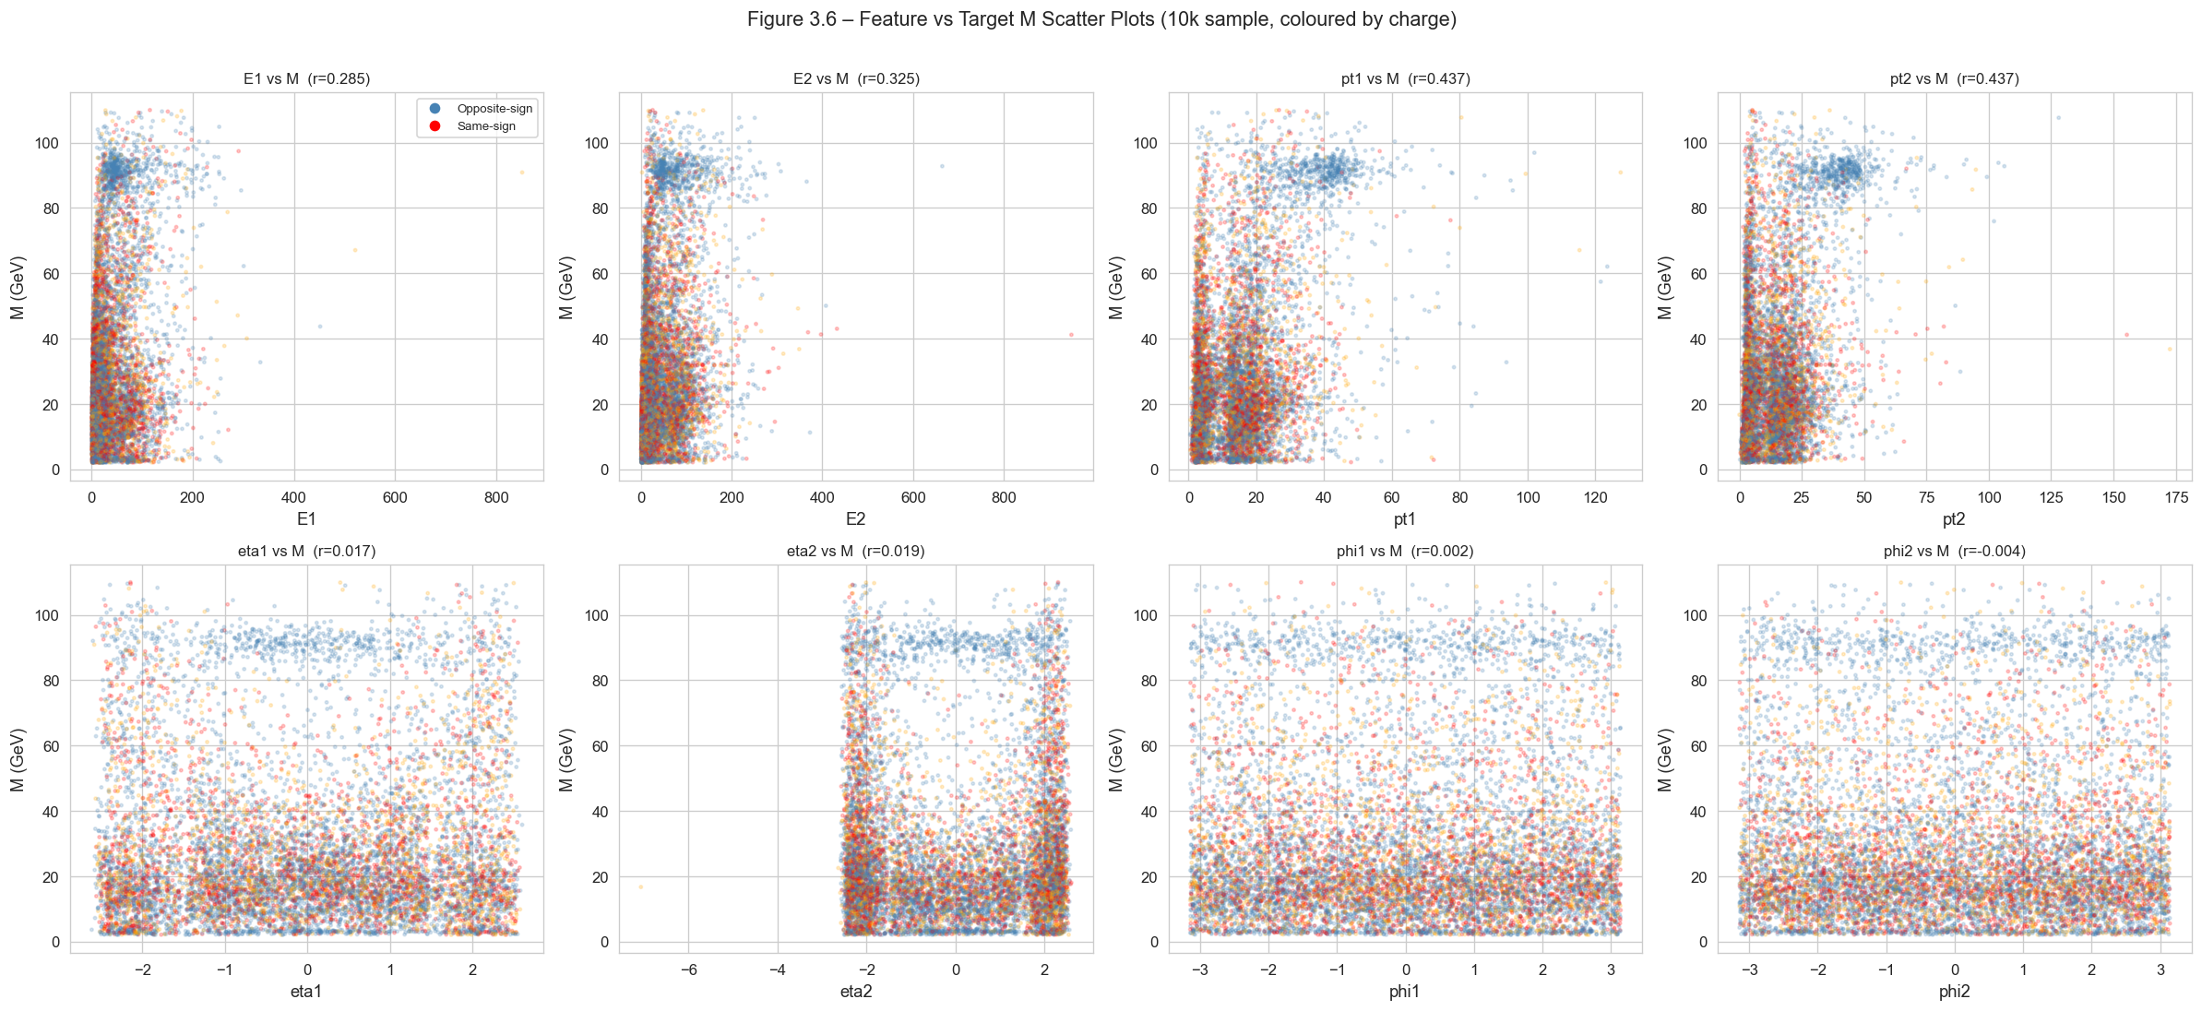
EDA — Features vs Target M
Energy features (E1, E2, pt1, pt2) show clear positive relationship with M. Angular features (eta, phi) show no linear trend — but may carry non-linear predictive value captured by tree-based models.
Team 2 · CERN Dielectron Dataset · EPL448 Spring 2026

Slide 9
Data Preprocessing
1
Clean
Drop ID columns (Run, Event). No missing values. Retain all 'outliers' — physically valid.
2
Engineer
Create physics features: sum_E, sum_pt, delta_R, delta_eta, delta_phi, opposite_sign, log_E1, log_E2.
3
Transform
Log1p on skewed energy/momentum features (skewness 2.3→~0). Optional log target (V3).
4
Scale
StandardScaler for KNN/PCA pipelines. Tree-based models are scale-invariant — no scaling needed.
5
Reduce
PCA retaining 95% variance (V5) — 10 components. Domain-driven V4: 8 selected features.
Team 2 · CERN Dielectron Dataset · EPL448 Spring 2026

Slide 10
Five Preprocessed Dataset Versions
V1
Baseline — original cleaned features, StandardScaler
V2
Log-transformed energy & momentum features
V3
V2 + log-transformed target (log M)
V4
Reduced 8-feature domain-driven set (sum_E, sum_pt, delta_R, delta_eta, delta_phi, opposite_sign, log_E1, log_E2)
V5
V2 + PCA (95% variance retained → 10 components)
80/20 stratified train/test split (stratified by binned mass region) — 79,932 train / 19,983 test events
Team 2 · CERN Dielectron Dataset · EPL448 Spring 2026

Slide 11
Regression Techniques
KNN
K-Nearest Neighbors
ExtraTrees
Extra-Trees Ensemble
Instance-based, distance-weighted. Sensitive to scaling — benefits from PCA.
Randomized tree ensemble (replaced Random Forest for efficiency). Scale-invariant.
CatBoost
Categorical Boosting
XGBoost
Extreme Gradient Boosting
Gradient boosting with ordered boosting & L2 regularization. GPU-accelerated.
Regularized boosting with column subsampling. State-of-the-art for tabular data.
Team 2 · CERN Dielectron Dataset · EPL448 Spring 2026

Slide 12
Initial Model Screening — 5-Fold CV
Key finding: CatBoost and XGBoost consistently outperform KNN and ExtraTrees. V4 (domain-driven) and V2 (log-transformed) are the strongest dataset versions. PCA-based V5 underperforms.
Team 2 · CERN Dielectron Dataset · EPL448 Spring 2026

Slide 13
Screening Results — Top Performers
Model | Dataset | R² (CV) | RMSE (GeV) | MAE (GeV)
CatBoost | V4 | 0.9922 | 2.230 | 1.389
CatBoost | V2 | 0.9913 | 2.353 | 1.621
ET | V4 | 0.9918 | 2.289 | 1.325
XGBoost | V4 | 0.9898 | 2.555 | 1.625
XGBoost | V2 | 0.9773 | 3.801 | 2.652
KNN | V4 | 0.9830 | 3.296 | 2.006
KNN | V1 | 0.9038 | 7.833 | 4.898
Selected for tuning: CatBoost × {V4, V2} + XGBoost × {V4, V2}
Team 2 · CERN Dielectron Dataset · EPL448 Spring 2026

Slide 14
Hyperparameter Tuning (GridSearchCV)
CatBoost
V4 & V2
depth = 8, learning_rate = 0.1, estimators = 500, L2 reg = 3
XGBoost
V4 & V2
max_depth = 6 (V4) / 10 (V2), learning_rate = 0.1, estimators = 500, colsample = 0.8–1.0
Tuning improvements (R² gain over defaults):
CAT/V4: +0.0007 CAT/V2: +0.0016 XGB/V4: +0.0036 XGB/V2: +0.0123
Preprocessing choices (especially V4) had at least as much impact as hyperparameter tuning.
Team 2 · CERN Dielectron Dataset · EPL448 Spring 2026

Slide 15
Final Model Evaluation — Test Set
Model | Dataset | R² | RMSE (GeV) | MAE (GeV) | MAPE (%)
CatBoost | V2 | 0.9937 | 2.003 | 1.347 | 9.96
XGBoost | V4 | 0.9935 | 2.041 | 1.065 | 4.76
CatBoost | V4 | 0.9924 | 2.196 | 1.305 | 6.14
XGBoost | V2 | 0.9902 | 2.496 | 1.724 | 12.64
Highest R²
Best Error Profile
CatBoost / V2
XGBoost / V4
R² = 0.9937
MAE = 1.065 GeV | MAPE = 4.76%
Team 2 · CERN Dielectron Dataset · EPL448 Spring 2026

Slide 16
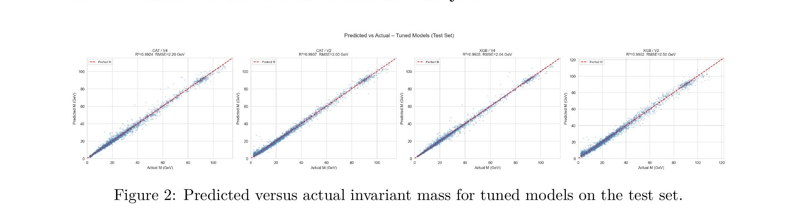
Predicted vs Actual — Test Set
All four tuned models follow the identity line closely across the full mass spectrum. R² and RMSE annotations per panel confirm strong fit, with CAT/V2 achieving the tightest scatter (R² = 0.9937).
Team 2 · CERN Dielectron Dataset · EPL448 Spring 2026

Slide 17
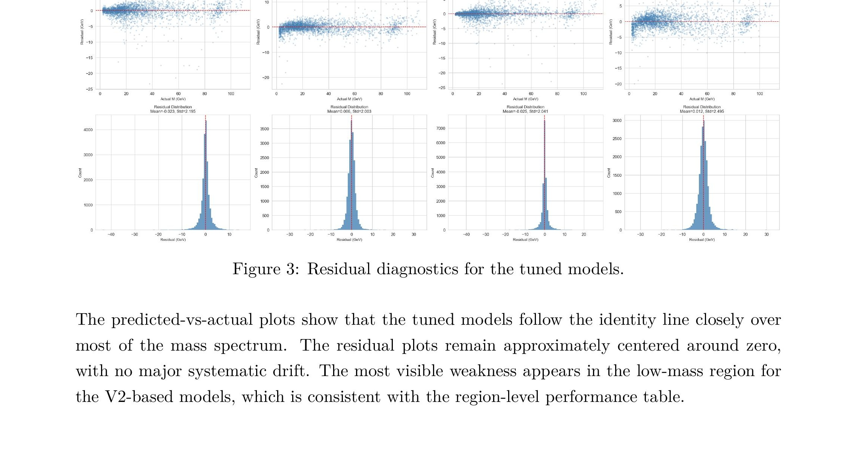
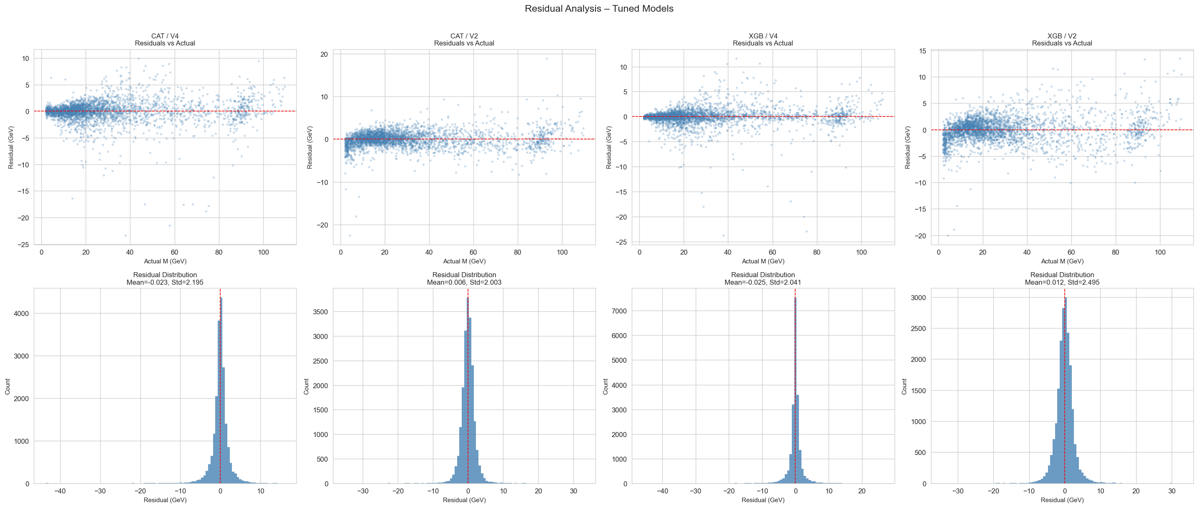
Residual Diagnostics — Tuned Models
Residuals centered near zero with no systematic drift. V2-based models show wider spread in the low-mass region — consistent with the region-level analysis.
Team 2 · CERN Dielectron Dataset · EPL448 Spring 2026

Slide 18
Performance by Mass Region
Model | Dataset | Region | R² | RMSE | MAPE (%)
XGB | V4 | Low (<10 GeV) | 0.9371 | 0.630 | 6.17
XGB | V2 | Low (<10 GeV) | 0.0567 | 2.441 | 41.73
CAT | V4 | Low (<10 GeV) | 0.9009 | 0.791 | 9.87
CAT | V2 | Low (<10 GeV) | 0.3201 | 2.072 | 32.73
XGB | V4 | Mid (10–50) | 0.9572 | 2.091 | 5.12
XGB | V4 | High (>50) | 0.9716 | 2.698 | 2.04
Critical Insight
V4 (domain-driven features) maintains strong performance across all mass regions, including the difficult low-mass regime. V2 models collapse in the low-mass region (R² near 0 for XGB/V2). Physics-informed feature engineering > generic transformations.
Team 2 · CERN Dielectron Dataset · EPL448 Spring 2026

Slide 19
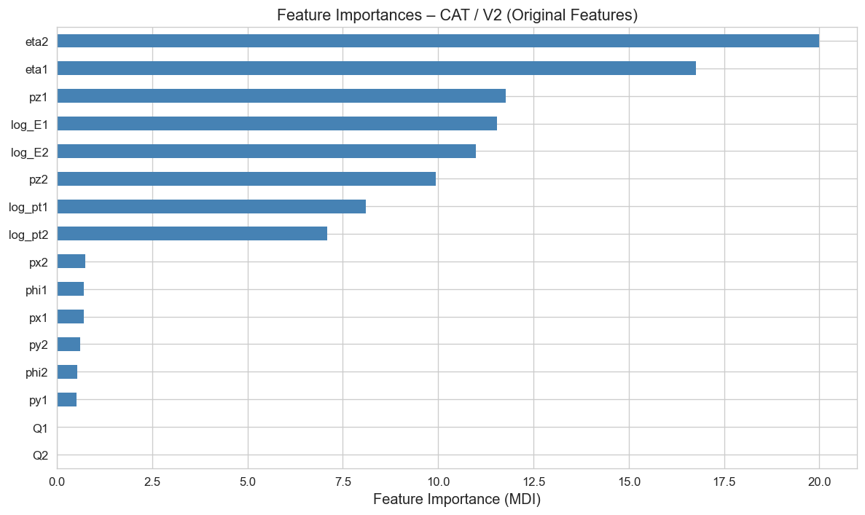
Feature Importance Analysis
Interpretation
Top features: eta2, eta1, pz1, log_E1, log_E2 — all kinematic variables directly connected to invariant mass.
Charge variables Q1, Q2 contribute almost nothing — consistent with physics (charge determines event category, not mass magnitude).
This confirms the domain validity of the trained models.
Team 2 · CERN Dielectron Dataset · EPL448 Spring 2026

Slide 20
Comparison with Literature
Aspect | Kilic et al. (2023) | This Study
Problem | Classification (Z-boson peak region) | Regression (full mass range)
Scope | Dielectron events near Z peak | Full invariant-mass spectrum
Algorithms | RF, WRF, BRF, LightGBM, DNN | KNN, ExtraTrees, CatBoost, XGBoost
Best result | 99.3% accuracy | R² = 0.9937, MAPE = 4.76%
Features | Not specified | Explicit engineering + V4 reduced set
Note: Direct metric comparison is not possible (classification vs regression on different subsets). The common conclusion is that ensemble tree-based methods are highly effective for this data family.
Team 2 · CERN Dielectron Dataset · EPL448 Spring 2026

Slide 21


Key Findings & Limitations
Key Findings
Limitations
All tuned models exceed R² = 0.99 on the test set
GridSearch remained computationally expensive even with reduced model set
Domain-driven V4 outperforms PCA-based V5 across all models
Single 80/20 hold-out split (no repeated resampling)
V4 is especially strong in the low-mass region where V2 collapses
Literature comparison is imperfect (classification vs regression)
Preprocessing matters more than hyperparameter tuning
PCA underperformance may be pipeline/parameter specific
Feature importance aligns with physics expectations
Performance gains partly from domain knowledge in features
Team 2 · CERN Dielectron Dataset · EPL448 Spring 2026

Slide 22
Conclusion
Modern boosted tree ensembles achieve R² > 0.99 for invariant mass prediction on the CERN dielectron dataset.
Physics-informed feature engineering consistently outperforms unsupervised dimensionality reduction.
The representation matters at least as much as the model — domain knowledge is the key differentiator.
Thank you. Any Questions?

Slide 23
References
[1] McCauley, T. (2014). Events with two electrons from 2010. CERN Open Data Portal.
[2] Kilic, H., Ozturk, S., & Yildirim, E. (2023). ML model performances for Z boson mass identification. EPJ Plus, 138.
[3] Pedregosa, F. et al. (2011). Scikit-learn: Machine Learning in Python. JMLR, 12.
[4] Chen, T. & Guestrin, C. (2016). XGBoost: A Scalable Tree Boosting System. KDD.
[5] Prokhorenkova, L. et al. (2018). CatBoost: unbiased boosting with categorical features. NeurIPS.
Team 2 · CERN Dielectron Dataset · EPL448 Spring 2026

