Slide 1
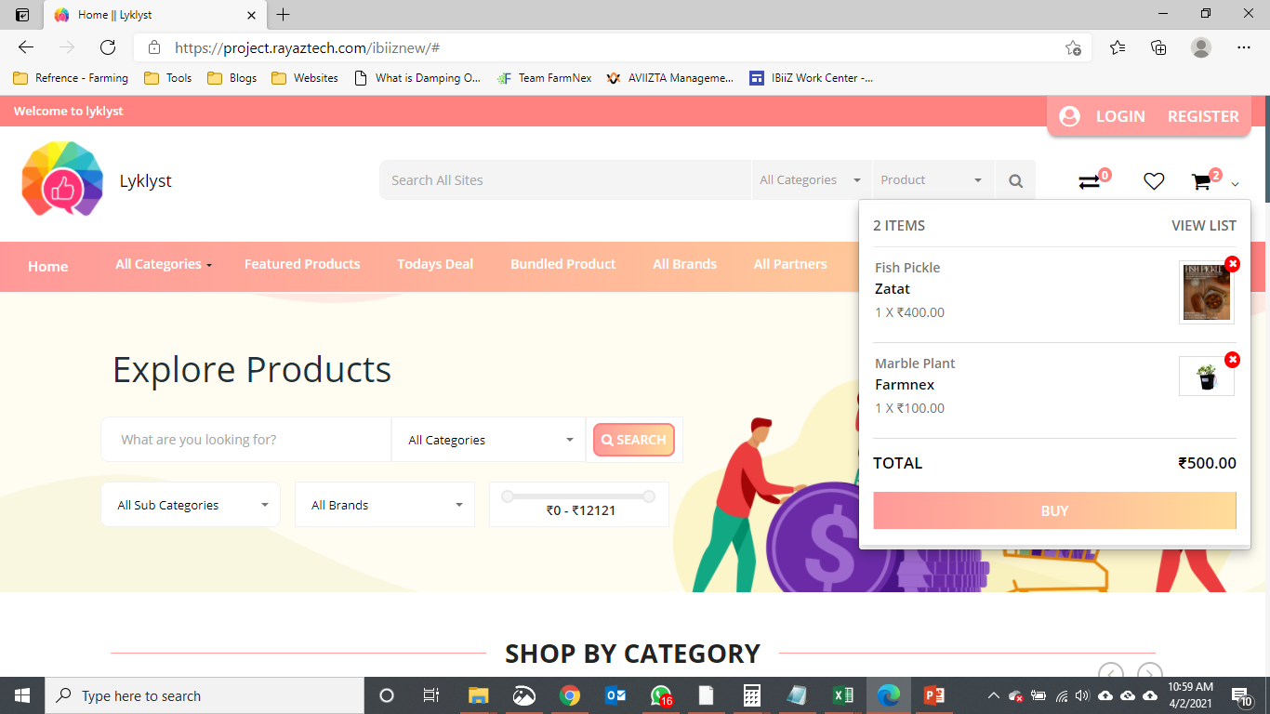
Hyperlink to product and vendor not working

Slide 2
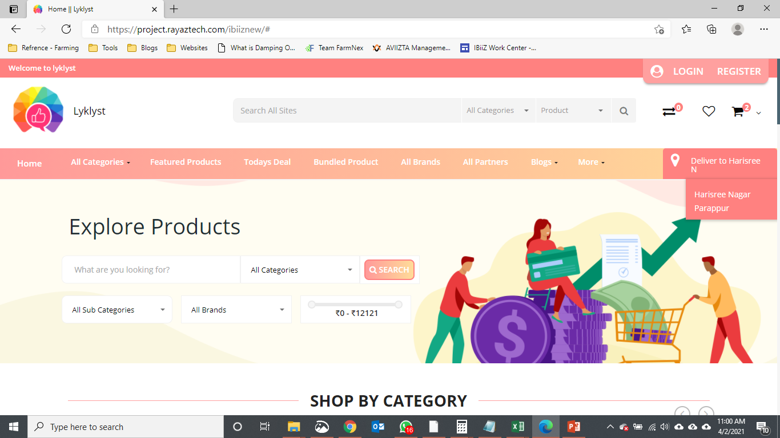
Location not picking up properly

Slide 3
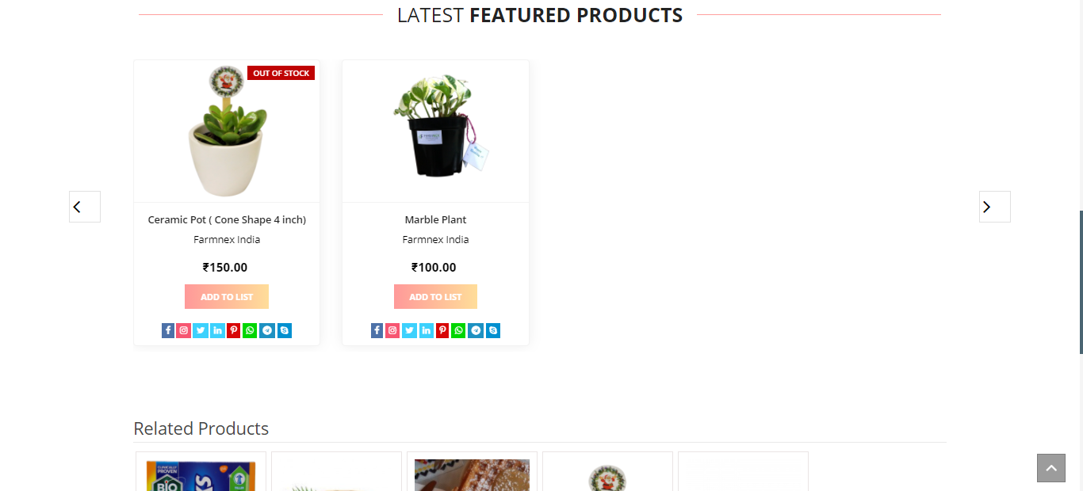
Related Product should be same as Latest Featured Product header

Slide 4
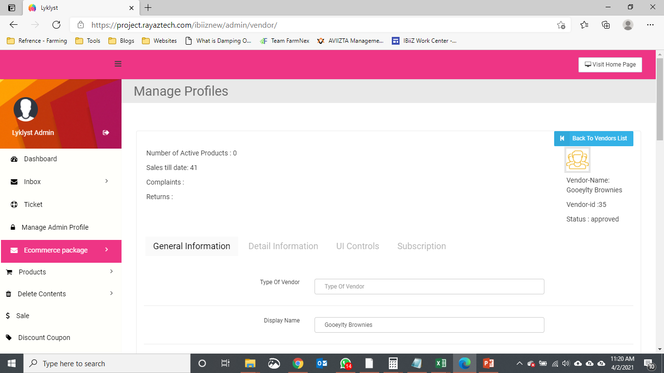
Back to vendor list not working Number of Active products not working Error message should be shown in the Header Page

Slide 5
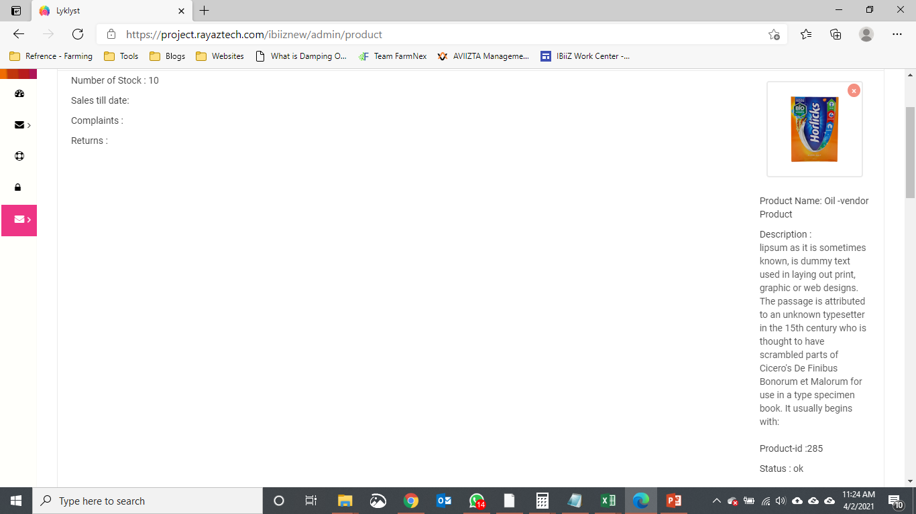
Remove description

Slide 6
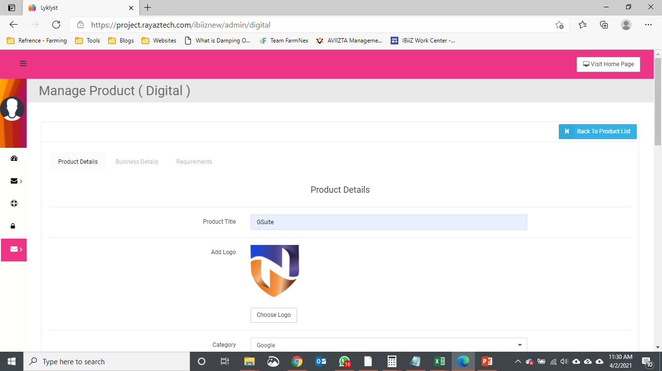
Error message should be shown in the Header Page The layout should be same as Physical Product

Slide 7
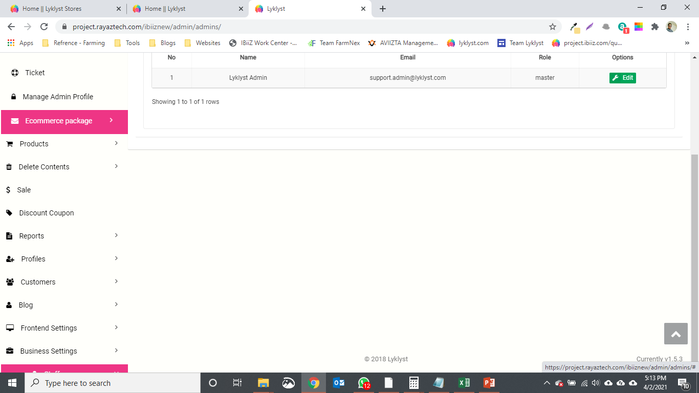
Not able to scroll down after staff option in the panel

Slide 8
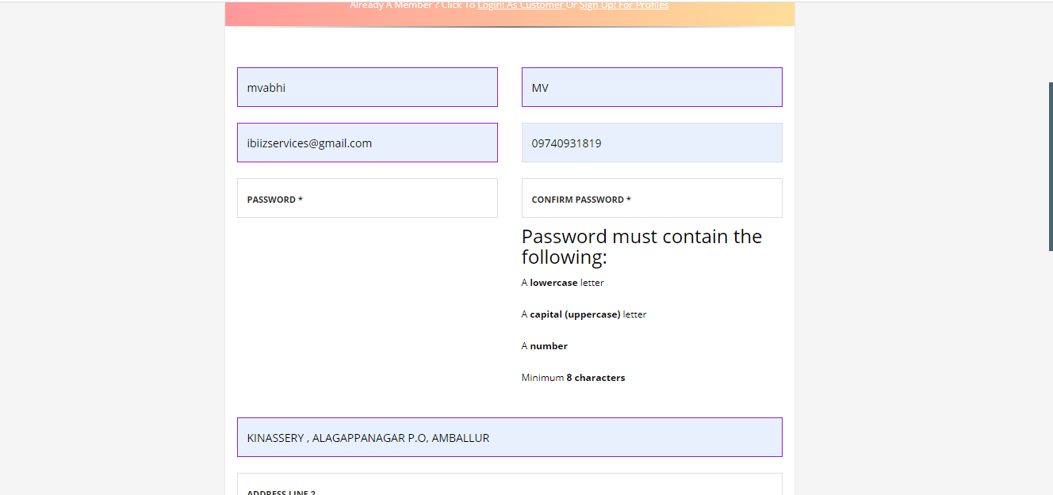
Password instruction should be small, just in a single line small fonts

Slide 9
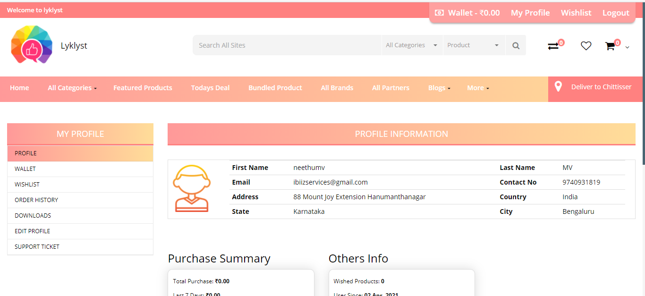
Deliver to Chittisser but address is Karnataka once logged in

Slide 10
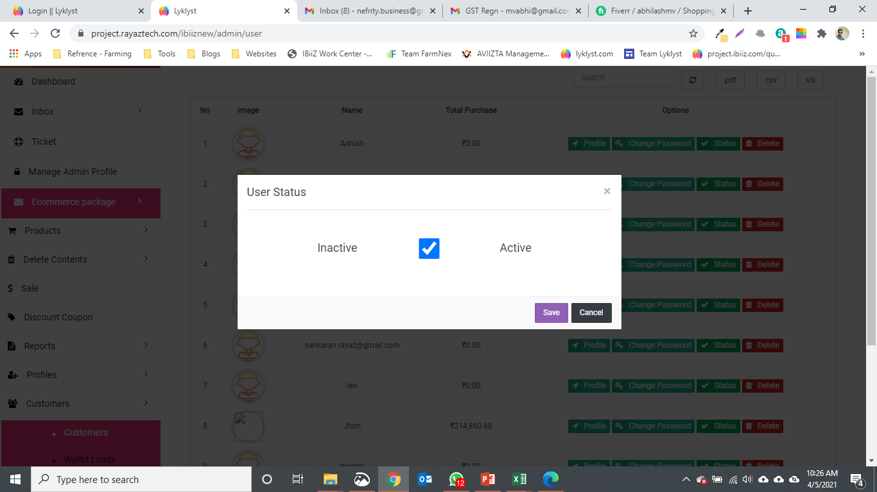
We have not asked this feature all customers should be active by default, only vendors require approval

