Slide 1
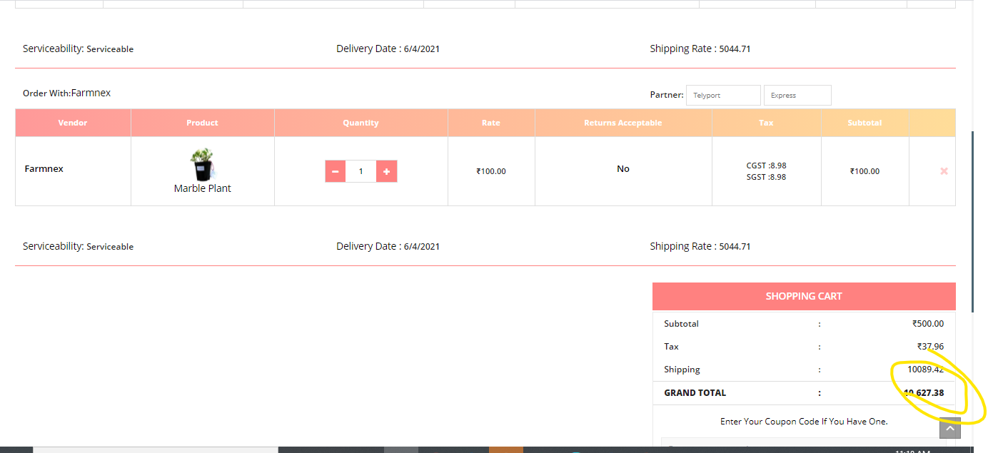
Shipping Cost is not getting calculated properly

Slide 2
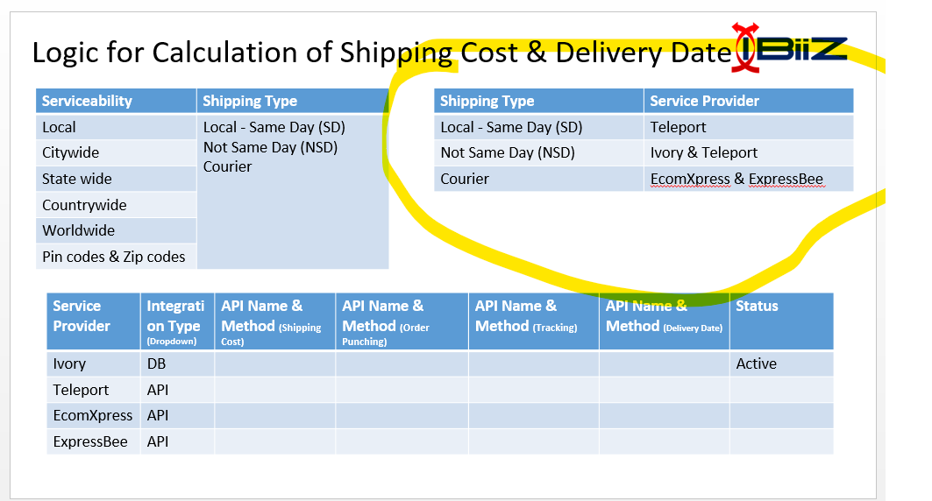
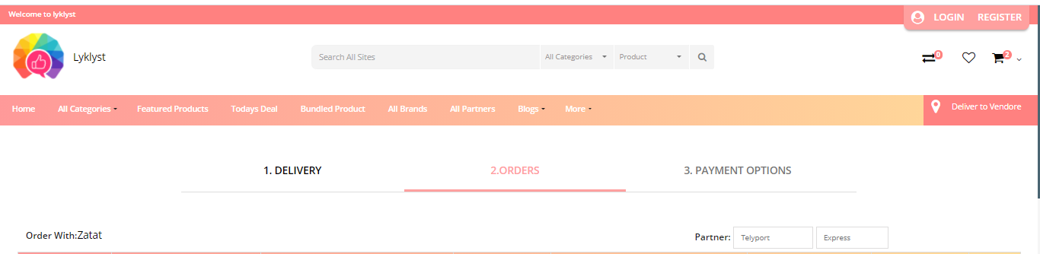
As per the requirement we need to have Delivery Options = Same Day / Not same Day / Courier
Based on the Delivery Options you need populate the Delivery Date
Based on the Delivery Options the partner should be automatically populated
Give a message or Information to choose Delivery Option

Slide 3
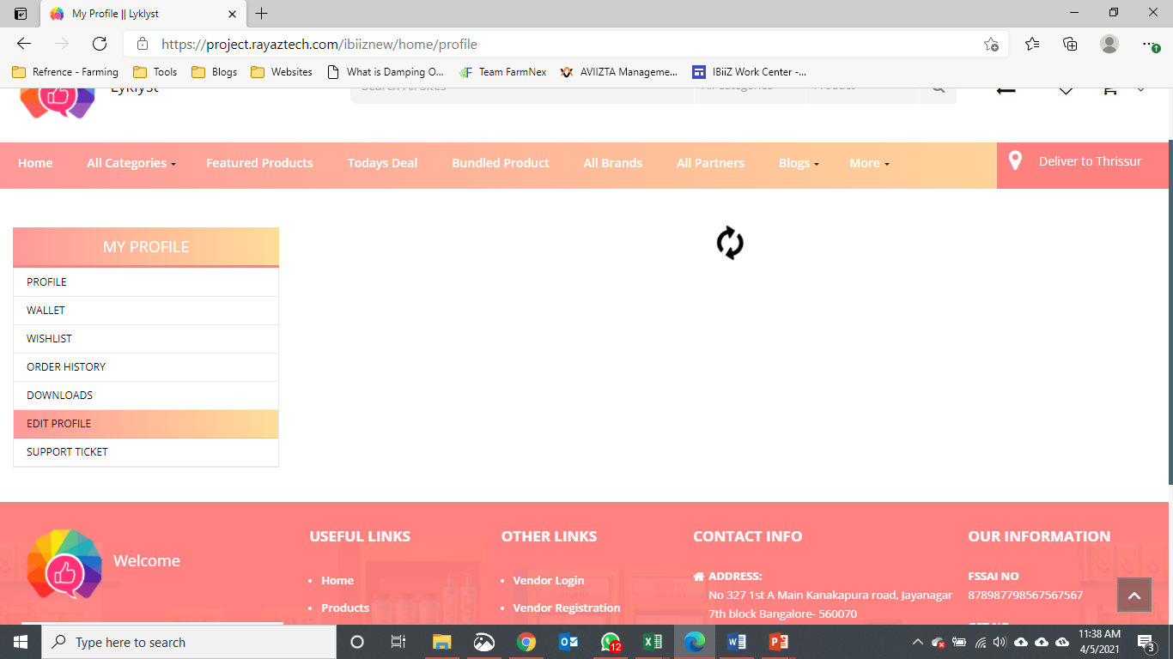
Edit profile not working properly, page not loading

Slide 4
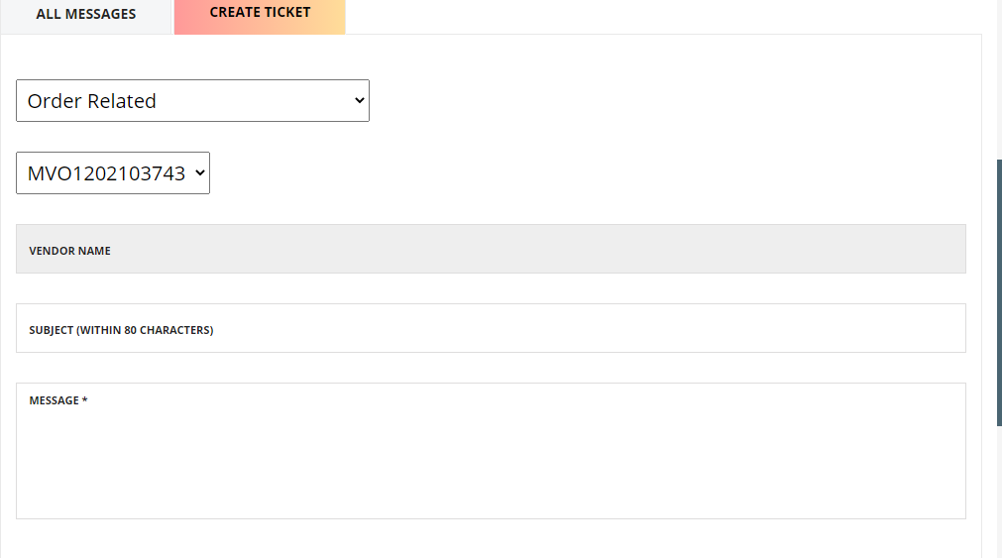
Vendor not able to be selected

Slide 5
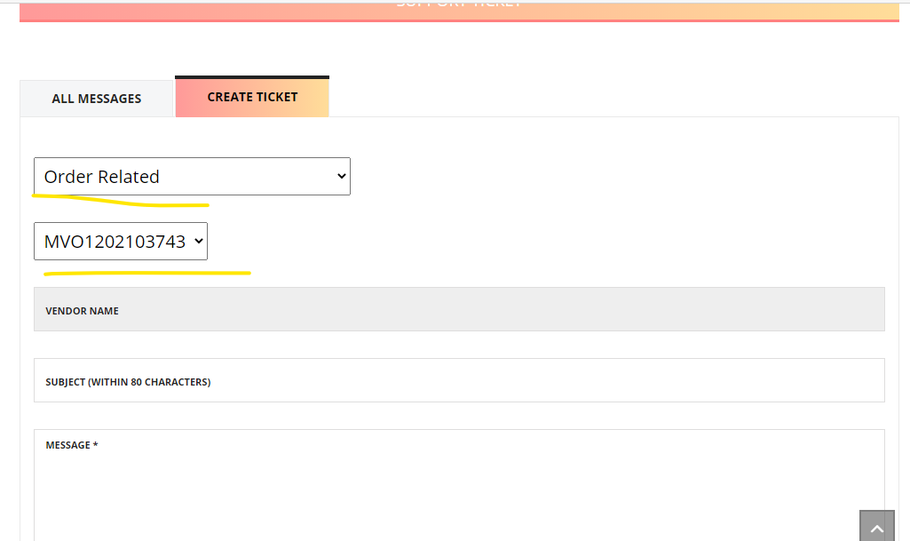
Check the font size and style, it should be as per the other font / styles

Slide 6
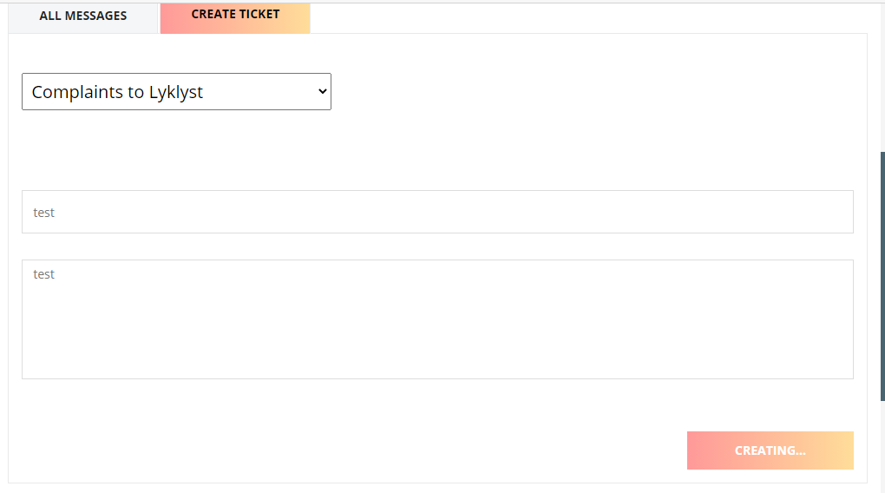
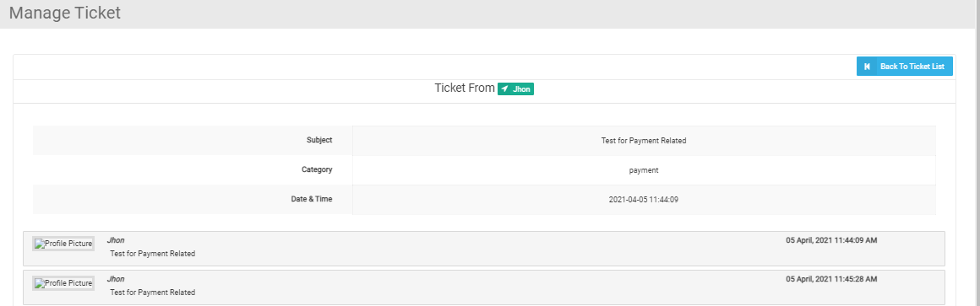
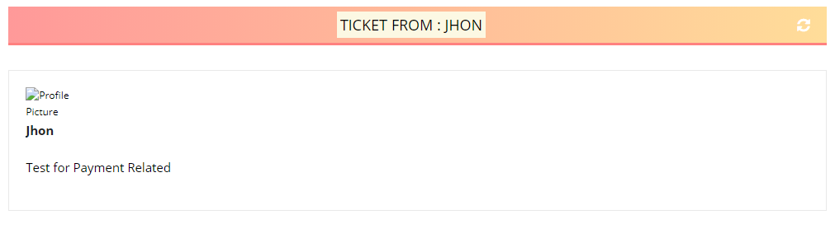
Change this to create Profile Image is not appearing

Slide 7
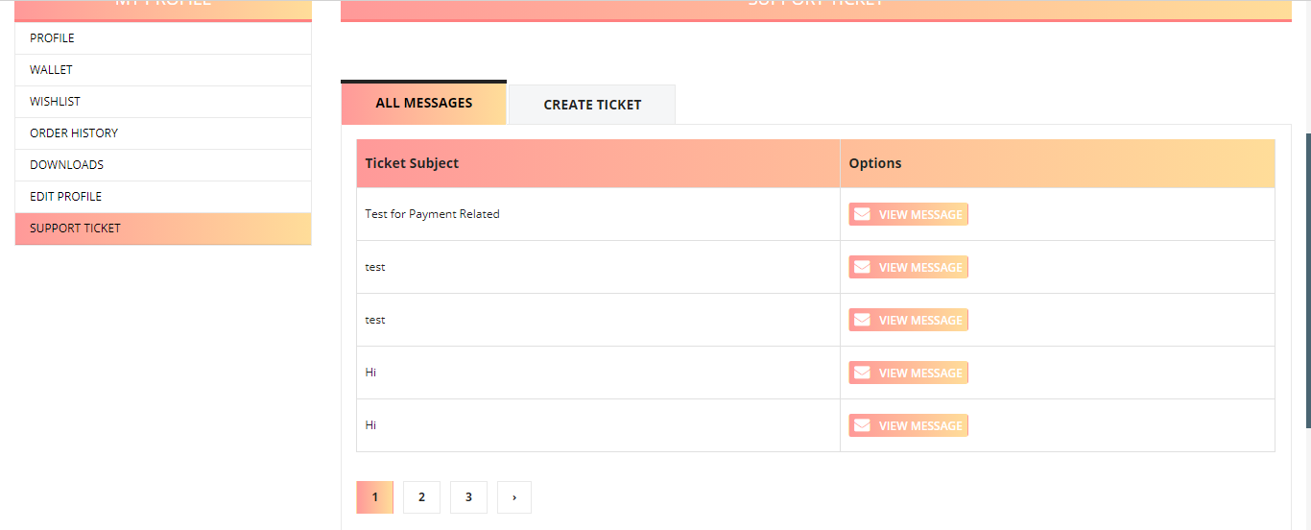
Sort by Latest Ticket in Customer vendor & Admin Panel

Slide 8
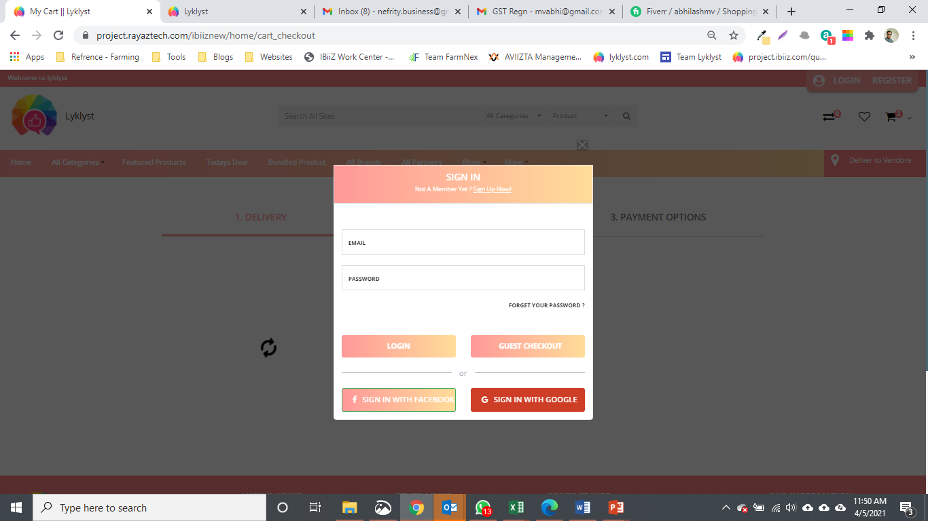
Disable Guest Checkout

