Slide 1
Chapter 4
Mathematical Expectation

Slide 2
Section 4.1
Mean of a Random Variable

Slide 3
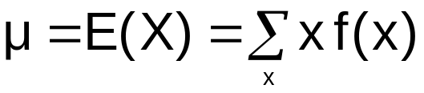
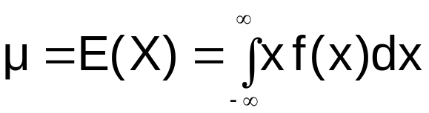
Mean / Expected value
Definition
Definition:
Let X be a random variable with probability /
Density function f(x). The mean or expected value of X is give by
if X is discrete, and
if X is continuous.

Slide 4
Mean / Expected value
Interpretation
Interpretation:
The total contribution of a value multiplied by the probability of the value – a weighted average.
Example:
Mean value= 1,5
f(x)
0.4
0.3
0.2
0.1
0 1 2 3
x

Slide 5
Example
Example: (Example 3.3)
A shipment of 8 similar microcomputers to a retail outlet contains 3 that are defective and 5 are non-defective. If a school makes a random purchase of 2 of these computers, find the expected number of defective computers purchased

Slide 6



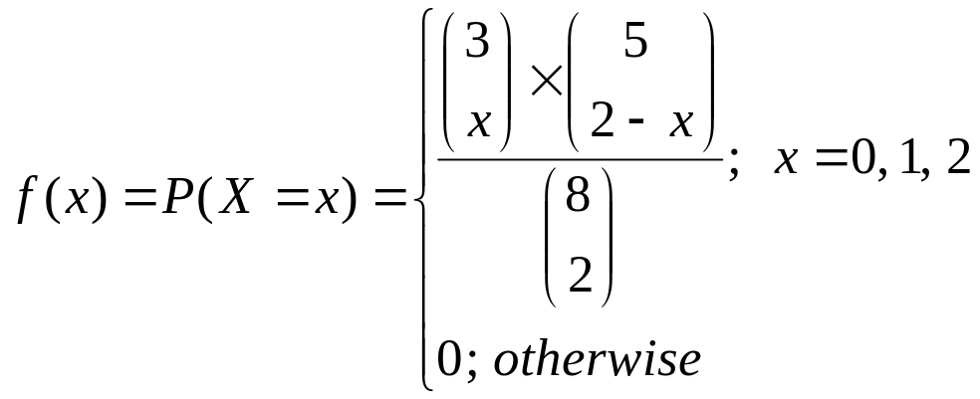
Solution
Solution:
Let X = the number of defective computers purchased.
In Example 3.3, we found that the probability distribution of X is:
x | 0 | 1 | 2
F(x)=p(X=x)
or:

Slide 7
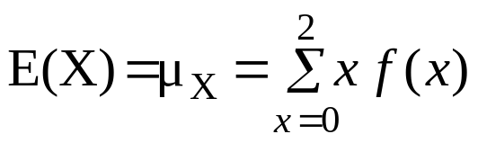
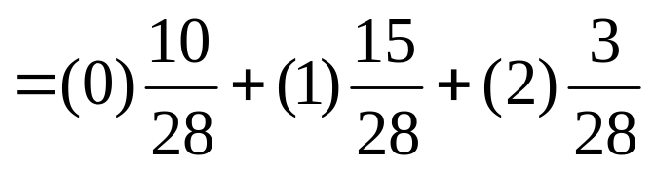
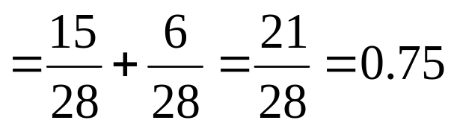
Solution
The expected value of the number of defective computers purchased is the mean (or the expected value) of X, which is:
= (0) f(0) + (1) f(1) +(2) f(2)
(computers)

Slide 8
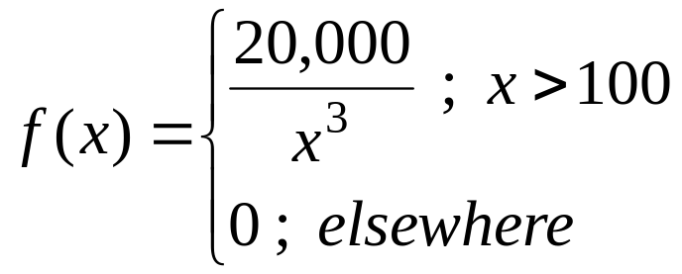
Example
Example 4.3:
Let X be a continuous random variable that represents the life (in hours) of a certain electronic device. The pdf of X is given by:
Find the expected life of this type of devices.

Slide 9
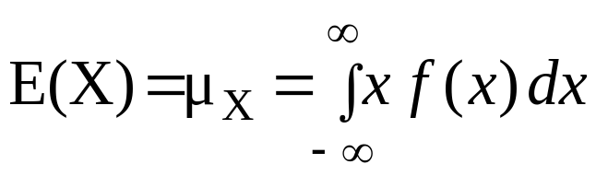
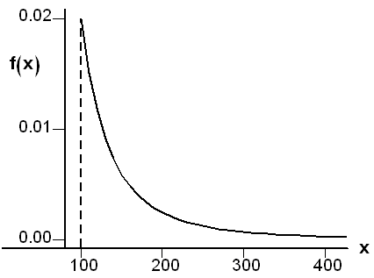
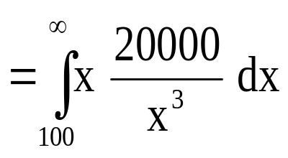
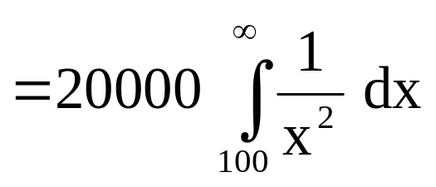
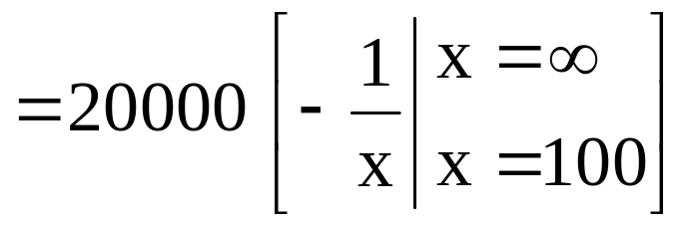
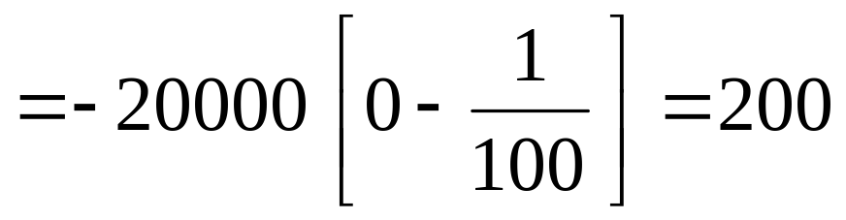
Solution:
(hours)
Therefore, we expect that this type of electronic devices to last, on average, 200 hours.

Slide 10
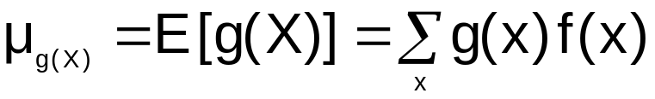
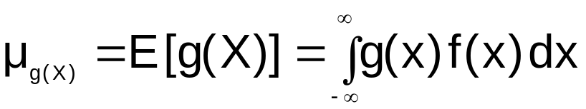
Mean / Expected value
Function of a random variable
Theorem:
Let X be a random variable with probability / density function f(x). The expected value of g(X) is
if X is discrete, and
if X is continuous.
lecture 3

Slide 11
Example
Example:
Let X be a discrete random variable with the following probability distribution
x | 0 | 1 | 2
f(x)
Find E[g(X)], where g(X)=(X −1)².

Slide 12
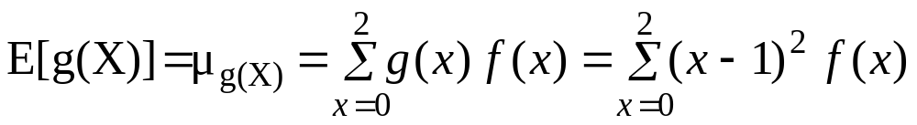


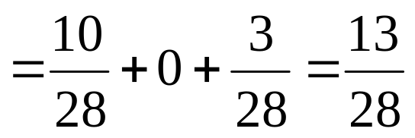
Solution
g(X)=(X −1)²
= (0−1)² f(0) + (1−1)² f(1) +(2−1)² f(2)
= (−1)²
+ (0)²
+(1)²

Slide 13
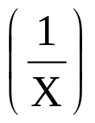
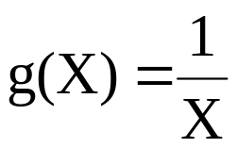
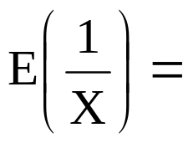
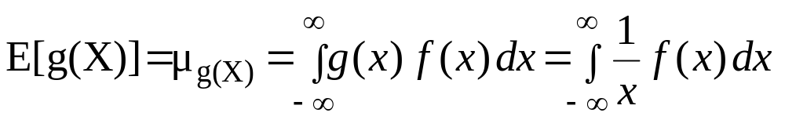
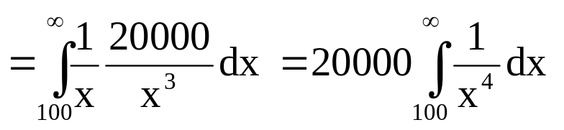
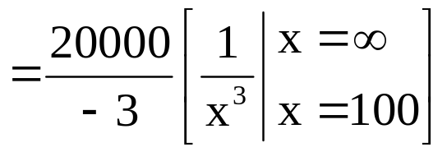
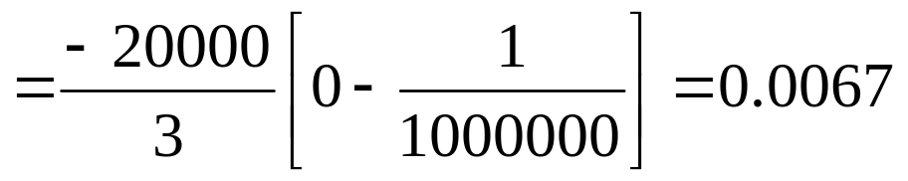
Example:
In Example 4.3, find E .
Solution:

Slide 14
Expected value
Linear combination
Theorem: Linear combination
Let X be a random variable (discrete or continuous), and let a and b be constants. For the random variable aX + b we have
      E(aX+b) = aE(X)+b
lecture 3

Slide 15
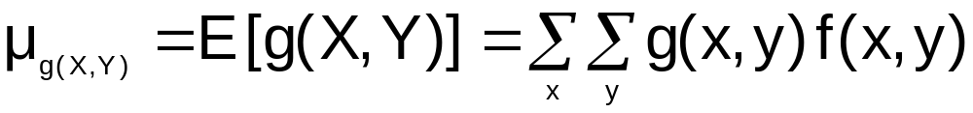
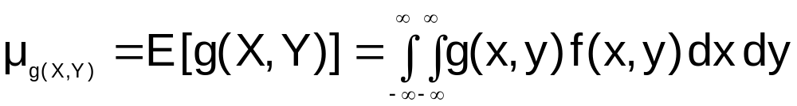
Mean / Expected value
Joint Function of two random variables
Definition:
Let X and Y be random variables with joint probability / density function f(x,y). The expected value of g(X,Y) is
if X and Y are discrete, and
if X and Y are continuous.
lecture 3

Slide 16

Mean / Expected value
Function of two random variables
Problem:
Burger King sells both via “drive-in” and “walk-in”.
Let X and Y be the fractions of the opening hours that “drive-in” and “walk-in” are busy.
Assume that the joint density for X and Y are given by
f(x,y) = {
4xy 0 ≤ x ≤ 1 , 0 ≤ y ≤ 1
0 otherwise
The turn over g(X,Y) on a single day is given by
        g(X,Y) = 6 X + 9Y
What is the expected turn over on a single day?
lecture 3

Slide 17
Mean / Expected value
Sums and products
Theorem: Sum/Product
Let X and Y be random variables then
E[X+Y] = E[X] + E[Y]
If X and Y are independent then
E[X Y] = E[X] E[Y]
.
.
lecture 3

Slide 18
Section 4.2
Variance and Covariance of Random Variables

Slide 19
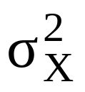
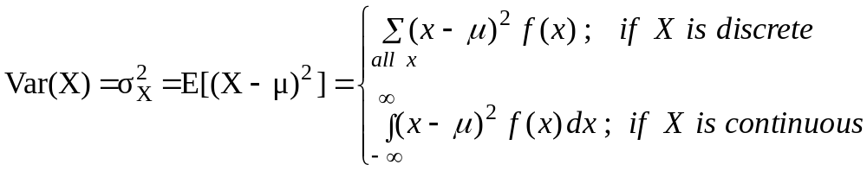
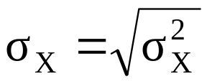
Variance
4.2 Variance (of a Random Variable):
The most important measure of variability of a random variable X is called the variance of X and is denoted by Var(X) or .
Definition 4.3:
Let X be a random variable with a probability distribution f(x) and mean μ. The variance of X is defined by:
Definition:
The positive square root of the variance of X, ,is called the standard deviation of X.
Note:
Var(X)=E[g(X)], where g(X)=(X −μ)²

Slide 20

Variance Interpretation
The variance expresses, how dispersed the density / probability function is around the mean.
Varians = 0.5
Varians = 2
f(x)
f(x)
0.5
0.5
0.4
0.4
0.3
0.3
0.2
0.2
0.1
0.1
1 2 3
x
0 1 2 3 4
x
Rewrite of the variance:

Slide 21
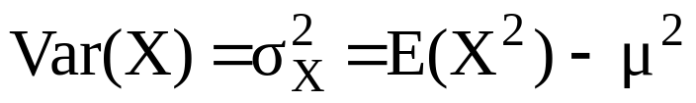
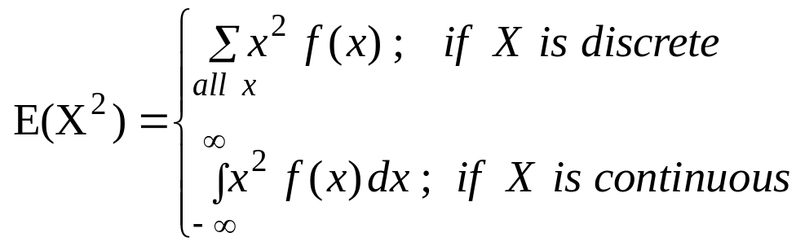
Theorem 4.2:
The variance of the random variable X is given by:
where
Example 4.9:
Let X be a discrete random variable with the following probability distribution
x | 0 | 1 | 2 | 3
f(x) | 0.15 | 0.38 | 0.10 | 0.01
Find Var(X)= .

Slide 22
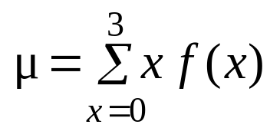
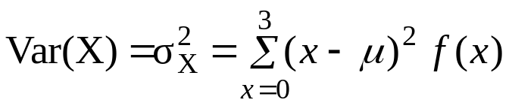
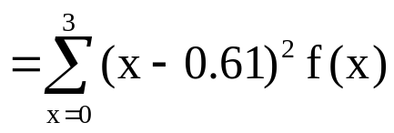
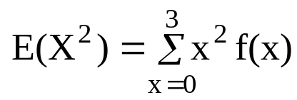
Solution:
= (0) f(0) + (1) f(1) +(2) f(2) + (3) f(3)
= (0) (0.51) + (1) (0.38) +(2) (0.10) + (3) (0.01) = 0.61
1. First method:
=(0−0.61)² f(0)+(1−0.61)² f(1)+(2−0.61)² f(2)+ (3−0.61)² f(3)
=(−0.61)² (0.51)+(0.39)² (0.38)+(1.39)² (0.10)+ (2.39)² (0.01)
= 0.4979
2. Second method:
= (0²) f(0) + (1²) f(1) +(2²) f(2) + (3²) f(3)
= (0) (0.51) + (1) (0.38) +(4) (0.10) + (9) (0.01) = 0.87
=0.87 − (0.61)² = 0.4979

Slide 23
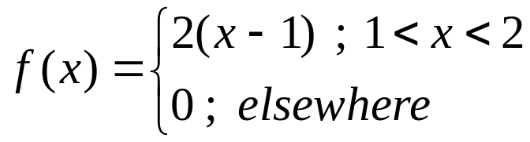
Example
Example 4.10:
Let X be a continuous random variable with the following pdf:
Find the mean and the variance of X.

Slide 24
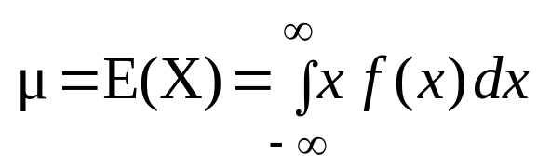
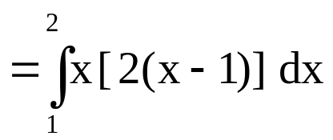
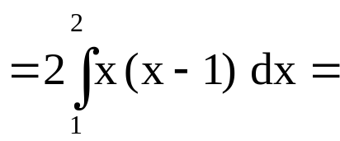
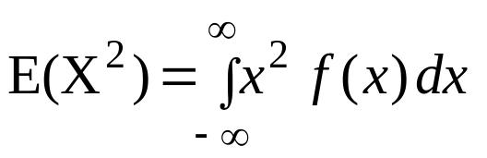
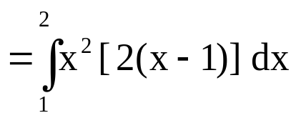
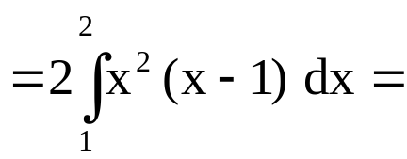
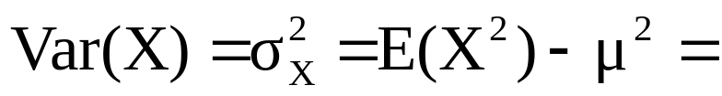
Solution:
5/3
17/6
17/6 – (5/3)² = 1/18

Slide 25

Variance
Linear combinations
Theorem: Linear combination
Let X be a random variable, and let a be b constants.
For the random variable aX + b the variance is
Examples:
Var (X + 7) = Var (X)
        Var (-X ) = Var (X)
Var ( 2X ) = 4 Var (X)
lecture 3

Slide 26
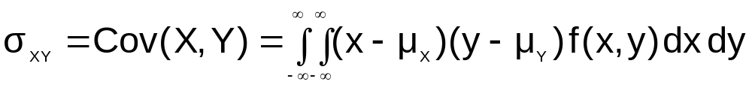
Covariance
Definition
Definition:
Let X and Y be to random variables with joint probability / density function f(x,y). The covariance between X and Y is
if X and Y are discrete, and
if X and Y are continuous.

Slide 27

Covariance
Interpretation
Covariance between X and Y expresses how X and Y influence each other.
Examples: Covariance between
X = sale of bicycle and Y = bicycle pumps is positive.
X = Trips booked to Spain and Y = outdoor temperature is negative.
X = # eyes on red dice and Y = # eyes on the green dice is zero.
lecture 3

Slide 28
Covariance
Properties
Theorem:
The covariance between two random variables X and Y with means μ_{X} and μ_{Y}, respectively, is
Notice! Cov (X,X) = Var (X)
If X and Y are independent random variables, then
Cov (X,Y) = 0
Notice! Cov(X,Y) = 0 does not imply independence!

Slide 29
Variance/Covariace
Linear combinations
Theorem: Linear combination
Let X and Y be random variables, and let a and b be
constants.
For the random variables aX + bY the variance is
Specielt: Var[X+Y] = Var[X] + Var[Y] +2Cov (X,Y)
If X and Y are independent, the variance is
Var[X+Y] = Var[X] + Var[Y]

Slide 30
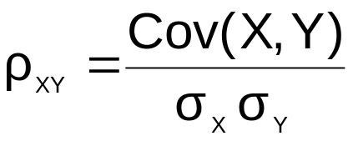


Correlation
Definition
Definition:
Let X and Y be two random variables with covariance
Cov (X,Y) and standard deviations σ_{X} and σ_{Y}, respectively.
The correlation coefficient of X and Y is
It holds that
If X and Y are independent, then
lecture 3

Slide 31
Section 4.3
Means and Variances of Linear Combinations of Random Variables

Slide 32
Theorem 4.5:
If X is a random variable with mean μ=E(X), and if a and b are constants, then:
E(aX±b) = a E(X) ± b
⇔
μ_{aX±b} = a μ_{X} ± b
Corollary 1: E(b) = b (a=0 in Theorem 4.5)
Corollary 2: E(aX) = a E(X) (b=0 in Theorem 4.5)
Copyright © 2010 Pearson Addison-Wesley. All rights reserved.
4 - <number>

Slide 33
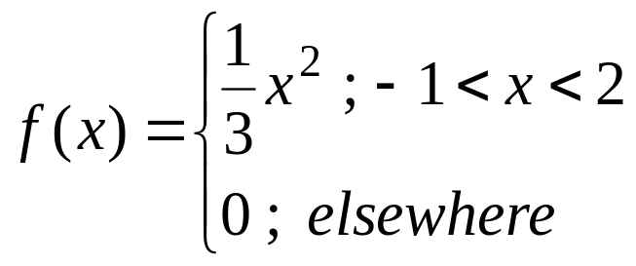
Example 4.16:
Let X be a random variable with the following probability density function:
Find E(4X+3).

Slide 34
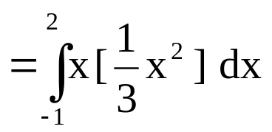
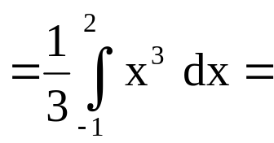
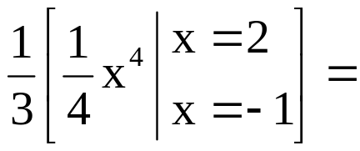
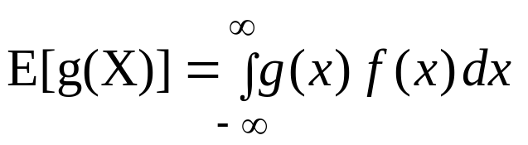


Solution:
5/4
E(4X+3) = 4 E(X)+3 = 4(5/4) + 3=8
Another solution:
; g(X) = 4X+3
E(4X+3) =

Slide 35

4.3 Means and Variances of Linear Combinations of Random Variables:
If X₁, X₂, …, X_{n} are n random variables and a₁, a₂, …, a_{n} are constants, then the random variable :
is called a linear combination of the random variables X₁,X₂,…,X_{n}.

Slide 36

Theorem:
If X₁, X₂, …, X_{n} are n random variables and a₁, a₂, …, a_{n} are constants, then:
E(a₁X₁+a₂X₂+ … +a_{n}X_{n}) = a₁E(X₁)+ a₂E(X₂)+ …+a_{n}E(X_{n})
⇔
Corollary:
If X, and Y are random variables, then:
E(X ± Y) = E(X) ± E(Y)

Slide 37


Theorem 4.9:
If X is a random variable with variance and if a and b are constants, then:
Var(aX±b) = a² Var(X)
⇔

Slide 38




Theorem:
If X₁, X₂, …, X_{n} are n independent random variables and a₁, a₂, …, a_{n} are constants, then:
Var(a₁X₁+a₂X₂+…+a_{n}X_{n})
= Var(X₁)+ Var (X₂)+…+ Var(X_{n})
⇔
⇔

Slide 39
Corollary:
If X, and Y are independent random variables, then:
· Var(aX+bY) = a² Var(X) + b² Var (Y)
· Var(aX−bY) = a² Var(X) + b² Var (Y)
· Var(X ± Y) = Var(X) + Var (Y)

Slide 40
Example:
Let X, and Y be two independent random variables such that E(X)=2, Var(X)=4, E(Y)=7, and Var(Y)=1. Find:
1. E(3X+7) and Var(3X+7)
2. E(5X+2Y−2) and Var(5X+2Y−2).

Slide 41
Example:
Let X, and Y be two independent random variables such that E(X)=2, Var(X)=4, E(Y)=7, and Var(Y)=1. Find:
1. E(3X+7) and Var(3X+7)
2. E(5X+2Y−2) and Var(5X+2Y−2).
Solution:
1. E(3X+7) = 3E(X)+7 = 3(2)+7 = 13
Var(3X+7)= (3)² Var(X)=(3)² (4) =36
2. E(5X+2Y−2)= 5E(X) + 2E(Y) −2= (5)(2) + (2)(7) − 2= 22
Var(5X+2Y−2)= Var(5X+2Y)= 5² Var(X) + 2² Var(Y)
= (25)(4)+(4)(1) = 104

Slide 42

Theorem 4.7
Copyright © 2010 Pearson Addison-Wesley. All rights reserved.
4 - <number>

Slide 43
Section 4.4
Chebyshev’s Theorem

Slide 44



4.4 Chebyshev's Theorem:
* Suppose that X is any random variable with mean E(X)=μ and variance Var(X)= and standard deviation σ.
* Chebyshev's Theorem gives a conservative estimate of the probability that the random variable X assumes a value within k standard deviations (kσ) of its mean μ, which is P(μ− kσ <X< μ +kσ).
* P(μ− kσ <X< μ +kσ)≈ 1−

Slide 45

Let X be a random variable with mean E(X)=μ and variance Var(X)=σ², then for k>1, we have:
P(μ− kσ <X< μ +kσ) ≥ 1− ⇔ P(|X −μ| < kσ) ≥ 1−
Example 4.22:
Let X be a random variable having an unknown distribution with mean μ=8 and variance σ²=9 (standard deviation σ=3). Find the following probability:
(a) P(−4 <X< 20)
(b) P(|X−8| ≥ 6)

Slide 46



Slide 47



Slide 48


Slide 49
Section 4.5
Review

Slide 50
Mean / Expected value
Definition
Definition:
Let X be a random variable with probability /
Density function f(x). The mean or expected value of X is give by
if X is discrete, and
if X is continuous.

Slide 51

Definition 4.1
Copyright © 2010 Pearson Addison-Wesley. All rights reserved.
4 - <number>

Slide 52

Theorem 4.2
Copyright © 2010 Pearson Addison-Wesley. All rights reserved.
4 - <number>

Slide 53

Definition 4.3
Copyright © 2010 Pearson Addison-Wesley. All rights reserved.
4 - <number>

Slide 54

Theorem 4.3
Copyright © 2010 Pearson Addison-Wesley. All rights reserved.
4 - <number>

Slide 55

Definition 4.4
Copyright © 2010 Pearson Addison-Wesley. All rights reserved.
4 - <number>

Slide 56

Theorem 4.6
Copyright © 2010 Pearson Addison-Wesley. All rights reserved.
4 - <number>

