Slide 1
Chapter 5
Some Discrete Probability Distributions

Slide 2
Discrete distributions
Four important discrete distributions:
The Uniform distribution (discrete)
The Binomial distribution
The Hyper-geometric distribution
The Poisson distribution

Slide 3
Section 5.2
Uninform
Distribution

Slide 4
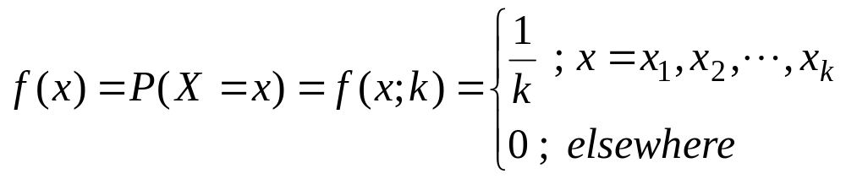
Uniform distribution
Definition
Experiment with k equally likely outcomes.
Definition:
If the discrete random variable X assumes the values x₁, x₂, …, x_{k} with equal probabilities, then X has the discrete uniform distribution given by:
Note:
f(x)=f(x;k)=P(X=x)
k is called the parameter of the distribution.

Slide 5
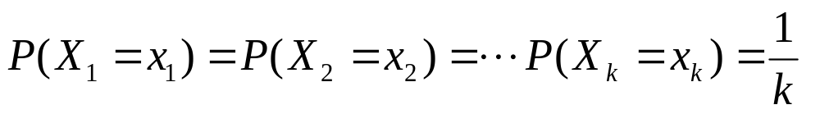
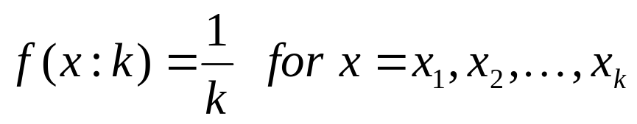
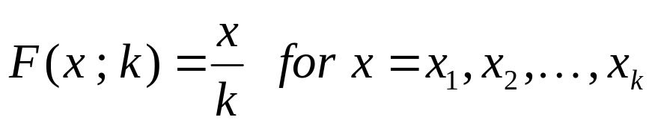
Uniform distribution
Definition
Let X: S → R be a discrete random variable. If
then the distribution of X is the (discrete) uniform distribution.
Probability function:
(Cumulative) distribution function:
lecture 4

Slide 6
Example
Example 5.2:
· Experiment: tossing a balanced die.
· Sample space: S={1,2,3,4,5,6}
· Each sample point of S occurs with the same probability 1/6.
· Let X= the number observed when tossing a balanced die.
The probability distribution of X is:

Slide 7
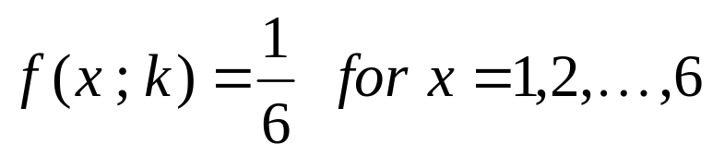
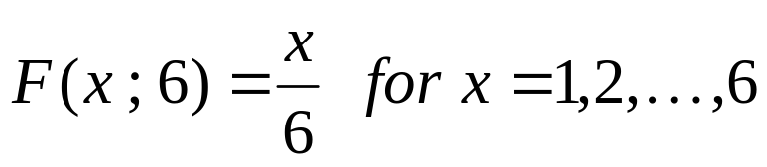
Uniform distribution
Example
Example: Rolling a dice
X: # eyes
f(x)
0.4
0.3
0.2
0.1
1 2 3 4 5 6
x
Probability function:
Distribution function:
lecture 4

Slide 8
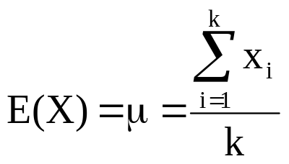
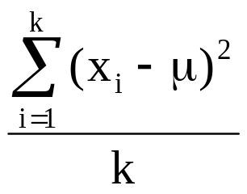
Theorem 5.1:
If the discrete random variable X has a discrete uniform distribution with parameter k, then the mean and the variance of X are:
Var(X) = σ² =

Slide 9
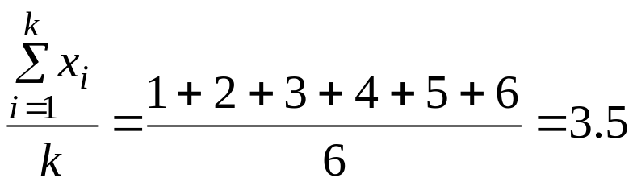
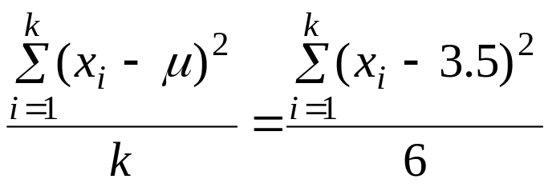
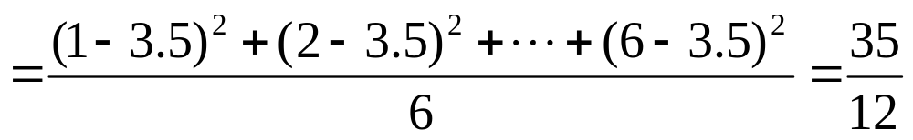
Example 5.3:
Find E(X) and Var(X) in Example 5.2.
Solution:
E(X) = μ =
Var(X) = σ² =

Slide 10
Section 5.2
Binomial
Distribution

Slide 11
Bernoulli Trial:
Bernoulli trial is an experiment with only two possible outcomes.
The two possible outcomes are labeled:
success (s) and failure (f)
The probability of success is P(s)=p and the probability of failure is P(f)= q = 1−p.
Examples:
1. Tossing a coin (success=H, failure=T, and p=P(H))
2. Inspecting an item (success=defective, failure=non- defective, and p=P(defective))

Slide 12
Bernoulli Process:
Bernoulli process is an experiment that must satisfy the following properties:
1. The experiment consists of n repeated Bernoulli trials.
2. The probability of success, P(s)=p, remains constant from trial to trial.
3. The repeated trials are independent; that is the outcome of one trial has no effect on the outcome of any other trial

Slide 13
Binomial distribution
Bernoulli process
Repeating an experiment with two possible outcomes.
Bernoulli process:
1. The experiment consists in repeating the same trail n times.
2. Each trail has two possible outcomes: “success” or “failure”, also known as Bernoulli trail.
3. P(”success”) = p is the same for all trails.
4. The trails are independent.

Slide 14
Binomial Random Variable:
Consider the random variable :
X = The number of successes in the n trials in a Bernoulli
process
The random variable X has a binomial distribution with parameters n (number of trials) and p (probability of success), and we write:
X ~ Binomial(n,p)

Slide 15
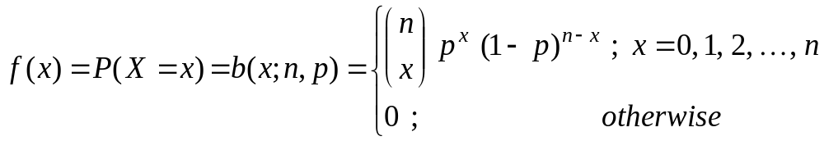
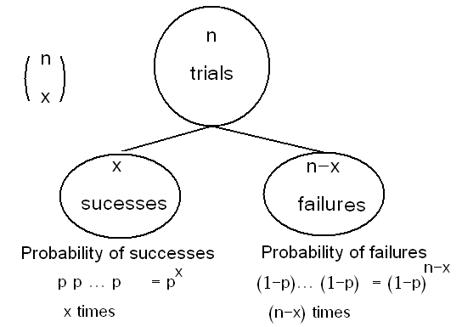
The probability distribution of X is given by:

Slide 16
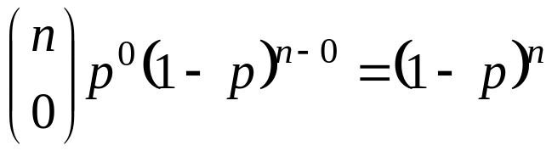
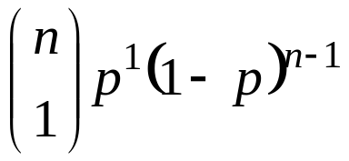


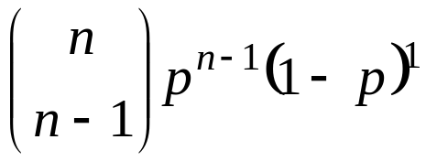
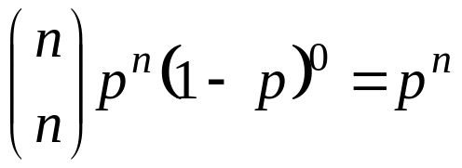
We can write the probability distribution of X
as a table as follows.
x | f(x)=P(X=x)=b(x;n,p)
0
1
2
n − 1
n
Total | 1.00

Slide 17
Example:
Suppose that 25% of the products of a manufacturing process are defective. Three items are selected at random, inspected, and classified as defective (D) or non-defective (N). Find the probability distribution of the number of defective items.

Slide 18
Solution:
· Experiment: selecting 3 items at random, inspected, and classified as (D) or (N).
· The sample space is
S={DDD,DDN,DND,DNN,NDD,NDN,NND,NNN}
· Let X = the number of defective items in the sample
· We need to find the probability distribution of X.

Slide 19
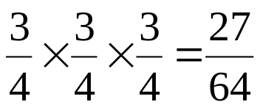
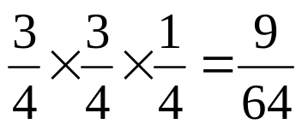
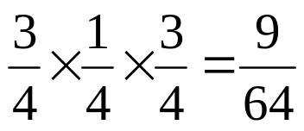
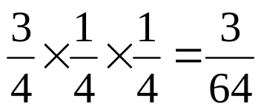
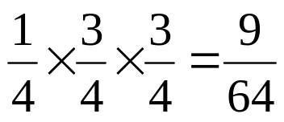
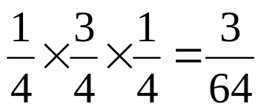
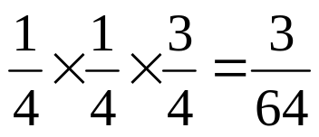
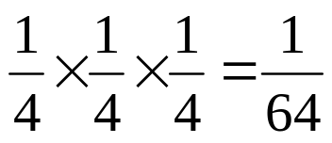
(1) First Solution:
Outcome | Probability | X
NNN |  | 0
NND |  | 1
NDN |  | 1
NDD |  | 2
DNN |  | 1
DND |  | 2
DDN |  | 2
DDD |  | 3

Slide 20

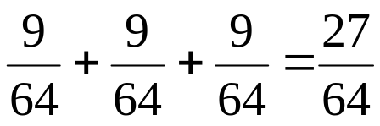
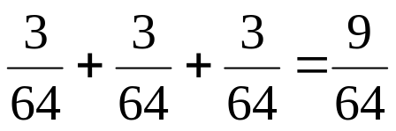

The probability distribution of X is
x | f(x)=P(X=x)
0
1
2
3

Slide 21
(2) Second Solution:
Bernoulli trial is the process of inspecting the item. The results are success=D or failure=N, with probability of success P(s)=25/100=1/4=0.25.
The experiments is a Bernoulli process with:
· number of trials: n=3
· Probability of success: p=1/4=0.25
· X ~ Binomial(n,p)=Binomial(3,1/4)

Slide 22
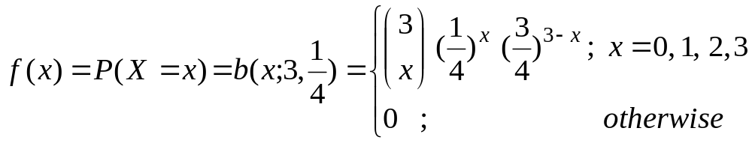
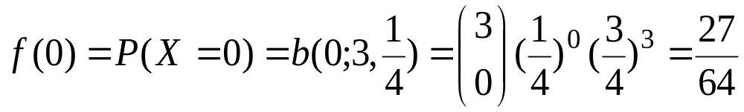
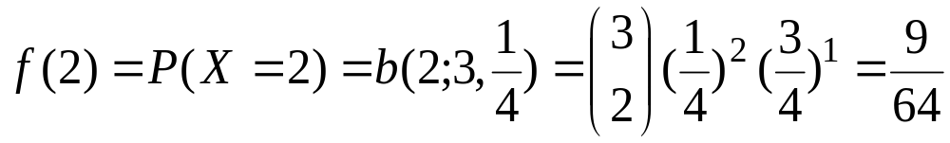
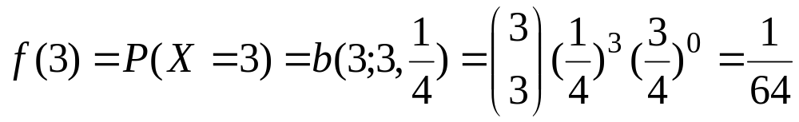
The probability distribution of X is given by:
The probability distribution of X is
x | f(x)=P(X=x) =b(x;3,1/4)
0 | 27/64
1 | 27/64
2 | 9/64
3 | 1/64

Slide 23
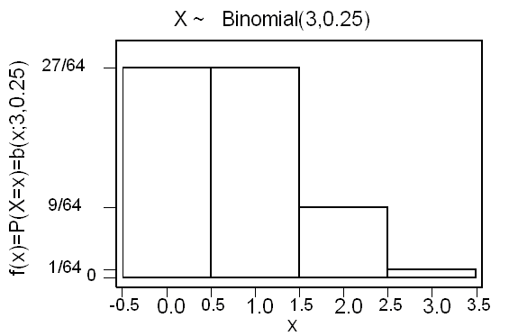

Slide 24
Theorem 5.2:
The mean and the variance of the binomial distribution b(x;n,p) are:
μ = n p
σ² = n p (1 −p)
Copyright © 2010 Pearson Addison-Wesley. All rights reserved.
5 - <number>

Slide 25
Example:
In the previous example, find the expected value (mean) and the variance of the number of defective items.

Slide 26
Example:
In the previous example, find the expected value (mean) and the variance of the number of defective items.
Solution:
· X = number of defective items
· We need to find E(X)=μ and Var(X)=σ²
· We found that X ~ Binomial(n,p)=Binomial(3,1/4)
· .n=3 and p=1/4
The expected number of defective items is
E(X)=μ = n p = (3) (1/4) = 3/4 = 0.75
The variance of the number of defective items is
Var(X)=σ² = n p (1 −p) = (3) (1/4) (3/4) = 9/16 = 0.5625

Slide 27
Example:
In the previous example, find the following probabilities:
(1) The probability of getting at least two defective items.
(2) The probability of getting at most two defective items.

Slide 28
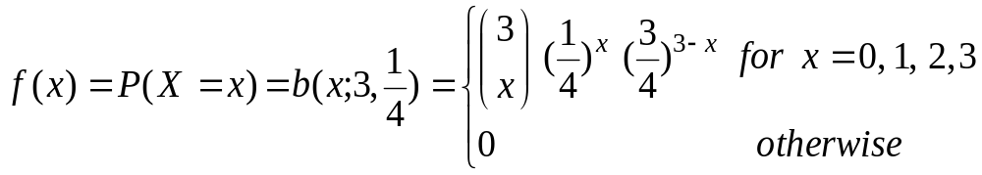
Solution:
X ~ Binomial(3,1/4)
x | .f(x)=P(X=x)=b(x;3,1/4)
0 | 27/64
1 | 27/64
2 | 9/64
3 | 1/64

Slide 29
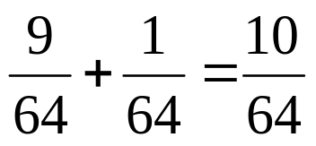
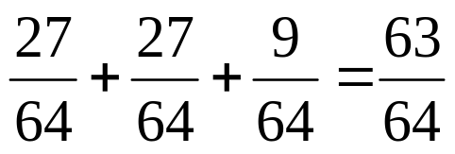
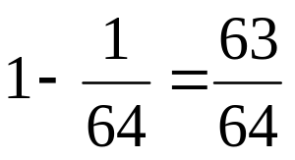
The probability of getting at least two defective items:
P(X≥2)=P(X=2)+P(X=3)= f(2)+f(3)=
(2) The probability of getting at most two defective item:
P(X≤2) = P(X=0)+P(X=1)+P(X=2)
= f(0)+f(1)+f(2) =
or
P(X≤2)= 1−P(X>2) = 1−P(X=3) = 1− f(3) =

Slide 30
Section 5.3
Hypergeometric Distribution

Slide 31
Hyper-geometric distribution
Hyper-geometric experiment
Hyper-geometric experiment:
1. n elements chosen from N elements without replacement.
2. k of these N elements are ”successes” and N-k are ”failures”
Notice!! Unlike the binomial distribution the selection is done without replacement and the experiments and not independent.
Often used in quality control.

Slide 32
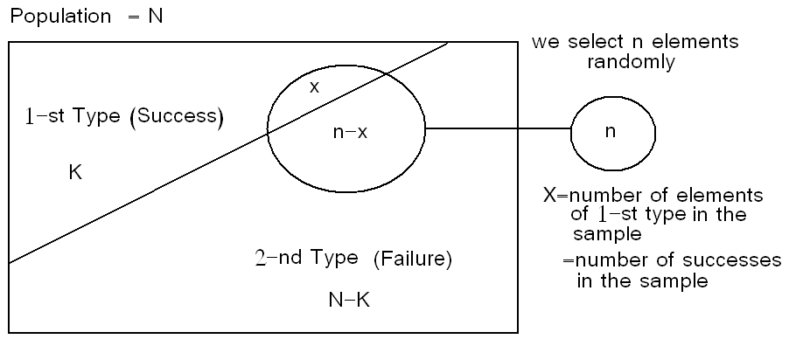
5.4 Hypergeometric Distribution :
Suppose there is a population with 2 types of elements:
1-st Type = success
2-nd Type = failure
N= population size
K= number of elements of the 1-st type
N −K = number of elements of the 2-nd type

Slide 33
We select a sample of n elements at random from the population
Let X = number of elements of 1-st type (number of successes) in the sample
We need to find the probability distribution of X.

Slide 34
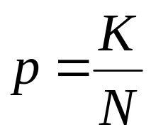
There are to two methods of selection:
1. selection with replacement
(1) If we select the elements of the sample at random and with replacement, then
X ~ Binomial(n,p); where
2. selection without replacement
(2) Now, suppose we select the elements of the sample at random and without replacement. When the selection is made without replacement, the random variable X has a hyper geometric distribution with parameters N, n, and K. and we write X~h(x;N,n,K).

Slide 35
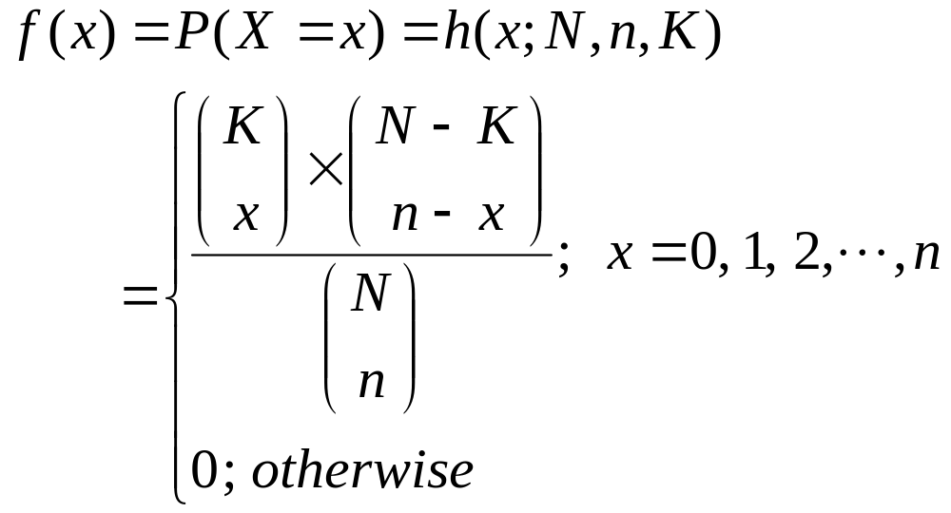
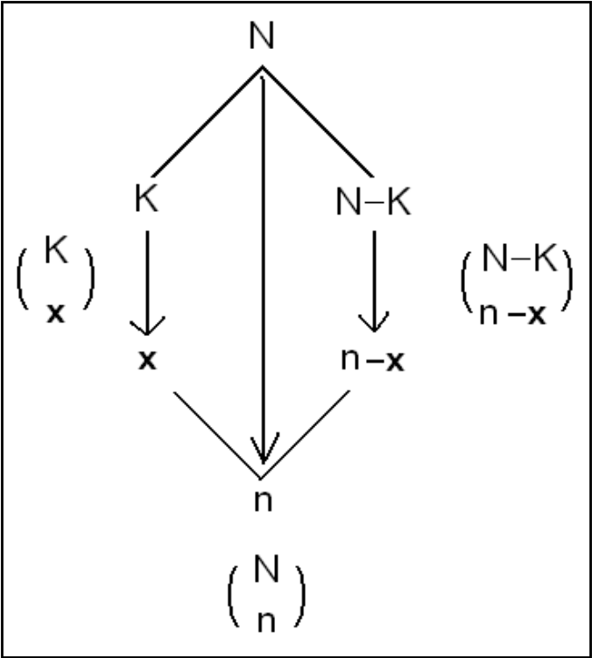
Note that the values of X must satisfy:
0≤x≤K and 0≤n−x≤ N−K
⇔
0≤x≤K and n−N+K≤ x≤ n

Slide 36
Example 5.9:
Lots of 40 components each are called acceptable if they contain no more than 3 defectives. The procedure for sampling the lot is to select 5 components at random (without replacement) and to reject the lot if a defective is found. What is the probability that exactly one defective is found in the sample if there are 3 defectives in the entire lot.

Slide 37
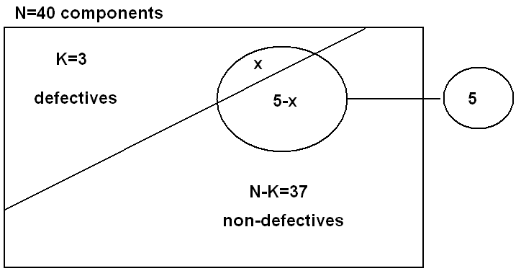
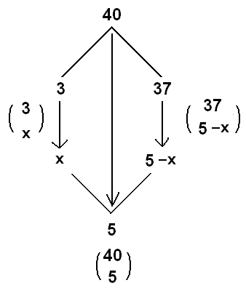
Solution:

Slide 38
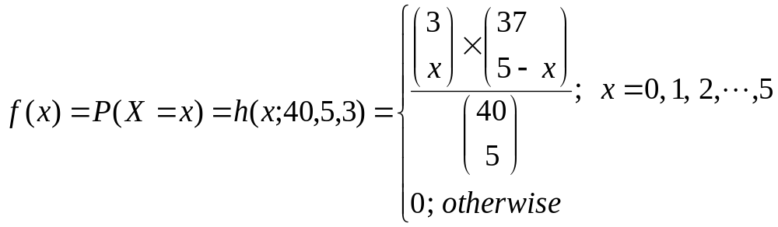
· Let X= number of defectives in the sample
· N=40, K=3, and n=5
· X has a hypergeometric distribution with parameters N=40, n=5, and K=3.
· X~h(x;N,n,K)=h(x;40,5,3).
· The probability distribution of X is given by:

Slide 39
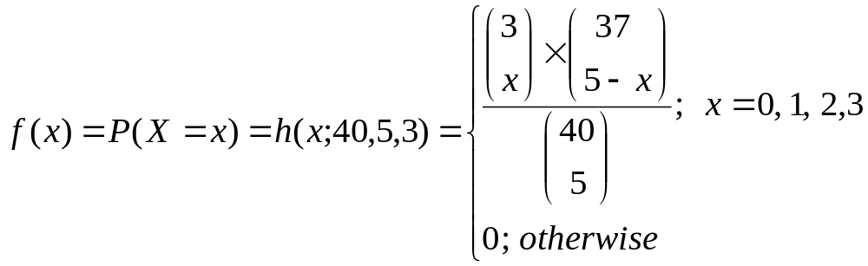
But the values of X must satisfy:
0≤x≤K and n−N+K≤ x≤ n ⇔ 0≤x≤3 and −42≤ x≤ 5
Therefore, the probability distribution of X is given by:

Slide 40
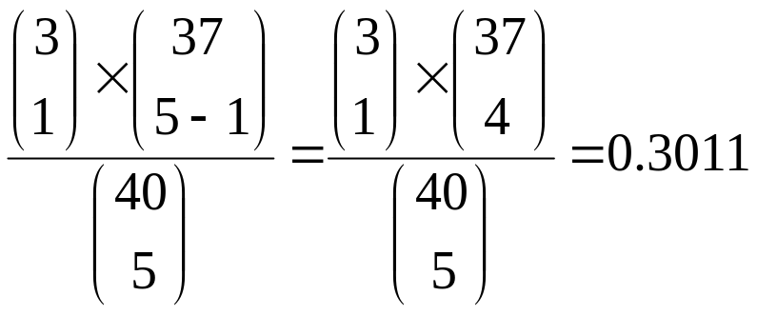
Now, the probability that exactly one defective is found in the sample is
f(1)=P(X=1)=h(1;40,5,3)=

Slide 41
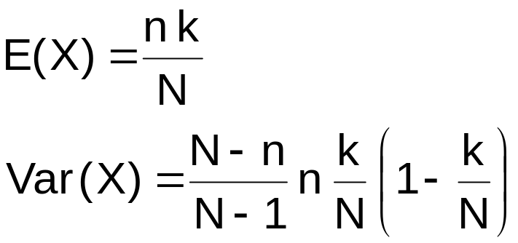
Hyper-geometric distribution
Mean & variance
Theorem:
If X ~ hg(N,n,k), then
  mean of X:
  variance of X:
lecture 4

Slide 42
Example 5.10:
In Example 5.9, find the expected value (mean) and the variance of the number of defectives in the sample.
Solution:
· X = number of defectives in the sample
· We need to find E(X)=μ and Var(X)=σ²
· We found that X ~ h(x;40,5,3)
· N=40, n=5, and K=3

Slide 43
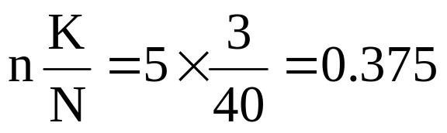
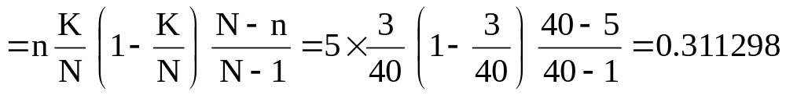
The expected number of defective items is
E(X)=μ =
The variance of the number of defective items is
Var(X)=σ²

Slide 44
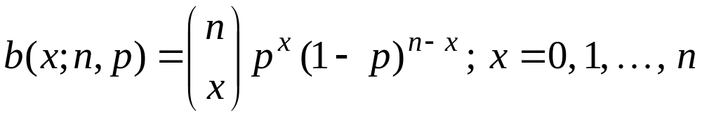
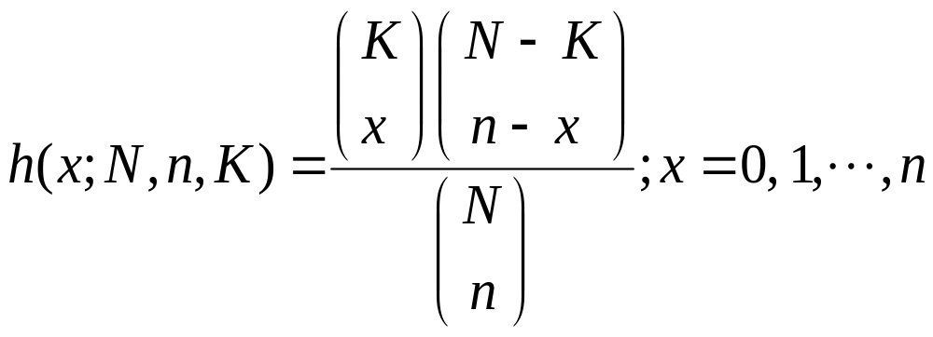
Relationship to the binomial distribution:
* Binomial distribution:
* Hypergeometric distribution:

Slide 45


Copyright © 2010 Pearson Addison-Wesley. All rights reserved.
5 - <number>

Slide 46
Section 5.5
Poisson Distribution and the Poisson Process

Slide 47
Poisson experiment is an experiment yielding numerical values of a random variable that count the number of outcomes occurring in a given time interval or a specified region denoted by t.
X = The number of outcomes occurring in a given time
interval or a specified region denoted by t.
Example:
X = number of field mice per acre (t= 1 acre)
X= number of typing errors per page (t=1 page)
X=number of telephone calls received every day (t=1 day)
X=number of telephone calls received every 5 days (t=5 days)
Let λ be the average (mean) number of outcomes per unit time or unit region (t=1).

Slide 48
Poisson distribution
Definition
Definition:
Let the random variable X be the number of events in a time interval of length t from a Poisson process, which has on average λ events pr. unit time.
The distribution of X is called the Poisson distribution with parameter μ = λt.
Notation: X ~ Pois(μ) , where μ = λt

Slide 49

Poisson distribution
The average (mean) number of outcomes (mean of X) in the time interval or region t is:
μ = λ t
· The random variable X is called a Poisson random variable with parameter μ (μ=λt), and we write X~Poisson(μ), if its probability distribution is given by:

Slide 50
Theorem 5.5:
The mean and the variance of the Poisson distribution Poisson(x;μ) are:
μ = λt
σ² = μ= λt
Note:
· λ is the average (mean) of the distribution in the unit time (t=1).
· If X=The number of calls received in a month (unit time t=1 month) and X~Poisson(λ), then:
(i) Y = number of calls received in a year.
Y ~ Poisson (μ); μ=12λ (t=12)
(ii) W = number of calls received in a day.
W ~ Poisson (μ); μ=λ/30 (t=1/30)
Example 5.16: Reading Assignment
Example 5.17: Reading Assignment

Slide 51
Theorem 5.5:
The mean and the variance of the Poisson distribution Poisson(x,μ) are:
μ = λt
σ² = μ= λt
Note:
λ is the average (mean) of the distribution in the unit time (t=1).
If X=The number of calls received in a month (unit time t=1 month) and X~Poisson(λ), then:
(i) Y = number of calls received in a year.
Y ~ Poisson (μ); μ=12λ (t=12)
(ii) W = number of calls received in a day.
W ~ Poisson (μ); μ=λ/30 (t=1/30)
Example 5.16: Reading Assignment
Example 5.17: Reading Assignment

Slide 52
Example:
Suppose that the number of typing errors per page has a Poisson distribution with average 6 typing errors.
(1) What is the probability that in a given page:
(i) The number of typing errors will be 7?
(ii) The number of typing errors will at least 2?
(2) What is the probability that in 2 pages there will be 10 typing errors?
(3) What is the probability that in a half page there will be no typing errors?

Slide 53




Solution:
(1) X = number of typing errors per page.
X ~ Poisson (6) (t=1, λ=6, μ=λt=6)
(i)
(ii) P(X≥2) = P(X=2)+ P(X=3)+ . . . =
P(X≥2) = 1− P(X<2) = 1 − [P(X=0)+ P(X=1)]
=1 − [f(0) + f(1)] = 1 − [ ]
= 1 − [0.00248+0.01487]
= 1 − 0.01735 = 0.982650

Slide 54


(2) X = number of typing errors in 2 pages
X ~ Poisson(12) (t=2, λ=6, μ=λt=12)

Slide 55


(3) X = number of typing errors in a half page.
X ~ Poisson (3) (t=1/2, λ=6, μ=λt=6/2=3)

Slide 56

Theorem 5.6: (Poisson approximation for binomial distribution:
Let X be a binomial random variable with probability distribution b(x;n,p). If n→∞, p→0, and μ=np remains constant, then the binomial distribution b(x;n,p) can approximated by Poisson distribution p(x;μ).
· For large n and small p we have:
b(x;n,p) ≈ Poisson(μ) (μ=np)
Example 5.18: Reading Assignment

Slide 57

Figure 5.1 Poisson density functions for different means
Copyright © 2010 Pearson Addison-Wesley. All rights reserved.
5 - <number>

Slide 58
Section 5.5
Geometric distribution

Slide 59


Geometric distribution
Notes:
Example: The number of days between accidents at a plant.
If an event is unlikely to occur, we should expect a lot of trials to happen before it does.

Slide 60
Examples of Geometric
First car arriving at a service station that needs brake work
Flipping a coin until the first tail is observed
First plane arriving at an airport that needs repair
Number of house showings before a sale is concluded
Length of time(in days) between sales of a large computer system

Slide 61
Example
The drilling records for an oil company suggest that the probability the company will hit oil in productive quantities at a certain offshore location is 0.2 . Suppose the company plans to drill a series of wells.
c) Is it likely that x could be as large as 15?
d) Find the mean and standard deviation of the number of wells that must be drilled before the company hits its first productive well.
P(X) = 0.2
P(x) = p(1 – p)^{x-1}
P(x=15) = p(1 – p)^{x-1} = (0.2)(0.8)¹⁵⁻¹ = (0.2)(0.8)¹⁴ = 0.008796
P(x ≥ 15) = 1 - P(x ≤ 14) = 1 - 0.95602 = 0.04398
Mean: μ_{x} = 1/p = 1/0.2 = 5 (drills before a success)
Standard Deviation : σ_{x} = (√1-p)/p) = √(.8)/(.2) = √4 = 2

Slide 62
Section 5.6
Multinomial
Distribution

Slide 63
Multinomial Distribution
Extension of Binomial Distribution to experiments where each trial can end in exactly one of k categories
n independent trials
Probability a trial results in category i is p_{i}
Y_{i} is the number of trials resulting in category I
p₁+…+p_{k} = 1
Y₁+…+Y_{k} = n

Slide 64

Multinomial Distribution

Slide 65

Example
    Specific Example: if you are randomly choosing 8 people from an audience that contains 50% democrats, 30% republicans, and 20% green party, what’s the probability of choosing exactly 4 democrats, 3 republicans, and 1 green party member?

Slide 66
Section 5.7
Review

Slide 67

Theorem 5.2
Copyright © 2010 Pearson Addison-Wesley. All rights reserved.
5 - <number>

Slide 68

Theorem 5.5
Copyright © 2010 Pearson Addison-Wesley. All rights reserved.
5 - <number>

