Slide 1
Chapter 6
Some Continuous Probability Distributions

Slide 2
Continuous distributions
Five important continuous distributions:
uniform distribution (contiuous)
Normal distribution
χ² –distribution [“ki-square”]
t-distribution
F-distribution
lecture 5

Slide 3
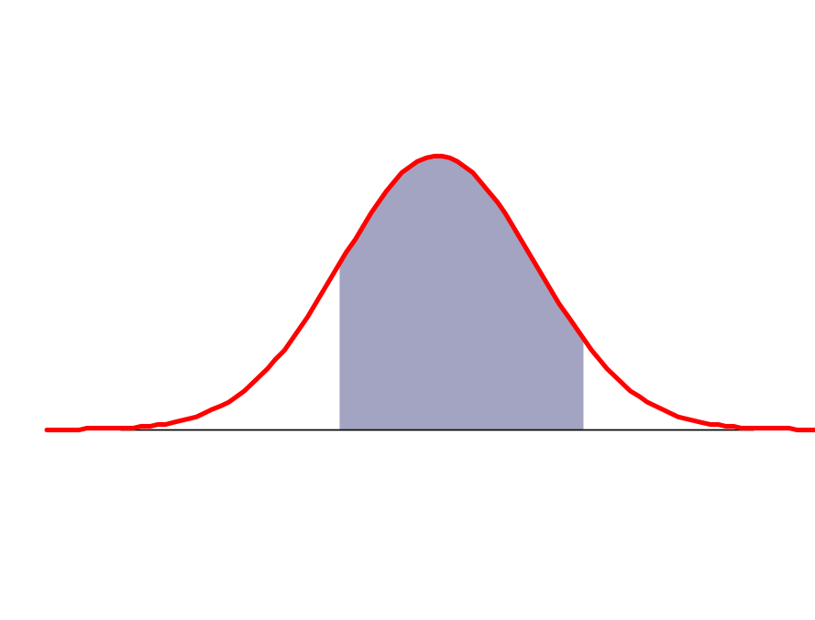
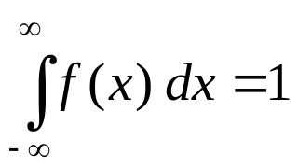
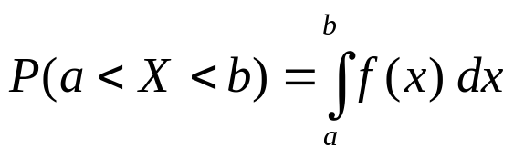
A reminder
Definition:
Let X: S → R be a continuous random variable.
A density function for X, f (x), is defined by:
  1. f (x) ≥ 0 for all x
  2.
  3.
f (x)
P(a<X<b)
a
b
x
lecture 5

Slide 4
Section 6.1
Continuous Uniform Distribution

Slide 5
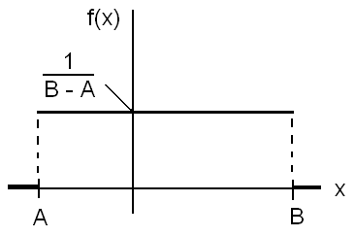
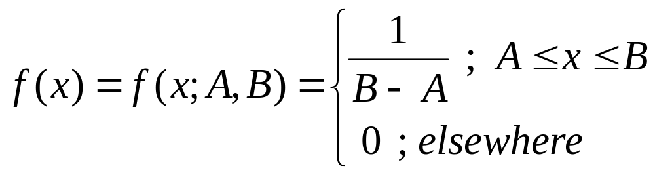
6.1 Continuous Uniform distribution:
(Rectangular Distribution)
The probability density function of the continuous uniform random variable X on the interval [A, B] is given by:
We write X~Uniform(A,B).

Slide 6
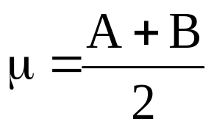
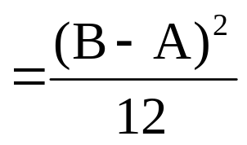
Theorem 6.1:
The mean and the variance of the continuous uniform distribution on the interval [A, B] are:
σ²

Slide 7
Example 6.1:
Suppose that, for a certain company, the conference time, X, has a uniform distribution on the interval [0,4] (hours).
(a) What is the probability density function of X?
(b) What is the probability that any conference lasts at least 3 hours?

Slide 8
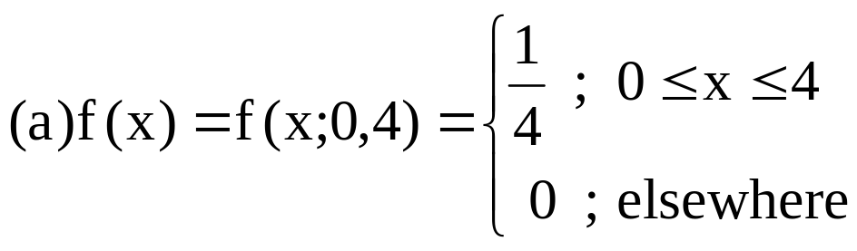
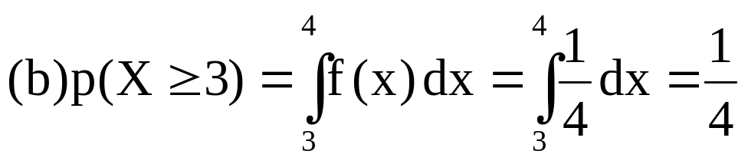
Solution:

Slide 9
Section 6.2
Normal Distribution

Slide 10
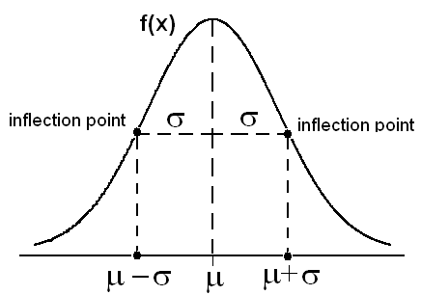
6.2 Normal Distribution:
The normal distribution is one of the most important distributions.
Many measurable characteristics are normally or approximately normally distributed, such as, height and weight.
The graph of the probability density function (pdf) of a normal distribution, called the normal curve, is a bell-shaped curve.

Slide 11
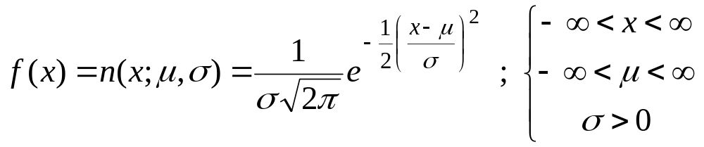
The pdf of the normal distribution depends on two parameters: mean = E(X)= μ and variance =Var(X) = σ².
If the random variable X has a normal distribution with mean μ and variance σ², we write:
X ~ Normal(μ,σ) or X ~ N(μ,σ)
The pdf of X ~ Normal(μ,σ) is given by:

Slide 12
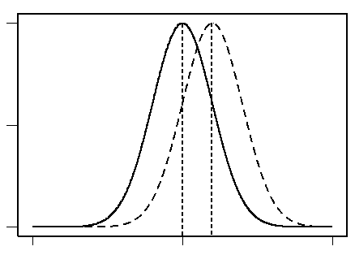
The location of the normal distribution depends on μ and its shape depends on σ.
Suppose we have two normal distributions:
_______ N(μ₁, σ₁)
----------- N(μ₂, σ₂)
μ₁ < μ₂, σ₁=σ₂

Slide 13
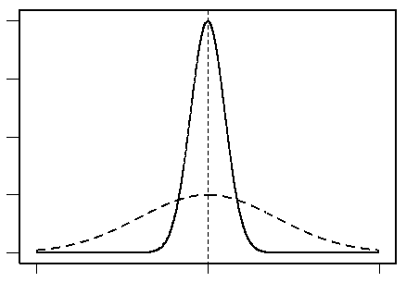
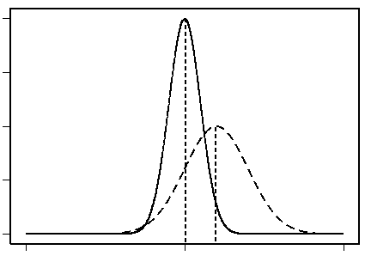
μ₁ = μ₂, σ₁<σ₂
μ₁ < μ₂, σ₁<σ₂
Some properties of the normal curve f(x) of N(μ,σ):
1. f(x) is symmetric about the mean μ.
2. f(x) has two points of inflection at x= μ±σ.
3. The total area under the curve of f(x) =1.
4. The highest point of the curve of f(x) at the mean μ.

Slide 14
Section 6.3
Areas under the Normal Curve

Slide 15
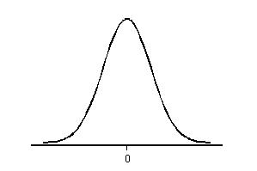
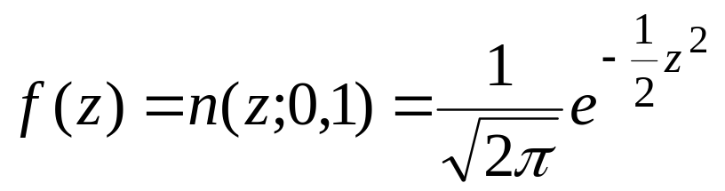
Standard Normal Distribution
Definition 6.1:
The Standard Normal Distribution:
The normal distribution with mean μ=0 and variance σ²=1 is called the standard normal distribution and is denoted by Normal(0,1) or N(0,1). If the random variable Z has the standard normal distribution, we write Z~Normal(0,1) or Z~N(0,1).
The pdf of Z~N(0,1) is given by:

Slide 16
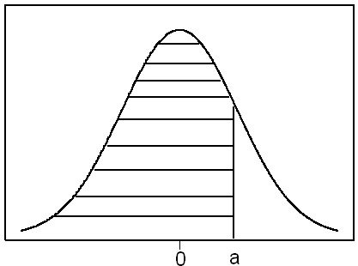
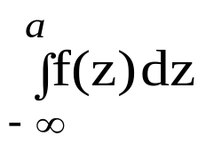
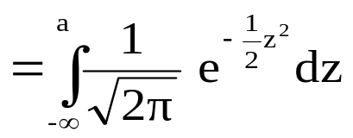
The standard normal distribution, Z~N(0,1), is very important because probabilities of any normal distribution can be calculated from the probabilities of the standard normal distribution.
Probabilities of the standard normal distribution Z~N(0,1) of the form P(Z≤a) are tabulated (Table A.3, p681).
P(Z≤a) =
= from the table

Slide 17
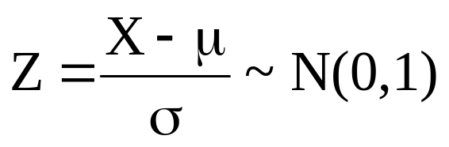
We can transfer any normal distribution X~N(μ,σ) to the standard normal distribution, Z~N(0,1) by using the following result.
Result: If X~N(μ,σ), then

Slide 18
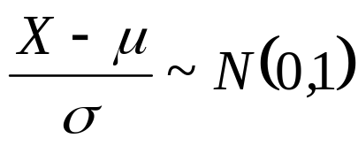
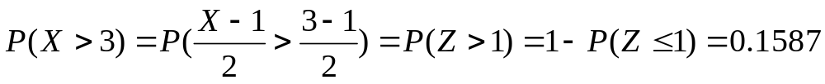
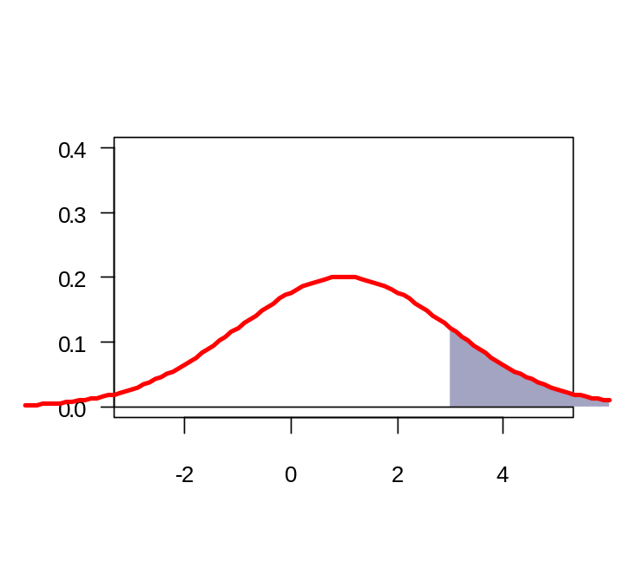
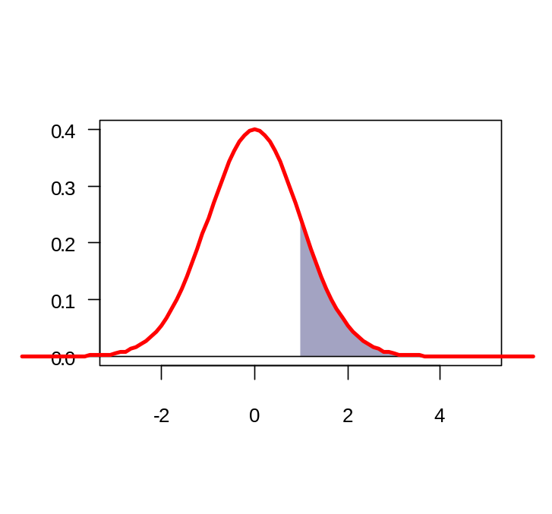
Example
Theorem: Standardise
If X ~ N(μ,σ²) then
Example cont.: X ~ N(1,4). What is P(X >3) ?
Z ~ N(0,1)
Z ~ N(0,1)
X ~ N(1,4)
Equal areas = 0.1587
lecture 5

Slide 19
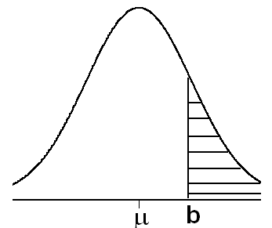
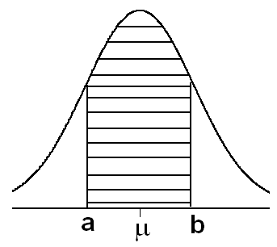
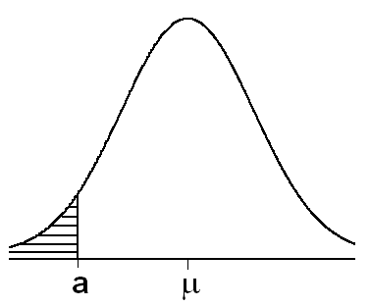
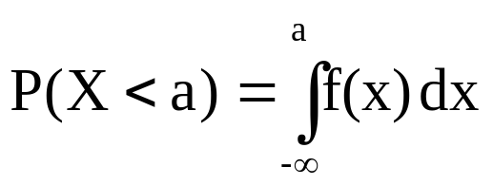
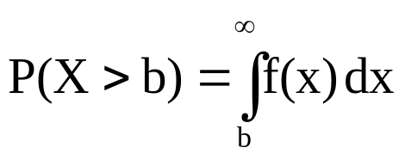
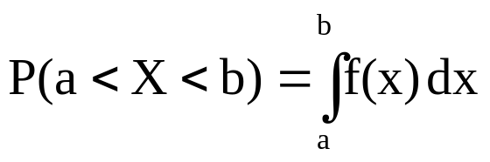
Areas Under the Normal Curve of X~N(μ,σ)
The probabilities of the normal distribution N(μ,σ) depends on μ and σ.

Slide 20
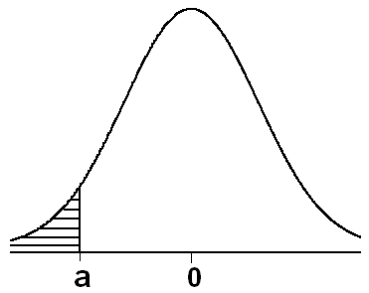
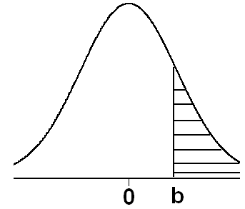
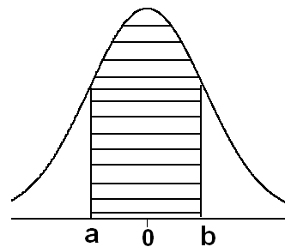
Probabilities of Z~N(0,1):
Suppose Z ~ N(0,1).
P(Z≤a) =From
Table (A.3)
P(Z≥b) = 1−P(Z≤b)
P(a≤Z≤b) =
P(Z≤b)−P(Z≤a)
Note: P(Z=a)=0 for every a .

Slide 21
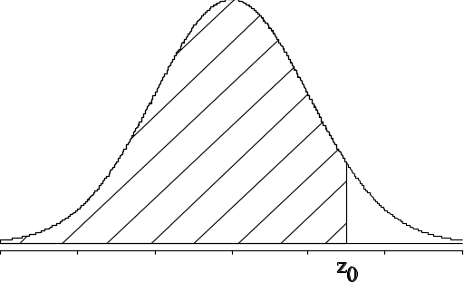
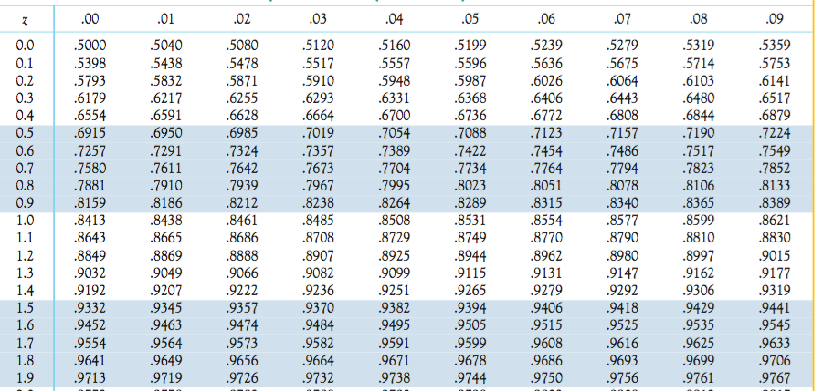
The values listed in Table I of the Appendix are P(Z ≤ z₀).
Thus, P(Z ≤ 1.96) = 0.9750
.9750 is the area under N(0,1) left of z₀ = 1.96
(…)

Slide 22
Example:
Suppose Z~N(0,1).
Z | 0.00 | 0.01 | …
: | ⇓
1.5 ⇒ | 0.9332
:
(1) P(Z≤1.50)=0.9332
(2) P(Z≥0.98)=1−P(Z≤0.98)
=1 − 0.8365
= 0.1635
Z | 0.00 | … | 0.08
: | : | : | ⇓
: | … | … | ⇓
0.9⇒ | ⇒ | ⇒ | 0.8365
(3)
P(−1.33≤ Z≤2.42)
= P(Z≤2.42)− P(Z≤−1.33)
= 0.9922 − 0.0918
= 0.9004
Z | … | 0.02 | 0.03
: | : | ⇓ | ⇓
−1.3 | ⇒ |  | 0.0918
: |  | ⇓
2.4 | ⇒ | 0.9922
(4) P(Z≤0)=P(Z ≥0)=0.5

Slide 23
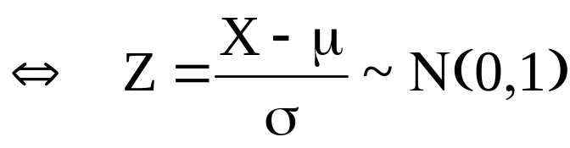
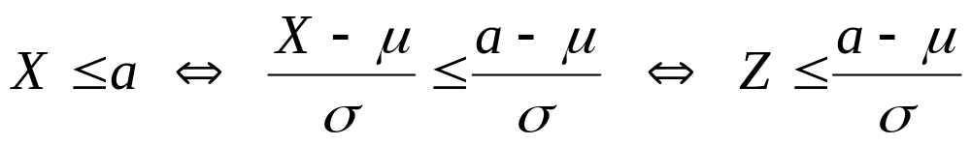
Example:
Suppose Z~N(0,1). Find the value of k such that
P(Z≤k)= 0.0207.
Solution:
.k = −2.04
Z | … | 0.04
: | : | ⇑ ⇑
−2.0 | ⇐⇐ | 0.0207
:
Probabilities of X~N(μ,σ):
Result: X ~N(μ,σ)

Slide 24
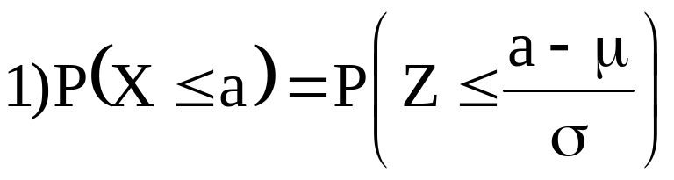
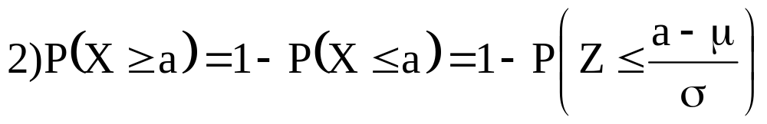
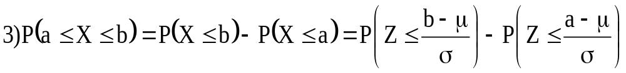
4) P(X=a)=0 for every a.
5) P(X≤μ) = P(X≥μ)=0.5
Example 6.4: Reading assignment
Example 6.5: Reading assignment
Example 6.6: Reading assignment

Slide 25
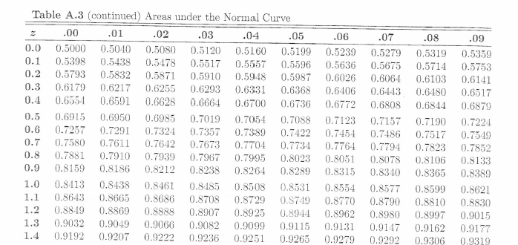
Normal distribution
Standard normal distribution
lecture 5

Slide 26
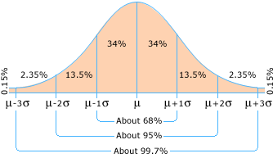
The Empirical Rule for any N(μ,σ)

Slide 27
Example:
Suppose that the hemoglobin level for healthy adults males has a normal distribution with mean μ=16 and variance σ²=0.81 (standard deviation σ=0.9).
(a) Find the probability that a randomly chosen healthy adult male has hemoglobin level less than 14.
(b) What is the percentage of healthy adult males who have hemoglobin level less than 14?

Slide 28
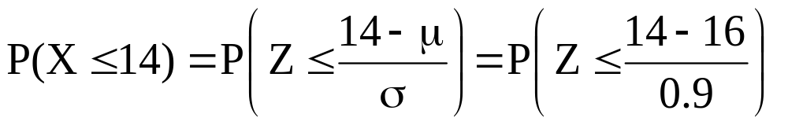
Solution:
Let X = the hemoglobin level for a healthy adult male
X ~ N(μ,σ)= N(16, 0.9).
(a)
= P(Z ≤−2.22)=0.0132

Slide 29
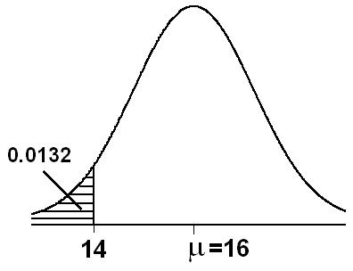
(b) The percentage of healthy adult males who have hemoglobin level less than 14 is
P(X ≤14) × 100% = 0.01320× 100% =1.32%
Therefore, 1.32% of healthy adult males have hemoglobin level less than 14.

Slide 30
Example:
Suppose that the birth weight of American babies has a normal distribution with mean μ=3.4 and standard deviation σ=0.35.
(a) Find the probability that a randomly chosen American baby has a birth weight between 3.0 and 4.0 kg.
(b) What is the percentage of American babies who have a birth weight between 3.0 and 4.0 kg?

Slide 31
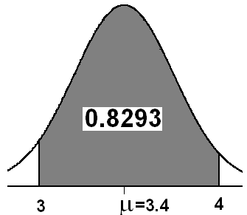
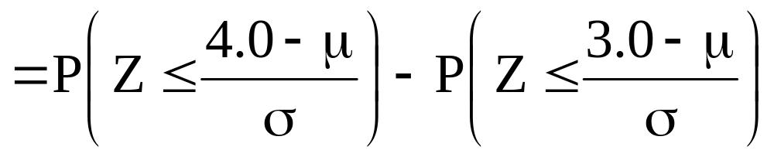
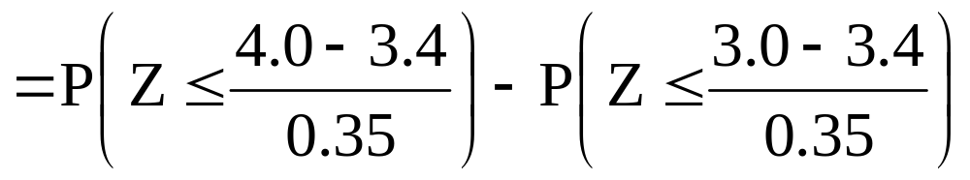
Solution:
X = birth weight of a American baby
μ = 3.4 σ = 0.35 (σ² = 0.35² = 0.1225)
X ~ N(3.4,0.35 )
(a) P(3.0<X<4.0)=P(X<4.0)−P(X<3.0)
= P(Z≤1.71) − P(Z ≤ −1.14)
= 0.9564 − 0.1271
= 0.8293

Slide 32
(b) The percentage of american babies who have a birth weight between 3.0 and 4.0 kg is
P(3.0<X<4.0) × 100%= 0.8293× 100%= 82.93%

Slide 33

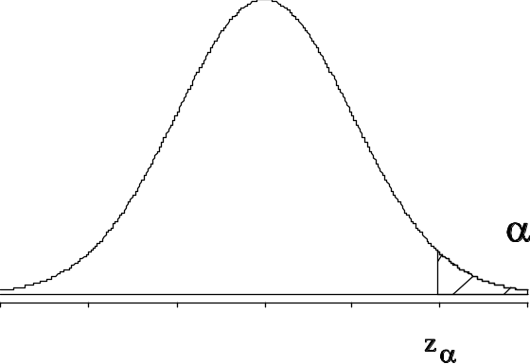



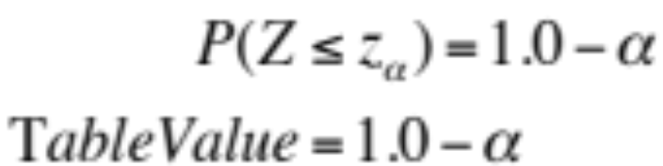
Standard Score (z-score)
We often need to use the Z-value associated with specific “tail” areas of the standard normal distribution.
Let represent the Z-value associated with a right hand “tail area” of .
is that value for Z such that

Slide 34
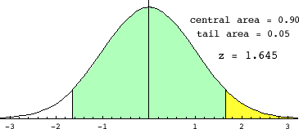



Standard Score (z-score)
Copyright © 2010 Pearson Addison-Wesley. All rights reserved.
6 - <number>

Slide 35


Standard Score (z-score)
Copyright © 2010 Pearson Addison-Wesley. All rights reserved.
6 - <number>

Slide 36
Notation:
P(Z≥Z_{α}) = α
Result:
Z_{α}= − Z_{1−α}
Example:
Z ~ N(0,1)
P(Z≥Z_{0.025}) = 0.025
P(Z≥Z_{0.95}) = 0.95
P(Z≥Z_{0.90}) = 0.90
Example:
Z ~ N(0,1)
Z_{0.025} = 1.96
Z_{0.95} = −1.645
Z_{0.90} = −1.285
Z | … | 0.06
: | : | ⇑ ⇑
1.9 | ⇐⇐ | 0.975
P(Z≥Z_{0.025}) = 0.025
Z_{0.025} = 1.96

Slide 37
Section 6.4
Applications of the Normal Distribution

Slide 38
Example 6.9:
In an industrial process, the diameter of a ball bearing is an important component part. The buyer sets specifications on the diameter to be 3.00±0.01 cm. The implication is that no part falling outside these specifications will be accepted. It is known that, in the process, the diameter of a ball bearing has a normal distribution with mean 3.00 cm and standard deviation 0.005 cm. On the average, how many manufactured ball bearings will be scrapped?
Example 6.7: Reading assignment
Example 6.8: Reading assignment

Slide 39



Solution:
μ=3.00
σ=0.005
X=diameter
X~N(3.00, 0.005)
The specification limits are:
3.00±0.01
x₁=Lower limit=3.00−0.01=2.99
x₂=Upper limit=3.00+0.01=3.01
P(x₁<X< x₂)=P(2.99<X<3.01)=P(X<3.01)−P(X<2.99)

Slide 40
= P(Z≤2.00) − P(Z ≤ −2.00)
= 0.9772 − 0.0228
= 0.9544
Therefore, on the average, 95.44% of manufactured ball bearings will be accepted and 4.56% will be scrapped?

Slide 41
Example 6.10:
Gauges are use to reject all components where a certain dimension is not within the specifications 1.50±d. It is known that this measurement is normally distributed with mean 1.50 and standard deviation 0.20. Determine the value d such that the specifications cover 95% of the measurements.

Slide 42
Solution:
μ=1.5
σ=0.20
X= measurement
X~N(1.5, 0.20)
The specification limits are:
1.5±d
x₁=Lower limit=1.5−d
x₂=Upper limit=1.5+d
P(X> 1.5+d)= 0.025 ⇔ P(X< 1.5+d)= 0.975
P(X< 1.5−d)= 0.025
P(X< 1.5−d)= 0.025

Slide 43





Z | … | 0.06
: | : | ⇑ ⇑
-1.9 | ⇐⇐ | 0.025
Z_{0.025}

Slide 44

The specification limits are:
x₁=Lower limit=1.5−d = 1.5 − 0.392 = 1.108
x₂=Upper limit=1.5+d=1.5+0.392= 1.892
Therefore, 95% of the measurements fall within the specifications (1.108, 1.892).
Example 6.11: Reading assignment
Example 6.12: Reading assignment
Example 6.13: Reading assignment
Example 6.14: Reading assignment

Slide 45
Section 6.5
Normal Approximation to the Binomial

Slide 46


If X is binomial distributed with parameters n and p, then
is approximately normal distributed.
Rule of thumb:
If np>5 and n(1−p)>5, then the approximation is good
lecture 5

Slide 47
Section 6.6
Exponential Distributions

Slide 48


6.6 Exponential Distribution:
Definition:
The continuous random variable X has an exponential distribution with parameter β, if its probability density function is given by:
and we write X~Exp(β)
Theorem:
If the random variable X has an exponential distribution with parameter β, i.e., X~Exp(β), then the mean and the variance of X are:
E(X)= μ = β
Var(X) = σ² = β²

Slide 49
Example 6.17:
Suppose that a system contains a certain type of component whose time in years to failure is given by T. The random variable T is modeled nicely by the exponential distribution with mean time to failure β=5. If 5 of these components are installed in different systems, what is the probability that at least 2 are still functioning at the end of 8 years?

Slide 50


Solution:
β=5
T~Exp(5)
The pdf of T is:
The probability that a given component is still functioning after 8 years is given by:

Slide 51

Now define the random variable:
X= number of components functioning after 8 years out of 5
components
X~ Binomial(5, 0.2) (n=5, p= P(T>8)= 0.2)

Slide 52


The probability that at least 2 are still functioning at the end of 8 years is:
P(X≥2)=1 − P(X<2)=1 − [P(X=0)+P(X=1)]

Slide 53
Section 6.6
Gamma Distributions

Slide 54

Gamma Function

Slide 55

Gamma Distribution
Family of Right-Skewed Distributions
Random Variable can take on positive values only
Used to model many biological and economic characteristics
Can take on many different shapes to match empirical data

Slide 56

Gamma Distribution - Expectations

Slide 57


Family of Gamma Distributions
The gamma distribution defines a family of which other distributions are special cases.
Important applications in waiting time and reliability analysis.
Special cases of the Gamma Distribution
  Exponential Distribution when α = 1
  Chi-squared Distribution when
Where is a positive integer

Slide 58



Standard Gamma Distribution
The standard gamma distribution has
The probability density function of the standard Gamma distribution is:
for
And is 0 otherwise

Slide 59

Gamma Distribution - Example
Suppose the reaction time of a randomly selected
individual to a certain stimulus has a standard
gamma distribution with α = 2 sec. Find the
probability that reaction time will be
(a) between 3 and 5 seconds
(b) greater than 4 seconds

Slide 60

Solution
Since
Copyright © 2010 Pearson Addison-Wesley. All rights reserved.
6 - <number>

Slide 61

The probability that the reaction time is more than
4 sec is

Slide 62
Section 6.7
Chi-Squared Distributions

Slide 63


The χ² distribution
Definition
Definition: (alternative to Walpole, Myers, Myers & Ye)
If Z₁, Z₂,..., Z_{n} are independent random variables, where
Z_{i} ~ N(0,1), for i =1,2,…,n,
then the distribution of
is the χ²-distribution with n degrees of freedom.
Notation:
lecture 5

Slide 64


The χ² distribution
Definition
Definition: A continuous random variable X follows a χ²-distribution with n degrees of freedom if it has density function
Y ~ χ²(1)
Antag Y ~ χ²(n)
E(Y) = n
Var(Y) = 2n
E(Y/n) = 1
Var(Y/n) = 2/n
Y ~ χ² (3)
Y ~ χ² (5)
lecture 5

Slide 65
Section 6.7
T Distributions

Slide 66

t-distribution
Definition
Definition:
Let Z ~ N(0,1) and V ~ χ²(n) be two independent random variables. Then the distribution of
is called the t-distribution with n degrees of freedom.
Notation: T ~ t(n)
lecture 5

Slide 67

The T probability density function
What does t look like mathematically? (You may at least recognize some resemblance to the normal distribution function…)
Where:
v is the degrees of freedom
(gamma) is the Gamma function
is the constant Pi (3.14...)

Slide 68
Degrees of Freedom
If the sample size is n, then t is said to have n – 1 degrees of freedom.
We use df to denote degrees of freedom.

Slide 69

t-distribution
Compared to standard normal
X ~ N(0,1)
T ~ T(3)
T ~ T(1)
The t-distribution is symmetric around 0
The t-distribution is more flat than the standard normal
The more degrees of freedom the more the t-distribution looks like a standard normal
lecture 5

Slide 70
Student’s t Table
Upper Tail Area
Let: n = 3
df = n - 1 = 2
α = .10
α/2 =.05
df
.25
.10
.05
1
1.000
3.078
6.314
2
0.817
1.886
2.920
3
0.765
1.638
2.353
α/2 = .05
The body of the table contains t values, not probabilities
0
2.920
t
from “Statistics for Managers” Using Microsoft® Excel 4th Edition, Prentice-Hall 2004

Slide 71
t distribution values
With comparison to the Z value
Confidence t t t Z
Level (10 d.f.) (20 d.f.) (30 d.f.) ____
.80 1.372 1.325 1.310 1.28
.90 1.812 1.725 1.697 1.64
.95 2.228 2.086 2.042 1.96
.99 3.169 2.845 2.750 2.58
Note: t Z as n increases
from “Statistics for Managers” Using Microsoft® Excel 4th Edition, Prentice-Hall 2004

Slide 72

F-distribution
Definition
Definition:
Let U ~ χ²(n₁) and V ~ χ²(n₂) be two independent random variables. Then the distribution of
is called the F-distribution with n₁ and n₂ degrees of freedom.
Notation: F ~ F(n₁ , n₂) Critical values: Table A.6
lecture 5

Slide 73

F-distribution
Example
F ~ F(20,50)
F ~ F(10,30)
F ~ F(6,10)
lecture 5

Slide 74
Section 6.11
Review

