Slide 1
Chapter 8
Fundamental Sampling Distributions and Data Descriptions

Slide 2
Section 8.1
Random Sampling

Slide 3
8.1 Random Sampling:
Definition 8.1:
A population consists of the totality of the observations with which we are concerned. (Population=Probability Distribution)
A sample is a subset of a population.
Note:
· Each observation in a population is a value of a random variable X having some probability distribution f(x).
· To eliminate bias in the sampling procedure, we select a random sample in the sense that the observations are made independently and at random.
· The random sample of size n is: X₁, X₂, …, X_{n}
It consists of n observations selected independently and randomly from the population.

Slide 4
Statistics： Sample
Population:
Sample: independent identically distributed (iid)
• •
• • • • •
• • • •
• • • •
• • • • •
Examples:
production
marketing research
• •
• •
Sample function: a function of the observed values in
the sample used for making general conclusion about the entire population.
lecture 6

Slide 5
Section 8.2
Some Important Statistics

Slide 6
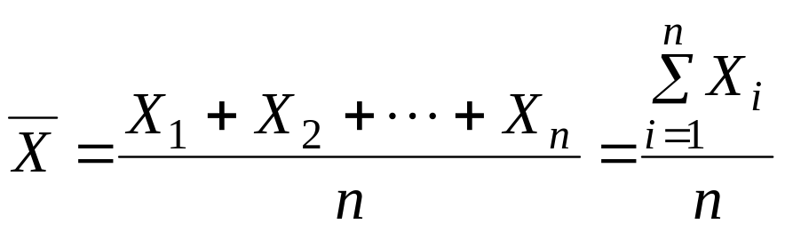

8.2 Some Important Statistics:
Definition 8.4:
Any function of the random sample X₁, X₂, …, X_{n} is called a statistic.
Central Tendency in the Sample:
Definition 8.5:
If X₁, X₂, …, X_{n} represents a random sample of size n, then the sample mean is defined to be the statistic:
(unit)
Note:
· is a statistic because it is a function of the random sample X₁, X₂, …, X_{n}.
· has same unit of X₁, X₂, …, X_{n}.
· measures the central tendency in the sample (location).

Slide 7
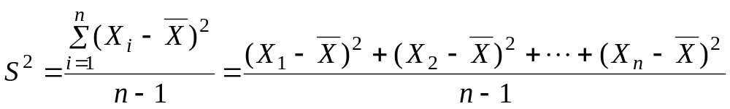
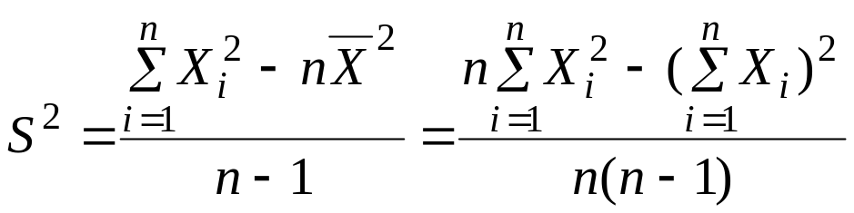
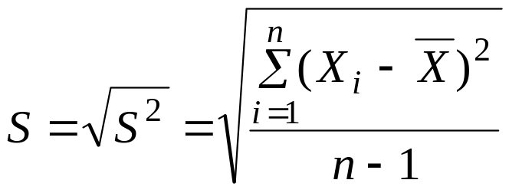
Variability in the Sample:
Definition 8.9:
If X₁, X₂, …, X_{n} represents a random sample of size n, then the sample variance is defined to be the statistic:
(unit)²
Theorem 8.1: (Computational Formulas for S²)
Note:
· S² is a statistic because it is a function of the random sample X₁, X₂, …, X_{n}.
· S² measures the variability in the sample.
(unit)

Slide 8
Section 8.3
Sampling Distributions

Slide 9
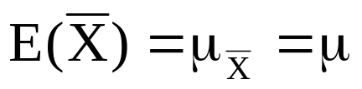
8.4 Sampling distribution:
Definition 8.13:
The probability distribution of a statistic is called a sampling distribution.
· Example: If X₁, X₂, …, X_{n} represents a random sample of size n, then the probability distribution of is called the sampling distribution of the sample mean .
8.5 Sampling Distributions of Means:
Result:
If X₁, X₂, …, X_{n} is a random sample of size n taken from a normal distribution with mean μ and variance σ², i.e. N(μ,σ), then the sample mean has a normal distribution with mean

Slide 10
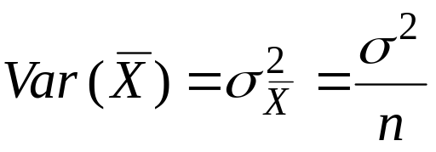



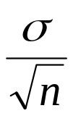
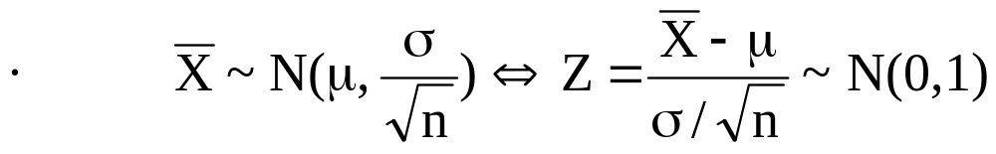
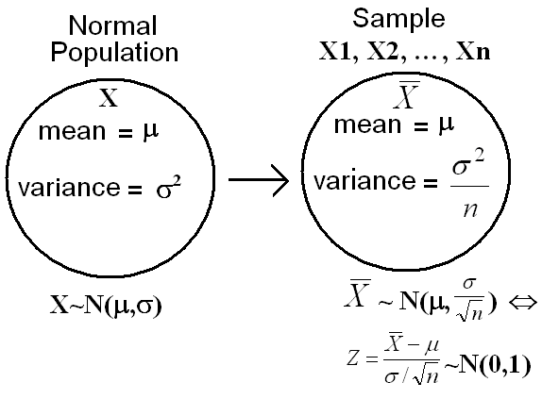
and variance
· If X₁, X₂, …, X_{n} is a random sample of size n from N(μ,σ), then ~N( , ) or ~N(μ, ).

Slide 11
Section 8.4
Sampling Distribution of Means and the Central Limit Theorem

Slide 12
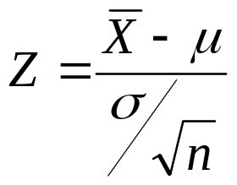
Sample mean
Distribution
The Central Limit Theorem (CLT):
Let X₁, X₂, ... X_{n} be independent identically distributed
random variables with same mean μ and same finite
variance σ². Then the distribution of
will tend towards the standard normal distribution as n → ∞.
How large should n be before the approximation is good?
  Most distributions: n > 30
  Normal distribution : for all n

Slide 13
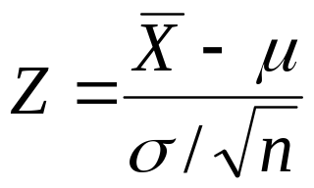
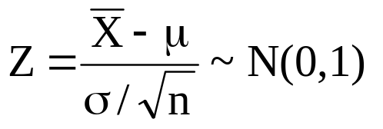
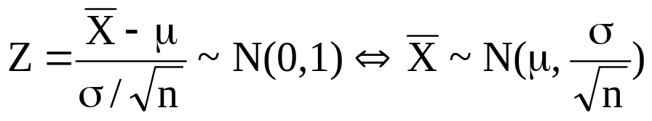
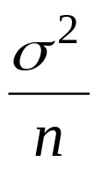
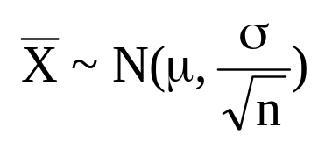
is approximately standard normal random variable, i.e.,
approximately.
We consider n large when n≥30.
For large sample size n, has approximately a normal
distribution with mean μ and variance , i.e.,
approximately.

Slide 14
The sampling distribution of is used for inferences about the population mean μ.
Example 8.13:
An electric firm manufactures light bulbs that have a length of life that is approximately normally distributed with mean equal to 800 hours and a standard deviation of 40 hours. Find the probability that a random sample of 16 bulbs will have an average life of less than 775 hours.

Slide 15
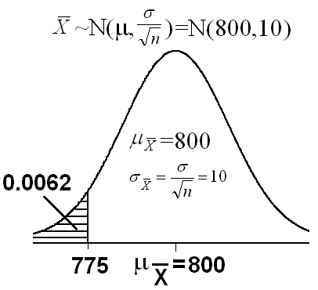

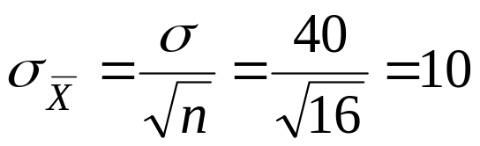
Solution:
X= the length of life
μ=800 , σ=40
X~N(800, 40)
n=16

Slide 16
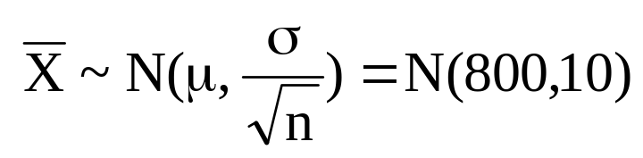
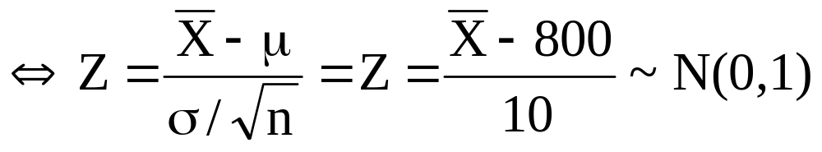
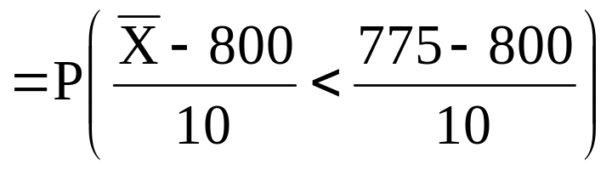
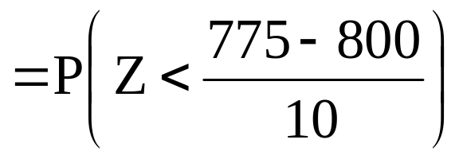
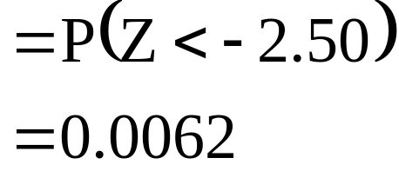

Slide 17
Section
Introduction to Inference

Slide 18
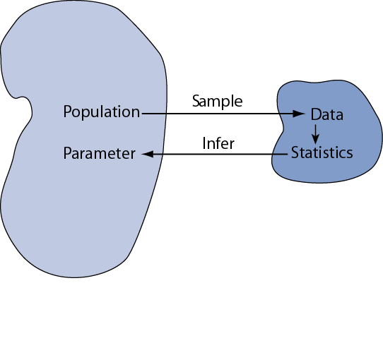
Statistical inference is the act of generalizing from a sample to a population with calculated degree of certainty.
We want to learn about population parameters…
…but we can only calculate sample statistics
8: Intro to Statistical Inference
Notes:
Chapter 8
Basic Biostat
Statistical inference is the logical process by which we make sense of numbers. It is how we generalize from the particular to the general. This is an important scientific activity.
Consider a study that wants to learn about the prevalence of a asthma in a population. We draw a SRS from the population and find that 3 of the 100 individuals in the sample have asthma. The prevalence in the sample is 3%. However, are still uncertain about the prevalence of asthma in the population; the next SRS from the same population may have fewer or more cases. How do we deal with this element of chance introduced by sampling?
A similar problem occurs when we do an experiment Each time we do an experiment, we expect different results due to chance. How do we deal with this chance variability?
Our first task is to distinguish between parameters and statistics. Parameters are the population value. Statistics are from the sample. The statistics will vary from sample to sample: they are random variables. In contrast, the parameters are invariable; they are constants.
To help draw this distinction, we use different symbols for parameters and statistics. For example, we use “mu” to represent the population mean (parameter) and “xbar” to represent the sample mean (statistic).

Slide 19
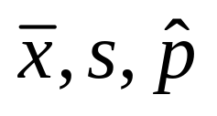
Parameters and Statistics
It is essential that we draw distinctions between parameters and statistics
 | Parameters | Statistics
Source | Population | Sample
Calculated? | No | Yes
Constants? | Yes | No
Examples | μ, σ, p
Basic Biostat

Slide 20

We are going to illustrate inferential concept by considering how well a given sample mean “x-bar” reflects an underling population mean µ
µ
Basic Biostat
8: Intro to Statistical Inference

Slide 21
Precision and reliability
How precisely does a given sample mean (x-bar) reflect underlying population mean (μ)? How reliable are our inferences?
To answer these questions, we consider a simulation experiment in which we take all possible samples of size n taken from the population
Basic Biostat
8: Intro to Statistical Inference
Notes:
Chapter 8
Basic Biostat
The next question we must address is “How precisely does a given sample mean reflect its underlying population mean? To address this question, we must first establish the concept of a sampling distribution of a mean, abbreviated SDM. Note the definition of the SDM presented on this slide; take it to heart.
Because the concept of the SDM is necessarily abstract, let us employ simulation experiment to embody the concept.

Slide 22
Simulation Experiment
Population (Figure A)
  N = 10,000
  normal shape (positive skew)
  μ = 173
  σ = 30
Take repeated SRSs (simple random samplings), each of n = 10
Calculate x-bar in each sample
Plot x-bars (Figure B , next slide)
Basic Biostat
8: Intro to Statistical Inference
Notes:
Chapter 8
Basic Biostat
Our simulation experiment is based in a population of adult males with a mean body weight of 173 pounds (see p. 159 for references). The distribution has a positive skew and standard deviation of 30 pounds.
The experiment proceeds by taking many independent SRSs from this population. Each sample has n = 10. We calculate the mean from each sample and study the distribution of these sample means. Table 8.1 in the text (p. 159) shows the first five independent SRSs from this experiment. The mean and standard deviation of each sample varies (of course)!
After several thousand repetitions, we plot the means from these independent samples. The distribution of these sample means is shown in the bottom of the two figures. This simulate a SDM.
The next slide lists findings from this experiment.

Slide 23
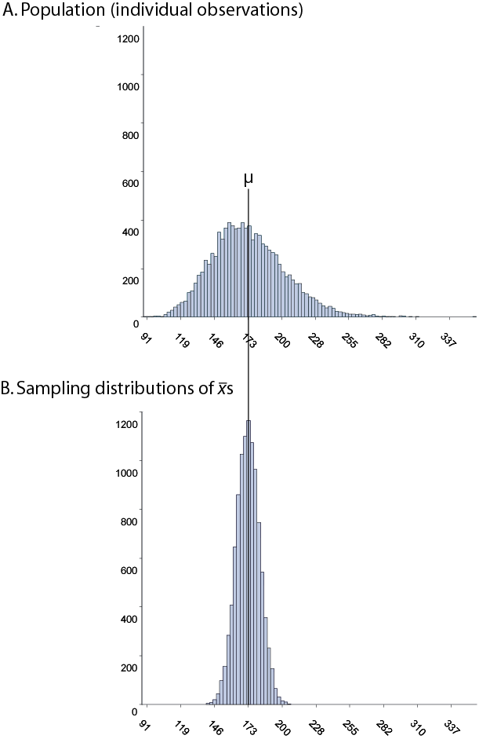
A. Population (individual values)
B. Sampling distribution of x-bars
Basic Biostat
8: Intro to Statistical Inference

Slide 24
Simulation Experiment Results
Distribution B is more Normal than distribution A ⇔ Central Limit Theorem
Both distributions centered on µ ⇔ x-bar is unbiased estimator of μ
Distribution B is skinnier than distribution A ⇔ related to “square root law”
Notes:
Chapter 8
Basic Biostat
Finding 1 is that the SDM looks Normal even though the population is not Normal. This is because of the Central Limit Theorem. Note that this will allow us to use Normal probability calculations when making inferences about population means.
Finding 2 is referred that, although some sample means will be less than the population mean and some will be more, these differences will balance out in the long run. Therefore, sample mean provides a “fair” or unbiased reflection of the population mean.
Finding 3 is that the SDM clusters more tightly around μ than individual observations: sample means are less variable than individual observations. This finding also suggest that a good measure of the precision of the sample mean is the standard deviation of the SDM. This standard deviation has a special name: it is called the standard error of the mean, abbreviated SE.

Slide 25
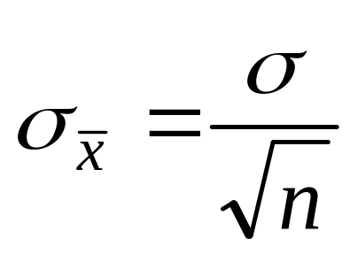
Reiteration of Key Findings
Finding 1 (central limit theorem): the sampling distribution of x-bar tends toward Normality even when the population is not Normal (esp. strong in large samples).
Finding 2 (unbiasedness): the expected value of x-bar is μ
Finding 3 is related to the square root law, which says:
Basic Biostat
8: Intro to Statistical Inference
Notes:
Chapter 8
Basic Biostat
This slide summarizes three major facts about SDMs.

Slide 26
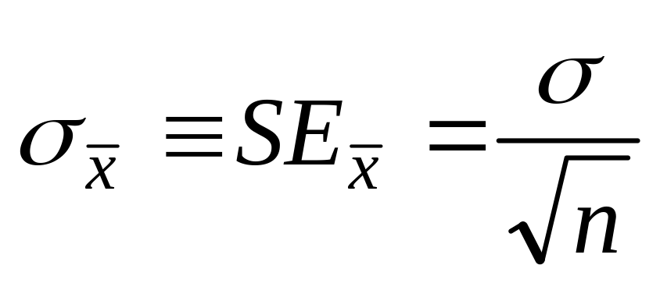
Standard Deviation of the Mean
The standard deviation of the sampling distribution of the mean has a special name: standard error of the mean (denoted σ_{xbar} or SE_{xbar})
The square root law says:
Basic Biostat
8: Intro to Statistical Inference
Notes:
Chapter 8
Basic Biostat
Consider Weschler Adult Intelligence Scores. Recall from Chapter 7 that this variable has a standard deviation of 15. This slide calculates SEs for this variable when n = 1, n = 4, and n = 16. Notice that quadrupling the sample size cuts the SE error in half. For example, a mean based on a sample of n = 16 is twice as precise as a sample mean based on n = 4.
The precision of the sample mean is inversely proportional to the square root of the sample size!

Slide 27



Sampling Distribution of the Difference between Two Means:
Suppose that we have two populations:
· 1-st population with mean μ₁ and variance σ₁²
· 2-nd population with mean μ₂ and variance σ₂²
· We are interested in comparing μ₁ and μ₂, or equivalently, making inferences about μ₁−μ₂.
· We independently select a random sample of size n₁ from the 1-st population and another random sample of size n₂ from the 2-nd population:
· Let be the sample mean of the 1-st sample.
· Let be the sample mean of the 2-nd sample.
· The sampling distribution of is used to make inferences about μ₁−μ₂.

Slide 28
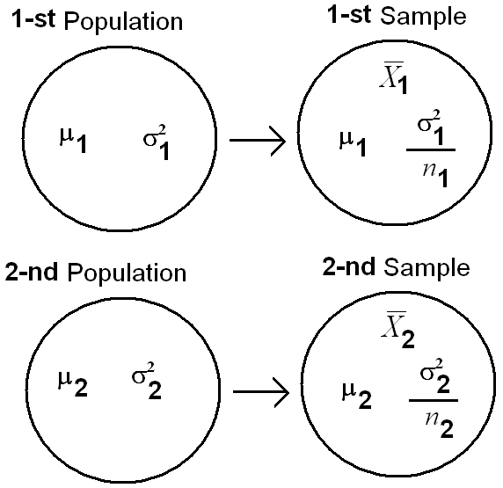

Slide 29
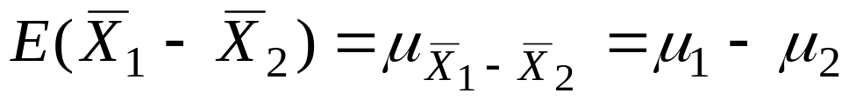
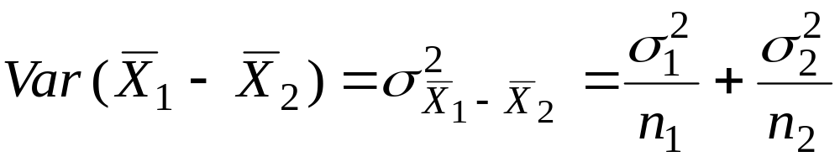
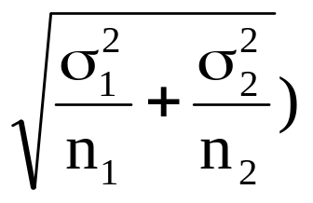
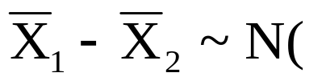
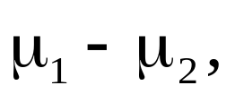
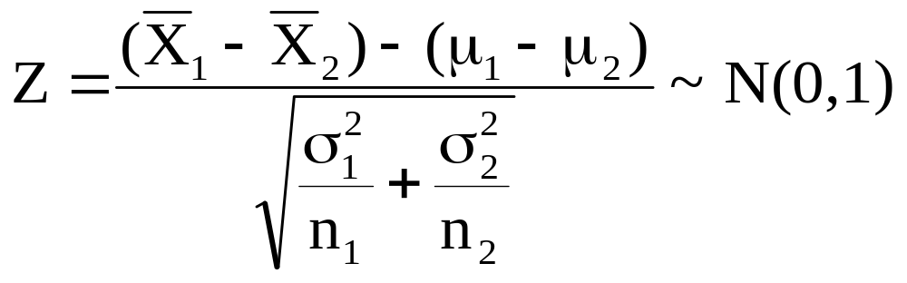
Theorem 8.3:
If n₁ and n₂ are large, then the sampling distribution of is approximately normal with mean
and variance
that is:

Slide 30
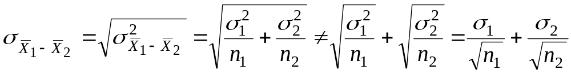
Note:
Example 8.16:
The television picture tubes of manufacturer A have a mean lifetime of 6.5 years and standard deviation of 0.9 year, while those of manufacturer B have a mean lifetime of 6 years and standard deviation of 0.8 year. What is the probability that a random sample of 36 tubes from manufacturer A will have a mean lifetime that is at least 1 year more than the mean lifetime of a random sample of 49 tubes from manufacturer B?

Slide 31

Solution:
Population A Population B
μ₁=6.5 μ₂=6.0
σ₁=0.9 σ₂=0.8
n₁=36 n₂=49
· We need to find the probability that the mean lifetime of manufacturer A is at least 1 year more than the mean lifetime of manufacturer B which is P( ).
· The sampling distribution of is

Slide 32
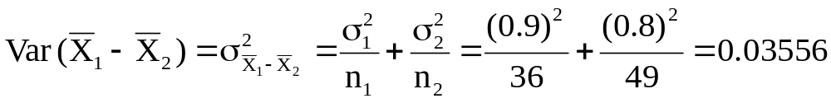
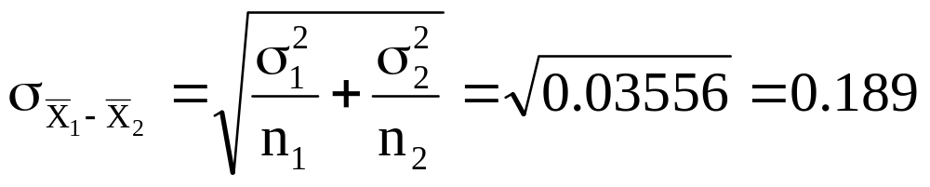
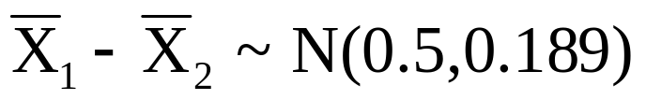
· We need to find the probability that the mean lifetime of manufacturer A is at least 1 year more than the mean lifetime of manufacturer B which is P( ).
· The sampling distribution of is

Slide 33

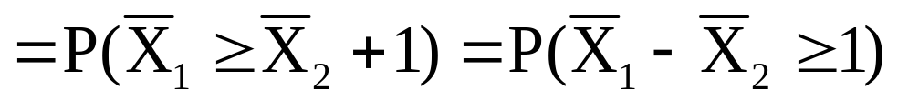
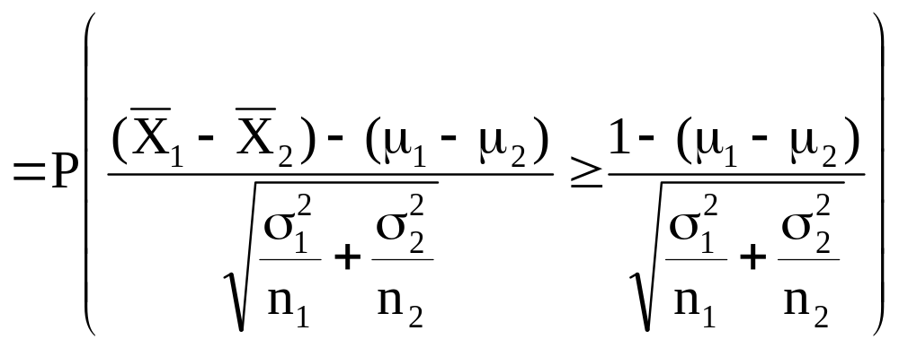
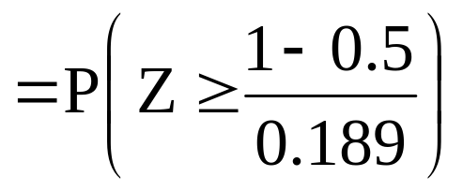
Recall
= P(Z≥2.65) = 1 − P(Z<2.65)= 1 − 0.9960 = 0.0040

Slide 34
Section 8.5
Sampling Distribution of S²

Slide 35
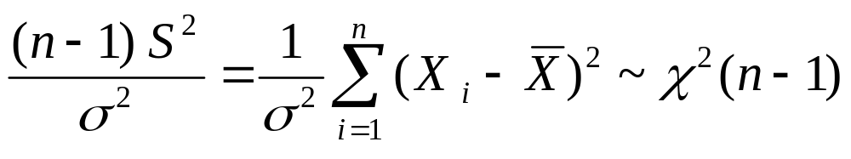
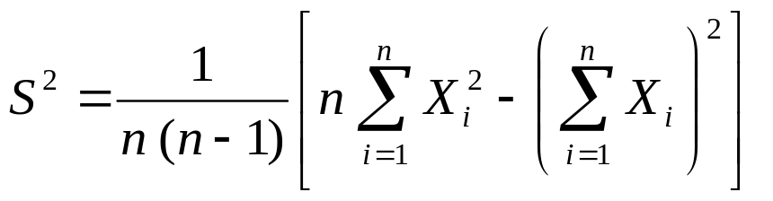
Sample variance
Distribution
Theorem:
Lad X₁, X₂, ... X_{n} be independent normal distributed
random variables with mean μ and variance σ².
Then
When calculating S², it’s usually more convenient to use
lecture 6

Slide 36
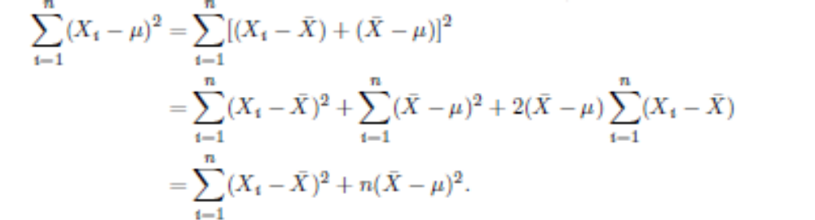
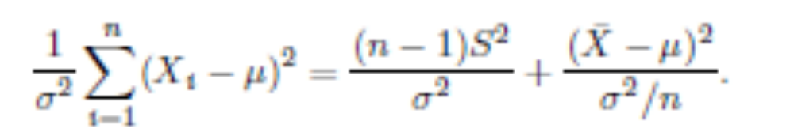
Proof
Dividing each term of the equality by σ²
Copyright © 2010 Pearson Addison-Wesley. All rights reserved.

Slide 37
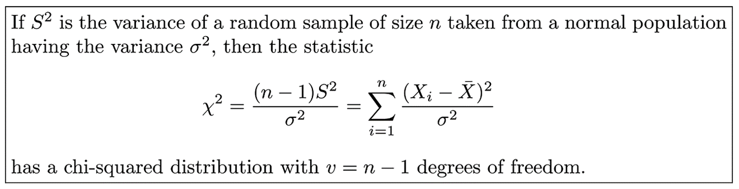
Theorem 8.4
Copyright © 2010 Pearson Addison-Wesley. All rights reserved.
8 - <number>

Slide 38
Sample variance Example
Problem: Car batteries
A producer of car batteries claims that the life time of their batteries are normal distributed with
  mean: μ = 3 year
  standard deviation: σ = 1 year
Sample of 5 batteries: 1.9 2.4 3.0 3.5 4.2
Calculate sample variance.
Should the manufacturer still be convinced that the batteries have a standard deviation of 1 year?
lecture 6

Slide 39
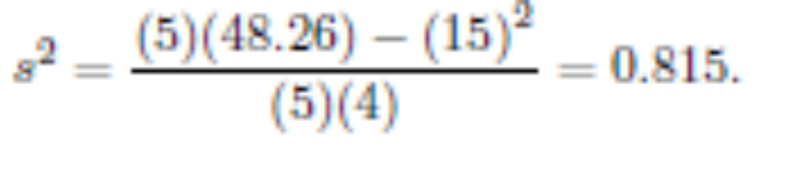
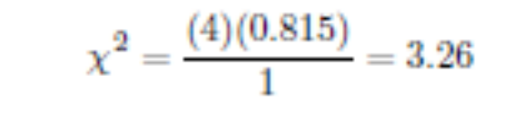
Solution
Step 1: Find out the sample variance
Step 2: Calculate the statistic Χ²
Step 3: Compare the calculated statistic Χ² with critical values
Since 95%of the Χ² values with 4 degrees of freedom fall between 0.484 and 11.143, the computed value with σ² = 1 is reasonable, and therefore the manufacturer has no reason to suspect that the standard deviation is other than 1 year.
Copyright © 2010 Pearson Addison-Wesley. All rights reserved.

Slide 40
Section 8.6
t-Distribution

Slide 41
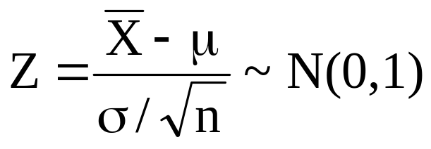
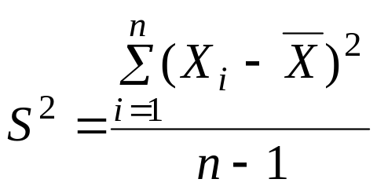

8.7 t-Distribution:
· Recall that, if X₁, X₂, …, X_{n} is a random sample of size n from a normal distribution with mean μ and variance σ², i.e. N(μ,σ), then
· We can apply this result only when σ² is known!
If σ² is unknown, we replace the population variance σ² with the
sample variance · to have the following statistic

Slide 42

Sample mean
Distribution (unknown varinace)
Typically the variance σ² is unknown.
If we replace the unknown variance by s² we obtain:
Theorem:
Lad X₁,X₂, ... X_{n} be independent normal distributed
random variables with mean μ and variance σ² (unknown).
Then
lecture 6

Slide 43

Result:
If X₁, X₂, …, X_{n} is a random sample of size n from a normal distribution with mean μ and variance σ², i.e. N(μ,σ), then the statistic
has a t-distribution with ν=n−1degrees of freedom (df), and we write T~ t(ν).
Note:
t-distribution is a continuous distribution.
The shape of t-distribution is similar to the shape of the standard normal distribution.

Slide 44

Notation:
t _{α} = The t-value above which we find an area equal to α, that is P(T> t _{α}) = α
Since the curve of the pdf of T~ t(ν) is symmetric about 0, we have
t_{1 − α} = − t _{α}
Values of t_{α} are tabulated in Table A-4 (p.683).

Slide 45
Example:
Find the t-value with ν=14 (df) that leaves an area of:
(a) 0.95 to the left.
(b) 0.95 to the right.

Slide 46

Solution:
ν = 14 (df); T~ t(14)
(a) The t-value that leaves an area of 0.95 to the left is
t_{0.05} = 1.761

Slide 47

(b) The t-value that leaves an area of 0.95 to the right is
t_{0.95} = − t _{1 − 0.95} _{= − t 0.05} _{= − 1.761}

Slide 48
Example:
For ν = 10 degrees of freedom (df), find t_{0.10} and t _{0.85} .

Slide 49

Solution:
t_{0.10} = 1.372
t_{0.85} = − t_{1−0.85} = − _{t 0.15} = −_{1.093 (t 0.15} = 1.093)

Slide 50
Section 8.7
F-Distribution

Slide 51



Two sample variances
Comparison
Theorem:
If two independent samples are taken from two normal populations with variances σ₁² and σ₂², respectively, then
Notice!!
lecture 6

Slide 52

Figure 8.11 Typical F-distributions
Copyright © 2010 Pearson Addison-Wesley. All rights reserved.
8 - <number>

Slide 53



Sampling Distribution of the Sample Proportion:
Suppose that the size of a population is N. Each element of the population can be classified as type A or non-type A. Let p be the proportion of elements of type A in the population. A random sample of size n is drawn from this population. Let be the proportion of elements of type A in the sample.
Let X = no. of elements of type A in the sample
p =Population Proportion

Slide 54





= Sample Proportion
Result:
(1) X ~ Binomial (n, p)
(2) E( )= E( )= p
(3) Var( ) = Var( ) =
(4) For large n, we have
~ N(p, ) (Approximately)
~ N(0,1) (Approximately)

Slide 55


Sampling Distribution of the Difference between Two Proportions:

Slide 56



Suppose that we have two populations:
· p₁ = proportion of the 1-st population.
· P₂ = proportion of the 2-nd population.
· We are interested in comparing p₁ and p₂, or equivalently, making inferences about p₁− p₂.
· We independently select a random sample of size n₁ from the 1-st population and another random sample of size n₂ from the 2-nd population:
· Let X₁ = no. of elements of type A in the 1-st sample.
· Let X₂ = no. of elements of type A in the 2-nd sample.
· = proportion of the 1-st sample
· = proportion of the 2-nd sample
· The sampling distribution of is used to make inferences about p₁− p₂.

Slide 57




Result:
(1)
(2)
(3)
For large n₁ and n₂, we have
(Approximately)
(Approximately)

Slide 58

Example
Copyright © 2010 Pearson Addison-Wesley. All rights reserved.
8 - <number>

Slide 59

Solution
1) Write the given information
n1 = 75, p1 = .40
n2 = 90, p2 = .40
difference between two sample proportions = .09
Find P(p1 - p2 greater than or equal to .09)
(2) Sketch a normal curve
Copyright © 2010 Pearson Addison-Wesley. All rights reserved.
8 - <number>

Slide 60

Solution
(3) Find the z score
4) Find the appropriate value(s) in the table
A value of z = 1.17 gives an area of .8790 which is subtracted from 1 to give the probability
P (z > 1.17) = .121
Copyright © 2010 Pearson Addison-Wesley. All rights reserved.
8 - <number>

Slide 61
Section 8.8
Descriptive data

Slide 62
The Five-Number Summary (FNS)
Minimum
Quartile One (Q1)
Median (Q2)
Quartile Three (Q3)
Maximum
Notes:
Data MUST be sorted in ascending order.
Q1 – 25% of the data fall below this value
Q2/Median – 50% of the data fall below this value, the middle value
Q3 – 75% of the data fall below this value
Median – (n+1)/2 th observation. If odd, will be the middle value in the data set. If even, will be the average of the two values in the middle.
Q1 – median of the lower half
Q3 – median of the upper half
Median, Q1, Q3 are resistant statistics because they do not change much if there is an outlier present, unlike the mean.
Extra info:
Range = Min – Max
Interquartile range (IQR) = Q3-Q1

Slide 63


The Five-Number Summary (FNS)
Median
1) Sort observations from smallest to largest.
n = number of observations
2) The location of the median is (n + 1)/2 in the sorted list
______________________________
⬅ If n is odd, the median is the value of the center observation
If n is even, the median is the mean of the two center observations ➔
n = 25
(n+1)/2 = 13
Median = 3.4
n = 24
(n+1)/2 = 12.5
Median = (3.3+3.4)/2
= 3.35

Slide 64

The Five-Number Summary (FNS)
The median, Q1 and Q3 are robust or resistant to outliers.
NOTE: Different technology platforms may use slightly different definitions for the quartiles.
Q₁= first quartile = 2.2
M = median = 3.4
Q₃= third quartile = 4.35

Slide 65
Box Plots(Box-and-Whisker Plots)
Purpose: To give a quick display of some important features of the data.
Note: The box plot represents a distillation of the data.
The box plot loses some of the information in the data.
However, under several very reasonable assumptions, the information lost is of little or no value.

Slide 66
Let’s Talk about Outliers
Any time you see outliers, you need to ask why the outlier is there! It could be any of the following:
  A typo or transcription error (like accidentally shifting a decimal point)
  A result of the measuring apparatus malfunctioning or changing with respect to time (like taking the operating temperature of an engine that isn’t warmed up yet)
  No explanation is available, in which case we have to assume the value is valid but rare.

Slide 67

Boxplot Interpretation
A boxplot can indicate the shape and spread of the distribution just as a stemplot can.
A symmetric distribution has quartiles that are approximately equidistant from the median.
One long quartile probably means that the distribution is skewed in some manner.
A longer whisker can sometimes indicate the same thing but more often is indicative of an extreme observation.

Slide 68

Boxplot
Box Plots can also be used to analyze designed experiments. When there are categorical factors, the design can be analyzed using parallel box plots.
Example: Consider an experiment to study the influence of operating temperature and glass type on light output.

Slide 69

Boxplot
The resulting box plot is given below.

Slide 70
Histograms
A histogram:
  Is a graph
  Groups the data into bins of the same length
  Displays the frequency of the data in each bin (small data sets)
  Displays the relative proportion of observations that fall in each bin (for large data sets)
  Easily shows the shape of a distribution
Downsides: we lose the individual data values; bin width can drastically affect the way the graph looks
Notes:
On a histogram, the bin size may be changed just as you can split the stems with the corresponding stemplot.
Downsides: we lose the individual data values; bin width can drastically affect the way the graph looks

Slide 71

Histograms
Too many bins – data looks choppy

Slide 72

Histograms
Too few bins – data gives us minimal information

Slide 73

Histograms
“Just Right” – nothing is ever perfect but you should experiment with the bins; the default option may not be the best one

Slide 74

Q-Q Plots:
Normal Probability Plot
Using software, make a scatter plot of the data values against the normal quantiles.
Notes:
The red line is the identity line y=x. If the data matches the quantile, the point will rest on this line. If most or all of the points are on or close to this line, you can assume that your data are normal.
In this example, we would say that the data are reasonably normal. The book uses the “fat pencil” rule. If you can cover all of the points with a fat pencil, there is a reasonable assumption of normality. Generally, the more data points we have, the stricter we need to be about how well they line up.

Slide 75

Definition 8.7
Copyright © 2010 Pearson Addison-Wesley. All rights reserved.
8 - <number>

Slide 76

Q-Q Plots
The top graph is from data that are approximately normal.
The bottom graph is from data that are exponential (clearly not normal!)

Slide 77
Section 8.9
Review

Slide 78
Definition 8.4
Copyright © 2010 Pearson Addison-Wesley. All rights reserved.
8 - <number>

Slide 79

Theorem 8.1
Copyright © 2010 Pearson Addison-Wesley. All rights reserved.
8 - <number>

Slide 80
Definition 8.5
Copyright © 2010 Pearson Addison-Wesley. All rights reserved.
8 - <number>

Slide 81

Theorem 8.2
Copyright © 2010 Pearson Addison-Wesley. All rights reserved.
8 - <number>

Slide 82

Theorem 8.3
Copyright © 2010 Pearson Addison-Wesley. All rights reserved.
8 - <number>

Slide 83

Corollary 8.1
Copyright © 2010 Pearson Addison-Wesley. All rights reserved.
8 - <number>

Slide 84

Theorem 8.6
Copyright © 2010 Pearson Addison-Wesley. All rights reserved.
8 - <number>

Slide 85

Theorem 8.7
Copyright © 2010 Pearson Addison-Wesley. All rights reserved.
8 - <number>

Slide 86
Definition 8.6
Copyright © 2010 Pearson Addison-Wesley. All rights reserved.
8 - <number>

Slide 87

Figure 8.15 Quantile plot for paint data
Copyright © 2010 Pearson Addison-Wesley. All rights reserved.
8 - <number>

Slide 88
Definition 8.7
Copyright © 2010 Pearson Addison-Wesley. All rights reserved.
8 - <number>

Slide 89

Figure 8.16 Normal quantile-quantile plot for paint data
Copyright © 2010 Pearson Addison-Wesley. All rights reserved.
8 - <number>

