Slide 1
Chapter 9
One- and Two-Sample Estimation Problems

Slide 2
Section 9.1
Introduction

Slide 3
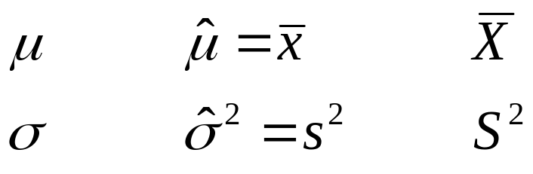
Estimation
Definition:
A (point) estimate θ of a parameter, θ, in the model is a “guess” at what θ can be (based on the sample). The corresponding random variable Θ is called an estimator.
^
^
Population
Sample
parameter estimation estimator
•
• • • •
• • •
• • • •
. . .
. . .
^
θ
θ
lecture 7

Slide 4
9.1 Introduction:
· Suppose we have a population with some unknown parameter(s).
Example: Normal(μ,σ)
μ and σ are parameters.
· We need to draw conclusions (make inferences) about the unknown parameters.
· We select samples, compute some statistics, and make inferences about the unknown parameters based on the sampling distributions of the statistics.
* Statistical Inference
(1) Estimation of the parameters (Chapter 9)
→ Point Estimation
→ Interval Estimation (Confidence Interval)
(2) Tests of hypotheses about the parameters (Chapter 10)

Slide 5
Section 9.2
Statistical Inference

Slide 6
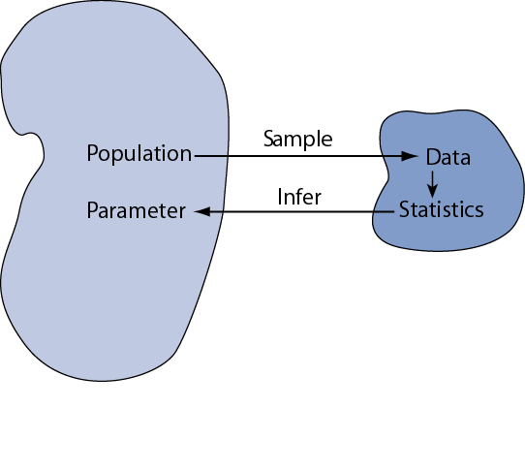
Statistical inference is the act of generalizing from a sample to a population with calculated degree of certainty.
We want to learn about population parameters…
…but we can only calculate sample statistics
8: Intro to Statistical Inference
Notes:
Chapter 8
Basic Biostat
Statistical inference is the logical process by which we make sense of numbers. It is how we generalize from the particular to the general. This is an important scientific activity.
Consider a study that wants to learn about the prevalence of a asthma in a population. We draw a SRS from the population and find that 3 of the 100 individuals in the sample have asthma. The prevalence in the sample is 3%. However, are still uncertain about the prevalence of asthma in the population; the next SRS from the same population may have fewer or more cases. How do we deal with this element of chance introduced by sampling?
A similar problem occurs when we do an experiment Each time we do an experiment, we expect different results due to chance. How do we deal with this chance variability?
Our first task is to distinguish between parameters and statistics. Parameters are the population value. Statistics are from the sample. The statistics will vary from sample to sample: they are random variables. In contrast, the parameters are invariable; they are constants.
To help draw this distinction, we use different symbols for parameters and statistics. For example, we use “mu” to represent the population mean (parameter) and “xbar” to represent the sample mean (statistic).

Slide 7
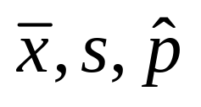
Parameters and Statistics
It is essential that we draw distinctions between parameters and statistics
 | Parameters | Statistics
Source | Population | Sample
Calculated? | No | Yes
Constants? | Yes | No
Examples | μ, σ, p
Basic Biostat

Slide 8
Section 9.3
Classical Methods of Estimation

Slide 9



9.3 Classical Methods of Estimation:
Point Estimation:
A point estimate of some population parameter θ is a single value of a statistic . For example, the value of the statistic computed from a sample of size n is a point estimate of the population mean μ.

Slide 10
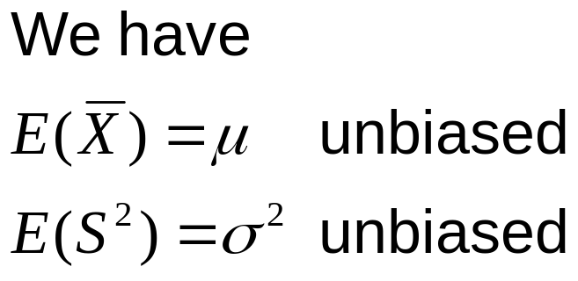
Estimation
Unbiased estimate
Definition:
An estimator Θ is said to be unbiased if
E(Θ) = θ
^
^
lecture 7

Slide 11
Definition 9.2
Copyright © 2010 Pearson Addison-Wesley. All rights reserved.
9 - <number>

Slide 12





Interval Estimation (Confidence Interval = C.I.):
An interval estimate of some population parameter θ is an interval of the form ( , ), i.e, <θ< . This interval contains the true value of θ "with probability 1−α", that is P( <θ< )=1−α
( , ) = <θ< is called a (1−α)100% confidence interval (C.I.)
for θ.
1−α is called the confidence coefficient
= lower confidence limit
= upper confidence limit
α =0.1, 0.05, 0.025, 0.01 (0<α<1)
Copyright © 2010 Pearson Addison-Wesley. All rights reserved.
9 - <number>

Slide 13
Section 9.4
Single Sample: Estimating the Mean

Slide 14
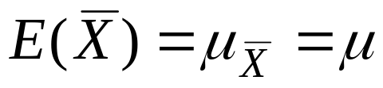
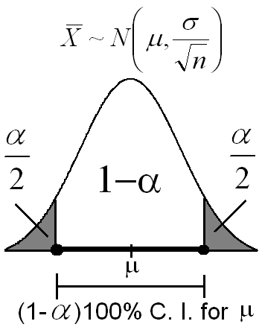
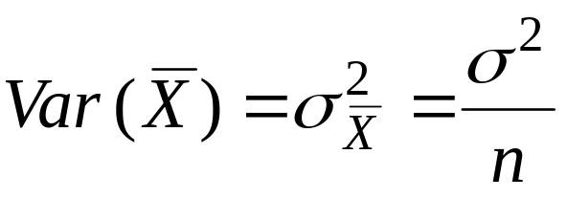
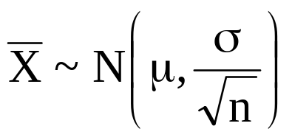
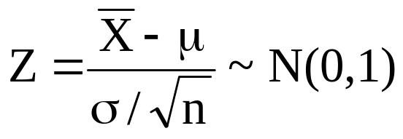
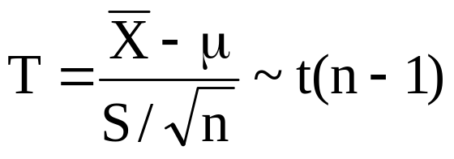

9.4 Single Sample: Estimation of the Mean (μ):
Recall:
(σ² is known)
(σ² is unknown)
We use the sampling distribution of to make inferences about μ.

Slide 15
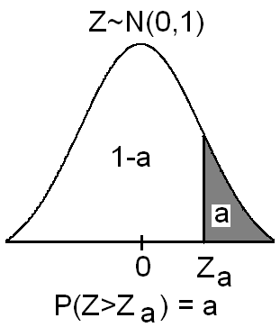
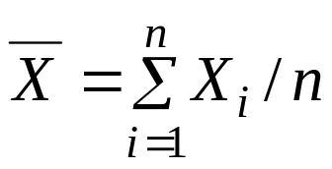
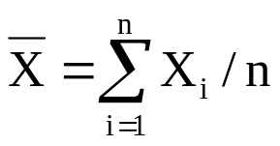
Notation:
Z_{a} is the Z-value leaving an area of a to the right; i.e., P(Z>Z_{a})=a or equivalently, P(Z<Z_{a})=1−a
Point Estimation of the Mean (μ):
· The sample mean is a "good" point estimate for μ.
Interval Estimation (Confidence Interval) of the Mean (μ):
(i) First Case: σ² is known:
Result:
If is the sample mean of a random sample of size n
from a population (distribution) with mean μ and known variance σ², then a (1−α)100% confidence interval for μ is :

Slide 16
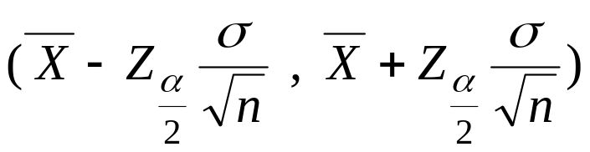
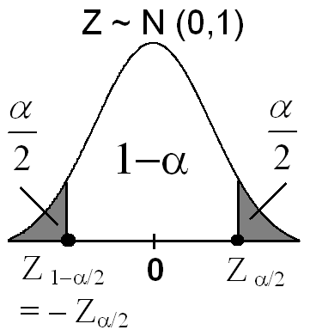
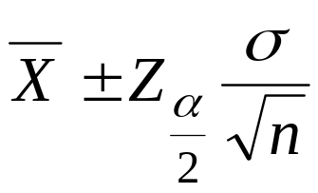
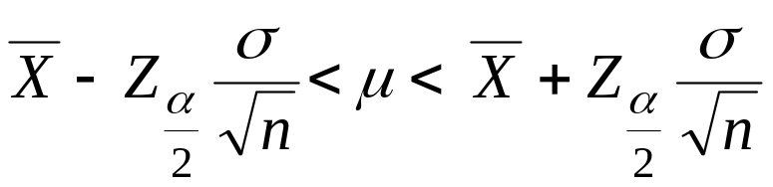

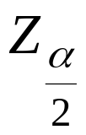
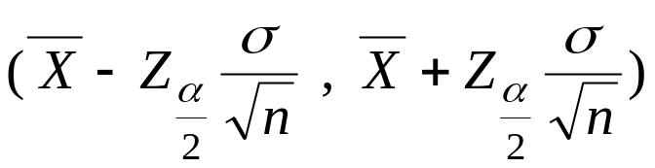
⇔
⇔
where is the Z-value leaving an area
of α/2 to the right; i.e., P(Z> )=α/2, or
equivalently, P(Z< )=1−α/2.
Note:
We are (1−α)100% confident that μ ∈

Slide 17
Example 9.2:
The average zinc concentration recorded from a sample of zinc measurements in 36 different locations is found to be 2.6 gram/milliliter. Find a 95% and 99% confidence interval (C.I.) for the mean zinc concentration in the river. Assume that the population standard deviation is 0.3.

Slide 18
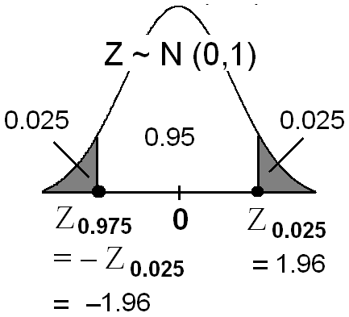
Solution:
= the mean zinc concentration in the river.
Population Sample
μ=?? n=36
σ=0.3 =2.6
First, a point estimate for μ is =2.6.
(a) We want to find 95% C.I. for μ.
α = ??
95% = (1−α)100%
⇔ 0. 95 = (1−α)
⇔ α=0.05
⇔ α/2 = 0.025

Slide 19
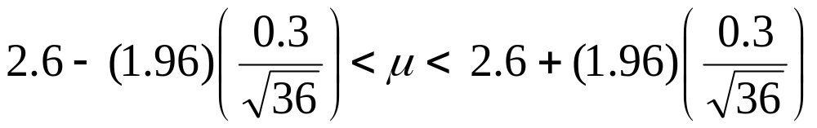
= Z_{0.025}
= 1.96
A 95% C.I. for μ is
⇔
⇔
2.6 − 0.098 < μ < 2.6 + 0.098
⇔ 2.502 < μ < 2.698
⇔ μ ∈( 2.502 , 2.698)
We are 95% confident that μ ∈( 2.502 , 2.698).

Slide 20

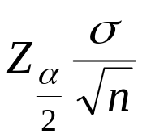
(b) Similarly, we can find that (Homework) A 99% C.I. for μ is
2.471 < μ < 2.729
⇔ μ ∈( 2.471 , 2.729)
We are 99% confident that μ ∈( 2.471 , 2.729)
Notice that a 99% C.I. is wider that a 95% C.I..
Note:
Error
|-----------|
______|____________________________|____
|----------------------|--------------------------|
Theorem 9.1:
If is used as an estimate of μ, we can then be (1−α)100% confident that the error will not exceed

Slide 21
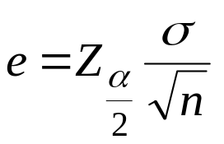
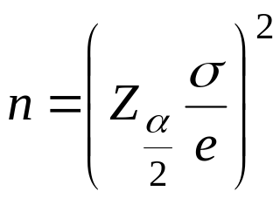
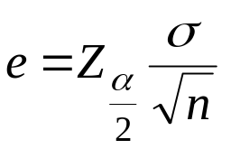
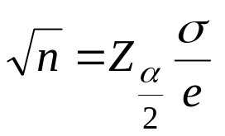

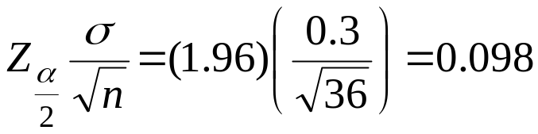
Note:
Let e be the maximum amount of the error, that is ,
then:
⇔
⇔
Example:
In Example 9.2, we are 95% confident that the sample mean differs from the true mean μ by an amount less than
Theorem 9.1:
If is used as an estimate of μ, we can then be (1−α)100% confident that the error will not exceed

Slide 22
Theorem 9.2:
If is used as an estimate of μ, we can then be (1−α)100% confident that the error (in estimation) will not exceed a specified
amount e when the sample size is

Slide 23
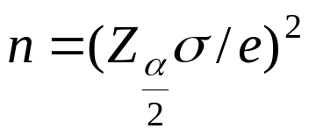
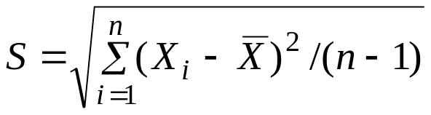
Note:
1. All fractional values of are rounded up to the next whole number.
2. If σ is unknown, we could take a preliminary sample of size n≥30 to provide an estimate of σ. Then using
as an approximation for σ in Theorem 9.2
we could determine approximately how many observations are needed to provide the desired degree of accuracy.

Slide 24
Example 9.3:
How large a sample is required in Example 9.2 if we want to be 95% confident that our estimate of μ is off by less than 0.05?
Example 9.2:
The average zinc concentration recorded from a sample of zinc measurements in 36 different locations is found to be 2.6 gram/milliliter. Find a 95% and 99% confidence interval (C.I.) for the mean zinc concentration in the river. Assume that the population standard deviation is 0.3.
Copyright © 2010 Pearson Addison-Wesley. All rights reserved.

Slide 25
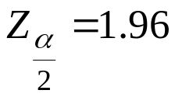
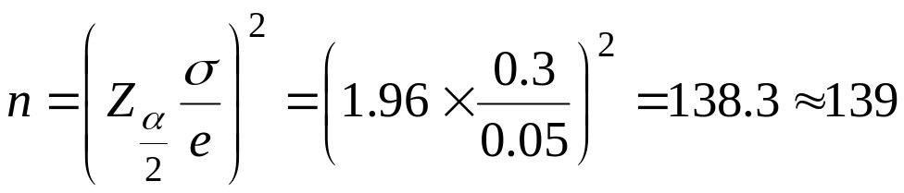
Solution:
We have σ= 0.3 , , e=0.05. Then by Theorem 9.2,
Therefore, we can be 95% confident that a random sample of size n=139 will provide an estimate differing from μ by an amount less than e=0.05.

Slide 26
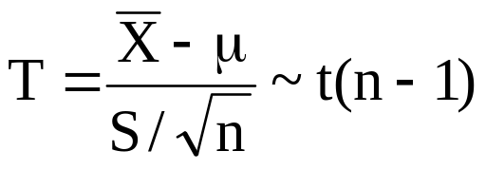
Interval Estimation (Confidence Interval) of the Mean (μ):
(ii) Second Case: σ² is unknown:
Recall:
Result:
If and are the sample mean
and the sample standard deviation of a random sample of size n from a normal population (distribution) with unknown variance σ², then a (1−α)100% confidence interval for μ is :

Slide 27
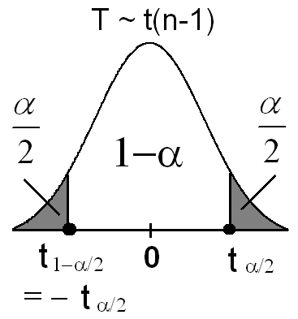
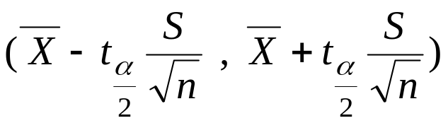
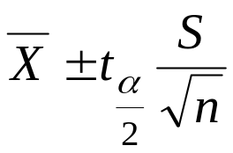
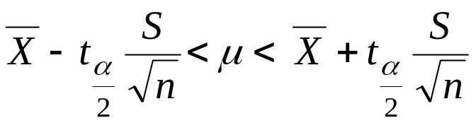

where is the t-value with ν=n−1 degrees of freedom leaving
an area of α/2 to the right; i.e., P(T> )=α/2, or equivalently, P(T< )=1−α/2.
Copyright © 2010 Pearson Addison-Wesley. All rights reserved.
9 - <number>

Slide 28
Example 9.4:
The contents of 7 similar containers of sulfuric acid are 9.8, 10.2, 10.4, 9.8, 10.0, 10.2, and 9.6 liters. Find a 95% C.I. for the mean of all such containers, assuming an approximate normal distribution.

Slide 29
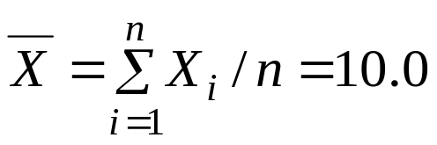
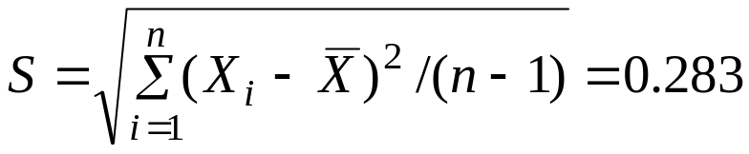
Solution:
n=7
First, a point estimate for μ is
Now, we need to find a confidence interval for μ.
α = ??
95%=(1−α)100% ⇔ 0. 95=(1−α) ⇔ α=0.05 ⇔ α/2=0.025
= t_{0.025} =2.447 (with ν=n−1=6 degrees of freedom)

Slide 30

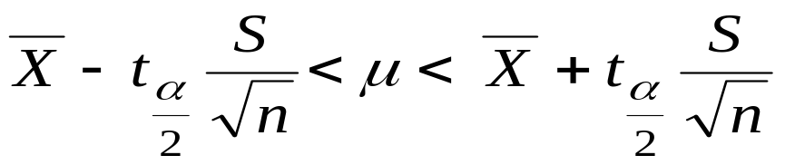
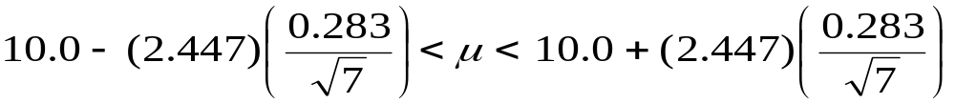
A 95% C.I. for μ is
 | 0.025
6 | ↓ → t_{0.025}=2.447
⇔
⇔
⇔ 10.0 − 0.262< μ < 10.0 + 0.262
⇔ 9.74 < μ < 10.26
⇔ μ ∈( 9.74 , 10.26)
We are 95% confident that μ ∈( 9.74 , 10.26).

Slide 31
9.5 Standard Error of a Point Estimate:
· The standard error of an estimator is its standard deviation.
· We use as a point estimator of μ, and we used
the sampling distribution of to make a (1−α)100% C.I. for μ.
·

Slide 32
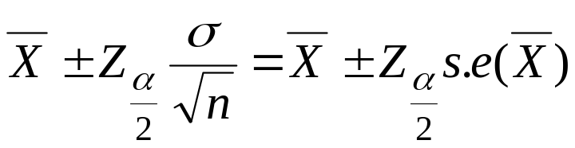
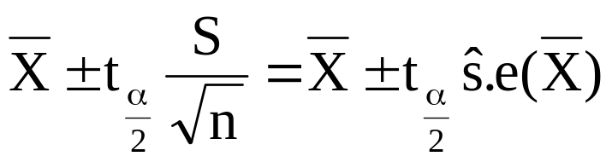
· Note: a (1−α)100% C.I. for μ, when σ² is known, is
· Note: a (1−α)100% C.I. for μ, when σ² is unknown and the distribution is normal, is
(ν=n−1 df)

Slide 33
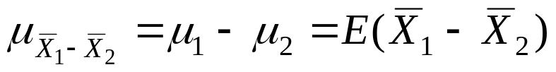
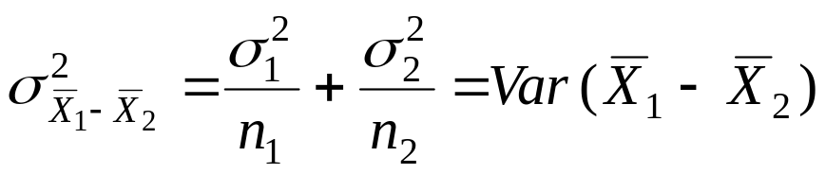
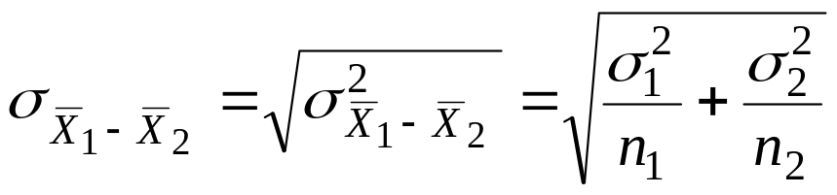
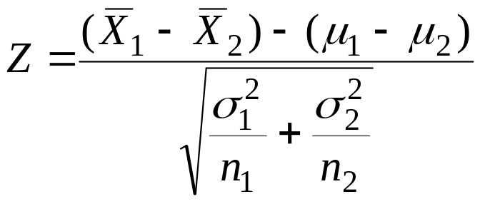
9.7 Two Samples: Estimating the Difference between Two Means (μ₁−μ₂):
Recall: For two independent samples:
~N(0,1)

Slide 34



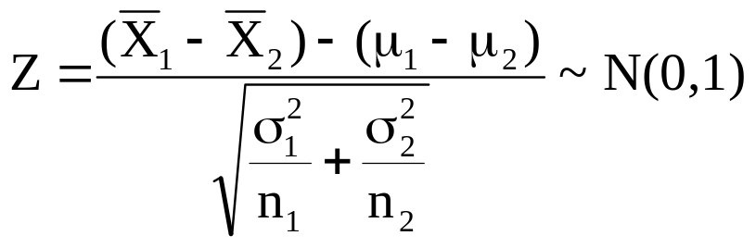
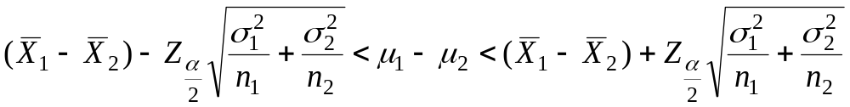
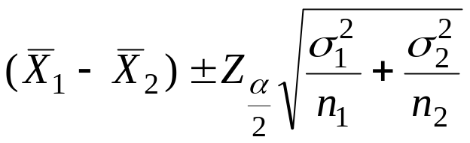
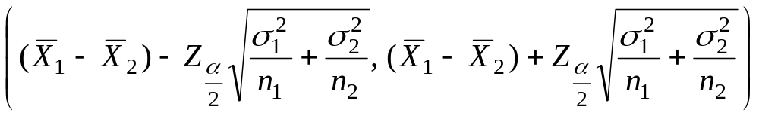
Point Estimation of μ₁−μ₂:
is a "good" point estimate for μ₁−μ₂.
Confidence Interval of μ₁−μ₂:
(i) First Case: and are known:
Result:
a (1−α)100% confidence interval for μ₁−μ₂ is :
or
or

Slide 35





(ii) Second Case: = =σ² is unknown:
If and are unknown but = =σ², then the pooled estimate of σ² is
where is the variance of the 1-st sample and is the variance of the 2-nd sample. The degrees of freedom of is ν=n₁+n₂−2.

Slide 36




Result:
a (1−α)100% confidence interval for μ₁−μ₂ is :
or
or
or
where is the t-value with ν=n₁+n₂−2 degrees of freedom.

Slide 37
Example 9.6: (1st Case: and are known)
An experiment was conducted in which two types of engines, A and B, were compared. Gas mileage in miles per gallon was measured. 50 experiments were conducted using engine type A and 75 experiments were done for engine type B. The gasoline used and other conditions were held constant. The average gas mileage for engine A was 36 miles per gallon and the average for engine B was 42 miles per gallon. Find 96% confidence interval for μ_{B}−μ_{A}, where μ_{A} and μ_{B} are population mean gas mileage for engines A and B, respectively. Assume that the population standard deviations are 6 and 8 for engines A and B, respectively.

Slide 38





Solution:
Engine A Engine B
n_{A}=50 n_{B}=75
=36 =42
σ_{A}=6 σ_{B}=8
A point estimate for μ_{B}−μ_{A} is =42−36=6.
α = ??
96% = (1−α)100% ⇔ 0. 96 = (1−α) ⇔ α=0.04 ⇔ α/2 = 0.02
= Z_{0.02} = 2.05
A 96% C.I. for μ_{B}−μ_{A} is

Slide 39



3.43 < μ_{B}−μ_{A} < 8.57
We are 96% confident that μ_{B}−μ_{A} ∈(3.43, 8.57).
Example 9.7: (2nd Case: = unknown) Reading Assignment

Slide 40
Example: (2nd Case: = unknown)
To compare the resistance of wire A with that of wire B, an experiment shows the following results based on two independent samples (original data multiplied by 1000):
Wire A: 140, 138, 143, 142, 144, 137
Wire B: 135, 140, 136, 142, 138, 140
Assuming equal variances, find 95% confidence interval for μ_{A}−μ_{B}, where μ_{A} (μ_{B}) is the mean resistance of wire A (B).

Slide 41


Solution:
Wire A Wire B .
n_{A}=6 n_{B}=6
S²_{A}=7.86690
S²_{B}=7.10009
____________________________________

Slide 42






A point estimate for μ_{A}−μ_{B} is =140.67−138.50=2.17.
95% = (1−α)100% ⇔ 0. 95 = (1−α) ⇔ α=0.05 ⇔ α/2 = 0.025
ν= df = n_{A}+n_{B} − 2= 10
= t_{0.025} = 2.228
A 95% C.I. for μ_{A}−μ_{B} is

Slide 43



or
−1.35< μ_{A}−μ_{B} < 5.69
We are 95% confident that μ_{A}−μ_{B} ∈(−1.35, 5.69)

Slide 44
Section 9.9
CI for variance

Slide 45
Sampling Distribution of s² (Normal Data)
Population variance (σ²) is a fixed (unknown) parameter based on the population of measurements
Sample variance (s²) varies from sample to sample (just as sample mean does)
When Y~N(μ,σ), the distribution of (a multiple of) s² is Chi-Square with n-1 degrees of freedom. (n-1)s²/σ² ~ χ² with df=n-1
Chi-Square distributions
  Positively skewed with positive density over (0,∞)
  Indexed by its degrees of freedom (df)
  Mean=df, Variance=2(df)
  Critical Values given in Chi-squared table

Slide 46


Chi-Square Distribution Critical Values

Slide 47

Confidence interval on the χ² distribution
The 100(1-α) confidence interval for the distribution of (n-1) s²/σ² is a two-tailed χ² distribution between
and . This interval is given by

Slide 48

(1-α)100% Confidence Interval for σ² (or σ)
Step 1: Obtain a random sample of n items from the population, and compute s²
Step 2: Choose confidence level (1-α )
Step 3: Obtain χ²_{L} and χ²_{U} from the table of critical values for the chi-square distribution with n-1 df
Step 4: Compute the confidence interval for σ² based on the formula below
Step 5: Obtain confidence interval for standard deviation σ by taking square roots of bounds for σ²

Slide 49
Example
In a study on cholesterol levels a sample of 12 men and women was chosen. The plasma cholesterol levels (mmol/L) of the subjects were as follows: 6.0, 6.4, 7.0, 5.8, 6.0, 5.8, 5.9, 6.7, 6.1, 6.5, 6.3, and 5.8. We assume that these 12 subjects constitute a simple random sample of a population of similar subjects. We wish to estimate the variance of the plasma cholesterol levels with a 95 percent confidence interval.

Slide 50
Solution
(1) Given
6.0 6.4 7.0 5.8 6.0 5.8
5.9 6.7 6.1 6.5 6.3 5.8
Estimate the variance with a 95% confidence interval.

Slide 51
Solution
(2) Calculations
Value of s = .3918680978
Values of χ² from table
= 21.920 = 3.816

Slide 52

Calculations

Slide 53
Section 9.10
Single Sample: Estimating a Proportion

Slide 54




9.9 Single Sample: Estimating of a Proportion:
.p = Population proportion of successes (elements of Type A) in the population
.n = sample size
X = no. of elements of type A in the sample of size n.
= Sample proportion of successes (elements of Type A) in the sample

Slide 55






Recall that:
(1) X ~ Binomial (n, p)
(2) E( )= E( )= p
(3) Var( ) = Var( ) =
(4) For large n, we have
~ N(p, ) (Approximately)
~ N(0,1) (Approximately)
Point Estimation for p:
A good point estimator for the population proportion p is given by the statistic (sample proportion):

Slide 56



Confidence Interval for p:
Result:
For large n, an approximate (1−α)100% confidence interval for p is :
or
or

Slide 57
Example 9.10:
In a random sample of n=500 families owing television sets in the city of Hamilton, Canada, it was found that x=340 subscribed to HBO. Find 95% confidence interval for the actual proportion of families in this city who subscribe to HBO.

Slide 58


Solution:
p = proportion of families in this city who subscribe to HBO.
n = sample size = 500
X = no. of families in the sample who subscribe to HBO=340.
= proportion of families in the sample who subscribe to HBO.
A point estimator for p is

Slide 59


Now,
95% = (1−α)100% ⇔ 0. 95 = (1−α) ⇔ α=0.05 ⇔ α/2 = 0.025
= Z_{0.025} = 1.96
A 95% confidence interval for p is:
0.64< p < 0.72
We are 95% confident that p ∈(0.64,0.72).

Slide 60


9.10 Two Samples: Estimating the Difference between Two Proportions:
Suppose that we have two populations:
· .p₁ = proportion of the 1-st population.
· .p₂ = proportion of the 2-nd population.

Slide 61


We are interested in comparing p₁ and p₂, or equivalently, making inferences about p₁− p₂.
We independently select a random sample of size n₁ from the 1-st population and another random sample of size n₂ from the 2-nd population:
Let X₁ = no. of elements of type A in the 1-st sample.
X₁~Binomial(n₁, p₁)
E(X₁)= n₁ p₁
Var(X₁)=n₁ p₁ q₁ (q₁=1− p₁)
Let X₂ = no. of elements of type A in the 2-nd sample.
X₂~Binomial(n₂, p₂)
E(X₂)= n₂ p₂
Var(X₂)=n₂ p₂ q₂ (q₂=1− p₂)
·
= proportion of the 1-st sample
·
= proportion of the 2-nd sample

Slide 62





· The sampling distribution of is used to make inferences about p₁− p₂.
Result:
( 1 )
( 2 )
( 3 )
For large n₁ and n₂, we have
(Approximately)
(Approximately)

Slide 63



Point Estimation for p₁− p₂:
A good point estimator for the difference between the two proportions, p₁− p₂, is given by the statistic:
Confidence Interval for p₁− p₂:
Result:
For large n₁ and n₂, an approximate (1−α)100% confidence interval for p₁− p₂ is :
or

Slide 64

or
Example 9.13:
A certain change in a process for manufacture of component parts is being considered. Samples are taken using both existing and the new procedure to determine if the new process results in an improvement. If 75 of 1500 items from the existing procedure were found to be defective and 80 of 2000 items from the new procedure were found to be defective, find 90% confidence interval for the true difference in the fraction of defectives between the existing and the new process.

Slide 65







Solution:
.p₁ = fraction (proportion) of defectives of the existing process
.p₂ = fraction (proportion) of defectives of the new process
= sample fraction of defectives of the existing process
= sample fraction of defectives of the new process
Existing Process New Process
n₁ = 1500 n₂ = 2000
X₁=75 X₂=80
Point Estimation for p₁− p₂:
A point estimator for the difference between the two proportions, p₁− p₂, is:

Slide 66



Confidence Interval for p₁− p₂:
A 90% confidence interval for p₁− p₂ is :
−0.0017 < p₁− p₂ < 0.0217
We are 90% confident that p₁− p₂ ∈(−0.0017, 0.0217).

Slide 67
Note:
Since 0∈90% confidence interval=(−0.0017, 0.0217), there is no reason to believe that the new procedure produced a significant decrease in the proportion of defectives over the existing method (p₁− p₂ ≈ 0 ⇔ p₁ ≈ p₂).

Slide 68
Section
Review

