Slide 1
Vasileios Tsiantis
13/05/2025
Some results

Slide 2
Calculation of optimal gains: 0.0001 → 0.003 for 3000 particles , 10000 turns → 10 scans and computing largest emittance reduction with gainL=0
0.0002 → 0.0012 for 3000 particles , 20000 turns → 10 scans and computing largest emittance reduction with gainL=0
Calculation of cooling time: fit exponential A * np.exp(-B * x) + C to emittance evolution over turns, cooling time = 1/B in turns, final cooling time =cooling time (turns)*Trev

Slide 3
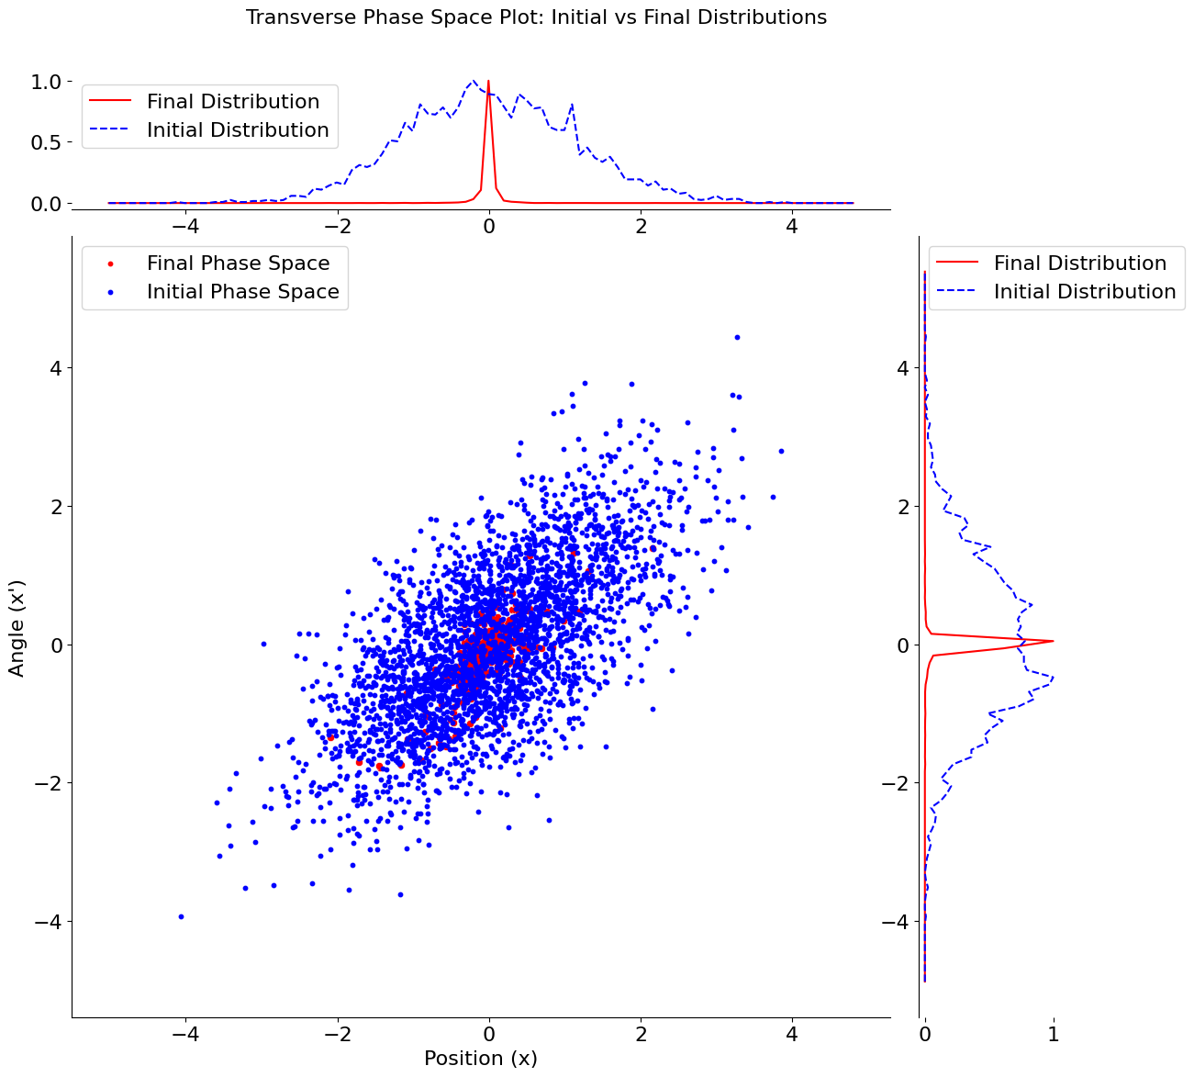
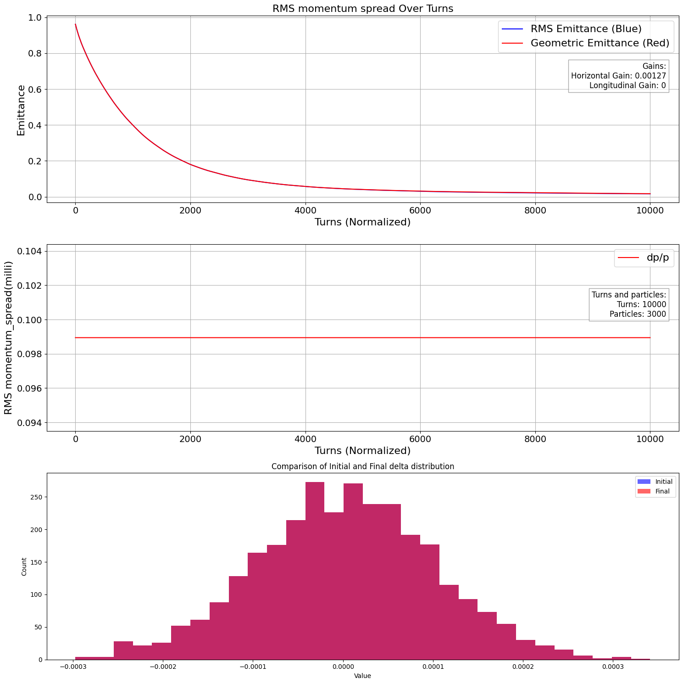
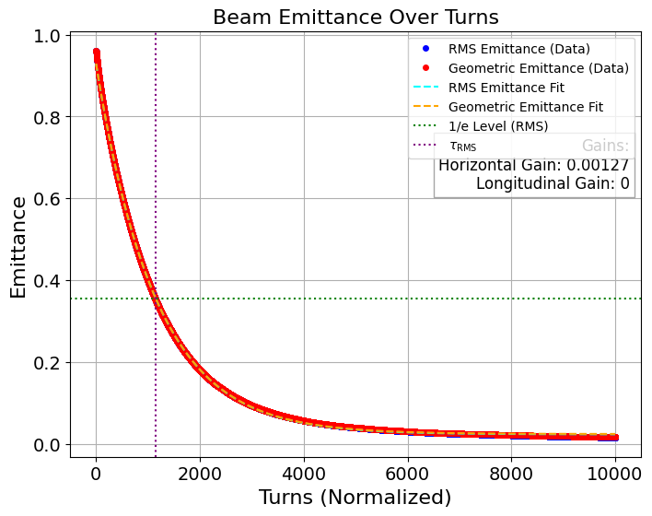
Gain=0.00127 → optimal gain for 10000 turns, emittance reduction → 98.62841742799654% , cooling time = 0.000712 sec

Slide 4
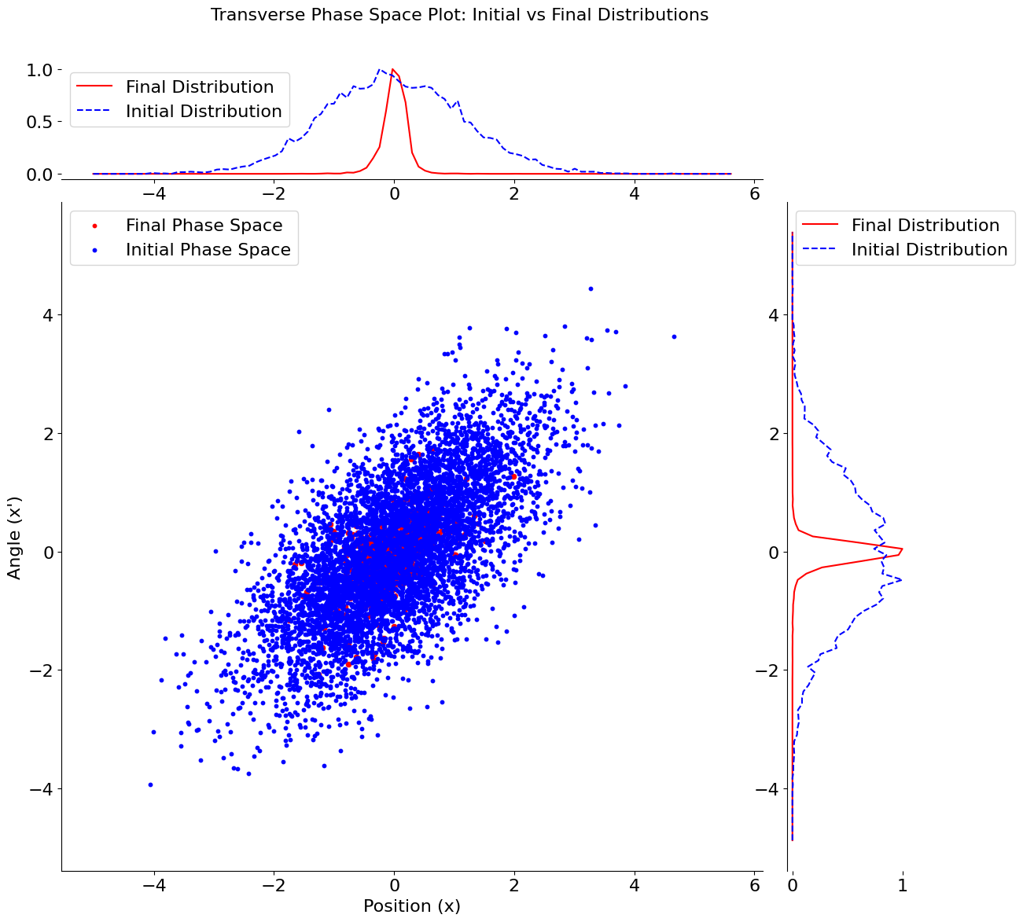
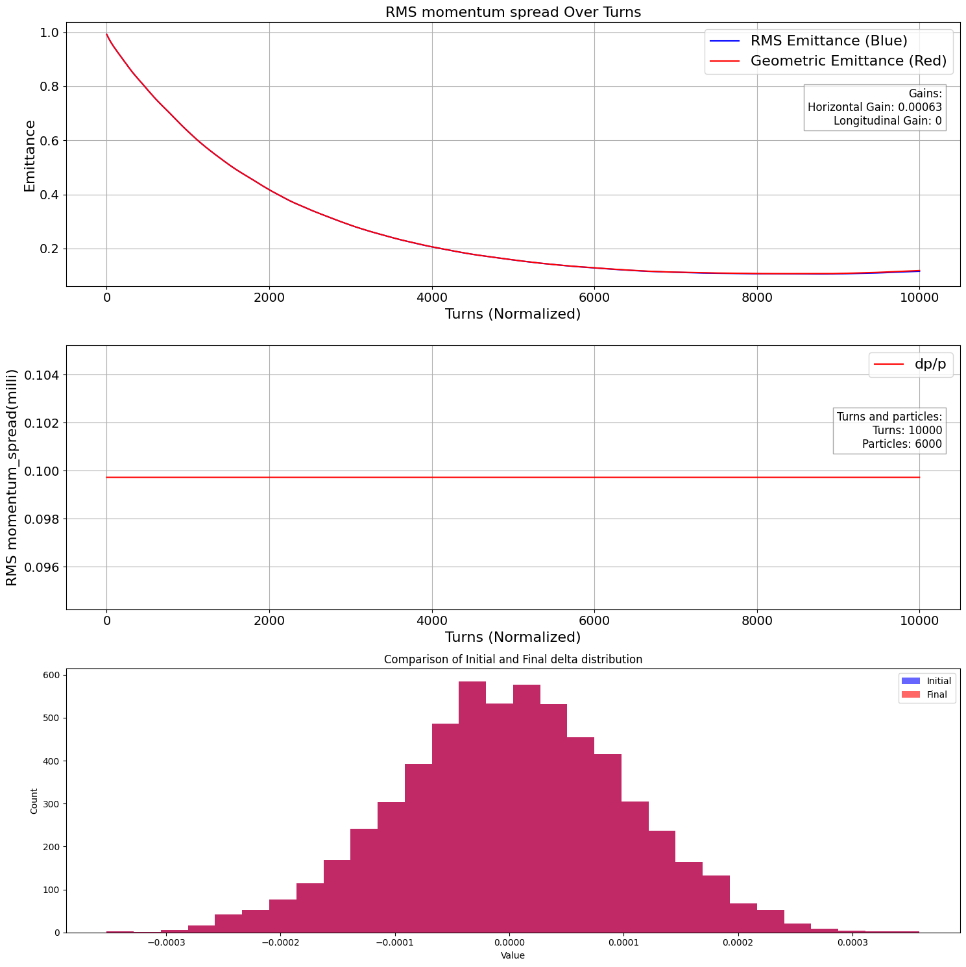
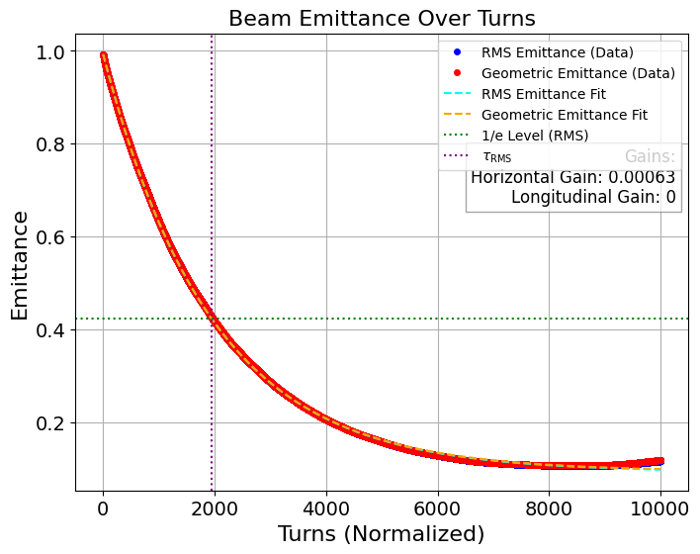
Gain=0.00127/2 → optimal gain for 6000 particles, 10000 turns, emittance reduction → 88.35% , cooling time = 0.001207 sec →69.5% increase

Slide 5

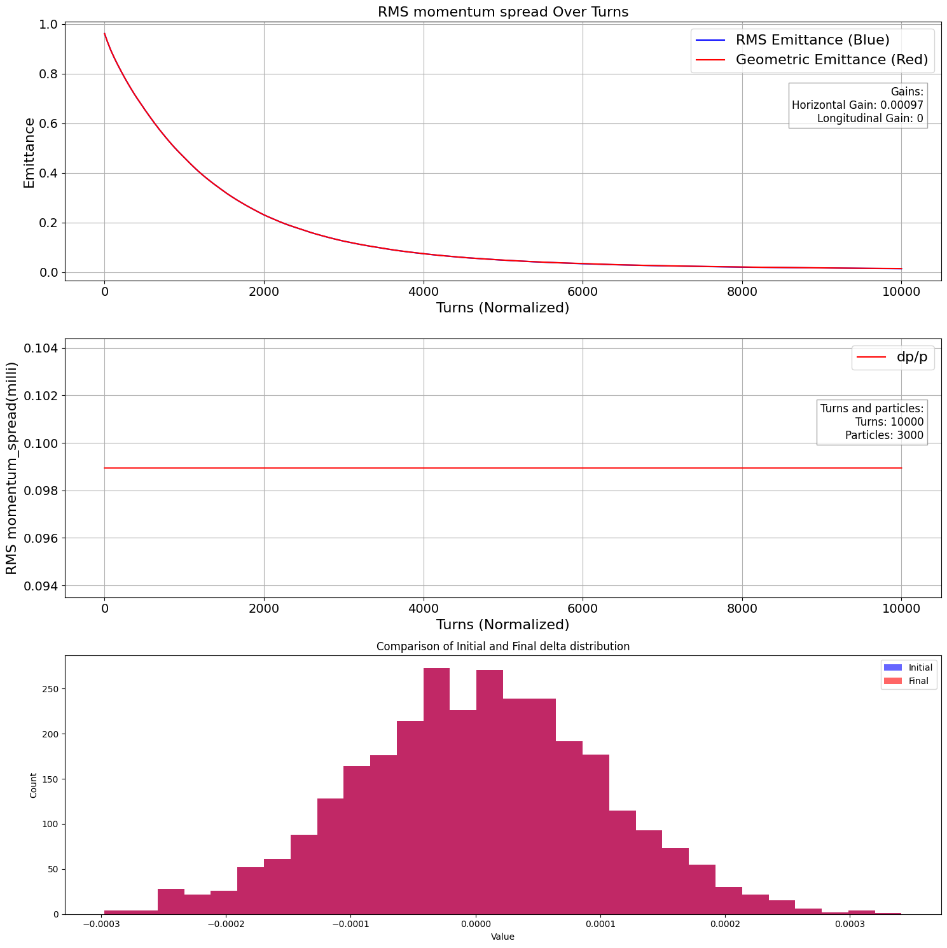
Gain=0.00127 /1.3 =0.00097 for 3000 particles and 10000turns, emittance reduction → 98.58% , cooling time = 0.000853 sec

Slide 6

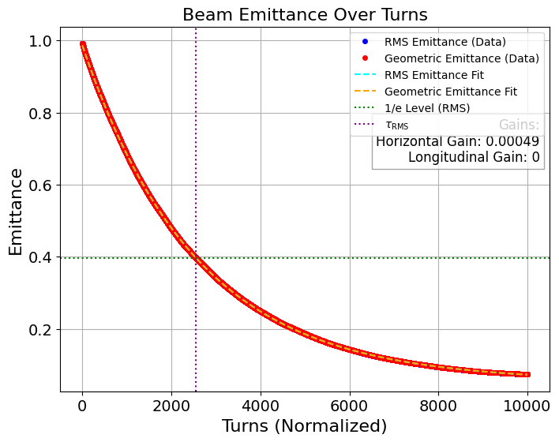
Gain=0.00127/2 /1.3 =0.00049 for 6000 particles and 10000turns, emittance reduction → 92.58% , cooling time = 0.001582 sec → 85.46% increase

Slide 7

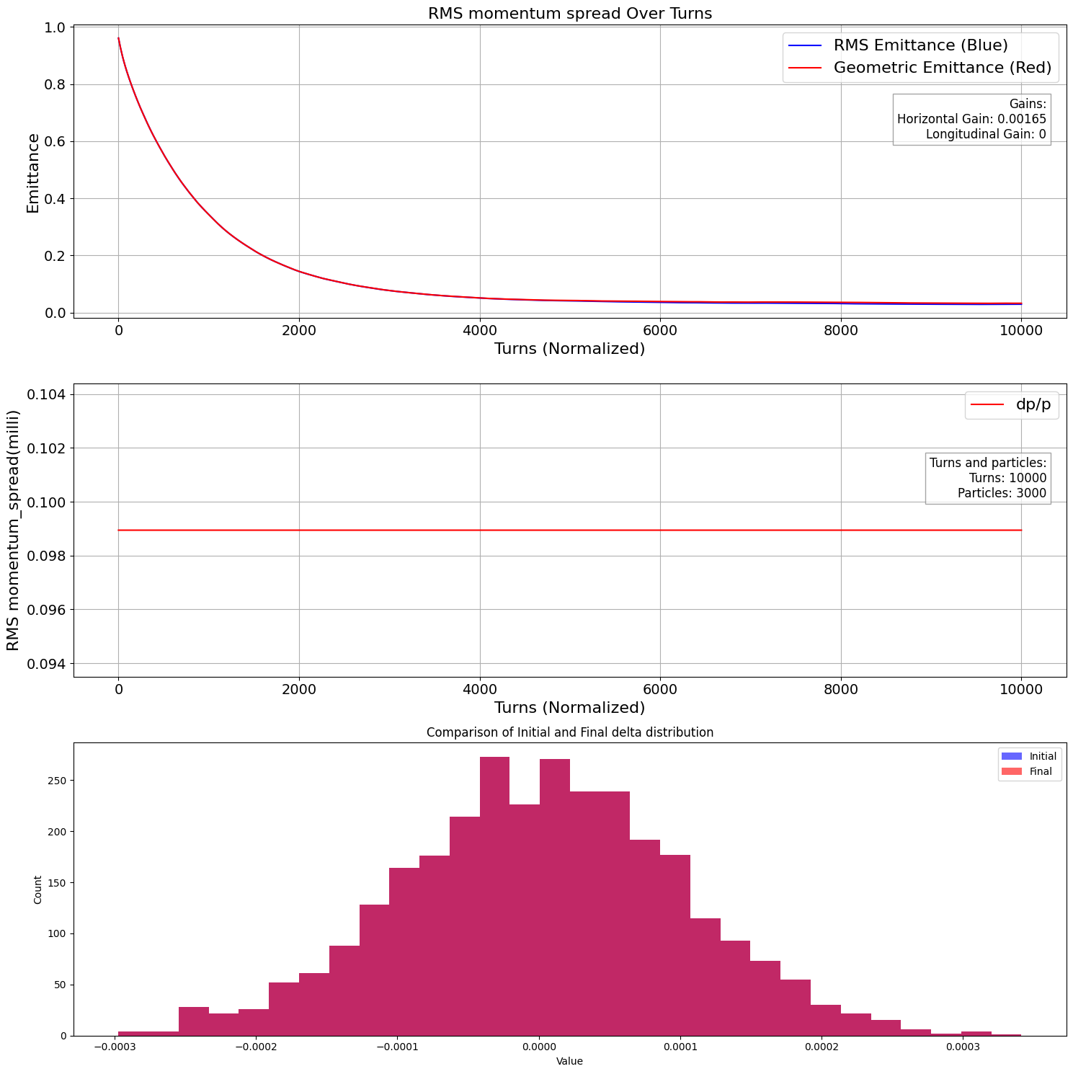
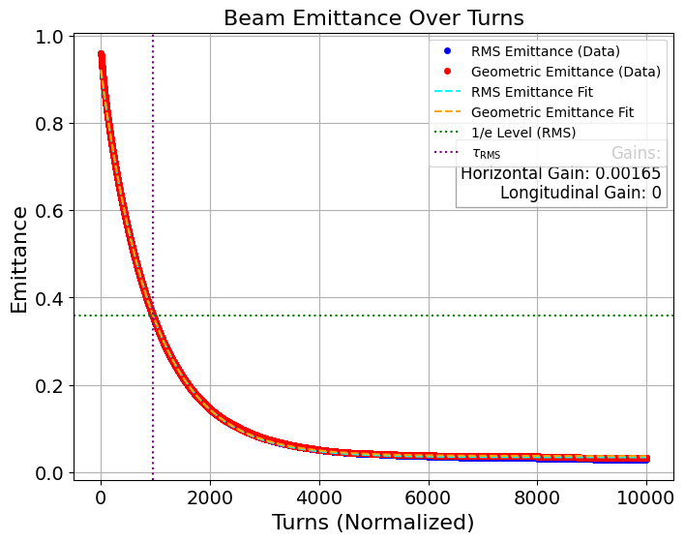
Gain=0.00127*1.3 =0.00165 for 3000 particles and 10000 turns, emittance reduction → 96.97% , cooling time = 0.000593 sec

Slide 8
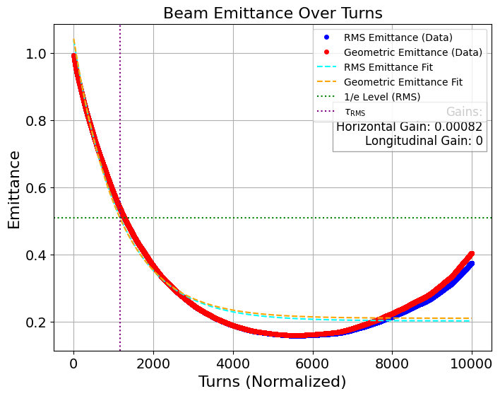
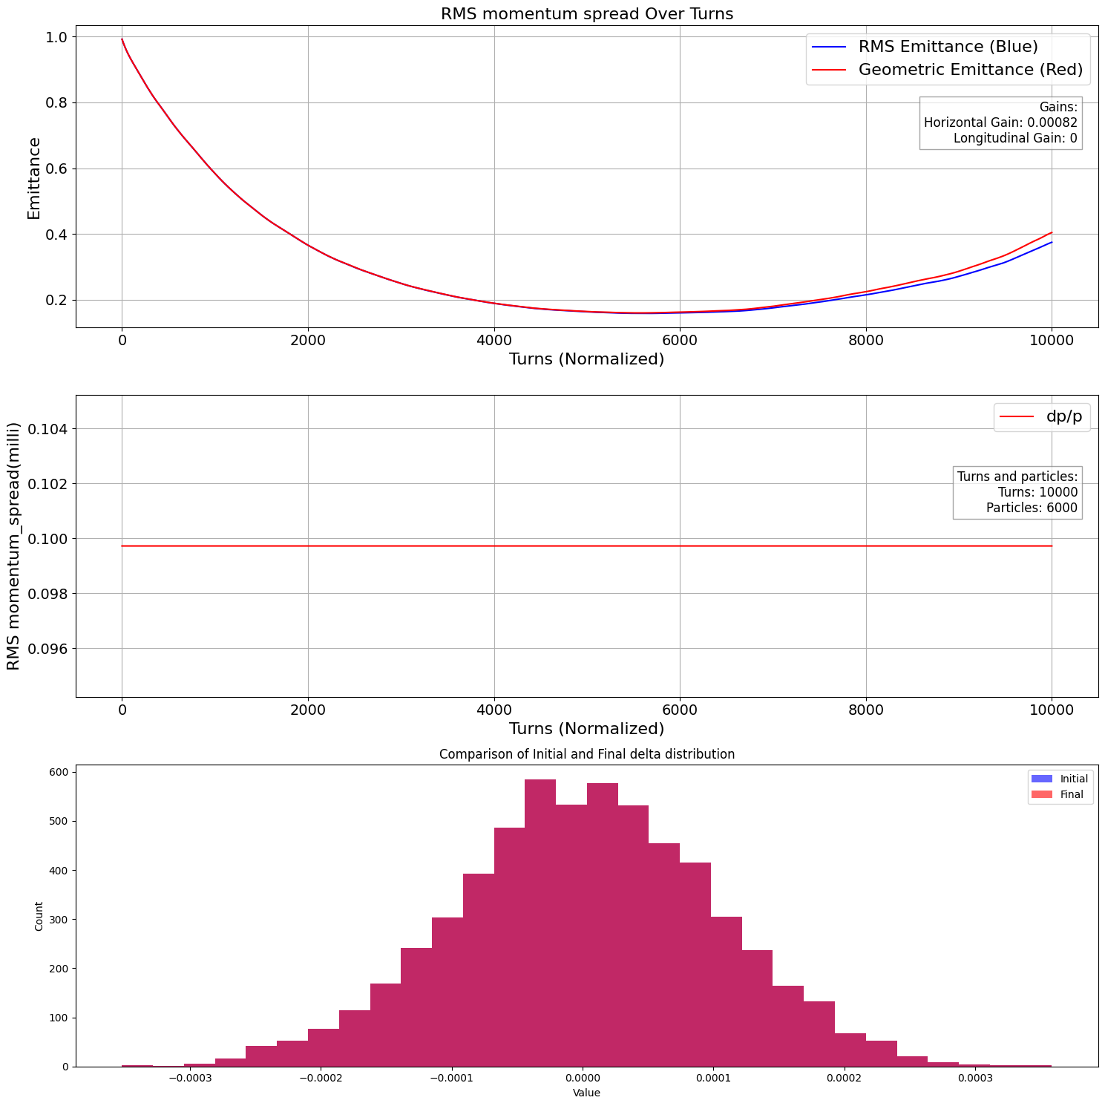
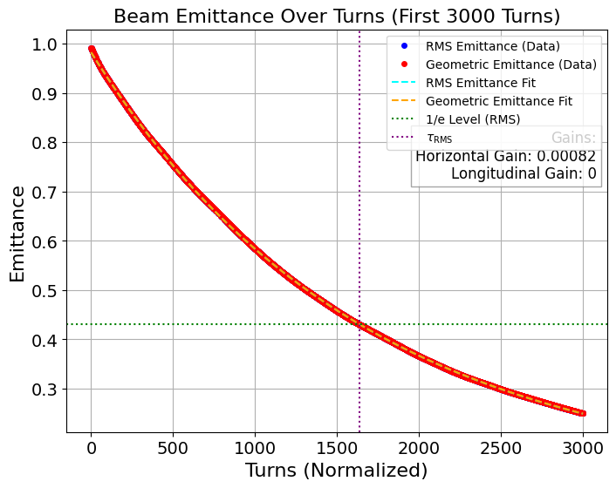
Gain=0.00127*1.3/2 =0.00082 for 6000 particles and 10000 turns, emittance reduction → 62.227% , cooling time = 0.000723 sec → 22% increase → different Fit → cooling time → 0.001016 sec → 71.33 % increase

Slide 9

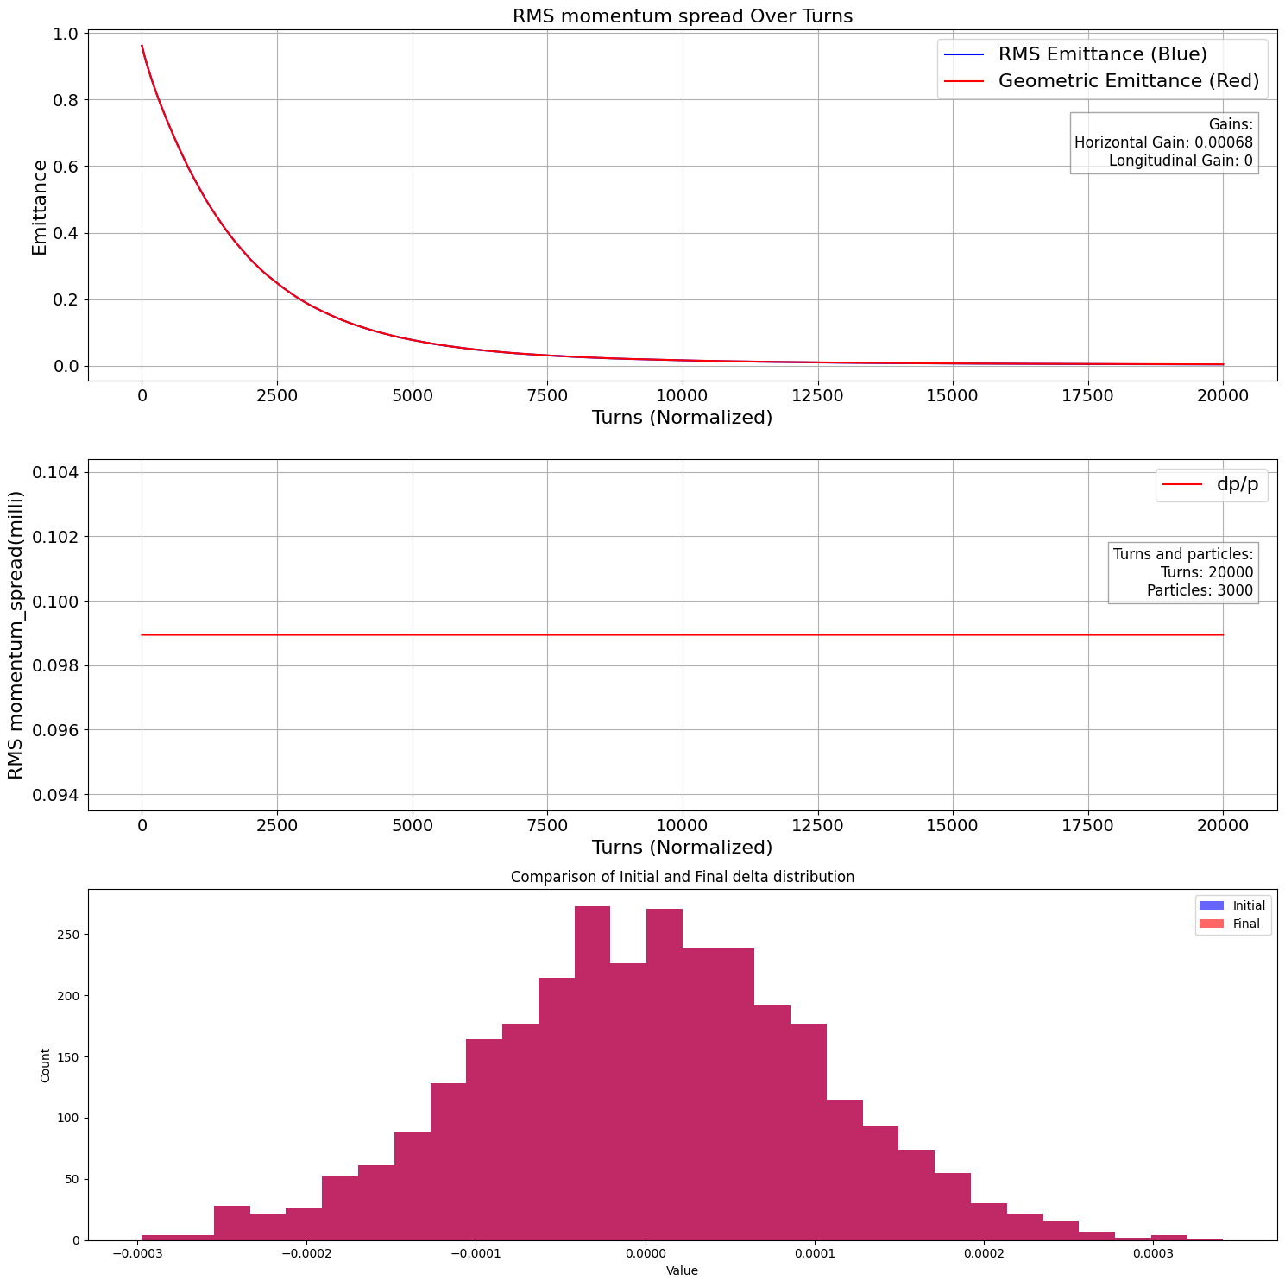
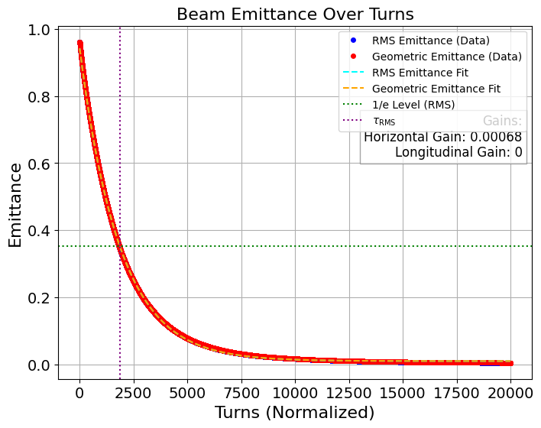
Gain=0.000677 for 3000 particles and 20000 turns→ optimal case, emittance reduction → 99.58% , cooling time = 0.001153 sec

Slide 10
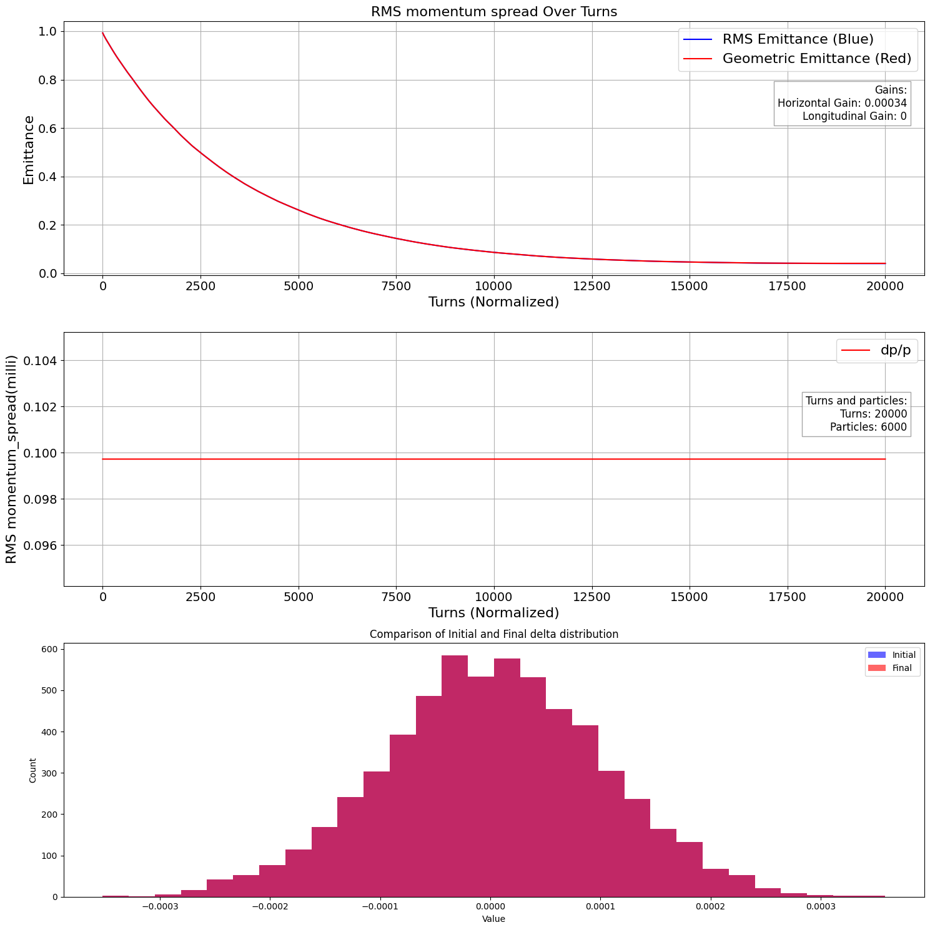
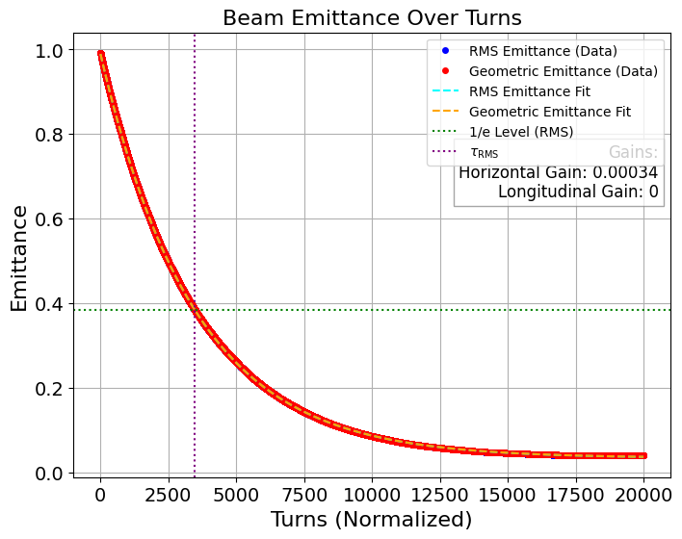
Gain=0.000677/2=0.00034 for 6000 particles and 20000 turns→ optimal case, emittance reduction → 95.97% , cooling time = 0.002150 sec → 86.47% increase

Slide 11

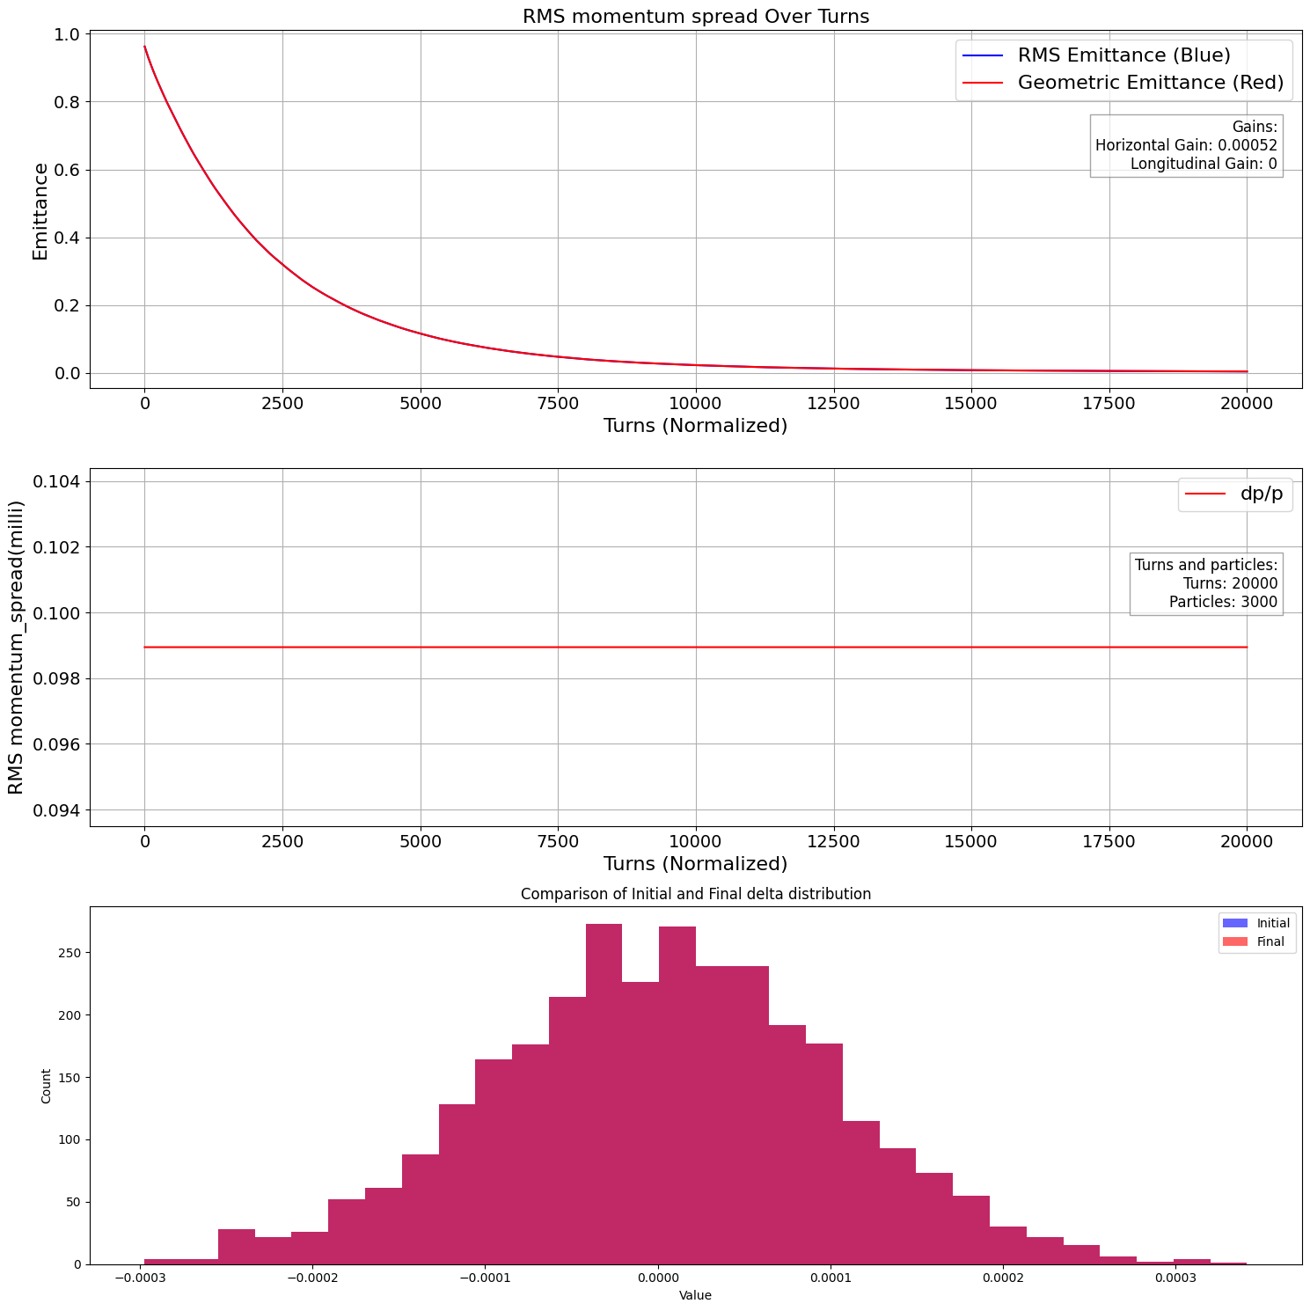
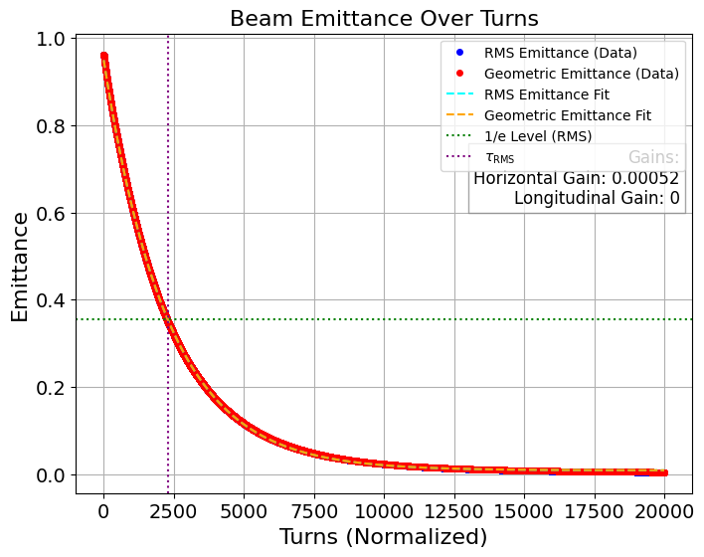
Gain=0.000677/1.3=0.00052 for 3000 particles and 20000 turns, emittance reduction → 99.53% , cooling time = 0.001419 sec

Slide 12

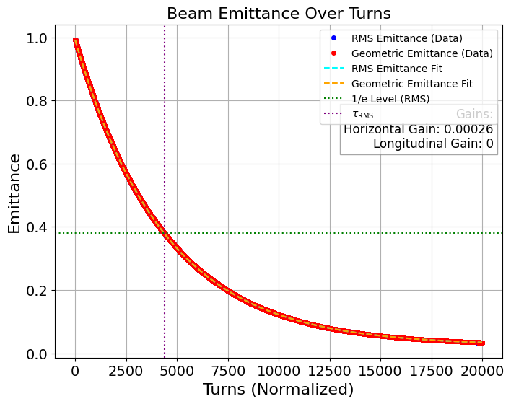
Gain=0.000677/2/1.3=0.00026 for 6000 particles and 20000 turns, emittance reduction → 96.59% , cooling time = 0.002712 sec → 91.12% increase

Slide 13
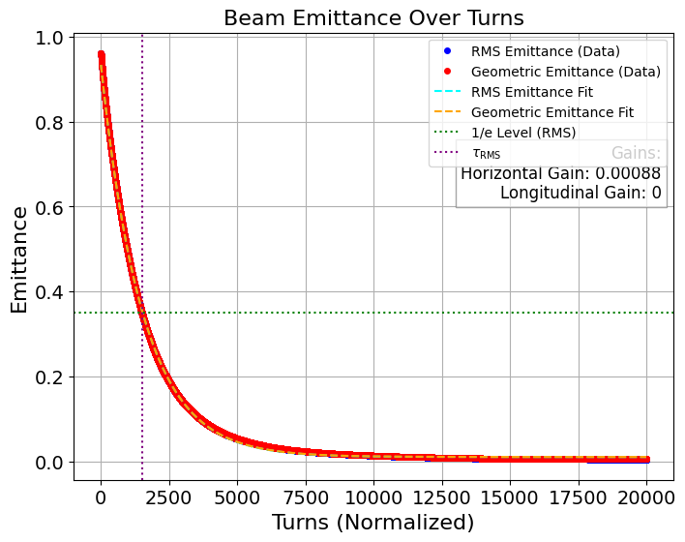

Gain=0.000677*1.3=0.00088 for 3000 particles and 20000 turns, emittance reduction → 99.52% , cooling time = 0.00095 sec

Slide 14
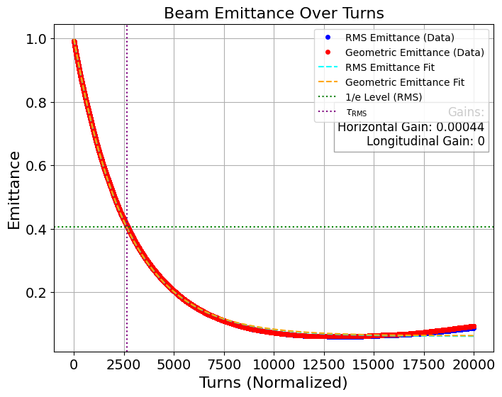

Gain=0.000677*1.3/2=0.00044 for 6000 particles and 20000 turns, emittance reduction → 91.2% , cooling time = 0.001638 sec → 72.42% increase

Slide 15

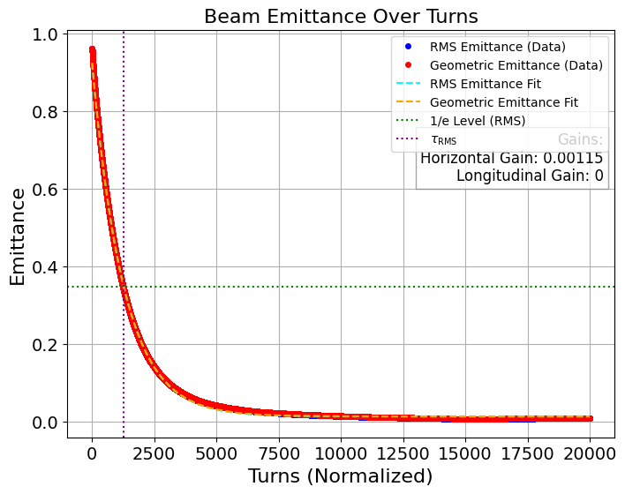
Gain=0.000677*1.7=0.00115 for 3000 particles and 20000 turns, emittance reduction → 99.015% , cooling time = 0.000788

Slide 16
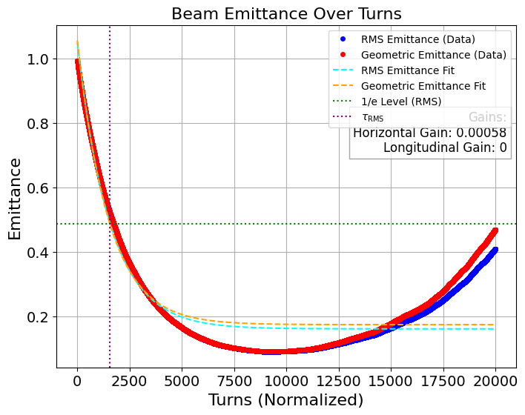

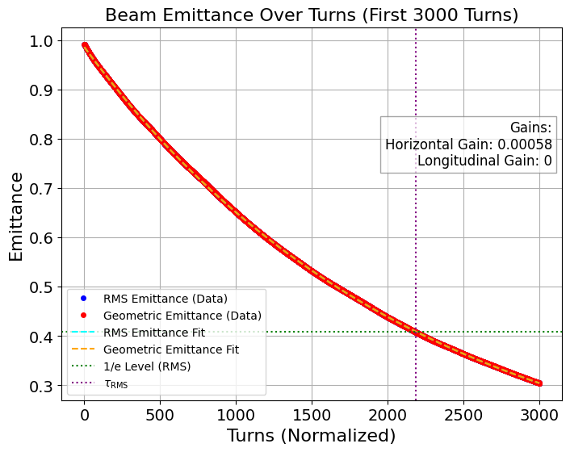
Gain=0.000677*1.7/2=0.0058 for 6000 particles and 20000 turns, emittance reduction → 58.8% , cooling time = 0.000972 sec → 23.35% increase → different Fit →cooling time =0.001357 sec → 72.21% increase

Slide 17
Turns | Particles | gain | Emittance Reduction(%) | Tc(sec) | Tc (new fit)(sec) (3000 turns) | Increase of cooling times(%)
10000 | 3000 | 0.00127(o) | 98.63 | 0.000712 | 0.000674 | -
10000 | 6000 | 0.00063 | 88.35 | 0.00121 | 0.001257 | 69.5 , 76.54 ,86.5%
10000 | 3000 | 0.00097 | 98.58 | 0.000853 | 0.00082 | -
10000 | 6000 | 0.00049 | 92.58 | 0.001582 | 0.001549 | 85.46 , 81.59, 88.9%
10000 | 3000 | 0.00165 | 96.97 | 0.000593 | 0.000564 | -
10000 | 6000 | 0.00082 | 62.23 | 0.000723 | 0.001016 | 22 , 71.33, 80.14%
20000 | 3000 | 0.000677(o) | 99.58 | 0.001153 | 0.001102 | -
20000 | 6000 | 0.00034 | 95.97 | 0.002150 | 0.002117 | 86.47, 83.61, 92.11%
20000 | 3000 | 0.00052 | 99.53 | 0.001419 | 0.001386 | -
20000 | 6000 | 0.00026 | 96.59 | 0.002712 | 0.002675 | 91.12, 88.51, 93%
20000 | 3000 | 0.00088 | 99.51 | 0.00095 | 0.000877 | -
20000 | 6000 | 0.00044 | 91.2 | 0.001638 | 0.001692 | 72.42, 92.93%
20000 | 3000 | 0.00115 | 99.015 | 0.00079 | 0.000722 | -
20000 | 6000 | 0.0058 | 58.8 | 0.000972 | 0.001357 | 23.35, 72.21, 87.95%

Slide 18
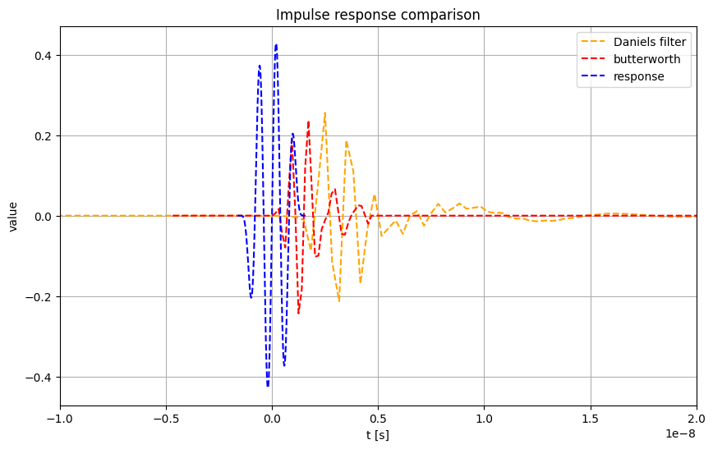

Slide 19
