Slide 1
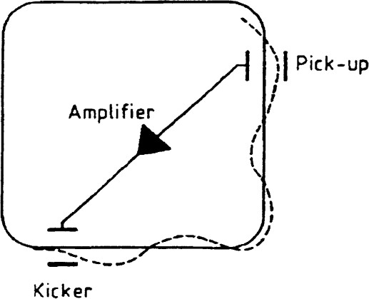
Stochastic cooling-Simplified model
Simplified model of stochastic cooling.
Beam of particles with Gaussian distribution (mean=0, standard deviation=1) on x(position) and x’(angle) .
No elements on the ring, just an empty ring with a pickup and
a kicker with a specified one-turn phase advance
and phase advance between PU and kicker=π/2
We give as an input the following parameters:
i) Num_turns= Number of turns the beam will perform in the ring
ii)gain= the gain is how strong the kick will be on the kicker
iii)N_particles=number of particles in the beam
iv)W=bandwidth of the system, for now is just used to create the samples ( W=20*10⁷ Hz )
v)Trev= time for the beam to complete a revolution in the ring, just for the samples for now (Trev=5*10⁻⁷ sec)
vi)noise_std= the standard deviation on the electronics noise with mean_noise=0
vii)one_turn_mi= one turn phase advance of the ring (one_turn_mi=1.779*3π/2)
viii)mi_pu_k= phase advance between pickup and kicker (mi_pu_k=π/2)
We measure the average position of every sample at the PU with some noise and after 90º we correct the angle of every particle of the sample (kick) by xc=-gain* measured_value_with_noise

Slide 2
Stochastic cooling-Simplified model(2)
Number of particles per sample=Ns=N_particles/(2*W*Trev)
Number of samples=ns=N_particles/Ns
We divide the particles on samples equally and randomly.
After each turn, we re-randomize the samples to assure perfect mixing (M=1).
Below are presented some results and characteristics of the simulation:
N_particles=10000, Num_turns=5000, gain=0.1 , noise_std=0.1
Beam mean x [mm]: 0.009
Beam mean x' [mrad]: 0.011
Beam rms size [mm]: 1.000
Beam rms divergence [mrad]: 0.999
gain is 0.1
number of samples are 200
Number of particles per sample are 50
the initial emittance is 0.999π mm*mrad
the final emittance after cooling is 0.026 mm*mrad
Is emittance reduced?? --> True
Emittance is reduced by 97.363%

Slide 3
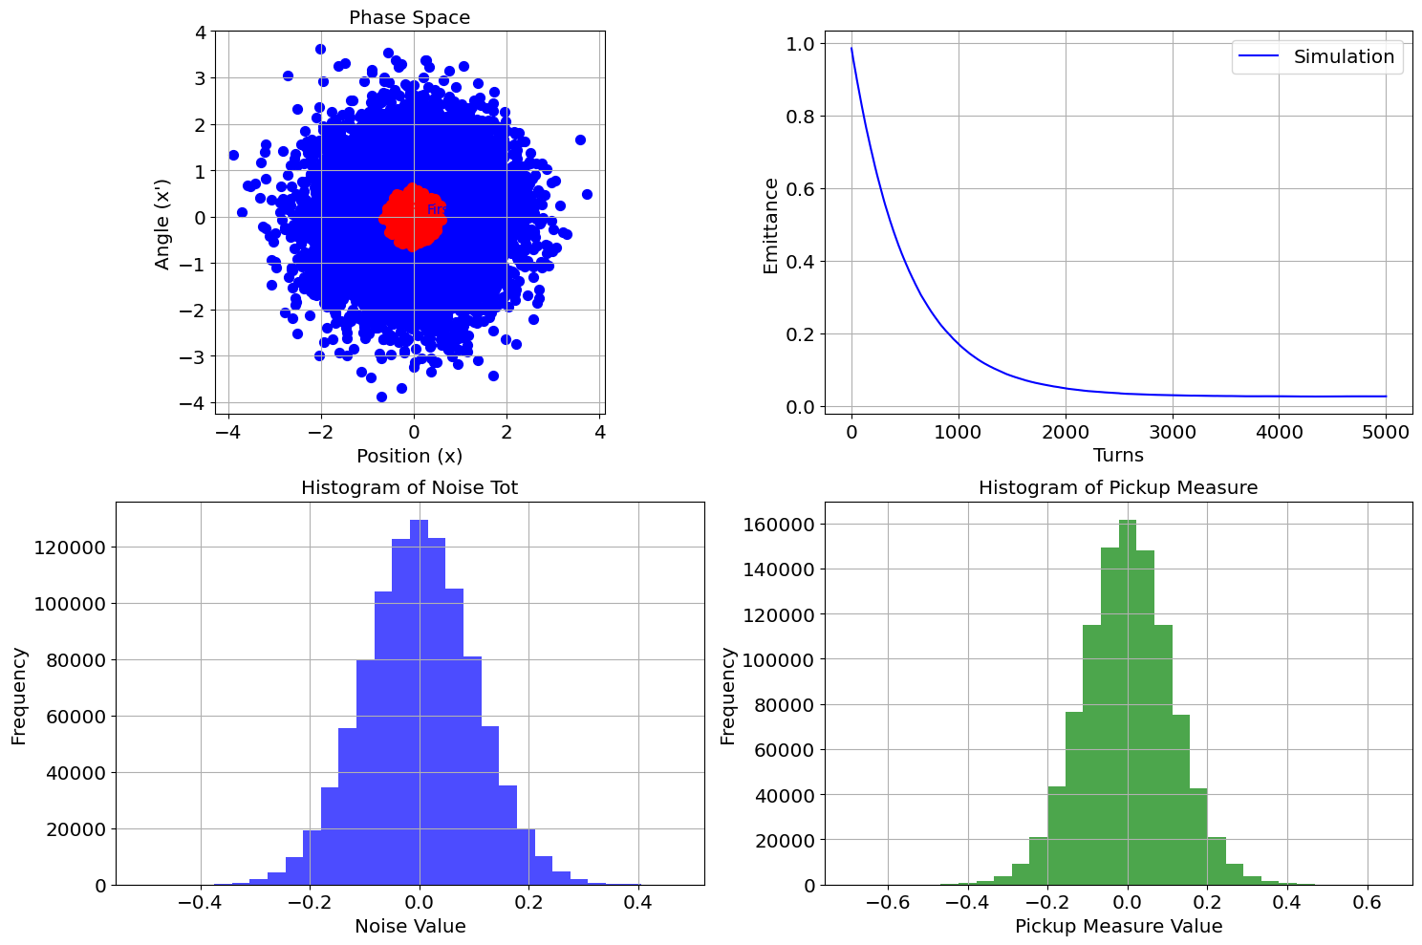
Stochastic cooling-Some results
N_particles=10000, Num_turns=5000, gain=0.1 , noise_std=0.1

Slide 4
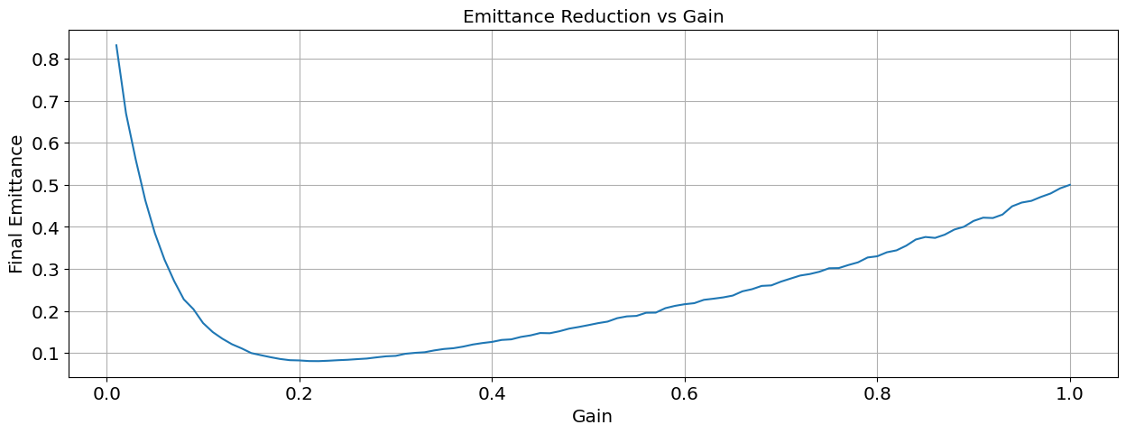
Stochastic cooling-Some results(2)
N_particles=10000, Num_turns=1000, gain=0.1-1 , noise_std=0.1
Optimal Gain: 0.22, Min Emittance: 0.07922405944096264

Slide 5
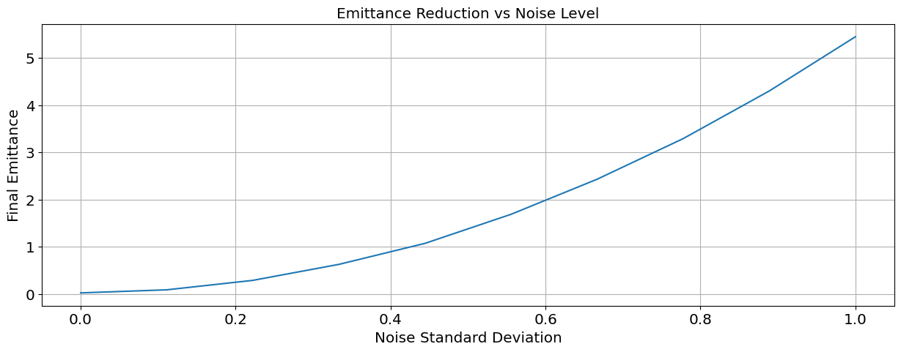
Stochastic cooling-Some results(3)
N_particles=10000, Num_turns=1000, gain=0.2 , noise_std=0-1

Slide 6
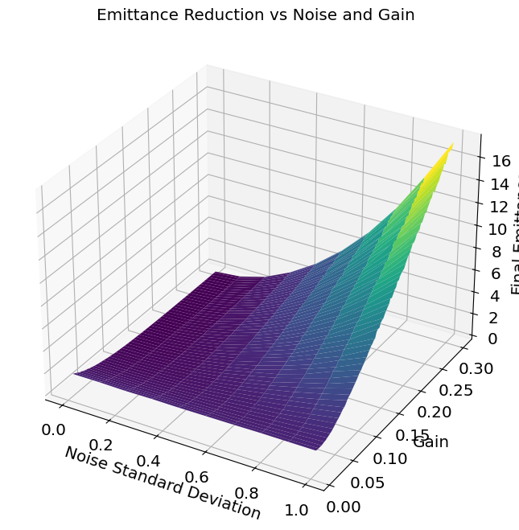
Stochastic cooling-Some results(4)
N_particles=10000, Num_turns=1000, gain=0.01-0.3 , noise_std=0-1
Minimum Emittance: 0.0126 at Noise: 0.0000 and Gain: 0.2971

Slide 7
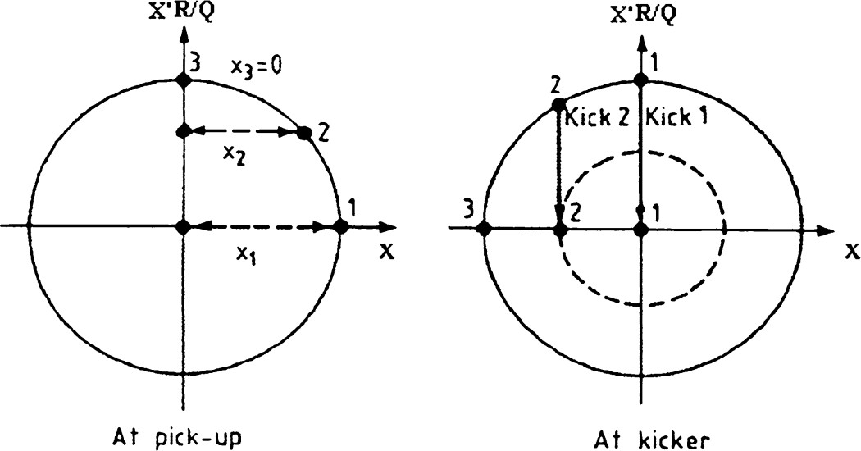
Stochastic cooling-Theoretical model
We have already computed the number of samples(ns) and number of particles per sample(Ns)
We will try to compute the emittance reduction based on this model.
The derivation will be on normalized phase space:
The rms emittance is given by: ε =<j²>=<j’²>=(<j²>+<j’²>)/2(taking the average of the 2)=σj²+σj’²/2
Pickup measurement: , where , noise is the noise in the pickup( in mm)
Phase advance PU → kicker = Δμ
Pickup measurement: , kick is , g=gain
This kick on the reference frame of PU :
Δj=-Δj’k sin(Δμ), Δj’=Δj’k cos(Δμ)
(We see kicks only on position, because Δμ=π/2)

Slide 8
Stochastic cooling-Theoretical model(2)
Expectation value :
Time derivative of emittance:
, with ,

Slide 9
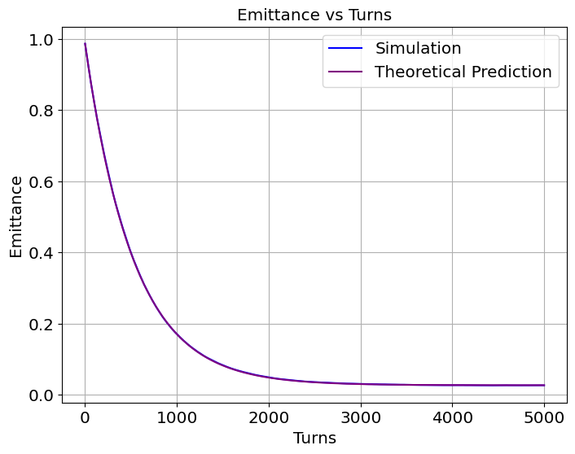
Stochastic cooling-Simulation vs Theory
N_particles=10000, Num_turns=5000, gain=0.1 , noise_std=0.1
The final emittance is 0.026 mm*mrad
Root Mean Square Error: 0.001

Slide 10

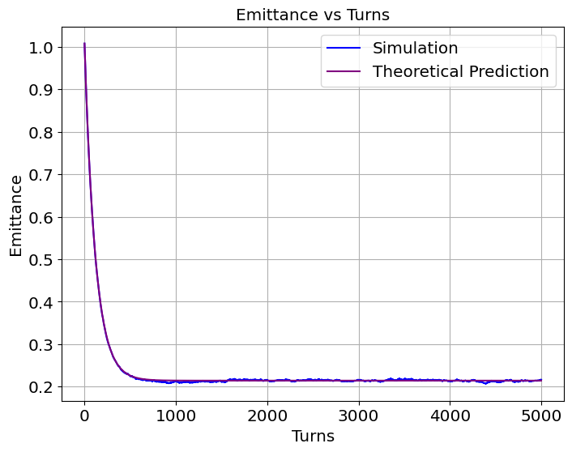
Stochastic cooling-Simulations
N_particles=10000, Num_turns=5000
gain=0.1 , noise_std=0.1 gain=0.6 , noise_std=0.1
The final emittance is 0.026π mm*mrad The final emittance is 0.211π mm*mrad
Root Mean Square Error: 0.001 Root Mean Square Error: 0.002
We observe that bigger gain can lead to faster but worst cooling!
That’s the reason why we decrease the gain as cooling proceeds (and also to counter the increasing noise-to-signal ratio!)

Slide 11
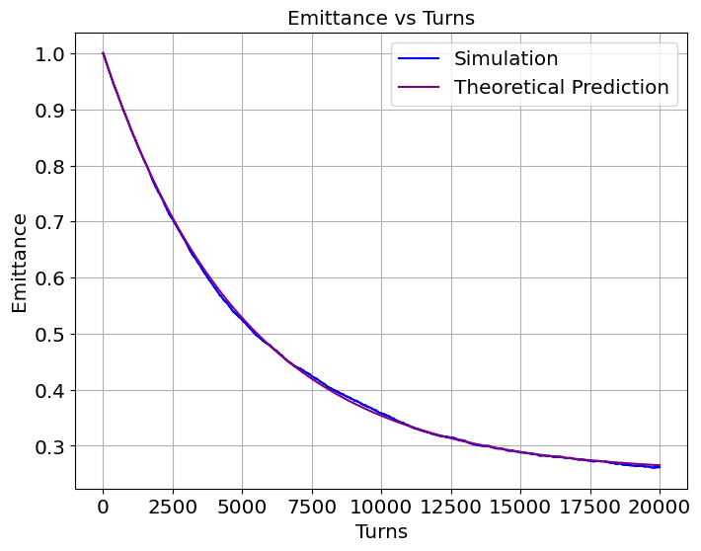
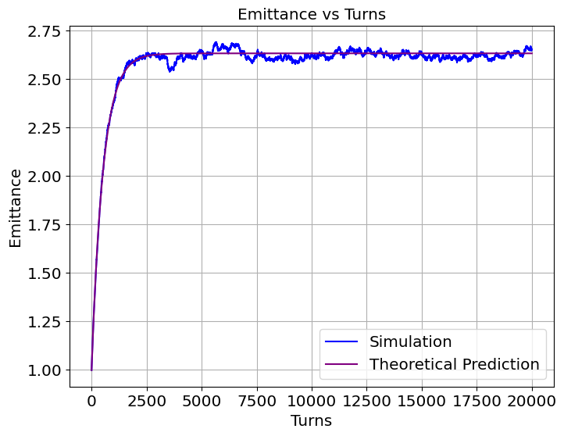
Stochastic cooling-Simulations
N_particles=10000, Num_turns=20000
gain=0.01 , noise_std=1 gain=0.1 , noise_std=1
The final emittance is 0.265π mm*mrad The final emittance increased!
Root Mean Square Error: 0.003 Root Mean Square Error: 0.023
We observe that gain small enough can counter high levels of noise and cooling remains possible but slower(20000 turns)!

