Slide 1
SiteOpt Assistant
User-Focused Achievement Summary
Purpose: Help users prepare inputs faster and understand data before running energy system studies.

Slide 2
1. What Users Can Do Now
Ask for input changes in plain language.
Ask questions about project data without manual searching.
Request visualizations directly from chat.
See generated plots in Data Editor → Assistant Plot.

Slide 3
2. End-User Experience
Assistant is available directly in the web interface.
Works in the currently active project context.
Responses are readable and structured.
Charts are shown where users already inspect data.

Slide 4
3. Separation of Responsibilities
Web Assistant: input preparation and insight.
Spine Toolbox: optimization/simulation execution.
Clear workflow: prepare in web app, execute in Spine Toolbox, review results.

Slide 5
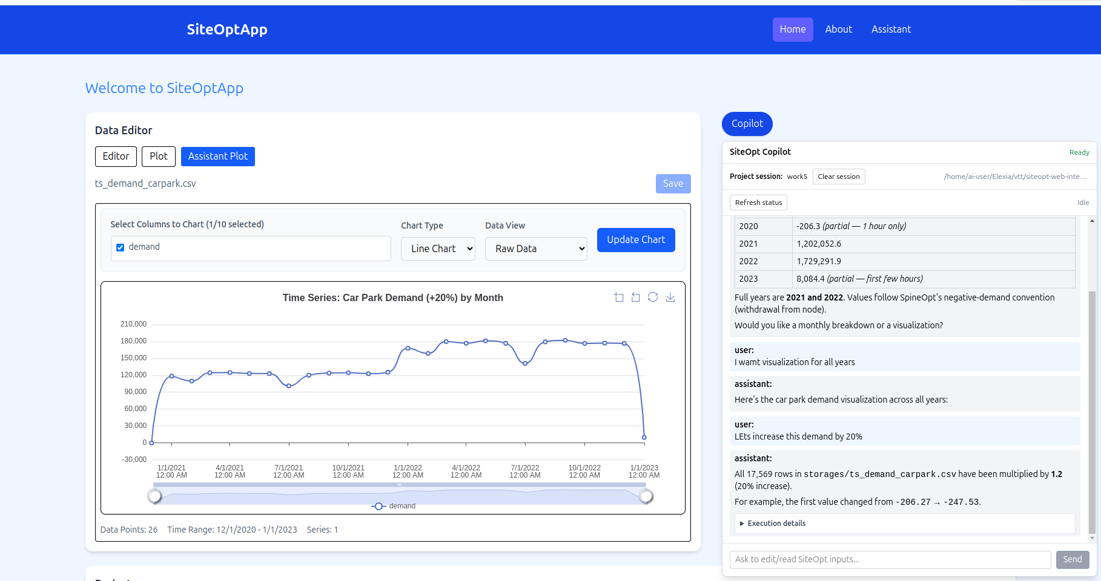
4. Assistant in Daily Workflow
• User asks naturally.
• Assistant responds with actionable guidance and summaries.

Slide 6
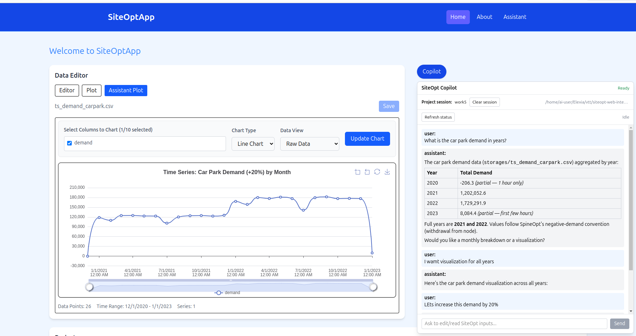
5. Visualization in Data Editor
• Requested chart appears in Assistant Plot tab.
• Users stay in one workspace while preparing inputs.

Slide 7
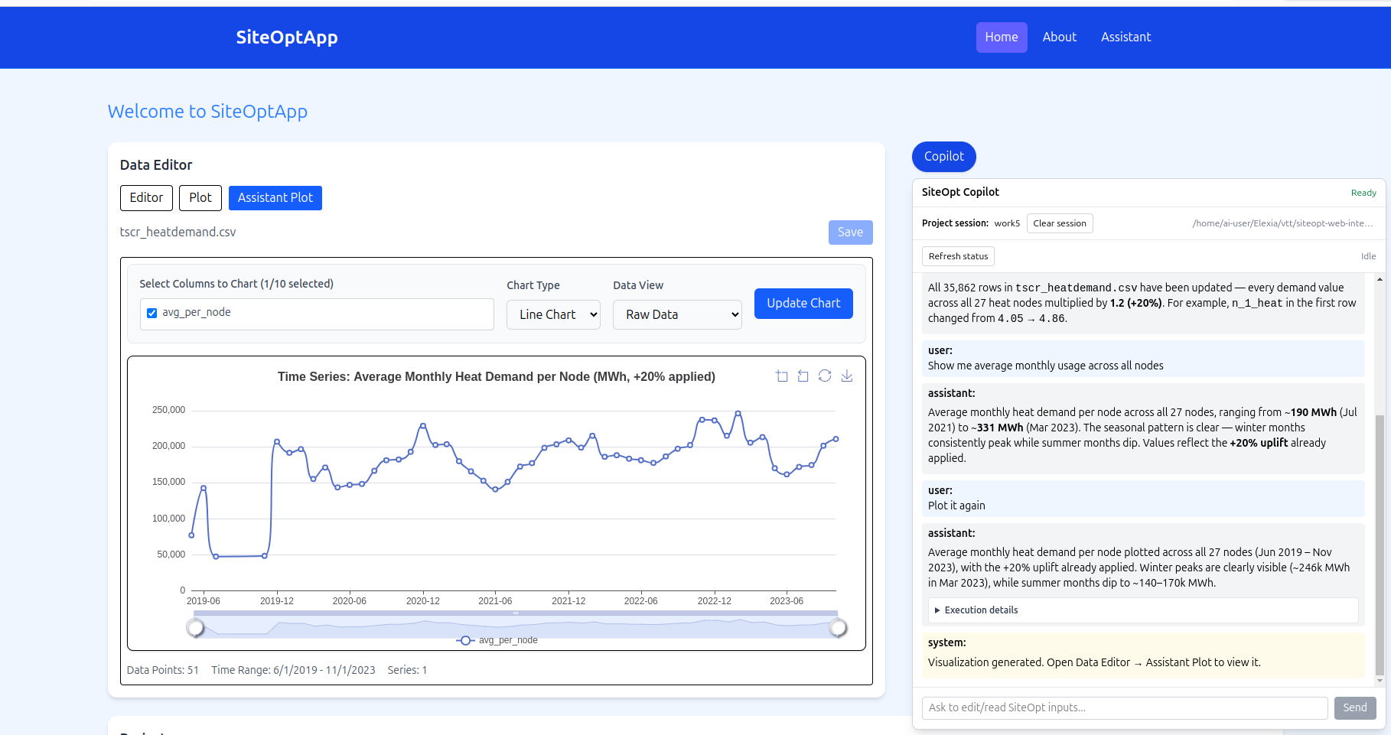
6. Copilot-Requested Data Visualization
• User asks for a specific data view in natural language.
• Copilot generates a matching visualization for decision support.

Slide 8
7. Practical Value for Users
Less time spent on repetitive manual edits.
Faster confidence checks with quick plots and summaries.
Lower risk of confusion from switching between many tools too early.
Better collaboration: requests and outputs are easy to discuss.

Slide 9
8. Message to Stakeholders
Usability improved without changing core simulation responsibility.
Supports current workflow rather than replacing it.
Creates a clear bridge between input preparation and model runs.

Slide 10
Thank You
Questions / Feedback

