Slide 1




PARTICIPANT PRESENTATION
Participant Details
Qiskit
Fall Fest
2026
PROJECT TITLE
QuantumShield: BB84 QKD & Eavesdropping Detection
TRACK
Quantum Cryptography & Security
TEAM NAME
AI Pirates
TEAM LEADER
Yash Vikas Gayake
EMAIL / CONTACT
Contact via team GitHub
Hackathon · Team Details
TEAM MEMBERS
Yash Gayake · Pranav Kadam · Kamini Borde
INSTITUTION / ORGANISATION
MES Wadia College, Pune
COUNTRY
India

Slide 2
Problem Statement
The problem: Quantum communication can reveal interference, but the underlying idea is difficult to inspect without a visual experiment.
BB84 uses non-orthogonal measurement bases so an interceptor who does not know the preparation basis can introduce detectable errors.
Learning gap: learners need to see how basis matching, key sifting and the Quantum Bit Error Rate (QBER) connect.
Project goal: provide a reproducible simulator to compare a clean channel with an optional intercept–resend attacker.

Slide 3
Objectives & Novelty
Build a Qiskit-based BB84 simulation with Alice, Bob, random bases and sifted-key generation.
Add an optional Eve intercept–resend path to demonstrate how measurement in a wrong basis can disturb quantum states.
Estimate QBER from a disclosed test sample and show the remaining sifted key separately from the revealed sample.
Novelty: combine protocol steps, attack toggle, metrics and explanatory visuals in one student-friendly dashboard.
Success criteria: Eve off should trend toward near-zero QBER; Eve on should trend toward ~25% under ideal random-basis intercept–resend assumptions.

Slide 4
Solution & Quantum Advantage
Workflow: prepare random bits → encode in Z/X basis → transmit qubits → measure with Bob’s random basis → sift matching bases.
Security signal: compare a randomly selected test subset; QBER estimates how many tested bits disagree.
Why quantum: unknown-basis measurement can disturb a qubit. Classical copying alone does not reproduce this BB84 disturbance behaviour.
Important scope: this is an educational simulation, not a production QKD system or a proof of real-world security.

Slide 5
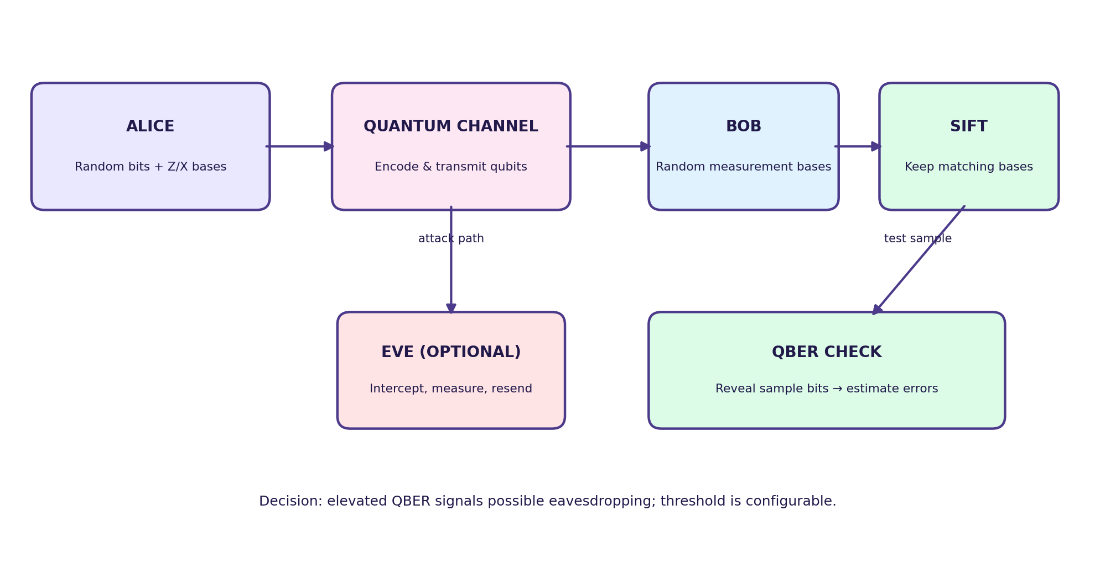
Algorithm & Circuit Design
1. Prepare: random bit + random Z/X basis.
2. Encode: X flips |0⟩; H creates/decodes X-basis states.
3. Measure: Bob selects a random basis.
4. Sift: retain positions where bases match.
5. Test: reveal sample bits and calculate QBER.
Eve: measure and resend in a random basis when enabled.

Slide 6
Implementation & Tech Stack
Quantum engine: Qiskit circuits and Aer simulator for local, repeatable runs.
Protocol layer: bit/basis preparation, measurement, basis reconciliation, key sifting and QBER estimation.
Interface: Streamlit dashboard for experiment controls, metrics and plots.
Analysis: NumPy / Pandas / Matplotlib for data handling and visualisation.
Quality: pytest unit tests for protocol utilities, metrics and simulation behaviour.
Reproducibility: configurable number of signals and optional Eve attack; results vary with random sampling.

Slide 7
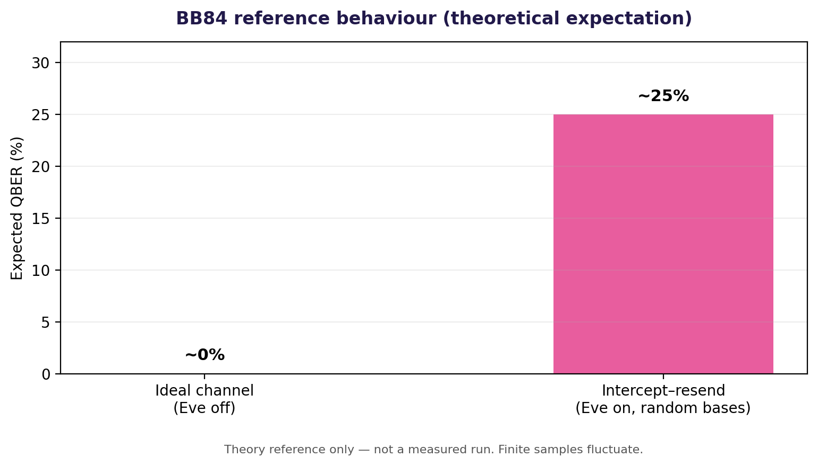
Results & Analysis
Reference expectation (not a measured run):
• Eve OFF: ideal channel QBER ≈ 0%.
• Eve ON: random-basis intercept–resend tends toward ≈ 25% QBER.
Finite sample sizes fluctuate, so measured values will not always equal theory.
Demo evidence to add: run the app in both modes and capture the actual output.

Slide 8
Impact & Real-World Applications
Education: makes BB84’s random bases, sifting and disturbance easier to understand.
Security awareness: demonstrates why an attacker can leave a measurable error signal.
Research prototyping: a safe sandbox for comparing signal counts, basis choices and attack settings.
Potential domain: quantum key distribution is studied for high-security key establishment in specialised communication links.
Boundary: simulation results do not establish deployment readiness or guarantee security against every attack.

Slide 9
Challenges & Future Scope
Current limitations: idealised channels, finite samples and simplified intercept–resend Eve model.
Not yet covered: authenticated classical channel, privacy amplification, finite-key security analysis and realistic device noise.
Future work: add noise models, configurable QBER thresholds, repeated-trial confidence intervals and exportable experiment reports.
Hardware extension: compare simulator output with IBM Quantum hardware where access and supported backend are available.
Next validation step: run automated tests and record real app screenshots before presenting measured results.

Slide 10
CLOSING
Thank You
Questions?
Inspiring Minds. Shaping Tomorrow.
GITHUB REPOSITORY
vtu-qiskit-fall-fest-2026/vtu-hc-ai-pirates
DEMO VIDEO LINK
Add recording link before submission

