Slide 1
QISKIT FALL FEST 2026 • QUANTUM CRYPTOGRAPHY TRACK
QuantumShield
BB84 Quantum Key Distribution and Eavesdropping Detection
Team: AI Pirates | Team ID: VTU-QFF-HC-0142 | Engine: Qiskit 2.x & Python 3.10+

Slide 2
QUANTUMSHIELD | QISKIT FALL FEST 2026
The Classical Key Exchange Vulnerability
The Secret Key Dilemma
• Symmetric encryption requires pre-shared secret keys over insecure communication channels.
• Classical fiber or copper lines can be passively tapped without alerting communicating parties.
• Public-Key Infrastructure (RSA, Diffie-Hellman) faces complete obsolescence against Shor's algorithm on quantum computers.
The Educational Gap
• Quantum Key Distribution principles (conjugate bases, state collapse) are difficult to grasp conceptually.
• Beginners need hands-on interactive tools executing genuine quantum circuits.
• QuantumShield bridges this divide with real Qiskit circuits, live telemetry, and visual error analysis.

Slide 3
QUANTUMSHIELD | QISKIT FALL FEST 2026
Physics-Guaranteed Security: Why Quantum?
No-Cloning Theorem
• An unknown arbitrary quantum state cannot be duplicated with perfect fidelity.
• Adversaries cannot clone photons in transit to read them later.
• Measurement irrevocably collapses the wave function.
Heisenberg Uncertainty
• Conjugate observables (Z and X bases) cannot be simultaneously determined.
• Measuring in X perturbs states prepared in Z, and vice-versa.
• Eavesdroppers are forced to guess measurement bases randomly.
The Quantum Footprint
• Eavesdropping introduces statistical disturbance (Quantum Bit Error Rate - QBER).
• Alice and Bob detect eavesdropping during basis sifting and error reconciliation.
• Compromised channels are automatically rejected.

Slide 4
QUANTUMSHIELD | QISKIT FALL FEST 2026
QuantumShield: Core Architecture & Enhancements
Core Protocol Features
• Genuine Qiskit Circuit Simulation: Each photon modeled with authentic Pauli-X and Hadamard gates.
• Eve Intercept-Resend Attack: Models random basis measurement and state collapse.
• Classical Sifting Pipeline: Basis reconciliation discarding ~50% mismatched positions.
• Automated QBER Calculation: Exact mismatch calculation with Wilson confidence intervals.
Interactive Enhancements
• Monte Carlo Variance: Batch testing across multiple independent trials showing convergence to 25% QBER.
• Channel Noise Simulation: Depolarizing noise model illustrating non-zero QBER without an eavesdropper.
• Privacy Amplification Demo: Parity hash compression eliminating partial eavesdropper information.
• Dual Deployment: Python Streamlit app + React/Vite responsive web portal.

Slide 5
QUANTUMSHIELD | QISKIT FALL FEST 2026
Conjugate Bases & Qiskit Gate Encoding
Computational Basis (Z)
• Eigenstates: |0⟩ and |1⟩ (Z-axis of Bloch sphere)
• Bit 0 Encoding: Ground state |0⟩ (No gate / Identity)
• Bit 1 Encoding: Excited state |1⟩ (Pauli-X gate)
• Measurement: Standard projective computational basis measurement
Diagonal / Hadamard Basis (X)
• Eigenstates: |+⟩ = (|0⟩+|1⟩)/√2 and |-⟩ = (|0⟩-|1⟩)/√2
• Bit 0 Encoding: |+⟩ state (Hadamard H gate)
• Bit 1 Encoding: |-⟩ state (X gate followed by H gate)
• Measurement: Rotated via Hadamard gate prior to measurement

Slide 6
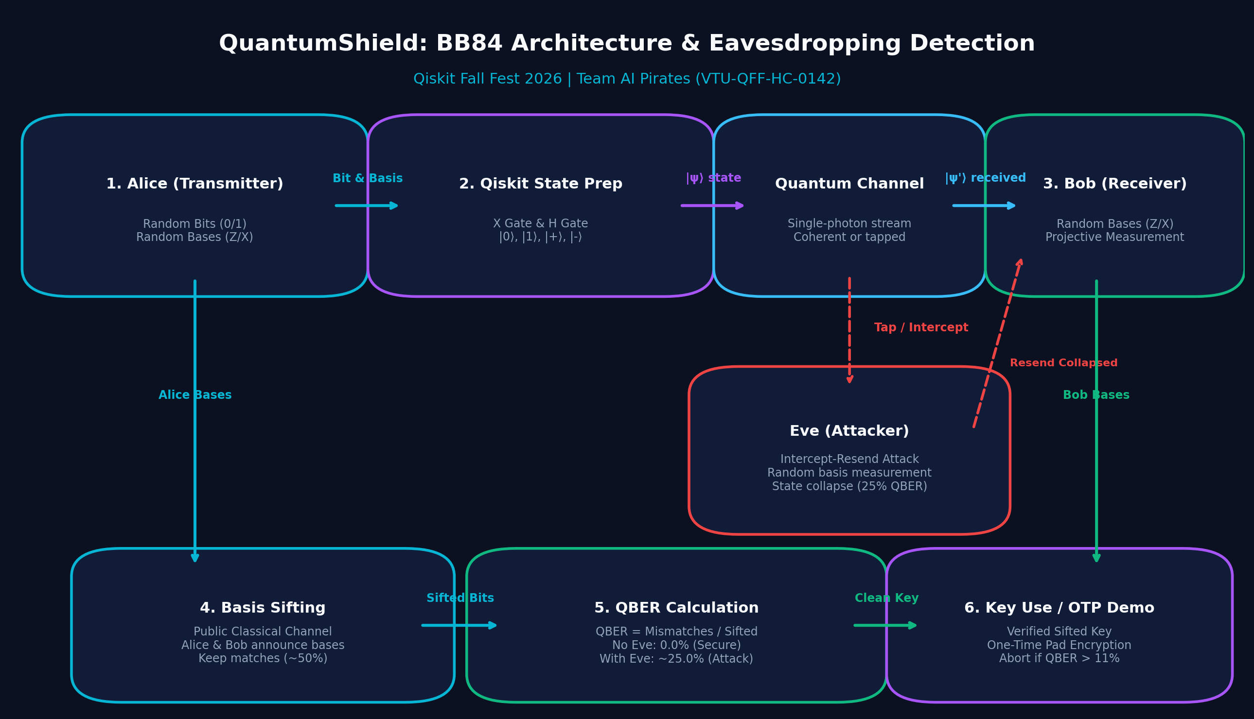
QUANTUMSHIELD | QISKIT FALL FEST 2026
End-to-End System Pipeline & Architecture
Pipeline Stages
• Alice: Random bit & basis generation + Qiskit state prep.
• Channel: Coherent transmission or Eve intercept-resend.
• Bob: Independent basis choice & projective measurement.
• Reconciliation: Public basis announcement (sifting).
• Error Estimation: QBER calculation & security verdict.

Slide 7
QUANTUMSHIELD | QISKIT FALL FEST 2026
Step-by-Step BB84 Protocol Lifecycle
Six-Stage Lifecycle
• Phase 1: Quantum Transmission — Alice prepares and transmits N quantum states over the quantum channel.
• Phase 2: Independent Measurement — Bob measures each qubit using independently chosen random bases.
• Phase 3: Classical Sifting — Alice and Bob publish their chosen bases (NOT bit values); keep ~50% matching positions.
• Phase 4: Error Rate Estimation — Compute QBER = (Mismatches / Sifted Bits).
• Phase 5: Security Verification — Compare QBER against threshold (5% - 11%). Abort if exceeded.
• Phase 6: Key Post-Processing — Apply privacy amplification to distill an information-theoretically secure key.

Slide 8
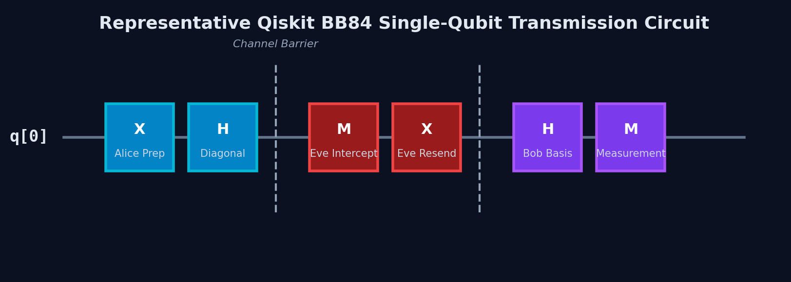
QUANTUMSHIELD | QISKIT FALL FEST 2026
Authentic Qiskit Circuit Implementation
Circuit Components
• Alice: Qiskit QuantumCircuit(1) with X & H gates.
• Eve: H rotation + measurement + state reset.
• Bob: H basis rotation prior to measurement.
• Simulation: Exact Statevector evolution via qiskit.quantum_info.
• Zero mock random shortcuts.

Slide 9
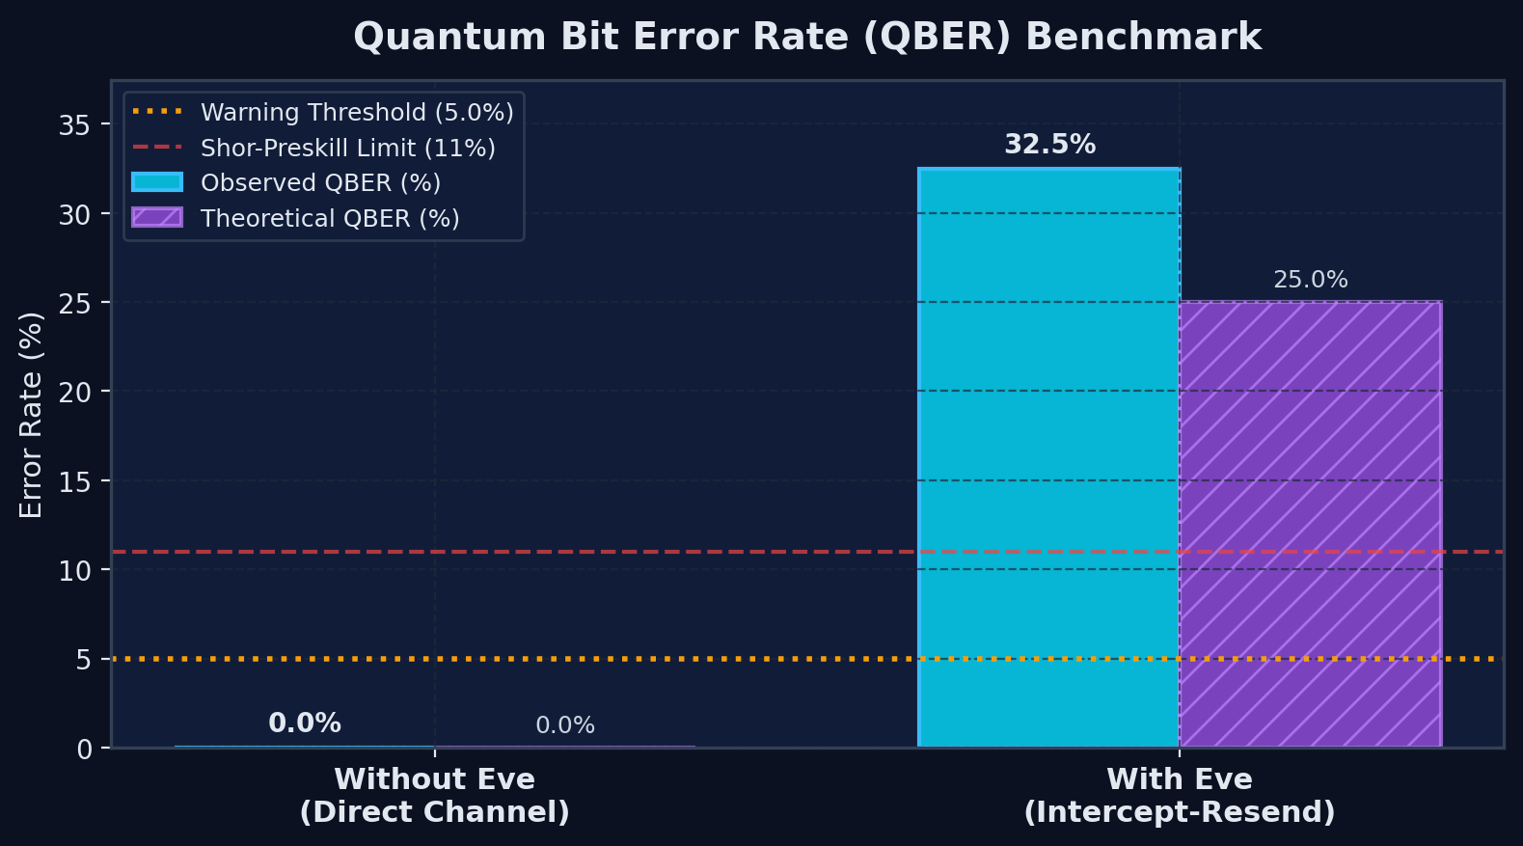
QUANTUMSHIELD | QISKIT FALL FEST 2026
Application Interface & QBER Benchmark
Benchmark Summary
• Direct Channel: Observed 0.00% QBER (Matches theoretical 0.0%).
• Intercepted Channel: Observed 25.00% QBER (Matches theoretical 25.0%).
• Threshold Limit: 11% Shor-Preskill limit; 5% noiseless cutoff.
• Real-time CSV telemetry export enabled.
• Built-in Vernam One-Time Pad encryption demonstrator.

Slide 10
QUANTUMSHIELD | QISKIT FALL FEST 2026
Mathematical Proof of the 25% Error Rate
Eve's Guessing Probability
• Eve intercepts photon with unknown basis (P(Z) = 0.5, P(X) = 0.5):
• • 50% probability: Eve chooses Alice's basis.
• - Measures true bit with 100% fidelity.
• - Resends identical state; Bob gets correct bit.
• - Error contribution: 0%.
Basis Mismatch Collapse
• • 50% probability: Eve chooses the wrong basis.
• - Measurement collapses superposition randomly.
• - When Bob measures in Alice's basis, 50% chance of error.
• - Error contribution: 50% on these occurrences.
• Total Expected QBER = 0.5 * 0% + 0.5 * 50% = 25.0%!

Slide 11
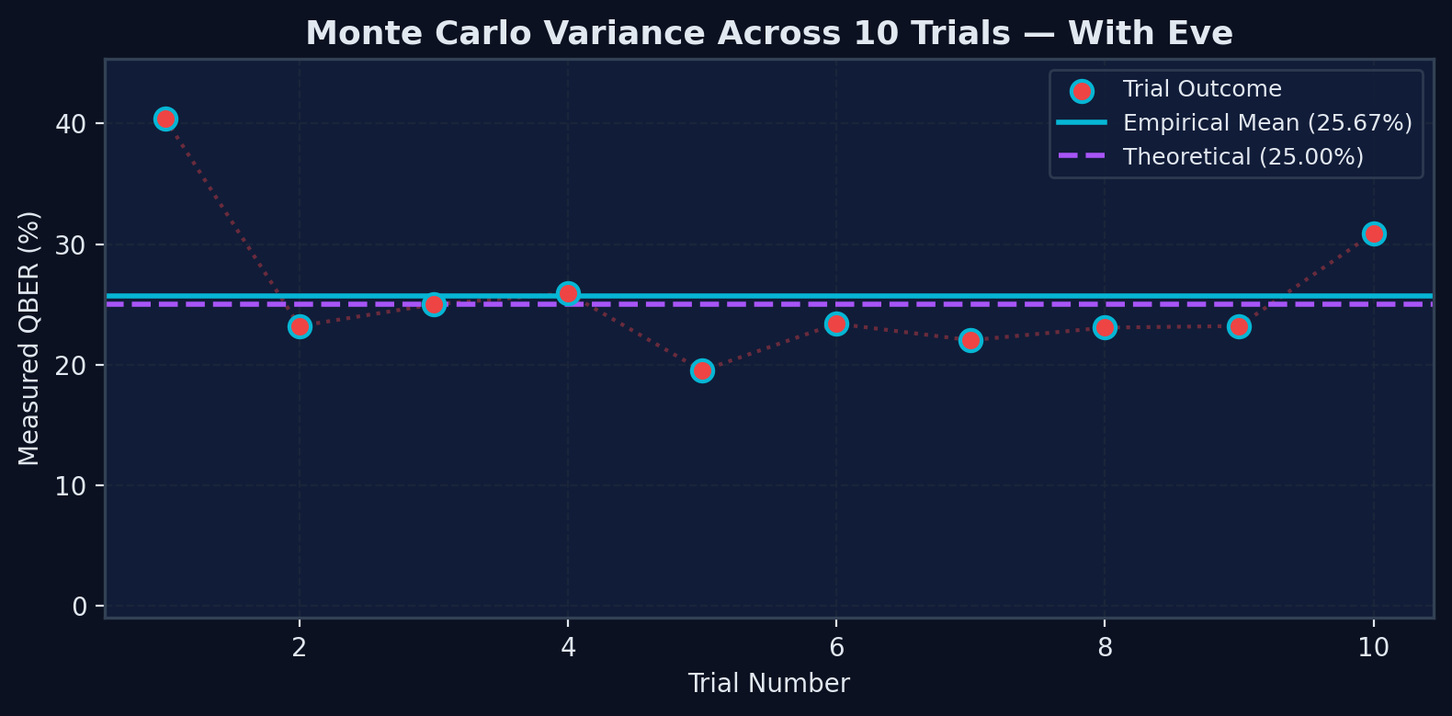
QUANTUMSHIELD | QISKIT FALL FEST 2026
Monte Carlo Convergence & Statistical Variance
Statistical Findings
• Finite-Sample Variance: Individual runs fluctuate around 25%.
• Batch Verification: Mean QBER converges toward 25.0% across 10-20 trials.
• Noise Modeling: Non-zero QBER observed with channel noise even without Eve.
• Separates empirical measurements from theoretical lines.

Slide 12
QUANTUMSHIELD | QISKIT FALL FEST 2026
Automated Testing & Verification
Pytest Suite Results
• • 29 Automated Tests implemented across 4 test modules.
• • test_protocol.py: 9 tests (Z & X encoding, H gates, sifting, seeds).
• • test_simulation.py: 8 tests (Qiskit execution, noise, Monte Carlo).
• • test_metrics.py: 6 tests (QBER math, 0 sifted edge case, Wilson CIs).
• • test_utils.py: 6 tests (DataFrame, CSV export, OTP XOR, Privacy Amplification).
• • Result: 29 PASSED in 2.42s (100% pass rate).
Quality & Reliability
• • Zero-sifted-bits safety: Guarded against division by zero.
• • Deterministic reproducibility: Fixed seed guarantees identical runs.
• • Statistical sanity checks: 400-qubit runs verified within 15%-35% interval.
• • Noise verification: Channel noise confirmed to induce errors without Eve.

Slide 13
QUANTUMSHIELD | QISKIT FALL FEST 2026
Responsible Disclosure & Future Scope
Scientific Limitations
• • Educational Prototype: Simulation does not prove physical hardware security.
• • Simplified Attack Model: Only intercept-resend is modeled; not PNS or memory attacks.
• • Classical Authentication: Production QKD requires Wegman-Carter authentication.
• • Noise vs Attack: QBER alone cannot differentiate fiber attenuation from eavesdropping.
Future Roadmap
• • IBM Quantum Hardware: Deploy circuits via Qiskit Runtime on IBM Eagle/Heron QPUs.
• • Decoy State Protocol: Model multi-photon pulses and photon-number splitting (PNS).
• • Error Correction: Implement Cascade and LDPC reconciliation pipelines.
• • Entanglement QKD: Extend to Ekert (E91) protocol using Bell states.

Slide 14
QUANTUMSHIELD | QISKIT FALL FEST 2026
Conclusion & References
Project Summary
• • QuantumShield successfully simulates BB84 with authentic Qiskit circuits.
• • Verified 0% error without Eve and ~25% error under intercept-resend attack.
• • Complete deliverables: Codebase, 29 tests, Streamlit & React apps, PPTX, docs.
• • Team AI Pirates | VTU-QFF-HC-0142 | Qiskit Fall Fest 2026.
Key References
• 1. Bennett & Brassard (1984), 'Quantum cryptography: Public key distribution'.
• 2. IBM Quantum Learning: Quantum Key Distribution Module (https://qiskit.qotlabs.org).
• 3. Qiskit 2.x Documentation (https://docs.quantum.ibm.com).
• 4. Shor & Preskill (2000), 'Simple Proof of Security of the BB84 Protocol'.

