Slide 1



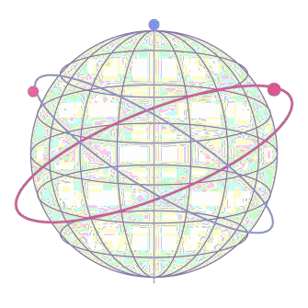


Q I S K I T F A L L F E S T 2 0 2 6
IBM Quantum
ವಿಶ್ವ ೇಶ್ವ ರಯ್ಯ ತಾಂತ್ರಿ ಕ ವಿಶ್ವ ವಿದ್ಯಯ ಲಯ್, ಬೆಳಗಾವಿ
Visvesvaraya Technological University, Belagavi
P A R T I C I P A N T P R E S E N T A T I O N
Participant Details
Qiskit Fall Fest 2026
Hackathon · Team Details
Q-Lithos -
Hybrid Quantum- Classical simulation for Battery material screening
TRACK 8 – Quantum Chemistry and sensing
TEAM NAME
Anonymous
TEAM LEADER
Nandita Salunke
EMAIL / CONTACT
nanditasalunke00@ gmail.com
TEAM MEMBERS
Ramling Belkeri
Visvesvaraya Technological university , Belagavi
COUNTRY
India

Slide 2
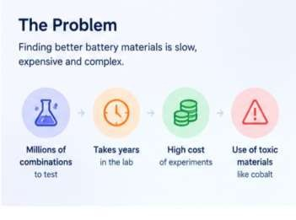
Q I S K I T F A L L F E S T 2026
IBM Quantum
ವಿಶ್ವ ೇಶ್ವ ರಯ್ಯ ತಾಂತ್ರಿ ಕ ವಿಶ್ವ ವಿದ್ಯಯ ಲಯ್, ಬೆಳಗಾವಿ
Visvesvaraya Technological University, Belagavi
Problem Statement
Why Battery Material Discovery is slow?
Battery performance depends on complex atomic interactions at electrode and solid-electrolyte interfaces. These interactions can involve strong electron correlation, which is difficult to model accurately.
Classical methods are useful for screening, but some approximations may miss important electronic behaviour. Testing every candidate physically is costly and time-consuming.

Slide 3
Q I S K I T F A L L F E S T 2026
IBM Quantum
ವಿಶ್ವ ೇಶ್ವ ರಯ್ಯ ತಾಂತ್ರಿ ಕ ವಿಶ್ವ ವಿದ್ಯಯ ಲಯ್, ಬೆಳಗಾವಿ
Visvesvaraya Technological University, Belagavi
Objectives & Novelty
EXPLORE
Study how molecular energy changes as the distance between atoms varies in
molecules.
COMPARE
Compare VQE-calculated energies with classical exact-diagonalization results for the same molecular model and bond distance.
VISUALISE
Present interactive energy curves, calculation errors, and molecular properties through an easy-to-use Streamlit dashboard.
OUR NOVELTY
One Interactive Platform
Combines molecular exploration, quantum-classical energy comparison, and
visual analysis in one dashboard.
Shows calculation errors and explains limitations, helping users understand what the results mean for battery-related research.
Transparent Results

Slide 4
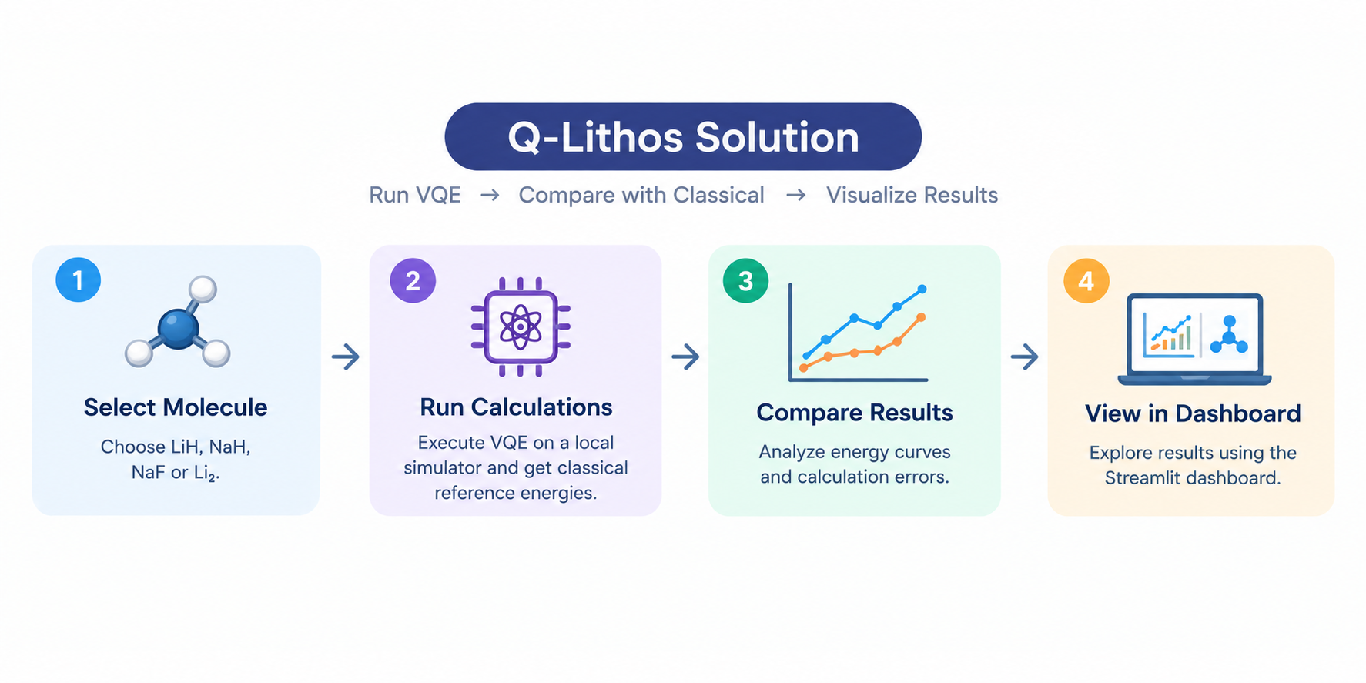
Q I S K I T F A L L F E S T 2026
IBM Quantum
ವಿಶ್ವ ೇಶ್ವ ರಯ್ಯ ತಾಂತ್ರಿ ಕ ವಿಶ್ವ ವಿದ್ಯಯ ಲಯ್, ಬೆಳಗಾವಿ
Visvesvaraya Technological University, Belagavi
Solution & Quantum Advantage
SOLUTION — Q-LITHOS
Q-Lithos uses Qiskit’s VQE to calculate molecular energies, compare them with classical results, and display the findings in an
interactive dashboard. HOW IT WORKS
Step
Select
Calculate
Compare
Visualize
Description
Choose a molecule for example, LiH, NaH, NaF, or Li₂.
Run VQE on a local simulator and obtain classical reference energies.
Analyze energy curves and calculation errors.
Explore results using the Streamlit dashboard

Slide 5
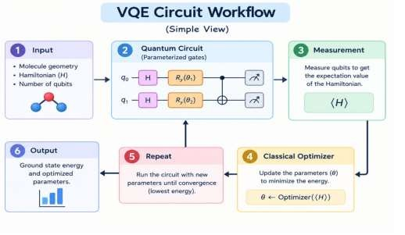
Q I S K I T F A L L F E S T 2026
IBM Quantum
ವಿಶ್ವ ೇಶ್ವ ರಯ್ಯ ತಾಂತ್ರಿ ಕ ವಿಶ್ವ ವಿದ್ಯಯ ಲಯ್, ಬೆಳಗಾವಿ
Visvesvaraya Technological University, Belagavi
Algorithm & Circuit Design
Component Ansatz Optimizer Simulator Reference
Method UCCSD SLSQP
Local ideal state vector Classical exact diagonalization
Insert circuit diagram
e.g. qc.draw("mpl")

Slide 6
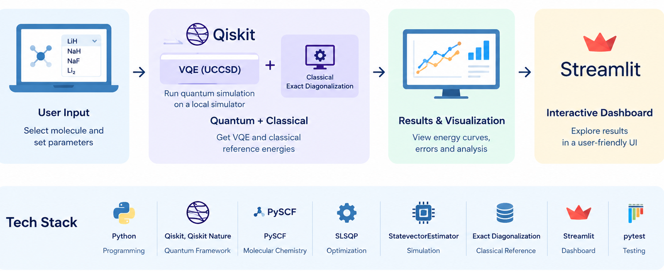
Q I S K I T F A L L F E S T 2026
IBM Quantum
ವಿಶ್ವ ೇಶ್ವ ರಯ್ಯ ತಾಂತ್ರಿ ಕ ವಿಶ್ವ ವಿದ್ಯಯ ಲಯ್, ಬೆಳಗಾವಿ
Visvesvaraya Technological University, Belagavi
Implementation & Tech Stack
IMPLEMENTATION
Q-Lithos is built in Python with a Streamlit dashboard. It combines Qiskit-based VQE simulations, classical energy comparisons, and interactive visualizations.
TECH STACK
Component Programming Quantum Framework Molecular Chemistry Quantum Algorithm Optimization Simulation
Classical Reference
Dashboard Testing
Technology / Purpose
Python
Qiskit, Qiskit Nature PySCF, where supported VQE with UCCSD
SLSQP
Local StatevectorEstimator Exact diagonalization Streamlit
pytest

Slide 7
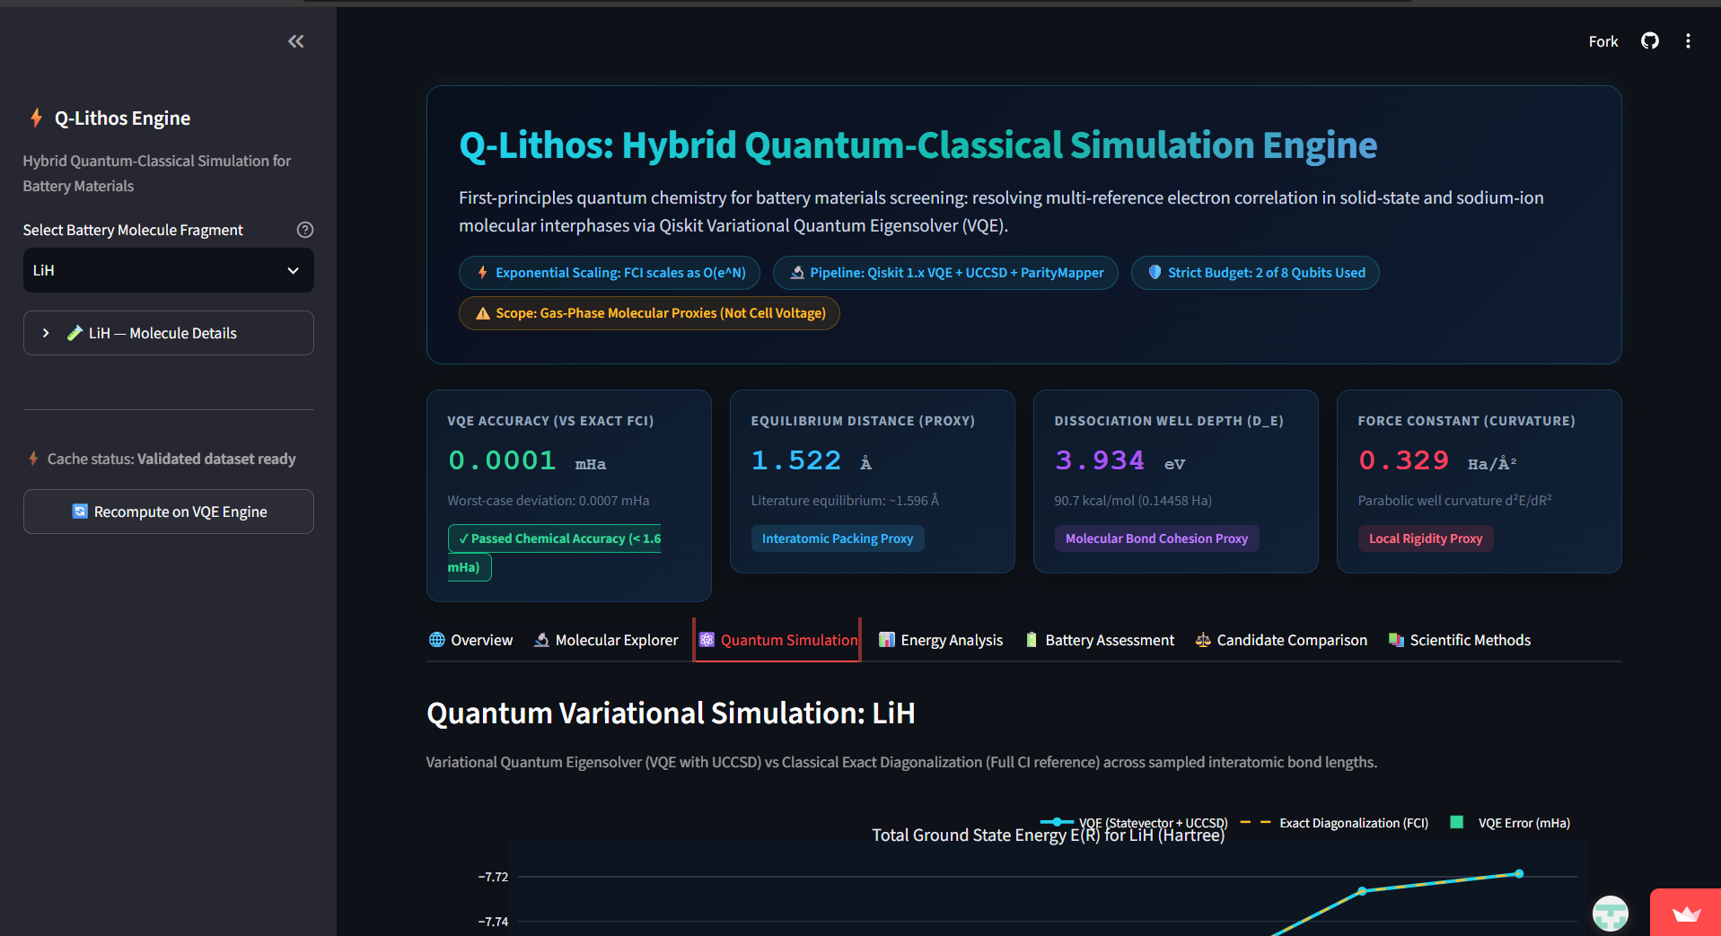
Q I S K I T F A L L F E S T 2026
IBM Quantum
ವಿಶ್ವ ೇಶ್ವ ರಯ್ಯ ತಾಂತ್ರಿ ಕ ವಿಶ್ವ ವಿದ್ಯಯ ಲಯ್, ಬೆಳಗಾವಿ
Visvesvaraya Technological University, Belagavi
Results & Analysis
RESULTS & ANALYSIS
Q-Lithos compares molecular energies calculated using VQE with classical exact-diagonalization results. The dashboard visualizes energy changes across bond distances and helps examine calculation errors.
Insert results
Histogram, plot or table

Slide 8
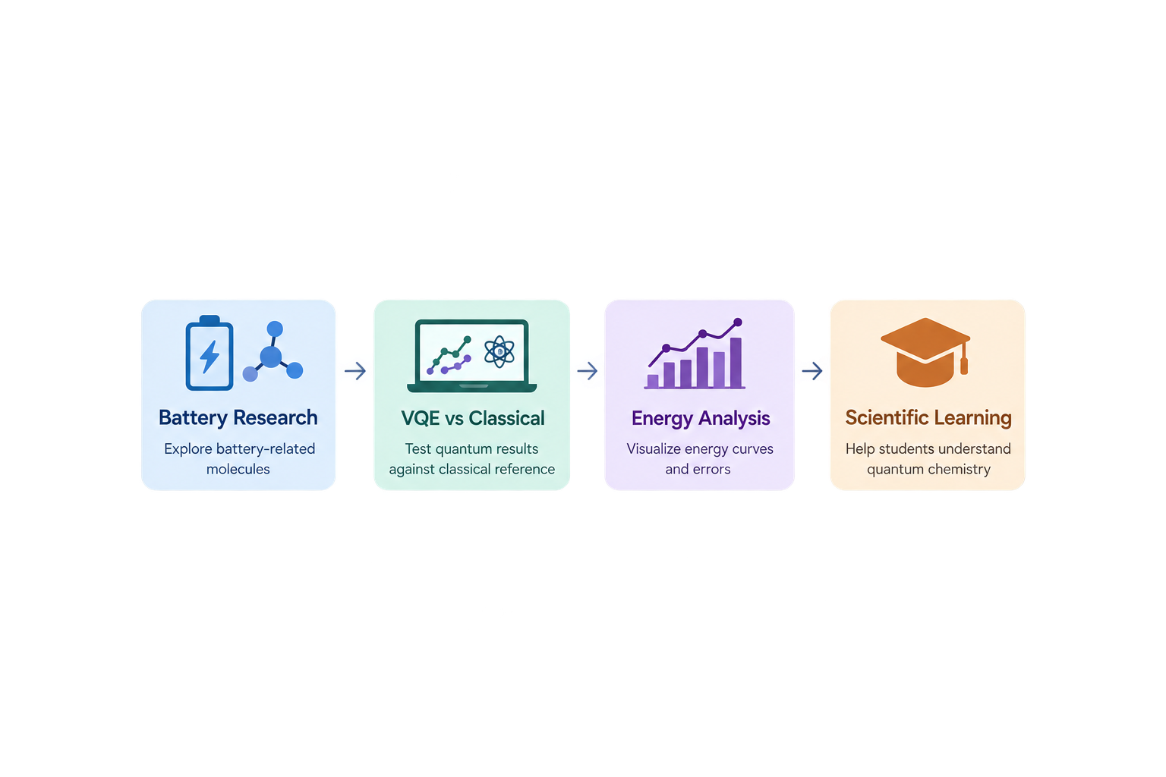
Q I S K I T F A L L F E S T 2026
IBM Quantum
ವಿಶ್ವ ೇಶ್ವ ರಯ್ಯ ತಾಂತ್ರಿ ಕ ವಿಶ್ವ ವಿದ್ಯಯ ಲಯ್, ಬೆಳಗಾವಿ
Visvesvaraya Technological University, Belagavi
Impact & Real-World Applications
REAL-WORLD IMPACT
Q-Lithos makes quantum-chemistry calculations easier to explore and understand. By comparing VQE results with classical calculations, it helps users study molecular energy changes and evaluate the accuracy of quantum-algorithm results.
APPLICATIONS & POTENTIAL IMPACT
Application
Battery Chemistry Research Quantum Algorithm Testing Scientific Learning
Early-Stage Exploration
Potential Impact
Explore the energy behaviour of selected battery-related molecules.
Evaluate VQE results against classical reference calculations.
Help students understand molecular energy curves and quantum
chemistry.
Visualize results and identify questions for further research.
OUR IMPACT
Explore molecules. Compare calculations. Understand limitations.

Slide 9
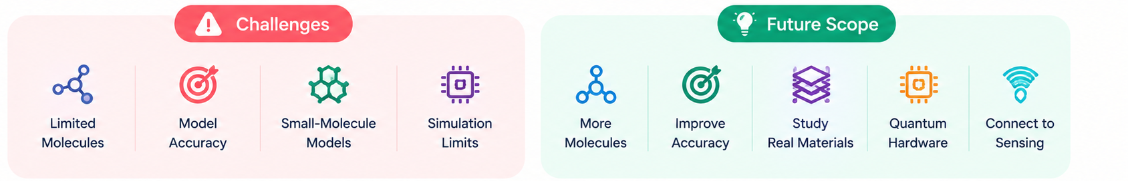
Q I S K I T F A L L F E S T 2026
IBM Quantum
ವಿಶ್ವ ೇಶ್ವ ರಯ್ಯ ತಾಂತ್ರಿ ಕ ವಿಶ್ವ ವಿದ್ಯಯ ಲಯ್, ಬೆಳಗಾವಿ
Visvesvaraya Technological University, Belagavi
Challenges & Future Scope
CURRENT CHALLENGES
Challenge
Limited Molecules
Model Accuracy
Small-Molecule Models
Simulation Limits
What it means
Currently explores LiH, NaH, NaF, and Li₂.
Results depend on the chosen basis set and active space.
Current calculations do not represent complete battery materials.
Uses an ideal local simulator, not physical quantum hardware.
FUTURE SCOPE
Planned Improvement Add More Molecules Improve Accuracy Study Real Materials
Explore Quantum Hardware
Connect to Sensing
Our Direction
Introduce more battery-relevant molecules selected for scientific value and computational feasibility.
Test larger basis sets and validate energy calculations and cached results.
Progress towards modelling interfaces, ion movement, and material properties using suitable
methods.
Investigate hardware execution and noise-aware simulations when feasible.
Explore a suitable chemistry-related sensing application as a future extension.

Slide 10
Q I S K I T F A L L F E S T 2026
IBM Quantum
ವಿಶ್ವ ೇಶ್ವ ರಯ್ಯ ತಾಂತ್ರಿ ಕ ವಿಶ್ವ ವಿದ್ಯಯ ಲಯ್, ಬೆಳಗಾವಿ
Visvesvaraya Technological University, Belagavi
C L O S I N G
Thank You Questions?
Inspiring Minds. Shaping Tomorrow.
GITHUB REPO
https:// github. com/ vtu - qiskit- fall-fest- 2026 / vtu- hc- anonymous
DEMO VIDEO LINK
https://youtu.be/ediQHrTX8oo

