Slide 1




PARTICIPANT PRESENTATION
Participant Details
PROJECT TITLE
Interactive Quantum Computing Learning Platform
Qiskit
Fall Fest
2026
TRACK
Quantum cloud based application
TEAM NAME
Quantum minds
TEAM LEADER
Soleha Soudagar
EMAIL / CONTACT
solehasoudagar7338282304@gmail.com
Hackathon · Team Details
TEAM MEMBERS
Soleha.S, Vaishnavi.K, Sanmeet.J
INSTITUTION
Jain College Of Engineering And Research
COUNTRY
India

Slide 2
Problem Statement
  Understanding quantum gates and quantum circuits is challenging for beginners due to their mathematical complexity and limited access to quantum computing resources. An interactive cloud-based application is needed to simplify learning and experimentation with quantum gates using Qiskit.

Slide 3
Objectives & Novelty
OBJECTIVES
• Make quantum computing easy for beginners
• Teach quantum gates and circuits interactively
• Visualize circuits and measurement probabilities
• Provide hands-on quantum experimentation
NOVELTY
• Interactive quantum gate visualization
• Real-time circuit simulation
• Dynamic probability-based results
• Learning, simulation and assessment in one platform

Slide 4
Solution & Quantum Advantage
SOLUTIONS
• Interactive cloud-based quantum learning platform
• Visual quantum gates and circuit construction
• Simulate circuits and display measurement probabilities
• Provide quizzes and performance-based scorecards
QUANTUM ADVANTAGES
• Faster understanding through visual simulation
• Hands-on experience without physical quantum hardware
• Demonstrates superposition and quantum behavior interactively
• Easy access to quantum computing concepts from anywhere

Slide 5
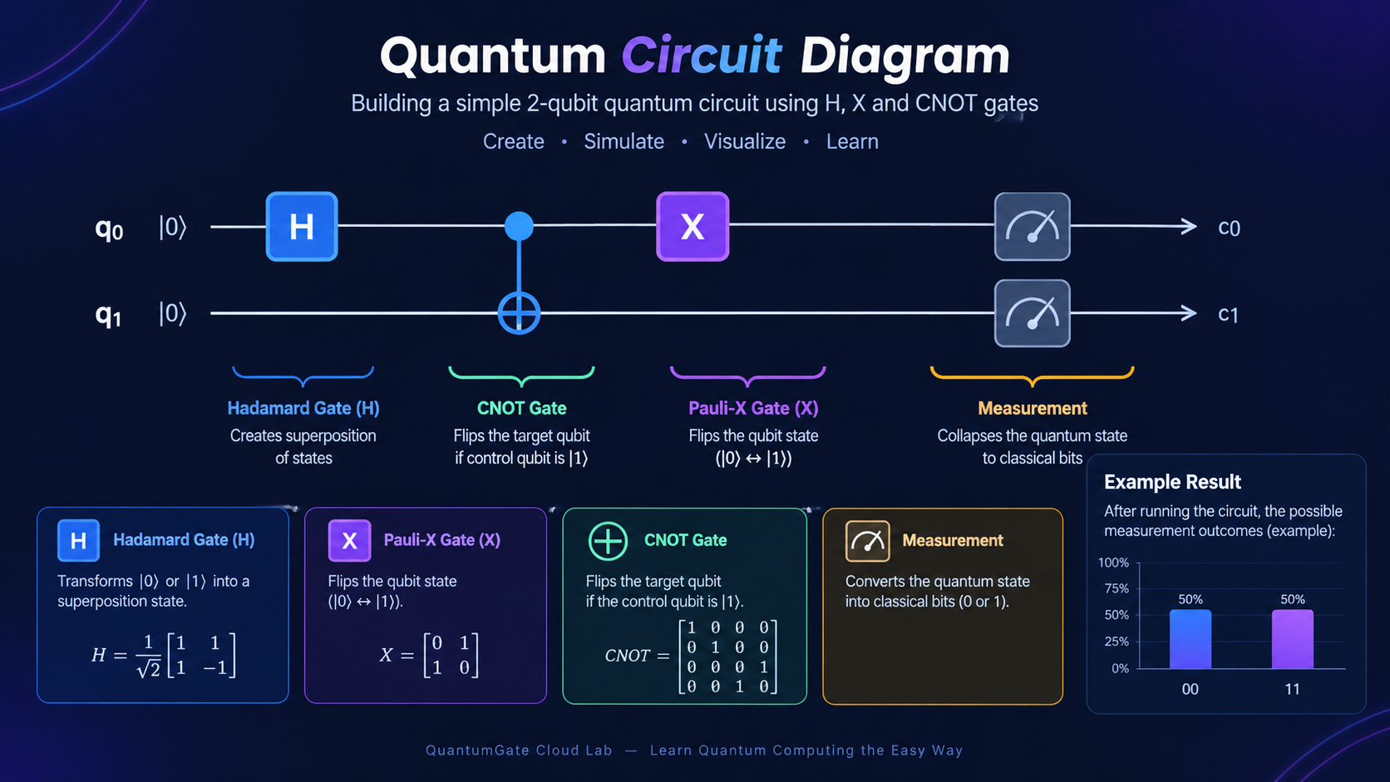
Algorithm & Circuit Design
Insert circuit diagram
e.g. qc.draw("mpl")
KEY DETAILS
• Platform: Web-based Quantum Learning Lab
• Core: Quantum gates & circuit simulation
• Visualization: Interactive circuit and probability graphs
• Learning: Gate explanations and step-by-step guidance

Slide 6
Implementation & Tech Stack
IMPLEMENTATION
• User selects quantum gates and builds a circuit
• Circuit is simulated using Qiskit
• Measurement results are calculated and visualized
• Probability graphs help users understand quantum behavior
• Quizzes and scorecards provide learning feedback
TECH STACK
• Frontend: HTML, CSS, JavaScript
• Quantum: Qiskit
• Visualization: JavaScript Charts / Graphs
• Deployment: Firebase Hosting

Slide 7
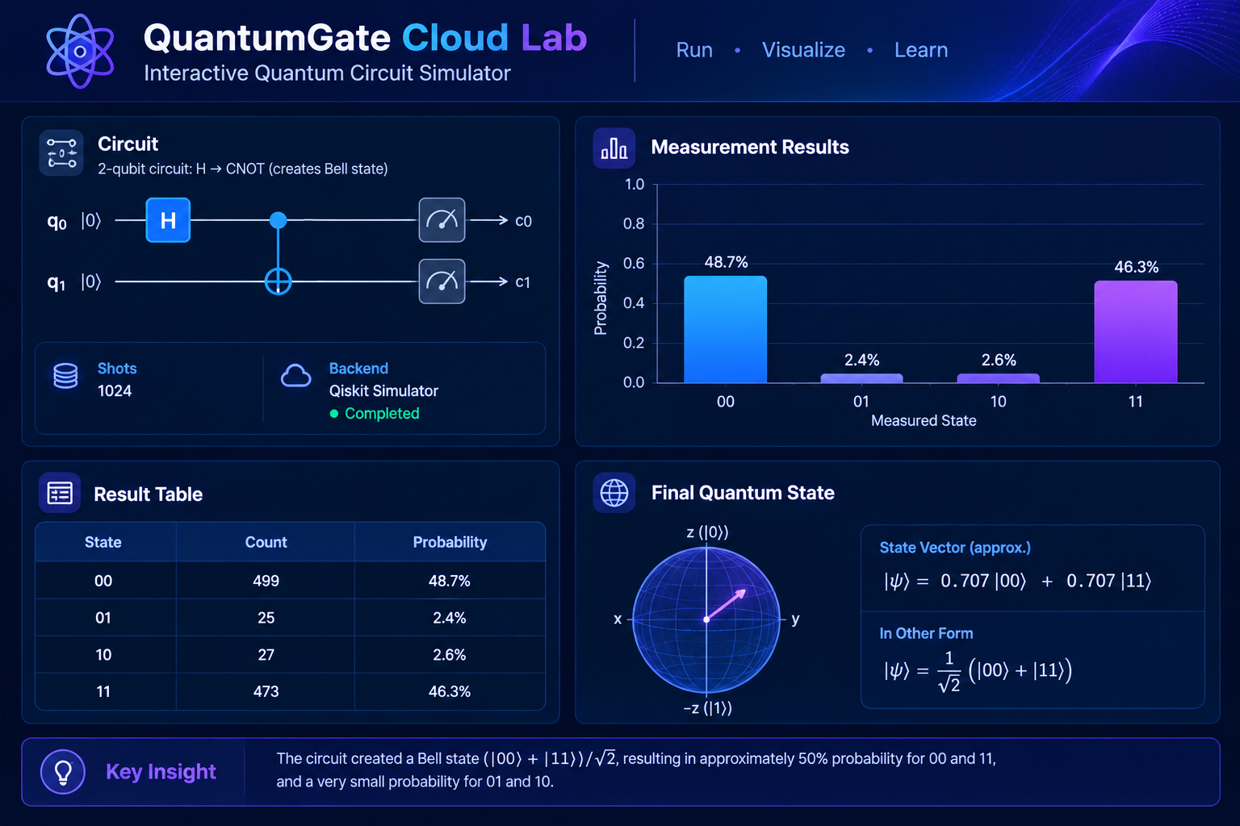
Results & Analysis
Insert results
Histogram, plot or table
Total Simulation Shots: 1,024
Most Frequent State: 00 — 499 counts (48.7%)
Second Most Frequent State: 11 — 473 counts (46.3%)
State 01: 25 counts (2.4%)
State 10: 27 counts (2.6%)

Slide 8
Impact & Real-World Applications
• Makes quantum computing simple and accessible for beginners
• Provides interactive, hands-on learning without physical quantum hardware
• Helps students understand quantum gates, circuits and probabilities
• Supports classroom teaching, workshops and academic training
• Enables experimentation with quantum algorithms
• Builds practical skills for future quantum technology careers
• Can support research and educational demonstrations
• Creates a foundation for quantum AI, cryptography and optimization

Slide 9
Challenges & Future Scope
CHALLENGES
• Quantum concepts can be difficult for beginners
• Accurate simulation of quantum behavior
• Making complex circuits easy to visualize
• Limited access to real quantum hardware
FUTURE SCOPE
• Connect with real quantum computers through cloud APIs
• Add more advanced quantum algorithms and gates
• Introduce multiplayer and collaborative circuit building
• Add AI-based personalized learning and guidance

Slide 10
CLOSING
Thank You
Questions?
Inspiring Minds. Shaping Tomorrow.
GITHUB REPOSITORY
https://sanmeet334.github.io/QuantumGate/
DEMO VIDEO LINK
https://youtu.be/XC_9ikKNNzo?si=sPJs9dxAsKMfrUr_

