Slide 1




PARTICIPANT PRESENTATION
Participant Details
Qiskit
Fall Fest
2026
PROJECT TITLE
Interactive QAOA Lab: Cloud-Based Quantum-Classical Comparison for Network Optimisation
TRACK
Quantum Cloud-Based Applications
TEAM NAME
Dark Scorpions
TEAM LEADER
Aditya B Koparde
EMAIL / CONTACT
adityakoparde001@gmail.com
Hackathon · Team Details
TEAM MEMBERS
Aditya B Koparde · Jeswin J Lazarus · Tejas Vithal Kadam
INSTITUTION / ORGANISATION
Visvesvaraya Technological University
COUNTRY
India

Slide 2
Problem Statement
Students, researchers, and industry practitioners lack an accessible, interactive, cloud-based tool to:
Test small network optimisation problems (MaxCut) on quantum hardware simulators
Compare quantum (QAOA) vs classical (brute force) solutions side-by-side with visual evidence
Understand the trade-offs in solution quality, circuit depth, and execution time
Current Qiskit tutorials are notebook-based, static, and disconnected from real-world context. There is no beginner-friendly web app that lets a user pick a real industry scenario, solve it quantumly, and immediately see how it compares to the classical answer.

Slide 3
Objectives & Novelty
Objectives:
Make quantum optimisation accessible to
non-quantum students via an interactive web lab.
Provide a side-by-side quantum vs classical comparison with visual evidence
Map an abstract algorithm (QAOA) to 5 named real-world problems.
Demonstrate that quantum approaches are honest (show where they fail, not just where they win)
Novelty:
Scenario picker — user chooses VLSI / Social / Data Center / Logistics / Finance, not just "a random graph"
3D animated landing page (Three.js + GSAP) as a team portfolio, not just a notebook
Modular src/ architecture — the solver is importable as a library, not locked in a notebook
One-line hardware swap — StatevectorSampler → Sampler(mode=backend) moves from simulator to real IBM QPU without code restructuring

Slide 4
Solution & Quantum Advantage
|
|
|
|
|
|
|
|
|
|
Aspect | Classical | Quantum
Scaling | 2^{n} | Polynomial in circuit depth
n=4 (demo) | Instant | Instant
n=30 | ~1B evaluations | Still runs in seconds(on simulator
n=100 | Almost Impossible | Feasible with NISQ-era Hardware.
The solution: A Streamlit web app that:
Generates a graph from a chosen real-world scenario
Solves MaxCut using classical brute force (2ⁿ possibilities)
Solves MaxCut using QAOA (variational quantum algorithm) on Qiskit Aer
Presents both answers side-by-side with timing, accuracy, and a verdict
Quantum advantage (honest framing):

Slide 5
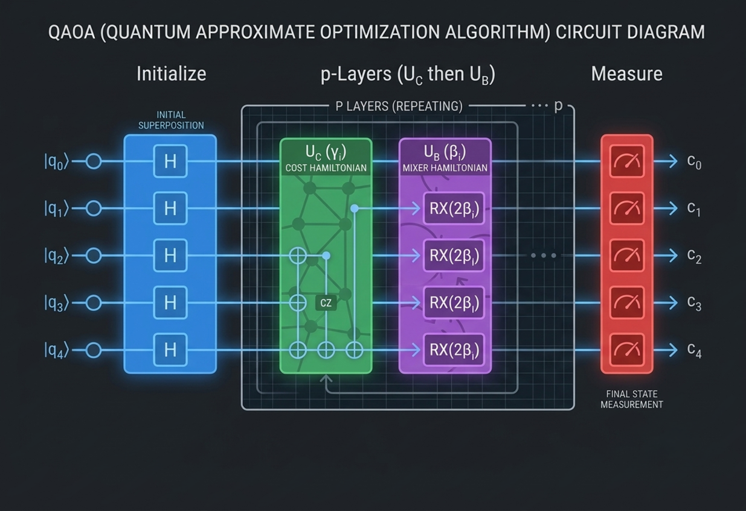
Algorithm & Circuit Design
Insert circuit diagram
e.g. qc.draw("mpl")
Parameters: γ₁…γₚ (cost angles), β₁…βₚ (mixer angles) — optimized classically by COBYLA to minimize the expected energy (maximize cut value).
Classical baseline: Brute force — iterate all 2ⁿ bitstrings, count cut edges, return the maximum. Exact but exponential.

Slide 6
Implementation & Tech Stack
Quantum | Qiskit 2.x · QAOA (p=1,2,3) · COBYLA · StatevectorSampler
Classical | Brute-force 2ⁿ enumeration
Graph | NetworkX 3.4
UI | Streamlit + Three.js + GSAP
Lang | Python 3.12 · venv

Slide 7
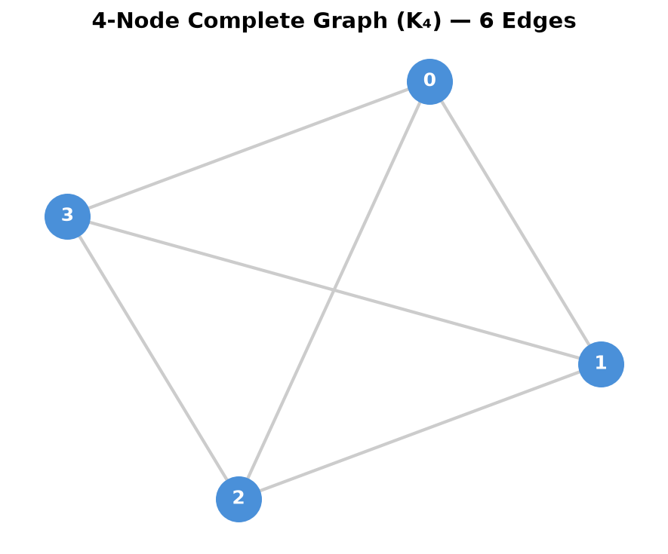
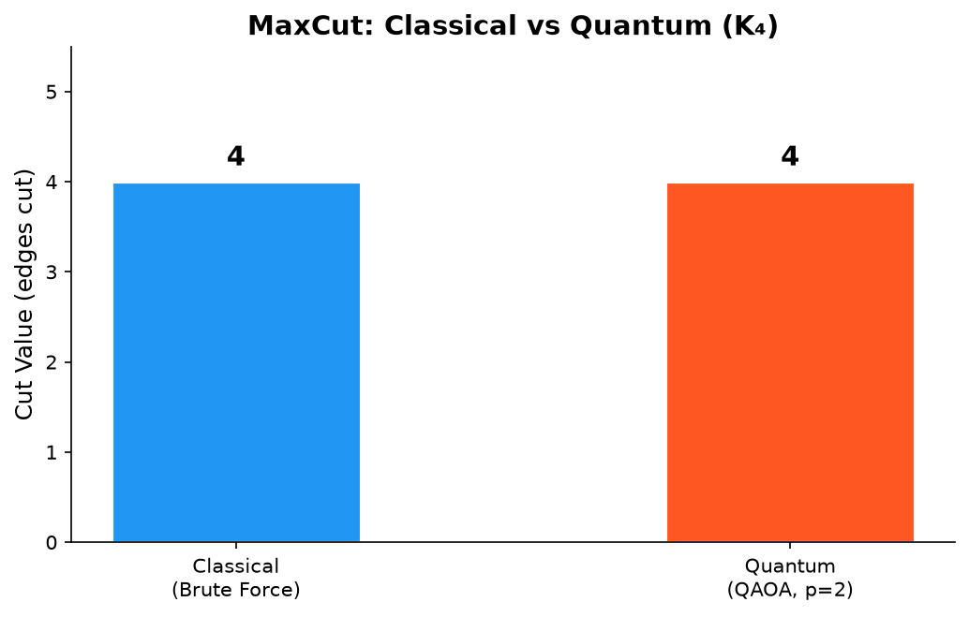
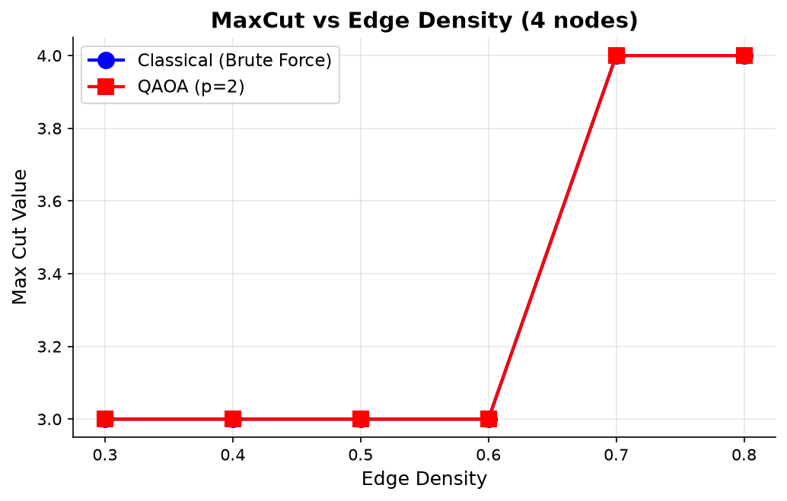
Results & Analysis
Metric | Classical | Quan-tum (QAOA)
Max Cut Value | 4 | 4
Time | 0.02 ms | 120 ms
Method | Brute force (16 checks) | QAOA p=2 (COBYLA, 200 iter)

Slide 8
Impact & Real-World Applications
Industry | Problem | MaxCut Mapping
Semiconductor | VLSI floorplanning — split a chip into 2 sub-chips | Minimise inter-chip wires (cost + signal delay)
Cloud Computing | Data-center rack partitioning | Minimise cross-rack network traffic (latency)
Social Media | Community detection in user graphs | Find natural 2-group split for recommendations
Logistics | Fleet routing — split deliveries between trucks | Maximise route efficiency
Finance | Portfolio allocation — buy vs sell split | Maximise expected return

Slide 9
Challenges & Future Scope
Challenge | Fix
Qiskit 2.x API breaks (QuantumInstance, to_ising()) | Migrated to MinimumEigenOptimizer
NetworkX 3.4 removed gnp_graph | Replaced with erdos_renyi_graph
QAOA misses optimal at n=6 | Stated honestly; increased p as mitigation
Streamlit + Three.js iframe sizing | Fixed with html(height=1400)
Future Scope | Effort
Run on real IBM QPU (one-line swap) | 10 min
Add noise model (depolarising channel) | 30 min
Scale to n=8–12 with SPSA optimiser | 1 hr
Deploy live URL (Streamlit Cloud) | 15 min

Slide 10
CLOSING
Thank You
Questions?
Inspiring Minds. Shaping Tomorrow.
GITHUB REPOSITORY
https://github.com/vtu-qiskit-fall-fest-2026/vtu-hc-dark-scorpions
DEMO VIDEO LINK
https://youtu.be/fnulXvdBycc?si=cnmr3JW3-_TKSpm4

