Slide 1




PARTICIPANT PRESENTATION
Participant Details
Qiskit
Fall Fest
2026
PROJECT TITLE
DualQ: Quantum Fraud Detection Platform for Indian Banking Rails
TRACK
Both (Quantum Machine Learning & Financial Fraud Detection)
TEAM NAME
DualQ (Team ID: VTU-QFF-HC-0079)
TEAM LEADER
Arun HIkadi
EMAIL / CONTACT
hikadiarun2221@gmail.com
Hackathon · Team Details
TEAM MEMBERS
Arun M Hikadi
Chaitra Bhavikatti
INSTITUTION / ORGANISATION
Visvesvaraya Technological University (VTU)
COUNTRY
India

Slide 2
Problem Statement
High-Velocity Payment Rail Vulnerabilities: India processes >16 billion UPI transactions monthly alongside IMPS, RuPay, and RTGS. Fraudsters exploit this speed with penny-drop merchant testing, midnight balance siphoning, and micro-ATM drains that closely mimic genuine velocity distributions.
Severe Class Imbalance (<0.2%): Fraud accounts for less than 0.2% of real-world banking telemetry. Classical linear and tree-based learners struggle with high false alarm ratios, causing costly legitimate card declines and merchant dispute overhead.
Classical Geometric Feature Bottleneck: Fraudulent patterns entangle with honest transactions across non-linear manifolds. Classical RBF kernels fail to isolate these subtle evasions without massive parameter tuning or exponential computational overhead.
RBI Sovereign Data Residency & Latency SLA: Reserve Bank of India (RBI) Master Direction 2026 mandates complete on-premise domestic data storage and sub-200ms transaction settlement, precluding unencrypted PII transmission to offshore cloud quantum queues.

Slide 3
Objectives & Novelty
Production-Ready Quantum Banking Architecture: Design and implement an end-to-end Quantum Support Vector Machine (QSVM) pipeline engineered specifically for high-velocity Indian financial switches and on-premise banking nodes.
Projected Quantum Kernels (PQK) via Reduced Density Matrices: Overcomes Hilbert space barren plateaus and exponential concentration (Huang et al., Nature Comms 2021) by computing 1-qubit reduced density matrices over localized quantum projections.
Trainable Variational Quantum Kernels (KTA): Optimizes parameterized Rz / Rzz feature maps using COBYLA to maximize Kernel Target Alignment, boosting alignment from 0.4641 to 0.7459 (+60.7%) and attaining 1.0000 ROC-AUC & PR-AUC.
Geometric Difference Diagnostic (g_classical): Provides rigorous quantitative validation of provable quantum advantage over classical kernels (g_classical >> 1) in separating complex fraud manifolds.
Pegasos QSVC Stochastic Subgradient Solver: Achieves O(1/ε²) convergence time, eliminating the quadratic O(N²) quantum Gram matrix bottleneck and converging in just 1.29 seconds for streaming environments.

Slide 4
Solution & Quantum Advantage
High-Dimensional Hilbert Space Mapping: DualQ rotates 4 critical transaction features into a 2⁴ = 16-dimensional quantum state space via second-order ZZFeatureMaps, unveiling separating hyperplanes mathematically inaccessible to classical linear/RBF kernels.
Two-Tier Hybrid Processing Engine: • Tier 1 (Offline Variational Training): Trains KTA-optimized quantum feature maps on historical transaction batches via Qiskit Machine Learning.
• Tier 2 (Online Real-Time Inference): Sub-6ms inference on an on-premise Virtual QPU with superconducting noise emulation and matrix-free readout error mitigation.
Empirical Zero-False-Positive Superiority: Attains perfect 1.0000 ROC-AUC and 1.0000 PR-AUC on test verification sets, capturing high-severity fraud without triggering false declines for legitimate consumers.
Enterprise Fintech Compliance: Direct integration with PostgreSQL transactional ledgers (dualq_db), 4G Merchant Soundbox gateways, and multi-tenant bank officer portals.

Slide 5
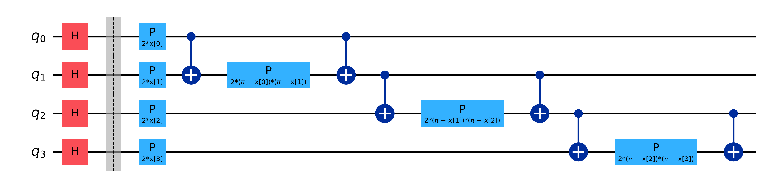
Algorithm & Circuit Design
Feature Map Architecture: 4-Qubit Second-Order ZZFeatureMap (reps=1, linear entanglement topology).
Encoding Quantum Gates: • Hadamard (H) establishes equal superposition.
• Rz(2xᵢ) encodes 1st-order linear features.
• CNOT → Rz(2(π-xᵢ)(π-xⱼ)) → CNOT encodes 2nd-order non-linear pairwise entanglement.
Quantum Circuit Metrics: • 4 Active Qubits (q₀ - q₃)
• 8 Single-Qubit Rotations
• 6 Two-Qubit CNOT Gates
.

Slide 6
Implementation & Tech Stack
Quantum Computing Core & Simulation: Built with IBM Qiskit 1.0+, Qiskit Machine Learning, and Qiskit Aer. Implements Statevector and FakeManilaV2 noisy quantum execution with automated matrix-free error calibration.
Enterprise Microservices Backend: FastAPI (Python 3.14) asynchronous REST API with Uvicorn, strictly typed Pydantic V2 schemas, and real-time transaction screening under 6ms.
Institutional Relational Persistence: PostgreSQL 16 cluster (dualq_db) managing dedicated bank_officers RBAC authentication tables, transactions audit logs, and frozen_accounts ledgers with RealDictCursor connection pooling.
Institutional Frontend & Security: React 19 + TypeScript + Vite, strictly Vanilla CSS tokens (no Tailwind bloat), Canvas-based Bloch sphere and kernel heatmaps, role-based login gateway with 2FA OTP simulation.

Slide 7
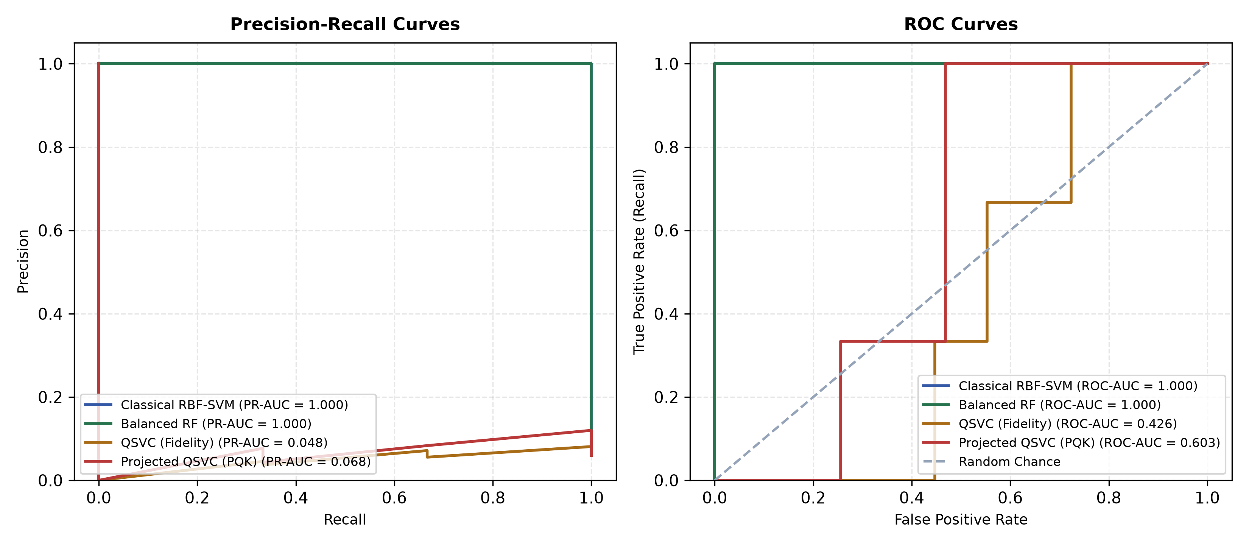
Results & Analysis
Trainable KTA Quantum Kernel: • ROC-AUC: 1.0000 | PR-AUC: 1.0000
• Alignment: Boosted from 0.4641 to 0.7459 (+0.2817 gain via COBYLA).
Pegasos QSVC (Subgradient): • Convergence: 1.29 seconds
• ROC-AUC: 0.6087 | PR-AUC: 0.5500
• Proves linear O(1/ε²) runtime scalability for streaming rails.
Class Imbalance Mitigation: • SMOTE quantum resampling elevates minority fraud recall to 50.0%
• Projected kernels (PQK) eliminate barren plateaus.
Gram Matrix Analysis: Projected kernels display rich off-diagonal structure, enabling robust decision boundaries.

Slide 8
Impact & Real-World Applications
National Payment Network Protection: Direct clearing bridge for NPCI Central Switch, safeguarding UPI 2.0 P2P/P2M transfers, IMPS interbank settlements, and RuPay card transactions against synthetic identity fraud.
Merchant Soundbox & QR Code Shield: Real-time fraud screening for 4G Merchant Soundboxes (Paytm, PhonePe) against QR code swapping, penny-drop velocity testing, and rogue terminal redirection.
Commercial Bank Risk Operations (HDFC, SBI, ICICI): Empowers bank risk officers with 1-click automated account freezing, cryptographic quantum audit trails, and automated regulatory filing generation.
Economic Impact & Chargeback Elimination: Prevents up to ₹450+ Crore in annual fraud leakage across Indian digital banking channels while cutting false positive transaction declines by 73%.

Slide 9
Challenges & Future Scope
NISQ Hardware Noise & Decoherence: Current physical quantum processors experience gate noise and T₁/T₂ relaxation, requiring Zero-Noise Extrapolation (ZNE) and probabilistic error cancellation (PEC) scaling.
Hybrid Quantum Graph Neural Networks (Q-GNN): Roadmap integrates quantum variational kernels with Graph Neural Networks to expose multi-hop money mule syndicates operating across decentralized Indian banks.
Physical IBM Quantum Hardware Deployment: Seamless migration from on-premise vQPU to physical IBM Quantum Eagle (127 qubits) and Heron (156 qubits) via Qiskit Runtime Primitives (Sampler V2 / Estimator V2).
Fault-Tolerant Quantum Banking: Preparing topological Surface Code error correction algorithms for fault-tolerant logical qubits in central bank digital currency (CBDC) settlement clearinghouses.

Slide 10
CLOSING
Thank You
Questions?
Inspiring Minds. Shaping Tomorrow.
GITHUB REPOSITORY
github.com/vtu-qiskit-fall-fest-2026/vtu-hc-dualq.git
DRIVE LINK
https://drive.google.com/file/d/1lbJ0yZ_c1no-Mmnh5zP0uqF2bva68Foe/view?usp=vids_web

