Slide 1

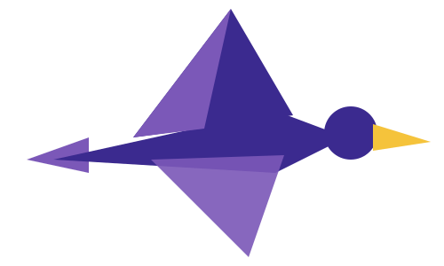


PARTICIPANT PRESENTATION
Participant Details
Qiskit
Fall Fest
2026
PROJECT TITLE
Nirikshak: Drift-Robust Eavesdropper Detection for BB84 QKD
TRACK
Track 1: Quantum Cryptography & Security
TEAM NAME
Essential Engineers · HC-0173
TEAM LEADER
J Bhuvanesh
EMAIL / CONTACT
github.com/Bhuvan-esh
Hackathon · Team Details
TEAM MEMBERS
J Bhuvanesh (Lead) · Dipankar Chettri · Anusha A
INSTITUTION / ORGANISATION
Shridevi Institute of Engineering and Technology
COUNTRY
India

Slide 2
Problem Statement
Eavesdropper detectors for QKD are trained and tested almost entirely in simulation. Nobody has measured whether they can tell normal hardware drift from a real attack on real quantum hardware, so deployed QKD links risk false alarms that discard valid keys, or eavesdroppers who go undetected.
WHY IT MATTERS
The 11% rule is not an attack detector. It is the security proof’s limit for distilling any secret key (Shor-Preskill). Intercepting 10% of rounds adds only about 2.5% QBER, so the operator never learns the link is tapped, cannot locate it, and cannot tell an attack from drift.
Real devices drift. Temperature, aging and recalibration shift the noise; simulation-trained QKD detectors degrade sharply under shifted conditions (arXiv 2610.25203, arXiv 2605.27497).
India’s QKD rollout is accelerating: a 1,000 km National Quantum Mission network, C-DOT QKD products, DRDO field and live-network trials, while ANSSI, BSI, NLNCSA and Swedish NCSA say QKD is not yet mature from a security perspective.

Slide 3
Objectives & Novelty
OBJECTIVES
Run honest BB84 sessions and qubit-level attacks on IBM Quantum hardware.
Stress-test simulation-trained detectors (11% rule, sim-calibrated threshold, Random Forest, XGBoost) on hardware data.
Build a detector whose false-alarm rate is stated in advance, even under device drift.
Release an open dataset of hardware BB84 attack logs, a reusable scorecard and a live dashboard.
NOVELTY
Hardware-in-the-loop: attacks run as real qubit operations across qubits, 22 hours and three IBM machines.
Per-session calibration: an honest reference circuit on the same qubits sets today’s threshold; a permutation test gives one verdict and p-value.
Fair emulation: same timing and spin echo on idle qubits, so only Eve differs.
Honest scope: optical-only attacks (photon-number splitting, blinding) are simulated and labelled.

Slide 4
Solution & Quantum Advantage
We run honest BB84 sessions and qubit-level attacks on IBM Quantum hardware, stress-test simulation-trained detectors on that data, and build a detector that stays calibrated under device drift.
QUANTUM ADVANTAGE
BB84’s security is physical: an eavesdropper’s measurement disturbs the qubits and shows up as errors (QBER). Nirikshak turns that disturbance into a calibrated, per-session alarm on real quantum hardware.
KEY IDEA
A separate honest calibration circuit on the same qubits (no channel, so Eve cannot touch it) measures today’s noise. Split-conformal calibration sets the alarm threshold, so the false-alarm rate is stated in advance, drift or not, and small attacks are flagged far below 11%.
WHY THIS WORKS
Real attacks on real qubits: intercept-resend (full/partial) and an entangling probe, repeated across qubits and time.
Sim-to-hardware stress test: sim-calibrated QBER threshold, Random Forest and XGBoost tested on drifted simulation, a Kingston snapshot and hardware.
Drift-robust detector: each session’s reference blocks set its own threshold.
Fair emulation: matched timing plus spin echo, so only Eve differs.
Honest scope: optical-only attacks are simulated and labelled.

Slide 5
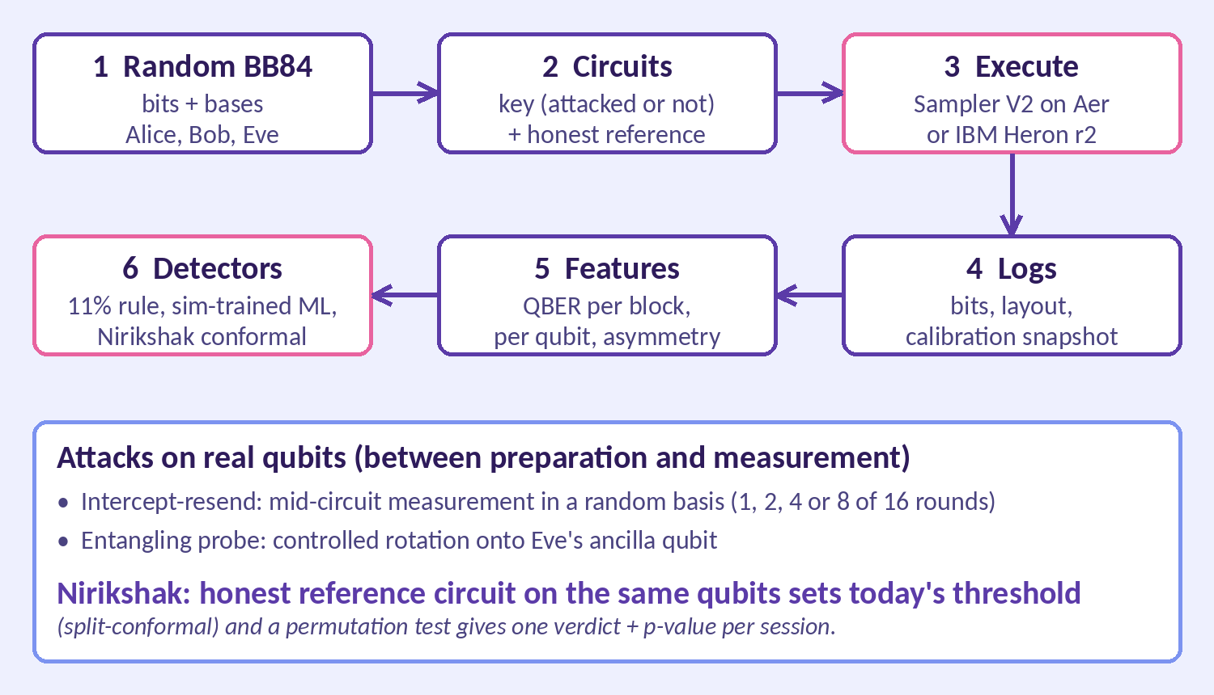
Algorithm & Circuit Design
Input: random bits and bases, 16 rounds per circuit (one per qubit), swept as Sampler V2 parameter bindings.
Core: BB84 prepare-and-measure circuits with intercept-resend (random-basis mid-circuit measurement) or an entangling probe (controlled rotation onto Eve’s ancilla).
Execution: same Sampler V2 interface on Aer and IBM hardware; one job = 10 sessions (key + reference circuit); qubits chosen from live calibration.
Post-processing: sifting, QBER per basis, basis asymmetry, per-qubit error rates.
Output: per-session verdict and p-value, block alarms, BB84 key rates, Streamlit dashboard.

Slide 6
Implementation & Tech Stack
Language Python 3.11+ (developed on 3.12)
Quantum SDK Qiskit 2.6.0, Qiskit IBM Runtime 0.50.0 (Sampler V2, job mode)
Simulation Qiskit Aer 0.18.0 (matrix product state), FakeKingston noise
Hardware IBM Quantum Open Plan: ibm_kingston, ibm_marrakesh, ibm_fez (Heron r2)
ML scikit-learn 1.9.1, XGBoost 3.4.1
Detectors 11% QBER rule, sim-calibrated threshold, Random Forest, XGBoost, Nirikshak (per-session conformal)
Statistics Split-conformal thresholds, permutation test (session verdict), Clopper-Pearson intervals (SciPy)
Frontend React 19 + TypeScript (Vite), hand-built SVG charts, GitHub Pages; Streamlit 1.66.0 dashboard; matplotlib figures
Testing pytest, GitHub Actions (tests.yml)
Version control Git + GitHub

Slide 7
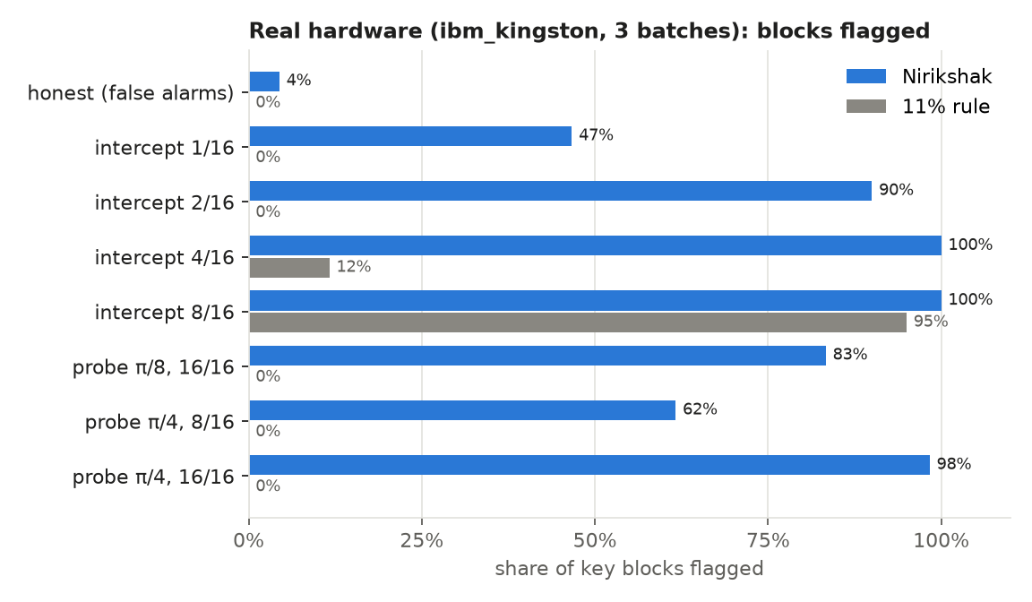
Results & Analysis
ibm_kingston, 3 batches over 22 h: all 21 attacked sessions flagged (p ≤ 0.0002), 0 of 9 honest.
Smallest attack (1 of 16 rounds): QBER only 3.0-3.2%; Nirikshak flags 47% of blocks and every session, the 11% rule 0%.
ibm_marrakesh (3.6% noise) and ibm_fez (2.0%): 7 of 7 attacked sessions flagged on each, nothing retuned.
All three machines: 35 of 35 attacked, 0 of 15 honest flagged.
Under noise shift, sim-trained detectors flag up to 88% of honest blocks; Nirikshak’s worst case is 13%.

Slide 8
Impact & Real-World Applications
THE GAP IT FILLS
BB84 can keep producing keys while a partial eavesdropper listens. On ibm_kingston, every attack except 8 of 16 rounds still leaves a positive key rate (0.16-0.61).
Nirikshak is the missing intrusion-detection layer: the operator learns the link is tapped and can tell an attack from drift.
NETWORK MONITOR PROTOTYPE
Runs on a stream of per-block link telemetry (link, time, key or reference, sifted bits, errors). No key material is needed.
Honest windows flagged: 5.3% (2,100 windows)
Link tapped on 1 of 16 rounds: 100% flagged after the tap; 11% rule 0
Drifting link: 1.0 false block alarm vs 8.2 for a frozen threshold
CONTEXT AND OUTPUTS
Relevant to India’s 1,000 km National Quantum Mission QKD network, C-DOT QKD products and DRDO trials.
Open dataset of hardware BB84 attack logs
Reusable detector scorecard
Live dashboard: Streamlit + React web app

Slide 9
Challenges & Future Scope
CHALLENGES
Timing artifact: batch 1 qubits idled during Eve’s measurements, inflating detection to 100%. Excluded; fixed with matched timing.
Idle dephasing: honest QBER 4.2% (X basis 7%) until a spin echo brought it to 1.7%.
Qubit-0 readout failure not predicted by IBM calibration, so qubits are chosen from live calibration.
Budget: 600 s quantum time per 28 days, at most 3 queued jobs (73 s used).
LIMITATIONS AND FUTURE SCOPE
More hardware data: 15 honest sessions bound the session false-alarm rate only to 0-22%; the 5% claim rests on 600 simulated sessions.
Photonic realism: decoy states, detector statistics, finite-key effects; optical attacks are not yet run on hardware.
Deployment: operator integration for the network monitor, validated beyond simulated binomial links.
Tighter block alarms: vary up to 15% in one honest session since thresholds use 20 reference blocks.

Slide 10
CLOSING
Thank You
Questions?
Inspiring Minds. Shaping Tomorrow.
GITHUB REPOSITORY
github.com/vtu-qiskit-fall-fest-2026/vtu-hc-essential-engineers
DEMO VIDEO LINK
youtu.be/gO9v1e-yHNs

