Slide 1




PARTICIPANT PRESENTATION
Participant Details
Qiskit
Fall Fest
2026
PROJECT TITLE
QuantumGreen AI — Quantum-Powered Sustainable Energy Optimizer
TRACK
Quantum Applications for Climate Change and Sustainability
TEAM NAME
Infinity Blaze
TEAM LEADER
Purvesh Raghatate
EMAIL / CONTACT
purweshraghatate@gmail.com
Hackathon · Team Details
TEAM MEMBERS
Purvesh Raghatate · Sahil Jadhao · Manish Rajak
INSTITUTION / ORGANISATION
Yeshwantrao Chavan College of Engineering
COUNTRY
India

Slide 2
Problem Statement
Today, electricity demand changes throughout the day. Solar power generation also changes depending on sunlight and weather. Electricity prices may vary by time.
Because of this, homes, businesses, and solar installation companies may not always use available solar energy at the best time. They may use more electricity from the grid, which can increase electricity costs.
Our project, QuantumGreen AI, aims to help users choose better time slots for flexible electricity use by comparing electricity demand, solar generation, and electricity prices.
Main problem: How can we choose the best time slots to reduce estimated electricity costs while making better use of available solar energy?

Slide 3
Objectives & Novelty
What is new about our project?
The main idea is to combine sustainable energy scheduling with quantum optimization techniques in one simple dashboard.
Our prototype compares two approaches:
1)Classical optimization: Checks all possible schedules for the four available time slots and finds the best valid one.
2)QAOA: Uses a quantum circuit simulation and a classical optimizer to search for a good schedule.
This comparison helps us study how quantum optimization methods could be used for future energy problems.
Note: This is a prototype using sample data. It does not yet predict future energy demand or control real electrical devices.
Objectives
Reduce estimated electricity costs by selecting suitable time slots.
Compare electricity demand, solar generation, and electricity prices.
Use an optimization algorithm to find a low-cost schedule.
Explore QAOA, a quantum-inspired-by-quantum-computing approach, for the scheduling problem.
Show the results in a simple, interactive dashboard.

Slide 4
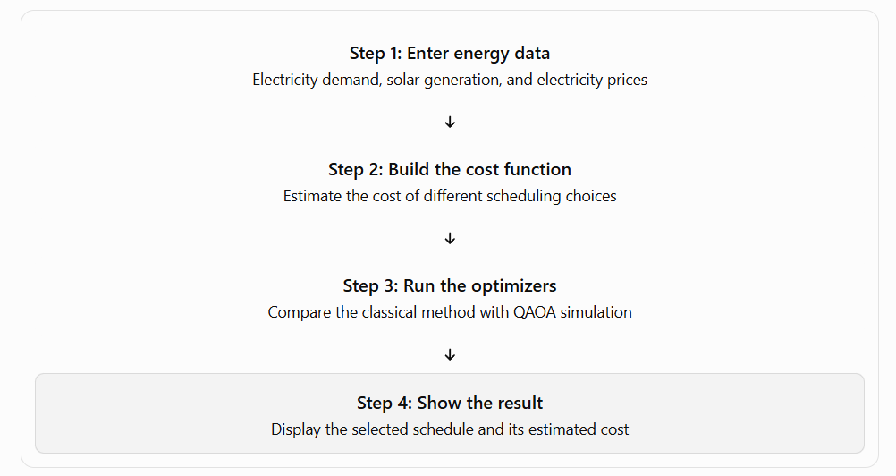
Solution & Quantum Advantage
Our solution
QuantumGreen AI follows these basic steps:

Slide 5
Solution & Quantum Advantage
What is quantum advantage?
Quantum computing uses quantum bits, called qubits, to process information using quantum principles. QAOA stands for Quantum Approximate Optimization Algorithm. It is designed to search for good solutions to optimization problems.
Our project simulates QAOA using software on a normal computer. It does not currently run on a real quantum computer.
Have we achieved quantum advantage? No, not yet. Quantum advantage means demonstrating that a quantum approach performs better than the best relevant classical approach under a fair comparison. Our project explores the method; it does not prove quantum advantage or guaranteed cost savings.

Slide 6
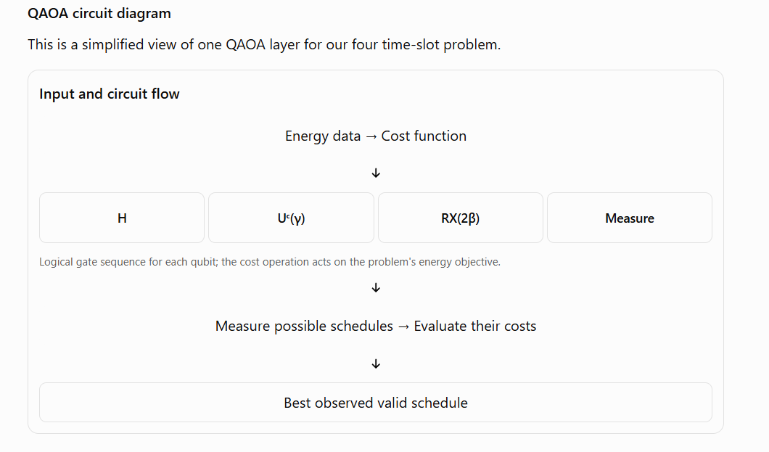
Algorithm & Circuit Design
Insert circuit diagram
e.g. qc.draw("mpl")
Algorithm in simple steps:
Load the sample energy data.
2) Create a cost function for possible schedules.
3) Run the classical optimizer to find the exact best schedule.
4) Initialize QAOA parameters, gamma and beta.
5) Simulate the QAOA circuit and sample candidate schedules.
6) Calculate the cost of the sampled schedules.
7) Adjust the QAOA parameters and repeat the circuit.
8) Display the best observed valid QAOA schedule and compare it with the classical result.

Slide 7
Implementation & Tech Stack
Technology | Purpose
Python | Main programming language
Streamlit | Creates the interactive web dashboard
NumPy | Numerical calculations
Pandas | Stores and processes energy data
Plotly | Displays charts and graphs
Qiskit | Builds the QAOA quantum circuit
Qiskit Aer | Simulates the quantum circuit on a classical computer
SciPy | Optimizes the QAOA parameters

Slide 8
Implementation & Tech Stack
How we implemented the project
We created sample energy data for four time slots.
We used electricity prices, demand, and solar generation to estimate scheduling costs.
We implemented an exact classical search by checking all 2^4 = 16 possible binary schedules.
We added a QAOA simulation to sample possible solutions.
We used Streamlit to display the data and compare the results.
Current project status: A software prototype using sample data. Live electricity data, machine-learning forecasting, real hardware control, and execution on a real quantum computer are not yet implemented.

Slide 9
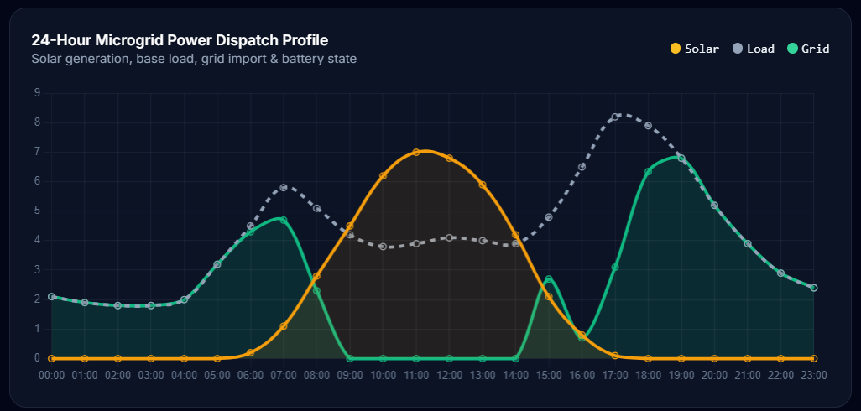
Results & Analysis
Insert results
Histogram, plot or table
This graph shows how solar generation, electricity demand (load), and grid power change throughout the day.
Solar (orange): Generation increases in the morning, peaks around 11 AM–12 PM, and falls to zero in the evening.
Load (grey): Electricity demand changes throughout the day, with high demand in the morning and evening.
Grid (green): Grid power helps meet demand when solar energy is insufficient.
Purpose: To understand when solar energy is available and when the system may need grid electricity or battery support.

Slide 10
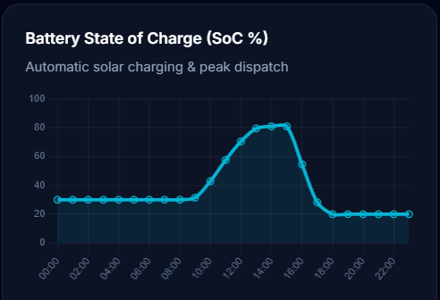
Results & Analysis
Insert results
Histogram, plot or table
This graph shows how the battery's stored energy changes over 24 hours.
The battery starts at approximately 30% charge.
It charges during sunny hours, reaching around 80% in the afternoon.
It discharges during the evening to support energy demand, ending at approximately 20%.
Purpose: To show how stored solar energy can be saved during the day and used when solar generation decreases.

Slide 11
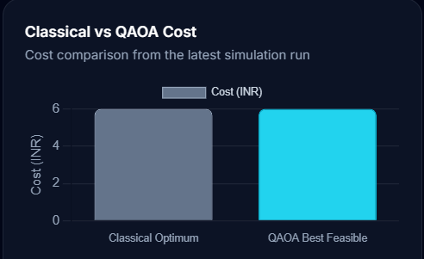
Results & Analysis
This graph compares the cost produced by a classical optimization method with the cost produced by a quantum-inspired or quantum optimization approach called QAOA (Quantum Approximate Optimization Algorithm).
Classical Optimum: The displayed cost is approximately ₹6.
QAOA Best Feasible: The displayed cost is also approximately ₹6.
Both methods appear to produce nearly identical costs in this simulation.
Purpose: To compare the solutions from classical and QAOA methods.
Important observation: This graph does not currently demonstrate a cost reduction or quantum advantage. To establish an advantage, you would need repeated tests, a fair comparison, and evidence that QAOA improves solution quality, runtime, or another relevant metric.
Insert results
Histogram, plot or table

Slide 12
Impact & Real-World Applications
Our project could support better energy decisions in the future, especially when combined with real data and practical scheduling constraints.
1. Solar installation companies
Help customers understand when electricity use may be cheaper and how solar generation relates to their demand.
2. Commercial buildings
Explore better schedules for flexible equipment, such as pumps or selected industrial loads, where operating constraints allow.
3. Solar and battery systems
A future version could consider battery charging and discharging schedules to help reduce grid electricity costs.
4. Electric vehicle charging
A future version could recommend charging times based on electricity prices, solar availability, and when the vehicle is needed.

Slide 13
Impact & Real-World Applications
How can it help society?
It could help users make better electricity-use decisions.
It could support better use of available solar power.
It could help reduce electricity costs when schedules are practical and tariffs make shifting worthwhile.
It could support the wider adoption of renewable energy.
These are potential benefits, not results already proven by the current prototype. Actual savings and environmental benefits would need to be measured using real energy data.

Slide 14
Challenges & Future Scope
Current challenges
Sample data: The current prototype does not use live electricity or weather data.
Small problem size: Four time slots are enough for a demonstration but not a realistic large energy system.
QAOA limitations: The result depends on parameter selection, circuit depth, and sampling. It may not find the best solution.
Classical comparison: Classical methods can be very effective for small problems, so quantum methods must be tested fairly.
No real device control: The prototype recommends a schedule but does not control solar equipment, batteries, or electrical loads.
Limited forecasting: It does not yet use a trained AI model to predict future demand or solar generation.

Slide 15
CLOSING
Thank You
Questions?
Inspiring Minds. Shaping Tomorrow.
GITHUB REPOSITORY
vtu-hc-infinity-blaze
DEMO VIDEO LINK
https://youtu.be/sFZE3ewlREs

