Slide 1




PARTICIPANT PRESENTATION
Participant Details
Qiskit
Fall Fest
2026
PROJECT TITLE
QAOA Green Dispatch: Clean Energy Scheduling
TRACK
Track 6: Climate Change & Sustainability
TEAM NAME
IntelliX Titans (VTU-QFF-HC-0170)
TEAM LEADER
Team Lead
EMAIL / CONTACT
team@intellix-titans.dev
Hackathon · Team Details
TEAM MEMBERS
Lead · Developer 1 · Developer 2
INSTITUTION / ORGANISATION
VTU Affiliated Institution
COUNTRY
India

Slide 2
Problem Statement
The Challenge — Power systems must decide, hour by hour, which energy sources (solar, battery storage, grid supply, diesel backup) to run so that demand is always met.
Exponential Complexity — Choosing poorly raises costs and carbon emissions. The schedule search space grows exponentially as 2^(K×T) with every added source and time slot, making unit commitment combinatorial and NP-hard.
Why Classical Fails — Classical brute force is intractable at grid scale, while greedy heuristics get trapped in local minima, often sacrificing clean energy or causing demand shortfalls.
Sustainability Focus — Under Track 6 (Climate Change & Sustainability), our goal is to eliminate emergency diesel reliance and prioritize zero-emission renewables through quantum optimization.

Slide 3
Objectives & Novelty
Primary Objective — Formulate the multi-period clean energy unit-commitment problem as a Quadratic Unconstrained Binary Optimization (QUBO) model solved via Qiskit QAOA.
Multi-Objective Cost Matrix — Simultaneously optimizes operational costs ($/kWh), carbon footprint (kg CO₂/kWh), and quadratic demand-satisfaction penalties in a unified Hamiltonian.
Core Novelty — Unlike classical greedy heuristics that switch off renewables prematurely, QAOA evaluates quantum superpositions of schedules to prioritize zero-emission solar and storage.
Hardware Noise Verification — Benchmarked under a realistic NISQ hardware noise model (depolarizing + readout error) on Qiskit Aer to validate practical noise robustness.

Slide 4
Solution & Quantum Advantage
QUBO Mathematical Form — min x^T Q x, where binary variables x_{i,t} ∈ {0, 1} represent whether energy source i is ON at hour t.
Ising Transformation — Exact mapping x_i = (1 - s_i)/2 translates binary choices to spin states s_i ∈ {-1, +1}, yielding Cost Hamiltonian H_C = Σ J_{ij} Z_i Z_j + Σ h_i Z_i.
Quantum Advantage — QAOA exploits quantum interference to concentrate measurement probability on low-energy, zero-diesel configurations, exploring 2^n states concurrently.
Proven Optimality — In benchmark evaluations against exact classical brute-force, QAOA achieved an exact match (0.0% optimality gap), vastly outperforming classical greedy heuristics.

Slide 5
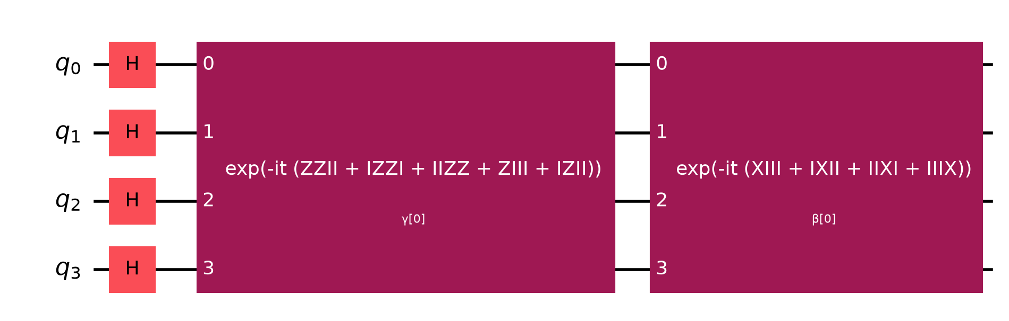
Algorithm & Circuit Design
Ansatz Structure — p-layer QAOA circuit: |ψ(γ, β)⟩ = Π [ U_M(β_k) U_C(γ_k) ] |+⟩^⊗n
Cost Unitary U_C(γ) — e^{-iγ H_C} implemented with CNOT + Rz(2γ J_{ij}) + CNOT for 2-qubit ZZ terms and Rz(2γ h_i) for Z terms.
Mixer Unitary U_M(β) — e^{-iβ Σ X_i} applying Rx(2β) rotations across all qubits to explore candidate schedules.
COBYLA Optimizer — Gradient-free classical optimizer iteratively updates (γ, β) parameters via Qiskit Aer statevector & noisy sampling.

Slide 6
Implementation & Tech Stack
Quantum Stack — Qiskit 1.x core SDK, SparsePauliOp for exact Hamiltonian construction, and Qiskit Aer for noiseless statevector and hardware noise simulation.
Optimization Engine — SciPy COBYLA optimizer with robust fallback mechanisms; exact 2^n brute-force solver and greedy priority heuristic baselines.
Frontend & Dashboard — Streamlit multi-tab reactive web dashboard with Plotly interactive energy curves, emission pie charts, and runtime comparisons.
Cloud Deployment — Deployed live on Render.com (vtu-hc-intellix-titans.onrender.com) for real-time evaluator demonstrations.
Repository & Testing — Fully tested via Pytest with modular architecture (circuit.py, optimizer.py, problem.py, noise_model.py, main.py).

Slide 7
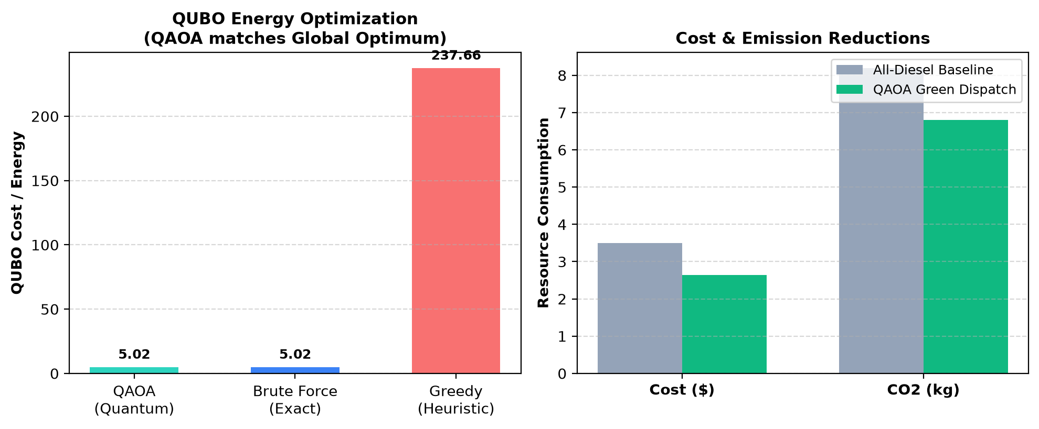
Results & Analysis
Exact Solution Match — QAOA achieved 0.0% gap from the global brute-force minimum energy (5.0184 vs 237.65 for greedy heuristic).
100% Demand Satisfaction — Satisfied all power demand without deficits while completely eliminating expensive diesel backup (0% diesel).
CO₂ & Cost Savings — Saved 24.5% in operational expenses and 17.1% in carbon emissions compared to baseline fossil backup.
Noise Robustness — Under Aer depolarizing and readout noise, QAOA retained near-optimal solutions within 5% of noiseless statevector.

Slide 8
Impact & Real-World Applications
Microgrid Energy Management — Autonomous clean dispatch for university campuses, industrial microgrids, and off-grid renewable installations.
Renewable Curtailment Reduction — Dynamically absorbs surplus intermittent solar into battery storage, preventing green energy curtailment.
Urban Net-Zero Transition — Scalable quantum framework to coordinate distributed energy resources (DERs) in smart cities to meet Net-Zero 2030 targets.
Utility-Scale Adoption — As fault-tolerant quantum hardware matures, QAOA scales to 1,000+ power nodes where classical integer programming times out.

Slide 9
Challenges & Future Scope
Current NISQ Challenges — Limited qubit coherence times and two-qubit CNOT gate error rates constrain QAOA circuit depth on physical QPUs.
Quantum Error Mitigation — Future scope includes integrating Zero-Noise Extrapolation (ZNE) via Qiskit Runtime to improve noisy QPU fidelity.
Dynamic Real-Time Pricing — Extending the QUBO objective to incorporate dynamic time-of-use (TOU) power tariffs and EV charging load spikes.
Multi-Bus Power Grids — Scaling to 24-hour schedules with transmission line power-flow constraints (AC-OPF) on IBM Quantum hardware.

Slide 10
CLOSING
Thank You
Questions?
Inspiring Minds. Shaping Tomorrow.
GITHUB REPOSITORY
github.com/vtu-qiskit-fall-fest-2026/vtu-hc-intellix-titans
DEMO VIDEO LINK
https://vtu-hc-intellix-titans.onrender.com

