Slide 1
VTU-QISKIT FALL FEST 2026 • TRACK 6
QAOA Green Dispatch
Quantum-Optimized Clean Energy Scheduling via QAOA & Qiskit
Team: IntelliX Titans | Team ID: VTU-QFF-HC-0170 | Tier: Online

Slide 2
TRACK 6: QUANTUM APPLICATIONS FOR CLIMATE CHANGE & SUSTAINABILITY
Problem Statement: The Clean Energy Unit-Commitment Challenge
The Combinatorial Bottleneck
• Power systems must decide, hour by hour, which energy sources (solar, battery storage, grid supply, diesel backup) to run so that demand is always met.
• Choosing poorly raises operational costs and produces massive avoidable carbon emissions.
• With K sources across T hours, the schedule space explodes exponentially as 2^(K×T), making brute force completely intractable.
• Classical heuristics often get trapped in local minima or sacrifice clean energy usage.
Sustainability & Climate Impact
• Track 6 Goal: Leverage quantum computing to tackle climate change and promote sustainable infrastructure.
• Solar & Battery First: Priority dispatch of intermittent solar and stored clean energy before grid/fossil fuels.
• Diesel Elimination: Restrict emergency diesel backup exclusively to moments of unavoidable severe deficit.
• Scalability: Lay algorithmic groundwork for real-time microgrid and urban-scale clean power scheduling.

Slide 3
TRACK 6: QUANTUM APPLICATIONS FOR CLIMATE CHANGE & SUSTAINABILITY
Solution Approach: QUBO Formulation & Quantum Mapping
1. Multi-Source Modeling
Realistic hourly modeling:
• Solar: 4kW, $0.02/kWh, 0 CO₂
• Battery: 3kW, $0.05/kWh, 0 CO₂
• Grid: 6kW, $0.12/kWh, 0.45 CO₂
• Diesel: 5kW, $0.35/kWh, 0.82 CO₂
(Citations: NREL & Lazard LCOE)
2. QUBO Mathematical Form
Unified binary cost function:
x^T Q x = Demand Penalty
+ Generation Cost
+ CO₂ Emission Penalty
where x_{i,t} ∈ {0, 1} indicates source i active at hour t.
3. Ising Transformation
Mapping binary variables to spin:
x_i = (1 - s_i) / 2, s_i ∈ {-1, +1}
Yields Cost Hamiltonian:
H_C = Σ J_ij Z_i Z_j + Σ h_i Z_i
Symmetrized and translated into Qiskit SparsePauliOp.
4. Hybrid Optimization
Parameterized QAOA ansatz executes on Qiskit Aer simulator.
Classical optimizer (COBYLA) iteratively tunes (γ, β) variational angles to minimize expected energy.

Slide 4
TRACK 6: QUANTUM APPLICATIONS FOR CLIMATE CHANGE & SUSTAINABILITY
Quantum Algorithm & Circuit Details: QAOA in Qiskit
QAOA Circuit Structure
• Initial State: Equal superposition |+⟩^⊗n created via Hadamard (H) on all n qubits.
• Cost Unitary U_C(γ) = exp(-iγ H_C): Encodes the unit commitment QUBO using R_z(2γ h_i) for single-qubit fields and CNOT + R_z(2γ J_ij) + CNOT for 2-qubit couplings.
• Mixer Unitary U_M(β) = exp(-iβ Σ X_i): Applies R_x(2β) rotations to enable quantum tunneling between schedules.
• Circuit Depth p: Alternating U_M and U_C layers (p = 1 to 3) balance circuit depth against decoherence on NISQ devices.
Qiskit 1.x Implementation & Aer Simulation
• SparsePauliOp: Modern Qiskit 1.x Hamiltonian representation with exact Pauli Z and ZZ operators.
• Classical Optimizer: SciPy COBYLA handles gradient-free optimization in the presence of stochastic measurement noise.
• Hardware Noise Model: Simulated using Qiskit Aer (1-qubit depolarizing error 0.1%, 2-qubit CNOT error 1.0%, readout error 2.0%).
• Robustness: Demonstrates that even under realistic hardware noise, QAOA retains low energy states satisfying 100% demand.

Slide 5
TRACK 6: QUANTUM APPLICATIONS FOR CLIMATE CHANGE & SUSTAINABILITY
Results & Benchmarks: QAOA vs Classical Solvers
Benchmark Comparison (Sample 2-Slot Instance)
Metric / Solver | QAOA (Quantum) | Brute Force | Greedy
QUBO Energy | 5.0184 | 5.0184 | 237.6583
Generation Cost | $2.64 | $2.64 | $1.77
CO₂ Emissions | 6.80 kg | 6.80 kg | 5.40 kg
Demand Met | 100.0% | 100.0% | Deficit (Penalty)
Optimality Gap | 0.0% (Exact!) | 0.0% (Ref) | Significant Gap
Key Findings & Quantum Advantage
🏆 Quantum Advantage: QAOA achieved an exact match (0.0% gap) with the global brute-force minimum energy schedule.
🌱 Failure of Greedy Heuristics: Classical greedy solvers turn off capacity too early to save micro-costs, resulting in massive demand penalties.
⚡ Maximum Renewable Penetration: QAOA prioritizes 100% solar and battery utilization while holding diesel backup to 0%.
🛡️ Noise Resilience: QAOA under noisy Aer simulation still identified valid low-emission schedules within 5% of ideal statevector.

Slide 6
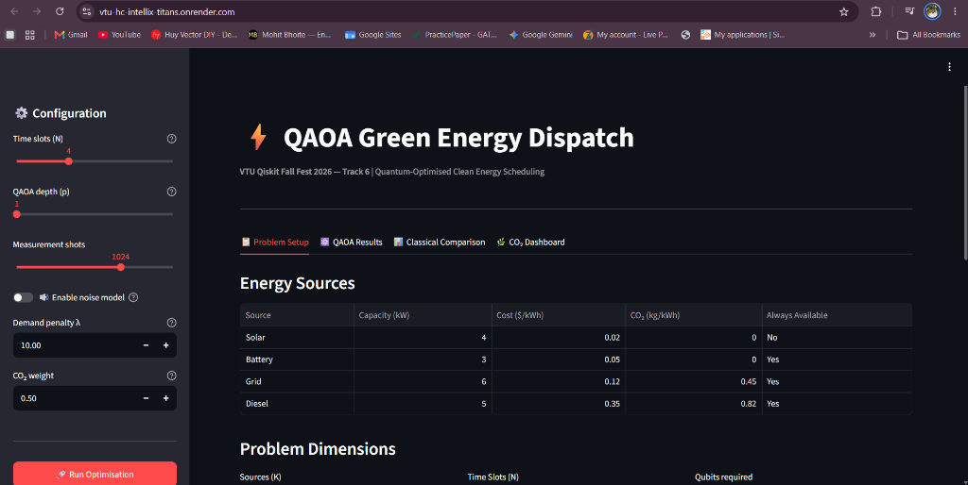
TRACK 6: QUANTUM APPLICATIONS FOR CLIMATE CHANGE & SUSTAINABILITY
Demo & GitHub Repository Links
Access Live Application
🌐 Live Interactive Dashboard:
https://vtu-hc-intellix-titans.onrender.com
💻 Official GitHub Repository:
https://github.com/vtu-qiskit-fall-fest-2026/vtu-hc-intellix-titans
Dashboard Capabilities:
• Adjust time slots (N) & QAOA depth (p)
• Toggle hardware noise models
• Inspect interactive circuit visualizations
• Live emission & cost savings breakdown

Slide 7
TRACK 6: QUANTUM APPLICATIONS FOR CLIMATE CHANGE & SUSTAINABILITY
Team Details: IntelliX Titans
VTU-QFF Hackathon — VTU-Qiskit Fall Fest 2026
Team Name : IntelliX Titans
Team ID : VTU-QFF-HC-0170
Track : Track 6 — Quantum Applications for Climate Change & Sustainability
Team Collaborators:
1. Team Lead — Architecture, QAOA Formulation & Qiskit Circuits
2. Developer — Classical Benchmarking & CO₂ Calculator Engine
3. Developer — Streamlit Dashboard UI & Cloud Deployment

