Slide 1




PARTICIPANT PRESENTATION
Participant Details
Qiskit
Fall Fest
2026
PROJECT TITLE
HEATSHIELD-Q: Quantum Allocation of Campus Cooling Resources
TRACK
Track 6: Climate & Sustainability
TEAM NAME
NEXORA
TEAM LEADER
Niranjan Mathapati
EMAIL / CONTACT
niranjanrm18@gmail.com/ 7204579919
Hackathon · Team Details
TEAM MEMBERS
Niranjan Mathapati (Lead) · Iqra Sanadi · Manyata Tegnale
INSTITUTION / ORGANISATION
Add college name
COUNTRY
India

Slide 2
Problem Statement
The challenge
Climate change is increasing the risk of extreme heat events on campuses.
Heat-relief resources (cooling units, shaded or air-conditioned spaces) are limited, so not every zone can be protected.
Zones differ in population, heat-risk level and the resources they need, so the best allocation is not obvious.
Our aim
HEATSHIELD-Q: a Qiskit-based quantum optimization system that allocates limited cooling resources across campus zones.
It uses QAOA to search for allocations and compares them with classical optimization.
INPUTS
Population, heat-risk level and cooling units needed per zone
CONSTRAINT
A fixed budget of cooling units
GOAL
Maximise heat-risk exposure covered (population × risk)

Slide 3
Objectives & Novelty
Objectives
Model campus cooling allocation as a binary optimization problem, one qubit per zone
Build a QAOA solver in Qiskit that finds high-quality allocations under a unit budget
Benchmark QAOA against exact search and a greedy method
Test how results change from 4 to 12 zones
Novelty
Applies QAOA to campus heat-risk planning, a sustainability problem rarely tackled with quantum methods
Budget handled by an unbalanced penalty term, so no extra slack qubits are needed
Penalty weights are tuned automatically so the lowest-energy state is the true best allocation
Honest benchmarking: we report where QAOA helps and where it does not

Slide 4
Solution & Quantum Advantage
Campus zones
(population, risk, units)
QUBO with
budget penalty
Ising Hamiltonian
(6 qubits)
QAOA circuit
(Qiskit)
Best allocation
(top measured)
How it works
Each qubit says whether a zone is funded (1) or not (0).
The cost rewards covered exposure and penalises going over the unit budget.
QAOA samples candidate allocations; the best-measured one is the answer.
Quantum advantage: our honest view
At 6 to 12 zones, brute force is instant, so we claim no speed-up.
QAOA finds the optimum more often than random guessing (up to 3.5× per shot).
The method is a full pipeline that can be scaled to larger campuses and real hardware.

Slide 5
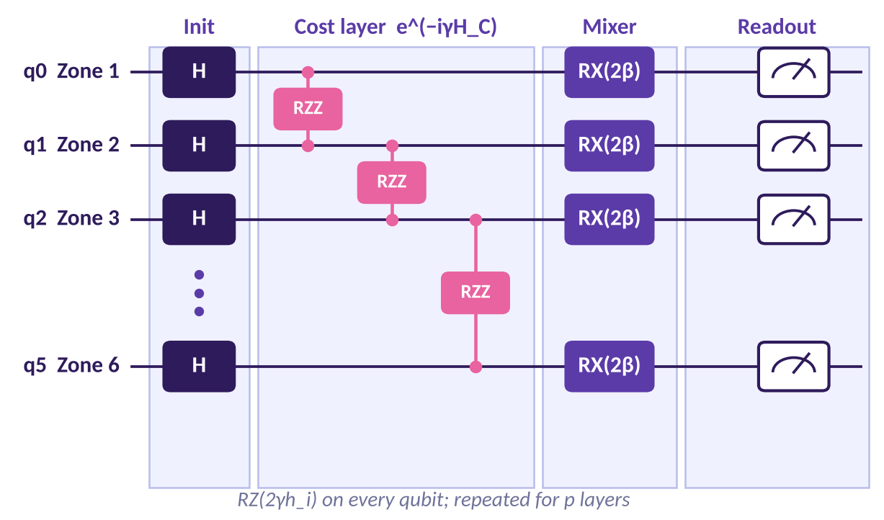
Algorithm & Circuit Design
Key details
Qubits: 6 (one per zone)
Start: Hadamard layer gives an equal superposition of all allocations
Cost layer: RZ and RZZ gates from the Ising Hamiltonian (QUBO + unbalanced budget penalty)
Mixer: RX rotations
Parameters γ and β are tuned by a classical optimizer; depth p layers (1 to 4 explored)
Measured with shots; the best-seen allocation is returned
Schematic: RZZ acts on every zone pair that has a cost term; shown for 4 of 6 qubits

Slide 6
Implementation & Tech Stack
1
Qiskit
2
heatshield/ package
3
Streamlit app
QAOA circuit, simulation and sampling
Data, problem, classical baselines, Hamiltonian and QAOA modules
Interactive demo; every number comes from Qiskit
4
run_hardware.py
5
run_scaling.py
6
Tests + web view
Noisy IBM-chip simulator run; ready for real IBM hardware with an API key
Scaling study from 4 to 12 zones
5 unit tests (pass); browser visualisation in web/

Slide 7
Results & Analysis
Key details
QAOA matches the exact optimum (58.0) and beats greedy (55.0) on the sample campus
Optimum measured in 4.9% of shots vs 1.6% for random guessing
1,024 shots are enough to find it
Scaling, 4 to 12 zones: 1.3 to 3.5× better than random; greedy stays within 2% of optimal
Noisy IBM-chip simulation also run

Slide 8
Impact & Real-World Applications
1
Safer campuses
2
Better planning
3
Climate resilience
Directs scarce cooling resources to the zones where people and heat risk are highest.
Gives administrators a repeatable, data-driven way to compare allocation options before a heatwave.
Supports sustainability goals by using limited resources more effectively as heat events increase.
Where it applies: university campuses, schools, hospitals and city wards with limited heat-relief resources. The same model extends to any "fund the highest-impact zones within a budget" problem.

Slide 9
Challenges & Future Scope
Challenges
Early QAOA runs found the optimum only about 1% of the time; tuning the penalty weights fixed this
No quantum speed-up at 6 to 12 zones, because classical search is instant
Results come from noise-free simulation; hardware noise will reduce quality
Sample zone data is illustrative, not measured
Future scope
Run on real IBM Quantum hardware and apply error mitigation
Use real campus data: zone populations, shade and temperature readings
Scale to larger zone counts and compare more classical solvers
Add time-varying heat forecasts and multiple resource types

Slide 10
CLOSING
Thank You
Questions?
Inspiring Minds. Shaping Tomorrow.
GITHUB REPOSITORY
https://github.com/vtu-qiskit-fall-fest-2026/vtu-hc-nexora-0022
DEMO VIDEO LINK
Add YouTube link

