Slide 1
VISVESVARAYA TECHNOLOGICAL UNIVERSITY, BELAGAVI
QISKIT FALL FEST 2026 • IBM QUANTUM
QISKIT FALL FEST 2026
LoadSetu
Quantum Fleet Optimizer
Quantum + AI & ML • Team OOPs
A logistics matching prototype and a quantum–classical optimization benchmark.
Yash Gaikwad • Tushar Deshmukh • Prasanna Padatare
LOADSETU • QISKIT FALL FEST 2026 • HOSTED BY VTU, BELAGAVI
27–31 OCT 2026

Slide 2
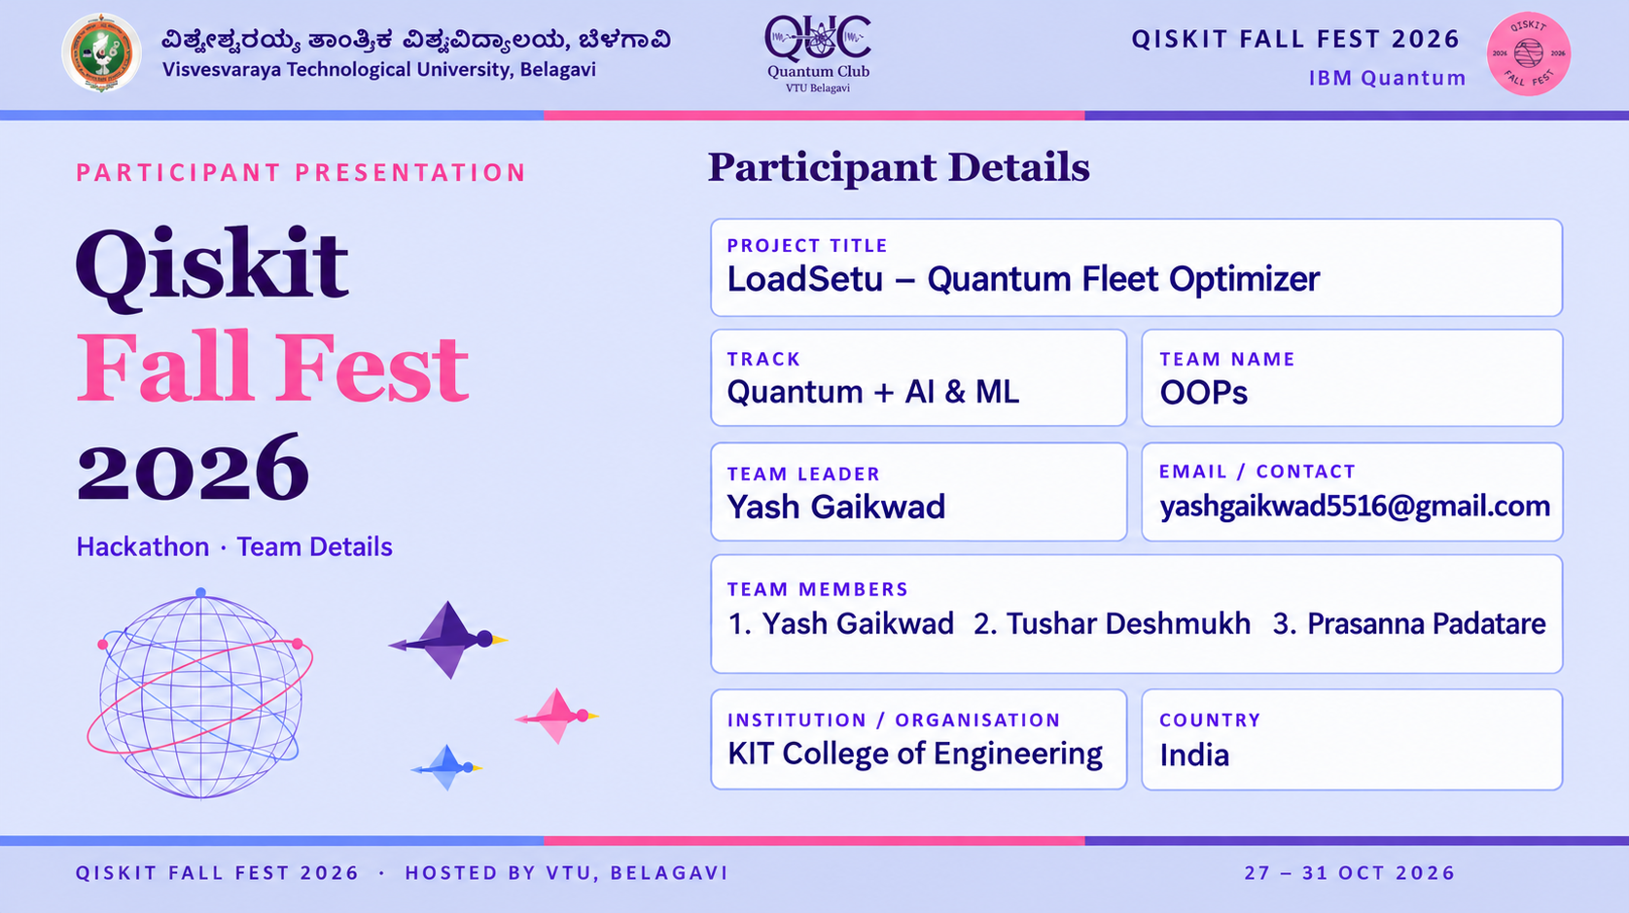

Slide 3
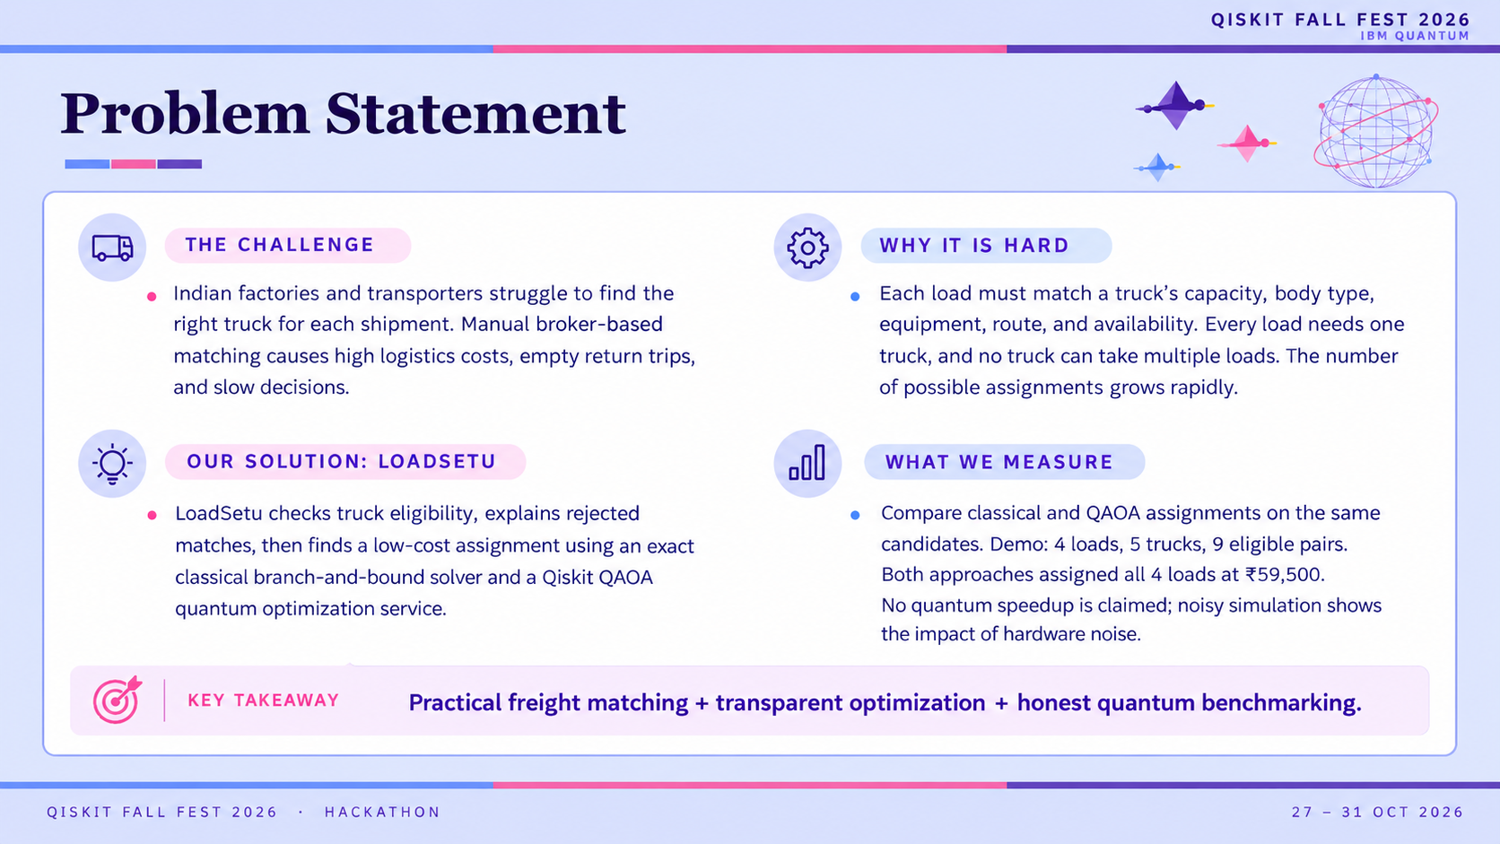

Slide 4
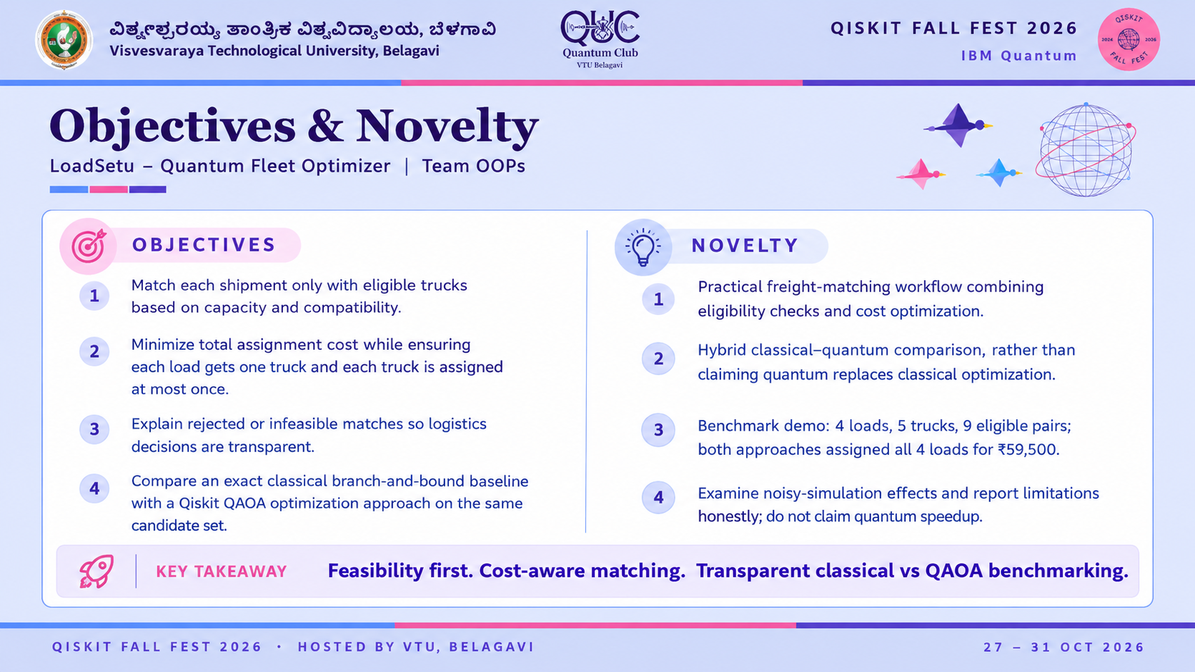

Slide 5
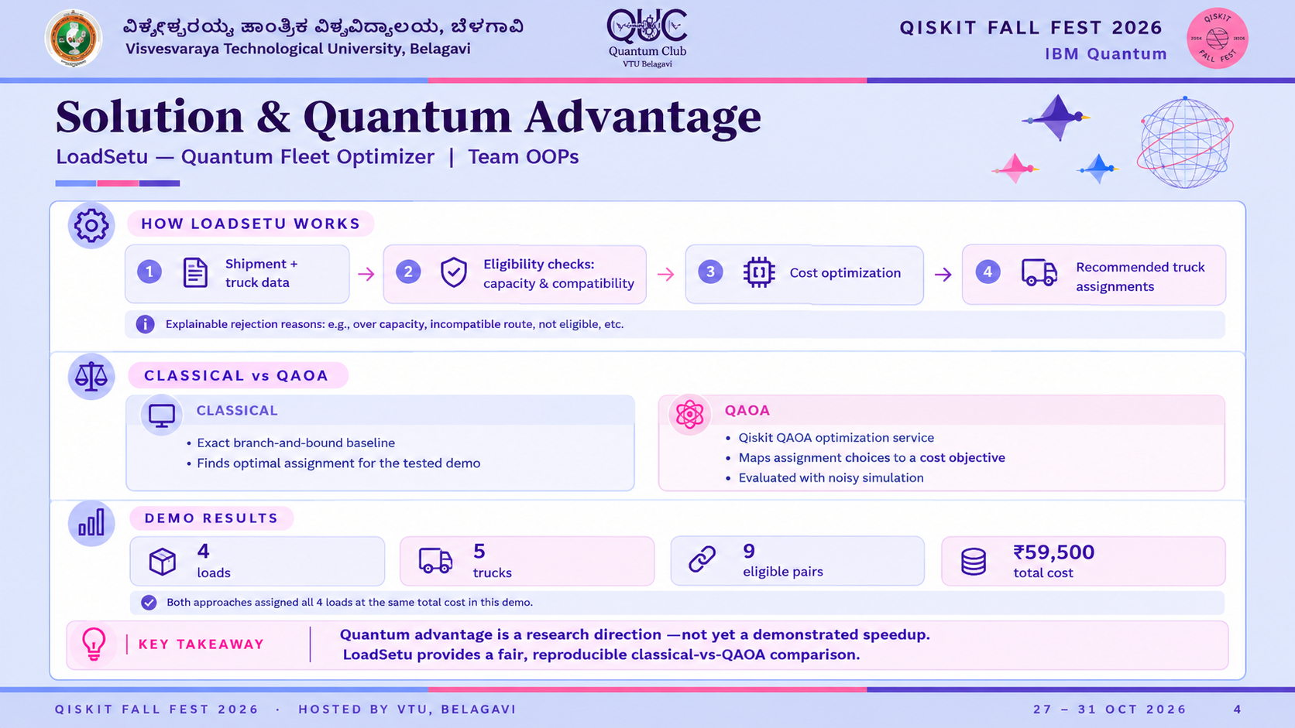

Slide 6
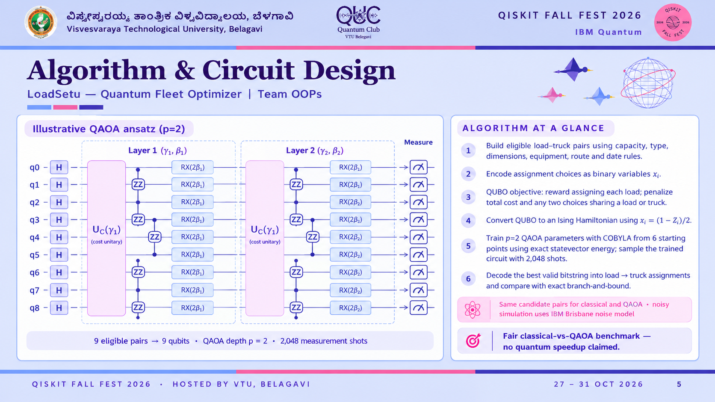

Slide 7
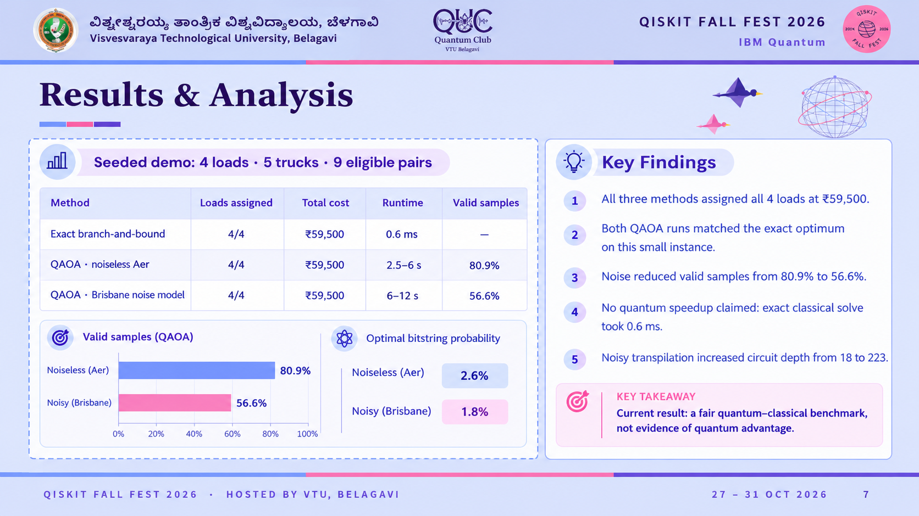

Slide 8
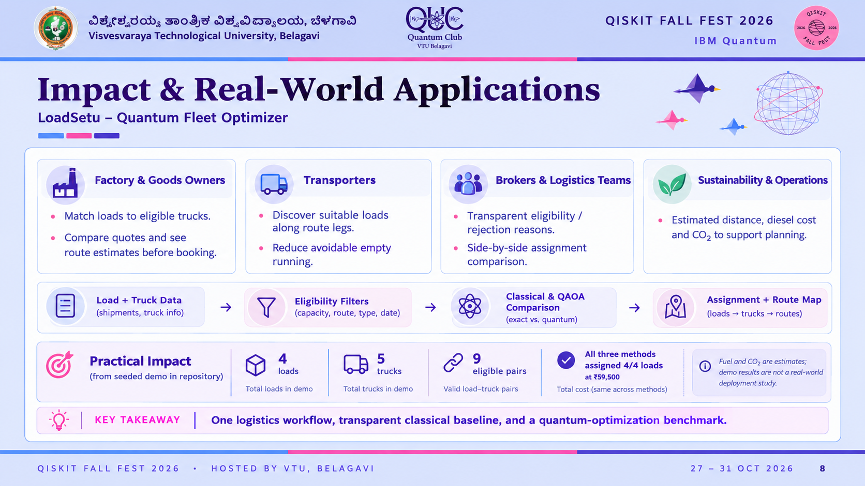

Slide 9
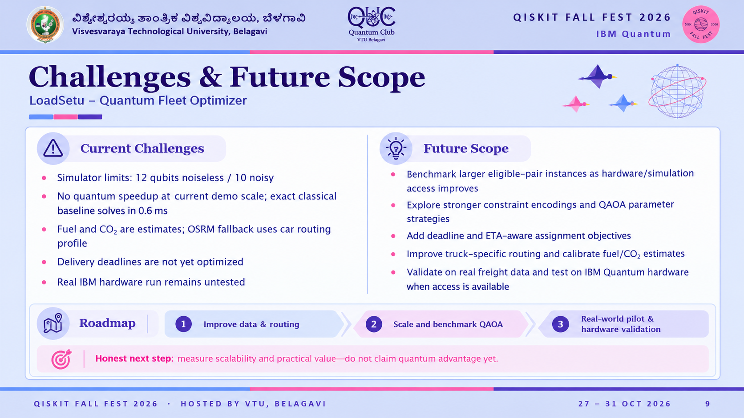

Slide 10
