Slide 1

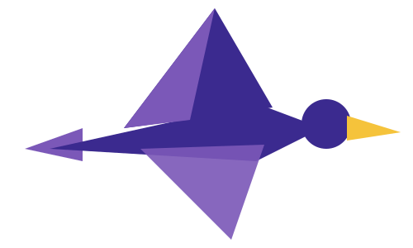

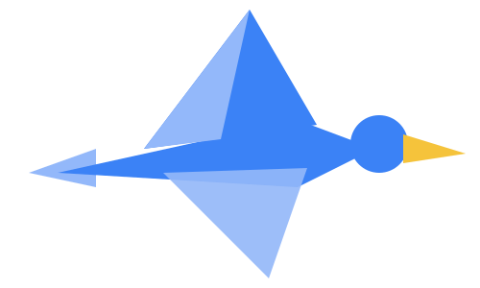
PARTICIPANT PRESENTATION
Participant Details
Qiskit
Fall Fest
2026
PROJECT TITLE
Quantum Astra: Interactive Simulation of Grover’s Quantum Search Algorithm
TRACK
TRACK A ONLINE
TEAM NAME
QUANTUM ASTRA
TEAM LEADER
SAGAR ZINGADE
EMAIL / CONTACT
zingade583@gmail.com
Hackathon · Team Details
TEAM MEMBERS
SAGAR ZINGADE · ABHILASH
INSTITUTION / ORGANISATION
VTU
COUNTRY
INDIA

Slide 2
Problem Statement
Problem Statement
Classical computers generally require searching items one by one when dealing with unstructured search problems. As the search space grows, the number of queries can increase significantly. Meanwhile, students often find quantum computing concepts difficult to understand because quantum states, quantum gates, and probability amplification are abstract mathematical concepts.
Our goal is to develop an interactive Qiskit-based simulator that demonstrates Grover’s quantum search algorithm and helps students visualize its operation and compare its theoretical query complexity with classical search.

Slide 3
Objectives & Novelty
Objectives
Implement Grover’s search algorithm using Qiskit.
Demonstrate quantum superposition, phase marking, and amplitude amplification.
Simulate quantum circuits using Qiskit AerSimulator.
Visualize measurement probabilities and search outcomes.
Compare classical and quantum query complexity.
Project Novelty
Quantum Astra combines quantum circuit simulation, probability visualization, and classical-versus-quantum comparison in a beginner-friendly learning experience.
Expected Outcome: A practical demonstration of how Grover’s algorithm increases the probability of finding a marked state.

Slide 4
Solution & Quantum Advantage
Quantum Astra uses Python and Qiskit to construct and simulate Grover’s search circuit. Users select a search-space size and target state, execute the algorithm, and analyze measurement probabilities and search outcomes.
Quantum Advantage
Classical unstructured search: O(N) query complexity in the worst case.
Grover’s algorithm: O(√N) oracle-query complexity.
Repeated oracle and diffusion operations amplify the probability of the target state.

Slide 5
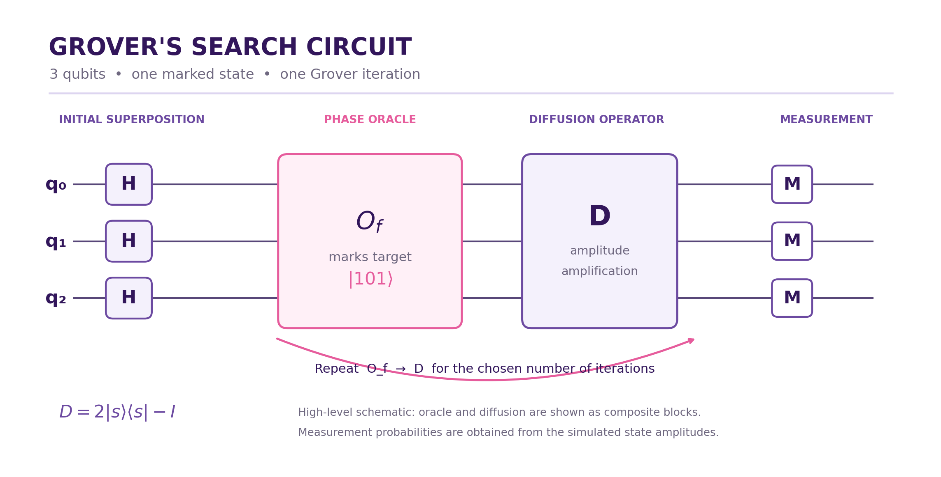
Algorithm & Circuit Design
Insert circuit diagram
e.g. qc.draw("mpl")
Initialization: Prepare the qubits in the |0⟩ state.
Superposition: Apply Hadamard gates to create an equal superposition of possible search states.
Oracle: Flip the phase of the selected target state.
Diffusion: Amplify the target state's probability amplitude.
Iteration: Repeat the Grover operator approximately the optimal number of times.
Measurement: Measure the qubits and analyze the output distribution.

Slide 6
Implementation & Tech Stack
Programming Language: Python 3.11+
Core Technologies
Qiskit SDK: Quantum circuit construction and algorithm implementation.
Qiskit AerSimulator: Local quantum circuit simulation.
NumPy: Numerical calculations and probability analysis.
Qiskit Visualization / Matplotlib: Circuit diagrams and measurement histograms.
JupyterLab / VS Code: Development and experimentation.
Git & GitHub: Version control and team collaboration.
Implementation Pipeline
User Input → Circuit Construction → Grover Algorithm → Local Simulation → Measurement Analysis → Visualization
Execution: The core simulation runs locally and does not require paid APIs. Actual quantum-hardware execution is an optional extension requiring suitable access and configuration.

Slide 7
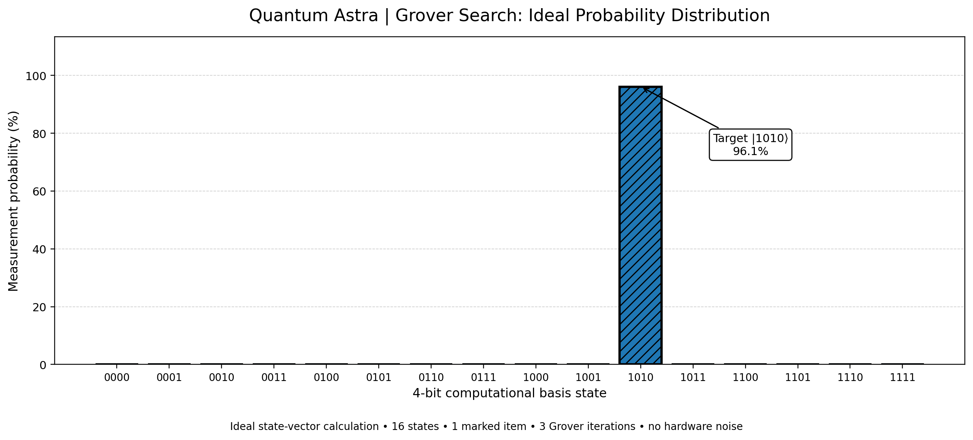
Results & Analysis
Insert results
Histogram, plot or table
Simulation Setup
Qubits: 4
Search space: 16 states
Target state: |1010⟩
Grover iterations: 3
Model: Ideal, noiseless simulation
Key Results
Target-state probability: 96.13%
Each non-target state's probability: approximately 0.258%
Classical linear search: 8.5 queries on average and up to 16 in the worst case.
Grover search: 3 oracle queries in this example.

Slide 8
Impact & Real-World Applications
Educational Impact
Makes quantum computing concepts easier to understand.
Provides hands-on exposure to quantum circuits and gates.
Helps students explore quantum measurement and probability distributions.
Supports practical learning through visual demonstrations.
Potential Applications of Grover’s Algorithm
Unstructured search problems.
Search-related algorithmic research.
Selected optimization and information-retrieval problems that can be formulated using suitable quantum oracles.
Broader Impact
Quantum Astra helps bridge the gap between theoretical quantum computing concepts and practical algorithm demonstrations while communicating both potential benefits and current limitations.

Slide 9
Challenges & Future Scope
Challenges
Constructing a correct oracle for the chosen target state.
Understanding phase inversion and amplitude amplification.
Choosing a suitable number of Grover iterations.
Managing simulation costs as qubit count increases.
Accounting for finite measurement shots and hardware noise.
Future Scope
Add noise-model simulations using Qiskit Aer.
Support multiple marked states.
Improve circuit and probability visualizations.
Compare ideal simulations with real quantum-hardware results, where access is available.
Expand the learning modules and interactive experiments.

Slide 10
CLOSING
Thank You
Questions?
Inspiring Minds. Shaping Tomorrow.
GITHUB REPOSITORY
https://github.com/vtu-qiskit-fall-fest-2026/vtu-hc-quantum-astra
DEMO VIDEO LINK
https://youtu.be/p92FF1HiGME?si=dctHeeCPM6XOI9Vm

