Slide 1
QubitSense AI
Quantum Kernel Intelligence Lab
Beyond accuracy: reliability, robustness and quantum resource trade-offs
QubitX | Qiskit Fall Fest 2026 | Track 4: Quantum + AI & ML
Team: Quantum Titans | Members: Abinaya S , Afrin U

Slide 2
01 | The Problem
A single accuracy score is not enough to judge a quantum ML method
• Quantum-kernel classifiers can represent data using quantum feature maps, but their usefulness depends on the dataset and circuit design.
• One train/test split can produce a misleading result.
• Deeper circuits and quantum-kernel evaluations can add computational cost.
• Teams need a reproducible way to study performance, stability and resource trade-offs.

Slide 3
02 | Our Contribution
A benchmarking workflow, not just a two-model demo
• Matched comparison: classical RBF SVC versus multiple Qiskit quantum feature-map configurations.
• Reliability: repeat experiments across fixed random seeds and report mean plus standard deviation.
• Robustness: perturb held-out input features and measure performance degradation.
• Resource inspection: report qubit count, decomposed circuit depth and gate count.
• Decision support: summarize which model is most practical for this experiment, with limitations.

Slide 4
03 | System Architecture
Same dataset and evaluation protocol across the model variants
Iris sample
Scale + PCA
Classical SVC
Quantum QSVC
ZZ reps 1 / 2
Metrics +
advisor
→
→
→
→
Outputs: repeated-run metrics, clean/noisy comparison, circuit resource table, CSV files and a plain-language recommendation.

Slide 5
04 | Quantum Kernel Experiment
What changes between the quantum configurations?
• Encode two PCA features into two qubits using Qiskit feature maps.
• Compare ZZFeatureMap with reps=1 against ZZFeatureMap with reps=2.
• Build a fidelity quantum kernel and use QSVC for classification.
• Record circuit depth and gate count as structural resource indicators.
• These circuit metrics describe the circuit; they do not by themselves prove a speedup or advantage.

Slide 6
05 | Reliability & Robustness
Does the result survive a different split or mildly perturbed input?
• Run the experiment with three fixed random seeds and report mean and standard deviation.
• Apply controlled Gaussian perturbation to test features after training.
• Compare clean accuracy with noisy-test accuracy for every model.
• Use the same test examples and perturbation per split for matched model comparisons.
• Interpret the result cautiously: simulated feature perturbation is not the same as physical quantum hardware noise.

Slide 7
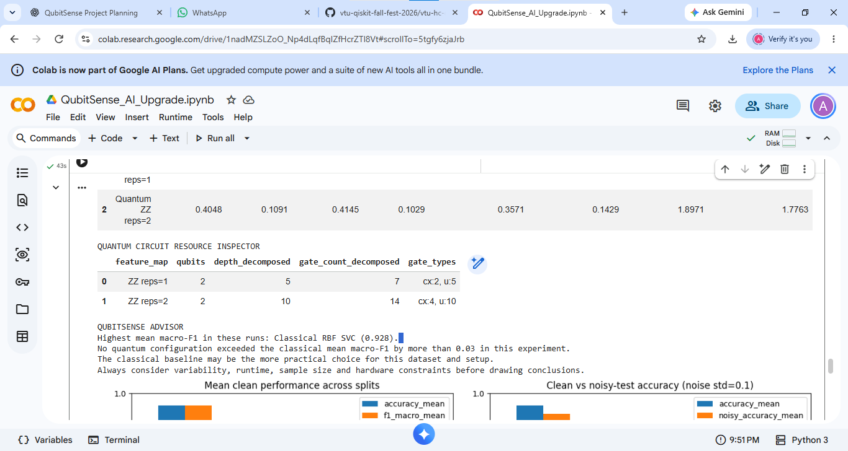
06 | Results

Slide 8
07 | Evidence-Based Model Advisor
A recommendation with context, not a claim that quantum is always better
• Rank models by mean macro-F1, while also showing variability and runtime.
• If a quantum model performs better, describe it as a result on this dataset and setup.
• If performance is similar, explain the classical model's practical simplicity and measured cost.
• Show the limitations and the conditions under which the recommendation may change.

Slide 9
08 | Limitations & Scientific Honesty
What this experiment can and cannot conclude
• Small Iris sample: findings may not generalize to other datasets.
• Three splits provide a stronger check than one split, but are not a large statistical study.
• Input noise is simulated in feature space; no hardware-noise claim is made.
• Simulator runtime is not a fair measure of real quantum hardware speed.
• No quantum advantage is claimed without a suitable, rigorous comparison.

Slide 10
09 | Conclusion & Future Work
QubitSense AI makes quantum ML evaluation more transparent
• Extends a basic SVC-versus-QSVC demo into a repeatable benchmark.
• Studies performance, stability, robustness and circuit complexity together.
• Future work: larger datasets, additional feature maps, formal statistical tests and real-device experiments.
• Team roles: Member 1 - classical baseline, evaluation and charts; Member 2 - Qiskit circuits, resource analysis and documentation.
• Thank you | Questions?

