Slide 1




PARTICIPANT PRESENTATION
Participant Details
Qiskit
Fall Fest
2026
PROJECT TITLE
QuantumaPredict : Intelligent Industrial Failure Prediction
TRACK
4
TEAM NAME
Qubexis
TEAM LEADER
Parvati Hurakadli
EMAIL / CONTACT
7019283837
Hackathon · Team Details
TEAM MEMBERS
Parvati Hurakadli · Sahana J C · Sadhana Vajramatti
INSTITUTION / ORGANISATION
UBDTCE,Davanagere
COUNTRY
India

Slide 2
Problem Statement
QuantumPredict — Intelligent Industrial Failure Prediction
Industrial machinery is critical to modern manufacturing, yet unexpected failures caused by changing operating conditions, excessive wear, and complex sensor interactions can lead to costly downtime, production losses, and safety risks. Conventional machine learning approaches offer predictive maintenance capabilities, but identifying intricate, nonlinear relationships among industrial sensor parameters remains a challenge.
The ultimate goal is to support timely maintenance decisions, reduce unexpected downtime, and explore the practical potential of quantum machine learning in intelligent manufacturing.

Slide 3
Objectives & Novelty
Objectives:
Predict machine failures early using industrial sensor data from the AI4I 2020 dataset.
Build and compare a classical machine-learning model (Random Forest) and a quantum machine-learning model.
Evaluate real-world usefulness using failure-detection metrics such as recall, precision, F1-score, and false alarms—not accuracy alone.
Novelty:
QuantumPredict explores whether quantum machine learning can complement classical AI in early industrial failure detection, using a fair, metrics-driven comparison.

Slide 4
Solution & Quantum Advantage
Solution
QuantumPredict analyzes machine sensor readings—such as temperature, rotational speed, torque, and tool wear—to estimate the risk of machine failure. It compares a Random Forest model with a 4-qubit variational quantum classifier, then evaluates their failure-detection performance to support earlier maintenance decisions.
Quantum Advantage
A quantum model may represent complex relationships among sensor features in a different way, potentially helping identify patterns that classical models find difficult. However, our current results do not demonstrate a quantum advantage: the quantum classifier produces many false alarms and performs worse than Random Forest. The project’s contribution is to test this potential fairly and identify where quantum ML may—or may not—be useful . We investigate whether quantum feature representations can improve industrial failure detection, benchmarking them against classical AI using the same data and metrics.

Slide 5
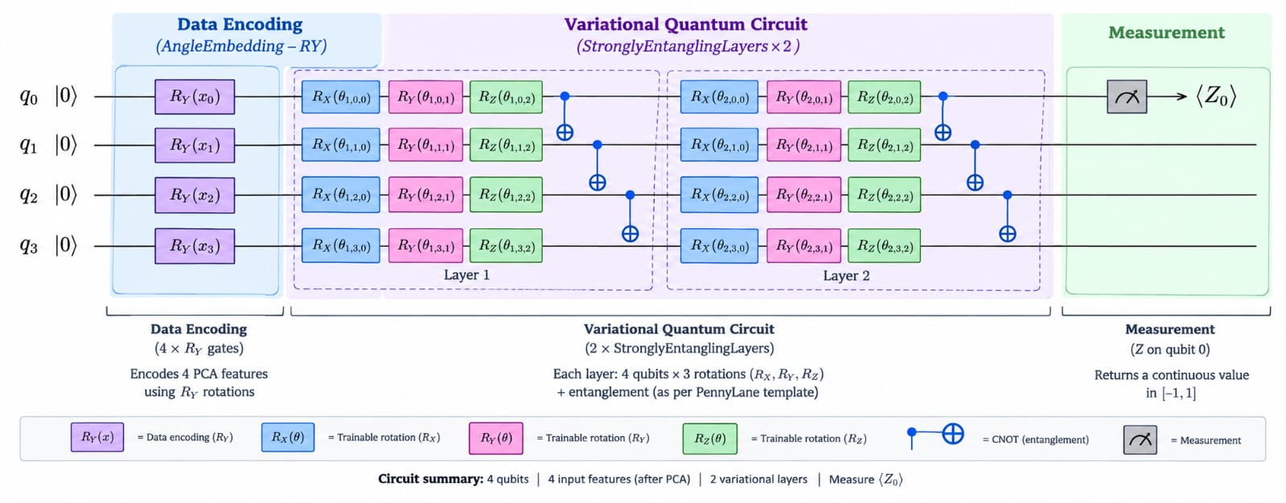
Algorithm & Circuit Design
Four-Qubit Variational Quantum Classifier Architecture
Include these three stages:
Data Encoding: Four PCA components encoded using Ry rotations.
Variational Circuit: Two trainable StronglyEntanglingLayers blocks.
Measurement: Expectation value of Pauli-Z on qubit 0, producing a score between −1 and +1.
Algorithm
Sensor data collection and preprocessing.
Feature scaling and 4-feature selection.
Random Forest baseline training.
Quantum data encoding using RY gates.
Variational training using parameterized quantum gates . Measurement and failure prediction.
Performance comparison using F1-score, recall, and precision.
Insert circuit diagram
e.g. qc.draw("mpl")

Slide 6
Implementation & Tech Stack
TECHNOLOGY STACK
💻 Programming Python
📊 Data Processing NumPy • Pandas
🤖 Classical Machine Learning Scikit-learn • Random Forest • PCA
⚛️ Quantum Computing PennyLane •default.qubit simulator
🧠 Quantum Circuit AngleEmbedding • StronglyEntanglingLayers
📈 Model Evaluation Accuracy • Precision • Recall • F1-score • Confusion Matrix
IMPLEMENTATION
1. Dataset & Preprocessing
AI4I 2020 Predictive Maintenance Dataset
Feature scaling and PCA dimensionality reduction (5 → 4 components)
2. Classical ML
Random Forest classifier (300 trees)
Class-weighted training for imbalanced data
3. Quantum ML
Four-qubit Variational Quantum Classifier (VQC)
Ry angle encoding and 2 variational layers
Adam optimizer, 25 training epochs
4. Evaluation
Validation-based threshold selection
Accuracy, Precision, Recall & F1-score
Classical vs. Quantum performance comparison

Slide 7
Results & Analysis
Insert results
Histogram, plot or table
Add key details

Slide 8
Impact & Real-World Applications
Impact
Reduce unexpected downtime by identifying machines at risk of failure.
Lower maintenance costs through better-timed inspections and repairs.
Improve operational safety by flagging potential equipment problems earlier.
Increase productivity by helping teams plan maintenance before disruptions occur.
Support smarter decisions with sensor-based, data-driven maintenance alerts.
Real-World Applications
Manufacturing plants: Monitor motors, pumps, conveyors, and production equipment.
Automotive industries: Predict wear or faults in assembly-line machinery.
Energy and utilities: Help monitor turbines, generators, and industrial pumps.
Mining and heavy industries: Prioritize inspections of critical equipment.
Smart factories: Integrate predictive alerts into industrial monitoring systems.

Slide 9
Challenges & Future Scope
Challenges
1. Class Imbalance
Machine failure cases are much fewer than normal cases.
Requires careful handling to improve failure detection.
2. Quantum Simulation Cost
Quantum circuit simulation can be computationally expensive.
Training time increases with circuit complexity.
3. Limited Qubit Count
The current VQC uses only four qubits.
PCA reduces five sensor features to four components.
4. Model Performance
Quantum model performance depends on circuit design and parameter optimization.
Quantum advantage has not yet been established.
Future Scope
1. Real-Time Monitoring
Integrate live sensor data for continuous machine monitoring.
2. Advanced Quantum Models
Experiment with different quantum circuits, encoding strategies, and optimizers.
3. Real Quantum Hardware
Test the VQC on available quantum processors and compare results with simulation.
4. Improved Predictive Accuracy
Explore additional features, hyperparameter tuning, and larger datasets.
5. Industrial Deployment
Develop a dashboard for failure alerts and predictive maintenance recommendations.

Slide 10
CLOSING
Thank You
Questions?
Inspiring Minds. Shaping Tomorrow.
GITHUB REPOSITORY
https://github.com/vtu-qiskit-fall-fest-2026/vtu-hc-qubexis.git
DEMO VIDEO LINK
Paste link

